Slide 1
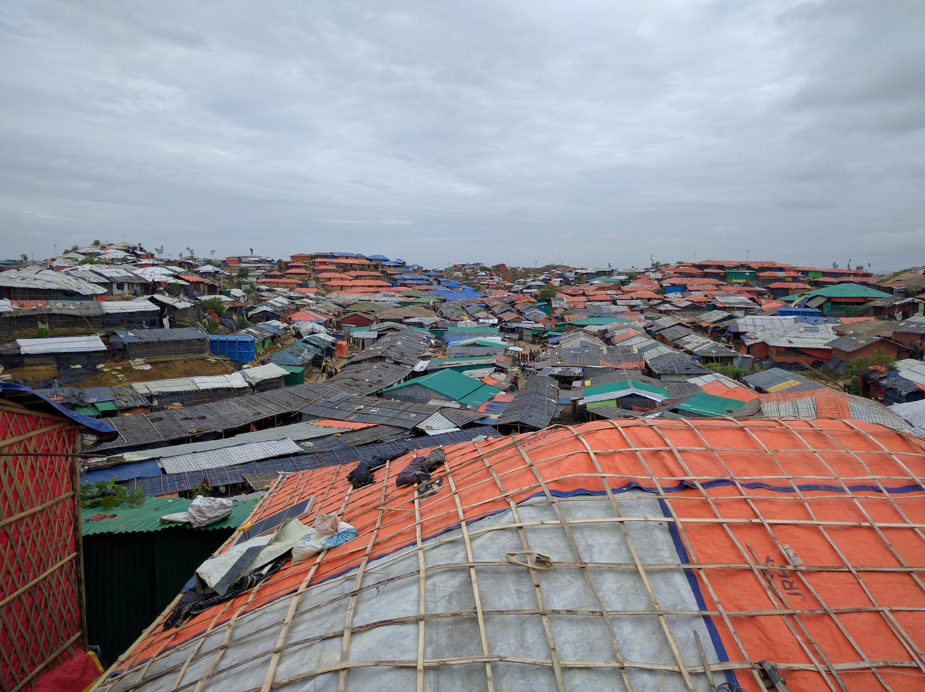


Key Findings - Menstrual Hygiene Materials Assessment
In support of the Cox’s Bazar WASH Sector’s
Technical Working Groups
November 2019 | Cox’s Bazar, Bangladesh

Slide 2
HP related assessments conducted in 2019
  Hygiene Item Market assessment and vendor survey (March 2019)
  WASH Household Survey
    Round 3: April 2019 (pre-monsoon / dry season)
    Round 4: October 2019
  Hygiene Item assessment (July 2019)
  Menstrual Hygiene Materials assessment (July 2019)
  WASH Focus Group Discussion Briefs (September 2019)
    Focusing on the ‘how’ and ‘why’ of the quantitative assessments
Notes:
Since the August 2017 influx, WASH Sector partners including REACH have produced a substantial amount of information on the conditions, perceptions, and needs of the Rohingya refugees residing in the camps. In order to increase the efficiency of response monitoring, minimise burdens on affected populations, and focus more specifically on outstanding data gaps, the following steps for future assessments are proposed:

Slide 3
Purpose of the assessment
Context
Objectives
Coordination
Since August 2017 an estimated 744,0001 Rohingya refugees have arrived from Myanmar to Cox’s Bazar district in Bangladesh, bringing the total number to approximately 912,000.
A crisis with especially acute water, sanitation, and hygiene (WASH) needs.
Menstrual Hygiene Materials Assessment (July 2019) – quantitative component
Menstrual Hygiene Management Brief (September 2019) – qualitative component
Identify WASH needs and service gaps among the Rohingya refugee population
Build a stronger understanding of what characterises individuals with high levels of WASH needs
Contextualise information from previous quantitative assessments
Fill additional identified information gaps with an emphasis on “how” and “why” questions
REACH implemented these MHM related assessments in support of and coordination with Cox’s Bazar Water, hygiene and sanitation (WASH) Sector

Slide 4
Methodology
Quantitative assessment:
Data was collected throughout 32 camps, where 472 households were surveyed.
An all female enumerator team surveyed only female respondents. The majority of the questions were asked to all respondents about experiences with menstrual hygiene management (MHM), with several questions specifically asked about the respondents’ direct experiences at distributions.
Findings are generalisable to the population of all assessed camps with a 95% confidence level and a 5% margin of error.
Qualitative assessment
19 Focus group discussions (FGDs) with Rohingya refugees in camps in Ukhiya and Teknaf Upazilas, Cox’s Bazar district
Three sets of six discussions using different tools, respectively focusing on water, sanitation, and hygiene issues.
  The topic of menstrual hygiene was addressed specifically in hygiene discussions with female participants, but was raised in other thematic discussions with both male and female participants. In total, 38 female participants across 4 FGDs (2 in Ukhiya and 2 in Teknaf) engaged in the menstrual hygiene section of the hygiene discussion.
Discussions were split by gender, with an equal number of male and female groups held in each location

Slide 5
Limitations
Quantitative assessment
Security restrictions: The findings cannot be extrapolated to sites that were not visited; aggregate data for this assessment is therefore representative of the refugee population living within camps exclusive of Kutupalong RC, Nayapara RC, Blocks A, C, and E in Camp 26, and Block B in Camp 27. These camps/blocks were not assessed due to security concerns during the data collection period.
Respondent bias: (social desirability bias) is likely to have influenced the responses to some questions. Families might have felt pressure to give answers that are socially acceptable or perceived to be the ‘right’ answer. Findings relating to a subset of the population may have a lower confidence level and wider margin of error.

Slide 6
Limitations
Qualitative assessment
Indicative findings: This study used qualitative research methods, as such results are indicative only and cannot be generalised for the entire camp population. However, efforts were made to ensure qualitative findings were crossed with previous quantitative assessments in order to triangulate findings.
Participant bias: Certain responses may be under-reported or over-reported due to the subjectivity, perceptions, and comfort level (related to MHM specifically) of participants, especially “social desirability bias” – the documented tendency of people to provide what they perceive to be the “right” answers to certain questions. Additionally, given that participants were recruited by WASH volunteers, it is possible that they may have been coached to provide positive responses on WASH service provision in that area.
Sampling bias: Although efforts were made to ensure a diverse range of participants, time constrictions for sampling and a lack of REACH footprint in the camps created a reliance on WASH partners – while WASH partners were briefed on how to select diverse participants in terms of age, camp block, and background – in practice, convenience sampling was often used. This is may have constrained the likelihood of some groups (e.g. female head of households, participants located further away from the discussion) from being under selected relative to others.

Slide 7
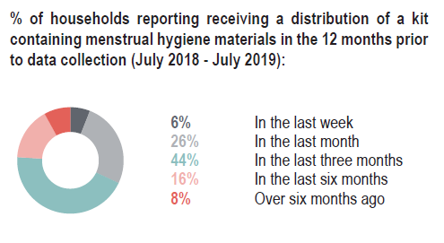
Key findings from household survey (quantitative)
Only 27% of respondents reported that they themselves directly received menstrual hygiene materials at a distribution site in the 12 months prior to data collection.
This suggests the following:
In the majority of cases, women are reportedly reliant on other household members to collect MHM materials. Findings from FGDs conducted in September 2019 indicate that husbands or sons often collect materials from distributions / markets or women cope through making their own materials / using materials for longer periods of time
Women and girls that do not attend distributions do not directly benefit from awareness sessions on menstrual hygiene materials / menstruation conducted at the distribution site.

Slide 8
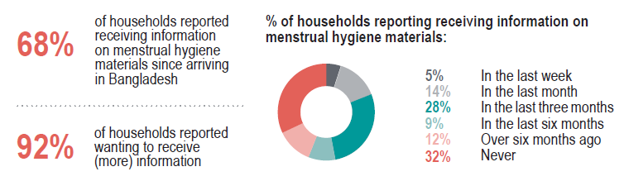
Key findings from household survey (quantitative)

Slide 9
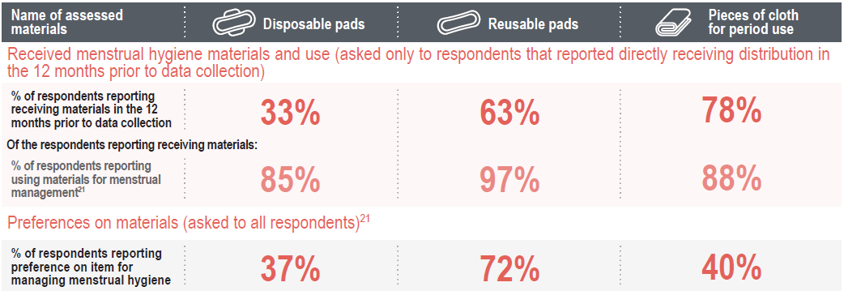
Key findings from household survey (quantitative)

Slide 10
Key findings from FGDs (qualitative)
The majority of female FGD participants reported first learning about menstrual hygiene practices through female relatives.
A number of women reported attending awareness sessions on MHM related topics following their arrival in Bangladesh.
Both male and female participants reported potentially harmful stigmatising beliefs related to menstruation, specifically that monthly periods are an illness, that women are dirty, or that menstrual bleeding is connected to black magic.
Targeted MHM awareness sessions for both genders may thus provide important opportunities for addressing social stigma and promoting key menstrual health messages.

Slide 11
Key findings from FGDs (qualitative)
Since arriving in Bangladesh, the majority of female FGD participants reported accessing a greater variety of menstrual hygiene materials via aid distributions—often for the first time
Many women now express a preference for reusable pads. However, not all women reported knowing how to properly use all distributed materials.
The distribution of preferred materials is not always reportedly consistent or timely, and women do not always have the resources available to access materials independently.

Slide 12
Key findings from FGDs (qualitative)
Women reported being uncomfortable accessing MHM materials at markets or non-MHM specific distributions.
They stated that when they do not receive preferred items at distributions, they prefer for male relatives to purchase materials at the market, or they cope by reverting to previous practices using old pieces of cloth for period use.
Evidence pilot programming by WASH actors in Cox’s bazar suggests that livelihood programmes training women to make their own MHM materials may be one effective means of enhancing women’s direct access to materials.

Slide 13
Key findings from FGDs (qualitative)
Findings from this assessment indicate a need for safe and discrete disposal methods for used menstrual hygiene materials.
Female FGD participants reported that it would be a sin or cause great harm if others see or come into contact with used menstrual hygiene materials.
As a consequence, practices such as disposing of used materials in the latrines or burying them in the ground are widely used. These practices can be harmful to the waste management system and / or can cause environmental pollution if used on a wide scale.

Slide 14
HP TWiG Recommendations
Ensure women and girls of reproductive age are able to personally access menstrual hygiene materials
Ensure both men and women have access to MHM specific messages. Specific messaging for women and girls should focus on addressing knowledge gaps related to menstruation and menstrual hygiene materials while general messaging targeted at decreasing period stigma should be provided for men, women, boys and girls.
Ensure that all WASH Staff (promoters and volunteers) are knowledgeable and comfortable discussing MHM

Slide 15
HP TWiG Recommendations
Ensure that women and girls are provided with safe, discrete and accessible disposal mechanisms and adequate access to water to meet menstrual hygiene needs
Ensure that MHM programming and operations are appropriately designed, sustained and improved upon

Slide 16
