Slide 1
Poverty Analysis
A secondary analysis on REACH’s 2021 Libyan population MSNA & JMMI data
July 2022

Slide 2
RELEVANCE
2021 Libyan population MSNA findings
Many of the sectoral needs found in Libya are driven by financial barriers
53% of the surveyed households reported having been unable to afford all of their basic needs (in the 30 days prior to data collection)
61% of households across the assessed baladiyas reported having faced issues in accessing sufficient cash (in the 30 days prior to data collection)
Using crisis and emergency coping strategies - measured through the Livelihoods Coping Strategies Index (LCSI) - is widespread in Libya, as 63% of households overall reported having used or exhausted at least one of these strategies to cope with meeting their basic needs (in the 30 days prior to data collection)

Slide 3
Context
Little information exists about income, expenditure, and poverty within Libya.
Due to the fragmented governance system in Libya, income data is scarce and rarely covers all regions.
Furthermore, when income data is available, it rarely considers the significant price differences across regions.
Objective
→ Informing on the poorest Baladiyas of the country by considering households' income and expenditure levels.

Slide 4
DATA SOURCES
2021 Libyan population MSNA data
Income data
Expenditure data
Collected:
14 June – 2 August 2021
2021 JMMI data
Minimum Expenditure Basket (MEB)
Collected:
1-11 June 2021
1-11 July 2021
1-13 August 2021

Slide 5
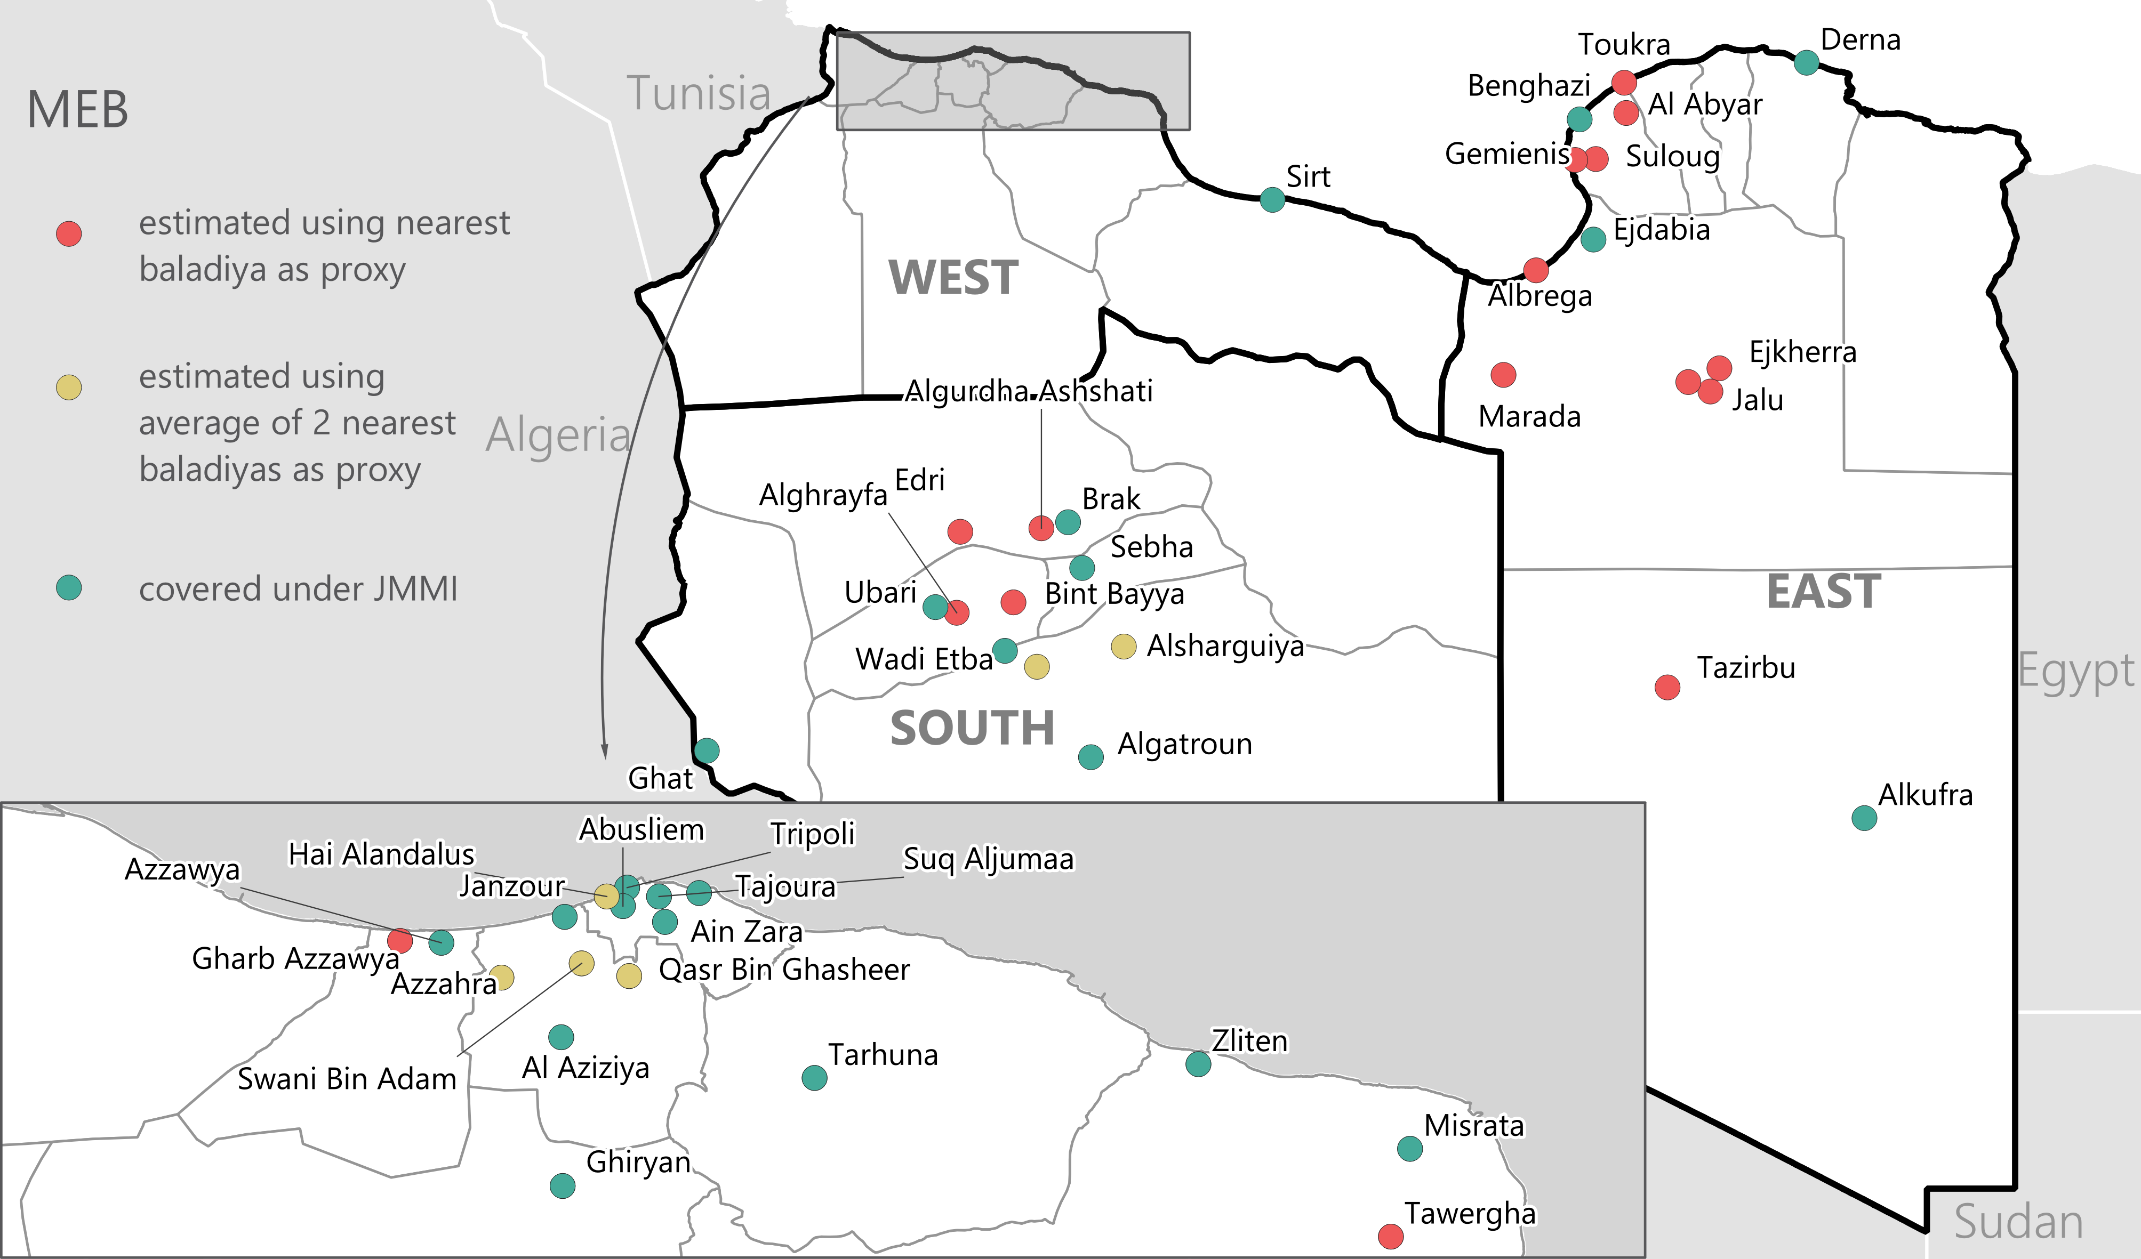
DATA SOURCES
Coverage of the assessment (45 baladiyas) by methods applied to calculate the MEB:

Slide 6
METHODOLOGY
MSNA data: composite indicators
Total income, Total expenditure, FCS, LCSI,
Equivalent HH size, income and expenditure for all potential equivalent scales,
Per capita income and expenditure
MSNA data: 2 separate dataframes
Dataframe related to income data (include only income values above 100 LBYD)
Dataframe related to expenditure data (include only expenditure values above 100 LBYD)
MSNA data: comparison of equivalence scales
OECD equivalence scale (« Oxford scale » or « Old OECD scale »)
OECD-modified equivalence scale
Square root equivalence scale
Selected (dividing by square root of HH size)
E.g. a 4-person HH has needs twice as large as a 1-person HH
MSNA data: Removing statistical outliers by using coherence checks
When conflicting with key socio-economic variables
Working HH members, FCS, Low income as reason for cash withdrawal issues, Inability to pay rent, LCSI (only for income)
MEB data: Averaging & adjusting to 1-person HH

Slide 7
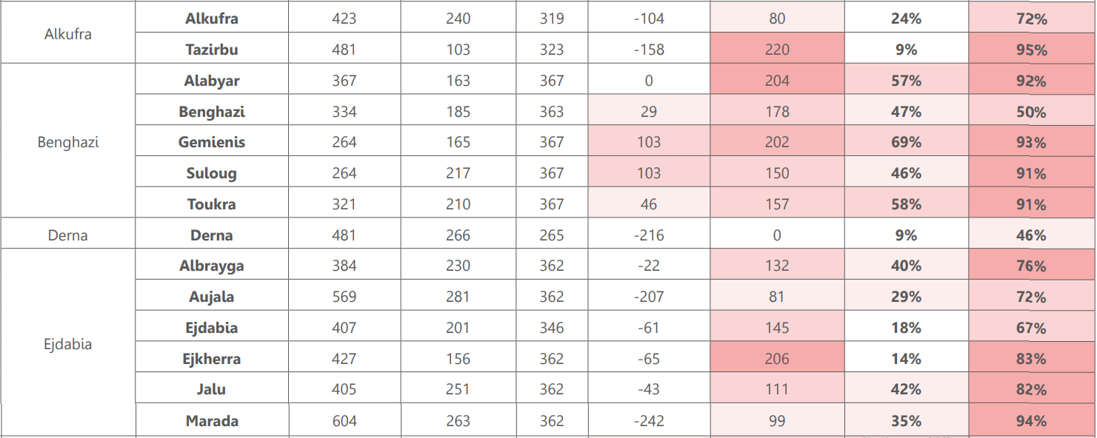
RESULTS TABLE
EAST

Slide 8
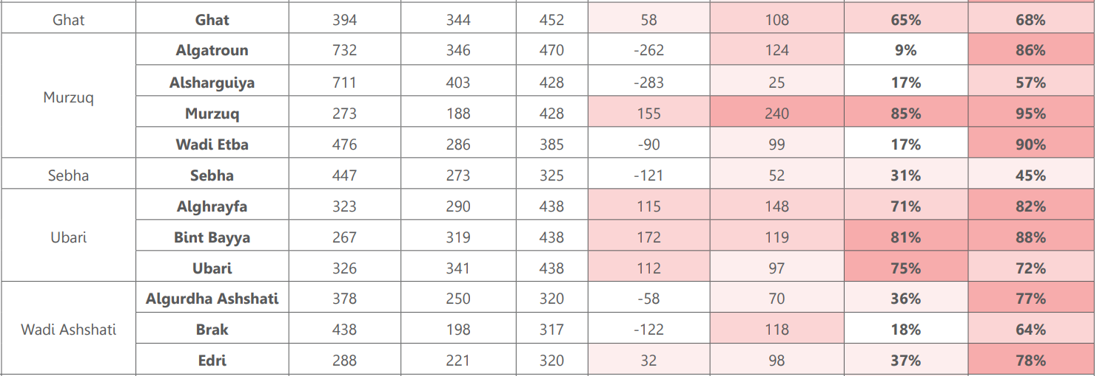
RESULTS TABLE
SOUTH

Slide 9
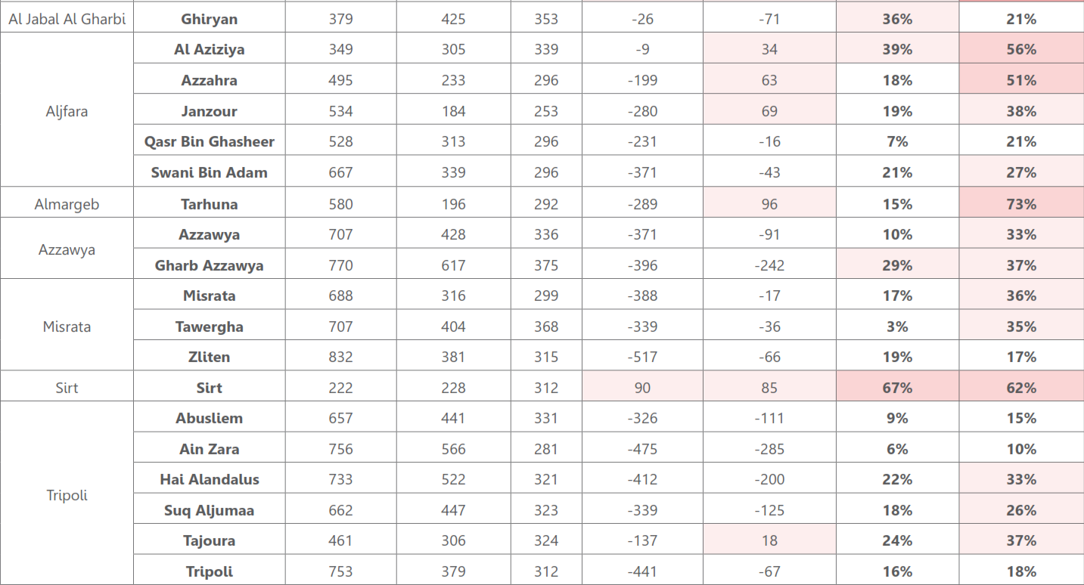
RESULTS TABLE
WEST

Slide 10
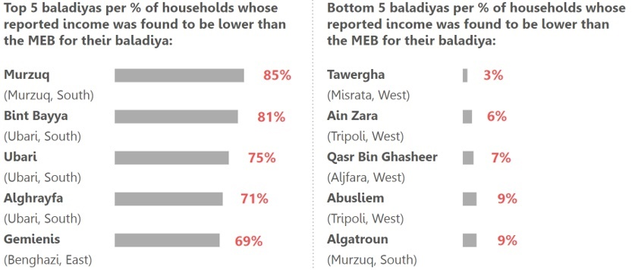
INCOME BELOW MEB

Slide 11
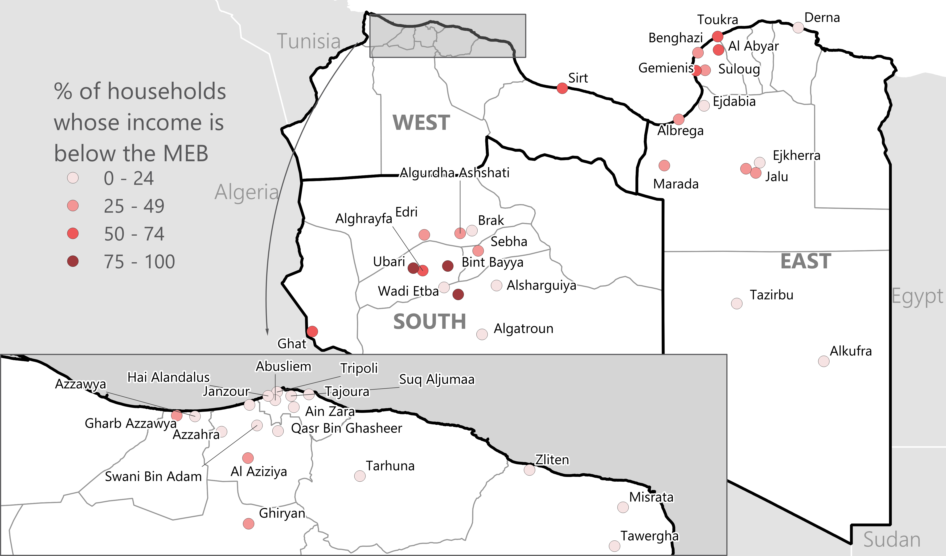
INCOME BELOW MEB
Baladiyas per proportion of households whose reported income was found to be lower than the MEB for their baladiya:

Slide 12
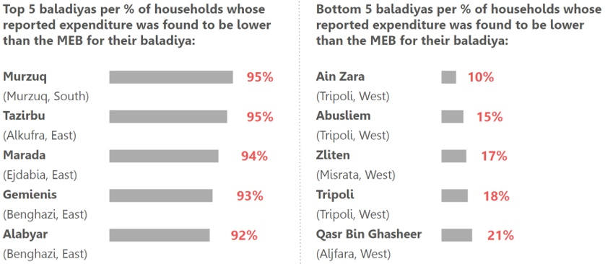
EXPENDITURE BELOW MEB

Slide 13
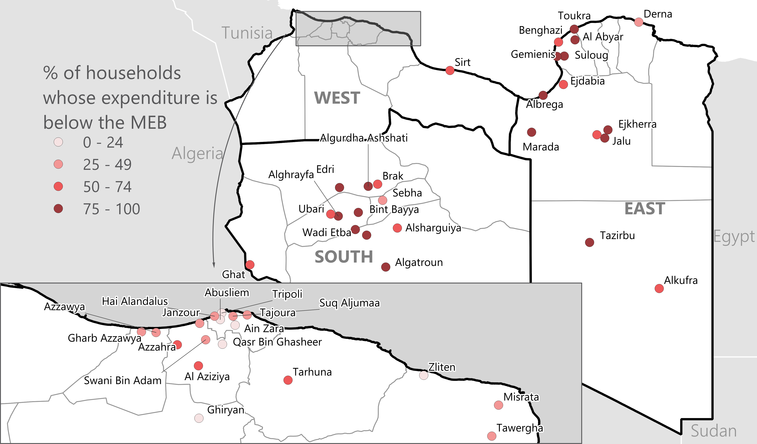
EXPENDITURE BELOW MEB
Baladiyas per proportion of households whose reported expenditure was found to be lower than the MEB for their baladiya:

