Slide 1
Detailed Site Assessment
Presentation of key findings
June 2020

Slide 2
01
Overview of the DSA

Slide 3
Context
Context
Continuous displacement makes it difficult to assess the number of (Internally Displaced Persons) IDPs and their needs
DSA is designed to provide information on the location of IDP sites and the needs of residents
Data collection for the current round of the DSA took place from November 2019 to February 2020 and assessed 2344 IDP settlements in 61 districts across Somalia.

Slide 4
Objectives
General objective
To inform stronger, more effective, evidence-based multi-sectorial interventions in IDPs settlements in urban areas across Somalia
Specific objectives
To collect multi-sector information on the availability of and access to basic services in IDP settlements in urban areas
To identify displacement trends of IDPs in assessed urban areas
Notes:
General and specific objectives

Slide 5
Methodology
Methodology and Data collection
Primary data collection employed a Key Informant (KI) methodology with KI interviews conducted by REACH enumerators in locations directly accessible by REACH Field Officers (FOs) and by CCCM partner organizations.
KIs were chosen based on knowledge of the site (e.g. community leaders)
REACH located IDP sites through contacting the lowest level of governance in each identified area to locate the IDP sites
The methodology for the third round of the DSA was developed in close consultation with clusters and partner organizations and updated to improve the quality and reliability of data collected
Notes:
2. Targeted urban areas within districts were determined based on a secondary literature review of previous assessments conducted on IDP populations.

Slide 6
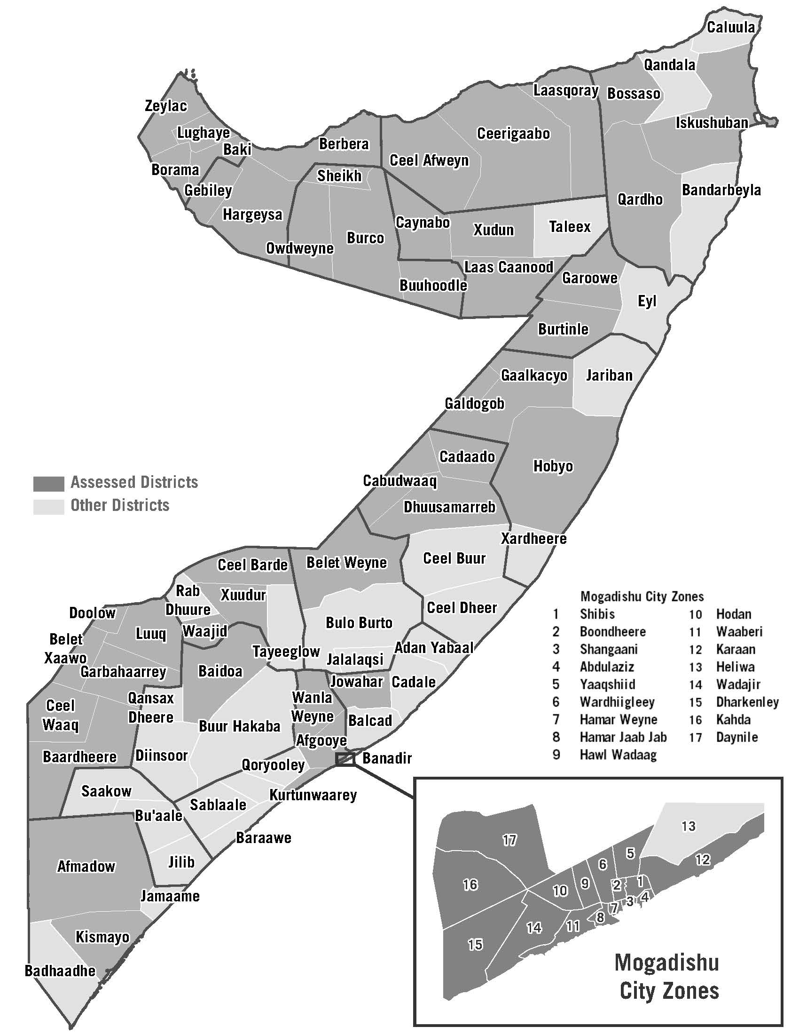
DSA Coverage
Regions: 17 (out of 18)
Districts: 61 (out of 74)
Assessed IDP sites: 2344
Site types
Informal / planned
Urban / semi-urban
Limitations and potential bias
Inaccessible Sites – H2R areas
KIs are mostly men – this may result in gender bias

Slide 7
02
Trend Analysis

Slide 8
Number of sites assessed – Trend 2018 - 2020

Slide 9
Severity Ranking of 2018, 2019 & 2020*
Districts | Year | CCCM | Shelter / NFI | WASH | Food Security | Health / Nutrition | Education | Protection | Cross Sector
Baidoa | 2018 | High | Critical | High | Medium | Critical | Critical | Medium | High
 | 2019 | Medium | Low / None | High | Low / None | Medium | Low / None | Medium | Low
 | 2020* | - | Extreme | Severe | Extreme | Severe | Extreme | Severe | -
Gaalkacyo | 2018 | High | Critical | High | Medium | High | Medium | High | Medium
 | 2019 | Medium | Medium | High | Low / None | Medium | Medium | Medium | Medium
 | 2020* | - | Extreme | Extreme | Extreme | Extreme | Extreme | Severe | -
Kismayo | 2018 | High | Medium | High | Medium | High | High | Medium | High
 | 2019 | Medium | Low / None | High | Medium | Low | Medium | High | Medium
 | 2020* | - | Extreme | Extreme | Extreme | Severe | Extreme | Severe | -
* The analysis methodology was adjusted between 2019 and 2020, in order to align with other multi-sectoral assessments carried out by REACH and other partners. This included adapting the ranking system. Therefore, the results for 2020 cannot be compared directly with the previous years, but can be useful to show the differences between the sectors and districts.
Notes:
As the causes of displacement, natural disaster and conflict, still persist, the number of IDPs continue to grow. Increased migration towards urban areas has resulted in high numbers of forced evictions. This continued displacement has resulted in increasingly fluctuating population estimates at informal and planned settlements complicating the ability of the humanitarian response to provide basic services to address the needs of IDP populations.

Slide 10
Severity Ranking 2020
Overall cluster severity phases:
Year | CCCM | Shelter / NFI | WASH | Food Security | Health / Nutrition | Education | Protection | Cross Sector
2020 | - | Extreme | Severe | Extreme | Extreme | Extreme | Severe | -
Cluster Scores: For each cluster, the median score of all indicators within that cluster is calculated to determine the final score and Severity Class for each settlement.
District-Level: Aggregating Settlements by Severity Class: The number of settlements falling into each Severity Class for each cluster will be tallied up at the District Level.
Rule of 20%: At the district level, the final Severity Class for each cluster will be the Severity Class in which at least 20% or more of the population in the district fall into.
.
Notes:
Settlement-Level
▪ Indicator Scores: For each cluster, a set of indicators and a method of scoring these indicators has been developed to evaluate severity of need. Based on the responses from the key informant interviews, each settlement is granted a score for all indicators of all clusters on a scale of 1 to 5 – None, minimal, stressed, severe, extreme

Slide 11
Percentage of assessed sites reporting access to potable water: 2018-2020

Slide 12
Percentage of assessed sites reporting access to health services: 2018-2020

Slide 13
Percentage of assessed sites reporting access to nutrition services: 2018-2020

Slide 14
Percentage of assessed sites reporting access to education services: 2018-2020

Slide 15
Percentage of assessed sites reporting access to markets: 2018-2020

Slide 16
Percentage of assessed sites reporting access to non-food items (NFI): 2018-2020

Slide 17
Severity score 2020 per District - WASH

Slide 18
Severity score 2020 per District - Health

Slide 19
Severity score 2020 per District - Nutrition

Slide 20
Severity score 2020 per District - Education

Slide 21
Severity score 2020 per District – Shelter / NFI

Slide 22
Severity score 2020 per District – Food Security

Slide 23
Severity score 2020 per District - Protection

Slide 24
Faraz Merchant
+252 636816546
faraz.merchant@reach-initiative.org
faraz.merchant
www.reach-initiative.org
IMPACT Initiatives
@REACH_info

