Slide 1
08/2022
Ajdabiya
Settlement-based Assessment of Ajdabiya municipality

Slide 2
In partnership with
Funded by

Slide 3
Settlement-based Assessment
Assessed Areas
Introduction to the Research Design
Key Findings on Vertical Social Cohesion
Formal Governance Stakeholders
Trust in Governance Stakeholders
Trust in Security Services
Trust in the Judicial System
Informal Governance Stakeholders
Key Findings on Horizontal Social Cohesion
Ajdabiya

Slide 4
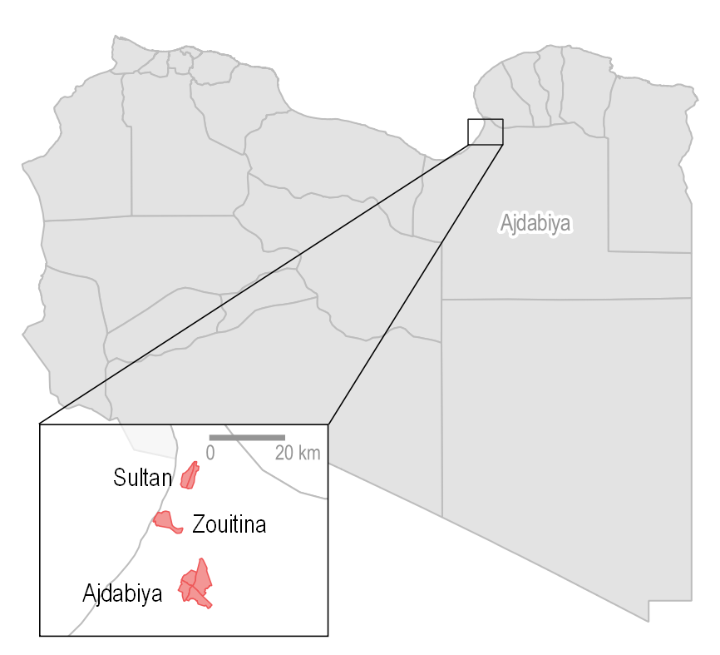
Assessed Areas
According to the Mapping Focus Group Discussion with the Municipal Council of Ajdabiya, the baladiya/municipality consists of three urban and peri-urban clusters:
Sultan (El Chamali and Janoubi);
Zouitina;
Ajdabiya downtown (Charkia, Aljanoubiya, Chamalia, and Al Gharbiya)
Notes:
Mapping Focus Group Discussion with the municipal council drew out the three clusters of peri-urban and urban muhallahs in Ajdabiya and it’s 37 neighborhoods
Downtown Ajdabiya (92% of Ajdabiya’s population reside in the city centre)
Ezahf El Akhthar (Ajdabiya Charkia) Eastern
El Wehda El Arabia (Ajdabiya Aljanoubiya) Southern
Thawra Echaabia (Ajdabiya Chamalia) Northern
El Fateh (Ajdabiya Al gharbiya) Western
Sidi Fredj
Zouitina
Sultan El Janoubi
Sultan El Chamali

Slide 5
Mapping
Quantitative Primary Data Collection
Qualitative Primary Data Collection
23 local governance Key Informant Interviews (KIIs)
1 Focus Group Discussion (FGD) with female CSO leaders
2 Migrant Protection KIIs
13 Migrant Livelihood KIIs
4 Libyan Livelihood KIIs
9 service FGDs
Timeline: December 2021 – March 2022
1 Mapping Focus Group Discussion on administrative boundaries and key service infrastructure (December 2021)
187 Direct Observations of key service infrastructure
Timeline: December 2021 – January 2022
385 individual surveys with Libyans and following an equal gender balance
200 individual surveys with long-term refugee and migrants (1+ years in Libya)
Timeline: January – March 2022
Notes:
Mapping
Municipal council of Ajdabiya
Quantitative Primary Data Collection
through randomized quota sampling per displacement status and location cluster
Through minimum non-probability quota sampling
Qualitative Primary Data Collection
Face-to-face FGDs and KIIs

Slide 6
Vertical Social Cohesion
The preparedness and willingness of local governance stakeholders and the population to cooperate with each other

Slide 7
Formal Local Governance Stakeholders
Mayor
Municipal Council
Muhallah council/ Mukhtar
Tribal Leaders
Elected by the municipal council in the summer of 2021
1 municipal council composed of 6 council members including one female member as per law No. 12 of 2021 on the Local Administrative System
5 Mukhtars in downtown Ajdabiya (One for each muhallah plus an additional overall Mukhtar)
1 Mukhtar for Zouitina
2 Mukhtars for Sultan (north and south)
Magharba
Zway/Zwayya
Al Fawakhir
Al Araibat
Al Gabail
Awlad El-Sheikh
Al-Majabra

Slide 8
Informal Governance Stakeholders
“The tribe is one of the main challenges related to governance, because there are positions that are transferred between people from the same tribe without change, because it is a large tribe and its number is large, and it [the tribe] is the one that has the largest share of access to power. The tribal society is a challenge because if your tribe is small, it will be difficult for you to reach a position [of power], so the tribe is considered a challenge and an important factor for governance.”
Formal local governance KI, Ajdabiya
8 out of 15 formal local governance stakeholders reported an increasing authority and influence of tribes in Ajdabiya as a main challenge to local governance
2 out of 3 tribal leaders, who also hold formal local governance positions, raised this concern
All tribal leaders reported their role to be peace and reconciliation actors
E.g., Solving disputes and issues locally

Slide 9
Table 1: % of Libyan respondent’s types of governance actors they feel most represented by, per location
Trust in Governance Stakeholders (Libyans)
 | Sultan | Downtown Ajdabiya | Zouitina | Total
The municipal council (a representative) | 57% | 61% | 44% | 56%
My Tribal Elder Council or notable elder | 34% | 23% | 45% | 31%
I don’t feel represented by any governance actors | 4% | 11% | 3% | 8%
A Civil Society Organization | 2% | 3% | 3% | 3%
My muhallah council/mukhtar | 0% | 1% | 4% | 1%
Other | 3% | 2% | 1% | 2%
56% of Libyans reported they felt represented by their municipal council
31% reported feeling most represented by tribal council
45% in Zouitina (Al Gabail tribe)
8% reported not feeling represented by anyone
19% of displaced respondents
5% of non-displaced respondents

Slide 10
Table 2: % of refugee and migrant respondents trust in local governance stakeholders
Trust in Governance Stakeholders (refugees and migrants)*
I do not feel represented by any governance actors | 65%
The municipal council (a representative) | 26%
A Civil Society Organization | 2%
A Tribal Elder Council or notable elder | 2%
A muhallah council/mukhtar | 2%
Embassy | 2%
Other | 2%
A local youth association | 1%
I don't know | 1%
65% of migrants reported not feeling represented by anyone
90% of East Africans
80% of West and Central Africans
65% of Southern Asians
43% of MENAs
26% reported the municipal council
49% MENA
14% West and Central African
10% Southern Asian
*All refugee and migrant findings are indicative
Notes:
If immigrants enter without identification papers, they will not go to the formal authorities, instead they will be afraid to file a complaint or to declare that they have been exposed to something.

Slide 11
Table 3: % of Libyan respondents trusting that their case would be treated fairly by the justice system, per location
Trust in the Judicial System (Libyans)
 | Sultan | Downtown Ajdabiya | Zouitina | Total
Completely | 7% | 16% | 22% | 15%
Very much | 8% | 35% | 27% | 26%
Moderately | 38% | 25% | 42% | 32%
Slightly | 44% | 19% | 9% | 23%
Not at all | 2% | 5% | 0% | 3%
88% of Libyans reported they have access to the justice system in Ajdabiya
7% reported they do not know if they have access
1% preferred not to answer
Notes:
Despite 88% of respondents in the citizen survey reported having access to the justice system only 42% of respondents reported that they either completely or very much trust their case being treated fairly in the justice system, while 58% of respondents reported that they either moderately, slightly, or not at all have trust their case to be treated fairly

Slide 12
Table 4: % of refugee and migrant respondents trusting that their case would be treated fairly by the justice system, per region of origin
Trust in the Judicial System (refugees and migrants)*
 | East Africa | MENA | South Asia | West and Central Africa | Total
Completely | 0% | 14% | 10% | 3% | 8%
Very much | 0% | 10% | 10% | 9% | 9%
Moderately | 50% | 59% | 40% | 45% | 51%
Slightly | 40% | 18% | 40% | 41% | 32%
Not at all | 10% | 0% | 0% | 3% | 2%
75% of refugees and migrants reported they have access to the justice system in Ajdabiya
24% reported they do not know if they have access
1% preferred not to answer
“If migrants enter without identification papers, they will not go to the formal authorities, instead they will be afraid to file a complaint or to declare that they have been exposed to something”
Protection Key Informant on Migrants, Ajdabiya
*All refugee and migrant findings are indicative
Notes:
Migrant respondents’ access and trust in due process in the judicial system in Ajdabiya however show a worse picture with 75% of respondents in the migrant survey reported having access to the judicial system, 24% not knowing if they have access, and 1% reported that they do not have access. While only 16% of respondents in the migrant survey reported either completely or very much trusting that their case would be treated fairly in the judicial system and 84% reported either moderately (51%), slightly (32%), or not at all (2%).

Slide 13
Horizontal Social Cohesion
The readiness of population groups to cooperate within their own community and with other communities

Slide 14
Table 5: % of Libyan respondent’s types of groups that they consider a part of their social network
Social Network
(Libyans)
People that have the same religion as you | 57%
People from the same tribe as you in your neighbourhood | 42%
People from the same tribe as you, but living in other neighbourhoods | 36%
People from another tribe than you and living in your neighbourhood | 30%
People that go to the same place of worships as you | 25%
People from the same tribe as you, but living in other cities than Ajdabiya | 25%
People from another tribe living in another neighbourhood | 14%
Non-Libyans living in your neighbourhood | 2%
Non-Libyans living in another neighbourhood | 1%
Religion, tribal affiliation, and geographical proximity are all core aspects of community forming
Different groups of community forming were reported across both Downtown Ajdabiya, Zouitina, and Sultan
No difference were observed of these between genders

Slide 15
Table 6: % of refugee and migrant respondents, who reported never attending a public social event, reasons for non-attendance, per region of origin (n=182)
Social Events (refugees and migrants)*
 | East Africa | MENA | South Asia | West and Central Africa | Total
I do not know about any public events | 67% | 86% | 90% | 77% | 81%
I do not feel safe during public events | 17% | 6% | 5% | 10% | 9%
I cannot attend public events as a migrant | 11% | 3% | 0% | 6% | 5%
I cannot attend public events (alone) | 6% | 5% | 5% | 5% | 5%
I cannot attend public events (alone) because of my gender | 0% | 0% | 0% | 1% | 1%
91% of refugees and migrants reported they never attended a public social event in Ajdabiya such as cultural events, sports events, or workshops
Only MENA region refugees and migrants reported to have attended public social events (n=10)
Coffee shops were reported as social gathering point for male Egyptian and Sudanese refugee and migrants
*All refugee and migrant findings are indicative

Slide 16
Table 7: % of Libyan respondents, who reported never attending a public social event, reasons for non-attendance, by gender (n=82)
Social Events (Libyans)
 | Female | Male
I cannot attend public events alone because of my gender | 23 | 0
I cannot attend public events because of my community affiliation/population group | 22 | 13
I do not feel safe during public events | 1 | 0
I don not know about any public events | 12 | 6
Other |  | 5
Total | 58 | 24
21% of Libyans reported they never attended a public social event in Ajdabiya such as cultural events, sports events, or workshops
36% of respondents in Sultan
31% of female respondents
24% of displaced respondents

Slide 17
Livelihoods
Livelihood opportunities for Libyan men and women

Slide 18
Table 8: % of Libyan respondents’ income source, per location
Income Sources
 | Government subsidies | A member of my household is working | Humanitarian assistance | I am working | I rely on the income/pension of my father | No income source | Other | Savings
Sultan | 13% | 6% | 1% | 75% | 0% | 3% | 0% | 1%
Downtown Ajdabiya | 11% | 8% | 3% | 67% | 4% | 4% | 1% | 1%
Zouitina | 46% | 0% | 0% | 48% | 0% | 1% | 0% | 5%
Total | 20% | 6% | 2% | 64% | 2% | 3% | 1% | 2%
64% of Libyan respondents reported they are working
20% reported that their main source of income is government subsidies
46% of respondents in Zouitina
Among non-working Libyan respondents (n=103), only 35% reported that they are looking for work
Thereof, 70% mostly female respondents are not looking for work

Slide 19
Table 9: % of Libyan respondents’ profession, per sector (n=243)
Type of profession
Teacher, lawyer, engineer, doctor | 32%
Public security official (police, military, etc.) | 16%
Home-based income-generating activity (sewing, shoe repair, small agricultural activity (garden, beekeeping, etc.) | 8%
Taxi or truck driver | 7%
Small business owner | 7%
Public sector employee (Administration) | 7%
Vocational (carpenter, electrician, plumber, or other professional) | 6%
Other (please specify) | 6%
Oil sector | 4%
Agriculture | 2%
Financial services | 2%
Pastoralism | 2%
Service industry (janitor, waiter, etc.) | 1%
Telecommunication | 1%
Location of jobs:
45% in downtown Ajdabiya
25% Sultan
21% Zouitina
8% another municipality than Ajdabiya

Slide 20
Livelihoods
Livelihoods for refugee and migrant men and women including access to employment, barriers, and working conditions

Slide 21
Table 10: % of refugee and migrant respondents, who are working, by sector, per region of origin (n=187)
Access to employment*
 | East Africa | MENA | South Asia | West and Central Africa
Vocational (carpenter, electrician, plumber, or other professional) | 16% | 38% | 47% | 31%
Construction | 53% | 15% | 16% | 44%
Service industry (janitor, waiter, etc.) | 16% | 14% | 5% | 13%
Small business owner | 0% | 18% | 5% | 0%
Agriculture, pastoralism, fishing, food industry | 5% | 10% | 0% | 3%
Domestic work (for someone else, i.e., not in my own house) | 0% | 1% | 5% | 6%
Home-based income-generating activity (sewing, shoe repair, small agricultural activity (garden, beekeeping, etc.) | 11% | 0% | 16% | 0%
Teacher, lawyer, engineer, doctor | 0% | 4% | 0% | 1%
Other (please specify) | 0% | 0% | 5% | 0%
Public security official (police, military) | 0% | 0% | 0% | 1%
94% of refugee and migrants reported working
Top five most reported job sectors:
34% vocational jobs
31% construction
13% service industry
7% small business owner
5% agriculture, pastoralism, fishing, food industry
Types of reported jobs:
72% reported the work to be daily labour
24% reported the work to be permanent
4% reported the work to be temporary
*All refugee and migrant findings are indicative
Notes:
Refugee and migrant profiles
90% more than two years in Ajdabiya
8% one – two years
3% six months – one year
1% less than six months
The unpredictable sectors of work are reportedly mainly construction and vocational professions. 5/7 KIIs on male migrant refugee and migrant livelihoods reported that particularly less reliable types of work are found through waiting on the public square Al Hay Sinai/Omar Al Mokhtar Square.

Slide 22
Enablers*
Main barriers*
Top three enabling factor for refugee and migrants to find employment:
A Libyan social network (5/13 KIs)
A refugee and migrant social network that have stayed in Ajdabiya for more than one year (5/13 KIs)
Previous similar work experience (5/13 KIs)
86% of working refugee and migrant respondents reported working in the same type of sector prior coming to Libya
Top three barriers for refugees and migrants to find employment:
Lack of or limited knowledge of Arabic (11/13 KIs)
Lack of skills and work experience (6/13 KIs)
Lack of general knowledge of the Ajdabiyan labour market (4/13 KIs)
The ways to access job opportunities
The types of jobs refugee and migrants can access
*All refugee and migrant findings are indicative

Slide 23
“Most of migrants’ work is difficult and dangerous, for example, construction work. It may require climbing to higher places using simple methods with lack of security. There are those who work in professions such as blacksmithing and carpentry that require dealing with dangerous machines, and there are those who work in unhealthy places where they are exposed to dust and dirt, and because of these risks, there are those who lost their life and one of their organs and caused them to suffer from chronic diseases”
Egyptian KI on male refugee and migrant livelihoods, Ajdabiya
Working conditions*
All refugee and migrant livelihood KIs reported that refugee and migrants work per verbal agreement
93% of working refugee and migrants reported they are paid cash in hand
All refugee and migrant livelihood KIs reported the work environment is categorized as dangerous and containing physical risks (men)
*All refugee and migrant findings are indicative

Slide 24
Working conditions*
“I know a migrant who fell into the sewers because of the nature of his work [working without protective gear or securing] and died, and there are those who worked in blacksmithing and carpentry and lost their hands. There are those who work in the factories for bricks and cement, and they are exposed to chronic respiratory diseases. This affects the nature of work in general and creates a barrier of fear among the rest.”
Egyptian KI on male refugee and migrant livelihoods, Ajdabiya
Types of health and safety concerns (male refugees and migrants)
Exposure to dust and dirt particles, when working in construction (3/7 KIs)
Injuries, fractures, falling, and exposure to chemicals when working in vocational jobs or brick and cement factories (6/7 KIs)
*All refugee and migrant findings are indicative

Slide 25
Working conditions*
Types of concerns (female refugees and migrants)
Exposure to sexual harassment, when in private homes (5/6 KIs)
In the form of verbal harassment (4/6 KIs)
Contracting COVID-19 when working in caretaking roles and private homes (4/6 KIs)
Movement restrictions in the evening and at night (4/6 KIs)
*All refugee and migrant findings are indicative

Slide 26
Social protection systems
Access to Libyan public social protection systems

Slide 27
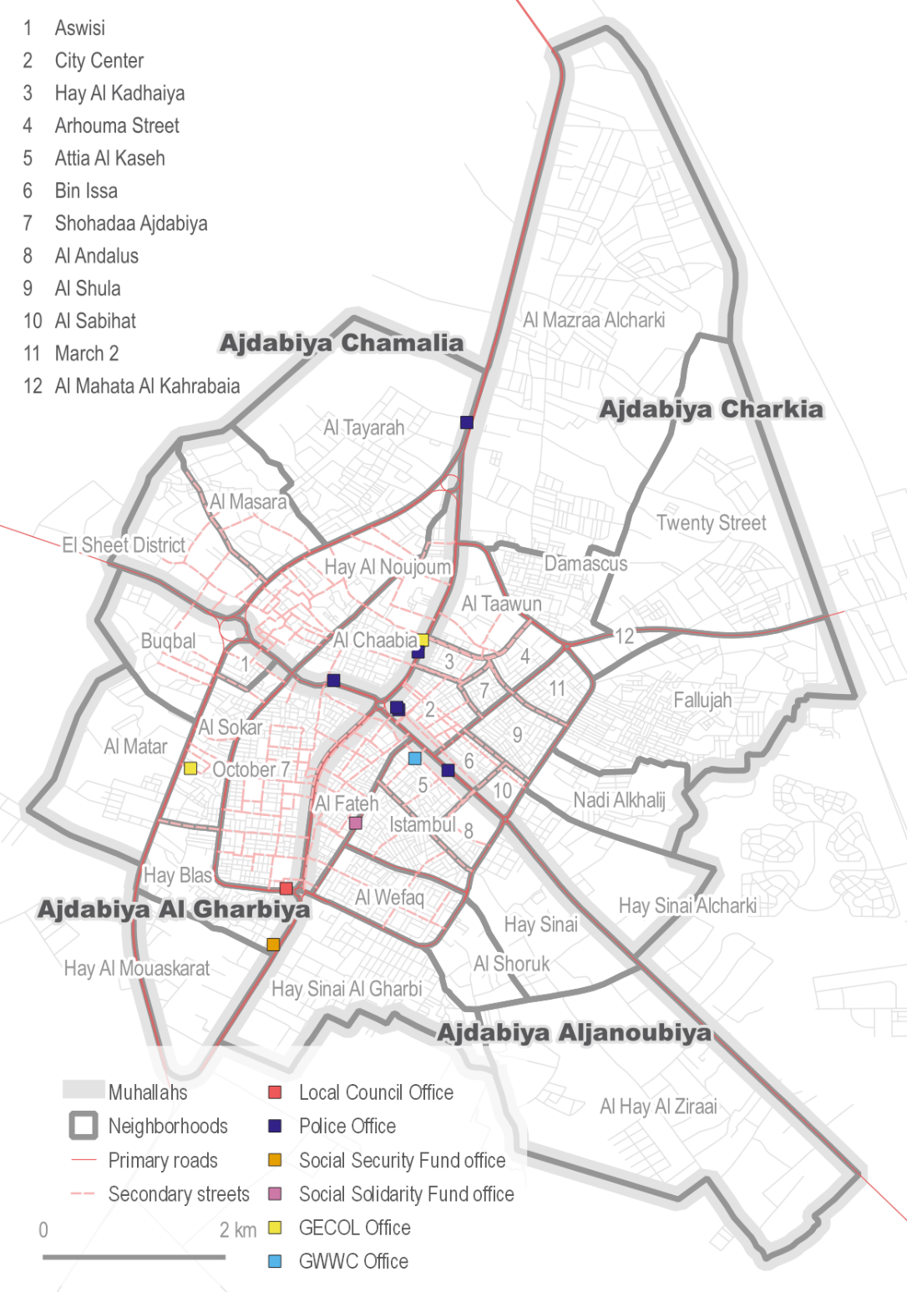
Social Protection Systems
20% of Libyan respondents reported that their main source income is government subsidies (n=77)
90% rely on the Basic Assistance Grant
61% younger than 55 years old
14% rely on the Wife and Children Grant
6% rely on smaller other grants
1% rely on the Zakat Monthly Assistance
65% of respondents were women
Notes:
Both the Social Security Fund and the Social Solidarity Fund has their offices in downtown Ajdabiya on Tripoli Street. Any registration for social protection programmes must happen in person at the offices in Ajdabiya with documentation for eligibility. Documentations need for social protection programmes were reported to include national identification, birth certificate, personal photograph, and the death certificate of the husband for widowed women.
Basic Assistance
Cash benefit established through Social Security Law no.13 of 1980, edited in the Basic Assistance Law no.16 of 1985 REACH Initiative, “Social Protection Systems for Children in Libya.”
Social Solidarity Fund (SSolF)
Libyan women above 60 years and men above 65, incapacitated people unable to work, widows, orphans, married women with disabilities, unmarried mothers, children with no legal guardian or breadwinner

Slide 28
Education
Attendance for school-aged children and challenges faced

Slide 29
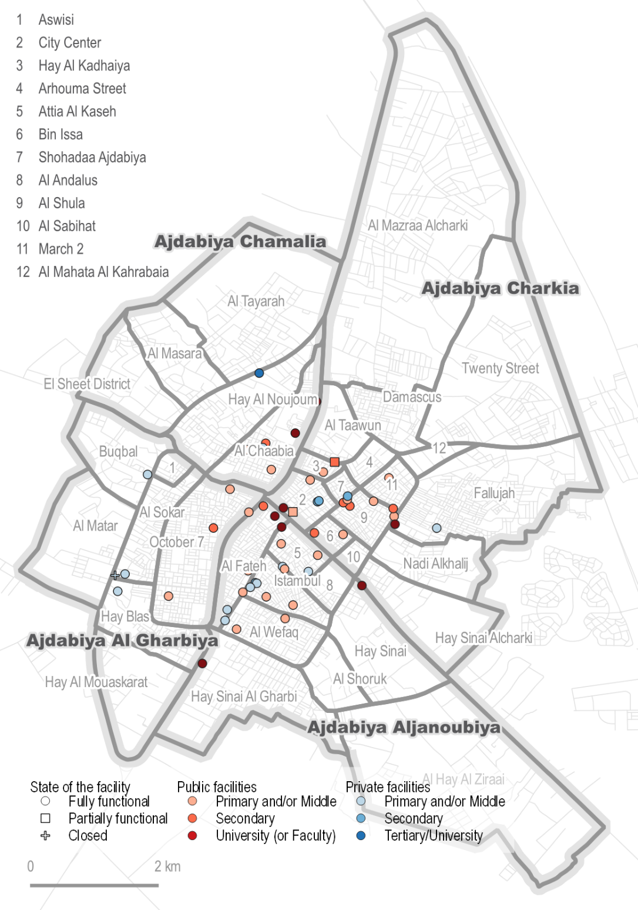
Education
Libyans
58% of the respondents in the Libyan individual interview have school-aged children (n=224)
Of these, 94% reported their children attending formal education
Issues faced by school-aged children, when attending school
49% reported no issues, when attending school
40% reported lack of teaching/learning material
37% reported poor quality teachers
11% reported overcrowding

Slide 30
Education*
Refugees and migrants
23 out of 200 respondents in the refugee and migrant individual interview have school-aged children
14 MENA households
6 West and Central Africa households
3 East African households
Issues faced by school-aged children, when attending school
16/23 reported no issues
2/23 lack of teaching/learning material
2/23 overcrowding
*All refugee and migrant findings are indicative

Slide 31
Health
Health care facilities locations, challenges, and complaint mechanisms

Slide 32
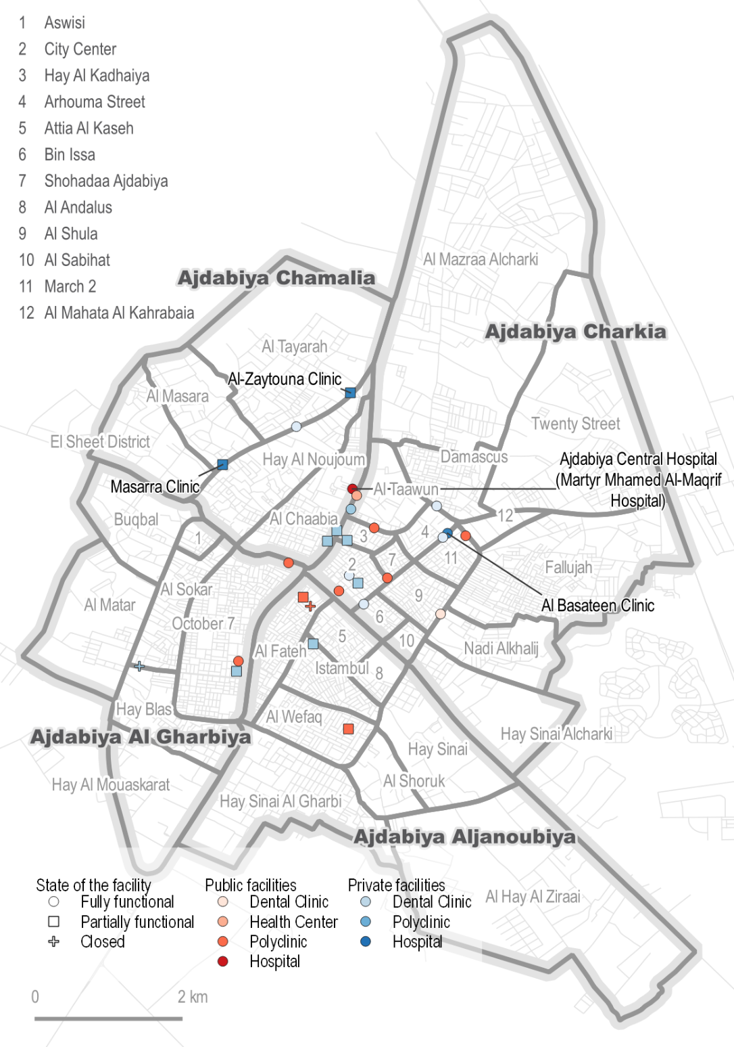
Health*
98% of Libyan respondents reported access to a doctor in the public healthcare system
74% of Libyan respondents reported considering they have access to sufficient healthcare services
51% of Libyan respondents reported having less than 30 mins to a public healthcare service, 31% less than 15 minutes, and 18% less than an hour
57% of Libyan respondents reported facing issues when accessing public healthcare facilities, while this was 65% of refugee and migrant respondents reported facing issues
*All refugee and migrant findings are indicative
Notes:
Health facilities in Ajdabiya are mostly clustered in specific neighbourhoods of downtown Ajdabiya while a combined health clinic and pharmacy is located in Sultan El Janoubi and El Chamali and a health centre, polyclinic, and villa hospital in Zouitina

Slide 33
Table 12: % of Libyan respondents’ specific challenges, when accessing healthcare services, by type of problem, by location
Health
 | Sultan | Downtown Ajdabiya | Zouitina
No problems | 33% | 32% | 72%
Lack of trust in health workers | 51% | 16% | 12%
Poor quality health care | 51% | 33% | 20%
Lack of medicines at the health facilities | 40% | 35% | 7%
No healthcare facilities available in my area | 16% | 15% | 1%
Cannot afford to pay for health services | 5% | 29% | 7%
Long waiting times at health facilities | 5% | 23% | 7%
Health facilities too far | 7% | 9% | 4%
Transport too expensive | 2% | 3% | 1%
Discrimination at health facilities | 1% | 5% | 1%
Overcrowding | 1% | 3% | 2%
43% reported no problems, when accessing healthcare facilities
Top five most reported problems when accessing healthcare facilities
34% poor quality health care
29% lack of medicines at the health facilities
24% lack of trust in health workers
18% cannot afford to pay for healthcare
15% long waiting time at the health facilities
Notes:
Health facilities in Ajdabiya are mostly clustered in specific neighbourhoods of downtown Ajdabiya while a combined health clinic and pharmacy is located in Sultan El Janoubi and El Chamali and a health centre, polyclinic, and villa hospital in Zouitina

Slide 34
Sewage
Mapping of the public sewage network and access for citizens

Slide 35
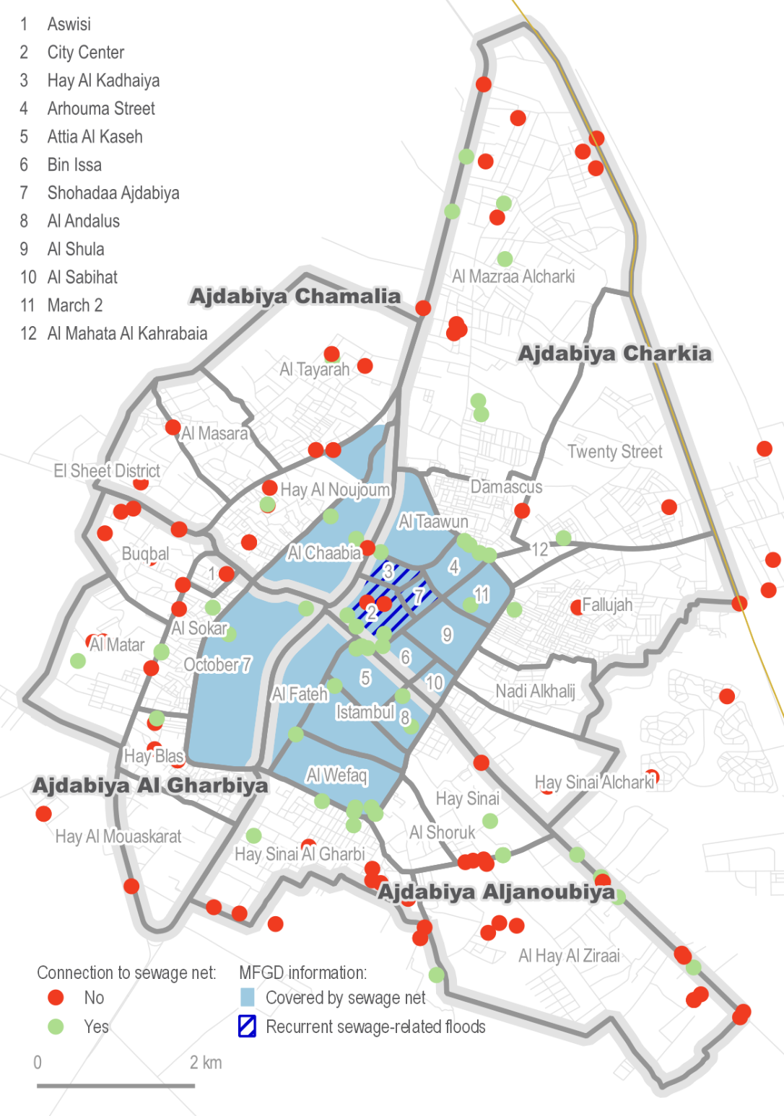
Public Sewage Network
41% of respondents in the Libyan individual survey reported to be connected to the public sewage network
64% in Zouitina
37% in Sultan
32% in downtown Ajdabiya
55% of respondents reported problems with sewage; floods, bad smells, and water contamination
Notes:
Informal connection to the main connection pipes

Slide 36
Electricity
Mapping of the electricity network and access for citizens

Slide 37
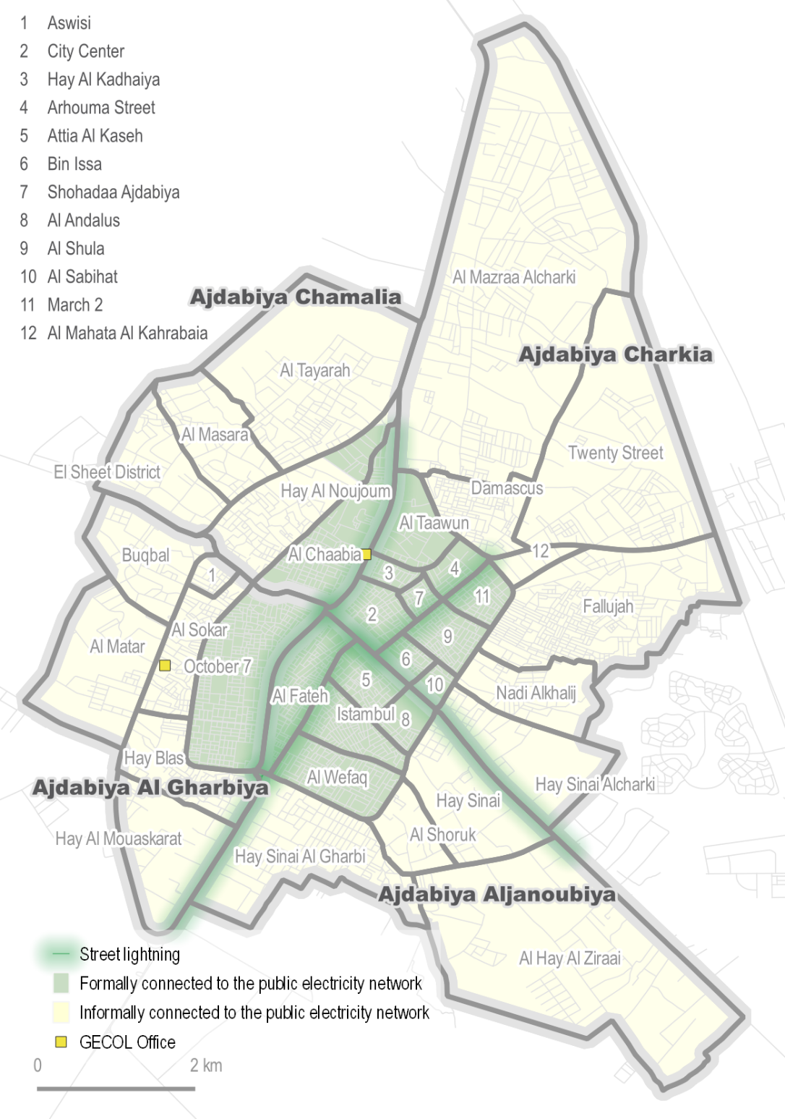
Electricity
98% of respondents in the individual interview reported being connected to the public electricity grid
2% without access in downtown Ajdabiya
The municipal council only mapped downtown Ajdabiya and a few neighborhoods in Zouitina and Sultan to be formally connected
Informal connections to the public electricity network are common in Ajdabiya

Slide 38
Figure 1: % of Libyan respondents’ average daily hours of electricity cuts during summer, by location (n=282)
Electricity
73% of Libyan respondents reported experiencing electricity cuts during Summer
41% of Libyan respondents reported not having access to a generator and needing one
33% of respondents reported having access to a generator with sufficient fuel
20% do not have access to a generator and do not need one
5% have access to a generator but not sufficient fuel
1% prefer not to answer

Slide 39
QUESTIONS
Immeuble Nour, Lac II, Tunisia
elisabeth.loewe@reach-initiative.org

