Slide 1
Preliminary analysis results
Key findings from quantitative and qualitative data collection
Joint Child Protection Sub-Sector (CPSS) Assessment
April 2020

Slide 2












CPSS ASSESSMENT PARTNERS
Coordinated by:
Funded by:
Technical contributions:

Slide 3
JOINT CPSS ASSESSMENT OVERVIEW
The assessment consisted of two parts: the secondary data review and primary data collection
Secondary data review included:
Document review of 20+ reports and assessments
Anonymized case data review of over 15,500+ cases in the child protection information management system (CPIMS+)
Key informant interviews with child protection (CP) partners
Findings and key information gaps identified in the secondary data review were used to inform the primary data collection
Primary data collection included:
Quantitative household surveys that were administered to adolescents and caregivers
Qualitative tools focused on adolescents that were facilitated by CP partners

Slide 4
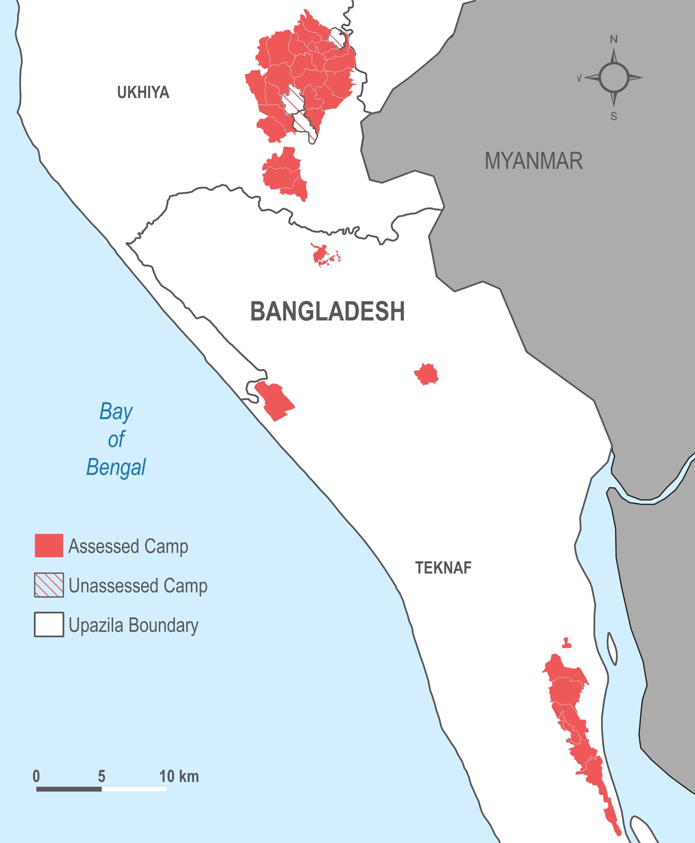
METHODOLOGY – QUANTITATIVE
DESIGN
With guidance and input from the CPSS and CP partners, two surveys were created focusing on protection concerns and access to services. One survey was targeted at adolescents (ages 15-20) and one survey at caregivers (ages 18+)
TRAINING
Enumerators received a two-day training from REACH that covered research ethics, an overview of the assessment, and review and practice with the tool
Additionally, they received a two-day training from CPSS and CP partners on child protection principles, child safeguarding, referrals, and consent

Slide 5
METHODOLOGY – QUANTITATIVE
DATA COLLECTION
Adolescent survey 13 February – 4 March 2020 50:50 female:male enumerators 829 eligible surveys completed | Caregiver survey 3 – 29 February 2020 75:25 female:male enumerators 820 eligible surveys completed
SAMPLING APPROACH AND COVERAGE
31 refugee camps in the upazilas of Ukhiya and Teknaf (excluding 12, 18, and Kutupalong Refugee Camp in Ukhiya) were surveyed
Sample points were randomly distributed proportional to the UNOSAT/REACH shelter footprints within ISCG camp boundaries, providing a sample significant at 95% confidence level and 5% margin of error at the upazila level and up to a 95% confidence level and a 3.5% margin of error for the refugee population
Unless otherwise noted, most findings presented here have been aggregated up to the refugee population-level

Slide 6
METHODOLOGY – QUALITATIVE
DESIGN
With guidance and input from the CPSS and CP partners, two qualitative tools were developed:
  Participatory Ranking Methodology (PRM): Adolescents ranked threats that children in their community faced from most common to least common
  Visual diary and Focus Group Discussion (FGD): Adolescents were asked to draw the activities they do during a typical day and were then led through a discussion about their daily lives
TRAINING
Facilitators received a one-day training from REACH that covered research ethics, an overview of the assessment, and review and practice with the tool
Additionally, they received a two-day training from CPSS and CP partners on child protection principles, child safeguarding, referrals, and consent
DATA COLLECTION
All field activities and primary analysis was conducted by CP partners
PRM Female adolescents: 4 sessions Males adolescents: 9 sessions Caregivers: 7 sessions | FGD Female adolescents: 8 sessions Male adolescents: 8 sessions

Slide 7
LIMITATIONS
SURVEYS
Coverage: The findings cannot be extrapolated to sites that were not visited; aggregated data for this assessment is therefore representative of the refugee population at the upazila-level, excluding camps 12, 18, and KRC in Ukhiya.
Respondent bias: Individuals might have felt pressure to give answers that are socially acceptable.
Representativeness: By only sampling adolescents who were present in their shelter during the day, key sub-groups of adolescents who are usually not present in their shelter during the day (those working, attending learning centers, collecting distributions, etc.) were likely under-represented in this survey.
QUALITATIVE
Note-taking limitations: Because of protection concerns associated with conducting research with adolescents, recordings and transcriptions of the tool facilitations were not permitted. As such, the only information available for secondary analysis was what could be captured during the activity in a note-taking template.
Coronavirus: Because of the rise of other obligations and tasks due to the global pandemic, communication and coordination with research partners during the analysis portion of the data collection was difficult.

Slide 8
01
DEMOGRAPHICS

Slide 9
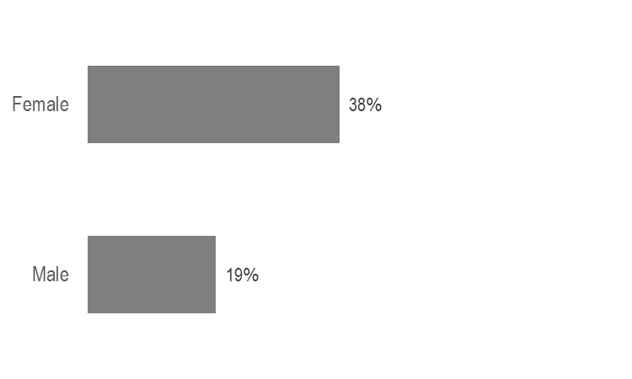
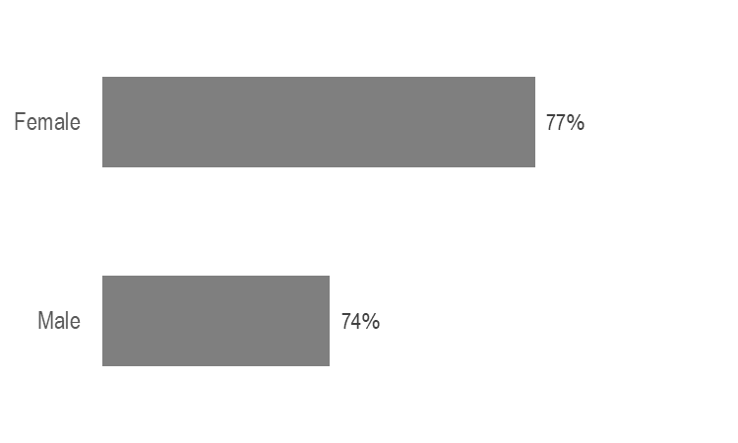
DEMOGRAPHICS
Average household size: 5.5 people
12% of adolescents and 20% of caregivers reported that someone in their household had a disability or chronic illness that affected their ability to do every day tasks
% of adolescents reporting being married
% of married adolescents reporting having children

Slide 10
02
DAILY ACTIVITIES

Slide 11
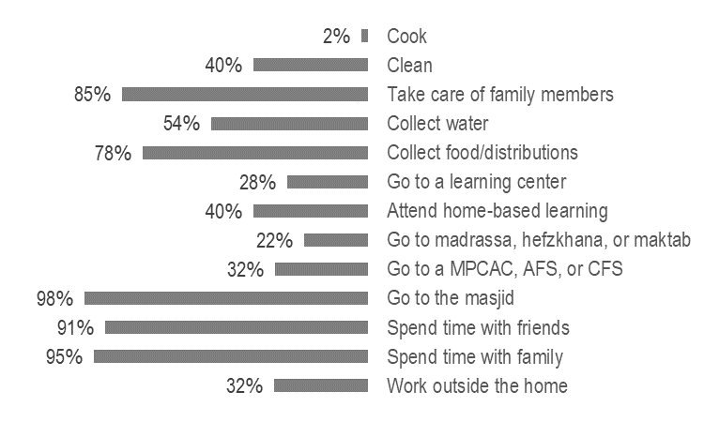
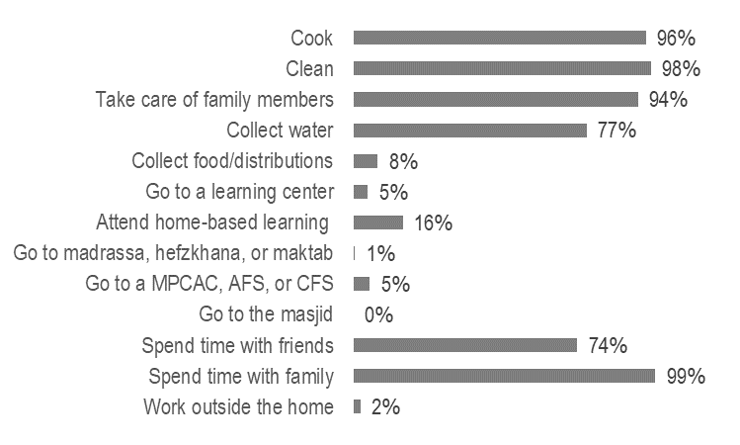
DAILY ACTIVITIES
% of adolescents who reported doing the following activities on a typical day*
Male adolescents
Female adolescents
**Multi-purpose Children and Adolescent Center (MPCAC), Adolescent Friendly Space (AFS), or Child Friendly Space (CFS)
*respondents could select multiple options

Slide 12
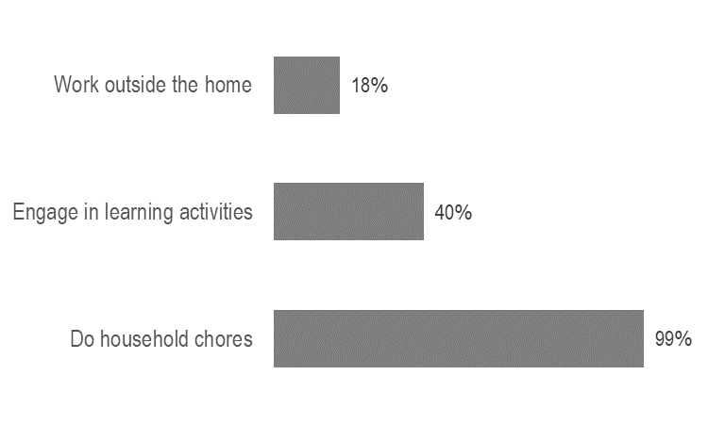
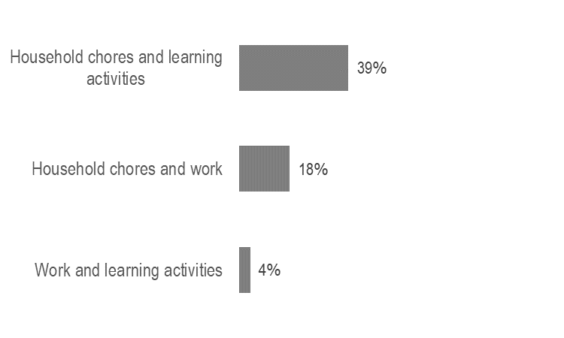
DAILY ACTIVITIES
% of adolescents who reported doing the following activities*
Almost all adolescents reported performing household chores on a daily basis, 40% engage in any form of learning activity (attend a learning center, madrassa, CFS, or home-based learning), and 18% work outside the home for a non-family member
% of adolescents who reported doing the following activities*
18% of adolescents perform household chores and work outside the home and only 4% work outside the home and attend any form of learning activities
*respondents could select multiple options

Slide 13
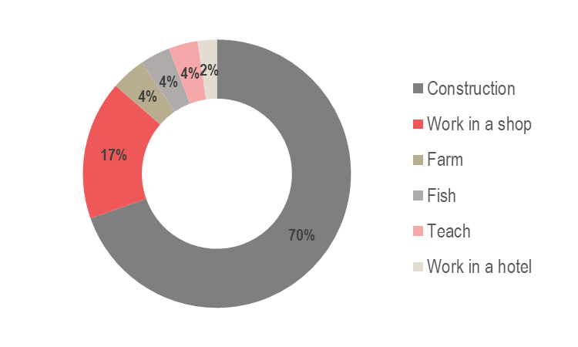
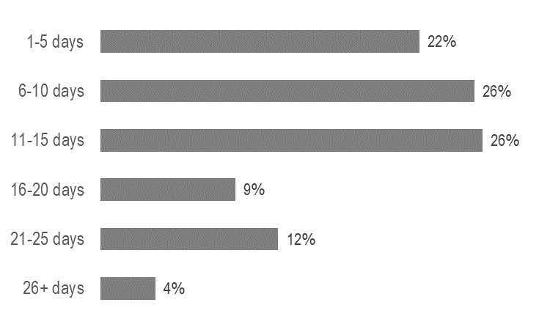
DAILY ACTIVITIES – WORKING MALES
Types of jobs worked by male adolescents*
Of the 32% of male adolescents who work, most are engaged in either construction work or working in a shop and typically work between 1-15 days out of the month.
Number of days reportedly worked in the 30 days prior to data collection
8.7 average number of hours worked in a day
336 average amount earned per day (BDT)
*respondents could select multiple options

Slide 14
DAILY ACTIVITES – MALE FGDs
Education, praying, working, spending time with friends, exercising/playing sports, and maintaining proper hygiene were considered important activities.
Participants emphasized that since they cannot attend learning centers, finding work so they can support their families is a priority for them
Difficult activities reportedly include:
Repairing their shelters
Collecting distributions
Working construction jobs (including carrying heavy items like iron rods and cement)
Participants reportedly take advice on their daily activities from their parents, teachers, imams, majhis, and siblings.
In their free time, participants:
Play sports
Socialize with friends
Sleep
Help their younger siblings or neighbors

Slide 15
DAILY ACTIVITES – FEMALE FGDs
Religious activities (reading the Quran, praying five times a days) and spending time with family and friends were considered to be very important activities
Difficult activities reportedly included fetching water because:
Tubewells are far from their shelter
Water supply is sometimes low
Arguments can occur in the tubewell queues
Participants said they leave their shelter usually only to do chores or go to a CFS, AFS, or WFS*. They take permission from their parents or elder siblings before leaving their shelter. Adolescent females prefer to not be outside their shelter by themselves, otherwise they face harassment and eve teasing.
In their free time, they reported usually:
Talk to their friends
Sleep
Make arts and crafts
Participants emphasized that it is important to help their parents by caring for them and doing chores for them.
*Women Friendly Space

Slide 16
03
CHILD PROTECTION RISKS

Slide 17
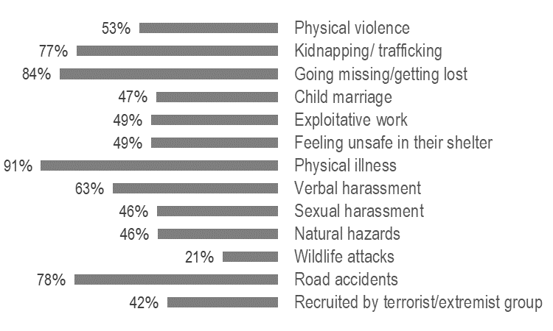
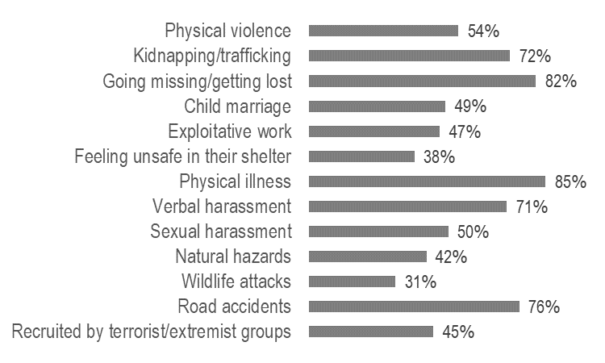
CHILD PROTECTION RISKS
% of respondents who reported being very or sometimes concerned about the following threats that youths face in their community*
Caregivers
Adolescents
*respondents could select multiple options

Slide 18
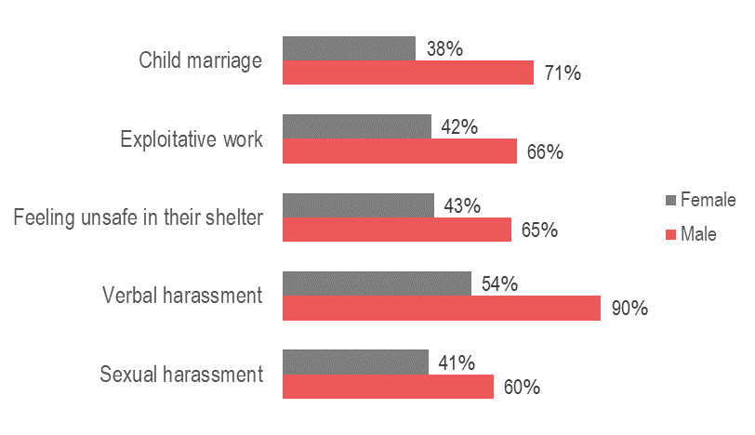
CHILD PROTECTION RISKS
Relative to female caregivers, male caregivers were reportedly more concerned about youths facing child marriage, exploitative work, unsafe shelters, verbal harassment, and sexual harassment.
% of caregivers who reported being very or sometimes concerned about threats that youths face in their community*
*respondents could select multiple options

Slide 19
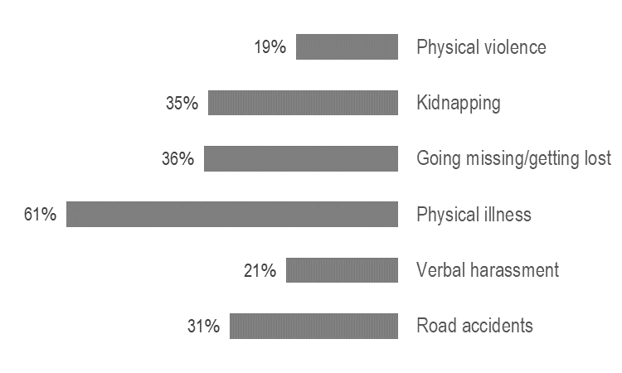
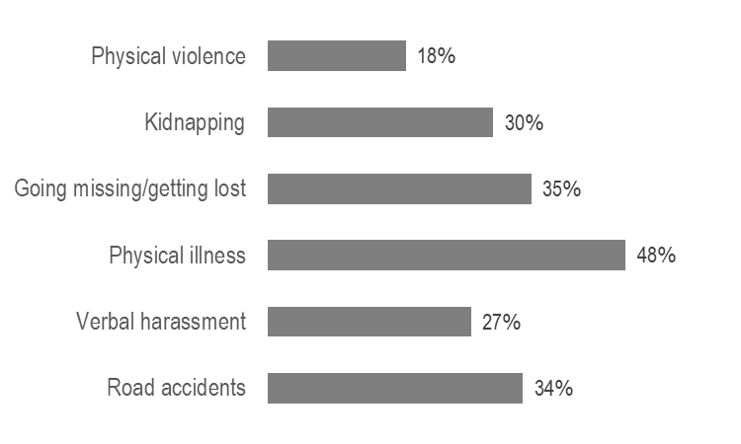
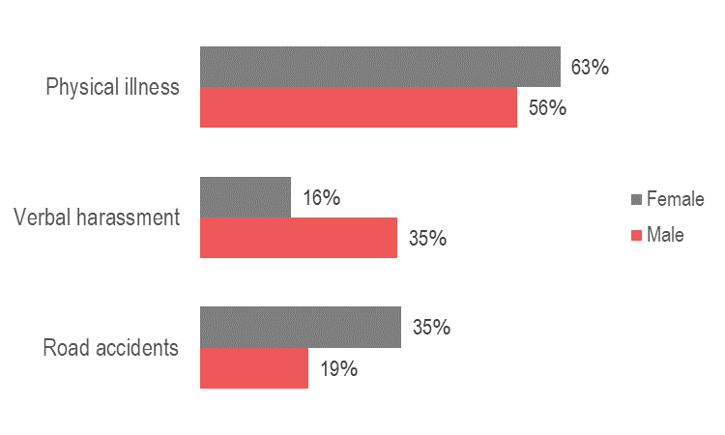
CHILD PROTECTION RISKS
% who reported witnessing the following threats in their community in the 30 days prior to data collection* **
Caregivers
Adolescents
Male and female caregivers reported different threats most frequently witnessed in the 30 days prior to data collection* **
**These results are not indicative of the prevalence of any of these threats
*respondents could select multiple options

Slide 20
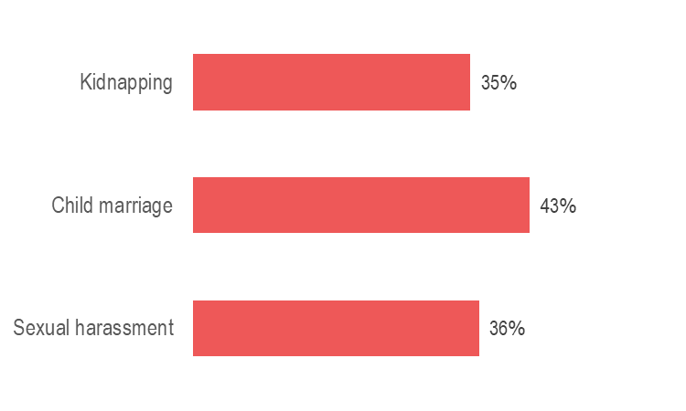
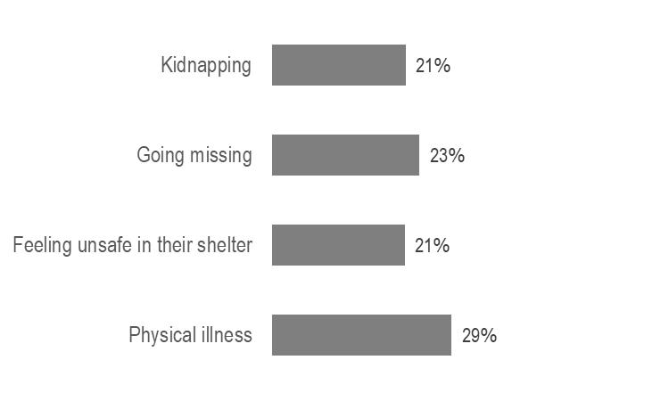
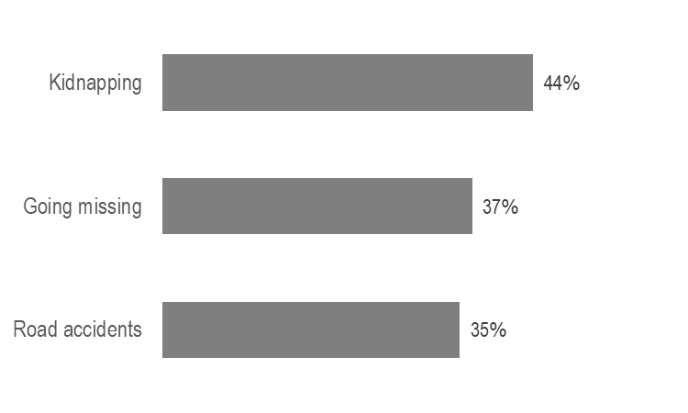
CHILD PROTECTION RISKS
% of adolescents who identified different threats that the following groups are most at risk of *
Girls
Children with disabilities
Boys
*respondents could select multiple options

Slide 21
CHILD PROTECTION RISKS – PRM
Participants were asked to rank the following threats from those they thought occurred most often to least often in their community
Average rankings based on 11 sessions with adolescents:
Average rankings based on 5 sessions with caregivers:
Physical illness 2.9
Eve teasing/sexual harassment 3.2
Child marriage 4.7
Child labour 4.8
Kidnapping 5.5
Getting lost 5.5
Road accidents 6.0
Verbal abuse 7.6
Physical abuse 7.7
Feeling unsafe in their shelter 9.3
Emotional abuse 10.1
Natural hazards 10.2
Wildlife attacks 12.1
Feeling unsafe in their shelter 2.0
Child labour 4.6
Physical abuse 5.4
Road accidents 5.8
Getting lost 6.0
Child marriage 6.5
Eve teasing/sexual harassment 7.0
Physical illness 7.6
Verbal abuse 7.8
Kidnapping 9.3
Emotional abuse 9.7
Natural hazards 10.4

Slide 22
CHILD PROTECTION RISKS – PRM
Adolescents feel unsafe in the:
Markets
Latrines
Distribution centers
Their parents are often anxious about road accidents, physical illness, kidnapping and eve teasing
In order to cope, adolescents:
Do not leave their shelter
Do not go out alone
Pray
Ignore the threat (eve-teasers)
In order to prevent these threats, adolescents want to build more awareness in the community.
The community provides essential support in dealing with various threats.

Slide 23
04
CHILD LABOUR, MARRIAGE, AND VIOLENCE NORMS

Slide 24
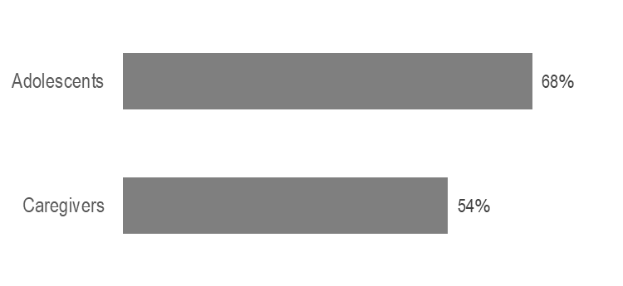
NORMS – CHILD LABOUR AND CHORES
Adolescents and caregivers overwhelmingly responded that children under the age of 14 should not:
Stop going to school to work
Work outside the house
Do chores that require a lot of strength
However, 55% of adolescents said it was okay for children to not attend school so they can help with household chores.
% of respondents who say it is okay for children to be responsible for taking care of their siblings
51%

Slide 25
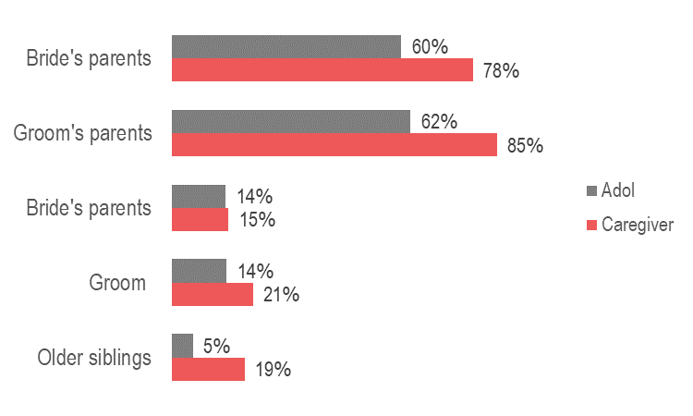
NORMS – CHILD MARRIAGE
Adolescents and caregivers overwhelmingly responded that children under the age of 14 should not get married, even for economic reasons, and should not stop going to school to get married.
However, 17% of adolescents and 25% of caregivers said it was okay for parents to arrange a marriage for their daughter to keep her safe and 31% of adolescents and 39% of caregivers said it was a girl’s main responsibility to become a mother after getting married.
Both adolescents and caregivers say that, on average: Girls can get married at age 18
Boys can get married at age 21
Who should decide if a child should get married?*
*respondents could select multiple options

Slide 26
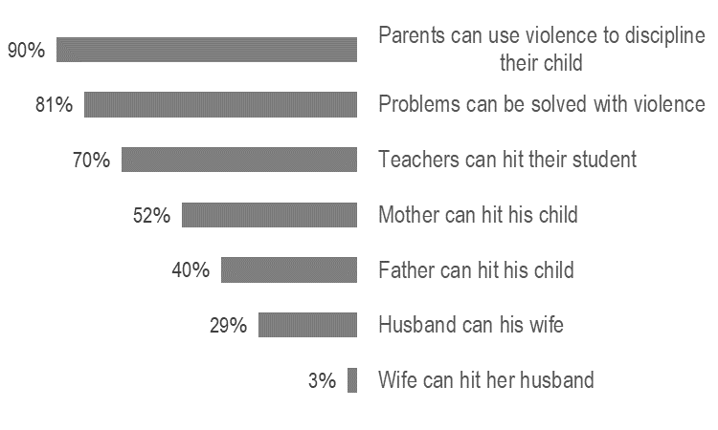
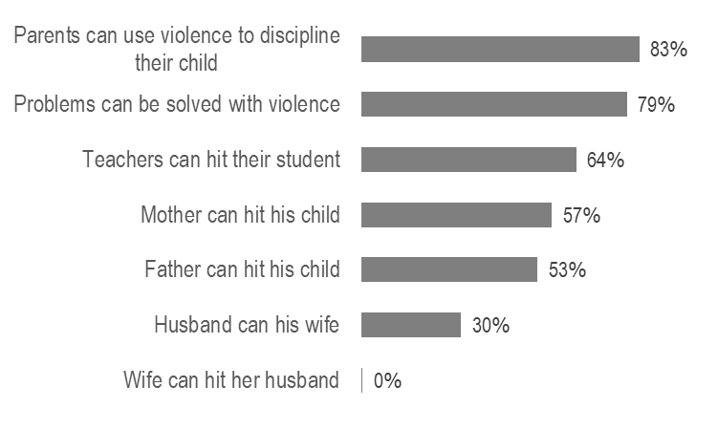
NORMS – VIOLENCE
Adolescents and caregivers agree that violence is acceptable in various situations.
Caregivers
Adolescents
When asked what they would do if they knew that a child in their community was experiencing harmful labor, domestic abuse, abuse at school, or sexual abuse, most adolescents and caregivers said they would:
Report the issue to the majhi
Report the issue to the Camp in Charge (CiC)
Inform the family
Try to intervene directly

Slide 27
05
ACCESS TO SERVICES

Slide 28
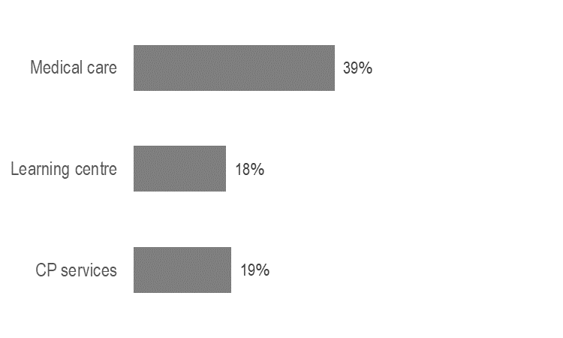
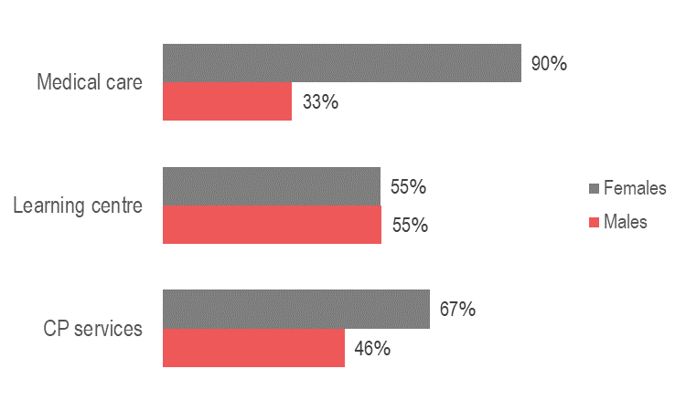
ACCESS TO SERVICES
% of adolescents who reported accessing the following services in the 30 days prior to data collection
Of the adolescents who went to a health center, learning center or CP service, % who took permission from someone else before accessing the service
Female adolescents reported mostly taking permission from their mother, father, or husband. Male adolescents reported mostly taking permission from their mother or father; some took permission from an older sibling.
*Medical care including: NGO clinic, private clinic, pharmacy, and/or traditional healer

Slide 29
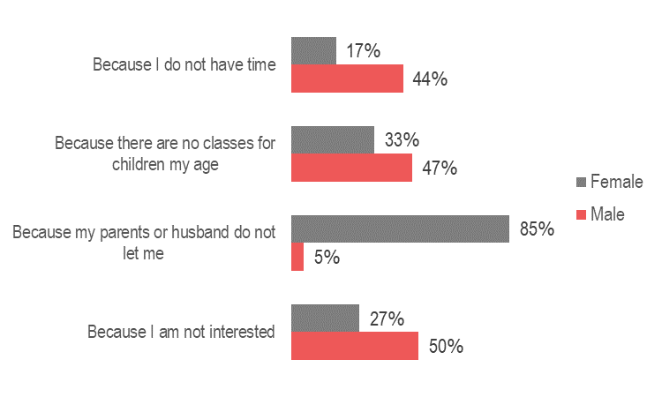
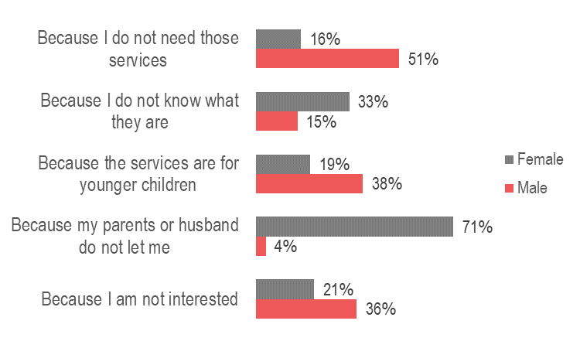
ACCESS TO SERVICES
% of adolescents who cited the following reasons for not attending a learning centre*
% of adolescents who cited the following reasons for not attending CP services*
*respondents could select multiple options

