Slide 1
Migrant and Refugee Multi-Sector Needs Assessent (MSNA)
Inter-Sectoral Coordination Group
October 2019

Slide 2



Coordination Framework
Design
ISCG oversaw and validated the indicators via sector consultation and in partnership with IMAWG.
Coordination
Humanitarian Country Team (HCT)
Inter-Sector Coordination Group (ISCG)
Information Management Working Group (IMAWG)
Donor
Joint analysis partners
Data collection partners

Slide 3
Contents
01
MSNA overview
Demographic overview
Regional disaggregation
Locations with the most complex unmet needs
Vulnerability factors
Next steps
02
03
04
05
06

Slide 4
01
Overview

Slide 5
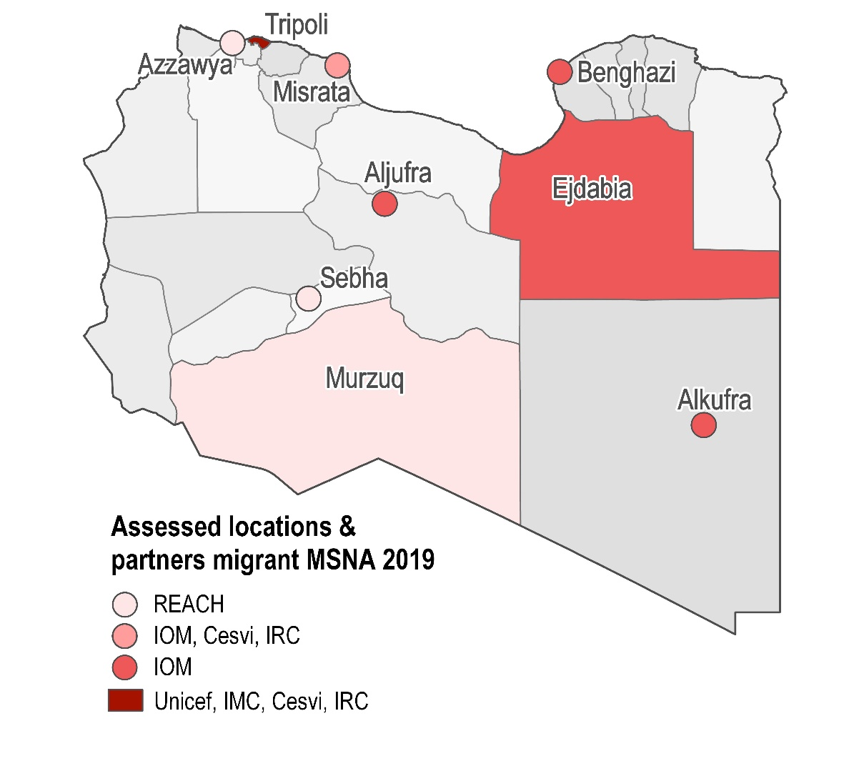

Geographical coverage
Sectors
Protection
Shelter and NFI
Food Security
Education
Health
WASH
Cash and markets

Slide 6
Methodology
Research design and data collection
Sampling
The migrant and refugee component of the 2019 MSNA employed purposive sampling methods. The sampling was stratified by location and region of origin, with a min. target chosen for some nationalities [in proportion to the relative population from that region in that location according to IOM-DTM data]
Individual surveys instead of household surveys (the Libya MSNA)
Mixed methods approach
Quantitative:
Individual surveys 1,716
Qualitative:
Focus Group Discussions 6 FGDs
Key Informant Interviews 45 KIIs
Notes:
REACH found that two criteria are particularly associated with migrants and refugees’ experience in Libya.
Firstly, migrants and refugees’ region of origin was found to be linked to different experiences in accessing services, separate coping strategies in use, and different extent of exposure to protection risks.
Secondly, long-term migrants and refugees were found to cope with adversity better than recently arrived migrants and refugees.
Interviewees for this assessment will be therefore classified according to their country of origin, four regions of origin (West Africa, MENA, East Africa and Other) and two times of arrival (within the past 12 months and longer than 12 months ago) in order to enable the comparison of subgroups within the sample.

Slide 7
Objectives and limitations
Objective
The 2019 MSNA will inform the 2020 Humanitarian Needs Overview (HNO) and the 2020 Humanitarian Response Plan (HRP).
MSNA rolled out in Libya for the fourth consecutive year, migrants and refugees (M&R) included for the first time in the 2019 MSNA.
Key limitations
The Migrant component of the 2019 MSNA is built on a purposive sampling strategy. Accordingly, findings are indicative only.
The 2019 Libyan and Migrant/Refugee MSNAs were implemented using separate methodologies, and the results cannot be directly compared.
Due to ethical reasons, no minors participated in individual surveys. Information about refugee and migrant children, unaccompanied minors, and separated children was acquired through surveys with adults and Focus Group Discussions with children, youth and parents.

Slide 8
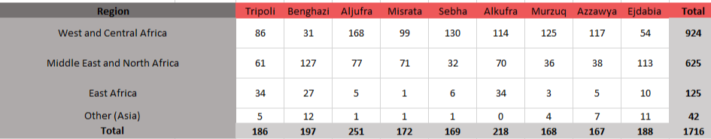
Number of interviews conducted

Slide 9
02
Demographic
Overview

Slide 10
Demographic overview
33
Average age of respondent
7.8%
Female respondents
3
Average HH size reported
54.5%
Proportion of respondents that reported
living in a household

Slide 11
Demographic overview
Region of origin of respondents
Notes:
South: W&C Africa
East: MENA

Slide 12
Demographic overview
Duration of stay of respondents per Libyan region

Slide 13
03
Regional disaggreagtion

Slide 14
Regional disaggregation
West
Respondents in the West are more inclined to leave Libya for Europe in the next 6 months than respondents in other regions (42% vs 34% oa):
Of the 42% that intend to leave Libya, 73% intend to go to Europe (vs. 61% oa), 22% intend to go to their home country (vs. 34% oa):

Slide 15
Regional disaggregation
West
Highest percentage of respondents being unemployed during the preceding 30 days across Libya: 13% vs. 6% oa
Highest percentage with high reduced coping strategy index (rCSI) scores during the preceding 7 days across Libya: 50% vs. 32% oa
Relatively high percentage use livelihood coping strategies in order to pay for smuggler (of those that use coping strategies, 12% compared to max. 5%):
05
Notes:
Needs high

Slide 16
Regional disaggregation
South
Respondents in the South were more likely to have come to Libya with the plan to return home after a short amount of time (14% vs. 8% oa)
A higher % of respondents in the South intended to move to another location in Libya in the next 6 months than in other regions (21% vs. 15% oa)
Of the 38% that intend to leave Libya, 50% intend to go to Europe (lowest % among regions), 44% intend to go to their home country (highest % among regions):
Notes:
Higher % of respondents in South want to return to their home country (44% vs. 34% overall)
Findings are indicative of circular labour migration

Slide 17
Regional disaggregation
South
Relatively low proportion of respondents reportedly unemployed during preceding 30 days: 3% vs. 6% oa
Low percentage of permanent job holders: 19% vs. 31% oa
A higher percentage were engaged in daily labour during preceding 30 days: 46% vs. 42% oa
Relatively high percentage use livelihood coping strategies in order to send money to family in country of origin: Of those using coping strategies, 68% vs. 49% oa
Notes:
Coping strategy reason – evidence of links to CoO and circular migration

Slide 18
Regional disaggregation
East
Respondents in the East are most likely to intend to stay in Libya during the next 6 months (73% vs. 46% oa)
Migration intentions are more based on employment or economic reasons than elsewhere (82% vs. 71% oa)
Had the highest percentage of permanent job holders (46% vs. 31% oa).
Of the 23% of people intending to leave Libya, 59% intend to go to Europe, 38% intend to go back to their home country:
Notes:
Has lowest % in following migration intention reasons:
-For security reasons,
-I came to Libya with the plan to travel to another country,
-I came to Libya with the plan to return home after a short amount of time

Slide 19
Regional disaggregation
Vulnerability and risk across Libya
A higher proportion of respondents reported feeling in danger in West Libya:

Slide 20
Regional disaggregation
Safety and Security
Compared to other regions, in West Libya:
Higher proportion of respondents reporting having faced previous protection incidents: robbery (39% vs. 26% oa), verbal harassment (20% vs. 16% oa), arrested for lack of documents (17% vs. 11% oa), and kidnapping (10% vs. 5% oa)*†
A higher percentage in West Libya reported security and safety concerns for M&R children where they lived (80% vs. 65% oa)
In the West, the most reported safety concerns for migrant and refugee children were: being robbed (47%), being kidnapped (34% vs. 15% oa), and being threatened (25% vs. 14% oa)†
In East Libya, fears of being held captive or detained against their will (32% vs. 17% oa), being arrested due to lack of documents (32% vs. 23% oa) and being tortured (21% vs. 13% oa) were reported by higher proportions of respondents than elsewhere*†
In South Libya, respondents’ most commonly reported reason for feeling in danger was fear of being robbed (32%)*†
*These percentages are of the subset of respondents reporting feeling in danger
†These were multi-select questions
Notes:
Real incidents in West
Fears in East

Slide 21
Regional disaggregation
Reasons for restricted freedom of movement:
  Lack of means of transportation relatively more reported in South
  Kidnapping and detainment relatively more reported in West
  Fear of being arrested higher relatively more reported in East
*Among respondents that reported experiencing restricted freedom of movement during the past year
Notes:
Reasons:
Conflict or security reported in all areas
Fear of being arrested reported everywhere
Lack of means of transportation bigger issue in South
Kidnapping and detainment in West
Fear of being arrested higher in East

Slide 22
Regional disaggregation
West Libya: Relatively frequent challenges faced due to
    Insecurity, language barriers, explosive hazards and lack of documents to travel
South Libya:
    Markets more frequently inaccessible due to distance and travel costs
Notes:
South:
-1. Transportation too expensive,
-2. Live too far from marketplace / no means of transport,
-3. Insecurity travelling to and from marketplace
West:
-1. Insecurity
(2. transport expensive)
-3. language barriers
-4. explosive hazards
-5. lack of documents to travel

Slide 23
Regional disaggregation
Reasons for limited access to healthcare:
  Lack of money and no facilities that accept refugees/migrants relatively more reported in West
  Lack of medical staff and medicines and fear of becoming known as a migrant relatively more reported in East
  Distance and routes to facilities being unsafe relatively more reported in South
Notes:
West:
Lack of money (higher than oa)
(Distance to health facilities is too far) (lower)
No available health facilities that accept refugees/migrants (a little higher)

Slide 24
Regional disaggregation - Access to markets
Availability and prices
Among respondents who reported that some items were too expensive to purchase in the market in the last 30 days (60% overall), the following items were reportedly unavailable due to high prices (% respondents) (multi-select question):
Notes:
Prices at informal markets are far higher: MEB in South Libya is traditionally higher than elsewhere in the country
Supply chain disruption due to conflict and closure of official markets in Murzuq due to clashes (JMMI August 2019)

Slide 25
Regional disaggregation - Access to markets
Availability and prices
Among respondents who reported that some items were not available in the market in the last 30 days (14% overall), the following items were reportedly consistently unavailable (% respondents) (multi-select question):

Slide 26
Access to markets
Availability and prices
South:
High unavailability of fuel and food types other than fresh produce and meat
Key items (NFIs and food items) reportedly too expensive
West
Lack of and high prices of medicine and health-related items
Fresh produce unavailable or too expensive
East:
Most respondents reported items consistently available, access to markets is good
Food items too expensive
Notes:
Prices at informal markets are far higher: MEB in South Libya is traditionally higher than elsewhere in the country
Supply chain disruption due to conflict and closure of official markets in Murzuq due to clashes (JMMI August 2019)

Slide 27
Regional disaggregation
Lack of documents
Fear of arrest (23% overall) and previous arrest (11% overall) due to lack of documents reported across all regions in Libya*†
Highest percentage of respondents that were previously arrested due to lack of documents was in West Libya (17%).*
Highest percentage of respondents that feared arrest for lack of documents in East Libya (32%).*
Of respondents that face challenges accessing health care, lack of documents limits their access to a similar extent across all regions (12% overall).
*These percentages are of the subset of respondents that said they felt in danger
†This was a multi-select question

Slide 28
Regional disaggregation - WASH
28% of respondents in the South and 32% of respondents in the West reported using the public network as their main drinking water source over the preceding 30 days.
Conversely, only 69% of respondents in the East reported using public networks for their main water source.
Of respondents without a water source available at their shelter (51% oa), 38% of those in the South had to travel over 500m to access water, compared to 3% in the other regions.
Notes:
In WASH :
in Libya MSNA, EAST also had highest use of public networks as main water source (70% in libya MSNA.
% reporting insufficient drinking water also highest in South (62%) in Libya MSNA, might be interesting to note

Slide 29
Regional disaggregation - Education
In the South, the highest proportion of respondents with school-aged children in their households reported that these children had no access to any formal education (59%), followed by the West (26%).
In the South and West, a minority of respondents reported that HH children had access to public school (20% and 33% respectively). In contrast, 75% of respondents reported HH children having access to public school in the East.

Slide 30
Regional disaggregation – Child Protecion
% of respondents that reported encountering refugee or migrant children working in their baladiya in the past year
South | East | West
79% | 32% | 54%

Slide 31
Regional disaggregation
Top 3 priority needs*
West
East
South
Food
Medical care
Employment
Employment
Medical Care
Food
Food
Employment
Medical Care
Self-reported needs consistent across Libya and across sampled population groups
Other reported needs: access to cash, shelter, electricity and fuel, water and education
*This was a multi-select question

Slide 32
04
Locations with the Most Complex Unmet Needs

Slide 33
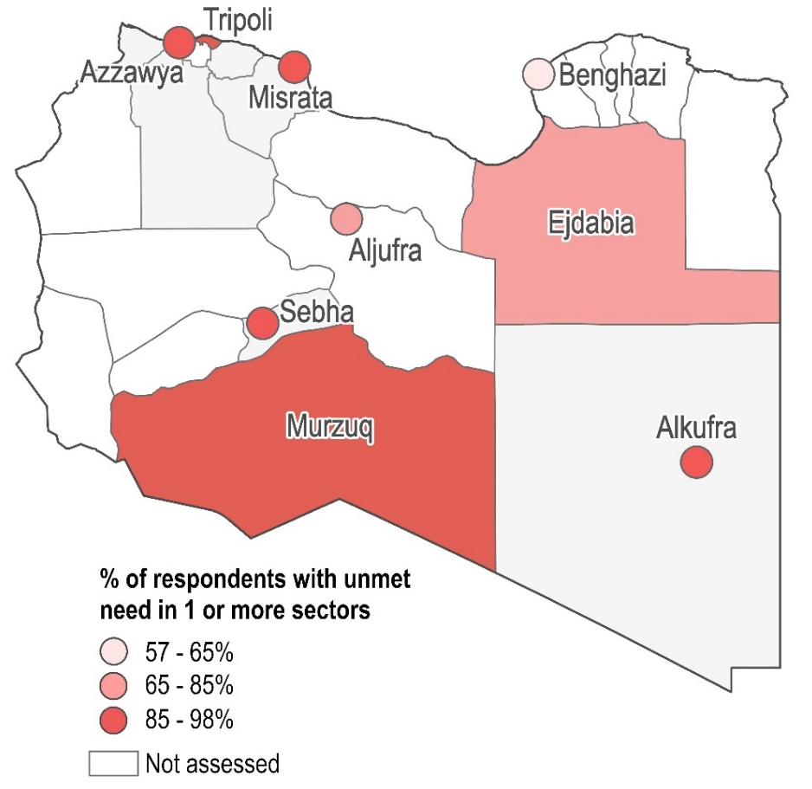

Intensity vs. Complexity of Needs: Locations with Any Unmet Needs vs. Unmet Needs in 3+ Sectors
Intensity: Locations with highest % of respondents with unmet needs in any (i.e., 1+) sectors*
Complexity: Locations with highest % of respondents with unmet needs in 3+ sectors*
*Calculated using thresholds for a number of key indicators in each sector
Notes:
Most intense: murzuq (98% have needs in at least 1 sector – biggest contributor: shelter)
Most complex: Tripoli (48% have needs in at least 3 sectors – biggest contributors: 1. protection, 2. shelter, 3. wash)
Libyan MSNA most intense: South (Aljufra, Ghat, Ubari)
Libyan MSNA most complex: South (Ubari, Ghat), West (Zwara, Al Jabal)

Slide 34
05
Vulnerability Factors

Slide 35
Vulnerabilities – Region of origin
Risks and freedom of movement
% of respondents that reported feeling in danger in current baladiya:
% of respondents that reported having experienced movement restrictions in their baladiya in the past year:
MENA | West & Central Africa | East Africa
19% | 28% | 45%
21% MENA
28% West & Central African
48% East African
  Among East Africans with restricted freedom of movement, restrictions were more related to fear of arrest (52% vs. 41% oa) than for others.*
  Among East Africans who felt in danger, proportions reporting fear of detainment (32% vs. 17% oa) and torture (32% vs. 13% oa) were high compared to other respondents.*
*This was a multi-select question
Notes:
Perception of danger and restricted freedom of movement was lower among other respondents
MENA respondents felt safest
Main perceived dangers among all respondents related to robbing, conflict and insecurity, detainment and kidnapping

Slide 36
Vulnerabilities – Region of origin
Shelter
W&C African respondents reported facing more access challenges, related to having insufficient funds and lacking appropriate documents than others.
East African respondents faced more access challenges related to insecurity, lack of information and restricted freedom of movement than other respondents.

Slide 37
Vulnerabilities – Region of origin
Livelihoods
  East Africans as well as West and Central Africans reported using the most severe livelihoods copings strategies during the preceding 30 days.
    East Africans reported using negative livelihoods coping strategies to pay smugglers more than other respondents

Slide 38
Vulnerabilities – Region of origin
% of respondents in each FCS category, by region of origin*
 | Acceptable | Borderline | Poor
East Africa | 61% | 21% | 18%
W&C Africa | 74% | 21% | 5%
MENA | 87% | 10% | 3%
 | Typically use only sustainable food sources | Typically use unsustainable food sources
East Africa | 60.00% | 40.00%
W&C Africa | 74.10% | 25.90%
MENA | 71.90% | 28.10%
% of respondents in each rCSI category, by region of origin*
 | None/Low 0-3 | Medium 4-9 | High >= 10
East Africa | 27% | 33% | 40%
W&C Africa | 39% | 23% | 38%
MENA | 50% | 27% | 23%
*Calculated using standard WFP guidance

Slide 39
Vulnerabilities – Gender
Comparison of Male and Female respondents in Tripoli and Misrata
Food security
A higher % of women reported using unsustainable food sources (M: 27%, F: 39%)
    Rely more on credit and less on cash for buying food, compared to men
Food consumption score (FCS), by gender
Shelter
Women are less likely to live in substandard shelter types than men (M: 34%, F: 20%)
    But more likely to live in damaged shelters (M: 41%, F: 59%)
Women reported overcrowding and insecurity as shelter-related concerns more than men
A higher % of women reported challenges accessing shelter (M: 70%, F: 83%)
    Mostly due to lack of money (M: 38%, F: 60%)
 | Poor | Borderline | Acceptable
Women | 23% | 12% | 65%
Men | 11% | 14% | 75%
Notes:
Women tend to live in houses – with family – not with employers or migrant friends
Substandard shelter types: unfinished rooms, public space not usually used for shelter, connection house, private building not usually used for shelter, camp or informal settlement, temporary shelter provided by INGO or local NGO, outdoors, tent or caravan

Slide 40
Vulnerabilities – Gender
Comparison of Male and Female respondents in Tripoli and Misrata
Women:
  received less income from work
    more from friends and family in country of origin and humanitarian assistance
  had more debt and saved less
A higher % of women faced barriers to consistently accessing marketplaces (M: 20%, F: 33%)
  More often due to transportation costs (M: 5%, F: 14%)
A higher % of women faced barriers to purchasing items (M: 55%, F: 77%)
  More often due to expense of items (M: 51%, F: 73%)
Notes:
Debt more often for healthcare among women

Slide 41
Vulnerabilities – Gender
Comparison of Male and Female respondents in Tripoli and Misrata
Health
Women were more likely to have been ill in the preceding 15 days (M: 33%, F: 65%)
  And ill women were less likely to visit a health facility than ill men (M: 73%, F: 51%)
A higher % of women reported facing challenges accessing health care (M: 28%, F: 52%)
Protection
Women are somewhat more likely to feel in danger in their current location (M: 40%, F: 47%)
  More often because they feel they have no one that can help or protect them
Women’s migration intentions are less likely to be based on employment or economic reasons (M: 62%, F: 35%); and more on security reasons (M: 29%, F: 37%) (multi-select question)
% of men and women in each LCSI category
 | None | Stress | Crisis | Emergency
Women | 18% | 7% | 46% | 29%
Men | 36% | 15% | 40% | 10%
Notes:
Women less frequently report actually having experienced protection incidents

Slide 42
Vulnerabilities – Time of Arrival
Food security
Most recent and oldest time of arrival groups depend more on unsustainable food sources

Slide 43
Vulnerabilities – Time of Arrival
Shelter
% of respondents per tenure type, by time of arrival
 | <6 mo.s ago | 6 mo.s-1 YA | 1-2 YA | 2- 4 YA | 4-6 YA | 6-8 YA | Over 8 YA
Rental (with verbal agreement) | 50% | 55% | 68% | 64% | 60% | 73% | 67%
Rental (with written contract) | 1% | 4% | 2% | 6% | 8% | 9% | 8%
Housing provided by employer | 32% | 32% | 23% | 23% | 22% | 14% | 12%
Being hosted for free | 9% | 6% | 4% | 3% | 5% | 3% | 2%
Housing provided by smuggler | 4% | 0% | 0% | 1% | 2% | 0% | 0%
Most recent time of arrival groups rely more on temporary housing being provided by others
Most recent and oldest time of arrival groups more frequently live in damaged shelters

Slide 44
Vulnerabilities – Time of Arrival
Cash & Markets
% of respondents that faced barriers to purchasing items on the market in the past 30 days
Within 6 months | 73%
6 months to 1 year ago | 77%
1 to 2 years ago | 67%
2 to 4 years ago | 66%
4 to 6 years ago | 57%
6 to 8 years ago | 53%
Over 8 years ago | 56%
Most recent and oldest time of arrival groups face more challenges obtaining enough money
Most recent time of arrival groups face more barriers to purchasing items on the market

Slide 45
Vulnerabilities – Time of Arrival
Health
Most recent and oldest time of arrival groups face more challenges accessing healthcare

Slide 46
Vulnerabilities – Time of Arrival
Protection
% of respondents that experienced restricted freedom of movement during the past year
Among respondents that experienced restricted movement, % due to fear of being arrested
Within 6 months | 28%
6 months to 1 year ago | 28%
1 to 2 years ago | 32%
2 to 4 years ago | 32%
4 to 6 years ago | 22%
6 to 8 years ago | 16%
Over 8 years ago | 13%

Slide 47
Vulnerabilities - Job Type
Temporary job holders, unemployed people and those with more than 1 job (during the preceding 30 days) tended to be more vulnerable than permanent job holders and daily laborers:
They present: the highest rCSI scores and the most severe LCSI scores
Unemployed respondents faced the most challenges obtaining enough money to meet their needs (72% vs. 42% oa)
Temporary job holders were the next most likely to face challenges obtaining money (55%)
  Largely due to not being regularly paid
Permanent job holders are likely to be the least vulnerable of all types of job holders:
Least difficulties obtaining enough money to meet needs (79% face no challenges vs. 56% oa)
Fewest shelter-related concerns (72% have none vs. 51% oa) and least challenges accessing shelter (64% face none vs. 43% oa)
Least severe Livelihoods Coping Strategy Index and rCSI scores
Notes:
*Unemployed respondents – challenges obtaining money because of lack of work opportunity
Respondents who work in more than 1 job relatively often use livelihoods coping strategies to pay smugglers

Slide 48
Vulnerabilities - Job Type
% of respondents in each LCSI category, by job type
 | None | Stress | Crisis | Emergency
Permanent job | 46% | 15% | 35% | 5%
Temporary job | 18% | 10% | 64% | 8%
Daily labour | 33% | 12% | 46% | 10%
Worked more than 1 job | 10% | 2% | 60% | 28%
Didn't work | 33% | 7% | 36% | 23%
% of respondents in each rCSI category, by job type
 | None/Low 0-3 | Medium 4-9 | High >= 10
Permanent job | 61% | 22% | 17%
Temporary job | 25% | 29% | 45%
Daily labour | 45% | 25% | 30%
Worked more than 1 job | 37% | 34% | 29%
Didn't work | 14% | 17% | 68%

Slide 49
06
Next Steps

Slide 50


M&R MSNA Next Steps
FACT SHEETS
FINAL REPORT
Sector- and location-specific fact sheets will be published in November
The final report with a cross-sector analysis will be published in December

