Slide 1
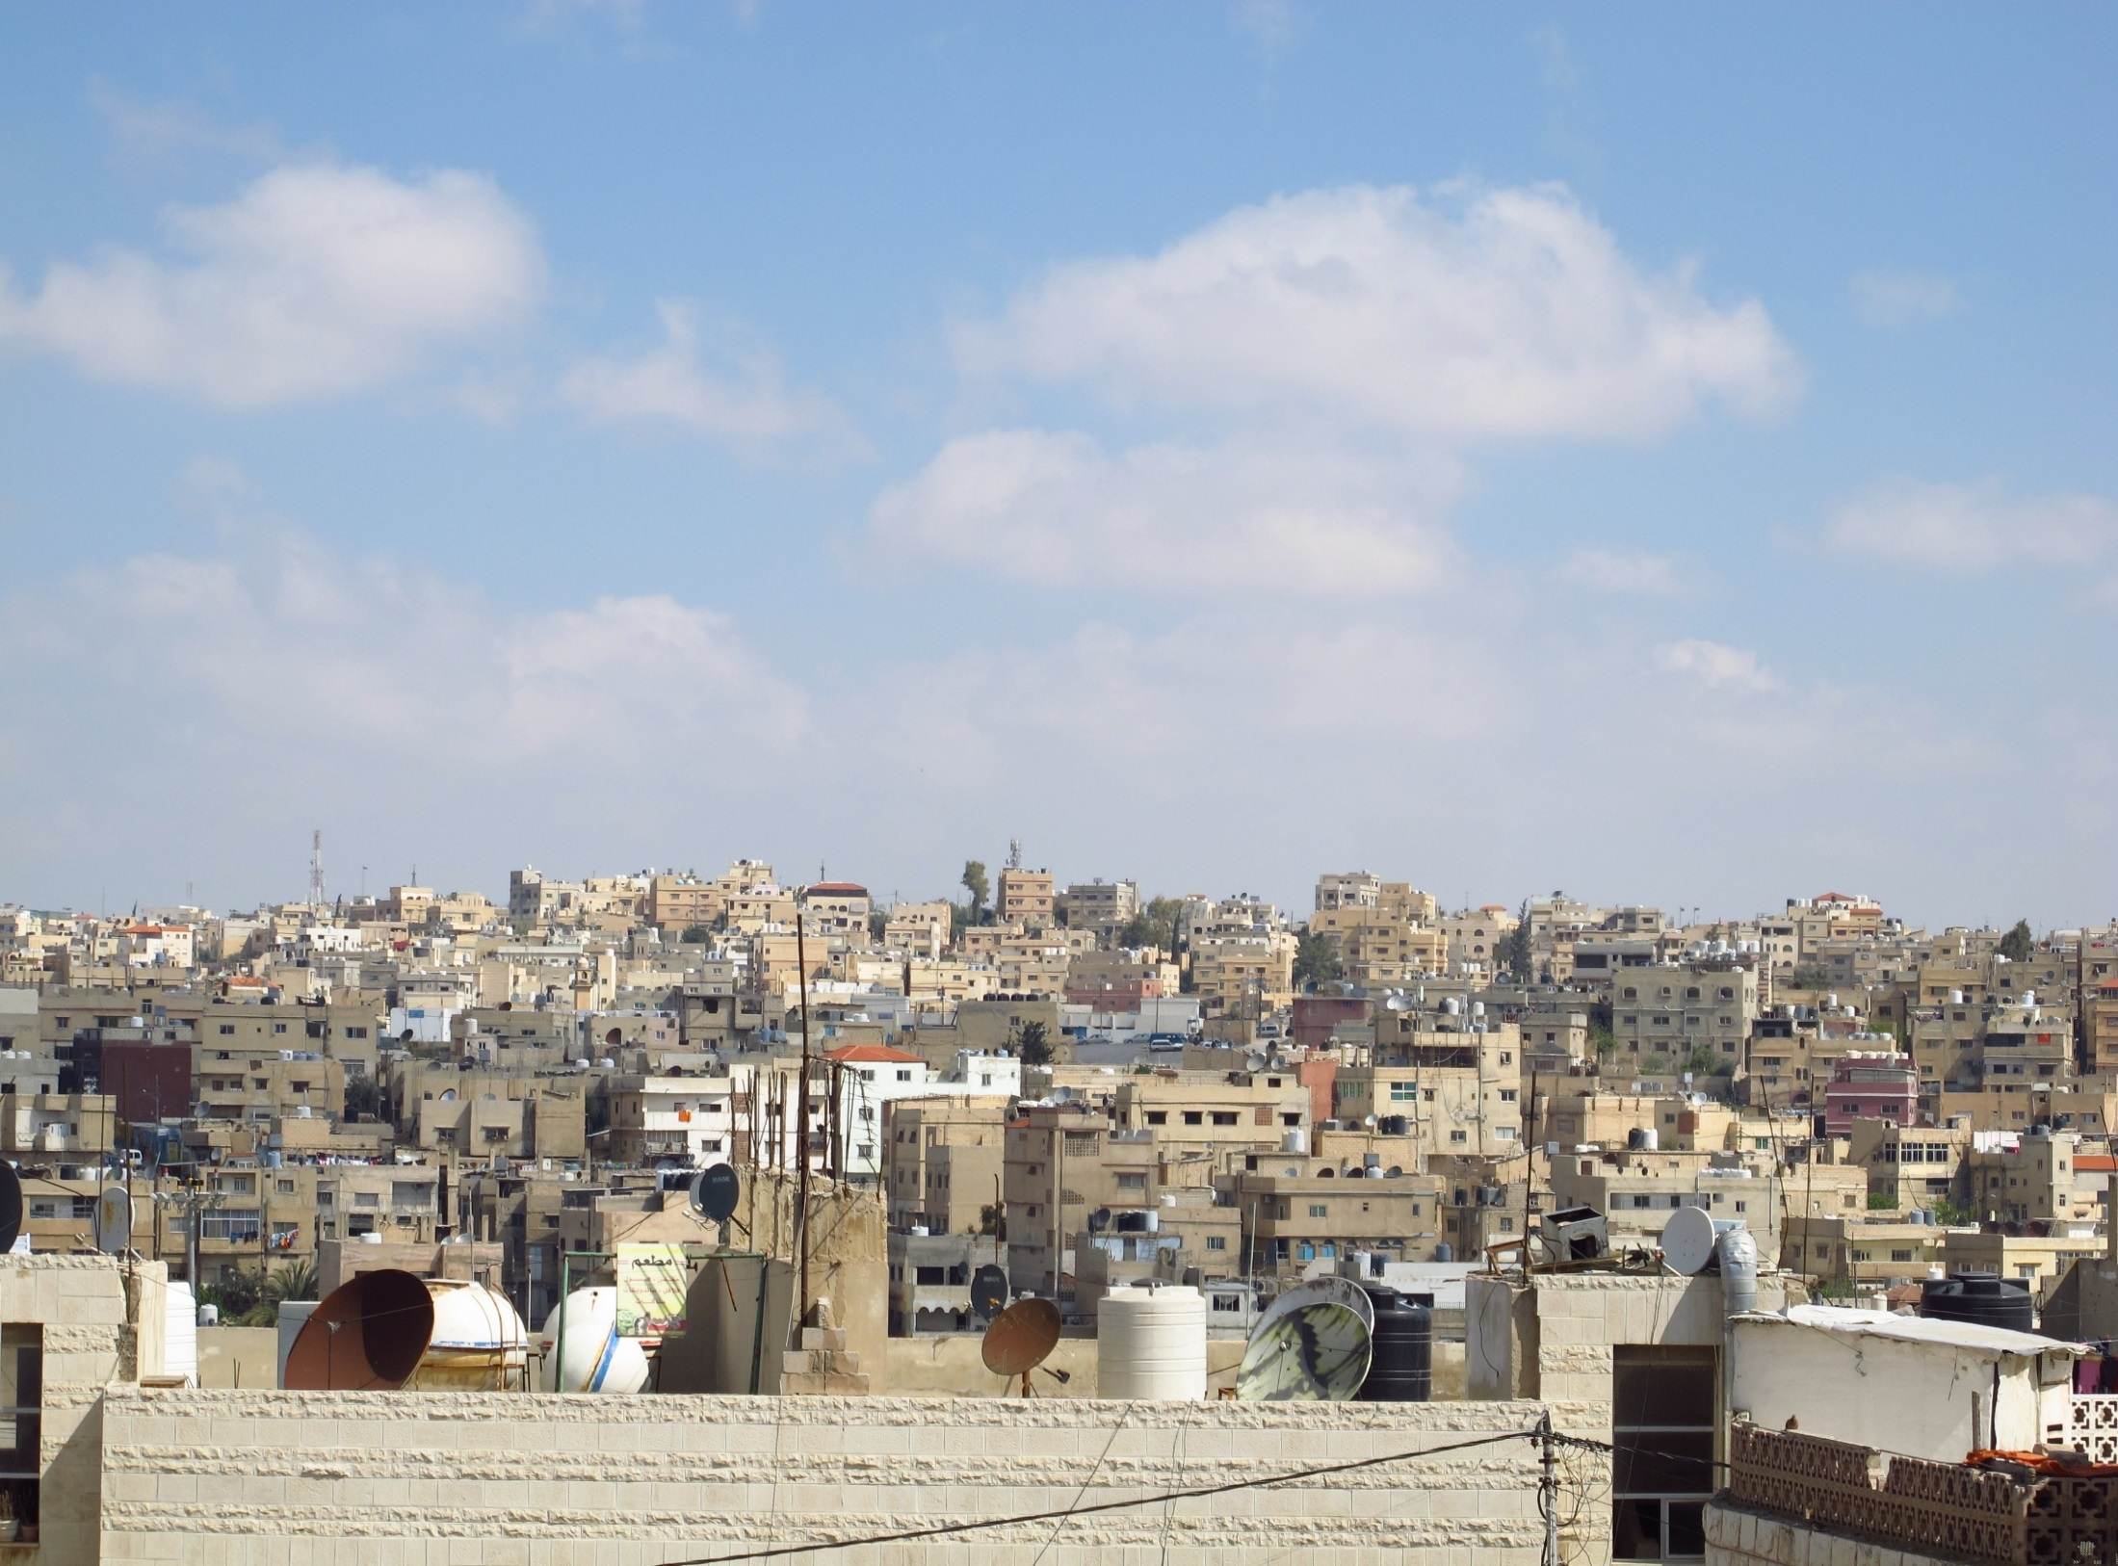
Women’s access to basic services in Irbid and Zarqa governorates
Amman, September 2016

Slide 2
Content
Context: Objectives & Methodology
Key Findings
  Access to Basic Services & Access Challenges
  Health Care
  Public Leisure Spaces
  Transportation
Conclusions & Recommendations
Questions

Slide 3
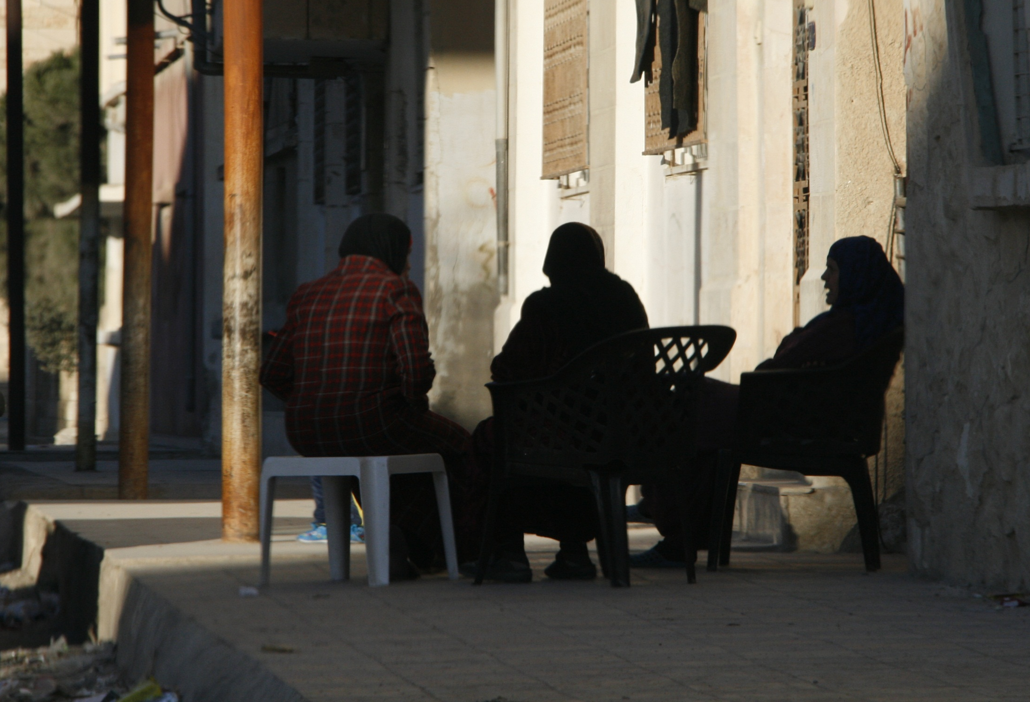
CONTEXT
Objectives & Methodology

Slide 4
Context
As a result of the Syrian crisis, over 655,000 Syrian refugees have sought safety in Jordan since 2011
State of women’s access to basic services?
Increased population has intensified strain on already overburdened infrastructure and heightened competition for scarce resources
It has impacted Jordanians and Syrians access to basic services, as well as housing and employment
Notes:
Key messages:
The surge in the population of Jordan since the beginning of the Syrian crisis has resulted in increasingly scarce resources, overburdened infrastructure, and growing competition for livelihoods, especially in the host communities with large percentages of Syrian refugees. Municipalities face difficulties in fully addressing needs of both the Jordanian and Syrian populations through public services, social assistance and social insurance as outlined in the JRP. The difficulty in accessing these services negatively impacts other areas of women’s lives, such as economic empowerment, sexual and gender-based violence (SGBV), and political participation, in addition to exacerbating other protection and livelihoods threats. Syrian women and girls in particular face daily harassment when securing food, water and shelter, when social services are not otherwise available.
Vulnerability in Jordan is driven by the increasing numbers of high unemployment and rising poverty which impact females more profoundly. Unemployment for Jordanian women stands at 22.1% for females, when compared to 12.9% for males. Wages are often lower than that of males
Currently, development and humanitarian stakeholder have little access to data on how women and girls are impacted by the change in context since the beginning of the Syrian crisis.
In particular, there is no public information on women’s and girls’ access to basic services in the municipalities, preventing targeted programming in the most refugee populated areas.
In order to better inform programming that targets service delivery and social cohesion, REACH is supporting UN Women in understanding women’s and girls’ access to basic social services and public space.

Slide 5
Assessment goal & objectives
Identify challenges women face in accessing particular services in their communities
Identify the services and types of public spaces most affected by these challenges
Explore conditions that might alleviate obstacles to women’s access to services
OBJECTIVES
OBJECTIVES
Promote gender equality through informing improvements in and better targeting of service delivery at municipal and governorate level in Irbid and Zarqa
GOAL
GOAL

Slide 6
Methodology
Literature Review
FGDs
Quantitative Survey
Identify reported factors impacting women's and girls' access to services in Jordan and globally.
Identify types of challenges, services affected by these challenges and ways and conditions to address them
  18 FGDs (9 in Zarqa, 9 in Irbid, evenly split between sexes, nationalities and urban-rural)
Measure prevalence of identified access challenges through individual perception survey
  Conducted in all municipalities in Irbid and Zarqa
  1,738 interviews in total, 68-72 per municipality, 50% women – 50% men
  90% level of confidence and 10% margin of error at the municipal level
Notes:
There were only 69 Syrian refugees interviewed (since it was representative samplng)

Slide 7
KHALID BIN ALWALEED MUNICIPALITY, IRBID Governorate
Sampling
Notes:
Notes for presenter
Random GIS sampling:
A random sample was drawn using randomized GPS points generated on maps of the 25 municipalities, with the probability of selection weighted based on population density across the different geographic locations in each municipality. Enumerators subsequently located the GPS points on the ground and approached the nearest household within a 125 meter radius of these coordinates. For each GPS point the number of male and female interviews to be conducted was listed. Once a household was approached, depending on whether a male of female member had to be interviewed, enumerators would enquire how many members of the household are either female or male, and how many of them were currently present and available to be interviewed. These numbers were then input in the Open Data Kit form, which was programmed to generate a random number based on the input. The number generated signified the person in the household that had to be interviewed, with the lowest number being associated with the youngest available number, and the highest with the oldest. This ensured that randomization was not just conducted at the household level, but also at the individual level within households.

Slide 8
Municipality groupings: Irbid
 | Municipality | Criteria
IRBID | Ramtha | a) similar population size
 | Irbid | b) urban municipalities
 |  | c) hosting large number of refugees
 | Shrhabeal Bin Hasnah | a) similar geography (Jordan Valley) b) similar traditions c) similar population size
 | Moath bin Jabal
 | Tabaqet Fahel
 | Altaybah Aljdedah | a) similar geography (Jordan Valley) b) similar traditions c) similar population size
 | Khalid Bin Alwaleed Al Wasatyah
 | Al Saro | a) similar traditions, cultures b) proximity to the Syrian border
 | Al Kfarat
 | Al Shoulah
 | Borqosh | a) similar population size b) proximity to Irbid city
 | Al Mazar
 | West Irbid | a) similar geography (mountainous) b) similar livelihoods activities
 | Dair Abi Said
 | Rabyet Al Korah
 | Al Yarmouk Al Jadedah Sahel Horan | a) similar traditions, cultures b) tribal connections c) similar proximity to the Syrian borders
Notes:
Notes for presenter
In order to identify areas of the governorate that face greater challenges with regard to female access to services, and given resource and time constraints set by the RFP, municipalities were grouped together to allow for the production of statistically significant results that are disaggregated by sex at a sub-governorate level. This level of sex disaggregation allows for the identification of key themes and trends across groups of similar municipalities, rather than allowing for sex disaggregation at the individual municipal level. Sex disaggregation at the individual municipality level would have required a much larger sample size (resources) (or a reduction in municipalities assessed).

Slide 9
Municipality groupings: Zarqa
 | Municipalities | Criteria
ZARQA | Al Hashemiah Al Jadeeda | a) similar geography and demographics b) similar traditions/cultures
 | Berean Al Jadeeda
 | Al Rusayfah Al Zarqa | a) similar population size and demographics b) cultural similarities c) urban municipalities
 | Al Azraq Al Jadeeda | a) distance to capital of governorate/remoteness b) tribal connections and similarities in traditions
 | Al Halabat
 | Al Dlail

Slide 10








Services and indicators assessed
Based on findings from FGDs and consultations with UN Women, the following services were assessed quantitatively
Indicators assessed include use and access, satisfaction with services provided/accessed, reasons for disuse, suggestions for improvement, perceptions on female use where relevant
BASIC SERVICES
Health care
Public leisure spaces
Livelihoods
& Employment
Transportation
Housing
Education
Markets
Notes:
This review considered information on (a) the overall degree of women’s and girls’ access to services in Jordan, and (b) access to a broad range of individual services provided by either municipalities or through national or governorate level ministries. Municipal services considered include public leisure spaces, roads and lighting, markets, as well as SWM, while health care, transportation, livelihoods/employment, education, water and housing were considered as government services.
Based on findings from FGDs, a range of these services or sectors were assessed in more detail through the quantitative survey: health care, public leisure spaces, livelihoods and employment, transportation, housing, education and markets.

Slide 11
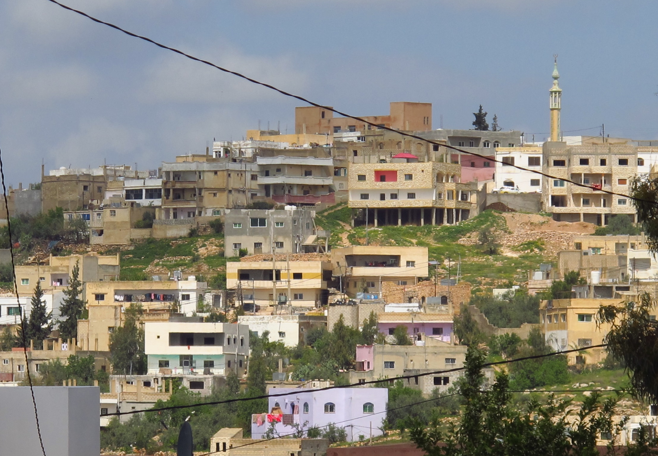
KEY FINDINGS
Notes:
Notes for presenter
The following sections provide an overview of key findings from the perception survey carried out between 24 April and 17 May 2016. These include findings aggregated across all municipalities, as well as findings disaggregated by gender, governorate or nationality, if significant. Findings disaggregated by municipality groups are included in the overall section, and will be presented in detail in the report and final key findings presentation. The final report will also, where significant, present findings disaggregated by age and geographical location (i.e. urban-rural).
Please note that while education and markets/shopping were assessed in the perception survey, questions on education (i.e. whether all boys/girls of school age are attending school and reasons for why not, as well as attendance of respondents to university, satisfaction with university etc.) revealed were answered by very small samples. Therefore, findings would be highly indicative and are thus not reported on here. Findings on markets will be reported on in the report to contextualize findings.

Slide 12
Overall use, access & challenges

Slide 13
Overall access: existence of challenges (1)
Challenges accessing basic services appear common, with women more commonly affected by such challenges than men.
Overall, 41% of respondents reported facing challenges in accessing basic services
A larger proportion of women (48%) reported facing challenges than men (35%)
Notes:
Notes for presenter
Key message: Challenges accessing basic services appear common, with 41% of all respondents reporting they were facing such challenges. Women appear to be affected by such challenges more commonly than men. This represents a 13 percentage point difference between men and women, representing a statistically significant gap between genders in service access!

Slide 14
Overall access: existence of challenges (2)
Women’s self-reported access to services varies greatly between municipality groups, with proportions of women reporting to face challenges in basic service access ranging from less than one third to more than a half.
Notes:
Notes:
Though there is variation, access challenges appear to be widespread across governorates.
The geographical variation of reported access to services could be due to a number of factors. A major factor may be that services are often localised, and therefore the ability or willingness of municipal government to provide services varies across municipalities.
REACH’s USAID Community Engagement Project report suggests that perceptions of effectiveness between municipalities may be explained through variation in the community’s financial capacities, and their administrative ability to plan effectively. It argues the importance of considering differences in local politics and economic situation in different municipalities. These differences may also be explained through variation in population or population density, a divide between urban and remote areas, or simply the size of the municipality relative to others. REACH, USAID Community Engagement Project (USAID CEP) Baseline Assessment Report, February 2016, p. 41

Slide 15
Most severe challenges (1)
Overall, access challenges appear related to low quality of services provided, or complete unavailability of certain services.
A majority of women and men reported low service quality as a primary challenge (71% and 64% respectively)
Women more frequently perceive services to be completely unavailable to them (58%) than men (43%)
WOMEN
MEN
Notes:
Notes for presenter
Key message: Overall, access challenges appear to be related to perceived low quality of services provided, or complete unavailability of certain services. Perceptions of most severe challenges differ between women and men, namely in terms of the ranking of challenges.
This seems to indicate that while women more frequently face a complete lack of services, men are more concerned with challenges that are related to services that are already present
Most severe challenges (most frequently mentioned, select all that apply)
Women: Followed by cost of service (30%), insufficient availability of service (number of facilities, opening hours) (23%)
Men: Followed by time it takes to reach service (31%), lack of information about service (30%)
Quality considerations may include the qualifications or manners of the staff providing the service, waiting times, infrastructure or machinery requiring maintenance, a lack of certain elements of the service (e.g. medical equipment or medications), physical accessibility for certain demographics (e.g. people with disabilities), or frequency with which services are provided

Slide 16
Most severe challenges (2)
Women across most municipal groups commonly cite low quality of services as an impediment to accessing services.
In every municipality group, low quality was either the first or second most frequently cited access challenge
Costs of services and time taken to reach services were other – however much less frequently – cited challenges
In Ramtha and Irbid, notably higher respondent rates than in other governorates indicated low quality (73%) and complete unavailability of services as a challenge (79%)
Notes:
Some municipality groups, such as Ramtha and Irbid, Altaybah Aljdedah, Khalid Bin Alwaleed, and Al Wasatya, and Al Yarmouk Al Jadedah, and Sahel Horan were either just as likely as or more likely to cite complete unavailability of services as low quality
Women across most municipal groups commonly cite low quality of services as an impediment to accessing services. In every municipality group, low quality was either the first or second most frequently cited access challenge. The disaggregated findings indicate that the problem of low quality of service is widespread geographically across Zarqa and Irbid.
Some municipality groups, such as Ramtha and Irbid, Altaybah Aljdedah, Khalid Bin Alwaleed, and Al Wasatya, and Al Yarmouk Al Jadedah, and Sahel Horan were either just as likely as or more likely to cite complete unavailability of services as low quality. In Ramtha and Irbid, for example, 79% of female respondents , who reported to have faced access problems, indicated the complete unavailability of services as a challenge, while 73% also cited low quality. These rates are notably higher than in other governorates, in some cases more than 40%, and could perhaps signal a unique set of issues or conditions unique to these governorates which may be driving the unavailability of services.

Slide 17
Services requiring better access (1)
Respondents primarily reported to need better access to government services, rather than municipal services
Overall, water (31%), transportation (30%) and health care (26%) were reported most frequently, and solid waste management (30%) as a municipal service
Both women and men frequently cited water and transportation as services requiring improved access
While SWM is the service most women reported needing better access to, it is not amongst the top 3 reported services for men
WOMEN
MEN
Notes:
Notes for presenter
Key message: When asked which services they need better access to, respondents most frequently cited government services, namely water (31%), transportation (30%) and health care (26%), in addition to solid waste management (30%). While women and men largely cite the same services, they appear to be prioritizing differently.
Reported frequency of garbage collection:
Men reported more frequent garbage collection than women, with 51% of men reporting daily collection, compared to 38% of women. Given women are likely to spend more time at home/around their house than men, it is likely that women have a better understanding of how often garbage collection actually occurs.
Services need better access to (most frequently mentioned, select all that apply)
Women: Followed by health care (20%), sanitation (17%)
Men: Followed by sanitation (30%), SMW (27%)

Slide 18
Services requiring better access (2)
There are differences regarding services requiring better access in the two assessed governorates and across municipality groups
In Zarqa, transportation is the most frequently cited service as requiring improved access
In Irbid, health care, water and SWM are frequently cited as services requiring improved access
Notes:
Notes:
women in municipalities in Zarqa governorate more frequently cited transportation as requiring improvement
women in municipality groups in Irbid governorate, such as the groups of Al Yarmouk Al Jadedah and Sahel Horan, and Shrhabeal Bin Hasnah, Moath bin Jabal and Tabaqet Fahel, reported water services as being more in need of improvement
The broader differences between municipality groups could be the result of a number of factors, including population density and municipality size, or simply reflective of differences in government oversight between municipalities. Some municipalities may not have the resources to adequately supply basic services, while others might lack the administrative capacity to plan for and deliver on service provision. Additionally, there may be issues related to demographics (i.e. nationalities, community groups) with more heterogeneous municipalities facing unique problems related to service delivery and access.
The differences shown here regarding services requiring better access across municipality groups give a general indication of which areas might stand to benefit the most by improving different services. This is explored in more detail in the following sections which examine access to specific services.

Slide 19
Health Care
Notes:
Notes for presenter
In a number of municipality groups, health care appeared as one of the key services women stated needing improved access to. Furthermore, during FGDs, health care was frequently mentioned as a service particularly affected by access challenges among women, not least in relation to transportation. In particular during Syrian FGDs access to health care was voiced as a particularly daunting challenge. Therefore, findings presented in this section first consider gender dimensions of access to health care, before considering the nationality dimension.

Slide 20
Health care need & ability to access health care
While more women reported requiring health care than men, women appear to have more limited access to health care.
A larger proportion of women reported having had a health care need over the past six months than of men (42% compared to 27%)
Meanwhile, the proportion of women subsequently reporting to have been unable to access health care for this need (20%) was larger than for men (3%)
Limited access to health care was also observed for other female members of the household
Notes:
Notes for presenter
Key message: While more frequently requiring it, women’s access to health care appears more limited than men’s.
Limited ability to access health care was also observed for other female members of the household
(respondents were further asked whether other female or male household (HH) members had had a health care need in the six months preceding the survey) Of the 39% of respondents who stated that female HH members had required health care in the last six months, a majority (56%) stated that only “some” or “none” of them had been able to access health care services)
This finding appears to confirm the existence of obstacles preventing women from accessing health care
Indicative findings suggest that Syrians’ ability to access health care is more limited than Jordanian’s, (but sample sizes were too small to make a valid claim)

Slide 21
Reasons for inability to access health care
Reasons for women being unable to access health care primarily relate to cost and lack of medication at health care facilities.
75% of women unable to access health care cited cost of treatment as impeding access, while 36% of women cited a lack of medications
Qualitative findings suggest that cost seems to be a most pressing access challenge for Syrian women
Notes:
Notes for presenter:
Key message: Reasons for women being unable to access health care primarily relate to cost and lack of medication at health care facilities
Consistent with access challenges reported across services, 18% of women reported the lack of a health care facility in their municipality as preventing health care access
Women: Cost of transportation to reach health care facility (15%), Specialization was not available (7%)
Men: Cost of treatment (69%) Medication was not available (64%), specialization was not available (37%), cost of transportation to reach health care facility (29%), No male hospital clinic personnel was available (28%)
Note: the sample for men unable to access health care was small, therefore these findings are indicative
Based on qualitative findings, this appears to be a particularly pressing access challenge for Syrian refugees, as cost was mentioned as a dominant challenge during all four FGDs with Syrian refugee women. For example, Syrian refugee women participating in an FGD in Ramtha in Irbid governorate reported cost as the main access challenge for health care, describing how upfront payment of consultations and treatment is required in public hospital and health care centres, including in emergencies. Participants highlighted that cost was a particularly severe challenge for dental care and treatment of chronic illnesses. Perhaps as a result of high costs of healthcare, Syrian refugees reported they were heavily reliant on health care provided by international NGOs, including Doctors Without Borders, Doctors of the World, and local charities. Syrian participants in Rusayfah (Zarqa governorate) described how having to pay for health care in Jordan represented a significant change for them, as in Syria health care had been provided free of charge. The challenges of cost are reportedly starting with obtaining the Ministry of Interior (MoI) service card, which requires refugees over the age of 12 to undergo medical tests and obtain a health certificate from the Ministry of Health (MoH), at a cost of initially 30JOD (42USD), now 5JOD (7USD). Without obtaining this certificate refugees cannot receive the MoI service card, which is necessary for accessing governmental health services Based on the exchange rate (1 JOD = 1.415 USD) on 23 August, 2016. All conversions from Jordanian Dinar to US Dollars in this document are based on this exchange rate.

Slide 22
Transportation & access to health care
Lack of access to affordable and reliable transportation is perceived as a hindrance to accessing health care services.
A majority of those able to access health care reported having used a car to reach the health care facility (58%)
Reported means of transportation used to access
health care
Notes:
In order to arrive at a more thorough understanding of the different factors influencing access to health care, the assessment also established
means of transportation used to reach health care facilities;
These findings highlight the importance access to public, as well as private means of transportation, has for people’s access to health care. Therefore, these findings appear to support observations made during FGDs, that lack of access to affordable and reliable transportation is perceived as a hindrance to accessing health care services. The importance of transport in relation to basic service access will be discussed in more detail in the relevant chapter later in this report.
(no significant gender differences were identified in terms of means of transportation used to access health care, time or cost to reach facilities, a larger proportion of men who stated they had been able to access health care reported they had done so at a facility in a public or private facility in another municipality than the one they live in (24%), than of women (15%). This might be indicating that men are more able to travel further to gain access to health care than women, which could relate to access to private or public transportation.)

Slide 23
Public and private health insurance
The main health care providers for those able to access health care when in need, appear to be public
Type of health insurance, among those able to access health care
A large majority of those accessing healthcare (76%) have insurance either provided by the government or military, or through a private scheme.
24% also reported they had no health insurance, meaning they covered all treatment costs themselves
Notes:
Notes for presenter:
Indicative findings suggest that health insurance might influence access to health care: those without health insurance represent a considerably larger proportion among those unable to access health care than among those able to (not statistically significant though)
No significant gender differences were found with regards to public versus private health care providers.

Slide 24
Satisfaction with health care services
Reported levels of satisfaction differed significantly between women and men, with women less likely to report being satisfied with health care quality.
86% of men reported being satisfied compared with 79% of women, a statistically significant difference
Dissatisfaction with health care services received was found to be very low, 4% for assessed women and men
Satisfaction with quality of health care received, by gender
Notes:
Notes for presenter:
These results were only for those who stated that they were able to access healthcare
The reasons cited for dissatisfaction with services received largely reflect the reasons reportedly preventing access more broadly, with cost of treatment, lack of medication and cost of medication being the most common stated reasons
Experienced Jordanian field staff suggested that medication was frequently imported, which was leading to high prices in general. It was also mentioned that at times health care centres do not have medicines in stock in their in-house pharmacies, which forces patients to purchase medication at external pharmacies, where prices might be higher. Furthermore, such pharmacies might have limited opening hours, as suggested by female FGD participants in Berean (Zarqa), which amplifies the lack of access to medications. As these findings are only indicative, further research would be required to properly understand the severity and implication of these challenges.

Slide 25
Public Leisure Spaces
Notes:
While public leisure spaces were mentioned less frequently as requiring improvements in access for women than other services, they appeared as key services with limited access for women in a number of municipality groups. Considering access to public leisure spaces also allows a glimpse at women’s access to public spaces more broadly.

Slide 26
Leisure time
Both women and men primarily spend their leisure time in the private, rather than public sphere.
Women primarily spend their free time in their own home (81%), while men more frequently spend their leisure time outside their own home.
A much lower proportion of Syrians stated they were spending the majority of their time at extended family’s home (17% to 52% of Jordanians)
Notes:
Notes for presenter
Key message: Both women and men primarily spend their leisure time in the private, rather than public sphere.
Women: Followed by mosque and mall/shopping centre (3%)
Men: followed by mosque (20%)
FGDs indicated that the fact that a higher proportion of women reported to mainly spend their time in their own home might be due to women having more household and child care responsibilities than men:
During FGDs women frequently stated that because most of their responsibilities centre around household and childcare, they perceive to have generally less actual free time, when they are literally not working (housekeeping, child caring, etc.), than men. Thus, they might be more likely to spend the free time they have close to their children or house.
Additionally, women might be considering the time they spend looking after children and taking care of household responsibilities at home as leisure time, rather than as work. Free time for women, this suggests, is not as distinct a time being “off work” than for men and borders between perceived work and perceived free time are more blurred for women, it seems.
As a result of displacement, fewer Syrians stated they were spending the majority of their time at extended family’s home. This finding should not be surprising considering the nature of Syrian displacement.

Slide 27
Public parks: Availability
While a large majority of respondents reported parks were unavailable, a majority of both men and women also stated they would use parks were they available.
Nearly 60% of both female and male respondents stated they would use a park if it was available
Notes:
Notes for presenter
Key message: Availability of public parks is limited in the first place and appears to be a common reason for limited use
A majority of both women (59%) and men (58%) reported they would use public parks were they available,

Slide 28
Public parks: Availability by governorate
Availability of public parks is more limited in Zarqa governorate than in Irbid.
An overwhelming majority of respondents in Zarqa (90%) reported there was no park in their municipality, compared to 76% in Irbid.
Experienced field staff suggested it is easier to build parks and public leisure spaces in Irbid governorate, given there are more green/free spaces already
Notes:
Notes for presenter
Key message: Availability of public parks is more limited in Zarqa governorate than in Irbid.
Given Zarqa governorate is largely barren, with some shrub and crops lands, as well as urban cover, it might be assumed that constructing a public leisure space such as a park would require considerable investment
These findings suggest that a lack of appropriate public leisure spaces, as opposed to for example bad maintenance, safety concerns or high costs, presents one of the primary challenges to accessing and using such services. Furthermore, they could be a partial explanation for women’s and men’s pronounced use of private spaces for leisure time.

Slide 29
Public parks: Use
If parks are being used, it is most commonly the entire family together who would visit them.
47% of those stating there was a park in the municipality reported members of the household were using this park
Parks were usually visited by the family as a whole (79%). Only 3% of respondents reported it was primarily women with children using parks.
Notes:
Notes for presenter
Key message: If parks are being used, it is most commonly the entire family together who would visit them, rather than commonly assumed women with children
There are differences between governorates for how many are using parks that are available, 52% of respondents in Irbid said people in their household were using available parks, compared to 22% in Zarqa governorate
In FGDs, both male and female participants described public parks as family spaces.
1% for male HH members with children; children by themselves; female HH members by themselves

Slide 30
Public parks: Reasons for disuse
Women’s main reasons for not using parks available are related to a lack of facilities for their children.
Over 80% of women cited either a lack of or poorly maintained playgrounds for their children as the main reason for not going to parks
A majority of women (54%) also cited a preference to stay at home as a reason for not using available parks
Notes:
[Select multiple]
Men: 72% prefer to stay at home; 19% cost of transportation; 8% takes too long to get there
Key message: Women’s primary reasons for not using parks available is related to a lack of facilities for their children at these parks
During FGDs it was frequently mentioned that the presence of groups of young men (at times seen as using drugs or generally harassing women and girls) were reasons for women to not go to the park and for men not wanting their wives or daughters to go (therefore not going themselves either). It was suggested to make sure parks and other leisure spaces be made exclusive family areas, while creating spaces for youth to gather.
Indicative findings of the qualitative and quantitative components of this assessment suggest a need for a revaluation of the common conception of public leisure spaces as a means to increase positive community interaction, not least between Jordanians and Syrian refugees. Findings from the perception survey indicate that Syrian refugees are less likely to use public parks than Jordanians:
Syrian refugee women explained that they were not going to parks or other public spaces for a fear to cause negative attention among Jordanians. They stated being afraid of getting involved in disputes, which might lead to increased scrutiny from authorities and entails the perceived danger of being relocated to Azraq camp or Syria. To reduce the potential of any negative attention Syrian participants stated their families were generally avoiding public spaces, with children playing inside and some household members – particularly males – not leaving the house altogether. This may point to the consideration that the provision of public leisure spaces is unlikely to automatically improve social cohesion between Jordanians and Syrian refugees.

Slide 31
Transportation
Notes:
Notes for presenter
As seen in the section on overall access to services, transportation was highlighted as a key issue among both women and men, in a majority of municipality groups. Findings from both the secondary data review and FGDs suggest that access to transportation has considerable secondary effects on access to other services, and could thus be considered as an access challenge in and of itself. During FGDs it was frequently mentioned, by women in particular, that improved transportation within and beyond municipalities would improve access to other services, particularly health care, education, markets and employment. This section thus considers women’s and men’s use and access to public transportation.

Slide 32
Travel patterns: Purpose of travel
Women’s and men’s primary purposes of travel appear to reflect responsibilities within the household.
Women reported primarily traveling for health care (45%), shopping (21%) and children’s education (9%), while men’s primary purpose of travel is work (67%)
WOMEN
MEN
Notes:
Notes for presenter
Key message: Primary purpose of travel appears to reflect responsibilities within the household
Since women generally take on more housework and childcare responsibilities, there is a greater need for travel to health facilities or to markets to shop.
As men are employed at far higher levels than women (67% compared to 16% of women), it should not be surprising that men overwhelmingly use transports to get to work. Since women generally take on more housework and childcare responsibilities, there is a greater need for travel to health facilities or to markets to shop. Given transportation is primarily used to access health care, markets, education, or employment, these findings indicate that access to other services might be negatively influenced if adequate transportation is not available.

Slide 33
Access to Private & Public Transportation
Overall, personal cars are the most commonly used form of transportation, at 52%
There are notable differences in transportation use across municipalities
Walking is the most common form of transit for Syrians, at 41%
Notes:
There were also notable differences in transportation use across municipalities , which may give some indication as to where access challenges are more or less prevalent. For example, among municipality groups, walking was most common form of transit in Shrhabeal Bin Hasnah, Moath bin Jabal, and Tabaqet Fahel, with 24% citing it as their primary source of transit. This is compared to only 7% in West Irbid, Dair Abi Said, and Rabyet Al Korah. Meanwhile, Al Saro, Al Kfarat, Al Shoulah is the municipality group with the largest proportion of respondents using buses primarily, at 39%. This is compared to only 15% in Ramtha and Irbid, which had the lowest reported bus use of any municipality group. This is contextualised by FGD findings from Ramtha, which cited a lack of regular public buses in the area which forced them to spend large amounts of money on taxis.
In the context of this assessment, private car ownership is not understood as a basic service. Therefore the focus will be on public transportation. While both women and men reported their most frequently used means of transport to be private cars, public buses are also frequently relied on

Slide 34
Public buses: Use by women and men
Public buses are the second most frequently used means of transportation, more relied on by women than by men.
48% of women stated they had used buses (including shared taxis) over the past six months, compared to 34% of men
Notes:
Notes for presenter
Key message: Public buses are relied on more by women than by men
FGD explained that some women are more reliant on public transportation than men.
Female participants in a Syrian FGD in Ramtha explained that transportation access affects women more than men, as women often have to travel to multiple places as part of their household responsibilities while men generally just travel to and from work. Since some women have more places to be on a given day, it places more of a burden on women when accessing public transportation.

Slide 35
Public buses: Reasons for disuse
Reasons given for disuse of public transportation were the same for both genders, with women and men most frequently reporting a lack of public transportation in their area (49% and 47%) or having access to a car (43% and 47%)
Between governorates, respondents in Zarqa were more likely to report a lack of public transportation in their area.
Notes:
Notes for presenter
Key message: Gender differences in terms of reasons for not using public buses were not significant, yet there were significant differences in terms of reporting of two most common reasons between governorates. Nearly twice as many respondents in Zarqa reported there was no public transportation in their area than in Irbid.
Might be explained by differences in car ownership, with respondents in Irbid reporting a personal car as their primary mode of transit 10 percentage points more frequently compared to those in Zarqa (56% compared to 46%)
[Select multiple]
Women: followed by buses are overcrowded (8%), buses are dirty (5%) and buses are unreliable and fear of harassment on the bus (3% respectively)
Men: followed by buses are overcrowded (5%), unreliable or dirty (3% respectively), everything else mentioned by less than 1%
Gendered findings:
While there were large gender differences in use of public buses, the reasons given for disuse were the same for both men and women. Overall, 49% of women and 47% of men stated that their primary reason for not using buses was simply a lack of public transportation in the area. FGDs support this result, with many women in particular explaining how there is simply no public transportation in their area, causing disruptions in their daily lives. In many cases, this meant them having to rely on more expensive taxis or borrow a car from neighbours.

Slide 36
Public buses: Perceptions on women’s use
Men’s perceptions of women’s use of public transportation are generally more negative than women’s.
Nearly half of all men interviewed (47%) stated buses should not be used by women, compared to 26% of women
FGD findings suggest these perceptions could stem from men’s concern over harassment of women on the way to or on the bus
Notes:
Notes for presenter
Key message: Men’s perceptions of women’s use of public transportation are generally more negative then women’s
These differences in perceptions on men women’s use of public transportation could possibly be indicative of an access challenge in itself. If husbands or male family members do not believe that women should be using public transit, then women may be discouraged or dissuaded from using it as a means of transportation.

Slide 37
Taxis: Perceptions of women’s use
Similar to buses, men’s perceptions of women’s use of taxis are more negative than women’s.
Over a third of men consider taxis to either be uncomfortable or unsafe to use for women, and 43% reported taxis should not be used by women altogether
The perceptions on taxis and buses likely point to an access challenge in themselves, discouraging women from more regular use
Notes:
Notes for presenter
Key message: Men’s perceptions of women’s use of public transportation are generally more negative then women’s
Taxis vs. buses: A greater proportion of women (31%) consider taxis to be unsafe to use for lone women compared to buses, ALTHOUGH this difference is hardly statistically significant. (The differences between men and women however are statistically significant!)
Similar to the previous slide, perceptions against women's’ use of taxis may be an access challenge in itself

Slide 38
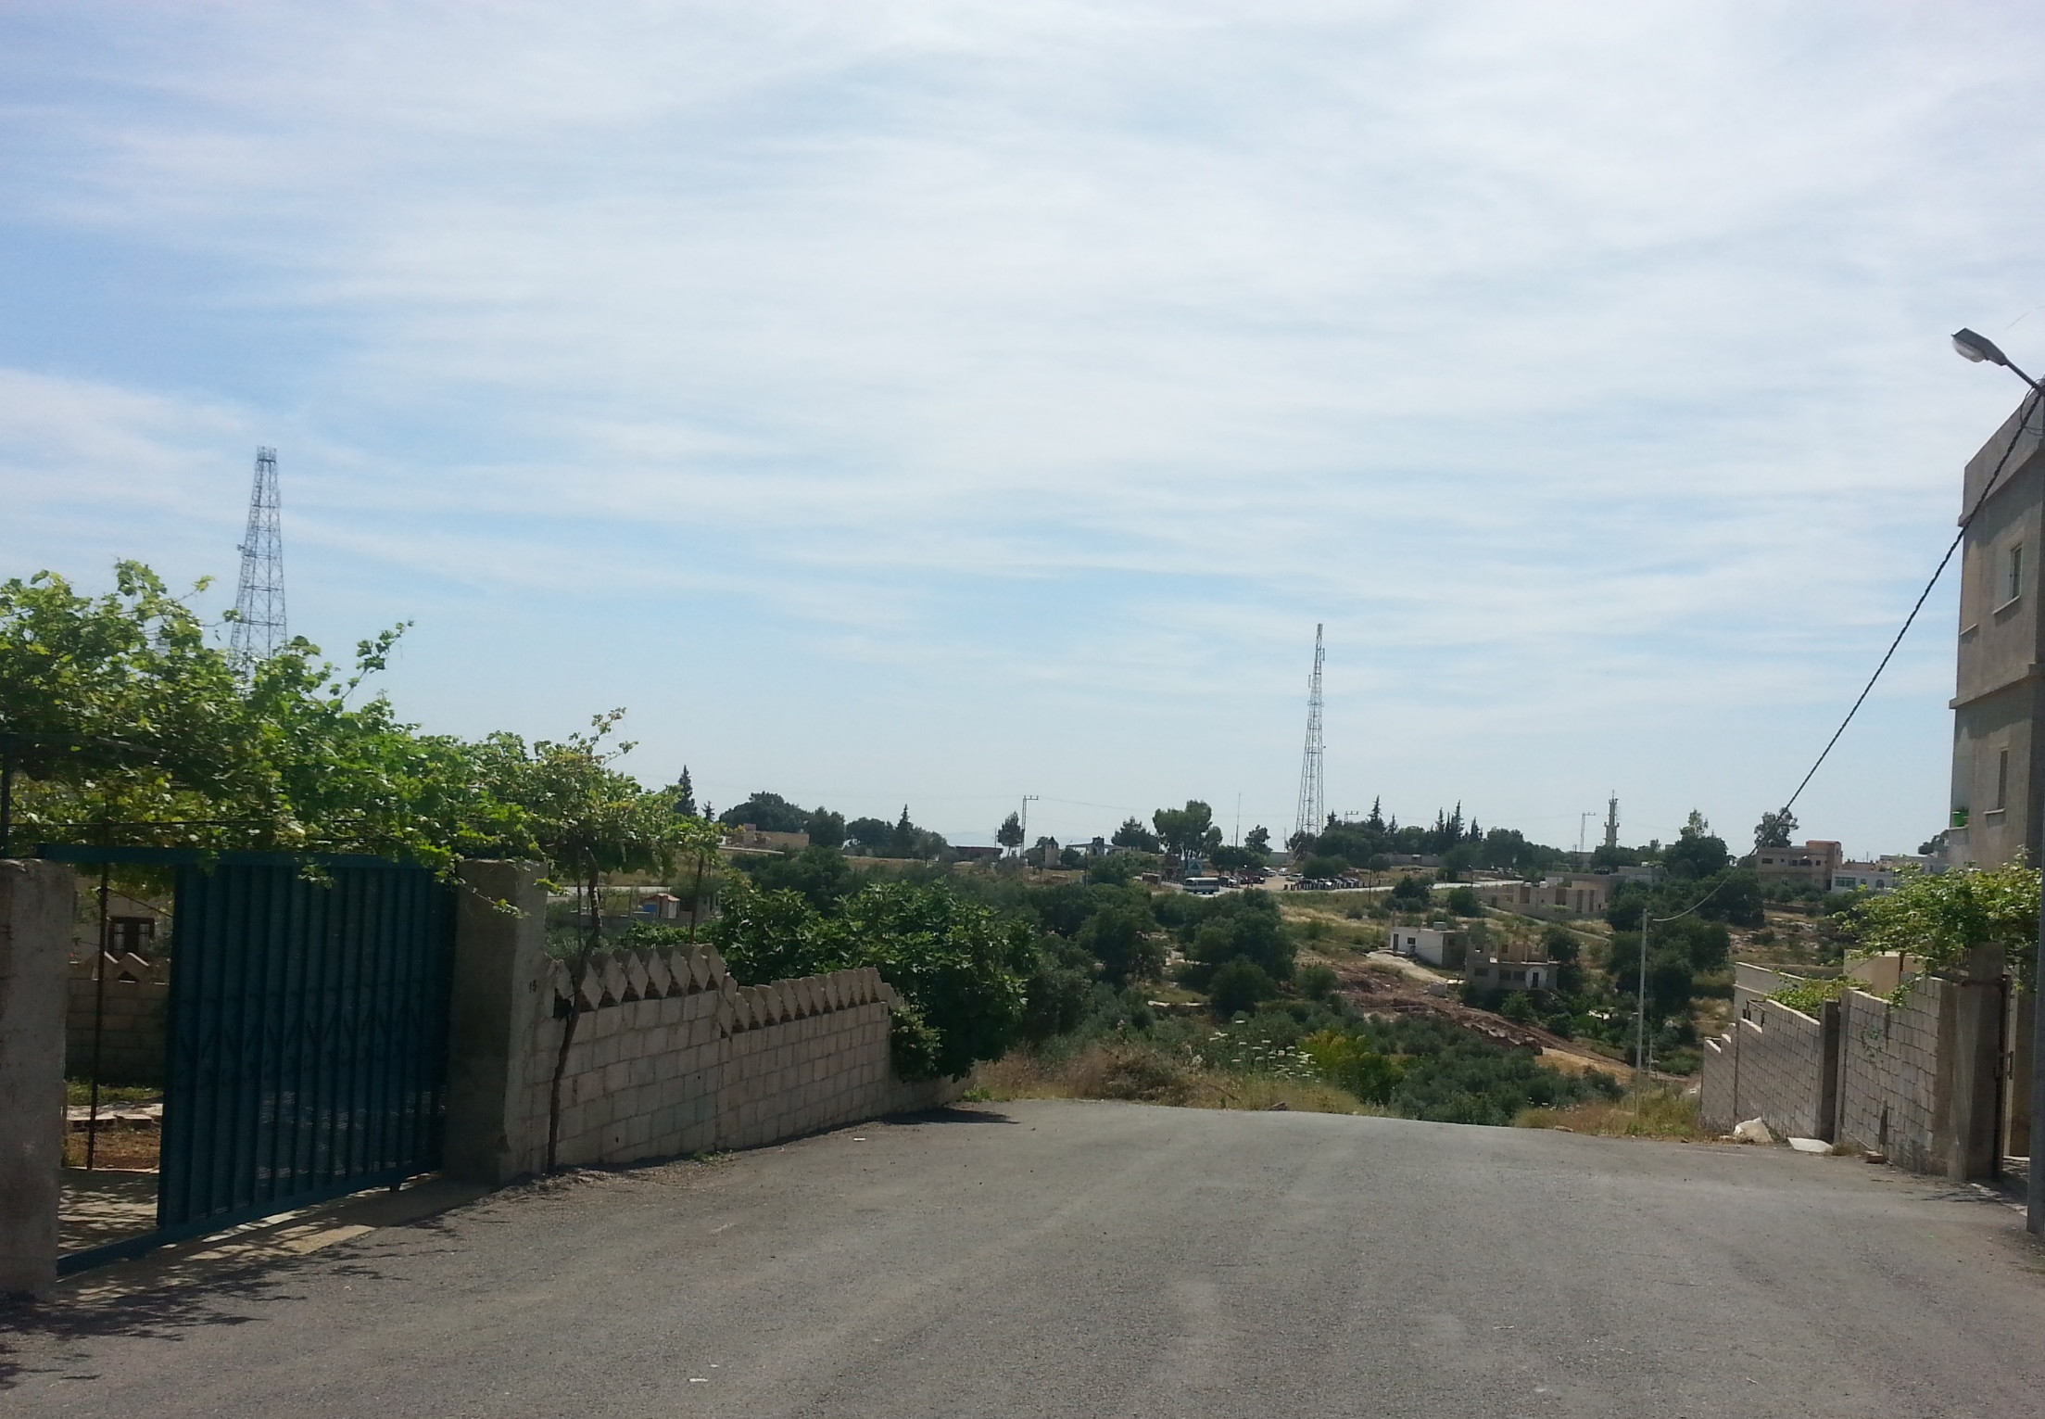
CONCLUSIONS & RECOMMENDATIONS

Slide 39
Summary & conclusions: Overall access and challenges
Overall, women more frequently reported facing challenges in access to services than men.
Low service quality was reported as the most pressing access challenge
Challenges and services affected are likely related to gendered roles and responsibilities within the HH
SWM was cited the most by women as a service requiring better access to, while reported less commonly by men
Recommendation:
Strengthen municipal solid waste management services to satisfy the needs of women in particular
Notes:
Notes for presenter
Nearly half (46%) of women reported to experience access challenges, compared to 35% of men
Improving access to services for women should be based on a thorough understanding of intra-household dynamics, roles and responsibilities.
To achieve improvements in satisfying the needs of women in particular, strengthening municipal solid waste management services should remain a component of ongoing and future basic service programming.

Slide 40
Summary & conclusions: Overall access and challenges – cont’d
There are considerable differences in service access between municipalities and municipality groups
Municipalities have each specific needs and challenges (urban vs rural areas, general remoteness, population size/density or demographic composition)
Recommendation:
Tailor basic services programmes to the varying characteristics and capacities of municipalities and governorates
Notes:
Considerable differences in service access were also noted between municipalities and municipality groups, which is understandable given services are either controlled or at least provided at the municipal level.
Recommendations:
programmes aiming to support equitable access to basic services should be tailored to the varying characteristics and capacities of municipalities and governorates. This entails local and international actors gaining a thorough understanding of the needs of local populations, service providers and authorities responsible for service provision, considering challenges related to urban-rural areas, remoteness, population size or density, demographic composition, as well as municipalities planning, human resource and financial capacities.

Slide 41
Summary & conclusions: Health care
Overall, women have more limited access to healthcare than men
The distance to health care facilities and access to transportation might be limiting women’s access to health services
Recommendations:
Emphasis should be on improving quality and reliability of health care services more generally
Ensure access to a wide range of specialisations, most notably reproductive health care
Efforts to improve access to health care for women should also consider proximity of health care facilities and access to transportation
Notes:
Notes:
20% of women who reported a health care need over the past six months were reportedly unable to access health care, compared to 3% of men.
Furthermore, as the majority of those women unable to access health care are of reproductive age, a relation between access to health care and the nature of the need, e.g. a need for reproductive health care compared to the need for other specialised or general treatment, could be suggested.
In light of the fact that women highlighted low quality of services as an overall access challenge, and seeing how high cost of treatment and limited availability of medication were mentioned as challenges even when women had been able to access health care, emphasis should be on improving quality and reliability of health care services more generally. Based on findings of the present study, improvements in terms of quality could, among others, relate to improved availability of medicines at health care facilities, longer or more reliable opening hours of health care facilities and pharmacies, increased oversight by the Ministry of Health for cost and quality control, as well as strengthened training for health care personnel
Furthermore, efforts should be made to ensure access to a wide range of specialisations, most notably reproductive health care
Finally, efforts to improve access to health care for women should also consider barriers in terms of physical access, taking into account reachability of health care facilities and access to transportation

Slide 42
Summary & conclusions: Public leisure spaces
Availability of appropriate public leisure spaces seems to be severely limited
Vast majority of respondents report spending their free time at home
Women in particular appear to be limited in their access to public parks
Recommendations:
Public leisure spaces should be made accessible and appealing for families and women with children
Public leisure spaces should take into account different demographic needs, respecting tensions between different communities
Notes:
Notes:
81% of women and 69% of men stated they primarily spent their free time at home
The primary reasons for limited access to public parks appear to be that these are seen as ill-equipped for their children: 43% of women reported the lack of a playground as a reasons for not using available parks, while 42% reported the fact that playgrounds at parks required maintenance.
Recommendations:
Public leisure spaces should be made accessible and attractive for families in general and women with their children in particular. Specifically, findings suggest that constructing or maintaining playgrounds at public parks could increase women’s use of such spaces.
The assumption that public leisure spaces can promote social cohesion through supporting interaction between different communities should be reconsidered in light of findings suggesting more limited use of public leisure spaces by Syrians, possibly relating to fears of harassment by or disputes with Jordanians.

Slide 43
Summary & conclusions: Transportation
Transportation was identified as a key service requiring better access by both women and men
Limited access to transportation may have considerable (gendered) effects on access to other services
Women may be disproportionately affected as they seem to be more reliant on public transit than men
Recommendations:
Improve availability of safe and reliable forms of transport
Ensure public transportation is provided in a way that is perceived culturally appropriate and safe for women
Notes:
Notes:
48% of women in Irbid and Zarqa reported to have used public buses and service in the six months preceding the survey, compared to 34% of men.
(Beyond limited availability overall – cited as a primary challenge by 49% of women –, negative perceptions of women’s use of either public buses or taxis, might be acting as a barrier to women’s access to transportation)
.Recommendation:
Ensure public transportation is provided in a way that both women and men perceive culturally appropriate and safe for women . The provision of women-only areas on buses or at bus stops, or supporting efforts to increase the number of female taxi or bus drivers might be some of the options that could be considered in this regard.

Slide 44
Summary & conclusions: Cross-cutting recommendations
Recommendations:
Take into account the interplay between different services
Ensure that services are perceived culturally appropriate for women
Improve the quality of services provided, rather than just focussing on physical availability
Promote an area-based approach to basic service programming accounting for the varying characteristics and capacities of municipalities and governorates
Notes:
Programming aiming to improve women’s access to basic services should accurately take into account the interplay between different services. In particular, the gendered implications of limited access to public transportation should be taken into account, as findings have shown that women rely more heavily on public transportation than men, and primarily do so for the purpose of accessing other services
Ensure services are perceived culturally appropriate for women: As findings related to transportation indicate that gender appropriateness is a more prevalent consideration on the part of men, efforts to address such perceptions should involve active engagement with men.
Improve the quality of services: programmatic attention should be focussed on improving or ensuring the quality of services provided, rather than first and foremost on making them physically available. This further highlights a need for stronger oversight over service providers to ensure services meet relevant standards and fulfil the needs of those that use them. Increased municipal and government oversight for quality control was reported as a solution to access challenges by a majority of respondents themselves (75%).
Need for an area-based approach to basic service programming, which should aim to analyse and understand local contexts. This entails taking into account specific needs or challenges of different municipalities or governorates, including e.g. those related to urban-rural areas, general remoteness, population size or density, as well as demographic composition
Programmes aiming to support equitable access to basic services should be tailored to the varying characteristics and capacities of municipalities and governorates. This entails local and international actors gaining a thorough understanding of the needs of local populations, service providers and authorities responsible for service provision, considering challenges related to urban-rural areas, remoteness, population size or density, demographic composition, as well as municipalities planning, human resource and financial capacities.

Slide 45
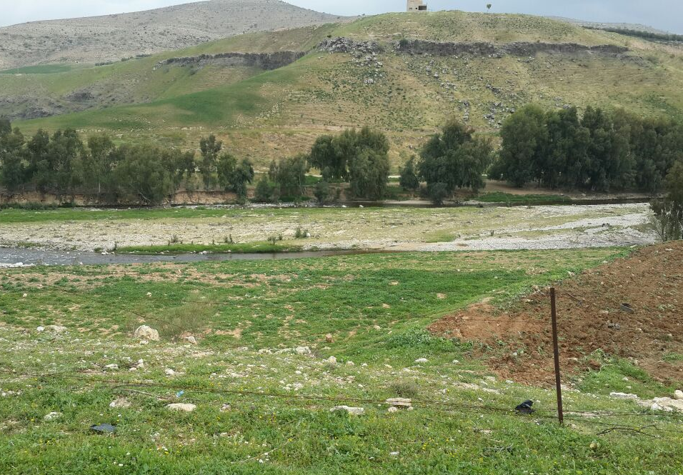
QUESTIONS?

Slide 46
Thank you
For further information regarding host community assessments in Jordan, please contact:
Christian Keller – Jordan Host Community Assessment Officer REACH
christian.keller@reach-initiative.org
Samuel Brett – Jordan Country Focal Point REACH
samuel.brett@reach-initiative.org

