Slide 1
Accountability to Affected Populations
AAP Assessment, Borno State Nigeria
AAP working group, June 2021

Slide 2

What is AAP?
Accountability to affected populations is an active commitment to use power responsibly by taking account of, giving account to, and being held to account by the people humanitarian organisations seek to assist (Inter-Agency Standing Committee).
Introduction to AAP
The importance of AAP
Ethical reasons
Practical reasons
The importance in Nigeria
Publicly available information surrounding beneficiaries' perceptions of humanitarian assistance is limited
2.7 million additional people are in need due to COVID-19 in the Northeast (United Nations Office for the Coordination of Humanitarian Affairs)
Notes:
Ethical: Rights-based approach and “do no harm”, right to dignity, protection, and to be heard/participate in decision making
practicial: Supports quality and effectiveness

Slide 3
General Objective
To strengthen the evidence base around affected populations’ perceptions of humanitarian assistance and feedback mechanisms, and inform human-centered approaches to humanitarian programming across Northeast Nigeria.
Objectives of REACH’s Assessment
Specific Objectives
1. Assess awareness
2. Understand perceptions of feedback mechanisms
3. Understand perceptions of the relevance of assistance and targeting models
4. Understand perceptions of fairness of assistance
5. Understand perceptions of respect
6. Understand the protection concerns
7. Understand the perceived barriers to accessing assistance

Slide 4

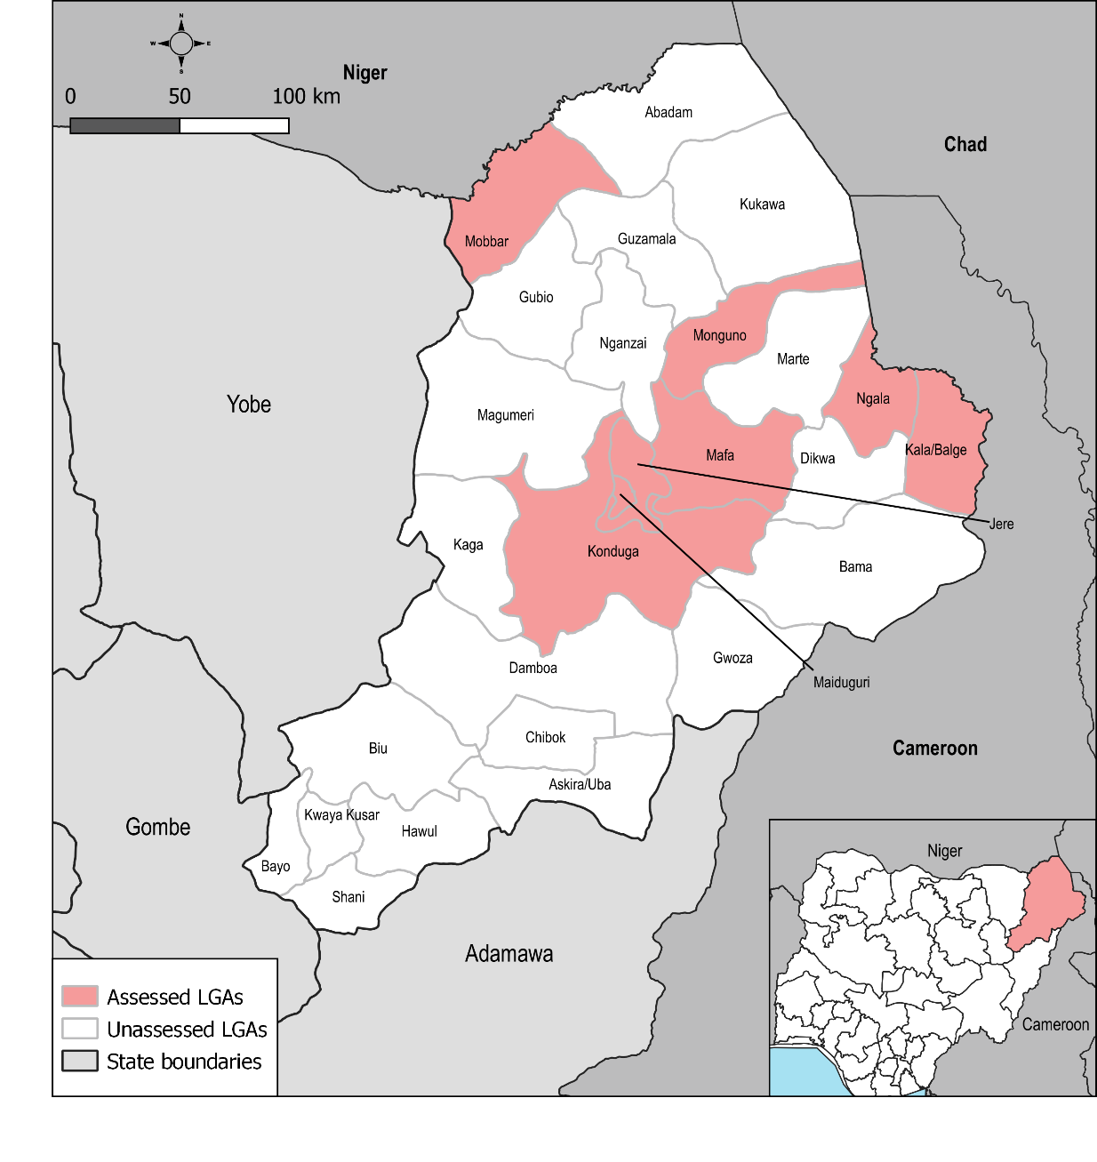

METHODOLOGY
8 LGAs 6 FGDs
245 Settlements 351 KIIs
Geographical Scope:
Settlement level data collection across 8 local government areas
Settlements received assistance in the 6 months prior to data collection
Mixed methods used:
Quantitative: Key informant interviews (KIIs)
Qualitative: Focus group discussions (FGDs)
Notes:
“% of households who received aid in the past 3 months” i.e. Kala/Balge, Mafa, Mobbar, Monguno, and Ngala LGA. The additional 3 LGAs (Jere, Konduga, and Maiduguri) were selected due their accessibility, and thus the ability to conduct both FGDs and KIIs within these areas.

Slide 5
Key Findings

Slide 6
TYPES OF HUMANITARIAN ASSISTANCE
% of settlements where KIs reported what types of humanitarian assistance their settlement received in the 6 months prior to data collection:

Slide 7
SOURCES OF HUMANITARIAN ASSISTANCE
% of settlements where KIs reported which sources most people in their settlement received assistance from in the 6 months prior to data collection:

Slide 8
MODALITIES OF HUMANITARIAN ASSISTANCE
% of settlements where KIs reported which modalities most people in their settlement received assistance from in the 6 months prior to data collection:

Slide 9
AWARENESS
  The majority of FGD participants reported receiving insufficient information about humanitarian assistance in the 6 months prior to data collection while the majority of KIs said otherwise.
Top 3 reported types of information most people in their settlements would like to receive from humanitarians, as reported by KIs:
Notes:
disconnect between the amount of information that community heads believe they share versus the amount of information the community perceives is shared

Slide 10
AWARENESS
  While KIs reported that community or religious leaders were the preferred source for reliable information in the settlement about assistance, FGD participants reported that humanitarian workers were their preferred source for reliable information.
  FGD participants perceived that community leaders often withhold information from them in order to prioritize their own family or friends for humanitarian assistance.
“Our community heads and camp chairmen are not being fair when providing us with information, instead we prefer group awareness or individual consultation (with humanitarians)”
- Female participant from Konduga LGA
Notes:
The discrepancy between KII and FGD findings may be attributable to the fact that KIs are often community leaders themselves, suggesting that community leaders perceive that they are the most reliable information source, where as community members in the FGDs perceive otherwise.

Slide 11
LANGUAGE AND COMMUNICATION
  Language preferences varied across LGAs and in some locations, the preferred spoken language differed from the preferred written language.
68%
68%
47%
of settlements where KIs
reported Hausa as the preferred
language to receive
written information within
their settlement
of settlements where KIs
reported Kanuri as the preferred
language to receive
spoken information in within
their settlement
of settlements where
KIs reported Kanuri as the
most spoken language
within their settlement
Notes:
The discrepancy between KII and FGD findings may be attributable to the fact that KIs are often community leaders themselves, suggesting that community leaders perceive that they are the most reliable information source, where as community members in the FGDs perceive otherwise.

Slide 12
FAIRNESS
  Beneficiary selection was perceived to be unfair because of favoritism, according to the people in the majority of FGDs.
  However, in only 3% of assessed settlements, KIs reported that people in their settlements believed beneficiaries are selected on the basis of favoritism.
  Sense of unfairness may be stemmed from the perception that the quantity of assistance has stayed the same while the populations in their settlements have increased, leading to thinner distributions, according to FGD participants from Jere, Konduga, and Maiduguri.
% of settlements where KIs reported assistance is evenly accessible in the settlement, including to the most vulnerable members:
34% Yes, always
29% Yes, most of the time
30% Yes, sometimes
4% Rarely
0% Never
8% No consensus
Notes:
This split in perceptions is likely linked to FGD participants’ beliefs that community leaders withhold information from them in order to prioritize their own family or friends for humanitarian assistance. The divergence in perspectives on fairness may be attributable to similar reasons reported in the Awareness section regarding KI and FGD participant identities.

Slide 13
FEEDBACK
  According to KIs and participants in most FGDs current feedback modalities are reportedly ineffective at addressing their communities’ or their concerns about humanitarian assistance.
  Preferred feedback modalities differed between LGAs, indicating the need to assess the local preferences prior to setting up a feedback system.
% of settlements where KIs reported that someone in their settlement has ever raised concerns on the assistance received through a complaint/feedback mechanism:
54% Yes
39% No
3% Don’t know/No response
4% No consensus
Notes:
Despite KIs in over half of settlements (54%) reporting that someone in their settlement had made a complaint, both KIs and most FGD participants alike reported that current feedback modalities are ineffective at addressing their communities’ or their concerns about humanitarian assistance.
The differing preferred feedback modalities between LGAs may suggest there are greater levels of trust between beneficiaries and community leaders in places where there is more humanitarian oversight or where there is greater social connectedness, such as in Maiduguri where the humanitarian response is centered and where FDG participants commonly reported preferring providing feedback through community leaders or community volunteers.
People feel comfortable reporting to the complaint box rather than in person, we think that if it is in person it might create misunderstanding among individuals but when kept anonymous, it can be resolved without anyone’s consent.”
- Male participant from Jere LGA

Slide 14
RELEVANCE
Generally, received assistance was perceived as appropriate to the needs of the community - according to both FGDs and KIs.
% of settlements where most people received assistance that was appropriate to the needs of the community, as reported by KIs:
64% Yes
31% No
2% Don’t know/No response
3% No consensus
However, the need for additional assistance was expressed in half of the FGDs.
In those settlements where people were reportedly partially satisfied or dissatisfied with the assistance (32%), the most commonly reported reasons were poor targeting of beneficiaries (61%), lateness (38%), and the most needed aid was not provided (16%).
Notes:
In those settlements where people were reportedly partially satisfied or dissatisfied with the assistance (32%), the most commonly reported reasons were poor targeting of beneficiaries (61%), lateness (38%), and the most needed aid was not provided (16%).
Notably, within 4 out of 6 of FGDs, participants indicated they were partially satisfied or unsatisfied with assistance due to the lack of assistance being provided while participants in 2 out of 6 FGDs mentioned poor targeting.

Slide 15
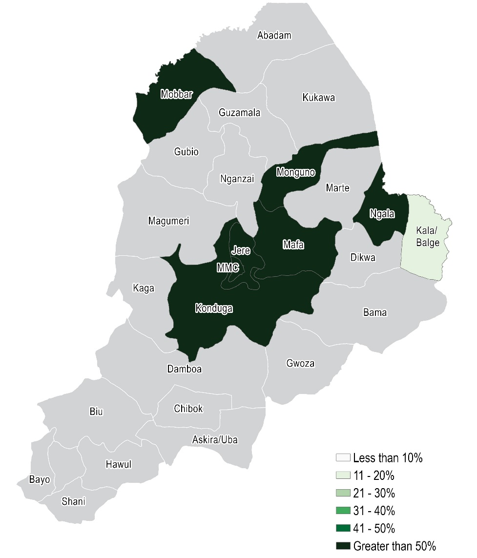
RESPECT
% of settlements where KIs reported most people were satisfied with the way aid workers behaved when providing assistance in the 6 months prior to data collection:
Notes:
While a significant portion of KIs and FGDs reported feeling respect. Participants in two FGDs did report that in the past, female humanitarian workers came to their settlement dressed in a manner that was inappropriate to local customs.

Slide 16
PROTECTION CONCERNS
Generally, protection concerns while receiving humanitarian assistance were minimally reported across KIIs and FGDs.
% of settlements where KIs reported who in the settlement is primarily responsible for retrieving in kind assistance:
In the majority of settlements, KIs reported neither women (97%) nor men (98%) were facing protection concerns while retrieving assistance.
However, some concerns were raised in FGDs, particularly for female community members.
44% Men, women, and children equally
29% Women
17% Men
3% Children
8% Don’t know/No consensus
“Some women do complain that they are scared after collecting aid as we have a lot of drug addicts in the community, so we try to ask one or two volunteers to see them off their homes.”
- Male participant from Konduga
Notes:
discuss that both women and men in KIIs and FGDs noted that protection concerns were more of an issue for females and the main concern for both groups was verbal harassment

Slide 17
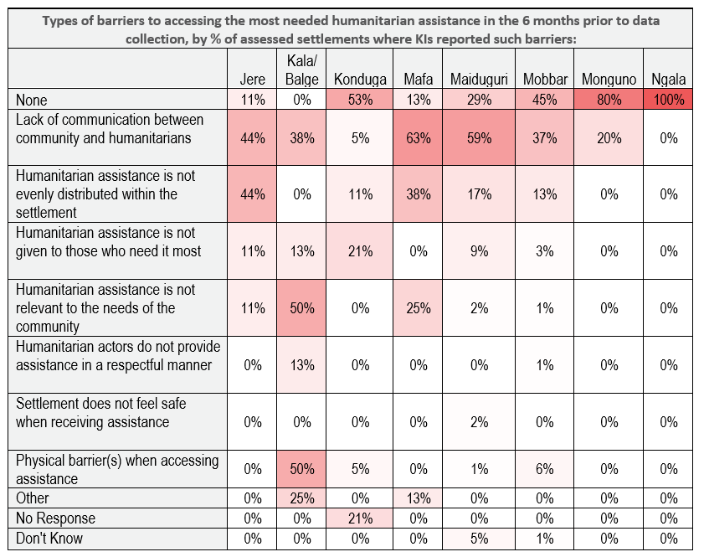
BARRIERS

Slide 18
Perceptions of awareness, fairness, feedback, relevance, respect, protection concerns and barriers varied between KIs and FGD participants and between LGAs.
KIs seemed to more commonly report satisfaction among the people in their settlement across all 7 themes, particularly related to awareness and fairness.
Both groups perceived respect and protection as themes where humanitarians were doing a satisfactory job.
Conclusion

Slide 19
Lessons learned:
Much of Borno is inaccessible, and therefore the KIs we speak with are from areas that are easily accessible for aid delivery meaning perceptions in inaccessible areas may differ
When choosing KIs, recognize community leaders hold great influence between humanitarians and beneficiaries
Think of ways to speak to different types of KIs to ensure answers are not biased towards community leader’s perceptions
Lessons Learned and Next Steps
Next steps:
Gather feedback from stakeholders and partners
Use feedback to revise/contextualize methodology
Launch AAP assessment in the Northwest

Slide 20
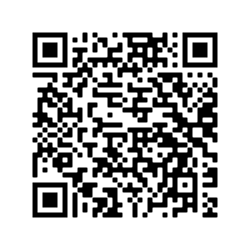
Situation Overview

Slide 21
Questions?

