Slide 1
Market Assessment – Earthquake Response in Herat
Oct 2023
OVERVIEW
REACH conducted a rapid ad-hoc JMMI in Herat on 10 October in response to the first 6.3 magnitude earthquake that hit the province on Sat 7 Oct 2023.
79 Key Informants (KIs) interviewed
Across 40 marketplaces in 6 districts
34 commodities: Food items, NFIs, shelter materials
Amidst on-going aftershocks, market functionality and conditions continue to change and may not be captured by this assessment.
Map of marketplaces assessed and no. KIs interviewed per type of marketplace

Slide 2
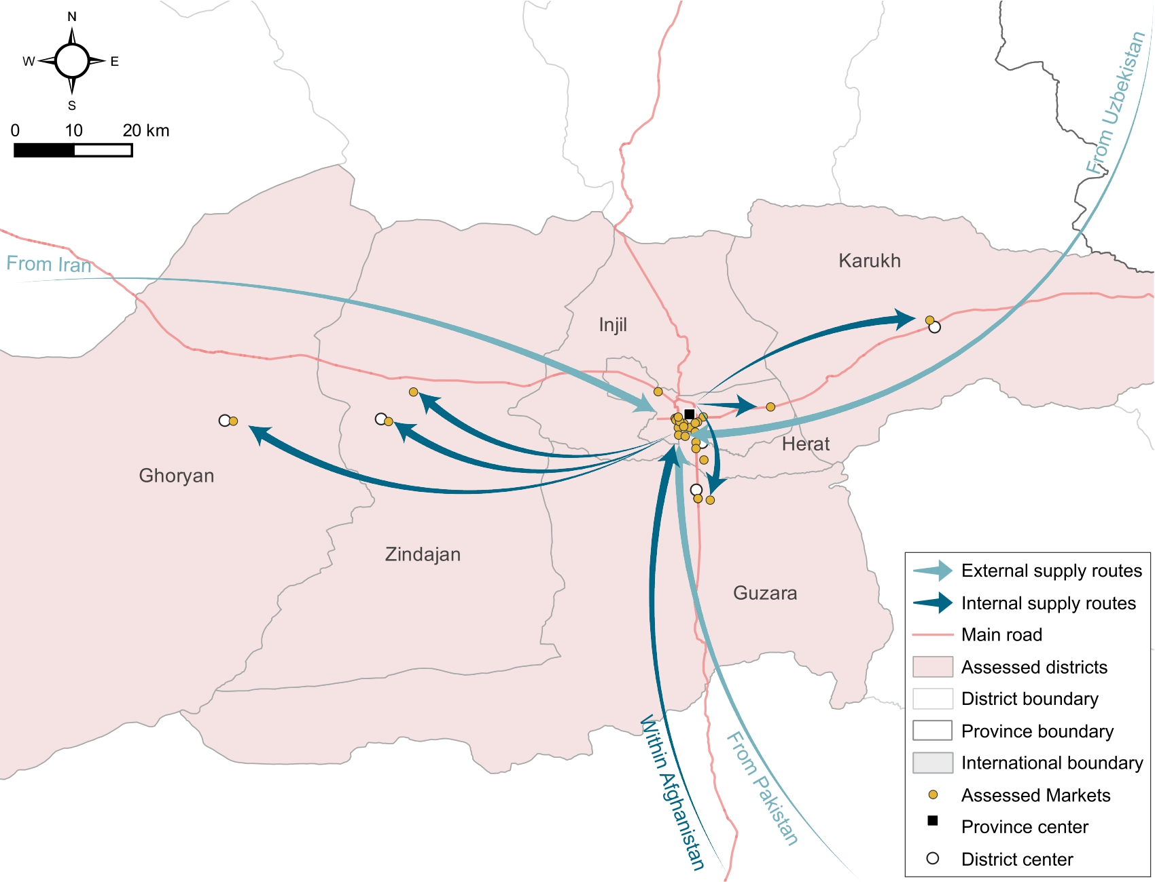
Supply Routes
Supply routes of food and NFIs go to and from Herat. As such, it is critical to monitor Herat markets and transportation routes to understand market functionality in the districts.
Reliance on importation of food items increased; 30% KIs reported food items to be imported from abroad following the earthquake, compared to 11% the month prior. The same trend was seen for NFIs (39%) and shelter materials (35%).

Slide 3
Market Overview
Calculated Minimum Expenditure Basket (MEB) and Food Basket in Herat Province, by month and round of assessment (AFN)
% KIs reporting change in the number of traders open in the marketplace since the earthquake, by district
Prior to the earthquake, costs had generally decreased over time and moving into the harvest season. The calculated MEB and Food Basket only increased slightly following the earthquake.
All 6 affected districts had open marketplaces – with half of KIs (52%) reporting the percentage of traders open had stayed the same (except for Herat).
Where number of traders open had decreased (42% KIs), the primary reason was fear of or damage from the earthquake.

Slide 4
Food Prices & Availability
% KIs reporting food items to be unavailable and median price (AFN) per item (1kg or 1L quantities)
 | Wheat (local) | Wheat (imported) | Pulses | Rice (local) | Vegetable Oil | Salt | Sugar | Tomatoes
Median Price (AFN) | 30 | 32 | 87 | 78 | 84 | 13 | 70 | 20
Unavailable (% Kis) | 23% | 17% | 6% | 19% | 8% | 8% | 6% | 14%
Overall, 78% KIs reported that food prices had stayed the same since the earthquake, including All KIs in Guzara, Ghoryan, and Karukh. However, prices had reportedly increased in Injil (39%) and Herat (29%) districts. This was primarily due to increased demand due to reduced number of stores open, reduced availability, and increased cost of supply.
Lack of availability, rather than price of food items, was a more prevalent issue in affected marketplaces immediately following the first earthquake. Core staples such as local wheat and rice were less available than in the month prior (5% and 7% unavailable respectively in September). Compounded by consequent shocks and damage to agriculture and livestock stores, it is likely that prices for essential food items will continue to increase over time, particularly if limited availability persists.

Slide 5
NFIs and Shelter Items
The majority of KIs reported that prices of NFIs and shelter items had largely stayed the same (71% and 76% respectively). However, reported increase in these costs was more prevalent for certain key items, and in Injil district in particular.
WASH
% KIs reporting availability of key items
Limited or no availability of key water and sanitation items indicates a possibly increased public health risk.
Shelter
Although prices were reportedly stable, key shelter items were reported to have limited availability across Herat province, indicating that in-kind shelter assistance may be more impactful.
Winterization
Coal was largely unavailable across the province. Combined with widespread unavailability of winter jackets, winterization may be a primary concern in affected areas.
Notes:
WASH: This may be exacerbated my limited or no availability of soap (21%) and sanitary products (46%) across Herat
Limited or no availability of key water and sanitation items indicates a possibly increased public health risk.
Safe water was completely unavailable in 77% of assessed marketplaces in Zindajan and Injil, 30% in Herat, and 17% in Guzara.
Shelter: Reported limited access and lack of availability, as well as limited income, indicate that in-kind shelter assistance may be more impactful.
Winter: Combined with widespread unavailability of winter jackets, winterization may be a primary concern in affected areas.
Coal was largely unavailable across the province. Except for Herat, 78% or more of KIs in all districts reported coal to be completely unavailable.
Overall, at least 10% of KIs reported other fuel and heating sources to be completely unavailable.*
*Fuel and heating sources recorded include: coal, firewood, LPG, diesel, and petrol.

Slide 6
Market Accessibility
ROAD TRANSPORT OF GOODS
Most KIs (92%) reported no difficulties in transporting goods via road, except in Zindajan where 22% said there were difficulties due to the earthquake.
This is likely to have worsened following successive shocks, affecting ability to restock.
PHYSICAL ACCESS
56% of KIs reported multiple earthquake related concerns presenting localised physical access barriers: hazardous buildings (26%), limited transportation (8%), and hazardous roads (6%). Prior to the earthquake, 27% of KIs across Herat reported any issues with physical access to markets.
Presence of any physical access barriers was greatest in Zindijan (100%), Herat (66%) and Injil (31%)
WOMEN’S ACCESS
Overall, women could reportedly access most markets unaccompanied (89% KIs). All KIs reported that women could access markets unaccompanied in 4 of 6 districts, with 31% and 11% of KIs reporting that women required a mahram in Injil and Herat respectively.

Slide 7
KEY FINDINGS
Overall, food and non-food item prices did not increase considerably immediately following the first earthquake. Prior, particularly food costs had gradually decreased over time and moving into the harvest season.
Open stores, cash availability, and initially estimated stock and restock times, all indicate functioning markets suitable for multi-purpose cash-based assistance.
However, whilst all districts had open markets since the earthquake, lack of availability or access to key items has become an increasing concern. Furthermore, traders are reportedly increasingly reliant on imported goods. Compounded by consequent shocks it is likely that prices will continue to increase over time, particularly if limited availability persists.
Field reporting of damage to agriculture and livestock stores further suggest that food prices may further rise, as well as limit livelihoods and resources to maintain food security over the winter.
Lack of availability of key NFIs and shelter items raise further issues around preparedness for winter, as well as possible public health concerns, indicating the need for sectoral interventions, such as WASH services and in-kind shelter assistance.
Assessment of prices and market dynamics following the more recent earthquakes, as well as ongoing monitoring of affected areas, will be critical to inform effective assistance modalities moving forward. Follow-up rounds of the JMMI will be discussed with the CVWG.
Notes:
Reported limited access and lack of availability, as well as limited income, indicate that in-kind shelter assistance may be more impactful.
Combined with widespread unavailability of winter jackets, winterization may be a primary concern in affected areas.

