Slide 1
Humanitarian Situation Monitoring
Briefing Note:
Focus on AAP and Information Needs
Ukraine, May 30th –June 11th 2022

Slide 2
Table of contents
Background and rationale
Methodology
Most useful assistance and priority needs in GCA settlements
Perceived gaps in the response in GCA settlements
Barriers to receiving humanitarian assistance in GCA
People most affected by barriers to receiving humanitarian assistance in GCA
Impact of humanitarian assistance on social cohesion in GCA
Consultation of affected communities in GCA
Access to information in GCA
Key findings
Next steps
Table of contents

Slide 3
As of 23 June 2022, there are estimated to be over 6.2 million people internally displaced in Ukraine.
Since early April, further escalation in the eastern and southern parts of the country have been causing more damages to infrastructure and disruptions in access to services in affected areas, as well as additional population displacement.
To better understand the changing humanitarian needs across the country, REACH has conducted monthly humanitarian situation monitoring (HSM) since March 2022.
This briefing note summarizes data on accountability to affected populations (AAP) in government-controlled areas (GCA), including the level of satisfaction with and barriers to receiving humanitarian aid, preferred channels of communication and information needs from REACH’s fourth round of HSM data collection exercise.
Background and rationale

Slide 4
Dual mode approach to ensure wide geographic coverage
Accessible areas
Key informant (KI) interviews with NGO staff and local authorities, in 2 settlements in each raion in Government-controlled areas (GCA).
Inaccessible areas
KI interviews with recently displaced persons from settlements in Non Government-controlled areas (NGCA) and along the current line of contact.
Methodology
(Structured data collection)
This presentation provides key findings on AAP and information needs in GCA settlements.
Structured data collection was conducted between May 30th and June 11th through:
639 telephone interviews with KIs in 213 different settlements in GCA (2 settlements selected in each raion)
* KI responses were aggregated at settlement level
Notes:
Accessible areas - (urban, urban-type (small urban towns), and rural settlements)

Slide 5
Semi-structured data collection was conducted between June 2nd and June 11th through 10 KI interviews: 5 interviewees from settlements in GCA and 5 interviewees from settlements in NGCA by face-to-face or telephone/remote interviews.
The interviews were conducted with officials of local government, representatives of non-government organisations, community-based organisations, and volunteers.
The settlements included in the sample were determined based on a secondary data review in order to ensure settlements that are included are facing a specifically deteriorating humanitarian situation.
The key findings were analysed in a Data Saturation and Analysis Grid (DSAG) and aggregated by discussion points.
Methodology
(Semi-structured data collection)

Slide 6
The semi-structured interviews were implemented as a means of triangulating the quantitative data and to add more depth to the findings. Findings from both tools should be considered indicative only: statistics based on quantitative data cannot be extrapolated to represent a proportion (%) of the population.
KIs were asked to report the overall situation in their settlement across multiple sectors and may not be sectoral experts on each topic.
The assessment only covers a sample of settlements in the areas of interest.
Even though REACH uses secondary data to triangulate findings, data collected in hard-to-reach areas is often hard to verify.
Interpretation of findings & Limitations
Notes:
Partners should reach out to the REACH team where they notice discrepancies between both quantitative and qualitative findings presented and observations on the ground.

Slide 7
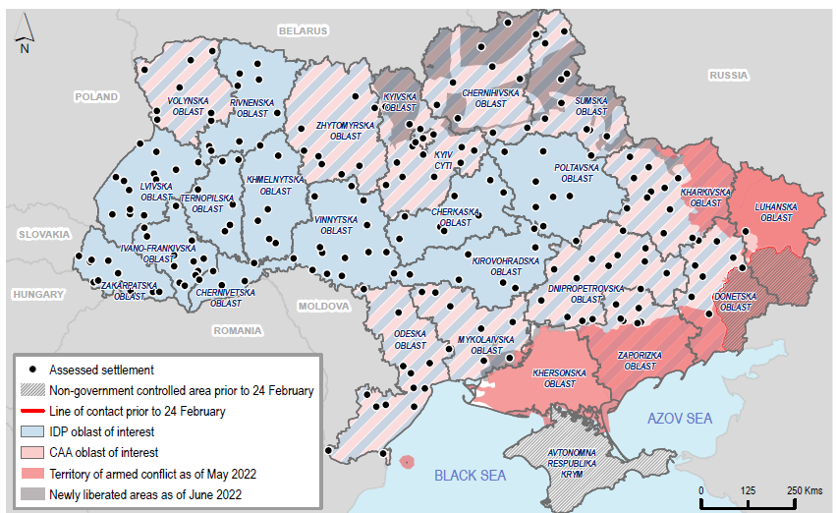
HSM: Assessment coverage - GCA
(Structured data collection)
 | GCA settlements (overall) | GCA settlements in CAA | GCA settlements hosting IDPs | Settlements in newly-liberated areas
# assessed settlements | 213 | 101 | 203 | 11
# KIs | 639 | 303 | 612 | 33

Slide 8
Settlements | GCA / NGCA settlement
Dnipro | GCA settlement
Kharkiv | GCA settlement
Lviv | GCA settlement
Mykolaiv | GCA settlement
Sumy | GCA settlement
Berdiansk | NGCA settlement
Izium | NGCA settlement
Kherson | NGCA settlement
Mariupol | NGCA settlement
Melitopol | NGCA settlement
HSM: Assessment Coverage
(Semi-structured data collection)
This presentation provides key findings on AAP and information needs in GCA settlements only.

Slide 9
Humanitarian assistance available in assessed settlements – reported to be generally appropriate and relevant, however, some perceived issues were:
decreasing amount of assistance,
inefficient targeting of aid to the people most in need,
lack of essential items in aid packages.
Food (including baby food), medicines, and cash assistance were reportedly the most useful types of assistance for the people in the assessed settlements.
Most useful assistance and priority needs in GCA settlements
Most commonly reported priority needs across all assessed settlements (n=213)
Quantitative data, HSM round 4
1
Car fuel 99% (n=210)
3
Financial resources 41% (n=87)
2
Baby food 44% (n=93)
4
Medicine 38% (n=82)
Most frequently cited types of delivered assistance:
food,
personal hygiene kits, and
cash assistance.
Notes:
Items cited to be most useful to affected communities appear to be largely consistent with some of the items that communities have received the most from aid workers, with the notable exception of car fuel and medicines.
In the five GCA settlements where semi-structured interviews were conducted, interviewees most frequently cited that people in their settlements had received food as part of the delivered aid, followed by personal hygiene kits and cash assistance.

Slide 10
Most interviewees reported that people generally perceived targeting was fair and aid was provided to those most in need.
Perceived instances of inefficient targeting of aid distribution:
cases of aid not reaching people most in need (Kharkiv), or
issues with some people or groups of people receiving aid more frequently than others (Sumy).
Most interviewees reported that ‘most’ or ‘all’ population groups had been able to access at least some humanitarian aid. Some interviewees reported perceptions that:
some population groups were more likely to be offered assistance than others, especially in light of increased pressure on aid actors due to return of the residents and increased number of IDPs (Kharkiv and Mykolaiv).
priority was given to the IDPs over other groups, such as returnees or local residents (Dnipro and Sumy).
Perceived gaps in the response in GCA settlements
“...the bulk of humanitarian aid was distributed to the older persons and IDPs, while young people and returnees received a smaller amount.”
Volunteer | Sumy

Slide 11
Barriers to receiving humanitarian assistance (including barriers faced at distribution sites and while registering for aid)
Most interviewees reported that people had been facing some barriers to receiving humanitarian assistance, particularly at distribution sites.
Most frequently cited barriers to people receiving assistance (reported by most or all interviewees):
long queues,
overcrowded distribution sites,
distance to distribution sites,
insufficiency of aid.
Most interviewees reported no major barriers for people trying to register for humanitarian aid.
Only in Lviv, bureaucracy and lack of documentation were mentioned as barriers to registering for aid.
Barriers to receiving humanitarian assistance in GCA
Notes:
Most frequently cited barriers to people receiving assistance: long queues and overcrowded distribution sites.
Distance to distribution sites and insufficiency of aid – barriers faced at distribution sites and reception centres.

Slide 12
Most reported groups of people having faced particular difficulties with accessing humanitarian assistance:*
people with physical or psycho-social disabilities,
older persons
* Experiencing barriers to accessing aid or being left out of the assistance, or needing additional support to access humanitarian aid.
Main reported reasons:
mobility limitations,
lack of access to information.
These qualitative findings triangulated with the quantitative data:
People most affected by barriers to receiving humanitarian assistance in GCA
Most commonly reported population groups that were ‘less able’ or ‘unable’ to meet their everyday needs, by % of assessed settlements (n=213)
Quantitative data, HSM round 4
People with physical disabilities | 82% (n=174)
Older persons | 77% (n=164)
Others | 40% (n=85)
Chronically ill | 37% (n=79)
Notes:
people with physical or psycho-social disabilities
older persons most frequently reported to be experiencing barriers to accessing aid or being left out of the assistance, or needing additional support to access humanitarian aid.

Slide 13
The majority of interviewees did not consider that the targeting of humanitarian assistance had major negative impacts on social cohesion.
However, some interviewees reported:
disputes in queues for assistance,
differences between aid packages people received (Mykolaiv), or
tension between people in different age groups (Sumy).
Findings suggest a level of distrust towards aid actors in some areas, with interviewees reporting instances of community members perceiving that volunteers or aid workers were engaging in aid embezzlement or misappropriation of assistance at the expense of affected communities.
Impact of humanitarian assistance on social cohesion in GCA
“There have been cases when volunteers of an international organisation kept the best medicines and distributed to people what was left over. They were identified and no longer recruited, but the locals remembered the incident.”
Volunteer | Mykolaiv

Slide 14
According to interviewees, humanitarian actors were generally coordinating with local authorities, as well as local activists, housing association representatives, and consulting them on priorities for assistance, according to the interviewees.
Some interviewees reported that community members had limited opportunities to inform programming.
Some interviewees recommended:
Holding consultations with IDPs in collective centers or representatives of Administrative Service Centers responsible for specific areas, and/or,
Conducting surveys with affected people regarding the forms of humanitarian aid.
Consultation of affected communities in GCA
“The local government is not aware of the people’s needs, they have not conducted a needs analysis. The assistance they provide is a “one size fits all” and superficial.”
Volunteer | Mykolaiv
Notes:
Interviewees from Mykolaiv and Dnipro reported that humanitarian aid actors did not consult with local population of the level of consultation was insufficient.

Slide 15
KIs in 14% (n=30/213) of assessed settlements reported that people in their settlements had partial access to information about humanitarian assistance.
According to interviewees in Mykolaiv and Sumy, people also relied on the city mayor’s or other official live broadcasts.
Access to information in GCA (1)
Most frequently reported means of obtaining information related to humanitarian assistance used by most people in the settlement (n=213)
Quantitative data, HSM round 4
Social media | 98% (n=208)
Phone communications | 91% (n=193)
Face-to-face communication | 88% (n=187)
Community group discussions | 56% (n=120)
Notes:
Most used communication channels about humanitarian assistance were: word of mouth, social media, as well as messaging apps (most frequently Telegram and Viber).

Slide 16
The most commonly reported information sources on humanitarian assistance used in assessed settlements were:
Government officials (in 90% (n=192/213) of settlements)
Volunteers (85% (n=181/213))
Social workers (84% (n=179/213))
Friends/family/neighbours (84% (n=179/213))
Community leaders (78% (n=166/213))
Access to information in GCA (2)
Most frequently cited information needs among the affected populations in assessed settlements (n=213)
Quantitative data, HSM round 4
How to register for assistance | 66% (n=140)
How to get money/financial support | 61% (n=129)
News on available resources in settlement | 53% (n=112)
Info on humanitarian assistance/agencies | 52% (n=110)
Findings suggest that older persons, people with physical or cognitive disabilities, as well as people who are unable to access digital services faced more challenges in terms of access to information.

Slide 17
Food, medicines, and multi-purpose cash assistance emerged as the most useful types of assistance in the assessed settlements. Car fuel was a top reported priority need, among all other needs.
While aid was generally perceived to be appropriate and relevant, inefficient targeting of aid distribution, decreased flow of aid, and lack of certain necessary items in ‘aid packages’ was reported by some interviewees.
Most interviewees reported that people had been facing some barriers to receiving humanitarian assistance, and the most commonly cited barriers were: long queues and overcrowded distribution sites, distance to distribution sites, and insufficiency of aid.
People with disabilities and older persons reportedly faced significant barriers in accessing humanitarian assistance, as well as difficulties accessing information about available assistance, especially in light of the common use of technologies such as smartphone applications to communicate with communities about aid availability.
Key
findings

Slide 18
Next steps
In Progress
WB: 1st of August
WB: 8th of August
HSM (Round 4) drafting of factsheet on findings in NGCA settlements (including AAP brief based on qualitative data)
HSM (Round 5) data collection
HSM (Round 5) data processing and aggregation
HSM (Round 5) drafting of factsheets including findings from both structured and semi-structured data collection

Slide 19
Thank you for your attention
Lviv, Ukraine & Rzeszow , Poland
Sarah Studds, <sarah.studds@impact-initiatives.org>
Atti Muriricho, <atti.muriricho@reach-initiative.org>
+48 881 648 312

