Slide 1
Returns and Durable Solutions Assessment (ReDS)
Markaz Tooz Khurmato
Tooz Khurmato - Salah Al-Din
Findings presentation, Iraq
Data collection period 11-17 October 2020

Slide 2
1. Introduction to ReDS
2. Methodology and limitations
3. Markaz Tooz Khurmato overview
4. Key findings
5. Detailed findings
6. Discussion
Presentation outline

Slide 3
1
Introduction to ReDS

Slide 4
In light of increased returns, coupled with persisting challenges in relation to lack of services, infrastructure and, in some cases, security in areas of origin (AoO), there is an identified need to better understand the sustainability of returns as well as their impact and conditions in AoO.
The assessment aims to provide a rapid evidence-based overview of the assessed areas to support humanitarian and development actors to promote durable solutions for returnees and IDPs in situations of protracted displacement at the local and national level.
ReDS background
Notes:
To address this gap, REACH proposed a rapid assessment to profile priority areas of return and/or secondary displacement where there may be a risk to sustainable (re)integration of populations.
Why conducting a rapid assessment?
In coordination with the RWG and other actors, discussions took place to conduct a rapid assessment in the way to immediately identify the main conditions affecting return, durable solutions and the sustainability of safe and dignified integration or re-integration in the community.
The aim of this REDS assessment is to have an immediate understanding and in-depth profiling of needs and community interrelations between remainee, returnee, and/or IDP populations.9 This report outlines the overall conditions to determine how and to what extent they are conducive to sustainable returns.

Slide 5
ReDS Specific Objectives
Provide an understanding about the effects of recent movement trends;
Assess perceived intentions to move among all relevant communities to identify potential risk or further instability;
Assess how conditions in areas affected by recent movements may impact the sustainability of durable solutions;
Identify any consequent shift in local social dynamics and power structures;
Explore conditions in the area in terms of community needs and inter-relations; and the viability of safe and dignified (re)integration.
ReDS objectives
Notes:
ReDS Specific Objectives
Provide an understanding about the effects of recent movement trends across different demographic groups in targeted areas;
Assess perceived intentions to move among all relevant communities within the areas to identify potential risk of further instability;
Assess how conditions in areas affected by recent movements may impact the sustainability of durable solutions;
Identify any consequent shift in local social dynamics and power structures following the recent movements;
Explore conditions in the area in terms of community needs and inter-relations; and the viability of safe and dignified (re)integration.

Slide 6
ReDS methodology and limitations
2

Slide 7
Methodology
The assessment tool combined qualitative and quantitative data.
Data collection was done remotely by phone between 11 and 17 October 2020, adapted to the context and restrictions related to the COVID-19 pandemic.
Methodology based on KI interviews
Purposive sampling methods were employed to identify key informants (KIs). Findings are based on KI level data and should therefore be considered as indicative.
 KI Profile in Markaz Tooz Khurmato
Community leaders 15 KIs
IDPs (displaced in the area) 11 KIs
IDPs (displaced from the area) 5 KIs
Returnees (less than 3 months) 5 KIs
Returnees (more than 3 months ago) 5 KIs
Remainees 5 KIs
^{46 KIs}
Notes:
Community leaders are members of the host community (regardless their displacement status) and were represented by 7 mukhtars and three tribal leaders, and four local authority officials.
IDPs (displaced from the area) refer to families from Markaz Tooz Khurmato displaced after 2014 events in other areas different than their AoO, specifically in Kirkuk and in other villages of Markaz Tooz Khurmato.
IDPs (displaced in the area) refer to families from AoO different than Markaz Tooz Khurmato who displaced after 2014 events and reside in Markaz Tooz Khurmato in the meantime.
IDPs interviewed were reportedly from Balad, Beygee, Al-Daur, Samarra, Tikrit and Al-Shirqat Districts and from other sub-districts in Tooz Khurmato District.
46 KIs in total of whom 40 male and 6 female KIs aged between 30 and 67 years old.

Slide 8
Limitations
Considering the findings as indicative
 46 KIs in Markaz Tooz Khurmato Sub-district.
KIs gender balance
 40 male and 6 female KIs.
Contextualization at sub-district level
To operationalize the identified trends, information was analysed and visualized at sub-district level, rather than village and neighbourhood.
Remote data collection
Data collected remotely by phone.
Notes:
Considering the findings as indicative: The sample is small (46 KIs) and findings will only be an indication of trends, needs, humanitarian concerns, gaps and flags for actors to assess further. Findings cannot be analysed or visualized at community-level in the current methodology but [mitigation] for the current analysis REACH included findings per community group as relevant and available.
KIs gender balance: The main concern still the consent from females to be contacted over the phone. [mitigation] REACH and RWG still working in the identification process to encourage women to participate in the rapid assessment. Coming assessment are expected to have an increased participation rate.
Contextualization at sub-district level: To operationalize the identified trends, information was analysed and visualized at sub-district level, rather than village and neighbourhood. Extending to more detailed assessment at village, neighbourhood or community-level will depend in the availability of data about KIs. Contact details will need to be provided since the sampling is purposive and snowballing is very limited while doing remote data collection and time consuming taking into consideration the need of the informed consent from individuals to share their contact information with REACH. It will also require additional resources such and budget and human resources (enumerators) and will affect the time-line of the project and report deadlines.
Remote data collection: There is a concern related to how accurate are the answers since interviewees have concerns to answer sensitive questions over the phone rather than face-to-face. [mitigation] Testing process was very strict and discussions with field staff were ongoing to avoid sensitive questions and doing harm to interviewees. Some sensitive terminologies related to Iraq context were identified and replaced by explanation text in the Arabic version of the ODK tool (e.g. ‘governance’ was replaced by ‘laws and regulations’).

Slide 9
Markaz Tooz Khurmato overview and demographics
3

Slide 10
Markaz Tooz Khurmato Sub-district overview
Markaz Tooz Khurmato is a sub-district of Tooz Khurmato district, located in the east of Salah Al-Din governorate.
During the occupation of Islamic State of Iraq and the Levant (ISIL) occupation in 2014, more than half of the population (71%) in Markaz Tooz Khurmato was forced to flee their homes, as reported by KIs at the time of data collection.
99% of the families displaced since 2014 had reportedly returned at time of data collection.
13,585 – 13,883 IDP families (area of origin (AoO) not specified) are reported to reside in Markaz Tooz Khurmato settlements.
Notes:
Markaz Tooz Khurmato Sub-district was selected for the assessment as: more than 50% of host community members are reported to have returned⁷; social cohesion severity⁸ is high; it is an AoO for IDPs in camps at risk of closure⁹; and dynamic population movements and movement intentions to/from this district recently reported by relevant actors through the Returns Working Group (RWG).
Salah Al-Din is the governorate with the highest number of returnees living in high severity conditions in terms of access to services and livelihoods and perception on safety and social cohesion in Iraq.¹⁰ As reported by IOM DTM 30% of the governorate’s total returnee population (200,000 individuals) are living in severe conditions, with Markaz Tooz Khurmato Sub-district highlighted as one of the five hotspots of severe return conditions.¹¹
7. IOM DTM: http://iraqdtm.iom.int/ReturnIndex -June 2020 and August 2020
8. IOM DTM: http://iraqtdm.iom.int/ReturnIndex - refer to methodology, to compute the severity index, different parameters are combined.
9. Data reported by the CCCM Cluster in Iraq, in April 2020, upon request for the purpose of the assessment.
10. IOM DTM: http://iraqdtm.iom.int/images/ReturnIndex - Return Dynamics in Salah Al-Din - July 2020
^{11. Ibid}

Slide 11
4
Key findings

Slide 12
Key findings
Returns reportedly resulted in a perceived reduced access to services and assistance and less available job opportunities. However, at the same time, family reunification, and a perceived increase in services and the availability of job opportunities were reported.
NGOs were reportedly implementing activities in Markaz Tooz Khurmato at the time of data collection. The availability of humanitarian assistance was perceived as a factor to encourage returns across respondent groups.
Priority needs:
Healthcare and education were cited as common priority needs for all KI groups.
Community leaders: Water and sanitation, electricity, and housing rehabilitation.
Returnees: livelihoods and housing rehabilitation.
IDPs: Livelihoods, housing rehabilitation, and water and sanitation.
Remainees: Electricity and waste disposal
IDPs persistently reported to have less access to housing and housing rehabilitation, livelihoods and basic public services, largely attributed to the lack of relationships and connections in the community.
Safety and security concerns will need to be addressed in Markaz Tooz Khurmato Sub-district to enable sustainable returns due to existing perceptions and concerns related to the 2014 conflict and occupation.
Notes:
More than half of the population of Markaz Tooz Khurmato was reportedly displaced during the ISIL occupation in 2014. Recent returns were reportedly driven by the perceived improved access to services and humanitarian assistance and safety and security situation in Markaz Tooz Khurmato. Even though the majority of the displaced population has returned at the time of data collection, there are still barriers causing prolonged displacement, re-displacement and failed returns in the sub-district. Increased livelihood opportunities, access to services, improved access to healthcare and housing support are the most commonly reported needs to enable more families to return to their AoO.
Understanding distinct barriers within society to access services, jobs and assistance will improve the overall conduciveness to return as well as its sustainability, therefore improving the well-being of vulnerable groups such as IDPs, female-headed households, child-headed households, unaccompanied/separated children (UASC), large families, elderly-headed households and people with disabilities.
Contradictory responses were reported related to the return of families to Markaz Tooz Khurmato.
Returns reportedly resulted in a perceived reduced access to services and assistance, and increased competition on the job market and consequently less available job opportunities.
Returns reportedly resulted in family reunification and a perceived increase in services and the availability of job opportunities due to the return of business owners.
The expected reasons for IDP departures were the same as the main reported barriers to return, with additional reporting of destroyed/damaged housing and lack of access to healthcare as barriers to return.
Livelihoods projects were reported by the majority of KIs as the most needed assistance followed by housing rehabilitation.
At the same time, gaps in services and ongoing needs were reported in Markaz Tooz Khurmato, with the top reported needs similar for the different KI respondent groups. Healthcare was cited as a common priority need for all KI groups. Further priority needs reported by community leaders were infrastructure for water and sanitation, electricity, education and projects for housing rehabilitation. Returnees highlighted livelihoods, education and housing rehabilitation as the main community needs. IDPs mostly shared the same priorities as returnees but also noted water and sanitation. Remainees reported electricity, waste disposal and education.
Differences in access to services across different groups with IDPs persistently reported to have less access to housing and housing rehabilitation, livelihoods and basic public services, largely attributed to the lack of relationships and connections in the community. This along with vulnerable groups such as female-headed households, child-headed households, UASC, large families, elderly-headed households and people with disabilities.

Slide 13
Key findings
Impact of COVID-19 pandemic and the related local restrictions and measures
COVID-19 related movement restrictions were reported as an expected barrier for further return of families to Markaz Tooz Khurmato during the six months following data collection.
Access to housing rehabilitation, basic public services and livelihoods were reportedly affected due to COVID-19 related movement restrictions and the closure of the relevant offices or departments.
Hospitals, public health centers and medical staff were reportedly not prepared or trained to respond to the COVID-19 pandemic.

Slide 14
Findings Markaz Tooz Khurmato
6.1. Recent movements
6.2. Expected movements
6.3. Primary community needs
6.4. Perceptions on access to services and assistance
6.5. Perceptions on justice and governance
6.6. Perceptions of community disputes, relations and co-existence
6.7. Perceptions of safety and security
5

Slide 15
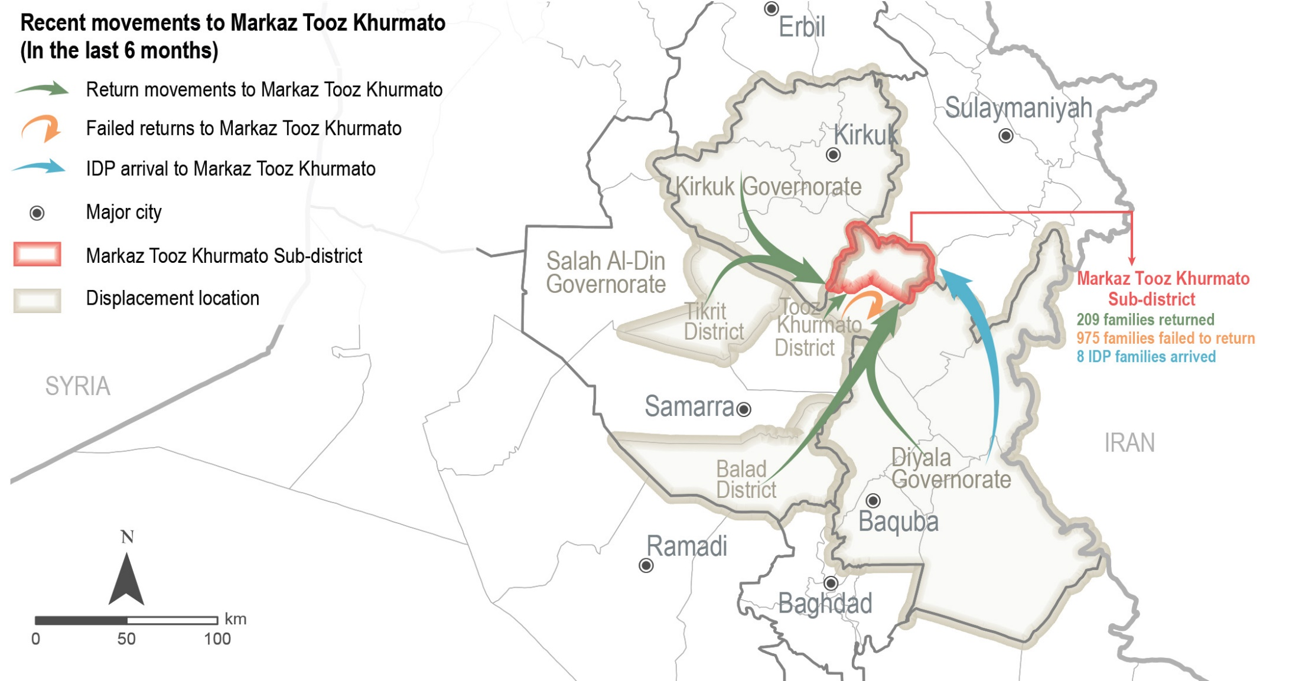
Markaz Tooz Khurmato Sub-district
Movements to Markaz Tooz Khurmato – data reported by KIs
Notes:
As reflected in the map, reported movements to Markaz Tooz Khurmato were all from non-camps areas. Families reportedly retuned from non-camp areas: Diyala Governorate, Kirkuk, Balad, and Tikrit districts and displacement areas within Tooz Khurmato District.
Re-displacement: within Tooz Khurmato District.
IDP arrivals from Diyala

Slide 16
Markaz Tooz Khurmato Sub-district
Recent movements- data reported by KIs
 Recent returns
¹⁷⁵⁻²⁴²
families reportedly returned to Markaz Tooz Khurmato in the six months prior to data collection, as reported by 11 KIs (out of 46).
Driver for recent returns (out of 11 KIs)*
Increased sense of safety and security 9 KIs
Return of other family members/family reunification 5 KIs
Perceived increase in access to services 2 KIs
Camp closure in area of displacement ( AoD) 1 KI
“People need job opportunities so that they can return and settle.”
- Male community leader KI -
 Attempted returns
families attempted to return to Markaz Tooz Khurmato from non-camp areas in the six months prior to data collection, but did not succeed and therefore stayed in the AoD, as reported by two community leader KIs.
^{650-1,300}
* Sum of answers may exceed the 100% due to KIs being able to select multiple response options, including other topics.
Notes:
175-242 families reportedly returned, as reported by 11 KIs. However, the rest of the KIs reported no returns (28 KIs) or did not know about recent movements (7 KIs) out of 46 KIs.
The reported increase in access to services and job opportunities was related to the return of business owners, while the perceived decrease in access to services and livelihood opportunities was reportedly due to the presence of a higher number of families in Markaz Tooz Khurmato and the increased competition in the job market.
Reported effects of returns are family reunification, increase in access to services and increase in job opportunities. On the other hand, returns reportedly lead to decrease in access to services and job opportunities.
Reported reasons for failed returns were the lack of job opportunities and services in AoO, presence of job opportunities in other areas, houses being destroyed in AoO, and COVID-19 related restrictions. Family separation was the main reported impact for the failed returns.

Slide 17
Markaz Tooz Khurmato Sub-district
Recent movements- data reported by KIs
 Recent IDP arrivals
⁵⁻¹⁰
IDP families have arrived to Markaz Tooz Khurmato in the six months prior to data collection as reported by one IDP KI.
According to the KI, IDP families arrived due to kinship ties with families in Markaz Tooz Khurmato.
 Recent IDP departures
No IDP departures were reported from Markaz Tooz Khurmato in the six months prior to data collection, as reported by 34 KIs (out of 46 KIs).
Family separation
Two community leader KIs (out of 46 KIs) reported that some families in Markaz Tooz Khurmato have family members, specifically adult sons, still living in displacement.
* Sum of answers may exceed the 100% due to KIs being able to select multiple response options, including other topics.
Notes:
5-10 IDP families have arrived to Markaz Tooz Khurmato in the six months prior to data collection as reported by one IDP KI.
However, a majority of the KIs reported no IDP arrivals (31 KIs) or did not know about recent arrivals (14 KIs).
Reportedly, the arrival of additional IDP families negatively affected access to jobs, assistance and services due to the increased number of families present in the area.
Family separation
The reported reasons for a prolonged displacement of family members were the fear resulting from the past security situation related to ISIL occupation, family members are already employed in the AoD, lack of job opportunities in the AoO, and lack of resources to be able to return.
No IDP departures were reported from Markaz Tooz Khurmato in the six months prior to data collection, as reported by 34 KIs (out of 46 KIs). The rest of the KIs (12 KIs) did not know about recent departures of IDPs.

Slide 18
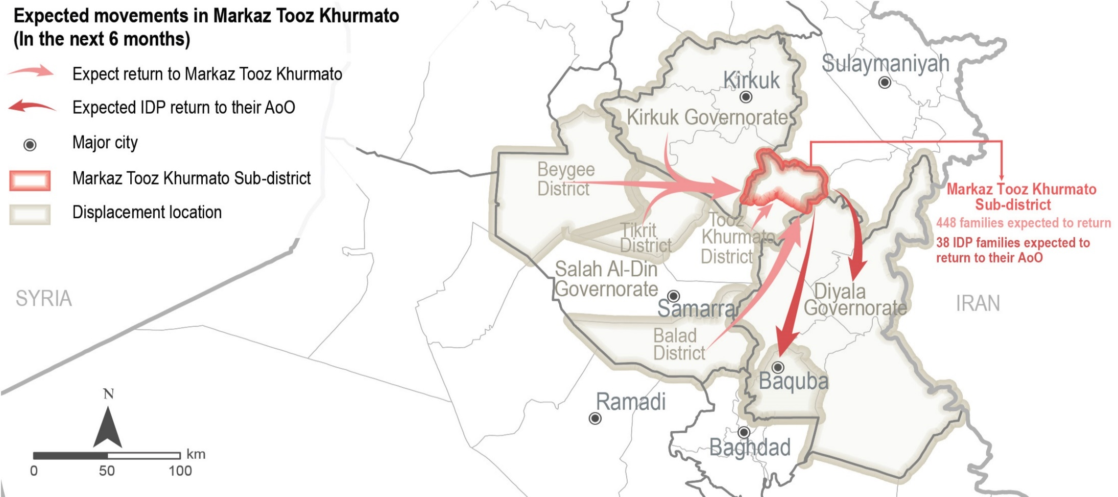
Markaz Tooz Khurmato Sub-district
Expected movements reported by KIs
Notes:
This map reflects the expected movements in the six months following data collection. As reported by KIs, it is expected returns to Markaz Tooz Khurmato from other sub-districts within Tooz Khurmato District, and from Tikrit, Beygee, Balad and Kirkuk Districts. Expectedly, IDPs will depart from Markaz Tooz Khurmato to return to their AoO in Diyala and Baguba.

Slide 19
Markaz Tooz Khurmato Sub-district
Expected movements – data reported by KIs
 Expected returns
³⁴⁶⁻⁵⁵¹
families are expected to return to Markaz Tooz Khurmato from non-camp areas in the six months following data collection, as reported by 8 KIs (out of 46).
Drivers for expected returns (most reported) (out of 46 KIs)*
Sense of increased safety and security 42 KIs
Sense of increased access to services and assistance 15 KIs
Return of other family members/family reunification 11 KIs
Barriers for expected returns (most reported) (out of 46 KIs)*
Lack of jobs and services 46 KIs
Destroyed/damaged housing in AoO 33 KIs
Lack of access to specialized medical treatment in AoO 11 KIs
“People need livelihood opportunities to meet their needs and continue to live in this region. If job opportunities are not available, not everyone will be able to return.”
- Male community leader KI -
.
* Sum of answers may exceed the 100% due to KIs being able to select multiple response options, including other topics.
Notes:
Expected returns
The rest of the KIs reported no expected returns (17 KIs) or did not know (21 KIs).
Other reported drivers were:
Camp closure in Area of displacement 9 KIs
Perceived increase in job opportunities 6 KIs
Nostalgia about previous life in AoO 1 KI
Properties left behind in Aoo 1 KI
Other reported barriers:
Security concerns 6 KIs
COVID-19 movement restrictions 5 KIs
Lack in documentation to return 3 KIs
Further returns were reportedly perceived to have negative impacts such as access to available job opportunities due to the increased competition for jobs (20 KIs); less available assistance due to higher demand (15 KIs); and less access to services due to the limited capacity of service providers to meet the needs of the community (1 KI) in Markaz Tooz Khurmato. However, it was also reported to positively impact the area leading to a potential increase in job opportunities due to the return of business owners (14 KIs); increased access to services and assistance due to focused attention of aid actors and service providers (8 KIs); and family reunification (5 KIs). There were no marked differences in the impacts reported across KI respondent groups.
The rest of the KIs (3 KIs) did not know about expected departures.

Slide 20
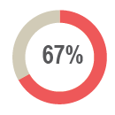
Markaz Tooz Khurmato Sub-district
Expected movements – data reported by KIs
 Expected IDP arrivals in Markaz Tooz Khurmato
of KIs (31 out of 46 KIs) reported that there are no IDP families expected to arrive in the six months following data collection.
Drivers for expected IDP arrivals (out of 46 KIs)*
Sense of increased safety and security 40 KIs
Increased access to services and jobs 23 KIs
Following in return of family members 8 KIs
Camp closure in AoD 5 KIs
 Expected IDP departures from Markaz Tooz Khurmato
²⁵⁻⁵⁰
IDP families residing in Markaz Tooz Khurmato are expected to return to their AoO in Baquba district in the six months following data collection, as reported by one KI.
* Sum of answers may exceed the 100% due to KIs being able to select multiple response options, including other topics.
Notes:
Expected IDP arrivals
The rest of the KIs did not know about expected movements.
Expected IDP departures:
25-50 IDP families, according to one KI. Reasons for these expected departures were reportedly related to lack of assistance and jobs in the area.
The rest of the KIs reported no families are expected to depart from Markaz Tooz Khurmato (45 KIs), and 9 KIs did not know.
No host community families are expected to depart in the six months following data collection, as reported by 43 out of 46 KIs.

Slide 21
Markaz Tooz Khurmato Sub-district
^{Primary community needs –} ^{reported by 46 KIs}
Top two reported primary, secondary and tertiary needs
Primary needs
Healthcare Livelihoods

Secondary needs
Water and sanitation Housing rehabilitation
Tertiary needs
Education Electricity
 Primary community needs per respondent group*
Community leaders (out of 15 KIs)
Returnees (out of 10 KIs)
IDPs (out of 16 KIs)
Remainees (out of 5 KIs)
Healthcare
House rehabilitation
Water and sanitation
Electricity
8 KIs
6 KIs
6 KIs
5 KIs
Livelihoods
Healthcare
Education
House rehabilitation
7 KIs
7 KIs
3 KIs
2 KIs
Healthcare
Livelihoods
House rehabilitation
Water and sanitation
11 KIs
10 KIs
8 KIs
5 KIs
Electricity
Waste disposal
Education
Healthcare
2 KIs
2 KIs
1 KI
1 KI
* Sum of answers may exceed the 100% due to KIs being able to select multiple response options, including other topics.
Notes:
KIs reported that the primary needs for the community are: 1) healthcare due to the reported limited access to public health clinics and hospitals in the sub-district, a lack of competent health staff, medical supplies and medications, in addition to the lack of knowledge and preparedness to support patients during the COVID-19 pandemic; 2) livelihoods, reportedly related to the lack of jobs and unstable economic situation21 in Markaz Tooz Khurmato.
The second main community needs most commonly reported were: 3) water and sanitation. The lack of maintenance of the water network, water filters and pumping stations in Markaz Tooz Khurmato was reportedly resulting in water pollution and scarcity, leading to unsustainable solutions like purchasing bottled drinking water and water trucking. In addition, the absence of a sewage network and lack of drainage for gray and black water in the sub-district has led to environmental and sanitation concerns; 4) housing rehabilitation, due to high levels of damage to shelter during the conflict in 2014 and the importance of shelter to enable families to return to their AoO.
The third main community needs most commonly reported were: 5) education due to reported decline in the quality of free education services, and the high cost of private education and school stationary; and 6) access to electricity, due to breakdowns of electrical transformers and intensified interruptions of public electricity. This not only affected families but also small businesses that require electricity to operate having to resort to private generators at increased costs per amperage.

Slide 22
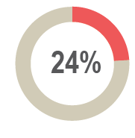
Markaz Tooz Khurmato Sub-district
Perceptions on access to services and assistance – data reported by KIs
 Access to humanitarian aid
of KIs (11 out of 46 KIs) reported that non-governmental organisations (NGOs) were implementing projects or activities in Markaz Tooz Khurmato at the time of data collection.
Reported activities implemented by NGOs in Markaz Tooz Khurmato (out of 11 KIs)*
Reported most needed projects or activities in Markaz Tooz Khurmato
(out of 46 KIs)*
Social cohesion
Livelihoods
NFI distribution
Food security
Water and sanitation
Psycho-social support
Rehabilitation of infrastructure
Protection
5 KIs
5 KIs
3 KIs
3 KIs
3 KIs
3 KIs
2 KIs
1 KI
32 KIs
9 KIs
3 KIs
1 KI
1 KI
Livelihoods
Housing rehabilitation
Social cohesion
Cash assistance
Water and sanitation
* Sum of answers may exceed the 100% due to KIs being able to select multiple response options, including other topics.
Notes:
28 KIs (out of 46) reported there was no NGO presence in the area and the rest (7 KIs) did not know.
Four KIs reported that IDPs, female-headed households, child-headed households, UASC, elderly people and people with disabilities are less involved in activities or projects.
41 out of 46 KIs reported that the availability of humanitarian aid was a factor to encourage return. 4 KIs reported that it was not an influencing factor and one KI did not know.

Slide 23
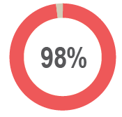
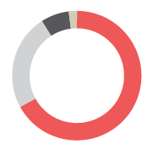
Markaz Tooz Khurmato Sub-district
Perceptions on access to services and assistance – data reported by KIs
 Access to housing
of KIs (45 out of 46 KIs) reported that the majority of families in the area reside in houses.
Reported housing agreement (out of 46 KIs)
Owned tenure 31 KIs
Verbal rental agreement 11 KIs
Formal/official rental agreement 3 KIs
Hosted by other family 1 KI
^{31%-50%}
of houses in Markaz Tooz Khurmato were reportedly damaged during the events in 2014 due to military operations, as reported by 36 KIs (out of 46).
Risk of eviction
All KIs (46 KIs) reported that there are no families from different population groups at immediate risk of eviction in Markaz Tooz Khurmato.
Notes:
Reported housing agreement:
One community leader KI reported that there are also families residing in apartments.
In addition to the reported housing agreements, the IOM DTM report on return dynamics in Salah Al-Din highlighted that illegal occupation of houses in Markaz Tooz Khurmato was an obstacle for families willing to return to the sub-district.
Specific groups being more likely to reside in damaged or unfinished housing were IDPs and returnees in addition to UASC, large families, people with disabilities, elderly-headed households and child-headed households, as reported by 30 KIs (out of 46).
Risk of eviction
In follow up questions on eviction 32 KIs (out of 46 KIs) reported that returnees, IDPs, child-headed households, UASC, large families, elderly people, people with disabilities, people without documentation, families with perceived affiliation to ISIL and people with less connections (wasta) would be most at risk of eviction.

Slide 24
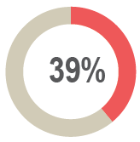
Markaz Tooz Khurmato Sub-district
Perceptions on access to services and assistance – data reported by KIs
 Access to housing rehabilitation
of KIs (18 out of 46 KIs) reported that access to housing rehabilitation is unequal.
Reported barriers to access assistance for rehabilitation (out of 18 KIs)*
Vulnerability criteria perceived as too specific
Lack of financial means for rehabilitation
Assistance perceived to target specific neighbourhoods
Less connections (wasta)
COVID-19 restrictions
Lack of necessary documentation
13 KIs
13 KIs
11 KIs
5 KIs
2 KIs
1 KI
“The area has largely been destroyed, including people’s homes, infrastructure and government departments. Therefore, the region needs significant housing support to stabilize the region.”
- Male community leader KI -
* Sum of answers may exceed the 100% due to KIs being able to select multiple response options, including other topics.
Notes:
Access to housing rehabilitation
Reportedly UASC, IDPs, elderly-headed households and child-headed households have less access to housing rehabilitation
Reported barriers to access
Wasta can be defined as the advantages a person might have due to using one’s social connections and influence.
Lack of necessary documentation is papers related to proof of house ownership, rent attestation, civil status certificates, birth certificates, police attestation, security clearance, passport and identification (ID) papers.

Slide 25
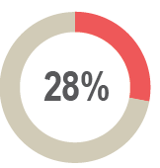
Markaz Tooz Khurmato Sub-district
Perceptions on access to services and assistance – data reported by KIs
 Access to basic public services
of KIs (13 out of 46 KIs) in Markaz Tooz Khurmato reported that access to basic public services was unequal, namely education, healthcare and water and sanitation.
Reported barriers to access basic public services (out of 15 KIs)*
Less connections (wasta) 12 KIs
Vulnerability criteria perceived as too specific 8 KIs
COVID-19 related restrictions 5 KIs
Lack of financial means to access services 3 KIs
* Sum of answers may exceed the 100% due to KIs being able to select multiple response options, including other topics.
Notes:
IDPs, elderly-headed households, female-headed households, child-headed households, UASC, large families, people with less connections and people with disabilities have reportedly less access to basic public services.
All KIs (46 KIs) reported that boys and girls (between 6-15 years old) can access public education. However, a decrease in the quality of public education in Markaz Tooz Khurmato was reported by 7 KIs. Furthermore, the stop of gratuitous distributions of educational items such as books, notebooks and pens (8 KIs), the lack of capacity in public schools to meet the current demand of students (1 KI), the lack of interest of children to attend school (1 KI) and the perceived low competency of public educational staff (1 KI) were reportedly perceived challenges regarding public education in the sub-district.

Slide 26
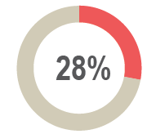
Markaz Tooz Khurmato Sub-district
Perceptions on access to services and assistance – data reported by KIs
 Access to livelihoods
of KIs (13 out of 46 KIs) reported unequal access to livelihoods opportunities in Markaz Tooz Khurmato Sub-district.
Reported barriers to access livelihoods (out of 13 KIs)*
Less connections (wasta) 9 KIs
Perceived limited physical/mental capacity of specific groups 4 KIs
COVID-19 restrictions 3 KIs
Vulnerability criteria perceived as too specific 3 KIs
Lack of financial means to provide assets 2 KIs
Lack of necessary documentation 1 KI
“An income is necessary to buy food and water, pay the rent, and to cover hospital costs in case of illness.”
- Male returnee KI -
* Sum of answers may exceed the 100% due to KIs being able to select multiple response options, including other topics.
Notes:
Access to livelihoods
IDPs, elderly heads of household, people with disabilities, female heads of household, child heads of household, UASC, and large families reportedly have less access to livelihood opportunities compared to other groups in the community in Markaz Tooz Khurmato.
Reported barriers to access livelihoods
Perceived limited physical/mental capacity of specific groups is reportedly related to groups represented by female, elderly, children and people with disabilities in the different population groups.
Lack of necessary documentation is papers related to proof of house ownership, rent attestation, civil status certificates, birth certificates, police attestation, security clearance, passport and identification (ID) papers.

Slide 27
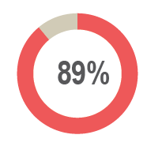
Markaz Tooz Khurmato Sub-district
^{Perceptions on} justice and governance– data reported by KIs
 Access to public judicial mechanisms
All KIs (46 KIs) reported that access to public judicial mechanisms is perceived equal for all members of the community.
The Ministry of Displacement and Migration (MoDM) in Markaz Tooz Khurmato was reportedly closed at the time of data collection, as reported by three community leader KIs.
of KIs (41 out of 46 KIs) reported that there are no types of documentation people cannot obtain in the offices closest to them.
 Governance and influencing bodies*
Local authorities are perceived as the most influential body with regards to governance, as reported by all 15 community leader KIs.
* Taking into consideration the sensitivity of this topic it was only answered by community leaders. .
Notes:
Access to public judicial mechanisms
There was no reporting on documentation that people cannot obtain in the offices closest to them.
The rest of the KIs reported that they do not know about access to documentation.
Governance and influencing bodies
All 15 community leader KIs reported that the main actors influencing the implementation of laws and rules did not change in the six months prior to data collection.
In addition, there has been no new appointments of local authorities reported in Markaz Tooz Khurmato in the six months prior to data collection.

Slide 28
Markaz Tooz Khurmato Sub-district
Perceptions of community disputes, relations and co-existence – reported by KIs
 Community disputes
^{96%}
of KIs (44 out of 46 KIs) reported that there were no disputes within the neighbourhoods in the six months prior to data collection. The rest of the KIs did not know.
^{91%}
of KIs (42 out of 46 KIs) reported that there were no disputes between villages in the six months prior to data collection. The rest of the KIs did not know.
^{65%}
of KIs (30 out of 46 KIs) reported that there were no retaliation incidents in the six months prior to data collection. The rest of the KIs did not know.
 Community relations and co-existence
^{98%}
of KIs (45 out of 46 KIs) reported that community members trust each other.
^{91%}
of KIs (42 out of 46 KIs) reported that their community members interact with other groups in the community.
All KIs (46 KIs) reported that there are no specific population groups which are not considered welcome by the majority of the community in the area.
Notes:
Community disputes
All 46 KIs reported no change is expected regarding disputes within or between communities in the six months following data collection. This is reportedly due to the (re)integration of IDPs and returnees in Markaz Tooz Khurmato facilitated by kinship ties and work relations between families of different groups in the community and the intervention of local authorities.

Slide 29
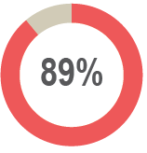
Markaz Tooz Khurmato Sub-district
Perceptions of safety and security – data reported by KIs
 Safety and security
All KIs (46 KIs) reported that their community members feel safe in Markaz Tooz Khurmato.
of KIs (41 out of 46 KIs) reported that their community members do not avoid any areas or neighbourhoods in Markaz Tooz Khurmato.
Two KIs reported that ensuring safety is one of the major concerns for the community in Markaz Tooz Khurmato to encourage returns.
 Perceived presence of security forces
All KIs (46 KIs) reported that the presence of security forces such as the police and the Iraqi armed forces contribute positively to a feeling of safety.
“To move with full personal freedom and not fear anything, they need those who protect them and protect their family.”
- Male returnee KI -
Notes:
All KIs (46 KIs) reported that their community members feel safe in Markaz Tooz Khurmato. In addition, it was reported that females and males move freely during the day and at night.
Perceived presence of security forces:
In addition, it was generally reported that security forces are effective in resolving disputes within the community and between different villages.
Data from the IOM DTM Returns index on return dynamics in Salah Al-Din, shows a need for reconciliation between different ethno-religious groups in Tooz Khurmato District and reported fear of ISIL returning to the area. In addition, safety and security issues in Markaz Tooz Khurmato are reported by IOM DTM regarding the presence of security forces, including multiple security actors competing for the control of the sub-district with in some locations up to six different actors.²⁷ KI data does not show any direct security threats or incidents, but the perception of security and trust after the violent events of 2014 are important for sustainable solutions for return in Markaz Tooz Khurmato.
27. IOM DTM: http://iraqdtm.iom.int/images/ReturnIndex - Return Dynamics in Salah al-Din - July 2020

Slide 30
Upon request
http://www.reachresourcecentre.info/
IMPACT Initiatives
@REACH_info
https://www.impact-repository.org/document/reach/0cedf235/REACH_IRQ_Factsheet_-REDS-Markaz-Tooz-Khurmato_October2020.pdf

