Slide 1
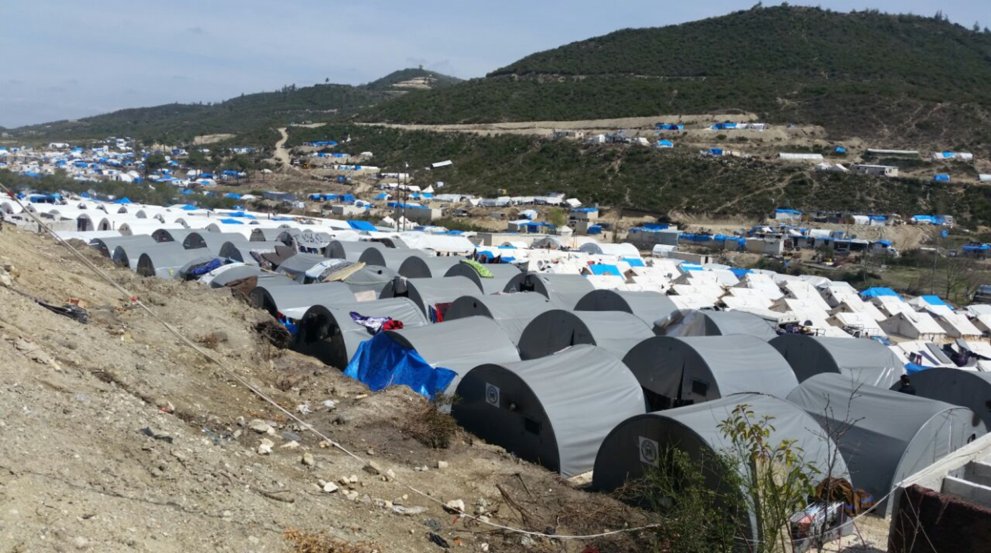
IMPACT
Shaping practices Influencing policies Impacting lives
Focus Group Discussions
Training & Best Practices
TRAINING TOOLS - October 2016

Slide 2
Training Objectives
This training has three main objectives:
Improve the monitors knowledge and skills on this type of data collection method
Improve the quality of the FGD data by training the monitors that will conduct the FGD sessions
Improve the satisfaction of the FGD participants by managing the FGD process

Slide 3
What is a FGD?
A focus group discussion (FGD) is a qualitative data collection method in which several participants meet as a group to discuss a given topic, in order to explore their perceptions, opinions, beliefs, and attitudes towards it
The key advantages of focus groups are:
Yielding a large amount of information over a relatively short period of time
Accessing a broad range of different views on a specific topic
Collecting data in a dynamic way as participants influence each other during the discussion

Slide 4
Defining a focus group
A focus group is a small group of six to ten people gathered together and led through an open discussion by a facilitator that moderate the discussion
The focus group facilitator’s role is to encourage each of the participants to talk openly about their opinions, to make sure that all the topics of interest are covered by the discussion and to properly record the views of the participants
The ideal amount of time to set aside for a focus group is anywhere from 45 to 90 minutes. Beyond that most groups are not productive and it becomes an imposition on participants’ time

Slide 5
Defining a focus group (cont)
Focus groups are structured around a set of carefully predefined questions – but the discussion is free-flowing. Ideally, participants’ comments will stimulate the thinking of others. Some people even find themselves changing their thoughts during the group.
A homogeneous group of people unrelated to each other comprise the focus group. Homogeneity levels the playing field and reduces inhibitions among people
It takes more than one focus group on any one topic to produce valid results – usually three or four. You’ll know you’ve conducted enough groups when you’re not hearing anything new anymore, i.e. you’ve reached a point of saturation.

Slide 6
How does a FGD work?
Team composition and roles:
One monitor (the facilitator)
  Introduces, moderates and closes the FGD session
  Fills the FGD debriefing form
  Provides debrief to the team leader
The second monitor (the note-taker) :
  Ensures all participants filled out the contact details forms at the end of the FGD
  Takes detailed notes of the FGD session
  Fill the FGD debriefing form
    Assists the moderator in debriefing the team leader

Slide 7
Focus Group Discussions
    The discussion

Slide 8
Introducing the FGD
The facilitator needs to introduce the FGD by:
welcoming the participants and thanking them
introduce yourselves and IMPACT (this will change in each case depending on the program), refer to the questionnaire!
explaining the purpose of the focus group
providing information on how long the FGD will last
assuring that everything said in the focus group is confidential
assuring that we will protect participants’ anonymity
Refer to the written introduction on the FGD guide!

Slide 9
Setting the ground rules
The facilitator needs to inform the participants about the ground rules they should respect during the discussion:
only one person speaks at a time
there are no right or wrong answers
participants do not have to speak in any particular order
when people have something to say, the may speak
people do not have to agree with the views of others in the group
Again, refer to the Ground Rules Section on the FGD guide!

Slide 10
Fueling the discussion
The facilitator fuels the discussion by asking questions to the group. There are two type of questions:
The main questions:
They kick out the discussion on a particular topic.
They are sometimes general to collect initial opinions on a given topic.
These questions should be read to the participants.
The probing questions:
They are more specific and help to dig deeper into the topic.
The facilitator does not read probing questions, but rather adapts them as necessary,
Make sure though that all of them are covered by the discussion!

Slide 11
Leading the discussion
In addition the facilitator manages the discussion by intervening when needed to make sure comments are relevant and everybody participates.
Here are some tips on how to…...
How to…
Dig deeper | Can you talk about that more? Please, continue, that’s if very interesting
Clarify the discussion | Can you help me understand what you mean? Could you please explain this point?
Be more specific | Can you give an example? Can you be more specific?
Engage with participant | What’s your view on this? What do other people think?

Slide 12
Key tasks during the discussion
Key tasks of a facilitator include:
Covering all prepared questions within the time available
Getting all participants to engage in the discussion
Paraphrasing and summarize long, complex or ambiguous comments, to clarify the discussion
Demonstrating active listening and interest in what they participants tell
Remaining neutral, refraining from agreeing/disagreeing, or praising/denigrating any comment made
Tactfully dealing with challenging participants.

Slide 13
Wrapping up the FGD
The facilitator is responsible for properly closing the session. This include:
Thanking the participant, as they are all volunteers
Appreciating the work that has been done as their opinions will be very valuable to the monitoring
Asking their comments of the FGD process
Communicating IMPACT Skype ID: IMPACT_Initiatives_Turkey that participants can use to provide feedback on the discussion

Slide 14
Recap for facilitators
A good facilitator . . .
Shows flexibility
Shows sensitivity
Has a sense of humor
Links ideas together
Encourages participation from everyone
A good facilitator tries not to . .
Dictate the course of discussion
Lose control over the conversation
Be judgmental
Try to be an “expert”
Lecture the group
Ask leading questions

Slide 15
Focus Group Discussions
    Note taking

Slide 16
Taking notes
The key output of an FGD are the records (notes) of the discussion. This is why the role of the note-taker is essential to the success of the FGD. During the discussion he/she is responsible for:
Taking detailed writing notes of the discussion, including (key answers of participants, disagreements/agreements between participants, body language, moments of silence etc.)
Using the empty space under each question – so the translator will know which notes belongs to which questions
Noting down direct observations on the overall FGD process
Details are crucial as they may cause big change during the analysis!

Slide 17
Recording metadata
Metadata are data that provide information (time, locations, etc.) about the data collected during the FGD. The note-taker is responsible of recording this type of data, including:
Recording the date, the start and end times of the FGD
Fulfill the Preliminary Information section, including the geographical location where the FGD is held
Engaging with the participants to record their personal details in the Annex One of the questionnaire – when possible
NB: do not write participants’ names, but use the list of codes provided by your team leader!

Slide 18
Focus Group Discussions
    Debriefing

Slide 19
Monitors debriefing
Both the note-taker and the facilitator need to debrief immediately after each FGD session. The debriefing, which should last about 20 minutes, aims at:
Providing additional details of the FGD process (including how they participants have reacted to the discussion)
Capturing information about the FGD process (what went well, what did not go well)
Please, use the Debriefing Questionnaire provided by the team leader!

Slide 20
Debriefing with Field Coordinators
The day after the FGD the note-taker needs to perform very important task including:
Expanding all notes for them to be as comprehensive as possible
Entering the notes into a new, clean questionnaire, making sure the writing is readable
Sending the notes to the Field Coordinators – Mahmood and Muna
Going through a debrief session with the Field Coordinators in order to make sure all fields have been correctly filled in, and notes are clear.
Good notes are always clear and comprehensive!

Slide 21
Focus Group Discussions
    Other information

Slide 22
External participation
What if nonparticipants want to observe the focus group?
  FGD preferably with no outside observers (neither facilitator nor participant)
  Presence of outsiders may influence the participants and inhibit them from speaking their mind
  Even stakeholders should be discouraged from attending the discussion
  If external people express the wish to participate in the FGD, this needs to be noted in the Debriefing Questionnaire

Slide 23
Participants leaving the group
What if a participant does not stay for the entire discussion?
Participation in FGD is always voluntary
If a participant does not want to remain, he/she should be reminded of the confidentiality agreement and thanked for his/her participation
The note-taker should handle the participant’s departure and the facilitator should take notes in the meantime
The withdrawal of a participant should be noted in the debriefing questionnaire, explaining the reasons that pushed him/her to leave

Slide 24
Focus Group Discussions
    Questions?

Slide 25
Focus Group Discussions
    Thank you!

