Slide 1

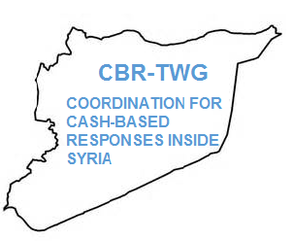
NORTHERN SYRIA
MARKET MONITORING EXERCISE
January 2016
Fuel and NFIs

Slide 2
TITLE 1 TITLE 1 TITLE 1
What is Market Monitoring?
Joint initiative by members of the Cash-Based Responses Technical Working Group, led by REACH
Monitors prices and stock levels of key commodities in markets throughout northern Syria
  17 food items, 5 hygiene NFIs, 6 types of fuel, winter blankets
  Private water trucking, currency exchange, winterisation supplements
Ongoing since March 2015 (8 months of data)
January 2016 coverage:
  28 subdistricts across 6 governorates
  8 partners: CARE/Shafak, Concern, GOAL, IRC, Mercy Corps, People in Need, REACH, Solidarités International

Slide 3
TITLE 1 TITLE 1 TITLE 1
The Process
Partners confirm participation and coverage, avoiding overlaps
Data
collection
Data
cleaning
Data
analysis:
Boxplots
Correlations
Restocking
SMEB map
Release report &
disseminate
to CBR–TWG
and clusters

Slide 4
FINDINGS

Slide 5
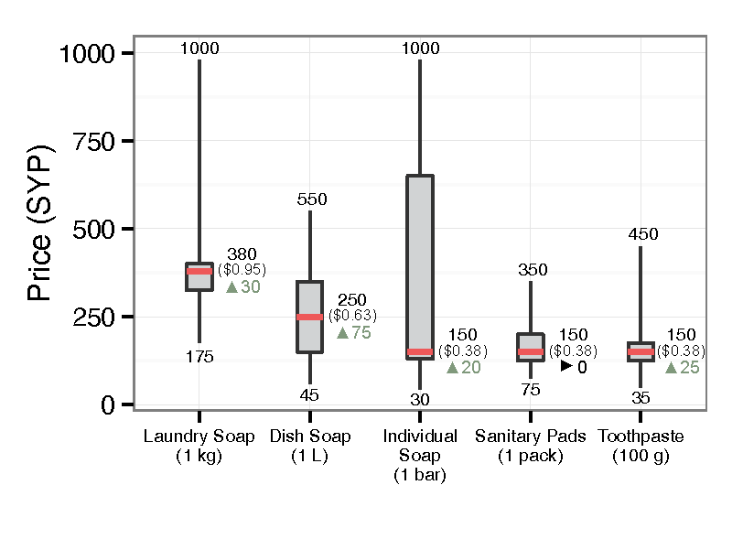
TITLE 1 TITLE 1 TITLE 1
Hygiene NFI Prices
Median prices of most hygiene NFIs rose at a rate in excess of inflation
Major price changes since November:
  Dish soap (median from 175 to 250 SYP)
  Individual soap (many localised price spikes)
Northern Syria exchange rate, January 2016: 398 SYP/USD

Slide 6
TITLE 1 TITLE 1 TITLE 1
Hygiene NFI Prices

Slide 7
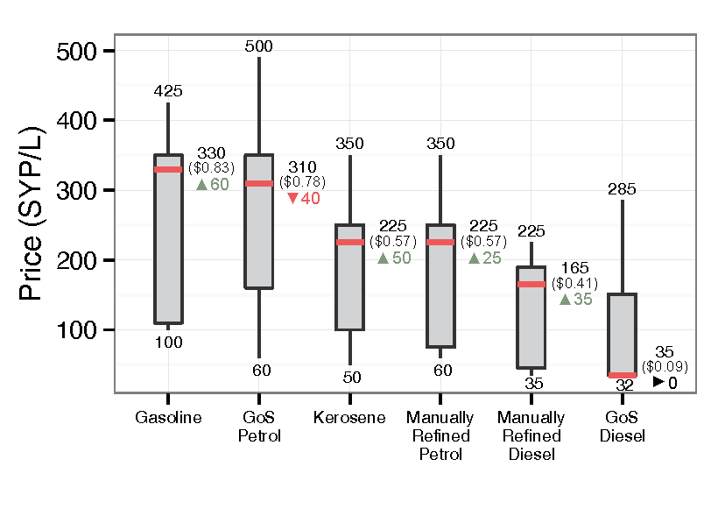
TITLE 1 TITLE 1 TITLE 1
Fuel Prices
Median and max prices of most fuels rose by 25-115 SYP/L
Prices of GoS fuels fell or stayed constant
  Shifting frontlines may be a factor
Kaz shortages in 6 subdistricts, GoS diesel shortages in 17
Min prices reflect subsidies in Kobane and al-Hasakeh
Northern Syria exchange rate, January 2016: 398 SYP/USD

Slide 8
TITLE 1 TITLE 1 TITLE 1
Fuel Prices

Slide 9
TITLE 1 TITLE 1 TITLE 1
Winter Blanket Prices
Median: 3000, average: 4036 SYP
Great variation due to different types of blankets (material, quality, etc.) being available in markets

Slide 10
Thank you!
For more information:
Visit our website: www.reach-initiative.org
Follow us on Twitter: @REACH_info

