Slide 1

Returns and Durable Solutions Assessment (ReDS)
Yathreb – Balad, Salah Al-Din
Findings presentation, Iraq
Data collection period: 15-19 January 2021

Slide 2
1. Introduction to ReDS
2. ReDS methodology
3. Yathreb overview
4. Key findings
5. Detailed findings
6. Questions from the audience
7. Discussion
Presentation
outline

Slide 3
1
Introduction to ReDS

Slide 4
In 2020, the number of internally displaced persons (IDPs) returning to their area of origin (AoO) or being re-displaced increased, coupled with persisting challenges in relation to social cohesion, lack of services, infrastructure and - in some cases - security in AoO. Increased returns were driven in part by the ongoing closure and consolidation of IDP camps; at the time of data collection, 14 camps and two informal sites had closed or been re-classified, with planning ongoing surrounding the future of the remaining camps across Iraq.
In light of recent return and re-displacement movement dynamics, REACH conducted a ReDS assessment in Yathreb Sub-district to provide an in-depth profiling of needs and understanding of social relationships between remainee, returnee, and/or IDP populations.
ReDS background

Slide 5
ReDS Specific Objectives
Provide an understanding about the effects of recent movement trends;
Assess perceived intentions to move among all relevant communities to identify potential risk of further instability;
Assess how conditions in areas affected by recent movements may impact the sustainability of durable solutions;
Identify any consequent shift in local social dynamics and power structures;
Explore conditions in the area in terms of community needs and inter-relations; and the viability of safe and dignified (re)integration.
ReDS objectives
Notes:
In general, the assessment aimed to provide rapid evidence-base overview of the assessed areas to support humanitarian and development actors to promote durable solutions for returnees and IDPs in situations of protracted displacement on multiple levels, including:
Development of strategic dialogue, policy development, and resource mobilization efforts,
Development of localized interventions,
Advocacy with government actors around camp closures, consolidation, premature returns, and conditions in areas of origin to allow sustainable returns.
ReDS Specific Objectives
Provide an understanding about the effects of recent movement trends across different demographic groups in targeted areas;
Assess perceived intentions to move among all relevant communities within the areas to identify potential risk of further instability;
Assess how conditions in areas affected by recent movements may impact the sustainability of durable solutions;
Identify any consequent shift in local social dynamics and power structures following the recent movements;
Explore conditions in the area in terms of community needs and inter-relations; and the viability of safe and dignified (re)integration.

Slide 6
2
ReDS methodology

Slide 7

Methodology
The multi-sectoral assessment tool combined qualitative and quantitative data.
Data collection was done remotely by phone between 15 and 19 January 2021, adapted to the context of the COVID-19 pandemic local restrictions and associated pandemic measures.
Purposive sampling methods were employed to identify KIs. Findings should therefore be considered as indicative.
Methodology based on key informant interviews (KIIs).
 KI profile in Yathreb Sub-district
Community leaders 15 KIs
Remainees/non-displaced 5 KIs
IDPs (displaced from the area) 18 KIs
IDPs (displaced in the area) 6 KIs
Returnees (more than 3 months ago) 5 KIs
Returnees (less than 3 months ago) 5 KIs
^{54 KIs}
Notes:
Community leaders are members of the host community represented by six mukhtars (from five different locations in Yathreb), seven employees in government ministries, a retired community leader and a female community leader. Mukhtar can be defined as the head of a village or neighbourhood in some Arab countries.
IDPs (displaced from the area) refer to households from Yathreb displaced after 2014 events to other areas different than their AoO, specifically in Bazian, Markaz Rania and Markaz Pshdar sub-districts (Al-Suleimaniyah Governorate); and Markaz Erbil Sub-district (Erbil Governorate).
IDPs (displaced in the area) refer to households from AoO different than Yathreb Sub-district who were displaced after 2014 events and reside in Yathreb. Households were reportedly originally from different sub-districts in Balad District of Salah Al-Din Governorate.
For the purpose of this research, returnees will be categorized as an IDP returning to their AoO, where AoO is defined as the stated original sub-district of origin for the IDP. Given the complexity of (re)integration, this could mean that returnees still face challenges to their sustainable return to their AoO.

Slide 8


Limitations
Considering the findings as indicative due to the small sample size and the purposive sampling method
54 KIs in Yathreb Sub-district
KIs gender balance
44 male KIs
10 female KIs
Contextualization at sub-district level
  To operationalise the identified trends, information was analysed
  and visualized at sub-district level, rather than village or neighbourhood
Remote data collection
Data collected remotely by phone


Notes:
Considering the findings as indicative: The sample is small (54 KIs), and findings will only be an indication of trends, needs, humanitarian concerns, gaps and flags for actors to assess further. Findings cannot be analysed or visualized at community-level in the current methodology but [mitigation] for the current analysis REACH included findings per community group as relevant and available.
KIs gender balance: There were 54 individuals aged between 20 and 58 years old interviewed for Yathreb assessment. The majority were male (44 KIs). Ensuring gender balance still a limitation to the assessment, mainly reported due to female KIs not answering to the phone calls. REACH and RWG are working on the identification process to encourage women to participate in the rapid assessment. Coming assessment are expected to have an increased participation rate.
Contextualization at sub-district level: To operationalize the identified trends, information was analysed and visualized at sub-district level, rather than village and neighbourhood. Extending to more detailed assessment at village, neighbourhood or community-level will depend in the availability of data about KIs. Contact details will need to be provided since the sampling is purposive and snowballing is very limited while doing remote data collection and time consuming taking into consideration the need of the informed consent from individuals to share their contact information with REACH. It will also require additional resources such and budget and human resources (enumerators) and will affect the time-line of the project and report deadlines.
Remote data collection: While collecting data remotely can sometimes, the openness of respondents is sometimes affected. [mitigation] Testing process was very strict and discussions with field staff were ongoing to avoid sensitive questions and doing harm to interviewees. Some sensitive terminologies related to Iraq context were identified and replaced by explanation text in the Arabic version of the ODK tool (e.g. ‘governance’ was replaced by ‘laws and regulations’).

Slide 9
3
Yathreb overview and current demographics

Slide 10
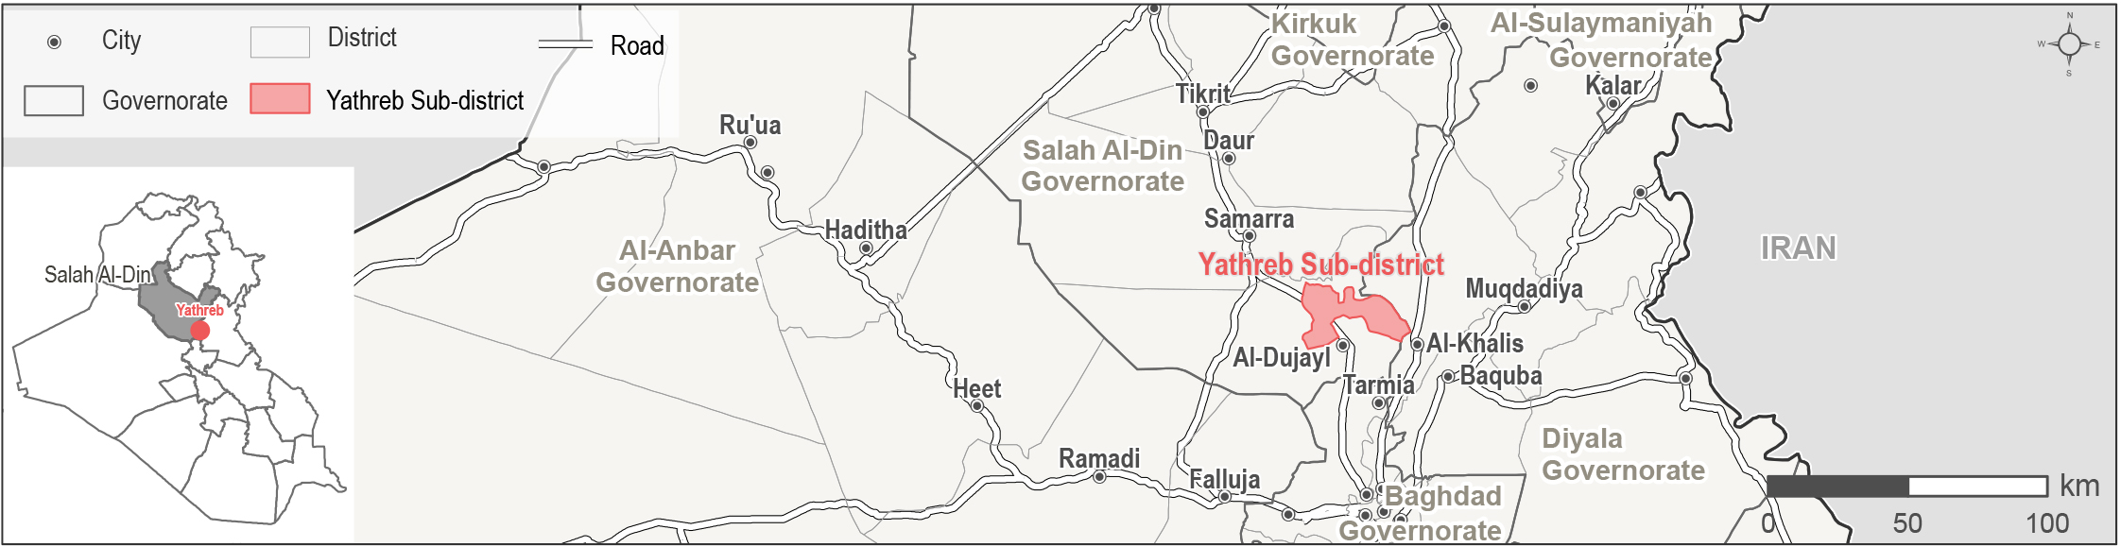
Yathreb Sub-district overview
Yathreb is a sub-district of Balad District in Salah Al-Din Governorate.
In August 2014, the so-called Islamic State of Iraq and the Levant (ISIL) undertook military activities in Yathreb Sub-district resulting in widespread displacement of 6,597-6,920 households as reported by KIs.
19-27 IDP households (area of origin (AoO) not specified) are reported to reside in Yathreb Sub-district.
Notes:
Yathreb Sub-district was selected for the assessment as: social cohesion severity classified as “medium”, affected by the illegal occupation of private residences and reports of blocked returns; it was an AoO for IDPs in camps at risk of closure or recently closed; and dynamic population movements to/from this sub-district were reported through the Returns Working Group (RWG).

Slide 11
4
Key findings

Slide 12
Yathreb Sub-district
Key findings
The situation regarding returns to Yathreb remains fluid, with KIs reporting ongoing returns and more projected in the six months following data collection, driven in part by decisions surrounding camp closures.
In general, most KIs noted that community members felt safe in Yathreb. There were no reported movement restrictions, though women and girls were reportedly less able to move freely during the day and slightly less at night compared to men.
Despite this, safety and security reportedly continued to be barriers to the return of IDP KIs originally from Yathreb displaced elsewhere.
Other barriers to return reported by KIs were: damaged or destroyed housing; lack of basic public services and job opportunities; and concerns around housing, land and property (HLP) as some households did not have the necessary documents to claim their properties.
Notes:
Perceived improvements in the safety and security situation was the main reported pull factor for returns to Yathreb, followed by family reunification.
Some IDPs from the same group reported the presence of armed groups in their AoO as a barrier for further returns. Additionally, while there were no groups reported to be unwelcome in Yathreb, IDP KIs originally from the area displaced elsewhere reported fear of persecution in their AoO due to outstanding disputes, fear of retaliation, or being perceived as affiliated with ISIL.
In addition, some IDP KIs originally from Yathreb displaced elsewhere reported perceived restriction on further return movements, and security clearance as barriers for further returns.

Slide 13
Yathreb Sub-district
Other key findings
KIs reported different levels of access to services across population groups.
All KIs reported an overall decrease in the availability of job opportunities compared to 2014, exemplified by the more limited access to employment in the private sector due to the prolonged displacement of business owners.
KIs from different population groups prioritized community needs differently.
Improving access to basic public services namely education, healthcare, WASH and electricity were also reported as a community needs considering reported decline in those services compared to prior 2014.
Generally, in terms of social cohesion indicators, there were no reported obstacles to the interaction between groups and their participation in social events by the majority of KIs.
Friendship, kinship ties between community members, work relationships, integration and acceptance of IDPs in Yathreb, in addition to the intervention of local authorities, were reportedly factors to ensure the stability in the area regarding disputes.
Notes:
IDPs and returnees persistently reported having less access to housing, namely being more likely to live in inadequate shelters including tents or living in informal, and therefore more insecure, housing agreements. In line with this, IDPs and returnees were also reportedly disadvantaged in access to compensation for housing and property rehabilitation and more at risk of eviction.
The most needed intervention to encourage further returns was reportedly increasing access to livelihoods.
In addition, KIs perceived that further returns to Yathreb increased the competition for the limited available job opportunities which consequently could lead to tensions between population groups.
Livelihoods was the most commonly reported primary community need, except for remainee KIs who reported access to water, sanitation and hygiene (WASH) as the primary community need. Returnee and IDP KIs reported the need to develop the health sector in Yathreb to meet the increased pressure resulting from the COVID-19 pandemic.
The lack of public services was not only reported as an obstacle to future returns to Yathreb, but equally contributed to reported risks to the sustainability of returnees’ re-integration and was identified as a push factor for expected departures of host community members.
IDP KIs reported a general perception that different population groups had different interests and thoughts (lack of shared goals) which negatively affected the interest to participate in social and public events, and sometimes the lack of harmony between different population groups in Yathreb reportedly reduced social interaction and participation in social events.

Slide 14
5
Yathreb findings

Slide 15
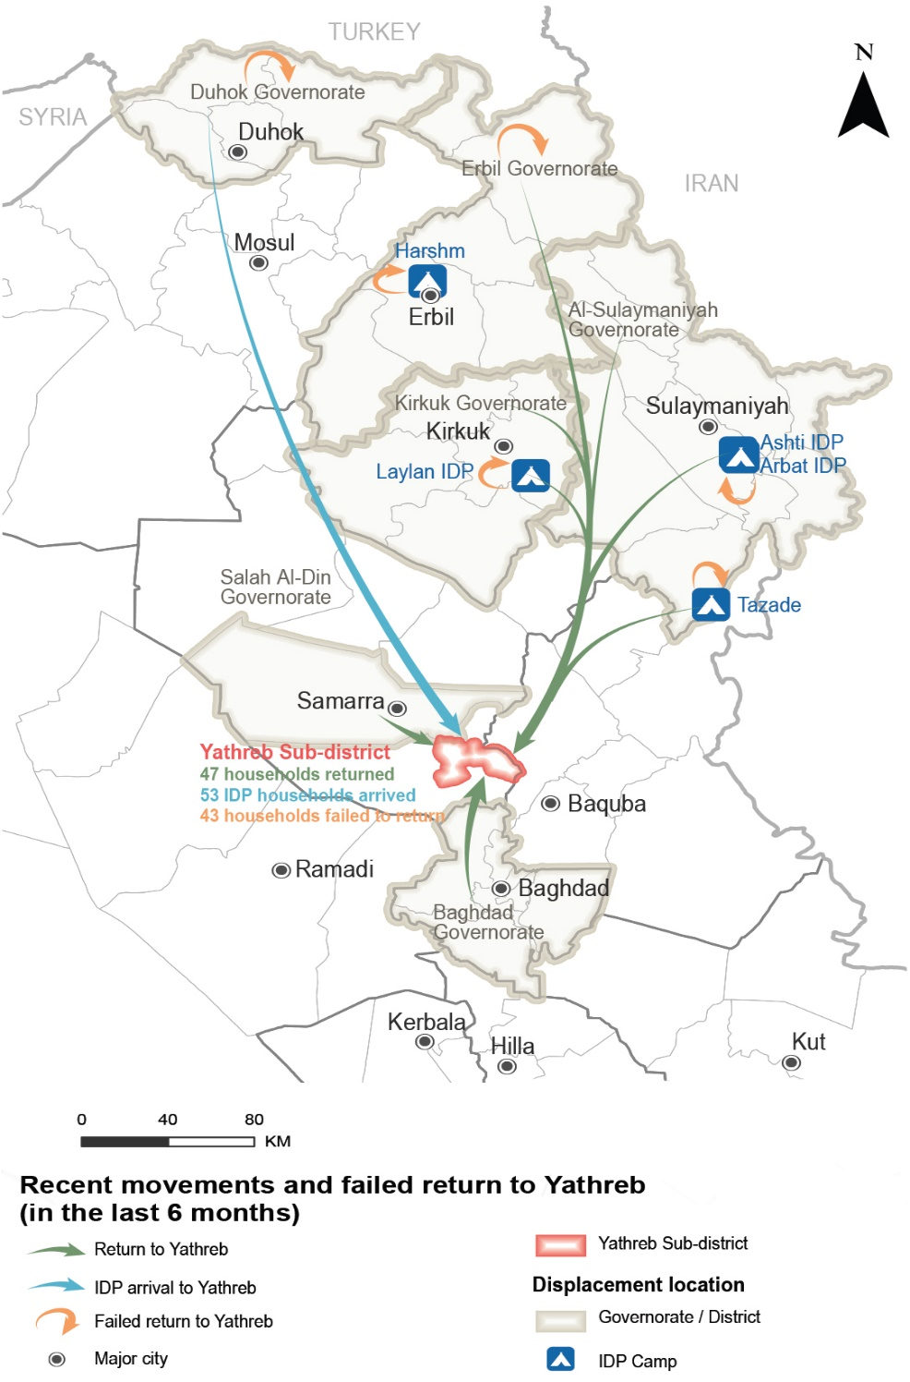
Yathreb Sub-district
Recent movements to Yathreb reported by KIs
Notes:
This map represents the recent movements to Yathreb in the last 6 months (prior to data collection), corresponding to recent returns, IDP arrivals and failed returns.

Slide 16
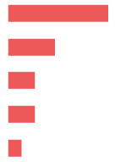
Yathreb Sub-district
Recent movements – data reported by KIs
 Recent returns
³⁶⁻⁵⁸
households returned to Yathreb in the six months prior to data collection, as reported by 24 KIs (out of 54).
Reported drivers for recent returns (out of 24 KIs)*
Sense of increased safety and security 15 KIs
Following the return of other family members 7 KIs
Camp closures in area of displacement (AoD) 4 KIs
Nostalgia about previous life 4 KIs
Availability of job opportunities 2 KIs
Reported impact of recent returns (out of 24 KIs)*
These movements reportedly led to higher competition in the labour market (18 KIs), however some KIs reported an increase in job opportunities (3 KIs out of 24).
Decrease in the level of household assistance due to increased demand (14 KIs), while some KIs reported that access to assistance increased (7 KIs).
* Sum of answers may exceed the 100% due to KIs being able to select multiple response options, including other topics.
Notes:
Recent returns
Returns were reported from non-camp areas in Erbil (3 KIs) and Samarra (1 KI) districts; as well as Baghdad (1 KI), Kirkuk (1 KI) and Al-Suleimaniyah (1 KI) governorates. Other households returned from camps in Al-Suleimaniyah (11 KIs), Kirkuk (4 KIs)21 and Erbil (2 KIs) governorates.
The rest of the KIs reported no returns (22 KIs), or they did not know about recent movements (8 KIs).
Recent returns reportedly lead to positive and negative impacts in terms of access to job opportunities and assistance, with negative consequences reported more frequently than positive. On one hand, while some KIs believed that recent returns contributed to increased job opportunities (3 KIs out of 24), the vast majority reported that these movements led to higher competition in the labour market (18 KIs). Similarly, while the majority reported a decrease in the level of household assistance due to increased demand (14 KIs), some KIs reported that access to assistance increased due to the response by different governmental and humanitarian actors to the recent returns (7 KIs).
Recent returns reportedly resulted in family reunification (7 KIs) which respondents perceived as positive, at the same time the reported occurrence of disputes between households (1 KI) affected the stability of the community in Yathreb (7 KIs).

Slide 17
Yathreb Sub-district
Recent movements – data reported by KIs
 Recent IDP arrivals
⁵⁰⁻⁵⁵
IDP households arrived in Yathreb in the six months prior to data collection from non-camp areas in Duhok Governorate (1 KI out of 54).
Reported driver for IDP arrivals (out of 1 KI)
Reportedly, this was due to failed returns to their AoO (AoO not reported) forcing them to secondarily displace to Yathreb chosen due to the sense of increased safety and security.
Reported impact of IDP arrivals (out of 5 KIs)*
Access to assistance reportedly increased due to the response from different governmental and humanitarian actors to the recent IDP arrivals.
Family reunification for some IDP households with family members displaced in Yathreb.

Slide 18

Yathreb Sub-district
Recent movements – data reported by KIs
 Failed returns
³¹⁻⁵⁶
households attempted return to Yathreb in the six months prior to data collection but did not succeed (8 KIs out of 54).
Reported reasons for failed returns (out of 8 KIs)*
Lack of services in AoO 8 KIs
Lack of job opportunities in AoO 6 KIs
Reported impact of failed returns (out of 8 KIs)*
The prolonged displacement of business owners reportedly resulted in more limited access to livelihoods (7 KIs).
In addition, less access to assistance was reported due to the perceived lack of interest of governmental and humanitarian actors in the area (7 KIs).
* Sum of answers may exceed the 100% due to KIs being able to select multiple response options, including other topics.

Slide 19
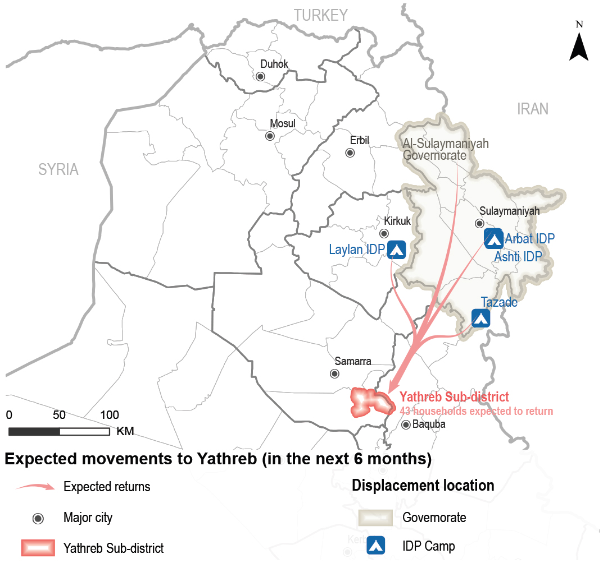
Yathreb Sub-district
Expected movements to Yathreb reported by KIs
Notes:
This map represents the expected movements to Yathreb in the last 6 months (prior to data collection), corresponding to expected returns.

Slide 20
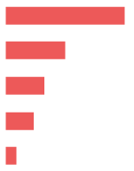

Yathreb Sub-district
Expected movements – data reported by KIs
 Expected returns
³⁹⁻⁴⁷
households are expected to return to Yathreb in the six months following data collection, as reported by 11 KIs (out of 54).
Most reported drivers for expected returns (out of 43 KIs)*
Sense of increased safety and security 34 KIs
Following the return of other family members 17 KIs
Camp closures in AoD 11 KIs
Availability of job opportunities 8 KIs
Nostalgia about previous life 3 KIs
Most reported barriers for expected returns (out of 54 KIs)*
Destroyed/damaged housing 36 KIs
Lack of job opportunities 24 KIs
Lack of services 22 KIs
Lack of documents needed to claim properties 8 KIs
* Sum of answers may exceed the 100% due to KIs being able to select multiple response options, including other topics.
Notes:
Returns are expected from camp (2 KIs) and non-camp areas (6 KIs) in Al-Suleimaniyah and Kirkuk21 governorates. The rest of the KIs reported no expected returns (7 KIs), did not know about expected movements (32 KIs), or refused to answer (4 KIs).
Other drivers
Difficult living conditions in AoD 1 KI
Families received the security clearance to return 1 KI
Did not know 3 KIs
Refused to answer 8 KIs
Other barriers
Prefer life in AoD 8 KIs
Lack of specialised medical treatment 2 KIs
Fear due to COVID-19 pandemic 1 KI
In addition to the above, IDP KIs originally from Yathreb displaced elsewhere reported that there were barriers to return related to the security situation in their AoO such as fear of persecution due to outstanding disputes (1 KI out of 2); fear of being perceived as ISIL-affiliated (1 KI); and presence of specific armed groups (1 KI). Other barriers reported included perceived limitations on further return movements (2 KIs), and lack of security clearance for some households (1 KI).23
Impact of expected returns
Further returns were more reported to have negative impacts than positive on access to job opportunities and assistance. While the vast majority reported that expected returns could increase the competition for the limited available job opportunities (34 KIs out 54), a smaller number reported that these movements could contribute to increased job opportunities with the return of business owners (9 KIs). Similarly, while further returns could decrease the household levels of assistance (24 KIs) and the limited capacity of humanitarian and governmental actors to absorb the demand for assistance (3 KIs), some KIs reported an expected increase in assistance due the potential attention of humanitarian and governmental actors (16 KIs).
Reportedly, expected returns could also result in family reunification (13 KIs out of 54) which was perceived positively by KIs.

Slide 21

Yathreb Sub-district
Expected movements – data reported by KIs
 Expected host community departures
No expected host community departures reported by 27 KIs (out of 54 KIs)
The rest of the KIs did not know about expected host community departure movements (23 KIs), or refused to answer (4 KIs).
However, while no expected departures were reported, 24 KIs (out of 54) reported drivers that might result in host community movements.
Drivers for expected host community departures (out of 24 KIs)*
Lack of services 21 KIs
Lack of job opportunities 14 KIs
Lack of specialised medical treatment 2 KIs
Lack of security 1 KI
* Sum of answers may exceed the 100% due to KIs being able to select multiple response options, including other topics.
Notes:
The rest of the KIs did not know about drivers to these movements (25 KIs), or refused to answer (5 KIs).

Slide 22
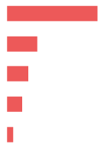
Yathreb Sub-district
Expected movements – data reported by KIs
 Expected IDP arrivals
No expected arrival of IDP households to Yathreb in the six months following data collection.
The rest of the KIs did not know about expected IDP arrivals (26 KIs), or refused to answer (2 KIs).
However, while no expected arrivals were reported, 33 KIs (out of 54) reported drivers that might result in further IDP household arrivals.
Drivers for expected IDP arrivals (out of 33 KIs)*
Sense of increased safety and security 30 KIs
Arrival of other family members 10 KIs
Availability of services and job opportunities 7 KIs
Camp closures 5 KIs
Difficult living conditions in AoD 2 KIs
* Sum of answers may exceed the 100% due to KIs being able to select multiple response options, including other topics.
Notes:
The rest of the KIs did not know about drivers to these movements (13 KIs), or refused to answer (8 KIs).

Slide 23




Yathreb Sub-district
Primary community needs – data reported by KIs
Top reported primary, secondary and tertiary needs (out of 54 KIs)
Primary needs
Livelihoods Housing rehabilitation

Water and sanitation Healthcare
Secondary needs
Tertiary need
Electricity
 Primary community needs per respondent group*
Community leaders
(out of 15 KIs)
Remainees
(out of 5 KIs)
Returnees
(out of 10 KIs)
IDPs
(out of 24 KIs)
Livelihoods
Water and sanitation
Housing rehabilitation
Water and sanitation
Education
Healthcare
5 KIs
4 KIs
3 KIs
12 KIs
9 KIs
7 KIs
Livelihoods
Housing rehabilitation
Healthcare
Livelihoods
Healthcare
Water and sanitation
8 KIs
7 KIs
6 KIs
18 KIs
14 KIs
10 KIs
“Developing livelihood opportunities is important taking into consideration the high number of newly graduated, unemployed youth and the lack of job opportunities for them in the public and private sectors.”
- Male returnee KI -
* Sum of answers may exceed the 100% due to KIs being able to select multiple response options, including other topics.
Notes:
The most commonly reported primary need for the community was access to livelihoods due to the perceived lack of governmental and private sector job opportunities (34 KIs out of 54), destroyed agricultural machinery (4 KIs), and the lack of investment in the private sector (1 KI). Housing rehabilitation was also reported as a primary need, due to housing destruction and heavy damage after the events in 2014 (22 KIs) and the lack of resources households have to rehabilitate their shelters (17 KIs).
The second most commonly reported main community need was access to WASH due to the limited access to public water services in Yathreb (12 KIs). As a result, households reportedly resorted to buying bottled water (12 KIs) and a KI reported that some households relied on wells as the main potable water source. Healthcare was also considered a second community need mainly due to the risks represented by the COVID-19 pandemic (12 KIs).
The third most commonly reported community need was access to electricity affected by the limited public service hours in Yathreb (14 KIs) and the limited number of private generators (3 KIs), which reportedly prevented small businesses from fully operating (3 KIs).

Slide 24
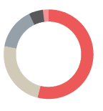
Yathreb Sub-district
Perceptions on access to services and assistance – data reported by KIs
 Access to housing
The majority of households in Yathreb reportedly resided in houses (46 KIs out of 54).
IDP KIs reported that the majority of the households in their community resided in tents (6 KIs), or resided in non-residential shelters such as garages (2 KIs).
Reported housing agreement (out of 40 KIs)
Owned tenure 29 KIs
Verbal rental agreement 13 KIs
Hosted by another family 8 KIs
Official rental agreement 3 KIs
Work-for-rent agreement 1 KI
Risk of eviction
IDPs and returnees were persistently reported to be more at risk of eviction in the long-term (26 KIs out of 54).
Notes:
Access to housing:
IDP KIs (24 KIs) reported that the majority of IDP households were hosted by families in the community, resided under official and verbal rental agreements or work-for-rent agreements.27 One IDP KI reported that some IDP households owned houses in Yathreb. Returnee KIs (9 KIs) reported that the majority of returnee households owned houses in Yathreb and a returnee KI reported that some returnee households resided under verbal rental agreement. Community leader and remainee KIs (20 KIs) reported that the majority of the households in the community resided in owned houses.
Risk of Eviction:
There were no families reported at immediate risk of eviction in Yathreb (47 KIs out of 54). The rest of the KIs did not know (7 KIs).
However, IDPs and returnees might be most at risk of eviction in the long-term, as reported by 26 KIs (out of 54), in addition to UASC (25 KIs), people with disabilities (23 KIs), child-headed households (23 KIs) and large households (20 KIs).

Slide 25
Yathreb Sub-district
Perceptions on access to services and assistance – data reported by KIs
 Access to housing rehabilitation
^{30%-60%}
of houses in Yathreb were damaged during military operations in 2014, as reported by all KIs (54 KIs).
IDPs and returnees were reportedly more likely to reside in damaged or unfinished buildings/houses (34 KIs out of 54).
IDPs and returnees reportedly had less access to housing rehabilitation (15 KIs out of 54).
Reported barriers to access rehabilitation assistance (out of 24 KIs)*
Selection criteria being perceived as too specific (15 KIs).
Assistance reportedly targeting specific neighbourhoods (15 KIs).
* Sum of answers may exceed the 100% due to KIs being able to select multiple response options, including other topics.
Notes:
Damaged houses population:
IDPs and returnees were reportedly more likely to reside in damaged or unfinished buildings/houses (34 KIs out of 54), as were large households (26 KIs), child-headed households (20 KIs), UASC (19 KIs) and people with disabilities (19 KIs).

Slide 26
Yathreb Sub-district
Perceptions on access to services and assistance – data reported by KIs
 Access to basic public services
^{15 KIs}
(out of 54) reported unequal access to basic public services namely healthcare, water and sanitation.
IDPs and returnees were perceived to have less access to basic public services due to having less connections (15 KIs).
 Access to public judicial mechanisms
^{53 KIs}
(out of 54) reported that access to public judicial mechanisms was equal for all population groups.
An IDP KI reported that the department granting civil status documents was closed during the period around data collection, affecting access to identity documentation.
* Sum of answers may exceed the 100% due to KIs being able to select multiple response options, including other topics.
Notes:
Related to access to public education, 53 KIs (out of 54) reported that boys and girls between 6-15 years old could access school and there were no children between those ages out of school in Yathreb. KIs reported a decline in the quality of public education in Yathreb (8 KIs) due to the number of damaged/destroyed schools and the lack of maintenance or rehabilitation. This situation resulted in imposed double shifts - one in the morning and one in the afternoon - in active schools and a lack of capacity to absorb the number of students (2 KIs). In addition, the lack of free distribution of books and/or educational stationery for students meant families had to purchase them, negatively affecting their monthly expenditure (8 KIs).
KIs reported a decline in the quality of the healthcare services after 2014 (14 KIs) and a lack of preparedness to respond to the COVID-19 pandemic, particularly due to the lack of medical staff (12 KIs) and limited availability of medications (24 KIs). This situation reportedly forced families to resort to private health services (8 KIs), move to other areas for treatment (5 KIs), and to keep sick family members at home even if they needed hospitalization (3 KIs).
Additionally, public electricity services reportedly had limited operating hours, not only affecting households but also preventing the operation of businesses29 in Yathreb (14 KIs). In addition, KIs reported the lack of electrical network and transformers maintenance resulted in households using private generators (5 KIs).
Limited capacity in terms of waste handling, transportation and disposal, at the municipal level resulted in the accumulation of waste in urban areas raising health concerns (5 KIs).
In terms of access to access to water, the lack of maintenance of the water network and water filters in Yathreb (23 KIs) reportedly resulted in water pollution (12 KIs). This reportedly contributed to reliance on purchased bottled water (12 KIs) or local wells (3 KIs). This situation contributed to highly inflated prices for private water services (as reported by 4 KIs).

Slide 27


Yathreb Sub-district
Perceptions on access to services and assistance – data reported by KIs
 Access to humanitarian aid and presence of NGOs
^{10 KIs}
(out of 54) reported that there were NGOs implementing activities and projects in Yathreb.
Reported activities implemented by NGOs (out of 10 KIs)
Food security programmes
Non-food items (NFIs) distributions
Housing rehabilitation
WASH
7 KIs
2 KIs
1 KI
1 KI
Reported most needed projects or activities in Yathreb (out of 42 KIs)
Livelihoods
Housing rehabilitation
Infrastructure rehabilitation
Social cohesion
Food and NFIs
33 KIs
9 KIs
7 KIs
3 KIs
2 KIs
Notes:
Access to humanitarian aid and presence of non-government organizations (NGOs)
The majority of the KIs reported there were no NGOs present in Yathreb at the time of data collection (43 KIs), and one KI did not know.
18 KIs (out of 54) reported that the availability of humanitarian aid would be a factor encouraging returns to Yathreb. The rest of the KIs reported that it was not a factor that would encourage returns (7 KIs), did not know (21 KIs), or refused to answer (8 KIs).

Slide 28


Yathreb Sub-district
Perceptions on access to services and assistance – data reported by KIs
 Access to livelihoods
^{23 KIs}
(out of 54) reported that access to livelihoods was unequal.
Types of jobs reportedly available in Yathreb in 2014 compared to January 2021
(out of 54 KIs)*
2014 January 2021
50 KIs
44 KIs
40 KIs
36 KIs
33 KIs
21 KIs
11 KIs
Public education
Construction
Health (public and private)
Agriculture
Finance
Trade and tourism
Public administration
35 KIs
20 KIs
9 KIs
11 KIs
21 KIs
5 KIs
1 KI
* Sum of answers may exceed the 100% due to KIs being able to select multiple response options, including other topics.
Notes:
The majority of KIs reported that it was equal for all groups (28 KIs), and the rest of the KIs did not know.
IDPs and returnees, people with disabilities and elderly reportedly had less access to livelihoods opportunities (23 KIs). In addition, 23 KIs reported that child-headed households and UASC had less access to income. To cope with this situation, these groups were expected to rely on child labour to meet their needs (23 KIs). Six IDP KIs also reported that internally displaced female heads of household were the most restricted in terms of accessing income generating opportunities.
The main reported reasons for different groups to have less access to livelihoods were: perceived limited physical capacity, skill or education level that prevents these groups from performing the available jobs (22 KIs), and the lack of connections (1 KI).
The types and number of jobs available in Yathreb reportedly shifted compared to 2014. This includes due to the reported reduction of available jobs in the private sector due to the prolonged displacement of business owners (7 KIs).

Slide 29
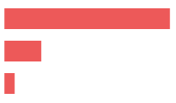
Yathreb Sub-district
Perceptions on governance and presence of security forces – reported by KIs
 Governance and influencing bodies
Reported most influential bodies in governance (out of 54 KIs)*
Local authorities 54 KIs
Mukhtars 12 KIs
Tribal leaders 3 KIs
^{48 KIs}
(out of 54 KIs) reported that there were no appointments resulting in turnover of existing local authorities in the six month prior to data collection and that were no expected changes in the most influential local actors related to governance in the six months following data collection.
 Perceived presence of security forces
All KIs (54 KIs) reported that the presence of the security forces contributed positively to a feeling of safety and that they are effective in resolving disputes within neighbourhoods and between different villages.
* Sum of answers may exceed the 100% due to KIs being able to select multiple response options, including other topics.
Notes:
Governance and influencing bodies
The rest of the KIs did not know (6 KIs).

Slide 30


Yathreb Sub-district
Perceptions of safety and security – data reported by KIs
 Explosive remnant of war (ERW) contamination
^{48 KIs}
(out of 54) reported that there were no contaminated fields in Yathreb.
 Safety and security
^{51 KIs}
(out of 54) reported that the community members felt safe in Yathreb
(out of 54) reported that the community members did not avoid any areas or neighbourhoods in Yathreb.
^{48 KIs}
Freedom of movement
Men and boys Women and girls
53 KIs
53 KIs
Can move freely during the day
Can move freely at night
52 KIs
49 KIs
Notes:
ERW presence and incidents
The rest of the KIs did not know (6 KIs).
All KIs (54 KIs) reported that no incidents occurred due to ERW in the six months prior to data collection.
Feeling of Safety
The rest of the KIs did not know (1 KI), or refused to answer (1 KI). A remainee KI reported not feeling safe but did not share the reasons.
Avoiding specific areas
The rest of the KIs did not know (5 KIs), or refused to answer (1 KI).
Freedom of movement
The majority of KIs reported that women, girls, men and boys can freely move during the day and at night.
Though women and girls were reportedly less able to move freely during the day and slightly less at night compared to men.

Slide 31
Yathreb Sub-district
Perceptions of community disputes, relations and co-existence – reported by KIs
 Community disputes
^{42 KIs}
(out of 54) reported that there were no disputes within neighbourhoods in Yathreb in the six months prior to data collection. This situation was reportedly not expected to change due to kinship ties between families (9 KIs), integration and acceptance of IDPs in the community (9 KIs) and the existing work relationships (1 KI).
^{24 KIs}
(out of 54) reported that there were no disputes between villages in Yathreb Sub-district in the six months prior to data collection. This situation was reportedly not expected to change due to the integration and acceptance of IDPs in the community (12 KIs), kinship ties between families (5 KIs), existing work relationships (2 KIs) and intervention of the local authorities (1 KI).
 Community relations and co-existence (out of 54 KIs)
^{13 KIs}
reported that their community members trust each other.
^{23 KIs}
reported that community members interact with other groups.
^{42 KIs}
did not know about community members participation in social and public events.
.
Notes:
Community disputes within the neighbourhoods:
The rest of the KIs did not know about disputes (12 KIs).
Changes: The majority of KIs (43 KIs) did not know if there would be a change in the occurrence of disputes within neighbourhoods in the six months following to data collection.
Community disputes between villages:
The majority of KIs (30 KIs) did not know about disputes.
Changes: The majority of KIs (42 out of 54 KIs) did not know if there would be a change in the occurrence of disputes between villages in the six months following data collection.
Retaliation Incidents
24 KIs (out of 54) reported that there were no retaliation incidents in the six months prior to data collection. The rest of the KIs did not know (30 KIs).
Community trust
The rest of the KIs did not know (27 KIs), or refused to answer (14 KIs).
Interaction with other groups
The rest of the KIs did not know (11 KIs), or refused to answer (10 KIs).
Interaction types (out of 23 KIs):
Kinship ties 23 KIs
Friendship 19 KIs
Work relationships (employment) 11 KIs
Attending to shops and public places 6 KIs
Common business operation37 1 KI
Barriers for interaction (out of 37 KIs)
No perceived obstacles for interaction 26 KIs
Different perceptions and thoughts 5 KIs
Lack of harmony between population groups 4 KIs
Lack of interest to interact 1 KI
Competition for livelihoods 1 KI
Did not know 17 KIs
Participation in social and public events
The rest of the KIs (12 KIs) refused to answer.
However, two IDP KIs reported that the main barrier for participation was the lack of interest of some groups (not specified) to be involved in social and public events.

Slide 32
6
Questions from the audience

Slide 33
Discussion
Any feedback or comments from those operational in these areas?
7

Slide 34
Link to the Factsheet ReDS Yathreb Factsheet January 2021
Upon request
http://www.reachresourcecentre.info/
IMPACT Initiatives
@REACH_info

