Slide 1
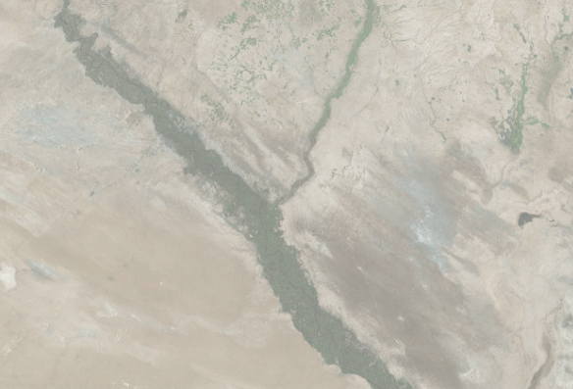
Deir ez-Zor
Situation Overview and Gap Analysis
October 22, 2018

Slide 2
Methodology
Data from this presentation comes from the fourth round of the Deir ez-Zor Situation Overview assessment, which aims to identify key needs in communities across the governorate.
Data were collected through remote Key Informant (KI) interviews between 24 September and 1 October 2018.
140 communities and IDP sites were assessed.
Enumerators used an average of 3 KIs to fill in one form, with different KIs contributing to different sections of the form.
Following preliminary analysis, the findings were contextualized in a workshop with the enumerator team in order to get extra details and contextual information on key indicators.
Identified needs were compared with available data about the response in order to establish an overview of potential gaps.
Given the highly dynamic situation in Deir ez-Zor, the findings should only be considered indicative of the situation during the data collection period.
It was not possible to obtain a full list of interventions undertaken in the governorate, so the gap analysis should be considered indicative only.
Data gathered through key informant interviews are not statistically significant and should be considered indicative only.

Slide 3
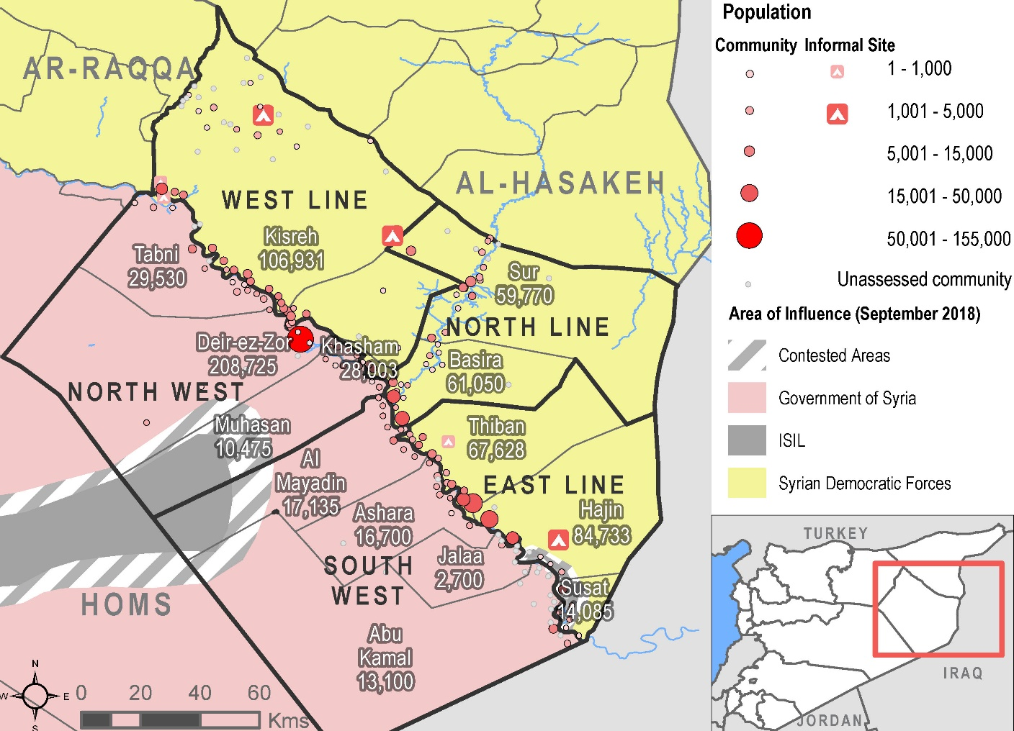
Coverage

Slide 4
Population and Displacement

Slide 5
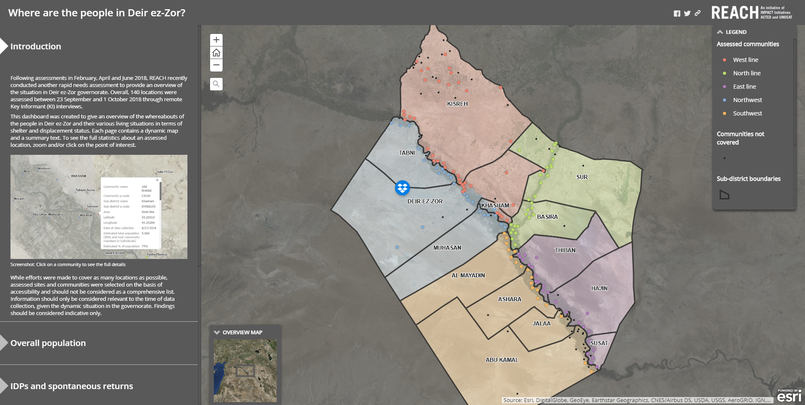
Population and Displacement
Deir ez-Zor Population and Displacement Dashboard

Slide 6
Population Summary
Estimated population by displacement status
Estimated proportion of host community population who are returnees

Slide 7
Top Reported Needs
Most commonly reported top three needs (with % of KIs reporting)
West Line | North Line | East Line
Income (88%) | Income (89%) | Water (76%)
Healthcare (83%) | Water (74%) | Electricity (72%)
Education (78%) | Healthcare (74%) | Healthcare (64%)
Electricity (32%) | Electricity (52%) | Income (40%)
Water (17%) | Education (7%) | Education (32%)

Slide 8
Shelter and NFIs (SNFI)

Slide 9
SNFI: Shelter Damage and Repair
Estimated % of houses with moderate (holes in walls, structural damage) or severe (collapsed walls, holes in roof) damage (by % of KIs reporting)
Most commonly reported shelter repair challenges (by % of KIs reporting)
 | West line | North line | East line
(1) | Cost of materials (88%) | Cost of materials (96%) | Cost of materials (84%)
(2) | Availability of materials (44%) | Cost of skilled labour (63%) | Cost of skilled labour (60%)
(3) | Cost of skilled labour (39%) | Availability of materials (11%) | Availability of materials (20%)

Slide 10
SNFI: Changes in Rent
Reported increases in rent (by % of KIs reporting)

Slide 11
SNFI: IDP Shelter Types
Estimated % of IDPs living in vulnerable shelter types

Slide 12
SNFI: NFI Needs
Most commonly reported top NFI needs (by % of KIs reporting)
 | West line | North line | East line
(1) | Sources of light (93%) | Winter clothes (48%) | Winter clothes (48%)
(2) | Heating fuel (90%) | Sources of light (48%) | Winter shoes (48%)
(3) | Disposable diapers (80%) | Winter shoes (44%) | Disposable diapers (40%)
(4) | Batteries (15%) | Winter heaters (44%) | Sources of light (40%)
(5) | Winter heaters (7%) | Heating fuel (44%) | Winter heaters (36%)

Slide 13
SNFI: Electricity
Main source of electricity in the community (by % of KIs reporting)
% of communities where KIs reported electricity as being a top 3 priority need
Estimated average daily hours of electricity available in the community (by % of KIs reporting)

Slide 14
SNFI Response
 | West line | North line | East line
Response (includes but is not limited to) | Informal tented shelter interventions Distributions of mattresses and NFI kits in IDP sites NFI distributions Cash programming | No programming reported | No programming reported
Potential gaps | Shelter rehabilitation Assistance with rent payments Shelter support to IDPs in shelters of last resort Additional NFI support, especially light sources, winterization items, and disposable diapers | Assistance with rent NFI support, especially light sources, heating fuel, and winter items Increased access to electricity | Shelter rehabilitation Assistance with rent payments (e.g. cash) Shelter support to IDPs in shelters of last resort NFI support, especially light sources, heating fuel, and winter items (including heaters) Increased access to electricity
Please note that obtaining a complete overview of the response was not possible and that the response section of this table only reflects those interventions that were reported and made available to REACH before the day of the presentation.

Slide 15
Food Security and Livelihoods (FSL)

Slide 16
FSL: Reported Needs
% of communities where KIs reported employment opportunities being a top 3 priority need

Slide 17
FSL: Main Income Sources
Income sources most commonly listed when ranking top sources of income for the community (by % of KIs reporting)
 | Employment with local authorities | Remittances | Raising livestock | Growing crops | Trade and shops
West line | 5% | 80% | 85% | 88% | 22%
North line | 30% | 59% | 44% | 33% | 96%
East line | 0% | 88% | 52% | 84% | 52%
Crop types most commonly reported to have been grown in the last 6 months (by % of KIs in communities where growing crops was listed as an income sources reporting)
Livestock types most commonly reported to be owned by community members (by % of KIs in communities where raising livestock was listed as an income sources reporting)

Slide 18
FSL: Crop Health
Satellite remote sensed NDVI (indicating vegetation abundance and health) in cropland areas of Deir ez-Zor governorate, compared to the medium-term average
More vegetation
Less vegetation
Note: Information for this graph was processed by WFP from satellite data made available by MODIS NDVI CMG and NOAA-NASA. To learn more about the methodology, visit http://dataviz.vam.wfp.org/seasonal_explorer/rainfall_vegetation/help
For an interactive NDVI dashboard, visit https://glam1.gsfc.nasa.gov

Slide 19
FSL: Barriers to Growing Crops
Barriers to growing crops (by % of KIs reporting in communities where growing crops was listed as a top income source)
 | Need for irrigation | Low profitability of selling outputs | Price/availability of equipment | Price/availability of fertilizer | Price availability of seeds
West line | 15% | 7% | 54% | 93% | 61%
North line | 78% | 22% | 7% | 48% | 33%
East line | 44% | 56% | 28% | 76% | 32%
Issues with irrigation in the North line (by % of KIs reporting in communities where the need for irrigation was a barrier to growing crops)
Issues with irrigation in the East line (by % of KIs reporting in communities where the need for irrigation was a barrier to growing crops)

Slide 20
FSL: Main Sources of Food
Food sources most commonly listed when ranking top sources of food for the community (by % of KIs reporting)
 | Own production | Markets inside the community | Markets outside the community | Food distributions
West line | 88% | 100% | 96% | 8%
North line | 89% | 100% | 67% | 0%
East line | 97% | 96% | 91% | 4%
% of communities where KIs reported that markets were functional

Slide 21
FSL Response
 | West line | North line | East line
Response (includes but is not limited to) | Distributions of goods in kind, vouchers, cash Market assessments | Distributions of food vouchers, one-off cash Market assessments Training and grants for enterprises in Sur | No programming reported
Potential gaps | Broad geographic response coverage General support establishing livelihood sources Agricultural support Monitoring of natural water availability | Agricultural support, especially for those who lost incomes due to low agricultural output rates. General support establishing livelihood sources Monitoring of natural water availability | General support establishing livelihood sources Agricultural support, including rehabilitation of irrigation infrastructure Monitoring of natural water availability
Please note that obtaining a complete overview of the response was not possible and that the response section of this table only reflects those interventions that were reported and made available to REACH before the day of the presentation.

Slide 22
Water, Sanitation and Hygiene (WASH)

Slide 23
WASH: Needs
% of communities where KIs reported water being a top 3 priority need

Slide 24
WASH: Drinking Water Sources
Primary reported sources of drinking water (by % of KIs reporting)
Population with enough water for their needs (by % of KIs reporting)

Slide 25
WASH: Drinking Water Issues
Most commonly reported issues with drinking water (by % of KIs reporting)

Slide 26
WASH: Latrines and Showers
Communities reporting that IDPs are using communal latrines or defecating outside in the open (by % of KIs in communities with IDPs reporting)
Communities reporting that IDPs are using communal bathing areas, private spaces outside or have no showers available (by % of KIs in communities with IDPs reporting)

Slide 27
WASH Response
 | West line | North line | East line
Response (includes but is not limited to) | Water trucking Rehabilitation of three water stations Water safety interventions Latrine maintenance projects in Abu Khashab | Water trucking Water safety interventions (storage tank flushing campaign, distribution of water cleaning supplies, etc.) | No programming reported
Potential gaps | Latrine and shower facility support Monitoring of drinking water quality and prices | Direct drinking water support to in areas where quantities are not sufficient Latrine and shower facility support Monitoring of drinking water quality and prices | Direct drinking water support to in areas where quantities are not sufficient Latrine and shower facility support Monitoring of drinking water quality and prices
Please note that obtaining a complete overview of the response was not possible and that the response section of this table only reflects those interventions that were reported and made available to REACH before the day of the presentation.

Slide 28
Health

Slide 29
Health: Reported Needs
% of KIs reporting healthcare as a top 3 need in their community
Reported top healthcare needs, by % of KIs reporting
 | West line | North line | East line
Surgery | 56% | 63% | 96%
Chronic disease treatment | 88% | 81% | 24%
First aid emergency care accident and injuries | 80% | 30% | 44%
Rehabilitation programmes following injuries | 12% | 33% | 48%
Skilled care for childbirth | 2% | 48% | 36%
Assistive devices (wheelchairs, prosthetics, etc) | 10% | 19% | 36%
Psychiatric care | 41% | 0% | 4%

Slide 30
Health: Barriers to Accessing Services
Reported transportation barriers to reaching emergency medical facilities (by % of KIs reporting)
 | Cost of transportation | Time required to reach facilities | Restrictions on freedom of movement
West line | 44% | 44% | 7%
North line | 78% | 52% | 11%
East line | 40% | 52% | 40%
% of KIs reporting that cost was a main barrier to accessing health care services

Slide 31
Health: Pregnant and Lactating Women
Pregnant and lactating women seeing medical professionals on a regular basis (% of KIs reporting)
Most common barriers for pregnant and lactating women wishing to see medical professionals (by % of KIs reporting)
 | Lack of female medical professionals | Cost of transportation | Cost of services | Time required to reach facilities | Lack of skilled medical professionals | Restrictions on freedom of movement
West line | 95% | 34% | 10% | 39% | 61% | 0%
North line | 22% | 74% | 96% | 63% | 0% | 0%
East line | 100% | 16% | 60% | 24% | 28% | 28%

Slide 32
Health Response
 | West line | North line | East line
Response (includes but is not limited to) | One primary healthcare facility One facility providing Emergency Obstetric and New-born Care Three ambulances One mobile medical unit | One primary healthcare facility | No programming reported
Potential gaps | Support with transportation to healthcare facilities Support access to medical care for women/to female medical professionals Monitoring of barriers to accessing healthcare | General medical programming Support with transportation to healthcare facilities Support with cost of accessing medical care Support access to medical care for women/to female medical professionals Monitoring of barriers to accessing healthcare | General medical programming Support with transportation to healthcare facilities Support with cost of accessing medical care Support access to medical care for women/to female medical professionals Monitoring of barriers to accessing healthcare
Please note that obtaining a complete overview of the response was not possible and that the response section of this table only reflects those interventions that were reported and made available to REACH before the day of the presentation.

Slide 33
Education

Slide 34
Education: Availability of Services
% of communities where KIs report availability of educational services by level

Slide 35
Education: Attendance by Age Group
% of communities where KIs estimated that more than half of children were in school at least 4 days per week, for IDP and host community children
Host
Community
IDP
Please note that this graph does not show the attendance rate, but rather the % of communities where KIs estimated more than 50% of children were in school. Estimated attendance rate ranges are available for individual communities but cannot reliably be aggregated.

Slide 36
Education: Barriers to Education
Most commonly reported barriers to education
% of communities where KIs reported that at least one school facility was currently closed because of building damage or buildings being used to host IDPs

Slide 37
Education Response
 | West line | North line | East line
Response (includes but is not limited to) | One NGO works in education in Abu Khashab, with plans to potentially cover nearby areas as well Some assessments carried out | No education programming reported | No education programming reported
Potential gaps | Programming for IDPs living in other locations than IDP sites Support with education beyond primary level A better understanding of barriers to education | General education programming Support with education beyond primary level Rehabilitation of damaged school buildings A better understanding of barriers to education | General education programming Support with education beyond primary level Durable solutions related to schools used as collective centres A better understanding of barriers to education
Please note that obtaining a complete overview of the response was not possible and that the response section of this table only reflects those interventions that were reported and made available to REACH before the day of the presentation.

Slide 38
Protection

Slide 39
Protection: Barriers to Movement
% of KIs reporting that barriers of movement were present in their community

Slide 40
Protection: Women and Girls
Women and girls were the two groups most commonly reported to be facing barriers to accessing services.
The most common barriers were related to movement and transportation, especially for women traveling alone.
These barriers on movement were most commonly reported to cause issues with accessing health services as well as water and sanitation.

Slide 41
Protection: IDP Populations
Estimated proportion of different age groups within IDP populations
Most commonly reported vulnerable groups among IDPs (by % of KIs in communities with IDPs reporting)

Slide 42
Protection Response
 | West line | North line | East line
Response (includes but is not limited to) | CP services: one Child-Friendly space and mobile teams GBV services: women’s safe space and mobile teams Risk education sessions Mine clearance ongoing | One risk education session in April Additional programming being designed | Apart from advocacy around the protection of civilians, no programming reported
Potential Gaps | Support with safe transportation and movement Additional GBV programming Support for elderly-headed households | Support with safe transportation and movement GBV programming Support for elderly-headed households | GBV programming Support with safe transportation and movement Advocacy regarding travel restrictions Support for elderly-headed households
Please note that obtaining a complete overview of the response was not possible and that the response section of this table only reflects those interventions that were reported and made available to REACH before the day of the presentation.

