Slide 1
REFUGEE AND MIGRANT (R&M)
2021 MULTI-SECTOR NEEDS ASSESSMENT (MSNA)
Sectoral Findings
Joint Analysis Workshop, August 2021

Slide 2
Funded by:

Slide 3
In partnership with:

Slide 4
Agenda
Introduction
Methodology overview
Key findings & Living Standard Gaps (LSGs)
Multi-Sectoral Needs Index (MSNI)
Education assessment
Key messages
Next steps

Slide 5
MSNA Overall objectives
Why an additional R&M MSNA?
Introduction
Update humanitarian actors’ understanding of the current needs that exist in the country
Inform the 2021 Humanitarian Needs Overview (HNO) and the Humanitarian Response Plan (HRP).
Contribute to a more targeted and evidence-based humanitarian response.
Data on the numbers and location of migrants and refugees are indicative only (thus preventing national-level stratification);
Migrants and refugees are not dispersed throughout Libyan territory but rather known to be clustered in certain (usually urban) areas

Slide 6
Analytical framework
Background and objectives
The REACH MSNA analysis method was developed internally by REACH and is implemented primarily using household-level data collected through the MSNA. While it shares some elements with the Joint Intersectoral Analytical Framework (JIAF), the methodology used is different
Analysis aims to determine the proportion of respondents* per stratum (location or region of origin) that have sectoral and/or thematic needs, and identify socio-demographic factors that influence refugees’ and migrants’ access to resources and vulnerability to protection violations
Analytical framework
Key terms
The Multi-sector Needs Index (MSNI) is a measure of a household’s overall severity of humanitarian needs, expressed on a scale of 1 – 4
A Living Standards Gap (LSG) signifies an unmet need in a given sector, when the LSG severity score is 3 or higher
*While the MSNA methodology focuses on households, due to the specific characteristics of the migrant population in Libya the R&M MSNA is conducted at individual level

Slide 7
Objectives of this meeting
Present our preliminary findings
Outline, discuss, and potentially amend the LSG framework
Identify key messages for MSNA
Meeting objectives
Potential LSG framework changes
Switch any of the non-critical indicators with critical indicators
Add or omit any non-critical or critical indicators, while keeping 1-3 critical indicators and 4 non-critical indicators
Amend the classification of answer options for any of the LSG indicators

Slide 8
MSNA Overview
CONSULTATION
DATA COLLECTION
DATA & RESULTS TABLES
Sectoral kick-off (Feb-May 2021)
Sectoral feedback on quantitative tools and indicators (May 2021)
Quantitative: 24 June – 14 August
Qualitative: October 2021
Findings published August 2021
Triangulation workshops (August to September 2021)
Outputs: Results tables, briefing notes, sectoral factsheets, dashboard, report

Slide 9
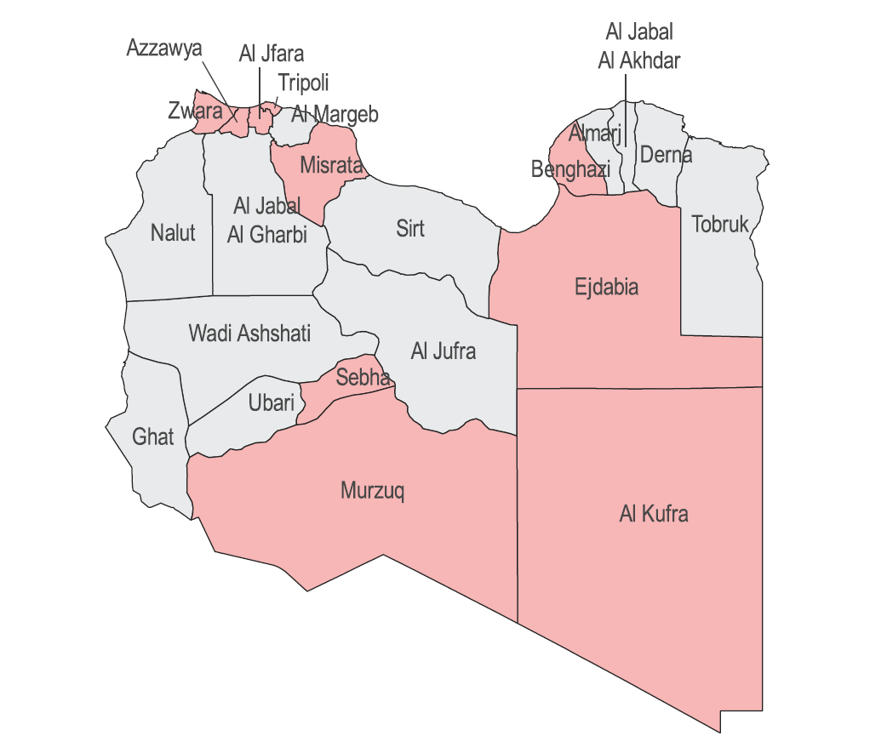
R&M MSNA: a closer look
Sampling strategy and methodology
1554 individual interviews
11 mantikas covered
Non-representative sampling
4 regions of origin
West/Central Africa: 780
East Africa: 101
MENA: 577
South East Asia: 96
10% female respondents
R&M MSNA Methodology Overview

Slide 10
CHALLENGES & LIMITATIONS
Non-representative sample
Purposive sampling
Comparability
MSNI approach
Hard-to-reach nature of migrant and refugee populations residing in Libya inhibits the ability to draw a statistically representative sample
Due to accessibility issues and COVID-19 related restrictions, it was impossible to carry out random sampling, as not all members of this population would have an equal chance of being contacted by phone
Differences in the sampling strategy and geographic coverage compared with the 2020 MR MSNA and the 2021 LBY MSNA mean that any comparisons between findings from different MSNAs are discouraged, and should be considered only broadly indicative.
Regardless of whether a household has a very severe LSG in one sector, or co-occurring severe LSGs across multiple sectors, their final MSNI score will be the same.

Slide 11
Context
Displacement
Employment
Income
Self-reported needs

Slide 12
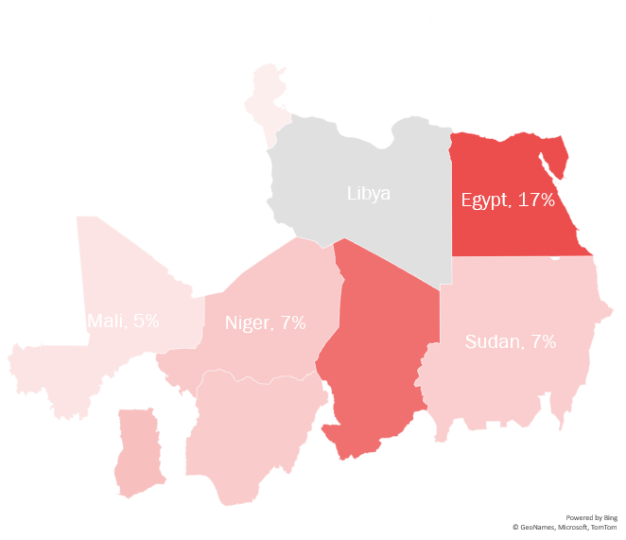
Displacement
Most represented nationalities by % of respondents
Tunisia, 4%
45% of respondents reported having been living in Libya for more than two years
6% of respondents reported having arrived to Libya during the 6 months prior to the interview
Chad, 14%
Nigeria, 7%
Ghana, 8%
Notes:
Egypt is the most represented country of origin with a percentage of 16%, followed by Chad and Ghana with 13.9 and 7.72% respectively.
There are many other nationalities not in the Map Bengladesh in one of them
44.66% of respondents are staying in Libya for more than two years and only 6% have arrived to Libya in the past six month.
13% of respondents came to Libya because of conflict and insecurity in their home country and most of them are east Africans.
Around 30% of respondent reported intention to leave Libya, 73% of which chose Europe as their next destination and 23% chose returning to their home country.

Slide 13
Displacement
51% of respondents reported the intention to remain in Libya in the 6 months following data collection
Of these, only 12% reported the intention to remain in Libya permanently
29% reported the intention to leave Libya in the next 6 months following data collection
Of these, 73% reported Europe as their planned destination after Libya
Notes:
The main reasons for migration that were reported are lack of job opportunities in the home country (HC) (reported 64% of the times). However, 49% of respondents reported that Job opportunities in Libya is the reason they migrated (the gap might indicate the intention of many to leave Libya towards Europe?).
Roughly half of respondents reported intentions to stay in Libya for the same reasons for which they came,
however only 12 % of them are planning to stay permanently.

Slide 14
Employment
Work was reported as the main source of income by 88% of respondents
Notes:
On a national level (88%) and the (3%) women reported higher than that (8%) no source of income
Work sector differs between men and women, men work mostly in construction and women work mostly domestic work
Job type as well differs per region (not that much per gender relatively to region), the ones that can have permanent jobs are mainly MENA region and those from east africa end up mostly in daily labour (discrimination or language barrier?)
Most of those who work (97%) reported receiving their payment as cash in hand.

Slide 15
Income
11% of respondents reported having received a monthly income below 750 LYD in the 30 days prior to data collection

Slide 16
Essential Needs
Priority Needs
% of respondents reporting challenges in obtaining enough money to meet their needs over the 30 days prior to data collection, per category of needs
Self-reported priority needs, by % of respondents

Slide 17
Food consumption
Food Consumption Score (FCS)
Reduced Coping Strategy Index (rCSI)
Meeting food needs
Access to markets
Livelihoods Coping Strategies Index (LCSI)
Livelihoods

Slide 18
Food Consumption
% of respondents per FCS category, by region of origin
Overall, 6% of respondents were found to have a medium or high rCSI score
10% of East African respondents were found to have a medium or high rCSI score
Notes:
17% of respondents were found to have either a ‘borderline’ or ‘poor’ Food Consumption Score (FCS)
Mantikas with the highest borderline/poor FCS include: Murzuq (61%), Sebha (51%) and Benghazi (25%)
Overall break down of FCS = 83% acceptable, 14% borderline and 3% poor
Mantika with the highest % of poor FCS = Ejdabia (8%)

Slide 19
Food Consumption
Overall, respondents reported having to rely on less preferred and less expensive food on average 2.5 days a week as the main food-based coping strategy

Slide 20
Meeting food needs
20% of respondents were found to have a food expenditure higher than 65% of total expenditure
21% of respondents reported having been unable to satisfy essential food needs in the 30 days before data collection
Notes:
50% of East Africans reported to be unable to satisfy essential food needs in the 30 days before data collection
FES:
FES above 65% was found for 20% of male respondents, as opposed to 14% of female respondents

Slide 21
Top 3 mantikas with highest % of respondents reporting barriers to accessing markets in the 30 days before data collection:
Sebha (47%)
Murzuq (47%)
Tripoli (42%)
Access to markets
8% of respondents reported not having access to a marketplace or grocery store within 30 minutes travel time in their muhalla or close to their muhalla
25% of respondents in Murzuq reported lacking access to marketplace or grocery store within 30 minutes
*Calculated out of a subset (22.14%) of respondents that reported facing barriers to consistently accessing markets

Slide 22
Livelihoods Coping Strategies Index (LCSI)
49% of respondents were found to have an emergency or crisis LCSI score
58% of female respondents were found to have an emergency or crisis LCSI score, as opposed to 47% of male respondents

Slide 23
Objectives of this meeting
Present our preliminary findings
Outline, discuss, and potentially amend the LSG framework
Identify key messages for MSNA
Meeting objectives reminder
Potential LSG framework changes
Switch any of the non-critical indicators with critical indicators
Add or omit any non-critical or critical indicators, while keeping 1-3 critical indicators and 4 non-critical indicators
Amend the classification of answer options for any of the LSG indicators

Slide 24
Food Security LSG
Non-critical indicators, by % of respondents per severity category
Critical indicators, by % of respondents per severity category
Indicator | Classification
 | No need | Need
 | 0 | 1
% of respondents relying on food-based coping strategies to cope with a lack of food in the previous 7 days (rCSI) | Low | Medium or High
 | 94% | 6%
Food expenditure share (Expenditure on food/Total expenditure) | <65% | >=65%
 | 92% | 8%
% of respondents that are able to access a marketplace or grocery store within 30 minutes | Yes | No
 | 92% | 8%
Indicator | Severity rating
 | None/ Minimal | Stress | Severe | Extreme
 | 1 | 2 | 3 | 4
Food Consumption Score, by % of respondents | Acceptable |  | Borderline | Poor
 | 83% |  | 14% | 3%

Slide 25
Food Security LSG
Food security LSG, per % of respondents per severity category, by gender
20% of respondents were found to have FS needs, 3% had extreme needs
Food security LSG, per % of respondents per severity category, by mantika
Food security LSG, per % of respondents per severity category, by region of origin

Slide 26
Health
Access to healthcare
Barriers to healthcare

Slide 27
Access to healthcare
2% of respondents reported not having access to any type of healthcare in their baladiya
24% of respondents reported not having access to a public hospital in their baladiya
Notes:
6% of East African respondents reported that they could not access primary health care within one hour using their normal mode of transportation

Slide 28
Access to healthcare
66% of respondents reported not having access to COVID-19 testing facilities in their baladiya or not being aware of such facilities
1% of respondents reported not having access to a health facility within 1 hour from their accommodation
Notes:
6% of East African respondents reported that they could not access primary health care within one hour using their normal mode of transportation

Slide 29
Barriers to healthcare
18% of respondents reported that they had needed healthcare during the 3 months prior to data collection
Of those, 14% reported that they were not able to obtain it
The top 3 barriers reported by this subgroup were:
26%
Inability to afford health services
16%
Lack of documentation
16%
Security concerns at the health facility
Among respondents who reported that they had needed healthcare but were not able to obtain it, 50% reported they had not faced any barrers
* Percentages calculated out of the sample who reported needing healthcare (18%) but were not able to access healthcare (14%).

Slide 30
Barriers to healthcare
29% of respondents who did not report having needed healthcare in the previous 3 months reported expecting that they would face barriers if they tried to access healthcare
% of respondents that reported expecting to face barriers if accessing healthcare, by region of origin
East Africa | West & Central Africa | South East Asia | MENA
53% | 33% | 32% | 19%

Slide 31
Health LSG
Non-critical indicators, by % of respondents per severity category
Critical indicators, by % of respondents per severity category
Indicator | Classification
 | No need | Need
 | 0 | 1
% of respondents with access to public and private health care | Access to public hospital, private clinic, NGO clinic mental healthcare private practitioner | No access to any of the facilities listed under ‘no need’
 | 95% | 5%
% of respondents that can access primary health care within one hour using their normal mode of transportation | Less than 1h | More than 1h
 | 99% | 1%
% of respondents with access to COVID-19 testing facilities | Yes | No/dk
 | 34% | 66%
Indicator | Severity rating
 | None/ Minimal | Stress | Severe | Extreme
 | 1 | 2 | 3 | 4
% of households with access to health care | did not need healthcare & report possible barriers that are not severe/dk OR needed healthcare & managed to access it |  | did not need healthcare & report possible barriers that are severe OR needed healthcare & did not manage to access it
 | 76% |  | 24%

Slide 32
Health LSG
Health LSG, per % of respondents per severity category, by gender
27% of respondents were found to have health needs
Health LSG, per % of respondents per severity category, by mantika
Health LSG, per % of respondents per severity category, by region of origin

Slide 33
Protection
Documentation
Movement restrictions
Safety and security (S&S)

Slide 34
Documentation
Top 5 essential services/activities that were reportedly inaccessible due to a lack of documentation in the 3 months prior to data collection, by % of respondents who reported having faced obstacles to accessing documentation
64% of respondents reported facing obstacles to obtain legal documentation
Top 3 most reported obstacles, by % of respondents:
Not familiar with the procedures
32%
13%
Cannot access Libyan authorities
Cannot access embassy/consulate
12%
21% of East African respondents reported not feeling comfortable accessing Libyan Authorities

Slide 35
Top 5 reported reasons for movement restrictions, by % of respondents who reported movement restrictions (24% of sample)
Movement restrictions
Women more commonly reported conflict-related insecurity than men (45% and 26%, respectively) and less commonly reported fear of arrest or detention compared to men (20% and 40%, respectively)*
* Percentages calculated out of a subset of 28% of women and 24% of men who reported experiencing movement restrictions

Slide 36
Safety and security incidents
% of respondents reporting safety and security incidents in their baladiya, by region of origin
26%
27%
50%
13%
23% of respondents reported being aware of safety and security incidents in their baladiya in the 3 months prior to data collection
East Africa
West/Central Africa
South/East
Asia
MENA
Most reported types of incidents that respondents reported had affected refugees and migrants in their baladiya in the 3 months prior to data collection, by % of respondents reporting such incidents and by gender*
% of respondents reporting safety and security incidents in their baladiya in the 3 months prior to data collection, by mantika
*Calculated out of a subset (23%) of respondents that reported being aware of safety and security incidents in their baladiya

Slide 37
Safety & Security concerns
42% of respondents reported having safety and security concerns
Most reported safety and security concerns, by gender:
3% of respondents reported being aware of explosive hazards in their baladiya
Top 3 mantikas with the highest % of respondents reporting being aware of explosive hazards:
Benghazi (9%)
Tripoli (5%)
Aljfara (3%)

Slide 38
Safety perception
% of respondents feeling somewhat unsafe or very unsafe, by region of origin:
26% of respondents reported feeling somewhat unsafe or very unsafe
42%
22%
27%
20%
East Africa
West/Central Africa
South/East
Asia
MENA
% of respondents reporting feeling somewhat unsafe or very unsafe, by mantika:
20% of respondents who reported feeling somewhat unsafe or very unsafe, also reported that they lacked any support networks
Most reported support networks, by % of respondents:

Slide 39
Non-critical indicators, by % of respondents per severity category
Protection LSG
Indicator | Classification
 | No need | Need
 | 0 | 1
% of respondents reporting feeling unsafe | Any other option | Very unsafe Somewhat unsafe
 | 74% | 26%
% of respondents reporting presence of explosive hazards at neighbourhood (baladiya) level | No | Yes
 | 97% | 3%
% of respondents reporting safety and security concerns | No concerns Verbal harassment Discrimination | Any other concerns
 | 55% | 45%
% of respondents that have experienced movement restrictions in the last 30 days | No movement restrictions OR movement restictions due to COVID-19 | Movement restrictions not related to COVID-19
 | 76% | 24%
Critical indicators, by % of respondents per severity category
Indicator | Severity rating
 | None/ Minimal | Stress | Severe | Extreme
 | 1 | 2 | 3 | 4
% of respondents reporting obstacles to accessing legal documentation, by reported impact on access to essential services | I have all the documentation I need/I don't face any obstacles OR Any obstacles reported & lack of documentation did not prevent access to essential services |  | Any obstacles reported & lack of documentation prevented them access to essential services
 | 46% |  | 54%

Slide 40
Protection LSG
Protection LSG, per % of respondents per severity category, by gender
59% of respondents were found to have protection needs
Protection LSG, per % of respondents per severity category, by mantika
Protection LSG, per % of respondents per severity category, by region of origin

Slide 41
Accommodation
Living arrangements
Security
Affordability
Shelter conditions
Sanitation
Utilities

Slide 42
Living arrangements
Top 3 most reported types of accommodation, by % of respondents
Shared room
50%
27%
Private room in shared accommodation
12%
Apartment
Men more commonly reported to be sharing a room with persons that are not part of their family (53%) compared to women (19%)
Notes:
Permanent job, temporary/daily labour, and own business incomes were asked of all those that reported household members working.

Slide 43
Security of tenure
9% of respondents overall reported having been evicted or threatened with eviction in the 6 months prior to data collection
No significant differences between respondents renting with verbal or written contract were observed
% of respondents reporting having been evicted or threatened with eviction, by type of rental contract
Of respondents with verbal contract
10%
Inability to pay for rent was the most reported reason for eviction/threat thereof, reported by 45% of those respondents who reported eviction or threat thereof (9% of the sample)
Of respondents with written contract
8%

Slide 44
Affordability
39% of respondents reported not having been able to afford essential shelter needs in the month prior to data collection
50% of respondents who reportedly cumulated debt in the 3 months prior to data collection (24% of the sample) reported paying for rent as one of the reasons for taking on debt
Affordability issues are most reported in Sebha where:
Of respondents reported having unsatisfied shelter needs
69%
Of respondents reported having cumulated debt in the 3 months prior to data collection
43%
Of the above reported 'Paying for rent' as one of the reasons for having contracted debt
80%

Slide 45
Shelter conditions
Self reported shelter damage, by most reported type of shelter
19% of respondents reported living in a shelter that was destroyed or presented medium to heavy damage. This was particularly commonly reported in Sebha (43%)
Private room (27% of respondents)
Apartment (12% of respondents)
Among respondents who reported no or light damage (80% of the sample), 62% reported that their accommodation presented shelter issues
Shared room (50% of respondents
Mattresses (39%) and blankets (30%) were the most reported NFIs needed
East African respondents particularly commonly reported being in urgent need of mattresses (68%)
No to light damage Medium damage Heavy damage to destroyed

Slide 46
Top 3 most reported problems with sanitation facilities, by gender of respondent*
Sanitation
22% of respondents reported relying on unimproved sanitation facilities
% of respondents reporting relying on unimproved sanitation facilities, per mantika
*Calculated out of 95% of respondents who did not report using an open hole, plastic bag, or not having access to any sanitation facility

Slide 47
Utilities
Top 3 most reported main sources of drinking water, by region in Libya
97% of respondents reported relying on the city grid as their main source of electricity
5 hours = average reported hours of power cuts per day
32% of respondents reported relying on the public network as their main source of water

Slide 48
32% of respondents reported not having had sufficient water to cover drinking, cooking, hygiene or domestic needs during the 30 days prior to data collection
Access to water
% of respondents reporting having had access to the public water network less than 3 days during the week prior to data collection, by mantika
Most reported needs not covered due to lack of water, per % of respondents and by region of origin
47% of respondents in Alkufra reported lack of sufficient drinking water during the 30 days prior to data collection

Slide 49
SNFI LSG
Non-critical indicators, by % of respondents per severity category
Indicator | Classification
 | No need | Need
 | 0 | 1
% of respondents reporting serious shelter issues | Serious shelter issues sum < 7 | Serious shelter issues sum >= 7
 | 99.6% | 0.4%
% of respondents that own the basic items needed to lead and sustain a minimum decent standard of living | Not missing items outlined under need | missing at least 75% of winter items or at least 66% of kitchen and home items or missing 100% of summer items*
 | 80% | 20%
% of respondents owning or renting their house with security of tenure | Any other options | Provided by smuggler, Hosted for free, Squatting
 | 98% | 2%
% of respondents reported eviction or threat thereof in the previous 6 months | No | Yes (threatened or evicted)
 | 91% | 9%
Critical indicators, by % of respondents per severity category
Indicator | Severity rating
 | None/ Minimal | Stress | Severe | Extreme
 | 1 | 2 | 3 | 4
% of respondents living in substandard shelter type | Apartment House Hotel Private room OR Shared room |  | Connection house Informal settlement NGO shelter | No shelter Emergency shelter Unfinished building Private building Public building
 | 95% |  | 1% | 4%
% of respondents whose shelter solutions meet agreed technical and performance standards | No/light damage |  | Medium damage | Heavy damage or destroyed
 | 81% |  | 17% | 3%
* In line with Libya SNFI sector *2021 HNO PiN categories

Slide 50
SNFI LSG
SNFI LSG, per % of respondents per severity category, by gender
23% of respondents were found to have SNFI needs, 7% had extreme needs

Slide 51
Non-critical indicators, by % of respondents per severity category
WASH LSG
Indicator | Classification
 | No need | Need
 | 0 | 1
% of respondents with access to sufficient water for drinking and domestic uses | All needs met OR Water for domestic purposes not met | Drinking needs Cooking needs Hygiene needs not met
 | 72% | 28%
% of household relying on unimproved sources of water OR on the public water network with access less than 4 days per week | Improved/ reliable | Unimproved/ unreliable
 | 93% | 7%
Most reported problems with sanitation facilities, by % | No problems | Any problems
 | 46% | 54%
% of respondents with access to soap | Yes | no
 | 97% | 3%
Critical indicators, by % of respondents per severity category
Indicator | Severity rating
 | None/ Minimal | Stress | Severe | Extreme
 | 1 | 2 | 3 | 4
% of respondents having access to a functional and improved sanitation facility | Improved facility |  |  | Unimproved facility
 | 78% |  |  | 22%

Slide 52
WASH LSG
WASH LSG, per % of respondents per severity category, by gender
25% of respondents were found to have WASH needs, 23% had extreme needs
WASH LSG, per % of respondents per severity category, by mantika
WASH LSG, per % of respondents per severity category, by region of origin

Slide 53
LSGs, per % of respondents per severity category
LSGs: Summary
Protection was the sector with the highest % of respondents found in need, followed by Health and WASH
In general, this held true across different population groups

Slide 54
Multi-Sectoral Needs Index (MSNI)
Example
Respondent LSG scores:
Protection LSG
1
SNFI LSG
2
WASH LSG
3
Health LSG
3
FS LSG
4
The MSNI
Is a measure of the respondent’s overall severity of humanitarian needs (expressed on a scale of 1 – 4)
It is based on the highest severity of sectoral LSGs identified for each respondent
MSNI
4
Limitation:
Regardless of whether a respondents has a very severe LSG in one sector, or co-occurring severe LSGs across multiple sectors, their final MSNI score will be the same
While this makes sense from a response-planning perspective, additional analysis is needed to break down the drivers of the score to more fully understand the situation for refugees and migrants. The full MSNA report will include more in-depth analysis.

Slide 55
MSNI
MSNI, per % of respondents per severity category, by gender
74% of respondents were found to have multisectoral needs, 28% had extreme needs
MSNI, per % of respondents per severity category, by mantika
MSNI, per % of respondents per severity category, by region of origin

Slide 56
Methodology
Demographics
Enrollment
Attendance
Child Labour
Child Protection
Access to Services
Education and Child Protection
Notes:
This slide is just to seperate the educaiton component section it won’t go into the final presentation

Slide 57
Education & Child Protection Component
Overall Objective
Rationale
Scope of the Project
Deliver up-to-date information on the education and child protection needs of refugees and migrants.
Low proportion of individuals travelling with school-aged children ➔ targeted assessment that focuses on this particular group.
9 Mantikas aross Libya: Tripoli, Misrata, Azzawya, Al Jfara, Al Jabal Al Gharbi, Zwara, Benghazi, Sebha, and Murzuq
MR MSNA Methodology Overview
Sampling Strategy: Non-probability purposive quota sampling
Ensure a robust cross-section of the population was assessed; Stratified by Arabic and non-Arabic speakers with indicative findings for all locations and sub-groups Only migrants and refugees with school age children are included in the sample
Methodology : Area of Knowledge-Neighbourhoods (AoK-N)
Neighbourhood approach | AOK approach
Respondents were asked about children in their household and children in the household of at least one and at most two migrant friends/acquaintances. Questions in this section mainly focused on access to education. | The same respondents were asked about the situation in their baladiya. This section collected broader information related to education and child protection concerns
231 respondents were interviewed, providing information for a total of 522 households

Slide 58
Demographics
82% of households were reported to have been in Libya for more than two years

Slide 59
Enrollment
33% of assessed households with school-aged children in Al Jfara and Zwara were reported to have no children in their household enrolled
Notes:
Question about barriers asked only to those who have at least one child not enrolled
Top 5 barriers national level
Text box to highlight whatever interesting findings per region

Slide 60
Attendance
Benghazi has the highest proportion of households with at least one child reportedly not attending school at 41%*
* Percentages calculated out of 87% of households in the sample who reported that at least one child is enrolled.
** Percentages calculated out of 87% of households in the sample who reportedly had at least one child in the household enrolled in school but then dropped out (15%)
Notes:
Question about barriers asked only to those who have at least one child not enrolled
Top 5 barriers national level
Text box to highlight whatever interesting findings per region

Slide 61
Child Labour
8% of households reportedly had children under 15 working outside of the house
15% of households reportedly had children age 15 or older working outside of the house
52% of households with at least one child working (23% of the sample), reportedly had at least one child working and not attending school
Notes:
Children with disability information not sure where to include them

Slide 62
Child Protection*
21% of respondents reported being aware of boys experiencing safety/security incidents
13% of respondents reported being aware of girls experiencing safety/security incidents
41% of respondents think COVID-19 increased safety and security risks for children
36% of respondents reported being aware of refugee and migrant children in their baladiya expressing psychological distress
*The findings presented in this and the following slides refer to the AoK portion, i.e. respondents were asked about the conditions in their baladiya
Notes:
This question is asked to those who answered yes to boys experiencing security issues (21%) and girls (13%)

Slide 63
Indicator | Severity rating
 | None/ Minimal | Stress | Severe | Extreme
 | 1 | 2 | 3 | 4
% of households with school-aged enrolled in formal education | All school-aged children in the households are enrolled in formal school |  | At least one child in the household is not enrolled in school OR Children are not enrolled in formal school
 | 51% |  | 49%
% of household with children who dropped out of school in the current school year | No school-aged children in the household dropped out |  | At least one child in the household dropped out
 | 85% |  | 15%
Education LSG
Critical indicators, by % of households per severity category
Due to the different methodology and sampling used for the education component, the Education LSG does not feed into the MSNI calculation

Slide 64
Education LSG
56% of households with children were found to have education needs
Education LSG, per % households with children respondents reported on per severity category, by mantika
Education LSG, per % of households with children per severity category, by primary language

Slide 65
Key messages
See chat for link to Mural page

Slide 66
Qualitative data collection
Overview
Structure

Slide 67
Qualitative data collection
Scope:
To be defined based on quantitative findings
Work in Progress
…priorities?
Objectives:
Triangulate findings
Contextualise findings
Understand the ‘why’ and ‘what then’
Identify vulnerable groups
Timeline:
Early September: Dissemination of draft tools for review and validation
Early October: Training of enumerators
Mid-October: Data collection

Slide 68
Qualitative data collection
Livelihoods​ | Accommodation​ | Access to humanitarian assistance
Context​ Policies Migration dynamics Gender dynamics Shocks Livelihoods strategies Access to employment Barriers to employment Work conditions Livelihoods outcomes Food security Coping strategies​ | Context Rental market Documentation Area level Spatial segregation Access to services and opportunities Protection concerns Individual level Vulnerable groups​ | Demand side Demand for assistance Priorities Obstacles Supply side Availability of assistance Priorities Obstacles
Protection
Gender
Mental
health

Slide 69
Feedback Polls

Slide 70
Contact
Thank you for your attention
Immeuble nour rue de corail les Berges du Lac 2, Tunis
Chiara.lozza@reach-initiatives.org
+216 50 220 859

