Slide 1
Returns and Durable Solutions Assessment (ReDS)
Al Rummaneh – Al Kaim, Al Anbar
and
Markaz Al Baaj – Al Baaj, Ninewa
Findings presentation, Iraq
Data collection period 4-23 June 2020

Slide 2
1. ReDS Background
2. ReDS objectives, methodology and limitations
3. Al Rummaneh overview and current demographic
4. Al Rummaneh findings
5. Markaz Al Baaj overview and current demographic
6. Markaz Al Baaj findings
7. Key findings
8. Questions from the audience
9. Discussion
Presentation outline

Slide 3
1
ReDS background

Slide 4
In light of recent movement trends related to returns, displacement and/or secondary displacement, there is a need for more immediate and in-depth profiling of affected areas to understand the needs and community inter-relations between remainee, host, returnee, and/or IDP populations.
To address this gap, REACH proposed a rapid assessment to profile priority areas of return and/or secondary displacement where there may be a risk to sustainable (re)integration of populations.
The assessment aimed to provide rapid evidence-base overview of the assessed areas to support humanitarian and development actors to promote durable solutions for returnees and IDPs in situations of protracted displacement on multiple levels, including:
Development of strategic dialogue, policy development, and resource mobilization efforts,
Development of localized interventions,
Advocacy with government actors around camp closures, consolidation, premature returns, and conditions in areas of origin to allow sustainable returns.
ReDS background
Notes:
Why conducting a rapid assessment?
In coordination with the RWG and other actors, discussions took place to conduct a rapid assessment in the way to immediately identify the main conditions affecting return, durable solutions and the sustainability of safe and dignified integration or re-integration in the community.

Slide 5
ReDS objectives, methodology and
limitations
2

Slide 6
ReDS specific objectives
Provide an understanding about the effects of recent movement trends;
Assess perceived intentions to move and identify potential risk;
Assess how conditions in affected areas may impact the sustainability of durable solutions;
Identify any consequent shift in local social dynamics and power structures;
Explore community needs and inter-relations; and the viability of safe and dignified (re)integration.
Assessment objectives
Notes:
Provide an understanding about the effects of recent movement trends across different demographic groups in targeted areas;
Assess perceived intentions to move among all relevant communities within the areas to identify potential risk of further instability;
Assess how conditions in areas affected by recent movements may impact the “sustainability” of durable solutions;
Identify any consequent shift in local social dynamics and power structures following the recent movements;
Explore conditions in the area in terms of community needs and interrelations and the viability of safe and dignified (re)integration.

Slide 7
Methodology
The assessment tool combined qualitative and quantitative data.
The assessed sub-districts were selected based on the following criteria:
more than 50% of host community members are reported to have returned;
social cohesion severity is medium or high;
it is an area of origin (AoO) for IDPs in camps at risk of closure; and
recent reports of dynamic population movements and movement intentions to/from this district.
Data collection was done remotely over the phone, adapted to the context of the COVID-19 pandemic and local restrictions associated pandemic measures.
Methodology based on key informant interviews (KIIs). Purposive sampling methods were employed to identify KIs. Findings should therefore be considered as indicative.
Al Rummaneh
Markaz Al Baaj
Community leaders 15 KIs 12 KIs
Returnees (more than 3 months ago) 5 KIs 5 KIs
IDPs (displaced from the area) 10 KIs 10 KIs
IDPs (displaced in the area) 5 KIs 5 KIs
Remainees 5 KIs 6 KIs
^{40 KIs}
^{38 KIs}
IOM DTM Link: http://iraqdtm.iom.int/ReturnIndex
Notes:
The criteria of selection was based on IOM DTM Iraq data for February and March 2020; and the result of consultations and coordination meetings with the RWG
IOM DTM Link: http://iraqdtm.iom.int/ReturnIndex
Why we cannot do all locations in Iraq? Why we need to prioritize?
Taking into consideration the limited capacity and timeframe of the project, REACH needed to prioritize the areas to be covered by the assessment.
We are presenting two specific areas (Al Rummaneh and Markaz Al Baaj) BUT that there will be further assessments conducted and this presentation offers an opportunity to also seek feedback from partners on any priority locations or key areas of exploration.
Community leaders: Al Rummaneh: 12 mukhtars, 2 sheikhs, and a local authority official; and Markaz Al Baaj: 10 mukhtars, and two governmental officers in Al Baaj district.
IDPs (displaced from the area): refers to members of the host community in Al Rummaneh displaced in other areas (mainly in Erbil governorate)
IDPs (displaced in the area): refers to individuals from other areas (outside of Al Rummaneh) who were displaced and are residing in Al Rummaneh.

Slide 8
Limitations
Tool design: It was tailored to ask specific questions to specific respondent groups, upon assumptions of relevancy to them or level of knowledge (e.g. Community leaders will know better the demography of the area since they are active local authorities)
Contextualization at sub-district level: To operationalize the identified trends, information was analysed and visualized at sub-district level, rather than location (village and neighbourhood)
Remote data collection: There is a concern related to how accurate are the answers since interviewees have concerns to answer sensitive questions over the phone rather than face-to-face
Small sample and considering the findings as indicatives: Findings will only be an indication of trends, needs, humanitarian concerns, gaps and flags for actors to assess further. Findings cannot be analyzed or visualized at community-level in the current methodology
Notes:
Examples on how to overcome the limitations:
Tool design: after lessons learned the tool was opened to ask the same questions to all respondent groups and the primary findings for the 3rd round showed the effectiveness of the new approach.
Contextualization at sub-district level: extending to more detailed assessment at village, neighbourhood or community-level will depend in the availability of data about KIs. Contact details will need to be provided since the sampling is purposive and snowballing is very limited while doing remote data collection and time consuming taking into consideration the need of the informed consent from individuals to share their contact information with REACH. It will also require additional resources such and budget and human resources (enumerators) and will affect the time-line of the project and report deadlines.
Remote data collection: testing process was very strict and discussions with field staff were ongoing to avoid sensible questions and doing harm to interviewees. Some sensitive terminologies related to Iraq context were identified and replaced by explanation text in the Arabic version of the ODK tool (e.g. ‘governance’ was replaced by ‘laws and regulations’)
Small sample and considering the findings as indicatives: analysis will include findings per community group as relevant in the coming reports.

Slide 9
3
Al Rummaneh overview and current demographic

Slide 10
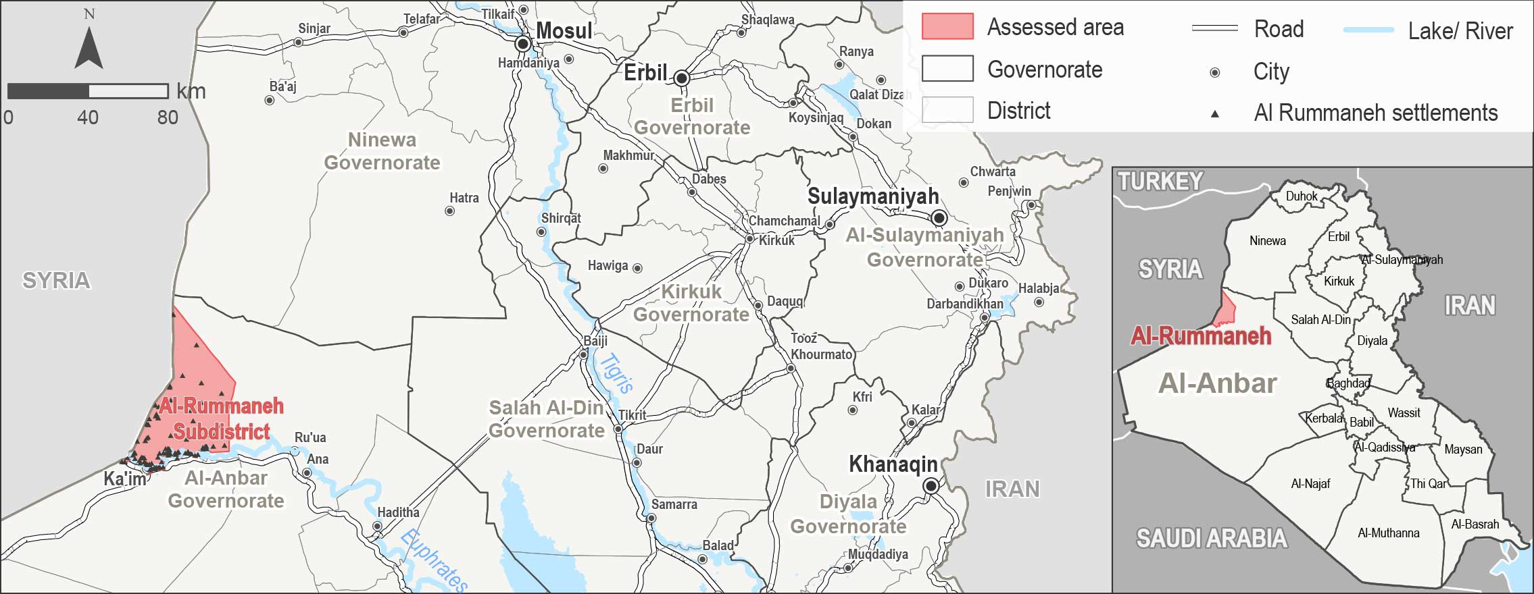
Al Rummaneh sub-district overview
Al Rummaneh is a sub-district of Al Kaim district, located in Al Anbar governorate.
It fell under the control of the so-called Islamic State of Iraq and the Levant (ISIL) in June 2014.
ISIL forced over 2,500 families to flee their homes, as reported by KIs during data collection.
It was retaken from ISIL in November 2017.

Slide 11
Al Rummaneh current demographic profile
Reported current demographic profile of the area in terms of displacement status
^{3,360-3,945}
families were reported to be residing in Al Rummaneh before the events of 2014.
of the pre-2014 population in Al Rummaneh settlements were displaced in 2014.
of the population displaced in 2014 have returned.
^{65-70%}
^{81-85%}
This section of the questionnaire was tailored to interview community leaders only.

Slide 12
Al Rummaneh findings
4.1. Recent movements
4.2. Impact of recent movements
4.3. Expected movements
4.4. Impact of expected movements
4.5. Primary community needs
4.6. Perceptions on access to services and assistance
4.7. Perceptions on governance, safety and security
4

Slide 13
Al Rummaneh sub-district
Recent movements reported by KIs
Recent returns excluded IDP from other areas who reside in Al Rummaneh
⁴⁶⁻⁷⁰
families reportedly returned to Al Rummaneh in the six months prior to data collection.
Reported reasons for recent returns:
- Sense of increased security; - Following the return of other family members; and
- Camps closure in the area of displacement (AoD).
Failed return movements excluded remainees and IDP from other areas who reside in Al Rummaneh
families reportedly attempted to return to Al Rummaneh in the six months prior to data collection but did not succeed.
Reported reasons for failed returns are related to the following conditions in the AoO:
- Destroyed/damaged housing; - Lack of jobs and services;
- Resistance from community and/or local actors; - Unstable security situation.
²¹⁰⁻³²⁵
Recent host community displacement excluded IDP from other areas who reside in Al Rummaneh
host community families reportedly moved to Erbil governorate in the six months prior to data collection due to lack of services and jobs in Al Rummaneh.
¹⁰⁻²⁰

Slide 14
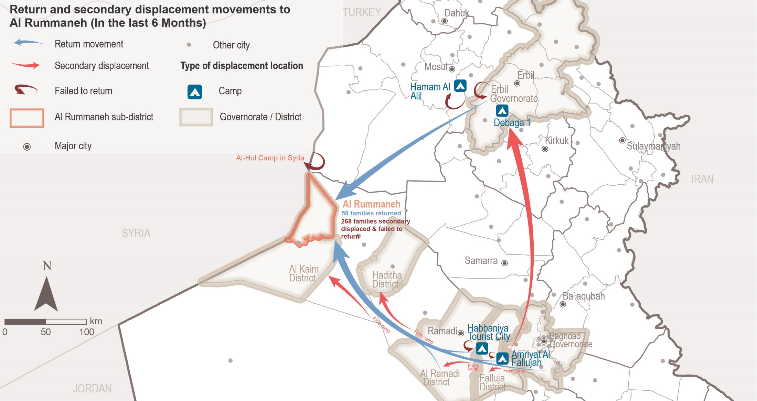
Al Rummaneh sub-district
Recent returns and secondary displacement movements reported by KIs
Notes:
Return movements refer to successful movements of host community families (originally from Al Rummaneh residing elsewhere).
Secondary displacement refers to those families original from Al Rummaneh who failed to return and were forced to secondarily displace to another area.
Failed return refers to those families original from Al Rummaneh who failed to return and were forced to go back to the area of displacement.
Host community families who moved/migrated to Erbil due to lack of services and jobs in Al Rummaneh was not reflected in the map but in the findings.

Slide 15
Al Rummaneh sub-district
Recent movements reported by KIs
^{Recent IDP arrivals}
¹²⁵⁻¹⁷⁵
IDP families arrived in the six months prior to data collection.
Reported drivers for recent IDP arrivals:
- Increased sense of safety and security;
- Kinship ties between community members;
- Expected increase in job opportunities and services; and
- Al Rummaneh is considered a transition area.
^{Recent IDP departures}
³⁰⁻⁵⁰
IDP families were recently displaced from Al Rummaneh (mainly to Erbil district) or returned to their AoO due to lack of jobs and services, and resistance from local actors in Al Rummaneh according to KIs.
This section of the questionnaire was tailored to interview community leaders and IDPs from other areas who reside in Al Rummaneh.
Notes:
Al Rummaneh is considered a transition area until the IDP families can move to another area or to AoO

Slide 16
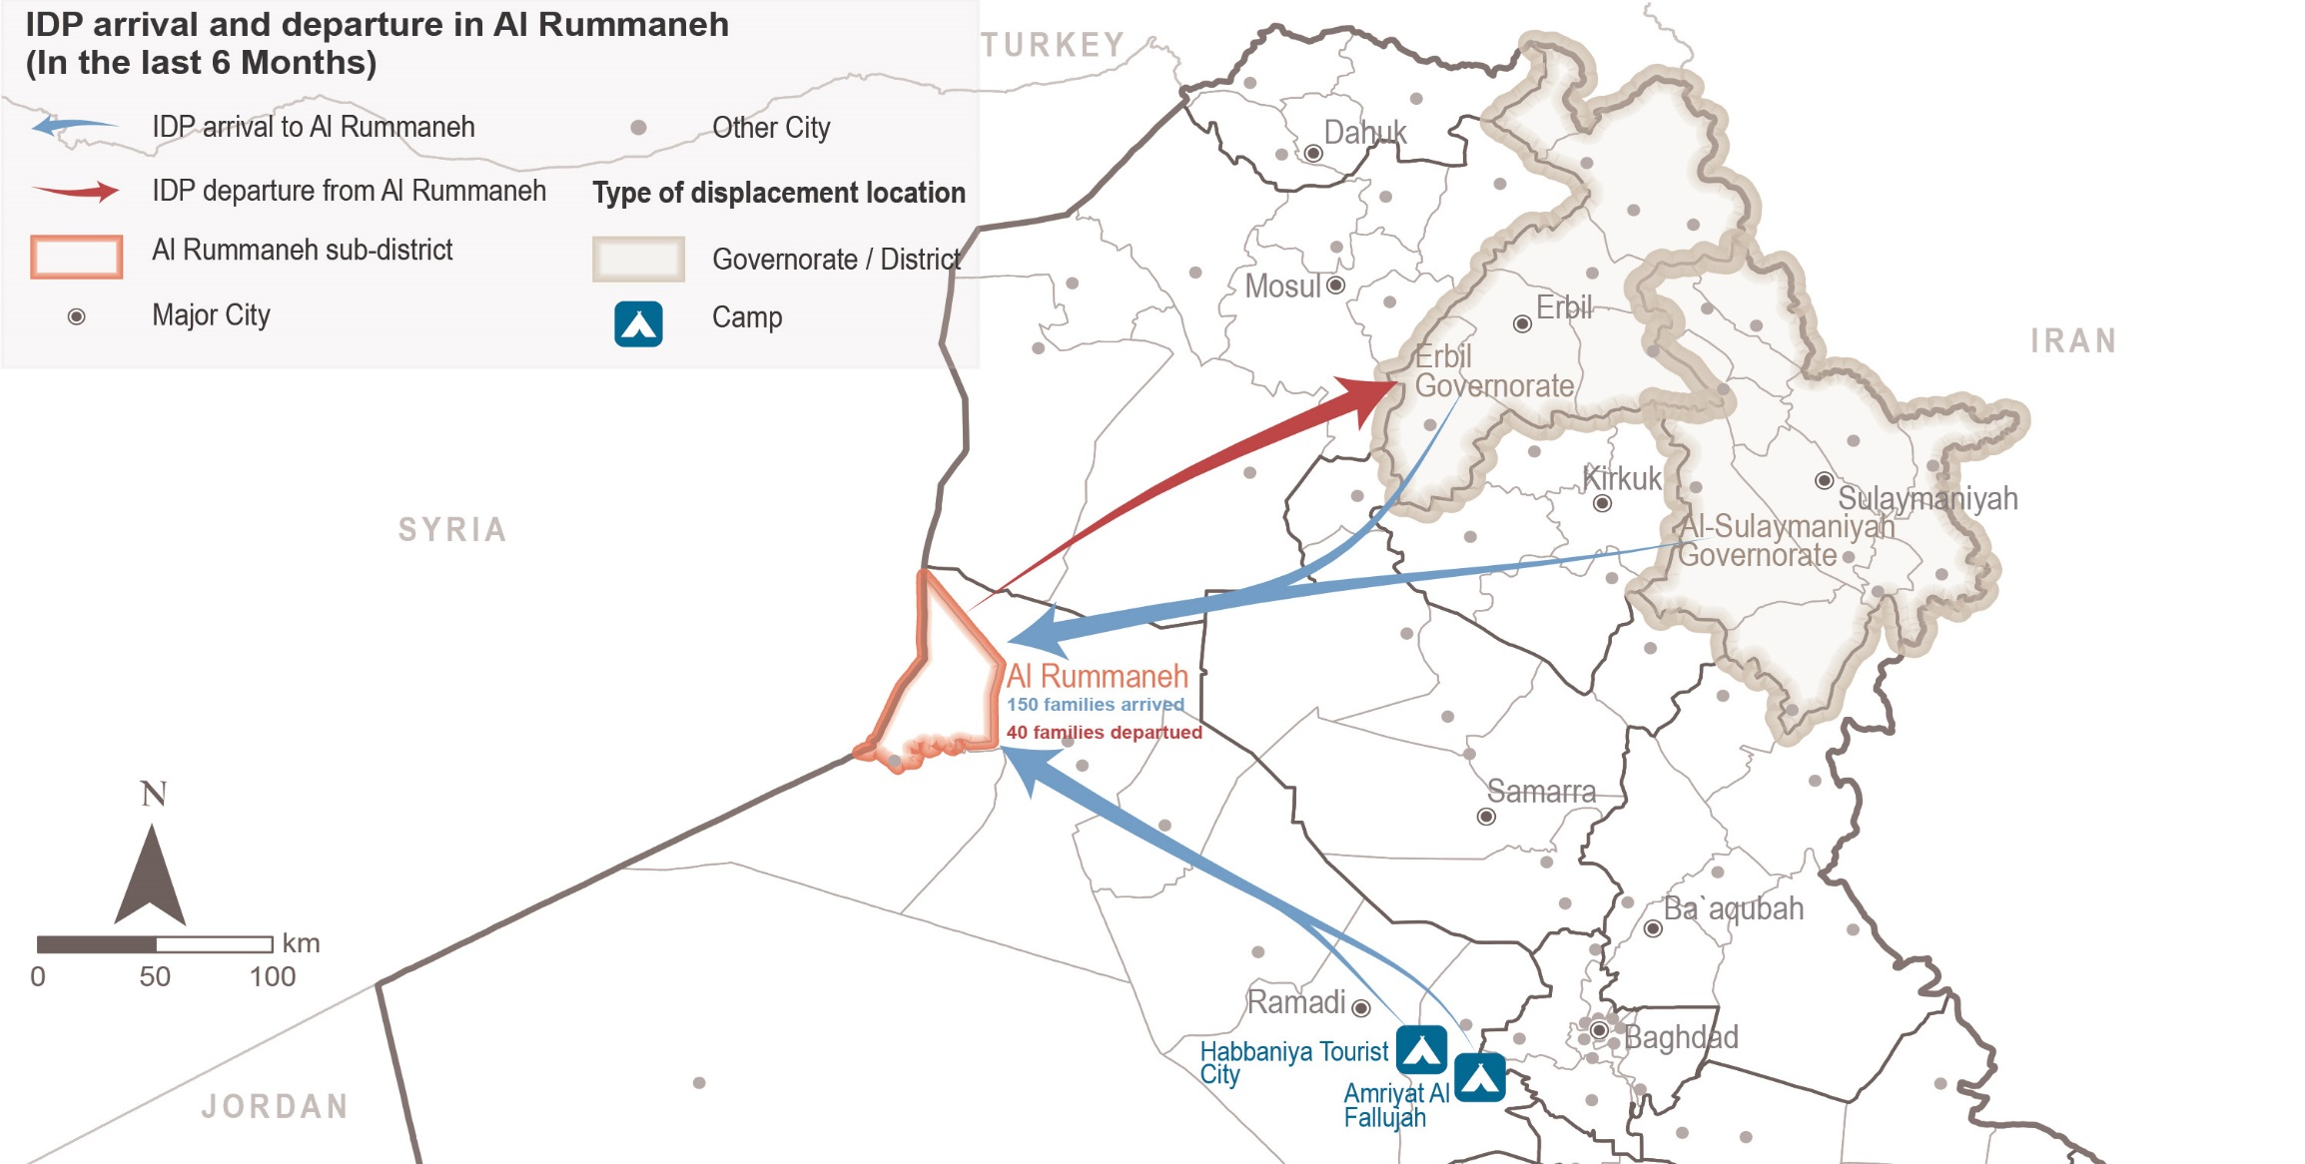
Al Rummaneh sub-district
Recent IDP movements reported by KIs
Notes:
IDP families refer to families from other areas of origin different than Al Rummaneh displaced in other areas or in Al Rummaneh.

Slide 17
Al Rummaneh sub-district
Impact of recent movements in the community as reported by 40 KIs
Impact of recent returns in the community
Family reunification; and
Increased access to assistance and jobs.
Impact of failed returns in the community
Less people present to compete for the reduced number of available jobs in the area; and
Less competition between business owners to sell their products.
However, some employees still have pending salaries since their employers have not yet returned to Al Rummaneh.
Impact of recent IDP arrivals in the community
Increased available assistance (humanitarian and governmental);
Family reunification for those with families residing in Al Rummaneh; and
Increased number of workers.
Impact of recent IDP displacements in the community
Family separation; and
Decreased number of disputes in the area.
Notes:
Reported impact of recent host community movements in the remaining community
KIs reported that recent host community movement did not impact the remaining community.

Slide 18
Al Rummaneh sub-district
Expected movements reported by KIs
Expected returns excluded IDP from other areas who reside in Al Rummaneh
families are expected to return to the area in the six months following data collection, according to KIs’ estimates.
Reported drivers for return: return of other family members; increased sense of safety and security; and perceived increase in access to services and jobs.
Reported barriers for return:
- Destroyed/damaged housing in AoO; - Unstable security situation in AoO;
- Lack of jobs and services in AoO; - Fear of being perceived as ISIL-affiliated;
- Family has settled in AoD and prefers to stay; - Medical treatment is not available in AoO.
⁸⁵⁻¹⁵⁰
Expected host community displacement excluded for both types of IDP KIs
families are expected to move to Al Falluja and Ramadi sub-districts looking for job opportunities.
⁵⁰⁻¹⁰⁰
Expected IDP movements including community leaders and IDP from other areas who reside in Al Rummaneh
According to KIs reports, some IDP families might be arriving in the six months following data collection, due to the sense of increased security in Al Rummaneh, following the arrival of other family members, and looking for jobs.

Slide 19
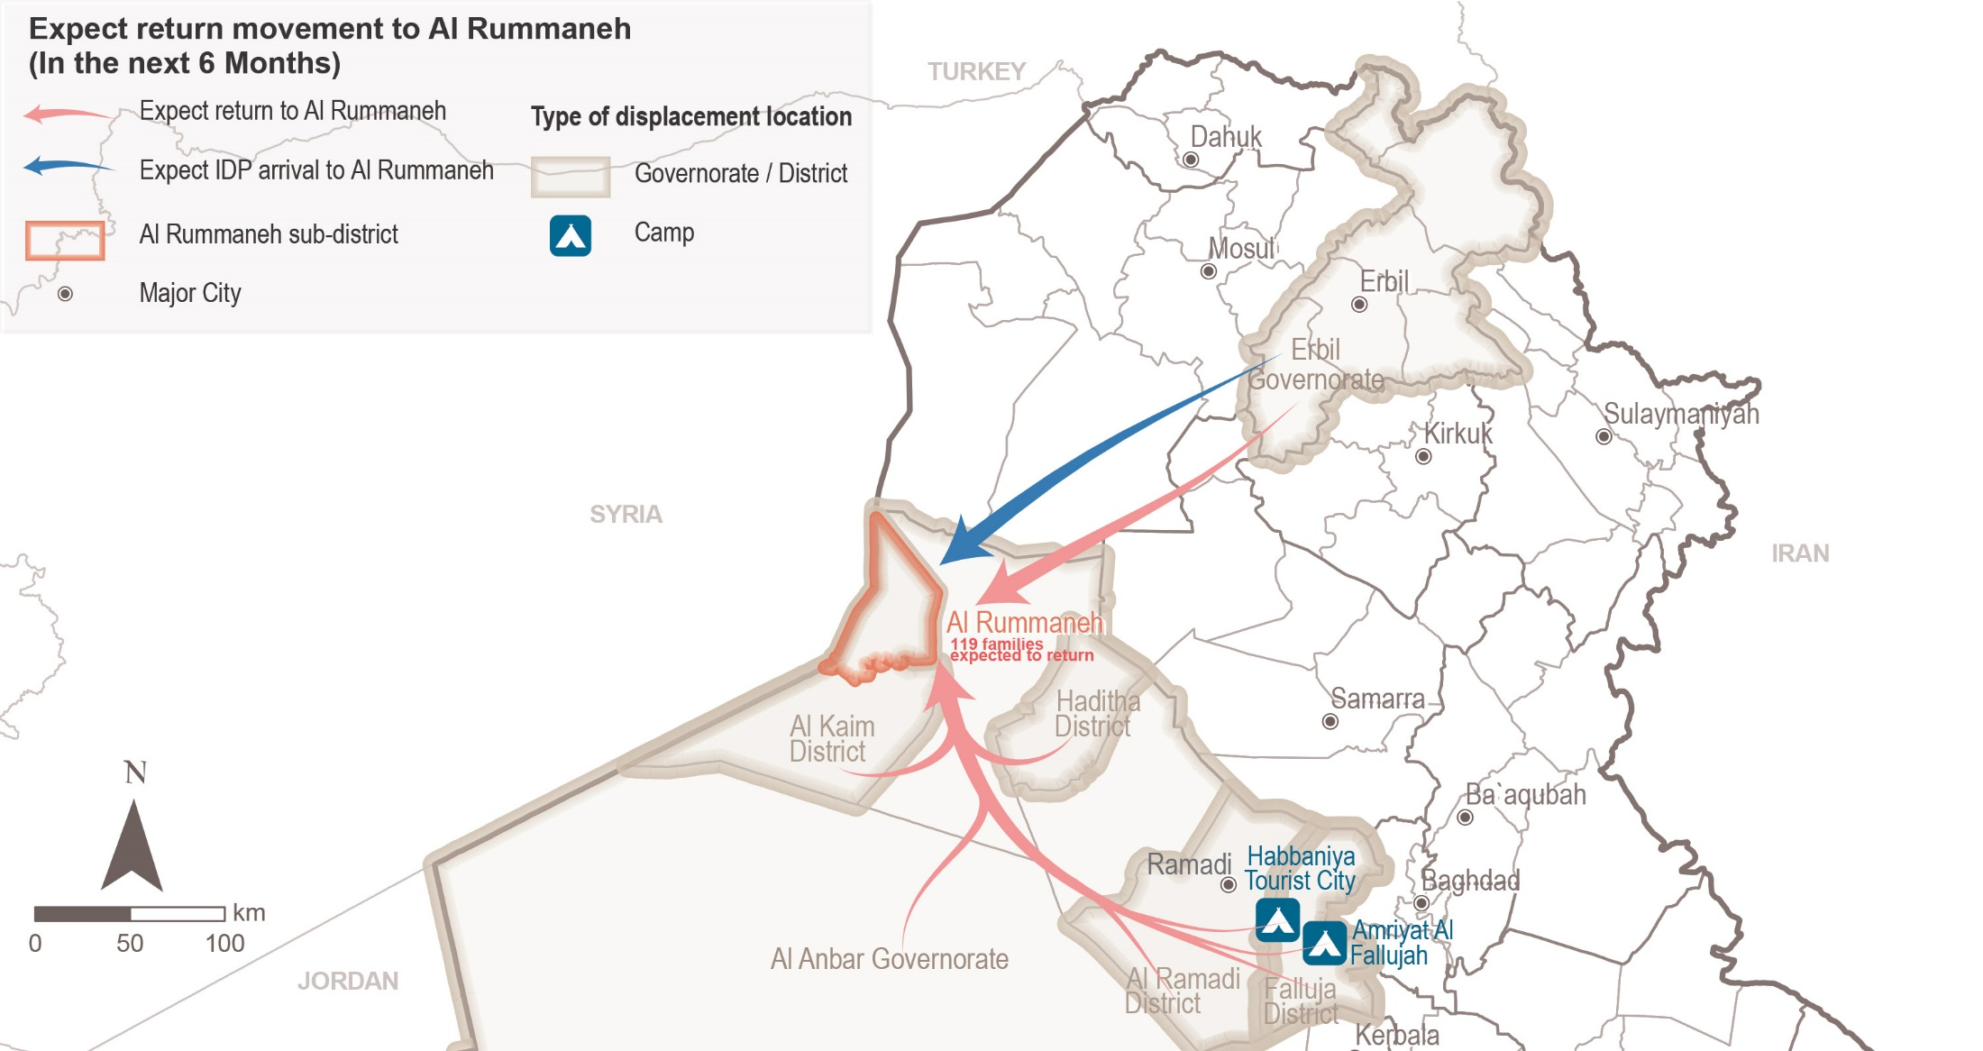
Al Rummaneh sub-district
Expected movements reported by KIs
Notes:
It was also reported that some host community families are expected to move/migrate to Al Falluja and Ramadi sub-districts looking for job opportunities, but it was not reflected in the map.

Slide 20
Al Rummaneh sub-district
Impact of expected movements in the community as reported by 40 KIs
Reported impact of expected returns in the community
Family reunification; and
Increased job opportunities and assistance (humanitarian and governmental).
However, one KI reported increase in disputes and less assistance for the current population.
^{Family reunification findings}
Family reunification section was tailored to interview returnees and remainees.
KIs reported that most of the families in the community still have members in displacement.
Reported family members who are still in displacement: brothers and/or sisters; sons and/or daughters (including minors); parents; and, other relatives.
Reported reasons for remaining displaced were:
- Presence of jobs in AoD; - Lack of jobs in AoO;
- Registration in school/university in AoD; - Access to medical treatment in AoD; and
- House partially/completely damaged in AoO.

Slide 21
Al Rummaneh sub-district
Primary community needs reported by 40 KIs
“Security is a basic requirement to start a decent life”
Male IDP KI from Al Rummaneh displaced in Erbil

First need Second need Third need
House rehabilitation | 15 KIs | 4 KIs | 5 KIs
Security | 14 KIs | 0 | 1 KI
Livelihoods | 6 KIs | 23 KIs | 4 KIs
Healthcare | 4 KIs | 5 KIs | 4 KIs
Electricity and water | 0 | 4 KIs | 13 KIs
Waste disposal | 0 | 0 | 8 KIs
Education | 0 | 3 KIs | 2 KIs
Unexploded ordinance (UXO) clearance | 1 KI | 0 | 0
Food | 0 | 1 KI | 1 KI
Documentation | 0 | 0 | 1 KI
Road rehabilitation | 0 | 0 | 1 KI
“If job opportunities are available, many families can meet their specific and basic needs, and many displaced families can return to the area”
^{Male remainee KI}
“Complex treatments are only available in Baghdad or Erbil”
^{Male remainee KI}
Sum of answers may exceed the total number of KIs, due to KIs being able to select multiple response options, including other topics.
Notes:
KIs reported that the primary needs for the community are: support to rehabilitate housing, taking into consideration that most of the houses were destroyed or partially damaged during the military operations by ISIL and that there is limited compensation from the government for rehabilitation; and, safety and security.
The second main community needs most commonly reported were: access to livelihoods due to reported lack of jobs in the area, including the need of livelihoods projects for women heads of households as reported by 11 KIs; and, healthcare due to lack of specialties, the high cost of health services, and damaged facilities.
Electricity, water and waste management were considered as the third need considering the limitations to access those services, the operational hours, reduced capacity of Municipalities to respond and the high cost for private related services.

Slide 22
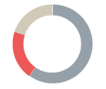
Al Rummaneh sub-district
Perceptions on access to services and assistance
Access to housing
15 KIs reported that the majority of families in the area reside in damaged houses.
80% of KIs reported that between 20% and 50% of houses are destroyed or damaged.
Reportedly returnees (6 KIs out of 15), IDPs (3 KIs) and remainees (2 KIs) are more likely to reside in damaged or unfinished buildings/houses. In all groups, female-headed households and families of members with alleged links to ISIL are the most affected.
Groups reported to be most at risk of eviction were families of members with alleged links to ISIL (2 KIs of 15), IDPs (1 KI) and returnees (1 KI).
Landlord’s decision to use or rehabilitate the property;
Unwillingness to host the family any longer; and
Reports of security incidents.
Families reside in owned houses reported by 9 KIs
Families under verbal rental agreement 3 KIs
Families hosted by other families 3 KIs
Main reasons:
Tailored to interview remainees, returnees and IDPs in the community
Notes:
Reasons for risk of eviction:
landlord’s decision to use or rehabilitate the property; or
unwillingness to host the family any longer;
reports of security incidents; and,
concerns about hosting family of members with alleged links to ISIL.
2 KIs reported that returnees are more likely to reside in tents

Slide 23
Al Rummaneh sub-district
Perceptions on access to services and assistance
Access to housing rehabilitation
73% of KIs reported unequal opportunities to receive support for damaged housing.
Reportedly, returnees, female-headed households, people with disabilities and people with fewer connections have less opportunities to receive housing support.
Reported barriers to access assistance for rehabilitation:
- Criteria of selection for support is perceived as too specific;
- Lack of financial means for rehabilitation;
- Less connections; and
- Rehabilitation is perceived to target specific neighbourhoods.
Tailored to interview remainees, returnees and IDPs in the community

Slide 24
Al Rummaneh sub-district
Perceptions on access to services and assistance
^{Access to basic services}
27% of KIs (4 KIs out of 15) reported unequal access to basic services .
Returnees, IDPs, female-headed households and people with less connections were reported to have less access to basic services.
Reported barriers to access basic services: vulnerability criteria perceived as too specific; assistance perceived to target specific neighbourhoods; less connections; and lack of financial means to access services.
^{Access to justice}
All KIs (15 KIs) reported that access to justice is equal for all population groups.
There are no closed public/governmental offices in Al Rummaneh.
Only one KI reported that for IDPs in Al Rummaneh it is difficult to obtain a passport as they often cannot afford the cost for the process or the transportation due to limited access to resources.
^{Access to humanitarian aid}
20% of KIs (3 KIs out of 15) reported knowledge of presence of NGOs in Al Rummaneh.
Most needed activities or projects according to KIs: livelihoods (73%) and rehabilitation (27%)
Tailored to interview remainees, returnees and IDPs in the community

Slide 25
Al Rummaneh sub-district
Perceptions on access to services and assistance
^{Access to public services}
87% of KIs (13 KIs out of 15) reported equal access to public services such as education and healthcare.
All KIs reported that boys and girls (between 5 and 15 years old) can access public education
Population groups residing in remote areas had reportedly less access to public services, namely schools and health centers.
Reported reasons for lower access to public services: long distance from the residency to the nearest public facility; the lack of financial means to cover the costs of services; and the perceived specificity of the selection criteria for the provision of some services.
^{Access to livelihoods}
33% of KIs (5 KIs over 15) reported unequal access to livelihoods services.
People with less connections; returnees; female-headed households; IDPs; elderly; unaccompanied/separated children (UASC) or youth; and people with disabilities or special needs are reported to have less access to livelihoods.
Reported barriers to access livelihoods: less connections; lack of financial means to provide assets; criteria of selection for support is perceived as too specific; services perceived to target specific neighbourhoods; and no job opportunities available in the area.
Notes:
This part of the tool was tailored to interview remainees, retunees and IDPs in the community

Slide 26
Al Rummaneh sub-district
Perceptions of governance, safety and security
Governance and influencing bodies
Governance and influencing bodies was tailored to interview community leaders only.
KIs (15 community leaders) reported that mukhtars and local authorities are the most influential bodies with regards to governance, followed by tribal leaders.
No changes in the levels of influence of groups were reported in the six months prior to data collection.
67% of KIs (10 KIs out of 15) reported that there has been no appointment of any new local authorities in the six months prior to data collection.
^{Safety and security}
Safety and security was tailored to interview remainees, retunees and IDPs in the community.
93% of KIs (14 KIs out of 15) reported that their community members feel safe in the area.
87% of KIs mentioned that they do not avoid any areas or neighbourhoods in Al Rummaneh.
93% KIs reported that females and males in the community can freely move at day and night.
All KIs reported that the presence of security forces such as the police and the Iraqi armed forces contributed positively to a feeling of safety.
Notes:
Al Rummaneh is considered as safe, however, a remainee KI reported feeling unsafe due to the presence of specific armed groups in the area and the fear that ISIL could return to Al Rummaneh; and, a returnee KI reported that some females and males do not freely move during the night or day due to the presence of checkpoints or control spots for specific political parties in the area.

Slide 27
Al Rummaneh sub-district
Perceptions of governance, safety and security
Community disputes, relations and co-existence
One KI reported that disputes took place in the area due to the return of some families in the six months prior to data collection.
No disputes were reported between villages or towns in Al Rummaneh.
It was generally recognized that security forces are effective in resolving disputes within the community and between different villages.
80% of KIs (12 KIs of 15) reported that community members trust each other.
53% of KIs (8 KIs over 15, the majority were IDPs from other areas displaced in Al Rummaneh) reported interacting with community members from other groups.
All KIs (15 KIs) reported that there are no specific population groups which are not welcome by the majority of the community in the area.
This part of the questionnaire excluded IDPs from Al Rummaneh displaced elsewhere

Slide 28
5
Markaz Al Baaj overview and current demographic

Slide 29
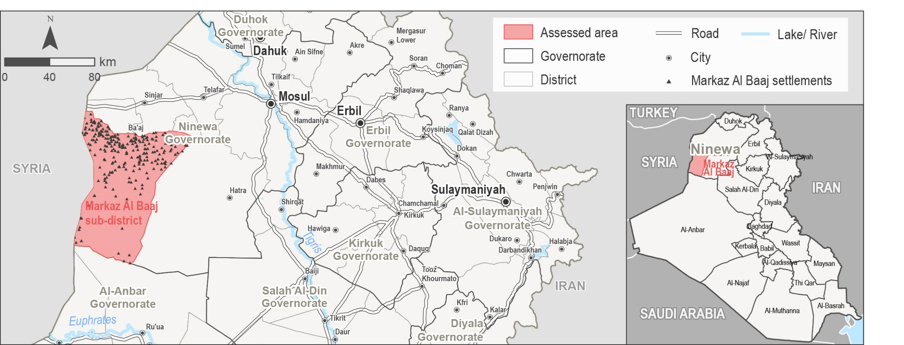
Markaz Al Baaj sub-district overview
Markaz Al Baaj is a sub-district of Al Baaj district, located south-west of Ninewa governorate.
It fell under the control of the so-called Islamic State of Iraq and the Levant (ISIL) in 2014.
ISIL forced over 6,000 families to flee their homes, as reported by key informants (KIs) during data collection.
It was retaken from ISIL in June 2017.

Slide 30
Markaz Al Baaj current demographic profile
Reported current demographic profile of the area in terms of displacement status
^{7,123-9,061}
families were reported by KIs to be residing in Markaz Al Baaj before the events in 2014.
of the pre-2014 population in Markaz Al Baaj settlements displaced in 2014.
of the population displaced in 2014 have returned.
IDP families are reported to reside in Markaz Al Baaj settlements (AoO not specified).
^{75-80%}
^{90-97%}
³⁶⁰⁻⁵⁶⁴
This section of the questionnaire was tailored to interview community leaders only.

Slide 31
Markaz Al Baaj findings
6.1. Recent movements
6.2. Impact of recent movements
6.3. Expected movements
6.4. Impact of expected movements
6.5. Primary community needs
6.6. Perceptions on access to services and assistance
6.7. Perceptions on governance, safety and security
6

Slide 32
Markaz Al Baaj sub-district
Recent movements reported by KIs
Recent returns excluded IDP from other areas who reside in Markaz Al Baaj
¹¹⁵⁻¹⁶⁰
families reportedly returned to Markaz Al Baaj in the six months prior to data collection.
Reported reasons for recent returns: sense of increased security; following the return of other family members; and camps closure in AoD.
Failed return movements excluded remainees and IDP from other areas who reside in Markaz Al Baaj
families reportedly attempted to return to Markaz Al Baaj in the six months prior to data collection but did not succeed.
Reported reasons for failed returns:
- Destroyed/damaged housing in AoO; - Lack of jobs and services in AoO;
- Resistance from community and/or local actors in AoO; - Unstable security situation in AoO; and
- Presence of jobs in AoD.
²³⁵⁻⁴²⁵
Recent IDP arrivals including community leaders and IDP from other areas who reside in Markaz Al Baaj
KIs reported the arrival of additional IDP families to Markaz Al Baaj in the six months prior to data collection.
Recent IDP departures including community leaders and IDP from other areas who reside in Markaz Al Baaj
Displacement of IDP families to camps located in Ninewa governorate due to lack of jobs and services in Markaz Al Baaj.
Notes:
Impact of recent returns
Family reunification; and,
Increased job opportunities.
Impact of recent IDP arrivals
Family reunification for those with families residing in Markaz Al Baaj (IDPs in camps secondarily displaced to Markaz Al Baaj looking to be reunited with their family members initially displaced in Markaz Al Baaj)

Slide 33
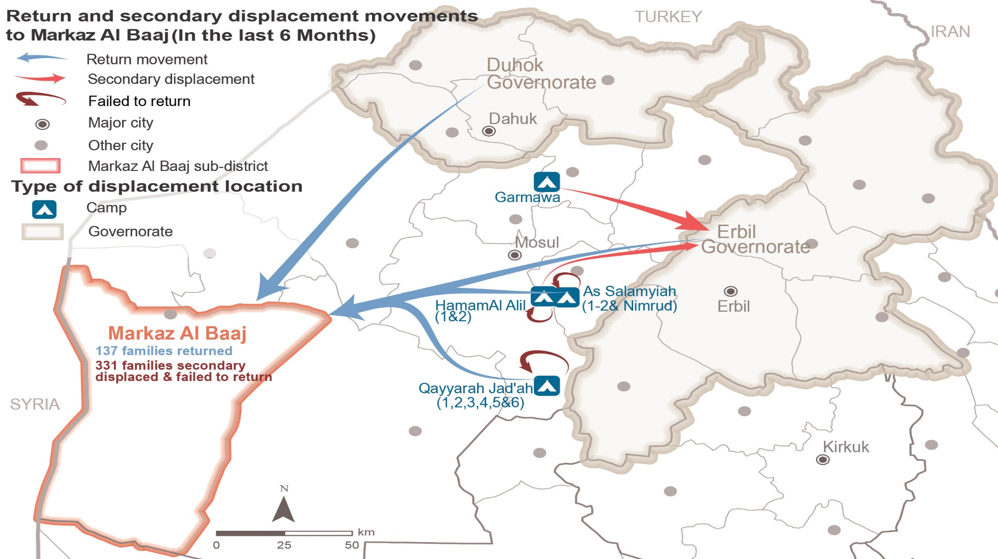
Markaz Al Baaj sub-district
Recent returns and secondary displacements reported by KIs
Notes:
Return movements refer to successful movements of host community families (originally from Markaz Al Baaj residing elsewhere).
Secondary displacement refers to those families original from Markaz Al Baaj who failed to return and were forced to secondarily displace to another area.
Failed return refers to those families original from Markaz Al Baaj who failed to return and were forced to go back to the area of displacement.

Slide 34
Markaz Al Baaj sub-district
Expected movements reported by KIs
Expected returns excluded IDP from other areas who reside in Markaz Al Baaj
families are expected to return to the area in the six months following data collection, according to KIs’ estimates.
Reported drivers for returns: return of other family members; increased sense of safety and security; perceived increase in access to services; and camps closure in AoD.
Reported barriers to return:
- Destroyed/damaged housing in AoO; - Lack of jobs and services in AoO;
- House is rented in AoO; - Fear of being perceived as ISIL-affiliated;
- Lack of documents to return; - Unstable security in AoO; and
- Family has settled in AoD and prefers to stay.
²⁶⁰⁻³⁸⁵
Expected IDP movements including community leaders and IDP from other areas who reside in Markaz Al Baaj
KIs reported that some IDP families might be arriving in the six months following data collection, due to the sense of increased security in Markaz Al Baaj; following the arrival of other family members; looking for services and jobs; and camps closure in AoD.

Slide 35
Markaz Al Baaj sub-district
Impact of expected movements in the community as reported by 38 KIs
Reported impact of expected returns in the community
Family reunification; and
Returns could result in increased job opportunities and humanitarian assistance.
^{Family reunification findings}
Family reunification was tailored to interview returnees and remainees.
Two KIs reported that most of the families in the community still have sons in displacement.
Reasons for remaining displaced were related to:
- Fear of return stemming from the 2014 crisis and the current security situation;
- Lack of adequate funds to return; and
- Access to employment in the AoD.

Slide 36
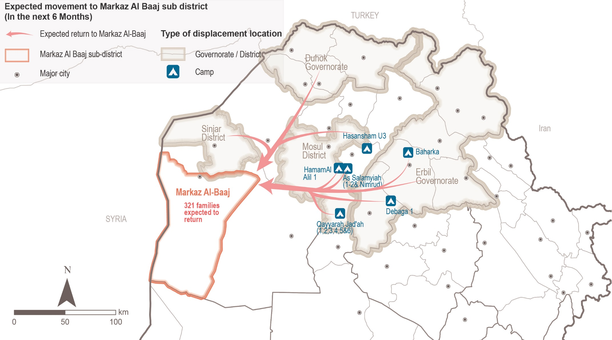
Markaz Al Baaj sub-district
^{Expected movements}

Slide 37
Markaz Al Baaj sub-district
Primary community needs reported by 40 KIs
First need Second need Third need
“After the conflict, the safety in the region has become the most important need. It affects the psychological status of a person which is the most important thing to go on opening business and any new project.”
Male community leader KI

Security | 11 KIs | 0 | 0
House rehabilitation | 9 KIs | 5 KIs | 4 KIs
Livelihoods | 6 KIs | 14 KIs | 8 KIs
Electricity and water | 6 KIs | 10 KIs | 20 KIs
Healthcare | 4 KIs | 8 KIs | 2 KIs
Education | 1 KI | 1 KI | 3 KIs
Food | 1 KI | 0 | 1 KI
“Work is important to be able to provide for the family, develop projects, stabilize the area, and IDPs will return if projects and services are available.”
Female remainee KI
Sum of answers may exceed the total number of KIs, due to KIs being able to select multiple response options, including other topics.
Notes:
KIs reported that the primary needs for the community are: safety and security and support to rehabilitate housing. These needs take into consideration that most of the houses were reportedly destroyed or partially damaged during the military operations by ISIL, and the increased demand for housing due to the presence of IDPs from nearby areas.
The second main community needs most commonly reported were: access to livelihoods due to reported lack of jobs in the area, including the need to develop projects to support agricultural activities as reported by four KIs; and, access to electricity and water due to the reduced operation hours for governmental services, and the high cost of private generators and water trucking.
Another commonly reported need was access to healthcare, considering the limited presence of specialized health facilities and hospitals in Markaz Al Baaj.

Slide 38
Markaz Al Baaj sub-district
Perceptions on access to services and assistance
^{Access to housing}
16 KIs reported that the majority of families in the area reside in damaged houses.
75% reported owning houses, 19% under verbal agreement and 6% under official rental agreement.
All KIs reported that between 20% and 40% of houses are destroyed or damaged.
Returnees (12 KIs out of 16), IDPs (7 KIs) and remainees (1 KI) are likely to reside in damaged or unfinished buildings/houses. In all groups, female-headed households and elderly people were reported to be the most affected.
Returnees and IDPs are the most likely to reside in tents. In all groups, female-headed households, elderly people and minor heads of household are the most affected.
94% of KIs reported that there is no risk of eviction across the different population groups.
Access to housing rehabilitation
25% of KIs reported unequal opportunities to receive support for damaged housing.
Returnees, female-headed households, elderly people and minor heads of household have less opportunities to receive housing support.
Reported barriers to access assistance for rehabilitation: criteria of selection for support is perceived as too specific; lack of financial means for rehabilitation; less connections; and rehabilitation is perceived to target specific neighbourhoods.
Notes:
This part of the tool was tailored to interview remainees, retunees and IDPs in the community

Slide 39
Markaz Al Baaj sub-district
Perceptions on access to services and assistance
^{Access to basic services}
18% of KIs (3 KIs out of 16) reported unequal access to basic services .
Returnees, IDPs and some remainees have less access to basic services. In all groups, female-headed households, elderly and people with less connections are the most affected.
Reported barriers to access basic services: criteria of selection for support is perceived as too specific; assistance is perceived to target specific neighbourhoods; less connections; and lack of financial means to access services.
^{Access to justice}
All KIs (16 KIs) reported that access to justice is equal for all population groups.
The civil status department and the irrigation department in Markaz Al Baaj are closed due to damage to the building and lack of funding for operations and rehabilitation.
One KI reported that for IDPs in Markaz Al Baaj it is difficult to obtain a passport as they often cannot afford the cost for the process or the transportation due to limited access to resources.
Tailored to interview remainees, returnees and IDPs in the community.
Notes:
Irrigation department is under the Iraqi Ministry of Water Resources

Slide 40
Markaz Al Baaj sub-district
Perceptions on access to services and assistance
^{Access to public services}
88% of KIs (14 KIs out of 16) reported equal access to public services such as education and healthcare.
All KIs reported that boys and girls (between 5 and 15 years old) can access public education
However, one KI reported that returnees and female-headed households have less access to public services.
Less connections to access the services;
Lack of financial means to cover the costs of services; and
Criteria of selection for some services is perceived as too specific.
Main reasons:
^{Access to humanitarian aid}
31% of KIs (5 KIs out of 16) reported knowledge of presence of NGOs in Markaz Al Baaj.
One KI reported that returnees, IDPs and female-headed households are less involved in activities or projects by NGOs.
82% of KIs (13 KIs over 16) reported that access to assistance is a factor to encourage return.
The most needed activities reported are: housing rehabilitation, livelihoods, psycho-social support (PSS); and water, sanitation and hygiene (WaSH).
Tailored to interview remainees, returnees and IDPs in the community.

Slide 41
Markaz Al Baaj sub-district
Perceptions on access to services and assistance
^{Access to livelihoods}
38% of KIs (5 KIs out of 16) reported unequal access to livelihoods services.
Returnees and IDPs reportedly have less access to livelihoods; but in all groups, female-headed households and minor-headed households are the most affected.
Reported barriers to access livelihoods:
Less connections;
Criteria of selection for support is perceived as too specific;
Services perceived to target specific neighbourhoods; and
Lack of financial means to provide assets.

Tailored to interview remainees, returnees and IDPs in the community.

Slide 42
Markaz Al Baaj sub-district
Perceptions of governance, safety and security
Governance and influencing bodies
Governance and influencing bodies was tailored to interview community leaders only.
All KIs (12 community leaders) reported that mukhtars and local authorities are the most influential bodies with regards to governance, followed by tribal leaders.
No changes in the levels of influence of groups were reported in the six months prior to data collection.
All KIs reported that there has been no appointment of any new local authorities in the six months prior to data collection.
^{Safety and security}
Safety and security was tailored to interview remainees, retunees and IDPs in the community.
All KIs (16 KIs) reported that their community members feel safe in the area.
All KIs mentioned that they do not avoid any areas or neighbourhoods in Markaz Al Baaj.
All KIs reported that females and males in the community can freely move during day and night.
All KIs reported that the presence of the security forces such as the police and the Iraqi armed forces contributed positively to a feeling of safety.
50% of KIs (8 KIs) reported that no retaliation incidents occurred in the six months prior to data collection.

Slide 43
Markaz Al Baaj sub-district
Perceptions of governance, safety and security
^{Community disputes}
Two KIs (of 28) reported that disputes took place within the neighborhoods in the six months prior to data collection due to the return of some families and housing issues.
Disputes are expected to decrease due to the intervention of local authorities; integration or re/integration of the families in the community; and work relationships.
No disputes were reported between villages or towns in Markaz Al Baaj and no change is expected in this regard in the six months following data collection.
It was generally recognized that security forces are effective in resolving disputes within the community and between different villages.
This part of the questionnaire excluded IDPs from Markaz Al Baaj displaced elsewhere

Slide 44
7
Key findings

Slide 45
Key findings
Camp closure was a pushing factor for families from Al Rummaneh and Markaz Al Baaj to return to their AoO; or a driver to secondary displacement to another area.
Return of other family members (or family reunification) encouraged families to return (host community) or to displace or secondarily displace to Al Rummaneh and Markaz Al Baaj (for IDPs from other AoO).
Family reunification is the main impact of returns in the community. However, family separation is a concern in both locations.
Perceived increased access to jobs and services as a driver to return is a concern for the durability/sustainability of the return, displacement or secondary displacement to Al Rummaneh.

Slide 46
Key findings
Failed returns are perceived to have a positive impact due to less competition between community members for jobs and between business owners for the market.
Access to housing and livelihoods are the main barriers for returns, taking into consideration that most population live in damaged houses and access to rehabilitation and livelihood opportunities are perceived as unequal.
The most vulnerable groups are IDPs (from other areas of origin), returnees and some remainees.
Both areas are reported as safe by most of the KIs.
Local authorities and security forces are perceived as effective in resolving disputes and contribute to the feeling of safety.
Notes:
Most affected categories inside the most vulnerable: mostly affecting female-headed householdss –widows-; elderly people; people with less connections and youth and families of members with alleged links with ISIL; in addition to minor heads of households in Markaz Al Baaj and Unaccompanied/separated children and youth in Al Rummaneh).
Considering both districts as safe areas
However in Al Rummaneh:
a remainee KI reported feeling unsafe due to the presence of specific armed groups in the area and the fear that ISIL could return to Al Rummaneh; and,
a returnee KI reported that some females and males do not freely move during the night or day due to the presence of checkpoints or control spots for specific political parties in the area.

Slide 47
8
Questions from the audience

Slide 48
Any key locations that should be prioritized for future locations?
Discussion
Any feedback or comments from those operational in these areas?
9
Additional themes it would be useful to explore in the assessment?

Slide 49
Upon request
حسب الطلب
http://www.reachresourcecentre.info/
IMPACT Initiatives
@REACH_info
https://www.impact-repository.org/document/reach/6cb06cfa/IRQ_ReDS_RA_Factsheet_Al_Rummanah_Final_31072020.pdf
https://www.impact-repository.org/document/reach/0c587abd/IRQ_ReDS_RA_Factsheet_Markaz_Al_Baaj_Final_31072020.pdf

