Slide 1
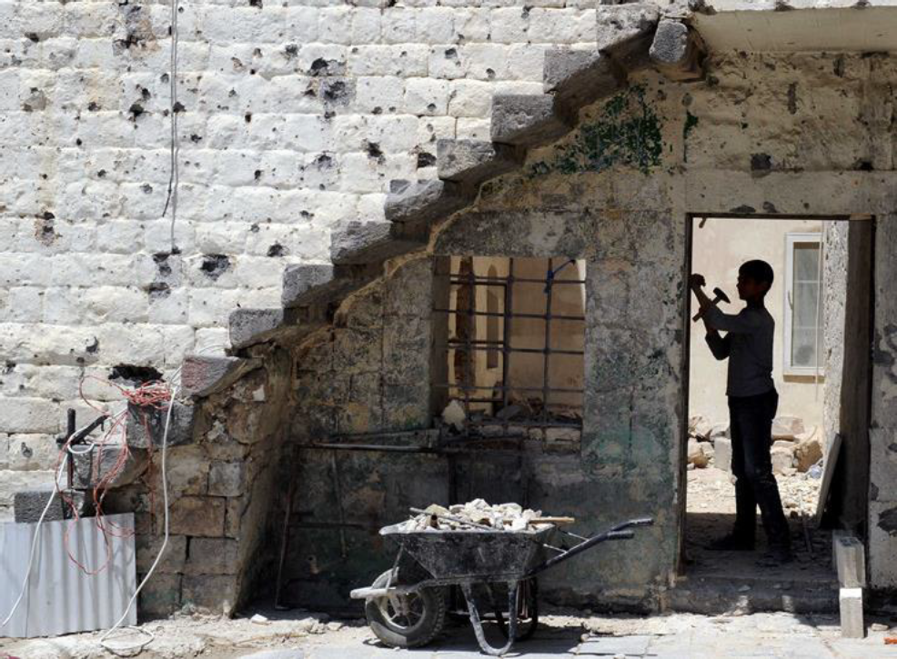


Gaziantep, Turkey
September 2017
UNHCR Shelter NFIs Assessment –Preliminary Findings Presentation

Slide 2
Introduction

Slide 3
Introduction
This presentation displays some of the data from the UNHCR-funded assessment of shelter and NFI needs across Syria, with a focus on results from North Syria.
Presentation objectives:
  Outline key findings from data collected;
  Feedback on findings;
  Confirm further analysis which would be of interest for final products.
The assessment covered the following sectors:
  Demographics and displacement;
  Shelter;
  NFIs.
Aims of the assessment:
  Provide comprehensive information and data on current access to and availability of NFIs, shelter status;
  Identify priority shelter and NFI needs;
  Assess disparities in needs and vulnerabilities between areas assessed.
Notes:
Presentation is a broad overview only – many indicators, large dataset, lots of disaggregated findings
Presentation focusses on results that might merit further discussion and interpretation
Presentation focussed on South Syria, although comparisons may be made with Northwest Syria in case of significant differences between regions

Slide 4
Methodology
Data collection conducted between 6 July and 10 August 2017.
Mixed methodology used to gather data on area as wide as possible.
Research questions
What is the current shelter adequacy and status of populations living in Syria?
What are the shelter needs of populations living in Syria?
What is the current availability and access to NFIs of populations living in Syria?
What are the NFI needs of populations living in Syria?
Are there disparities in the shelter/NFI situation and needs of populations living in different areas across Syria, between governorates, sub-districts and urban/rural areas?
Notes:
Mixed methodology: HH used where security and access constraints permit. Not possible to conduct random HH interviews in DeZ / Ar-Raqqa.

Slide 5
Methodology
Aleppo, Idleb, Hama, Homs, Dar’a, Quneitra - Household interviews
For household interviews, used of statistically significant stratified sample with a confidence level of 95% and a margin of error 10% at the sub-district level.
For governorate results, findings generalizable to the sub-districts included in the sampling frame only.
Deir-ez-Zor and Ar-Raqqa – Key Informant interviews
Data collected through purposively sampled Key Informant interviews – results indicative rather than representative.
Notes:
Household
HH: Explain MoE / CL for sub-district and governorate, representative results, approximately 106 interviews in each SD (with a 10% buffer). Overall aim of sampling: all HH in the SD have the same chance of being selected
Probability Proportional to Size sampling methods used to randomly generate a list of communities to survey within each sub-district, with the number of surveys to be conducted dependent on community size. Within each community, a simple random sample was taken.
During analysis, results were weighted to account for the fact that a household in a smaller sub-district is more likely to be selected – to allow results to be representative at the governorate level with a confidence level of 99% and a margin of error 5%
Results also representative at urban / rural breakdown in each governorate, though no urban areas were assessed in Quneitra
KI interviews
Approximately 10 KI interviews conducted in each sub-district at the community level. In larger communities (above 20,000 people), a greater number of KI interviews conducted. Records weighted and aggregated to sub-district level during analysis.
KIs selected on the basis of relevant shelter / NFI specific knowledge – local aid workers, mukhtars, those in construction / shelter related businesses; also shop-owners, farmers, former members of local councils.

Slide 6
Methodology
Indicators and questionnaire design
Indicators designed in collaboration with UNHCR and the Shelter Cluster.
Tools developed with UNHCR using indicator list as a basis.
HH and KI questionnaires designed to allow limited comparability of results between the two methodologies where possible.
Data collection
Data collected through REACH and partner enumerators, using the same tools and training materials
Enumerators entered data into smartphones (either directly or via a paper form) using the Kobo Collect platform.
Data checking and cleaning
Data uploaded to a server daily and checked three times each week.
Immediate follow-up conducted where possible to correct inconsistencies and errors.
Final review and cleaning of data undertaken upon completion of data collection.
Notes:
Indicators: based on a) WoS shelter cluster common floor tool; b) input received from cluster members; c) shelter/NFI components of previous assessments in Syria
Indicators aligned with those in previous assessments where possible to allow comparability (e.g. HNO 2017, SNFI 2016), although there are limits to comparability
KI questionnaire aimed to cover as many indicators as possible as those covered through HH and FGDs – not always possible due to nature of KI interviews (i.e. difficult to calculate some indicators to same level of detail) – noted in an analysis plan beforehand
Data collection
HoH defined as those in charge of making decisions for the household and managing household resources. If heads of households were unavailable, enumerators interviewed a household member above the age of 18 able to speak on behalf of the household
Training and pilot conducted before commencement of survey
Kobo: allows constraints to be built into tool to reduce data entry mistakes; allows geo-referencing so sampling could be checked
Data checking: checking entries for inconsistencies and following up with enumerators, tracking length of time for each survey – follow-up limited in some cases due to difficulties contacting enumerators (particular issue for partners / enumerators in government controlled areas)

Slide 7
Coverage
Governorate | Method | Sub-districts in which accessible communities were assessed |  | % of the governorate pop living in assessed sub-districts | Total HH sample (106 HH per SD) | Total KI sample
Aleppo | HH | 18 / 40 | Afrin, Aghtrin, Ain al Arab, Atareb, A'zaz, Bulbul, Daret Azza, Haritan, Jandairis, Ma'btali, Mare', Menbij, Raju, Sharan, Sheikh El-Hadid, Suran, Tall Ed-daman, Zarbah | 40% | 2,206
Ar-Raqqa | KI | 9 / 10 | All except Maadan | 96% |  | 123
Deir-ez-Zor | KI | 14 / 14 | All | 100% |  | 121
Hama | HH | 6 / 22 | As-Saan, As-Suqaylabiyah, Hamra, Kafr Zeita, Madiq Castle, Ziyara | 7% | 680
Homs | HH | 3 / 23 | Homs, Taldu, Ar Rastan | 9% | 336
Idleb | HH | 24 / 26 | Abul Thohur, Ariha, Armanaz, Badama, Bennsh, Dana, Darkosh, Ehsem, Heish, Idleb, Janudiyeh, Jisr-Ash-Shugur, Kafr Nobol, Kafr Takharim, Khan Shaykun, Maaret Tamsrin, Ma'arrat An Nu'man, Mhambal, Sanjar, Saraqab, Salqin, Sarmin, Tamanaah, Teftnaz | 95% | 2,624
Dar’a | HH | 10 / 17 | As-Sanamayn, Busra Esh-Sham, Dar'a, Hrak, Izra', Jasim, Jizeh, Mseifra, Mzeireb, Nawa | 78% | 1,085
Quneitra | HH | 3 / 6 | Quneitra, Khan Arnaba, Al-Khashniyyeh | 97% | 321
 |  | 87 / 158 |  |  | 7,252 | 244
Notes:
Slide shows breakdown of surveys collective in each governorate – see % of population covered
Coverage: based largely on accessibility – not possible to conduct HH interviews in Deir-ez-Zor and Ar-Raqqa. As explained in the methodology, this means results are indicative rather than representative across the assessed area.

Slide 8
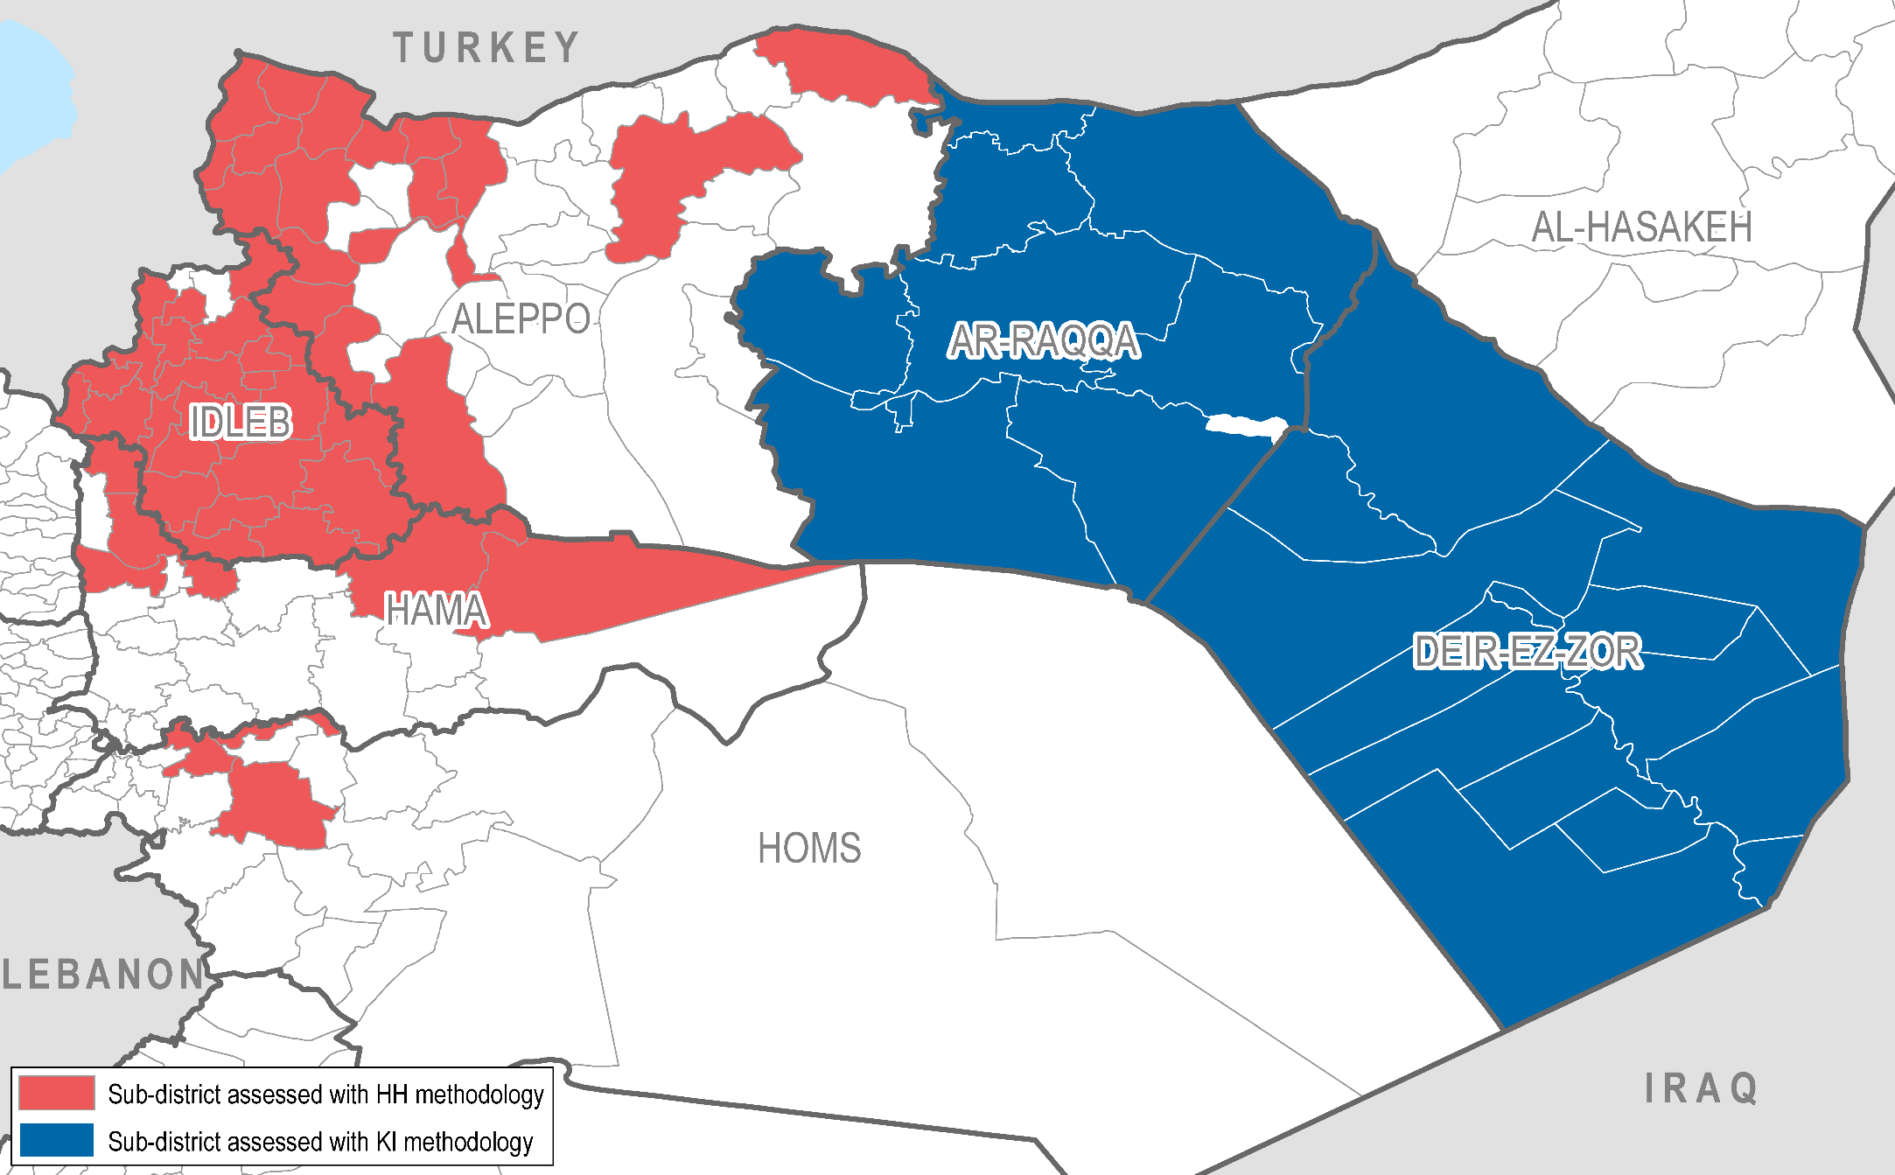
Coverage map – North Syria coverage

Slide 9
Demographics

Slide 10
Household composition
Population distribution by age and gender (Aleppo, Idleb, Hama, Homs)
Population distribution in Ar-Raqqa and Deir-ez-Zor:
  60% female in both
  50% below 18 years old in both
  37% aged 18-59 in Ar-Raqqa and 42% in Deir-ez-Zor

Slide 11
Displacement

Slide 12
Population groups: non-displaced, IDPs and returnees
Highest proportion of IDPs found in Aleppo and Hama.
Highest proportion of returnees found in Ar-Raqqa and Hama. Similar proportions of returnees to urban and rural areas in each governorate, with the exception of Hama (where more returnees were in urban areas).
Proportion of non-displaced, IDPs and returnees
Multiple displacement: average number of times displaced highest in Hama and Ar-Raqqa.
Areas of origin: largely intra-governorate displacement, other than in Idleb, where more than half of IDPs came from Hama or Aleppo.
Notes:
Aleppo, DeZ, Ar-Raqqa: Higher proportion of IDPs to urban areas.
Idleb, Hama, Homs: Higher proportion of IDPs to rural areas.
In NW Syria, a higher proportion of FHH were IDPs than MHH (usually 5-10% difference between FHH and MHH, but 25% difference in Hama)
Multiple displacement: average number of times displaced was between 1.5-1.8 everywhere except Hama and Ar-Raqqa (where it was 2.2). Higher in the South (2.3 in Dar’a and 3.0 in Quneitra).
Areas of origin: vast majority (>80%) of IDPs from within the governorate, except in Idleb where only 25% from within Idleb, but 33% from Hama and 20% from Aleppo.

Slide 13
IDPs: property possessed before displacement
In Northwest Syria, 82% of IDP households reported owning property before displacement.
Of those who had owned property, top 3 most common types:
Status of property owned before displacement (top 3):
6% reported that property was unaffected.
Notes:
Higher rates of property possession in Aleppo and Hama (90% and 94%) than Homs and Idleb (80% and 70%)
Higher rates of unaffected property in the South (12%)
0% unaffected in Hama and Homs (4% in Idleb and 8% in Aleppo)
40% in Hama reported that property was destroyed
Current status of properties indicates that many IDPs will face issues if they want to return to area of origin.

Slide 14
Movement Intentions
Percentage of the population intending to leave their shelter within the next month
Higher intended departures reported from Ar-Raqqa and Deir-ez-Zor.
95% of those intending to leave in Homs reported a different shelter in the same community as their intended destination
31% of those intending to leave in Idleb reported that they intended to go outside of Syria.
Intended destinations for those planning to leave
Notes:
Ar-Raqqa and DeZ reporting higher rates of “yes” probably due to likelihood of heightened conflict (data collected in July).
31% of the intended destinations in Idleb were outside Syria

Slide 15
Shelter

Slide 16
Shelter sharing/crowding
Percentage of HHs sharing a shelter:
  Northwest Syria: ranges from 12% in Idleb to 21% in Hama
  Northeast Syria: 17% in Ar-Raqqa and 18% in Deir-ez-Zor
Average number of individuals per shelter:
  Northwest Syria average: 6.2
  Northeast Syria average: 10.7
Average number of people per bedroom:
  Northwest Syria: 3.6 (ranges from 3.2 in Idleb and Homs to 4.1 in Aleppo)
  Northeast Syria: 3.6 in Deir-ez-Zor and 7.8 in Ar-Raqqa
Notes:
% sharing shelter: NW mostly around 20%
Individuals per shelter: Homs and Idleb (5.5 and 5.8) lower than Aleppo and Hama (6.6 and 7.4)

Slide 17
Proportion of households living in different shelter types
Solid finished house
Solid finished apartment
Unfinished building
Informal settlement
Other*
*Collective centres, managed camps, non-residential public buildings, individual tents
Notes:
IDPs in more vulnerable shelter types:
20% in informal/managed camps in Aleppo, 30% for Idleb
High numbers in unfinished buildings in Hama

Slide 18
Proportion of households in different shelter occupancy arrangements
Ownership
Renting
Hosted without rent
User rights
Other*
Notes:
Female-headed households (FHH) more likely to be hosted without rent:
22% vs 9% in Aleppo
55% vs 18% in Hama
IDPs much more likely to be hosted without rent:
24% vs 3% in Aleppo
45% vs 7% in Hama
51% vs 17% in Homs

Slide 19
Renting
Ability to pay rent on time over the past 3 months:
Average monthly rent (USD):
48% in Aleppo and 38% in Hama report rent increases over the past 3 months (20-30% reporting increases elsewhere)
31% of KIs in Ar-Raqqa report that rent has decreased in their communities
Notes:
Rent is lower in South Syria, but so is ability to pay (in the 50% range)
Lower average rent doesn’t seem to imply higher ability to pay - price may not be best indicator of rent burden
FHH seem to have more issues paying rent (both in N and S) – could be linked to livelihoods or exploitation by landlords
Nowhere other than Ar-Raqqa reported rent decreases

Slide 20
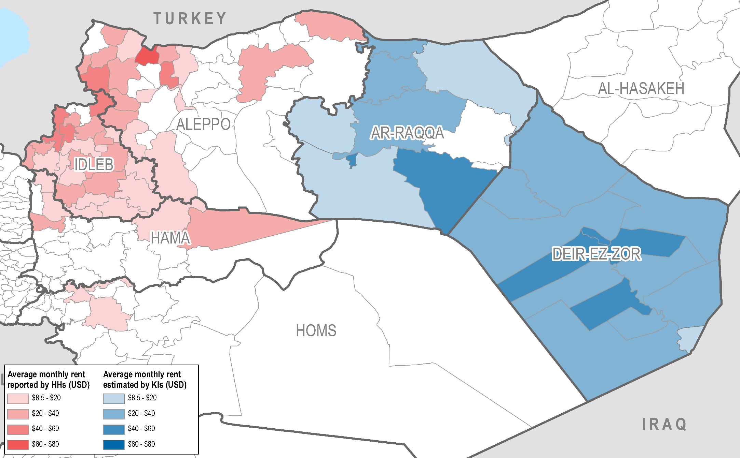
Average monthly rent (per sub-district)

Slide 21
Housing, Land and Property (HLP)

Slide 22
HLP Issues
25% of households in Northwest Syria reported facing HLP issues
  Higher rates of HLP issues than in the South
  Highest rates in Hama (40%) and Idleb (32%)
  The vast majority of these was a lack/loss of HLP documentation
  4% in Hama reported that they faced looting of private property
More HLP issues in rural Aleppo and Hama than urban
Half of IDPs in Idleb reported HLP issues
Notes:
No rural/urban difference in Idleb and Homs, but higher rates of HLP issues in rural areas of Aleppo and Hama

Slide 23
Housing documentation
30% estimated not to have documentation to prove their occupancy status in Northwest Syria:
  Large difference between Aleppo (16%) and Homs (19%) vs Idleb (40%) and Hama (50%)
Most common types of housing documentation:
  Around 50% in Idleb and Aleppo used a formal real-estate registry document (around 75% in Hama and Homs)
  Around 30% in Idleb and Aleppo used buyer-seller contracts, with user rights agreements and court contracts together comprising most of the remaining 20%
  In Ar-Raqqa and Deir-ez-Zor, vast majority of KIs (89% and 98% respectively) reported that buyer-seller contracts were most common in their communities
  In Ar-Raqqa, 10% of KIs reported that no legal document was most common
All KIs in Ar-Raqqa and Deir-ez-Zor reported that land registries were not functioning
Notes:
Reason was most commonly “could not obtain documentation”, especialy in Idleb and Hama (around 80%)
“Documents were lost” was common in Aleppo (32%)
“Verbal agreements customarily used” was common in Homs (26%)
User rights agreements mostly for camps, but also in other situations
Idleb reported 17% with court contracts, while in Aleppo both court contracts and user rights were 11%
Reasons for land registries not functioning were varied:
In DeZ, most commonly lack of authority to run them (70% of KIs)
Even in Ar-Raqqa, land registries do not yet seem to have been rehabilitated since these areas were retaken. In Northern Ar-Raqqa, KIs reported that land registries had not been present even in the past

Slide 24
Eviction
Female-headed households (FHH) and IDP HH reported high eviction rates in many governorates
Eviction rate of 9% in Hama
29% of KIs in Deir-ez-Zor reported that evictions were common in their communities
Percentage reporting eviction:
Percentage of KIs reporting evictions in their communities:
Notes:
Overall, eviction is more of an issue in South Syria (especially Dar’a), although Hama reports the highest governorate rate of eviction.
Wide range of reasons for eviction:
FHH in Aleppo mostly unable to pay rent (52%)
FHH in Idleb face ownership disputes (86%)
In Hama overall, rent issues (inability to pay or price disputes) around 50%, and other disagreements with landlord 28%
Some evictions may be linked to returnees in Hama (especially ‘other disagreements with landlords’), or may also signify unstable rent rates and exploitation by landlords.
In NE Syria, the main reason for eviction was displacement by armed groups (especially DeZ – 98%), although 40% of KIs in Ar-Raqqa also reported ownership disputes as a reason.

Slide 25
Shelter conditions

Slide 26
Shelter Adequacy
Northwest – top 5 shelter adequacy issues (% of those with adequacy issues reporting each):
Percentage reporting shelter adequacy issues:
Northeast – top 5 shelter adequacy issues (% of KIs reporting each):
Notes:
FHH and IDP HH report more shelter adequacy issues in Aleppo and Idleb (10-20% difference)
South Syria comparable to Hama

Slide 27
Shelter damage
Percentage reporting shelter damage issues:
Northwest – top 5 shelter damage issues (% of those with damage issues reporting each):
Northeast – top 5 shelter damage issues (% of KIs reporting each):
Northwest – Top 3 causes of damage (% of those with damage reporting each):
Notes:
25% of HHs in Hama report moderate or heavy fire damage (most report heavy). 25% also report partial or total wall collapse.
60% in Hama report broken/cracked windows.
Fire damage more of an issue in the Northeast (especially DeZ)
Generally damage and adequacy reports are similar, except Homs where more damage reported (suggests that they found a fix for windows cracked)
FHH and IDPs report more issues in Aleppo and Idleb (17% difference in Aleppo and 10% in Idleb for both groups)
Airstrikes and explosives are a big cause of damage, although general disrepair is quite a big issue in Aleppo and Idleb (40%-ish)

Slide 28
Shelter repair and support

Slide 29
Shelter repairs
Percentage of those with damage reporting that repairs were needed over past 3 months, but they were unable to conduct repairs (% of KIs reporting for overall population in Ar-Raqqa and Deir-ez-Zor):
Main reasons for those unable to conduct repairs in North Syria:
  Aleppo, Homs, Hama, Ar-Raqqa: Repair materials too expensive
  Idleb, Deir-ez-Zor: Could not afford to pay a professional for repairs
Notes:
Generally more than half were unable to conduct needed shelter repairs in N and S Syria
Price factors (of professionals and repair materials) were the most common issues by a large majority in all governorates. Both these reasons features prominently everywhere (even in places where they weren’t the top reason)

Slide 30
Shelter repair material availability and affordability issues
Percentage of those with availability/affordability issues reporting each item as unavailable/unaffordable (% of KIs reporting for Ar-Raqqa and Deir-ez-Zor):
 | Plastic sheeting / tarpaulin | Iron sheeting | Timber | Nails / screws | Bricks | Concrete | Wood | Basic electrical items | Basic tools | Other
Aleppo | 16% | 29% | 18% | 10% | 50% | 95% | 19% | 32% | 39% | 4%
Hama | 29% | 21% | 16% | 1% | 39% | 94% | 25% | 26% | 62% | 3%
Homs | 13% | 20% | 40% | 5% | 3% | 93% | 24% | 10% | 32% | 43%
Idleb | 27% | 35% | 37% | 26% | 44% | 88% | 46% | 53% | 67% | 5%
Ar-Raqqa | 33% | 39% | 17% | 6% | 37% | 88% | 37% | 64% | 37% | 0%
Deir-ez-Zor | 20% | 7% | 54% | 2% | 3% | 93% | 39% | 79% | 46% | 0%
Notes:
Even though we have put unaffordable/unavailable together here, the issues are overwhelmingly affordability
Concrete is the main unaffordable/unavailable item
‘Other’ for Homs is mostly cinderblocks

Slide 31
Shelter support
Main sources of information in Northwest Syria: Friends/relatives and local councils
Main source of information in Ar-Raqqa: friends/relatives and community representatives
Percentage reporting that they received information on shelter support over the past year:
Northwest Syria – preference for shelter support modality:
KIs report that the largest preference in Ar-Raqqa is for direct assistance with repairs, and in Deir-ez-Zor is for shelter repair materials
Only 6% of KIs in Northeast Syria report a preference for unconditional cash support
Notes:
Local councils a bit lower in Aleppo (50%), but 60-70% in Hama and Idleb and 90% in Homs
Big difference between Ar-Raqqa and DeZ:
In Ar-Raqqa, 90% of KIs reported that information had been available in their communities
In Deir-ez-Zor, 95% of KIs reported that there had been no information in their communities
Lack of preference for cash in NE Syria could be due to more challenges to accessing markets (or less availability of goods), or a limitation of using KI methodology to assess preferences

Slide 32
NFIs

Slide 33
NFI needs by age and gender
Northwest – top 3 NFI needs by age and gender:
 | 1 | 2 | 3
Girls (0-17 years) | Clothing | Shoes | Winter clothes
Boys (0-17 years) | Clothing | Shoes | Portable light sources
Women (18-59 years) | Cooking fuel | Clothing | Cooking utensils
Men (18-59 years) | Portable light sources | Cooking fuel | Clothing
Elderly (60+ years) | Portable light sources | Heating fuel | Clothing
Northeast (% of KIs reporting) – top 3 NFI needs by age and gender:
 | 1 | 2 | 3
Girls (0-17 years) | Clothing | Shoes | Sanitary pads
Boys (0-17 years) | Clothing | Shoes | Water containers
Women (18-59 years) | Cooking fuel | Clothing | Cooking utensils
Men (18-59 years) | Water containers | Portable light sources | Batteries
Elderly (60+ years) | Clothing | Adult diapers | Heating fuel
Notes:
Generally quite similar, although there are some additional points of note:
Sleeping mats/mattresses and bedding are a significant need for children in Hama and Homs (30% each)
Baby diapers are also of quite high need
Heating fuel is a significant need for women in Homs
Water containers and batteries are significant needs for men in Idleb and Homs

Slide 34
Means of accessing NFIs
Markets are the main means of accessing NFIs in North Syria:
  More than half in all governorates (99% of KIs report in Deir-ez-Zor)
  In Hama (52%) and Idleb (32%), humanitarian deliveries directly to households are also a major source
  In Homs, aid distributed at collection points is a major source (80%)
FHH were less likely than MHH to use markets and more likely to rely on aid distributions (10 percentage point difference between MHH and FHH in market use in Aleppo, 25 percentage point difference in Idleb, and 30 percentage point difference in Hama and Homs)
High rates of challenges to accessing aid through distributions reported in Hama (52%), mostly due to lack of access for people with restricted mobility and security constraints restricting movements to distribution points.
Notes:
Higher market usage rates in Aleppo and Homs (80%) than Idleb and Hama (55 and 70%)
FHH 10-20% higher rates of usage of humanitarian aid distributions in Northwest Syria
IDPs less likely to use markets in Idleb and Hama (20% and 15% difference but still more than half); more likely to use distributions directly to households
15% in Aleppo also reported challenges to accessing aid through distributions, almost entirely due to distance and transportation issues
1/3 of FHH in Hama using distributions report that lack of access for women is a challenge

Slide 35
Access to markets
Percentage reporting challenges to accessing markets:
  17% in Aleppo (28% for FHH)
    Distance and transportation challenges are more of an issue for FHH than MHH
  Less than 10% in Idleb and Homs (19% for FHH in Idleb)
  45% in Hama (62% for FHH)
    Top issues are distance, security concerns, transportation, and lack of functionality during conflict
    37% of FHH in Hama report lack of access for women as a challenge
  54% of KIs report challenges in Deir-ez-Zor: mostly security concerns and lack of access for women
  72% of KIs report challenges in Ar-Raqqa: mostly lack of transportation, lack of functionality during conflict and security concerns

Slide 36
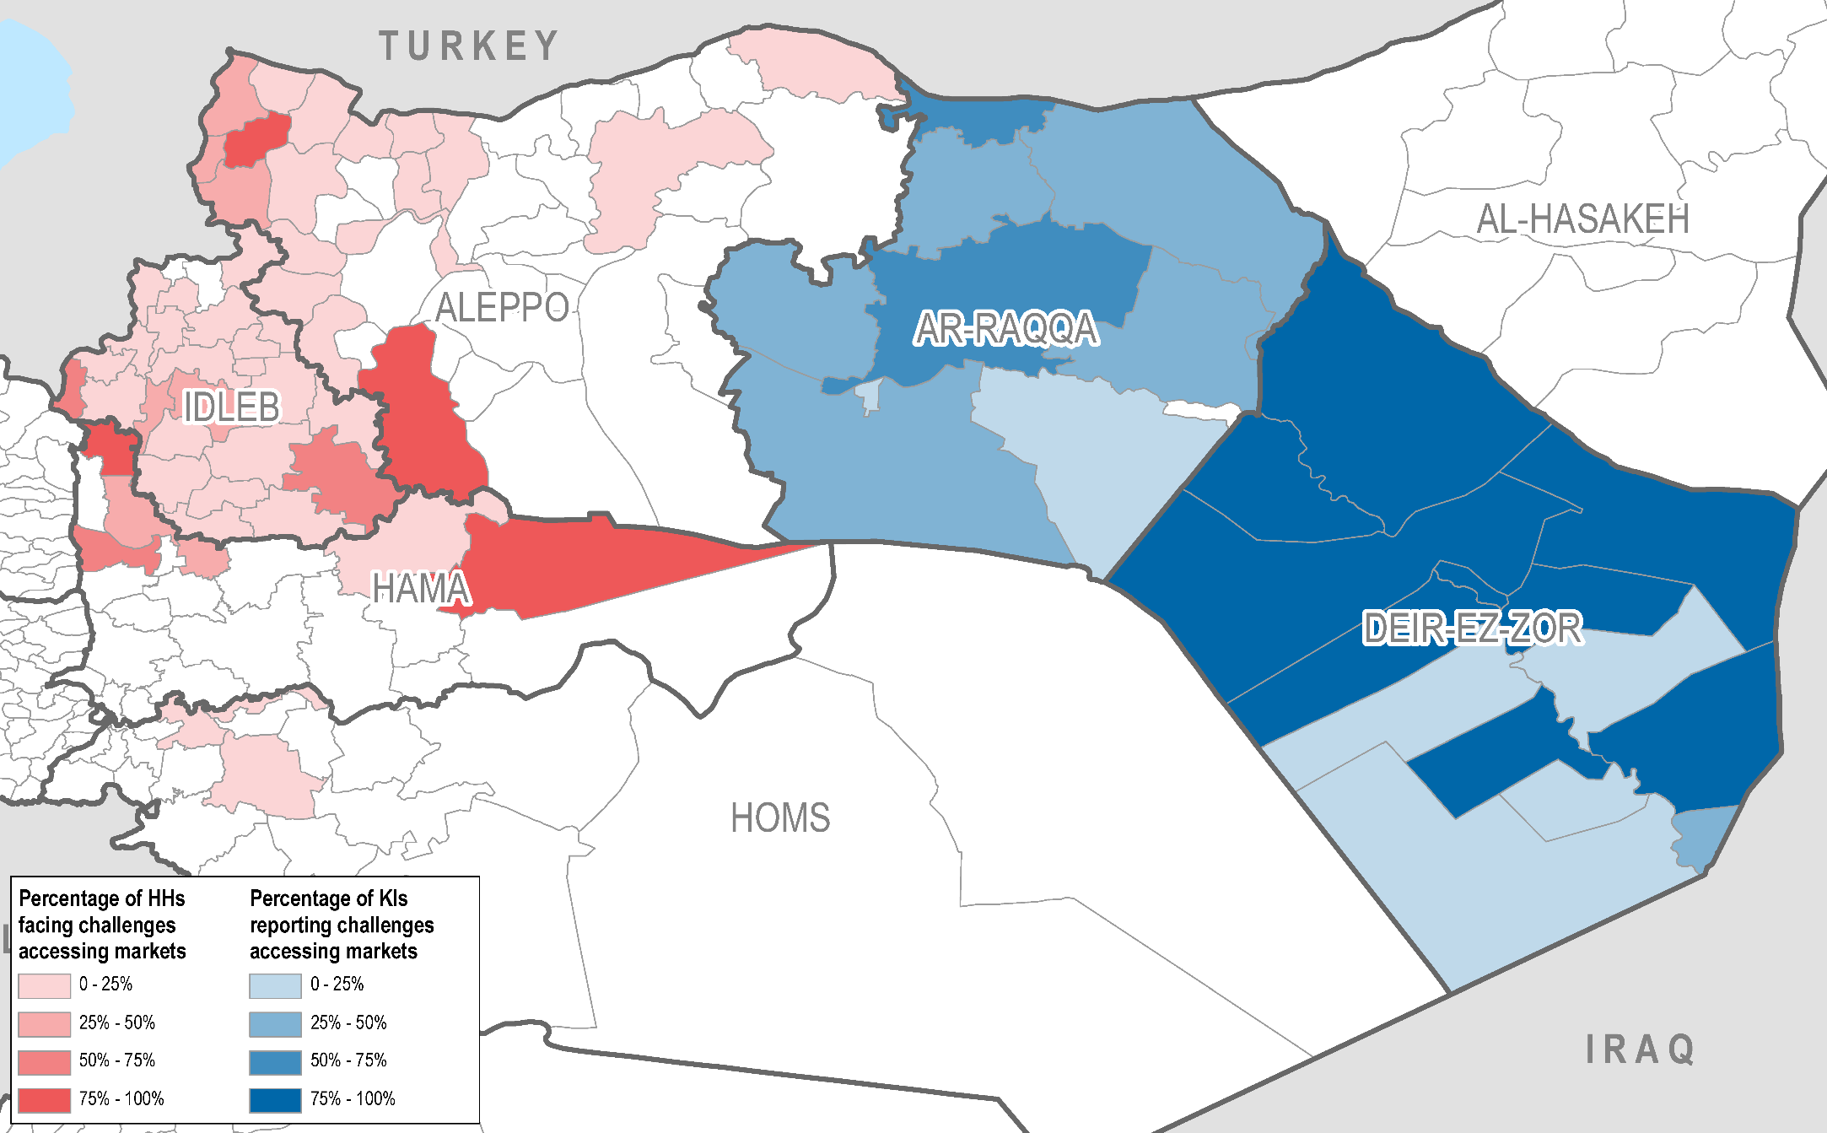
% reporting challenges to accessing markets

Slide 37
NFI availability and affordability
80-85% of HHs report availability and affordability challenges for NFIs (mostly affordability) in most governorates in NW Syria
  65% of HHs in Homs report availability/affordability issues for NFIs
100% of KIs report availability and affordability challenges in their communities for NE Syria
Percentage of those with availability/affordability issues reporting each item as unavailable/unaffordable (% of KIs reporting for Ar-Raqqa and Deir-ez-Zor):
 | Bedding items | Mattresses/Sleeping mats | Cooking utensils | Cooking fuel | Portable light sources | Clothing | Shoes | Batteries | Winter heaters | Heating fuel | Winter clothes | Winter shoes | Winter blankets
Aleppo | 3% | 5% | 5% | 29% | 49% | 21% | 9% | 21% | 6% | 17% | 6% | 4% | 3%
Hama | 1% | 1% | 5% | 47% | 36% | 10% | 3% | 29% | 3% | 18% | 2% | 1% | 0%
Homs | 1% | 1% | 2% | 20% | 40% | 5% | 0% | 22% | 1% | 37% | 2% | 0% | 2%
Idleb | 3% | 3% | 6% | 39% | 66% | 18% | 16% | 45% | 7% | 15% | 8% | 6% | 5%
Ar-Raqqa | 25% | 28% | 23% | 73% | 96% | 56% | 58% | 63% | 58% | 72% | 58% | 58% | 58%
Deir-ez-Zor | 7% | 7% | 7% | 69% | 55% | 50% | 36% | 32% | 31% | 43% | 25% | 24% | 22%
 | Water containers | Disposable diapers | Sanitary pads | Soap | Washing powder | Cleaning liquid for house | Detergent for dishes | Baby diapers | Adult diapers
Aleppo | 27% | 2% | 5% | 5% | 8% | 12% | 9% | 7% | 1%
Hama | 23% | 1% | 3% | 5% | 27% | 19% | 13% | 12% | 0%
Homs | 8% | 0% | 0% | 0% | 0% | 0% | 1% | 3% | 0%
Idleb | 14% | 2% | 6% | 10% | 15% | 7% | 9% | 13% | 2%
Ar-Raqqa | 62% | 51% | 52% | 37% | 39% | 37% | 32% | 55% | 54%
Deir-ez-Zor | 62% | 7% | 6% | 2% | 7% | 3% | 4% | 24% | 29%
Notes:
Mostly affordability issues
Interesting to note that availability/affordability issues don’t necessarily correlate with top 3 needs reported earlier (for children’s clothing and shoes in particular, but also for other items)
WASH and health items seem to have fewer availability/affordability issues

Slide 38
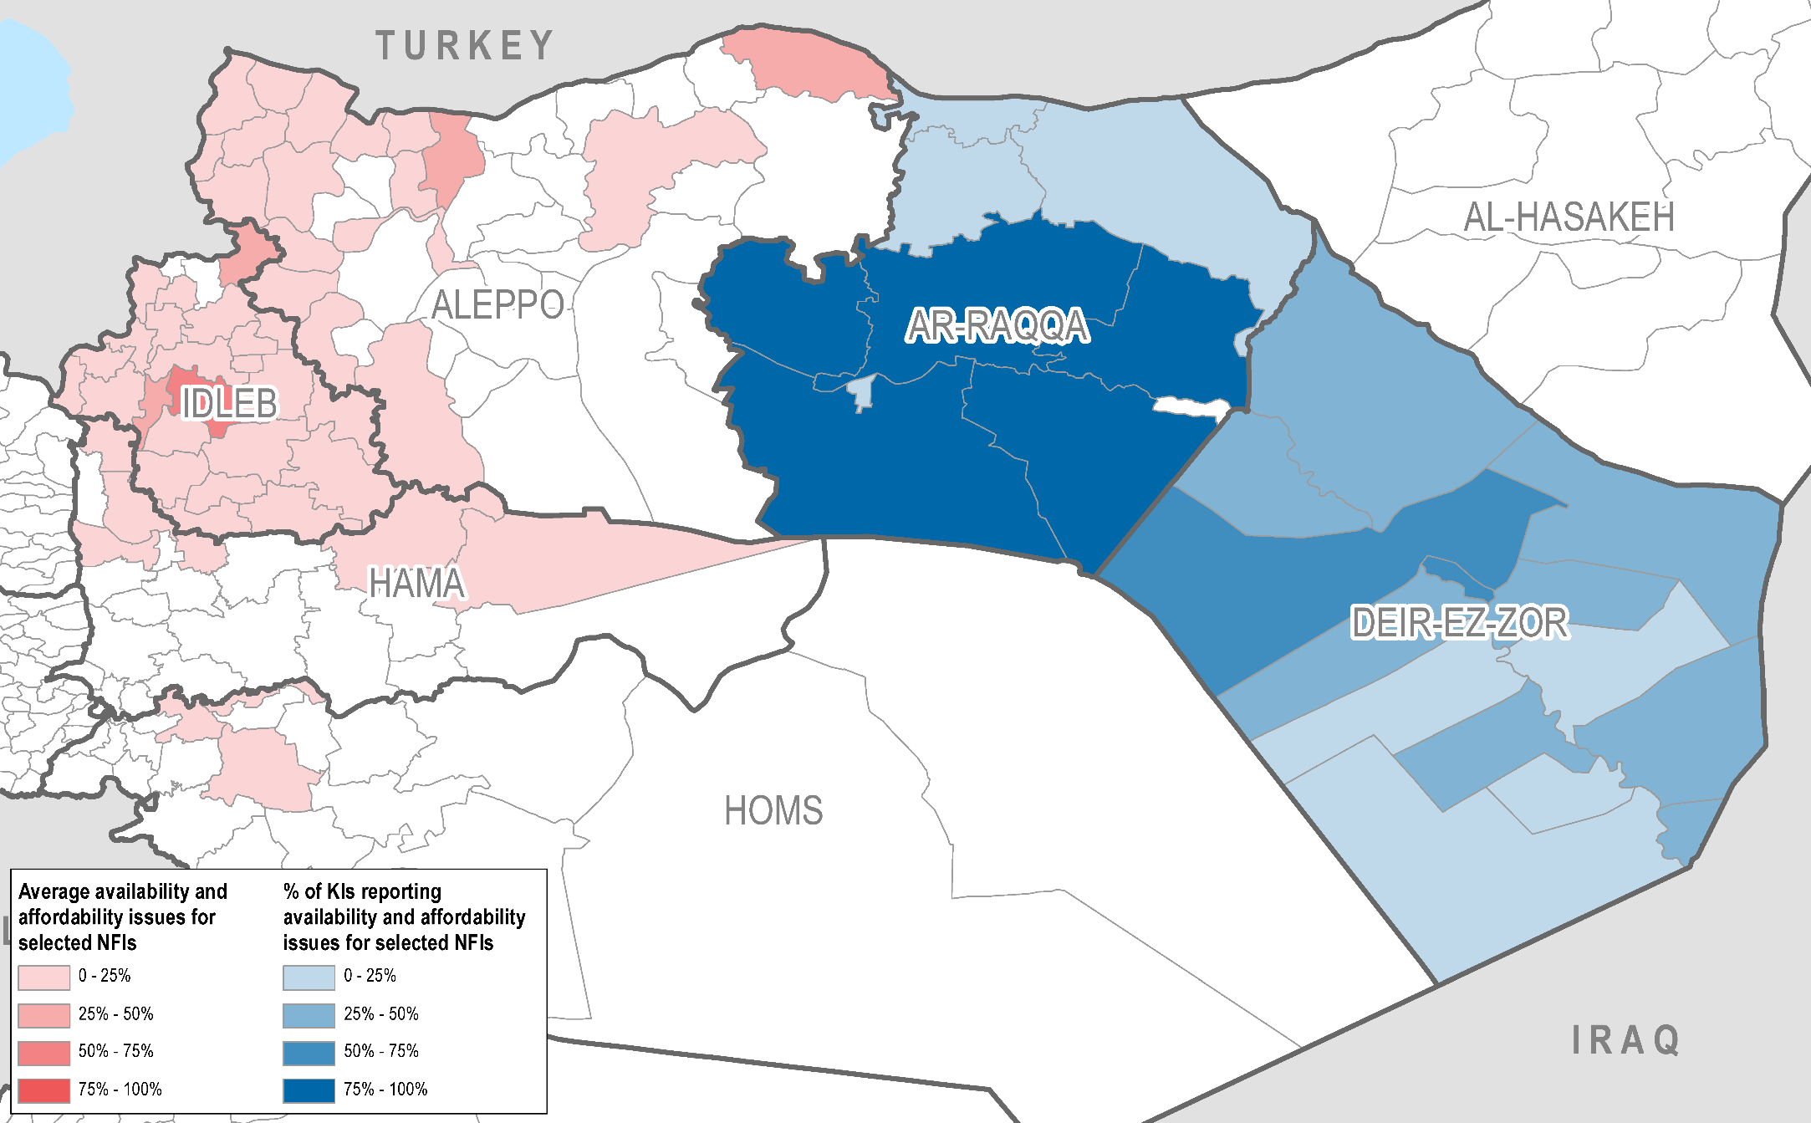
Average reported NFI availability/affordability issues (per sub-district)
Notes:
The selected NFIs are those in the first row of the heat map of the previous slide and water containers (i.e. excluding all WASH/health items except water containers)

Slide 39
NFI coping strategies
Percentage reporting the use of coping strategies in response to a lack of NFIs:
Top 3 coping strategies used in Northwest Syria (% of those using coping strategies reporting each):
Top 3 coping strategies used in Northeast Syria (overall % of KIs reporting each):
Notes:
FHH more likely to use coping strategies in Aleppo and Hama (by around 15-20%)

Slide 40
Fuel and electricity

Slide 41
Cooking fuel
Main sources of cooking fuel:
Notes:
Estimated %s for KI governorates
Gas (LPG) is the main source in NW Syria, although Kerosene still significant in Aleppo and Idleb
Electricity a major source in Hama
‘Other’ in Homs is diesel and burning plastic/waste
Kerosene the main source in Ar-Raqqa

Slide 42
Cooking fuel – coping strategies
Northwest Syria – Percentage of HHs using coping strategies in response to a lack of cooking fuel:
Top 3 coping strategies used in Northwest Syria (% of those using coping strategies reporting each):
Notes:
Higher coping strategy rate in Aleppo and Homs
Same coping strategies reported in NE Syria (except diet change less frequent and borrowing fuel more common)

Slide 43
Heating fuel
Main sources of heating fuel:
Notes:
Estimated %s for KI governorates
Kerosene used a lot more in NE Syria
‘Other’ is mostly burning animal waste or plastic
Interviewees were told to answer this question for last winter

Slide 44
Electricity
Percentage of HHs using more than one source of electricity:
Main sources of electricity:
38%
79%
94%
35%
Notes:
Hama seems to be mostly connected to the network
Almost no network in Idleb and Ar-Raqqa, none in Deir-ez-Zor
Deir-ez-Zor seems to have relatively high access to electricity: could be that fuel for generators is more easily available than in Ar-Raqqa

Slide 45
Electricity – hours of access per day and coping strategies
Average number of hours of access to electricity per day:
90% of households in Northwest Syria reported coping strategy use in response to a lack of electricity
Most common coping strategies: using battery-powered devices such as torches; using electricity only at certain times or for certain purposes.
Notes:
Lower coping strategy use in Hama (83%)
Same coping strategies in NE Syria

Slide 46
NFI support

Slide 47
NFI support
Main sources of information:
  Northwest: Local councils (65-75%)
  Ar-Raqqa: Friends/relatives and community representatives (more than half of KIs reporting each)
Only 5% of KIs in Deir-ez-Zor report that NFI support information is available in their communities
Percentage reporting that they received information on NFI support over the past year:
Preference for NFI support modality:
Notes:
Friends/relatives and internet/media also significant sources in NW
95% of KIs in Ar-Raqqa report that NFI support information was available in their communities
Majority of KIs in Ar-Raqqa report preference for unconditional cash support in their communities
Majority of KIs in Deir-ez-Zor report no preference, but of those reporting a preference, majority report preference for unconditional cash support:
Interesting to note the difference in NE Syria between preference for cash for NFI assistance but not for shelter assistance
Homs reports a lower preference for cash assistance than elsewhere
Low preference for conditional vouchers everywhere

Slide 48
Cash
The majority of HHs in Northwest Syria (85-90%) and KIs in Deir-ez-Zor reported that cash was accessible through pawnshops/remittance shops.
47% of KIs in Ar-Raqqa reported no means of cash distribution in their communities
Items that HHs would most likely buy if given cash or vouchers for NFIs (respondents were asked to list top 3 items):
 | Bedding items | Mattresses/ Sleeping mats | Cooking utensils | Cooking fuel | Portable light sources | Clothing | Shoes | Batteries | Winter heaters | Heating fuel | Winter clothes | Winter shoes | Winter blankets
Aleppo | 4% | 5% | 5% | 42% | 48% | 31% | 13% | 17% | 15% | 40% | 8% | 1% | 2%
Hama | 4% | 18% | 12% | 67% | 42% | 31% | 1% | 13% | 7% | 53% | 1% | 1% | 1%
Homs | 3% | 2% | 2% | 42% | 47% | 48% | 2% | 17% | 3% | 82% | 11% | 1% | 2%
Idleb | 2% | 2% | 4% | 49% | 72% | 19% | 4% | 45% | 8% | 32% | 8% | 1% | 3%
 | Water containers | Disposable diapers | Sanitary pads | Soap | Washing powder | Cleaning liquid for house | Detergent for dishes | Baby diapers | Adult diapers
Aleppo | 34% | 0% | 0% | 2% | 4% | 4% | 8% | 7% | 0%
Hama | 25% | 0% | 0% | 1% | 6% | 3% | 3% | 5% | 0%
Homs | 23% | 0% | 0% | 0% | 1% | 2% | 2% | 5% | 1%
Idleb | 20% | 0% | 0% | 1% | 3% | 2% | 3% | 9% | 0%
Notes:
98% of KIs in DeZ reported the presence of pawnshop/remittance shops as cash distribution points in their communities.
Interesting to note overlap between reported top 3 needs and items that HHs would buy with cash/vouchers
Fuel seems to feature heavily as an item that would be bought with vouchers/cash

Slide 49
Questions/Discussion/Feedback

