Slide 1
Study on Impact of Debt on IDP, Refugee and Host Community Households in Iraq
Inter-Sectoral Working Group Iraq
9 July 2020

Slide 2
AGENDA
1 – Introduction
2 – Assessment Methodology
3 – Findings
4 – Questions?

Slide 3
1
Introduction

Slide 4
Introduction
Main objective: To better understand how debt and borrowing affects socio-economic security and overall household vulnerability in Iraq
Population of interest: Out-of-camp IDP and refugee households and host community households
Geographical coverage: nationwide (nine governorates across the northern, central and southern region of Iraq)
Data collection: Two qualitative tools
8 Focus Group Discussions (FGDs): 10 to 18 December 2019
60 Individual Interviews (IIs): 17 to 19 December 2019

Slide 5
2
AssessmentMethodology

Slide 6
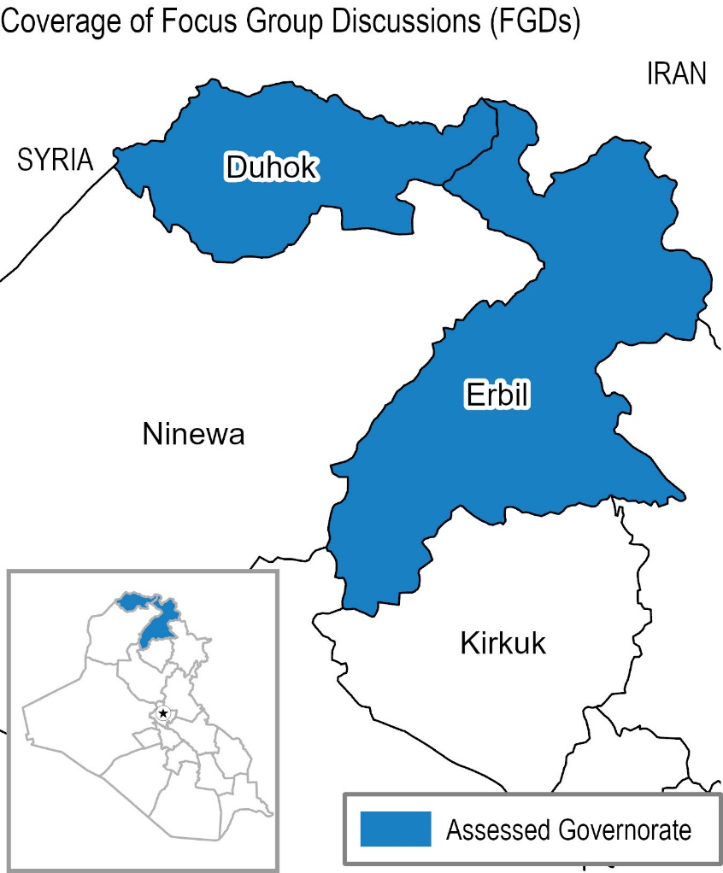
Assessment Methodology: FGDs
Target population | Gender of FGD | Selected locations in North (1 FGD per location)
IDPs | Female | Erbil
 | Male | Erbil
Refugees | Female | Erbil and Duhok
 | Male | Erbil and Duhok
Host community | Female | Duhok
 | Male | Duhok
Total |  | 8 FGDs

Slide 7
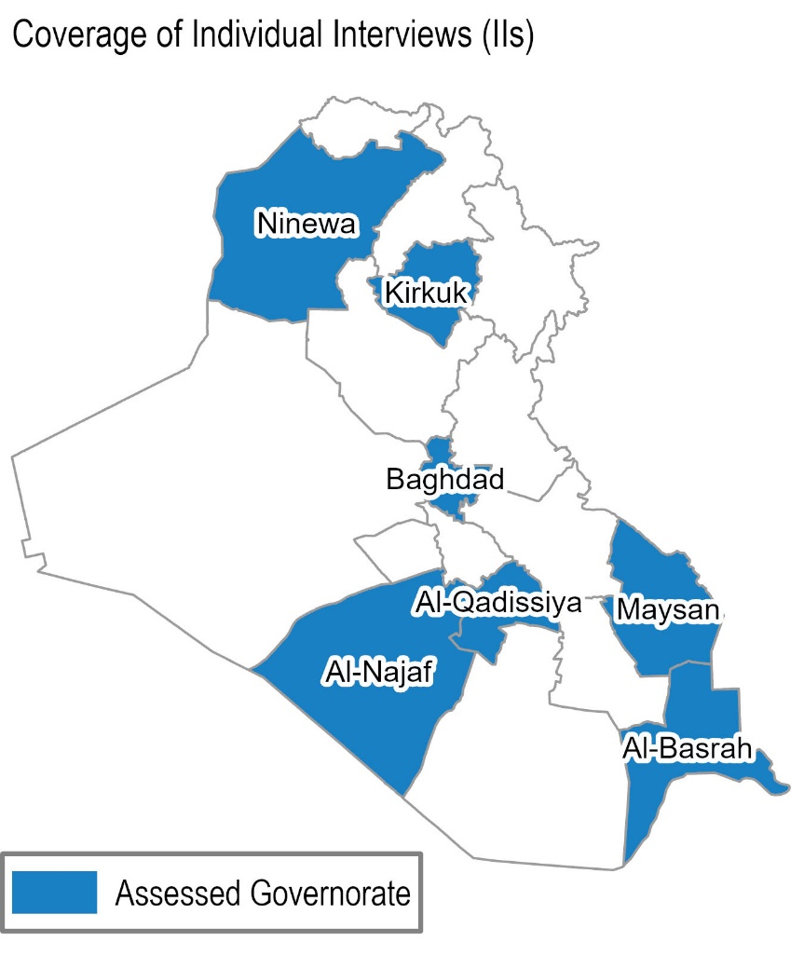
Assessment Methodology: Individual Interviews
Target population | Gender of IIs | North (3 IIs per location) | Centre (3 IIs per location) | South (3 IIs per location) | Total
IDPs | Female | Ninewa | Baghdad & Kirkuk | Al-Basrah & Al-Najaf | 15
 | Male | Ninewa | Baghdad & Kirkuk | Al-Basrah & Al-Najaf | 15
Host community | Female | Ninewa | Baghdad & Kirkuk | Al-Qadissiya & Maysan | 15
 | Male | Ninewa | Baghdad & Kirkuk | Al-Qadissiya & Maysan | 15
Total |  |  |  |  | 60 IIs

Slide 8
Assessment Methodology: Challenges and Limitations
Remote FGDs due to lack of access outside the KR-I – less personal interaction and discussion over the phone than in person
Limitations of purposive sampling through known networks – participants with ties to the humanitarian system
Self-reported findings from the FGDs and IIs are subject to a degree of desirability bias
Social desirability bias and group dynamics in FGDs might highlight a topic as more prevalent than other – might be more reflective of socially acceptance to discuss it instead of being more prevalent
Comparability of secondary and primary data – different population of interest in different assessments
Primary data: population with known existing debt – indicative qualitative data
Secondary data: population at large – statistically representative quantitative data

Slide 9
3
Findings

Slide 10
Key Findings: The status of debt in Iraq
Frequency of taking on debt varied depending on the individual household’s situation and needs
1 out of 3 FGD participants: regularly or at least monthly
1 out of 2 II participants: three times or more often
Items frequently reported as reason to have taken on debt
Rent
Food
Utilities and other household costs
Host community, IDP and refugee households all overwhelmingly borrowed from friends and family and often relied on verbal agreements and trust. This trustful relationship allowed them to have a more flexible timeline to repay their debts.
> This highlights the informal nature of the Iraqi debt network.

Slide 11
Key Findings: Impact of debt on household vulnerability
While employment might be available to participants, it was not sufficient and could often not prevent a household from taking on debt to cover daily or emergency expenses.
Lack of regular income was the most frequently reported challenge households faced when trying to repay debt.
Taking on debt was only one of the coping strategies reported to be used regularly by participants. Other coping mechanisms frequently reported:
Limiting portion size at mealtimes
Reducing essential expenditures
> Most participants reported taking on debt as a ‘last resort’ and first used other coping strategies
Being in debt prevented participants from investing in productive assets that would be an important source of future income.
The constant knowledge of their debt affected the participants on a psychological level.

Slide 12
Key Findings: Impact of debt on household vulnerability
All refugee participants reported having more debt after having been displaced.
“We used to live in our own house in Syria and did not have to pay rent” Female FGD participant in Duhok
“Expenses are much higher here than in Syria” Male FGD participant in Duhok
About two thirds of refugee participants reported that being in debt affected their decision to return to Syria or stay in their current location.
“As we borrow from our community, we cannot ‘escape’ debt, even back to Syria.” Female FGD participant in Erbil
“We don’t want to leave without repaying our debt” Female FGD participant in Duhok
“It is our responsibility to pay back our debt, otherwise it might affect fellow refugees” Female FGD participant in Erbil

Slide 13
Key Findings: Debt and multi-purpose cash assistance (MPCA)
+ MPCA had an impact on HH debt (14 out of 27 participants)
Helped to repay debt
- MPCA did not have an impact on HH debt (13 out of 27 participants)
The amount was not enough
The assistance was used for basic needs and specific purpose (i.e. winterization needs)
“I used half of the assistance to repay debt, and the other half to pay for basic needs” (Female IDP II participant in Al-Basra)

Slide 14
Key Findings: Differences of debt across population groups
Only host community members reported borrowing from formal institutions (three residing in Maysan and two in Duhok).
Reasons discussed in FGDs: lack of knowledge of institutions to borrow from and missing necessary documentation
Refugees in the FGDs in Erbil and Duhok mentioned borrowing almost exclusively from other Syrians, with the notable exception of Iraqi shop owners for smaller amounts.
Reasons discussed in FGDs: lack of trust of host community and established family ties and friendships
Host community households more frequently reported using debt to finance investments such as purchasing productive assets, while IDP and refugee participants reported using debt to pay for regularly occurring expenses such as rent or food.

Slide 15
Key Findings: Differences of debt across gender and location of residence
Borrowing was perceived to be more difficult for women in central and south locations in Iraq. However, participants in the northern locations, particularly in Erbil and Duhok, reported that this depended on the amount and the lender.
Reasons discussed in FGDs: many participants agreed that borrowing from family was easier for women, as women were reported to be closer to their relatives and there was more trust.
Otherwise, no clear different trends could be established across the different locations of residence. However, in the secondary data analysis, the average amount of reported debt was larger in the northern Iraqi governorates than in the southern governorates.
Reasons: conflict-affected governorates and governorates hosting IDPs and refugees showing larger average amount of debt

Slide 16
Conclusion
Overall, stories of participants of all three population groups assessed stressed the importance of regular employment to be able to not take on debt and to repay outstanding amounts they had taken on for various purposes.
Overwhelmingly, being in debt affected the households on a psychological level and prevented them from focusing their scarce resources on daily expenses and future investments, and instead led them to worry about how to repay outstanding debt.

Slide 17
4
Questions?

Slide 18
Questions?
Study on Impact of Debt on Internally Displaced Person (IDP), Refugee and Host Community Households
Available online
Research Contacts
Anja Grob, Senior Assessment Officer, IMPACT Initiatives anja.grob@reach-initiative.org
Nick Archdeacon, Research Manager, IMPACT Initiatives nicholas.archdeacon@impact-initiatives.org

