Slide 1
MENBIJ DISTRICT
Situation Overview and Gap Analysis Workshop

Slide 2
Outline
SECURITY BRIEF
OVERVIEW
  Methodology + Population
  Inter-Sectoral Overview
  Area Overview
  Response Overview
Sector/Area Discussions
  Livelihood and Food Security
  Shelter and NFIs
  WASH
  Health
  Education and Protection

Slide 3

SECURITY BRIEF

Slide 4
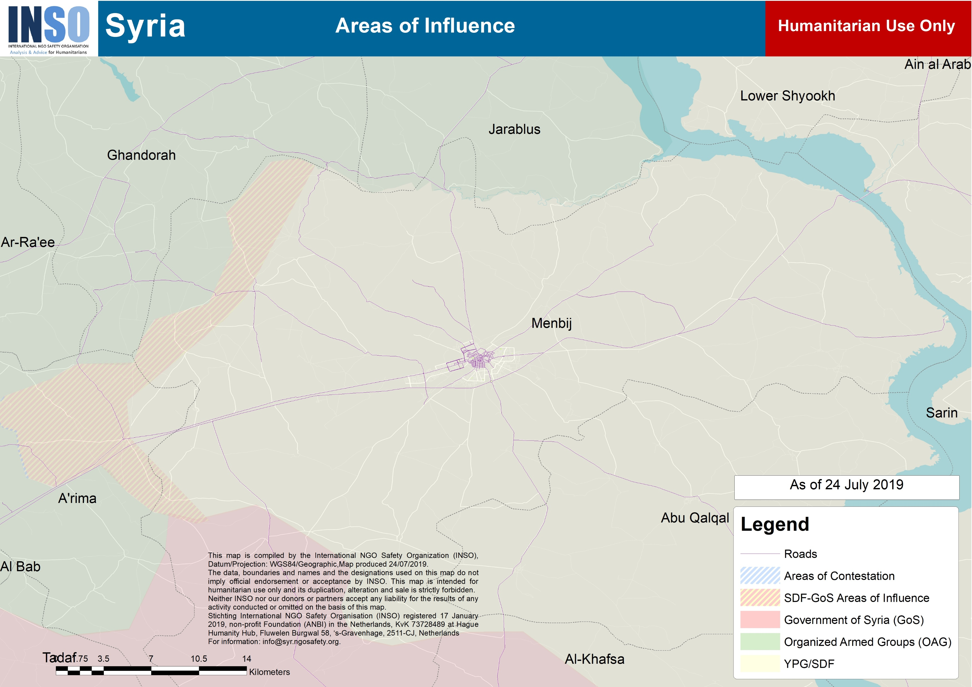
Dadat
Crossing
Halawanji
Crossing
Um Jlud
Crossing
Tayha Crossing
Notes:
Green - GoS-SDF area => GoR/GoS deployment to create a buffer/ separation between SDF and OAGs (December 2018)
Red – Menbij Roadmap (June 2018) Joint TAF-CF patrols

Slide 5
Frontlines
High level of activity along the OAG/SDF frontlines
    Regular clashes and skirmishes
    More than 50 incidents of direct and indirect fire attacks
    Menbij road map (June 2018) = TAF/CF patrols
Limited level of activity along the GoS/SDF frontlines
    Limited incidents recorded
    SDF-GoS area of influence
Notes:
SDF/OAGs = lot of smuggling business (mainly vehicle although now decreasing)

Slide 6
Conscription
Six circulars issued since 03 November 2017 by MCC/MMC regarding conscription.
Civil unrest/ demonstrations => since then only limited number of conscription arrests
Civilians required to “report” to conscription centres, but no arrests conducted.
Civilians from NES can be conscripted in Menbij and vice-versa.
Notes:
Conscription for people living in menbij but not from menbij.
Or from membij in the rest of NES

Slide 7
Tribal DynamicS
Menbij District is inhabited by at least 20 Arab Tribes, mainly Bu Bana, Bu Sultan, Bani Said, Ganayim, Kharaj, Ajlan, Al-Aoun, Bani Assed, Glad, Khanafra, Adwan, Naim, Al-Jays, Hamdoun, Bu Batoush, Ameirat, and Damalkha.
Menbij City is a very diverse environment with the majority of the population coming from the 20 above-mentioned Arab tribes, Kurds (mainly in the eastern sector of the city), Turkman, and few Circassians.
Tribal tensions and altercations are relatively rare in Menbij Sub-District, compared to the tribal tensions in NES (the Justice committee of MCC established the reconciliation committee —consisting of several tribal and community leaders in Menbij District— to settle tensions between MMC and tribes as well as altercations within the tribes)
Noticeable tribal/local authorities tensions (settled by SDF relations office/and reconciliation committee) include but are not limited to:
The tensions and demonstrations with Bu Bana Tribe after the killing of 2 Bu Bana tribesmen in MMC prison. (January 2018)
Tensions/demonstration by Bu Sultan tribesmen following the arrest of Bu Sultan tribal leader after he spoke out against the MMC imposed conscription law (Late 2017).
Tensions/demonstration by most of the tribes following the conscription campaign in late 2017.

Slide 8
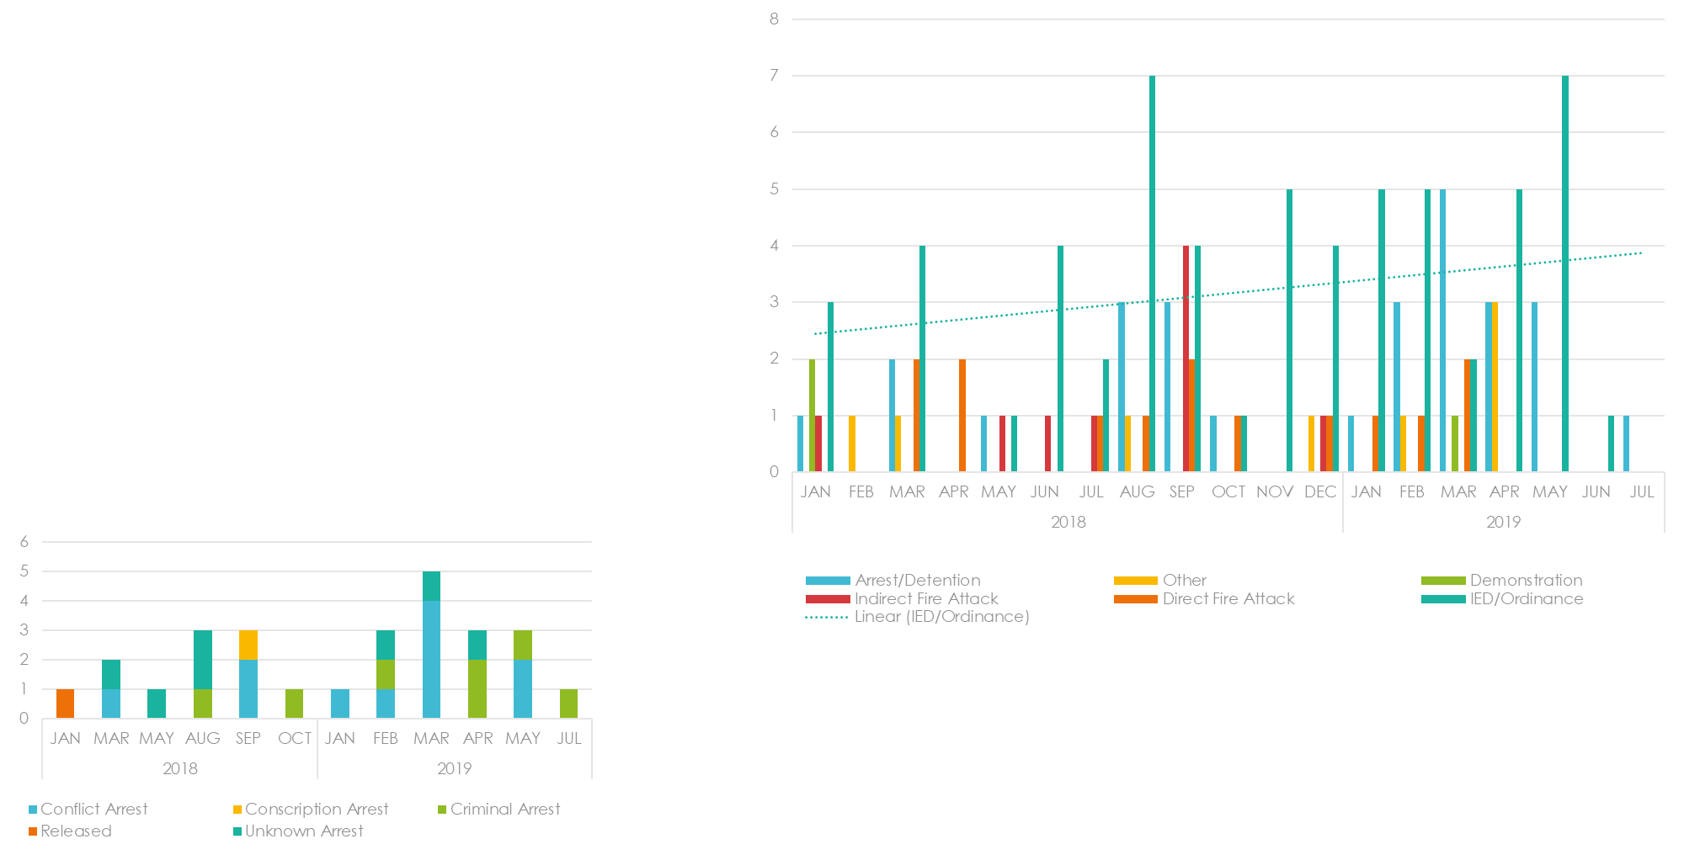
Menbij city
    25 IED attacks + 2 IED Rendered Safe
    15 Arrests/Detentions
        8 Conflict (IS/OAGs)
        5 Criminal
    4 Direct Fire Attacks
    3 Robberies
    1 Demonstration
Notes:
Every actor can find a lot of supporters
IED = OAGs/GoS/IS
IS (more capacity than in Hasakeh but less than Raqqa) => not strategic anymore in terms of going into GoT, but remains an smuggling route to go to GoT or Idlib
Motorbike ban around the market => related to traffic

Slide 9
TAF/OAG
TAF agenda in Menbij = prevent expansion of SDF area
    Menbij Road map = TAF/CF joint patrols
    OAG/SDF frontline = more possible probing
    December /January : switch from Menbij => East Euphrates
        GoS proximity & GoS/MMC relations
        Menbij remains vulnerable by geographical positions (west Euphrates; OAG frontline)
Indicators
    Removal of parts of the border wall
    Increased cross-border fire
    Increased IED attacks in ES and OB areas by YPG/YPG-supported armed groups (Falcons of Afrin)
    GoT deporting Refugees/IDPs

Slide 10
Questions?
Advisory Team
North Safety Advisor – Maiwand Halaimzai
+90 537 445 1187| Skype: inso.syr.north | email: sa.north@syr.ngosafety.org
East Safety Advisor – Mahaut de Talhouet
+963 998 9080 96 | +90 534 885 1536 | +964 751 520 8056 | Skype: inso.syr.east | email: sa.east@syr.ngosafety.org
Mobile Safety Advisor – Greg Beattie
+961 71 878 348 | +962 799 457 842 | Skype: inso.syr.mobile | email: sa.mobile@syr.ngosafety.org

Slide 11
Methodology and Population Figures

Slide 12
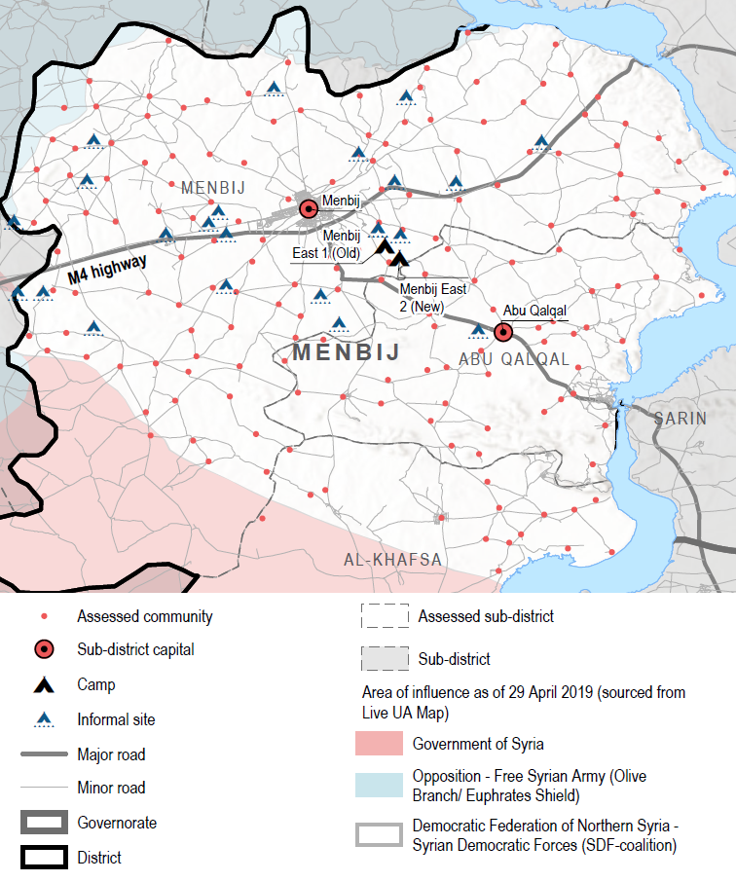
Methodology
MENBIJ DISTRICT AREA OF ASSESSMENT
Data collection by HNAP - 9 to 29 April 2019 in 171 locations across three opposition-controlled sub-districts in Menbij district. REACH conducted analysis and undertook reporting.
Data collected at neighbourhood level in all 16 neighbourhoods of Menbij city. Two KIs interviewed in each area, triangulated with other sources.
Response info for NGOs from NES Forum and for UN by OCHA..
KI methodology – indicative only

Slide 13
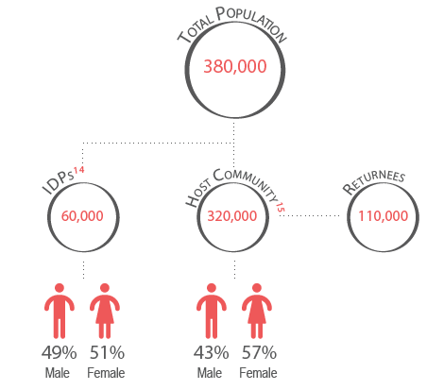
Demographics
Population figures for assessed communities in Menbij district:

Slide 14
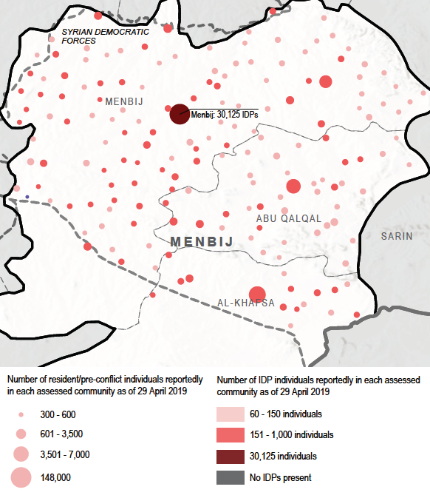
Demographics
Population size and distribution in assessed communities:

Slide 15
INTER-SECTORAL OVERVIEW

Slide 16
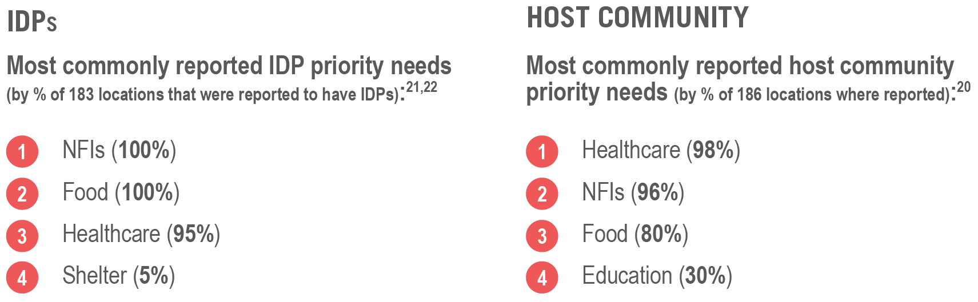
Key findings
 People living in Menbij district have significant needs related to past and current displacement, a lack of sufficient livelihoods, and reduced access to services in rural areas.
 People struggle to afford costly medical services, food, non-food items (NFIs) and education materials even though they are largely available.
 The humanitarian situation and access to services was notably worse for IDPs and host community members living in rural areas than for people in urban areas.
 Despite an active humanitarian response in the area, gaps remain between the available assistance and needs.
 Food, healthcare, and NFIs are the most commonly reported priority needs in the assessed area.

Slide 17
AREA OVERVIEW
Urban vs Rural
Informal Sites
Menbij City
Camps

Slide 18
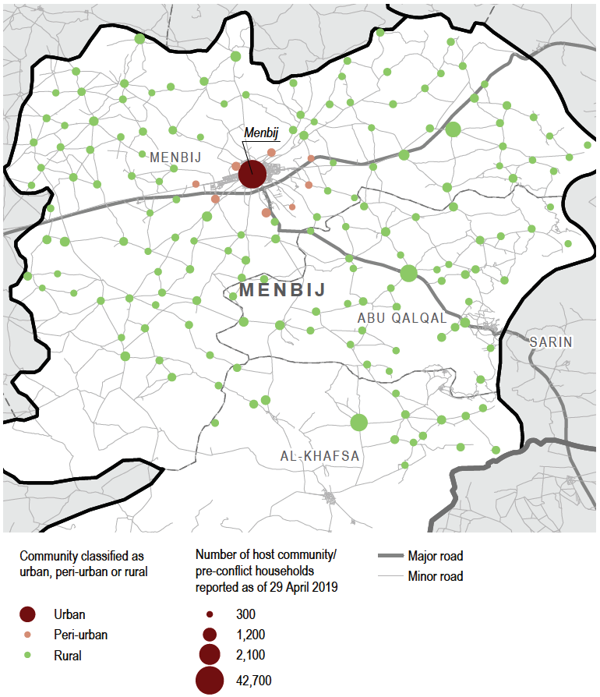
Urban and peri-urban vs. rural communities
Population in peri-urban/urban areas better able to access essential goods and services due to the availability of markets, schools, and health facilities in proximity.
Other infrastructure, such as the main water network, was also more commonly available in urban than in rural areas.
Limited response in rural areas despite poorer access to services.

Slide 19
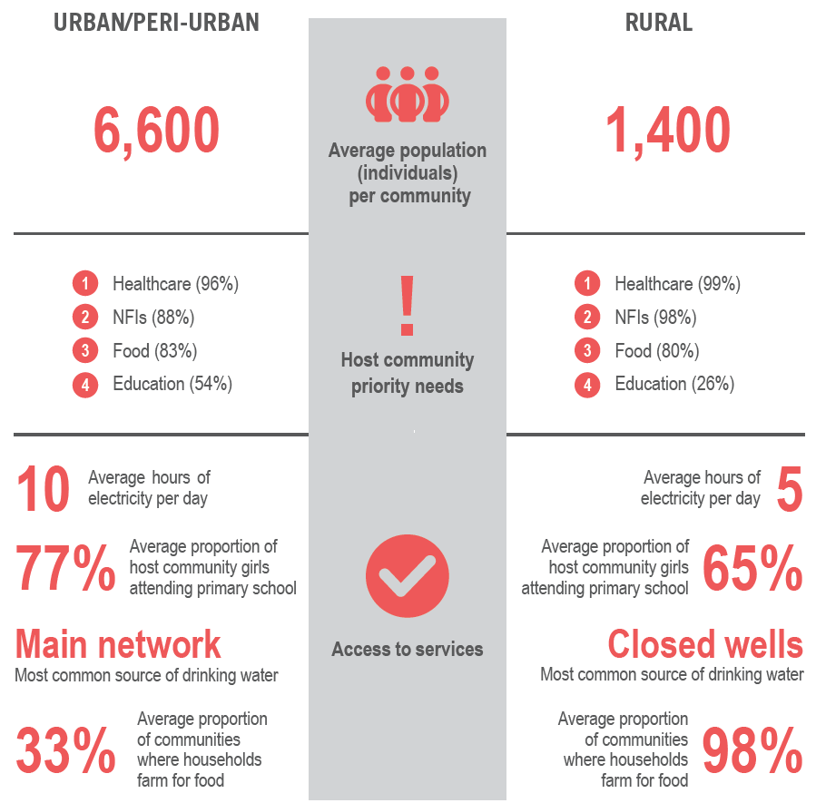
URBAN VS RURAL

Slide 20
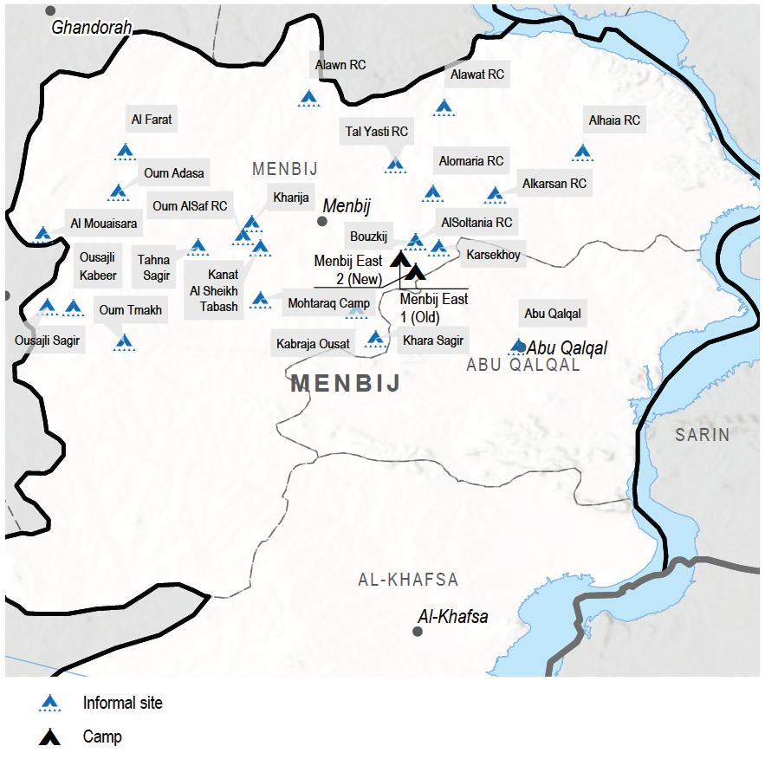
Informal Sites: Locations
Findings from informal site assessment in Dec 2018
Of 22 known sites from NGO mapping, 7 assessed.
Most common area of origin within Aleppo - with some coming from Idleb and Ar-Raqqa governorates.

Slide 21
INFORMAL SITES (as of December 2018)
 There reportedly was no access to education due to a lack of schools within accessible distance, while a lack of livelihoods also likely limited access, as children reportedly worked.
 The majority of people residing in informal sites lived in tents, with shelter conditions reportedly inadequate for winter. Tents, winter blankets, and heating fuel were among the most common priority needs.
 Markets outside the settlement were the most commonly reported source of food. In one site, Um Tnakh, food distributions were reportedly available, while in another site, Little Osajli Camp, some people reportedly spent days without eating.
 While access to water varied significantly across sites, sanitation problems were common in all assessed locations, with open defecation the most common alternative to latrine use and a severe lack of garbage collection and sewage systems.
 People reportedly most commonly accessed health facilities in neighbouring communities. Six of the seven assessed sites reportedly had no access to some essential medical services.

Slide 22
MENBIJ CITY
 People live within accessible distance of hospitals, schools, and markets, yet healthcare was largely unaffordable and not easily accessible. Safety and security concerns were the main barriers to accessing markets, but all food items were generally available.
 Healthcare was reportedly the first priority need in Menbij city, followed by NFIs and food.
 Day labour, skilled trade, and shop keeping were key sources of income for host community members. Low wages and restrictions by local authorities were main barriers to livelihoods. Child labour was reported in every neighbourhood, particularly for boys.
 The main water network was the main source of water in Menbij city, working only a few hours per day. Alternative sources of water were generally too expensive.
 Education was widely available, but a lack of personal documentation, teaching and learning supplies as well as overcrowding negatively influenced access (for both IDP and host community children).
 8% of shelters reportedly had major damage in Menbij city (compared to 1% for the district as a whole), and 4% of shelters saw severe damage, while 4% were completely destroyed (compared to less than 1% for the entire district).

Slide 23
Menbij Old Camp
Population: 1,910 ind/ 366 HHs. 99% have no intention to leave
Regular Response: WASH, food vouchers, CFS, CFW (2 NGOs)
One-off Response: Tent replacement, NFI summer kits (3 NGOs)
Services: WASH (NGO), CFS (NGO), Primary school (LA), PHC clinic (LA)
Notes:
We will add heat map indicating number of sector reporting by community

Slide 24
Menbij New Camp
Population: 3,072 ind/ 535 HHs. 100% have no intention to leave
Regular Response: WASH, food vouchers, CFS, CFW (2 NGOs)
One-off Response: Tent replacement, NFI summer kits (3 NGOs)
Services: WASH (NGO), CFS (NGO), Primary school (LA), PHC clinic (LA)
Notes:
We will add heat map indicating number of sector reporting by community

Slide 25
Camps: Key Issues
High prevalence of child protection issues, with 67% of HHs in old camp and 58% of HHs in new camp reporting child protection issues.
Low levels of primary school attendance, especially in new camp
Low recourse to health clinic inside the camps, while barriers reported by almost 50% of HHs in both camps (e.g. Old: of 55% of HHs who required health treatment, only 3% received treatment inside camp.
Limited access to income-sources outside the camp, with only 43% (old) and 51% (new) of HHs report earning an income outside the camp
Notes:
We will add heat map indicating number of sector reporting by community

Slide 26
Multi-sector Response Overview

Slide 27
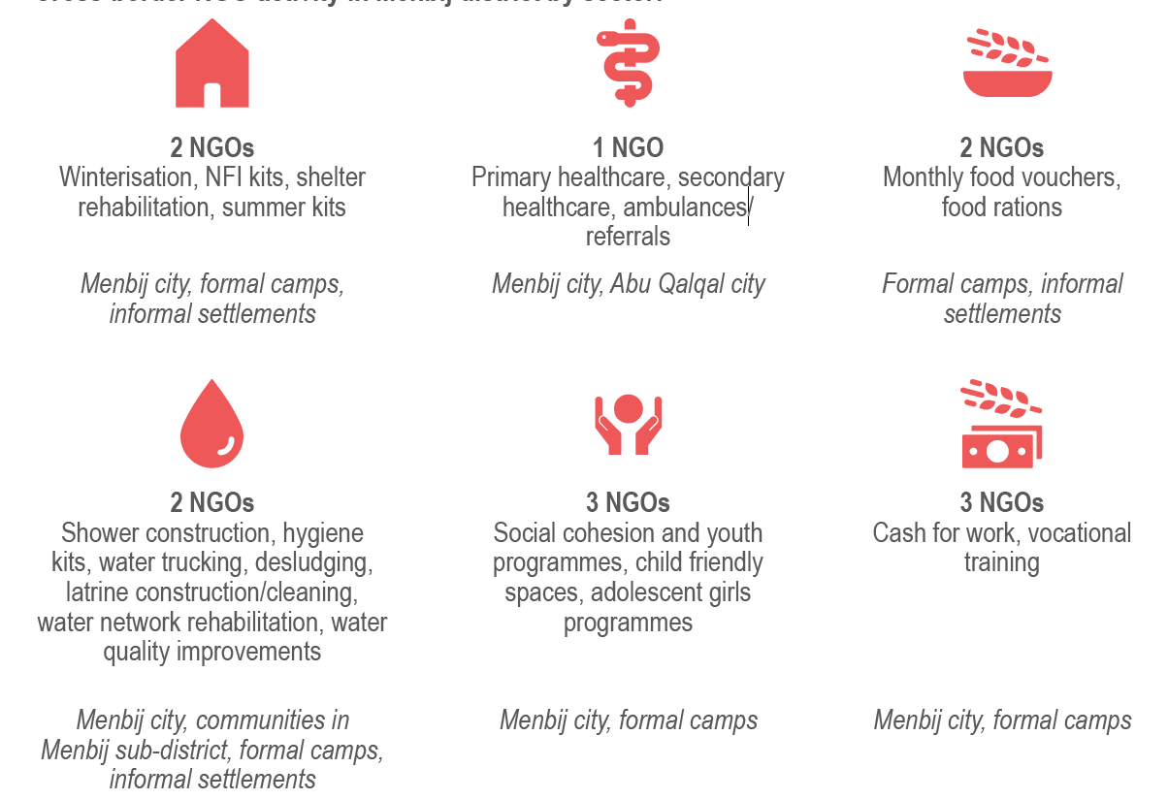
Cross-border NGO activity in Menbij district by sector

Slide 28
People reached per month
Number of partners reported: 4
27 k
26 k
22 k
People reached refers to the number of people provided with humanitarian assistance (WASH, SNFI, FSL, CASH and Education), or interventions (Health and Protection) by one or more sectors during the month, taking the highest sector total per sub-district.

Slide 29
People reached by area (March – May 2019)
Average reach per area:
Menbij City | Camps | SD rural | Al Khafsa | Abu Qalqal
5 | 2 | 2 | 1 | 1
Area
Partners

Slide 30
Average # people reached against PiN (March – May 2019)
12%
Area | PIN | Reached | Percentage
Menbij City | 87452 | 15642 | 18%
Camps | 5338 | 3500 | 66%
SD rural | 90601 | 10532 | 12%
Al Khafsa | 19602 | 8048 | 41%
Abu Qalqal | 26901 | 463 | 2%
18%
2%
41%
66%

Slide 31
Scope of response by area (March – May 2019)
Notes:
We will add heat map indicating number of sector reporting by community

Slide 32
SECTOR DISCUSSIONS
Livelihoods + Food Security
Shelter + NFIs
WASH
Health
Education + Protection

Slide 33
 LIVELIHOODS +
FOOD SECURITY

Slide 34
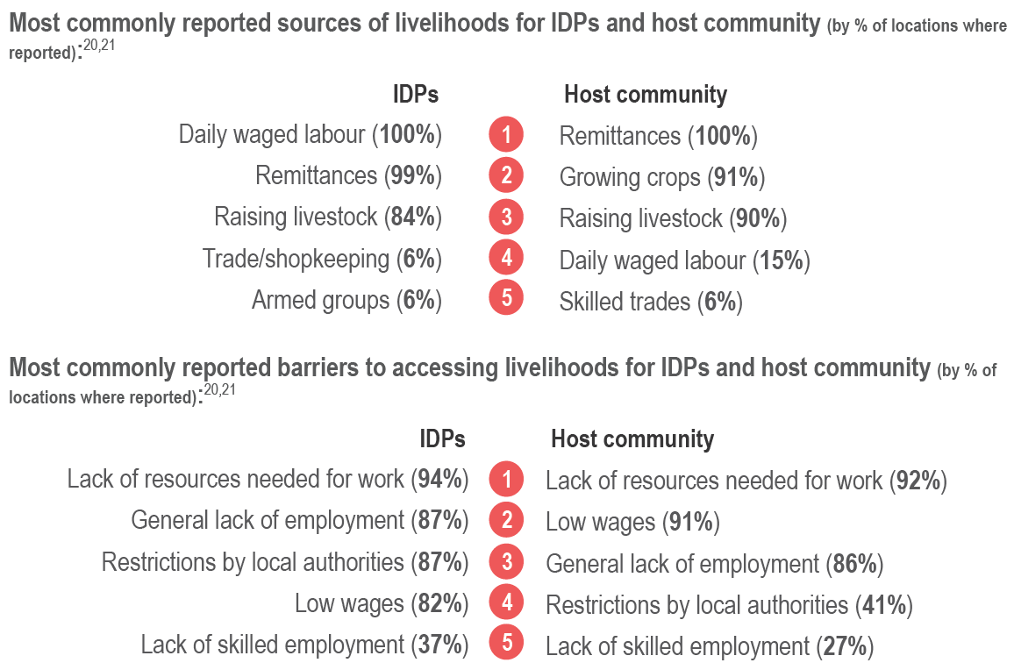
Livelihoods – challenges, sources & barriers
A lack of sufficient livelihoods affects needs across nearly all sectors.
Most common sources of income are agriculture and remittances, rather than skilled employment or trade. The average IDP household earned 10,000 SYP less per month than an average host community household.
In Menbij City, day labour, skilled trade, and shop keeping were reported as sources of income for host community members.
Low income and high prices of goods, services, and transport limit households’ access to food, healthcare, WASH, electricity, NFIs, and education.

Slide 35
Livelihoods – IDPs
The livelihoods situation for IDPs in Menbij is considerably worse than that of host community households.
Average income for both IDPs and residents in Menbij district is reportedly on par with an average salary between 50,000 and 100,000 SYP for most regions of NES.
Accessing healthcare, NFIs and food are the most commonly reported obstacles for IDP and host community households earning less than 50,000 SYP, as reported by KIs.

Slide 36
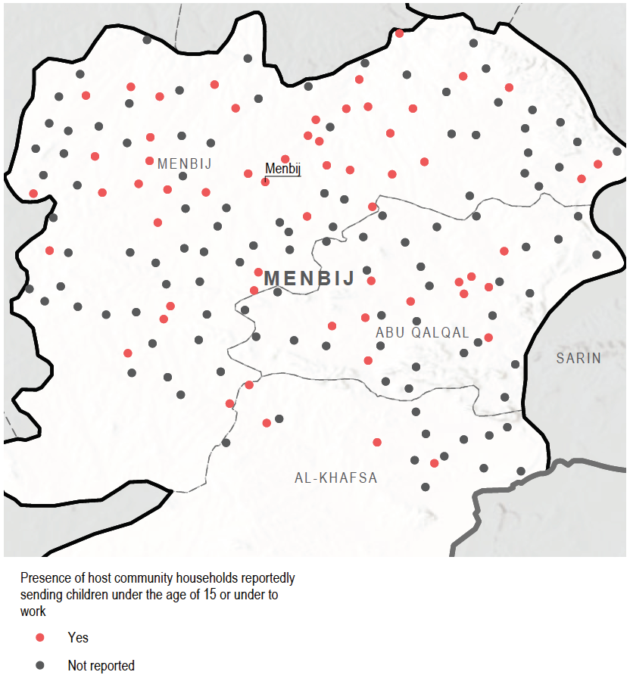
Livelihoods – coping strategies
Communities where host community child labour was reported

Slide 37
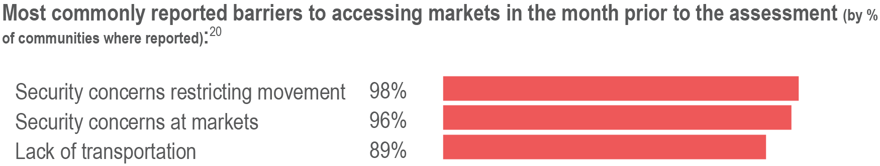
Barriers to accessing markets
Access to food and markets was reportedly hampered by security concerns and challenges to travelling to markets, such as lack of transportation.
UXOs pose danger to travel throughout the district, potentially having broader implications for markets in other areas of NES as well.

Slide 38
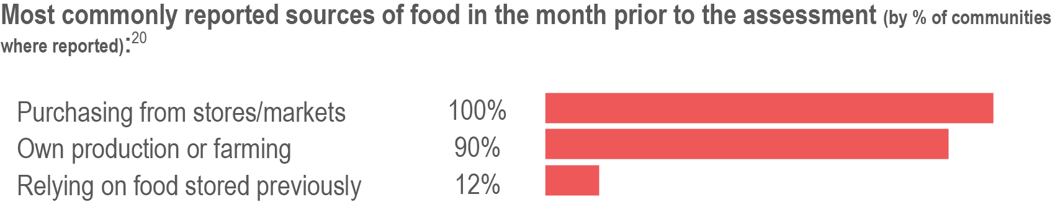
Sources of food
Most of the population has access to available and affordable food items, despite security and transportation challenges to access markets.
Households purchase food from stores and markets, but also rely for a great part on their own agriculture and livestock as sources of food.
Essential food items were available for purchase in all communities and most households could reportedly afford them.
Food was reportedly not sufficient in one informal site, Little Osajli Camp, with households reportedly spending days without eating.

Slide 39
FSL
Average number of people reached over 3 months: 23,000
Average reach per area:

Slide 40
ERL

Slide 41
Food Security
 | Menbij Camps | Menbij City | Menbij SD (rural) | Abu Qalqal | Al Khafsa
Response | Food vouchers (monthly) | Food vouchers to 1,076 IDP HHs in unfinished buildings monthly UN Convoy: 2,208 food rations, 1,692 RTERs and 2,469 wheat flour rations | Food rations to 210 HHs in informal settlements | ? | Food rations to informal settlements
Key Issues/ Gaps |  | Safety and security concerns | Safety and security/ perceived presence of UXOs | Safety and security/ perceived presence of UXO | Safety and security/ perceived presence of UXOs
Food items reported as affordable for the majority of people in the month prior to the assessment. Are these findings consistent with your experience? Are there additional challenges in areas outside Menbij city in terms of food affordability?
Notes:
We will add heat map indicating number of sector reporting by community

Slide 42
Livelihoods
 | Menbij Camps | Menbij City | Menbij SD (rural) | Abu Qalqal | Al Khafsa
Response | Cash for Work | 2 NGOs supporting VT including sewing, mobile phone repair, refrigerator, washing machine maintenance, electrical wiring, stylist and barber training | No response reported | No response reported | No response reported
Key Issues/ Gaps | Expanding access to income outside camps. Integrated programming to address child labour | Livelihoods for IDP HHs who earn less, face more barriers to basic needs. Restriction from authorities. Integrated livelihood programming which address child labour | IDP HHs earn less. High recourse of food-based coping strategies in informal sites | High number of communities where child was labour reported
What kind of livelihood interventions have been most feasible in Menbij city
How can partners support livelihood interventions for IDPs living in camps and sites? What are appropriate interventions?
Notes:
We will add heat map indicating number of sector reporting by community

Slide 43
 SHELTER, NFI + ELECTRICITY

Slide 44
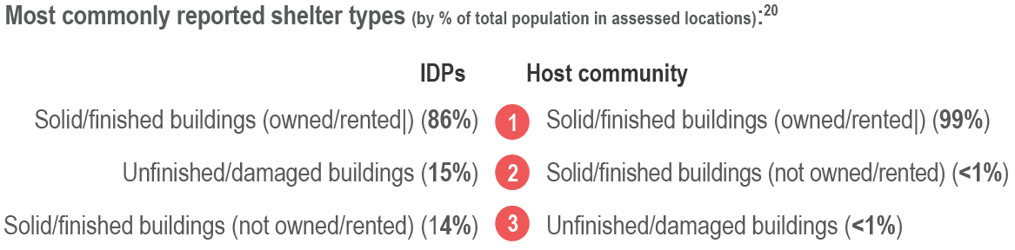
Shelter types
Most IDPs and host community members reportedly lived in solid finished buildings, despite commonly reported shelter inadequacies such as lack of heating, lack of insulation from cold and lighting inside/around shelter.
The majority of people living in Menbij district own or rent the shelter they are living in.
The cost of rent has stayed approximately the same compared to the month before in 98% of assessed communities.

Slide 45
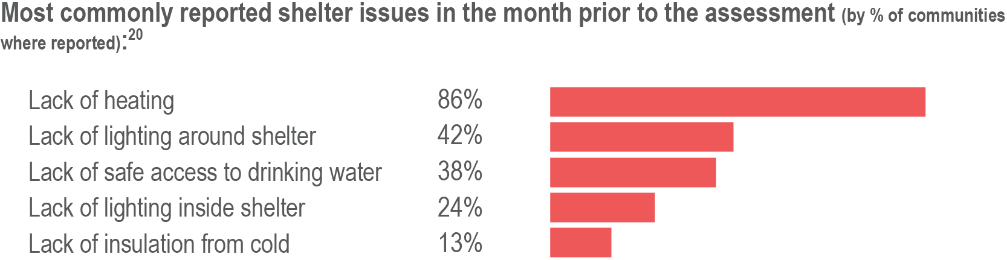
Shelter issues
Lack of lighting in and around shelters is a protection risk impacting mainly women and children, reported in 42% of assessed communities.
Shelters in Menbij city were particularly unequipped to keep residents warm, as a lack of heating possibilities and a lack of insulation from cold widely reported.
The majority of people residing in informal sites lived in tents, with shelter conditions reportedly inadequate for winter. Tents, winter blankets, and heating fuel were among the most common priority needs.

Slide 46
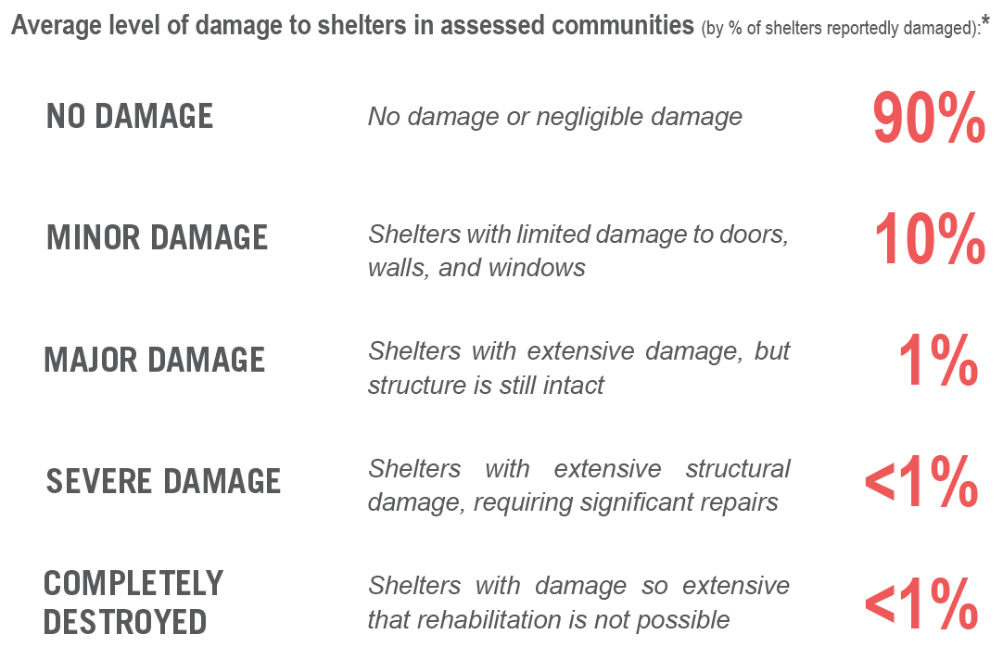
Shelter damage
Two years after the end of active conflict, some buildings across the district remain damaged, negatively impacting access to services and creating challenges for already precarious livelihoods.

Slide 47
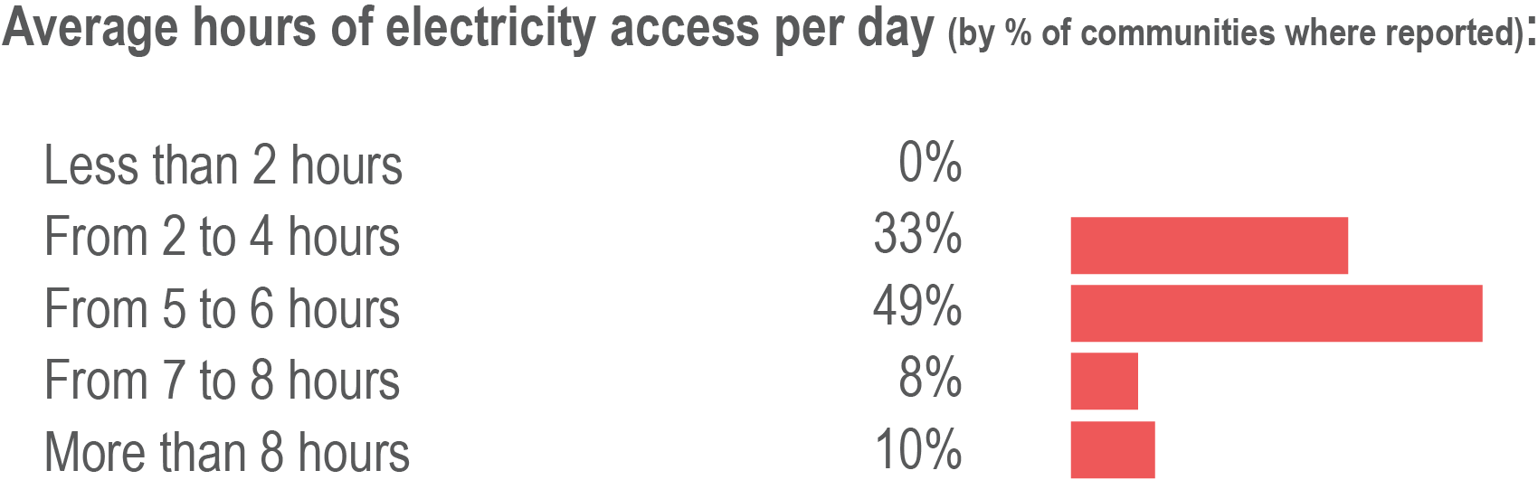
Electricity sources and access
Electricity access was fairly limited for those living in Menbij district with an average of 5-6 hours of electricity per day – at least 11 hours in Menbij City. Affordability for alternatives sources was the key barrier to access electricity.
Community generators were the most common source of electricity in Menbij city, while in the rest of Menbij district, the key source of electricity was the main network (reported in 72% assessed communities outside of Menbij city).
The high cost of fuel and solar panels were the key barriers to electricity access across Menbij district.

Slide 48
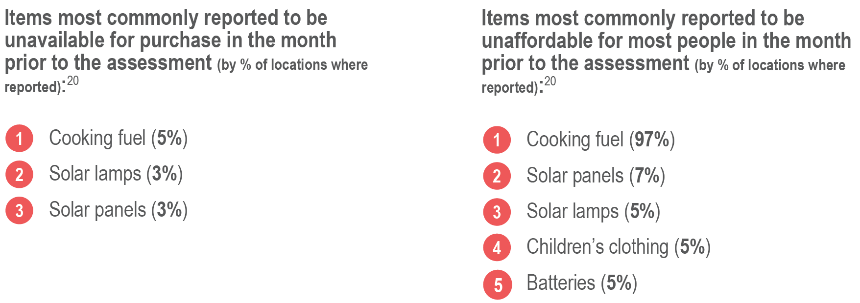
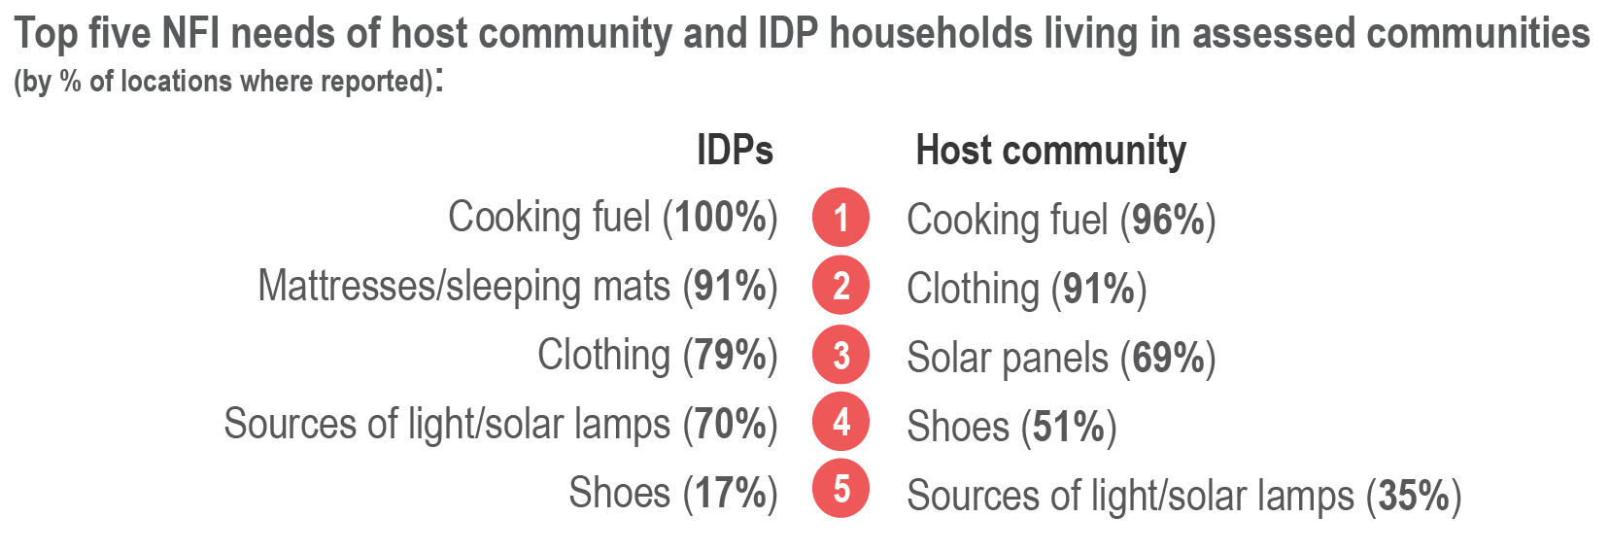
Non-food items

Slide 49
Shelter + NFIs
 | Menbij Camps | Menbij City | Menbij SD (rural) | Abu Qalqal | Al Khafsa
Response | Tent replacements by two NGOs Summer kits (in-kind assistance and cash) Winterisation assistance: kerosene stoves, cash for fuel | Shelter rehabilitation of unfinished buildings where IDPs residing, Winterisation assistance: NFI vouchers and diesel stoves to IDPs in unfinished buildings, UN convoy: Plastic sheets, IKEA mattresses, blankets | No Shelter response, but NFIs in inf. Settlements. | No response reported | No response reported
Key Issues/ Gaps | High level of shelter inadequacy issues: Current gap of 116 tents to be addressed within next 2 weeks. | Winterisation interventions aimed at addressing high level of reported shelter inadequacy issues including lack of heating, lighting, access to water, lack of insulation. Cooking fuel | Tent replacement and repair in inf.settl, winter NFIs, cooking fuel Electricity – 5-6hrs compared to 11 in city | Cooking Fuel | Cooking Fuel
What are barriers to providing shelter support/ tents to IDPs living in rural informal settlements?
What are the main challenges in addressing shelter inadequacy issues in Menbij city?
Noting the higher proportion of communities in Abu Qalqal and Al Khafsa reporting damage to shelter, do any partners have plans to support shelter rehabilitation outside Menbij city?
What is the winterisation strategy for Menbij – lessons learned from last year?
Notes:
We will add heat map indicating number of sector reporting by community

Slide 50
 WASH

Slide 51
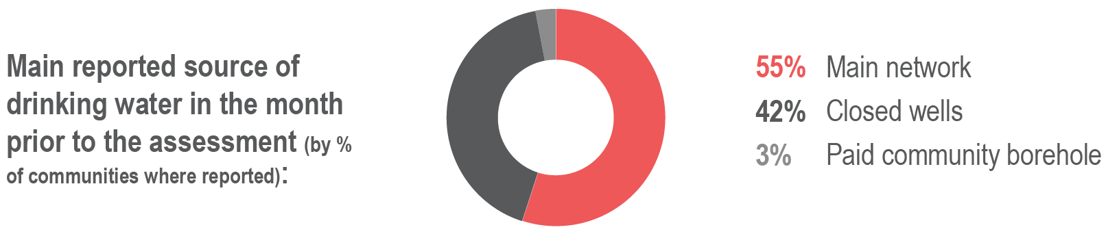
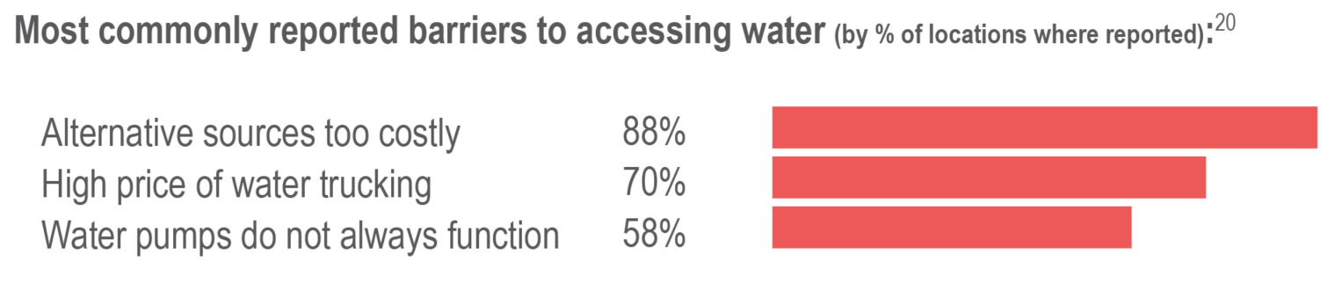
(Drinking) water: sources and issues
While many communities in Menbij district were connected to a main water network, infrastructure-related problems were reported as major barriers to water access.
Water from the main network was on average available 3 days per week at district level and 4 days per week in Menbij City, where it is the main source of water – usually the main network is not functioning properly due to disrepair.
Closed wells is commonly reported as a main source of water in rural areas.

Slide 52
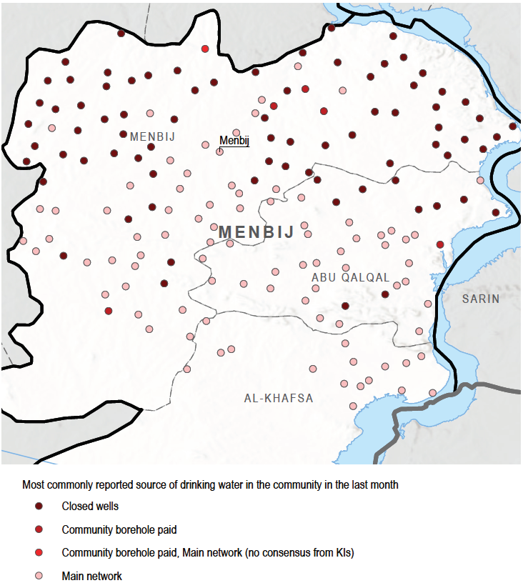
Most common source of drinking water, by community

Slide 53
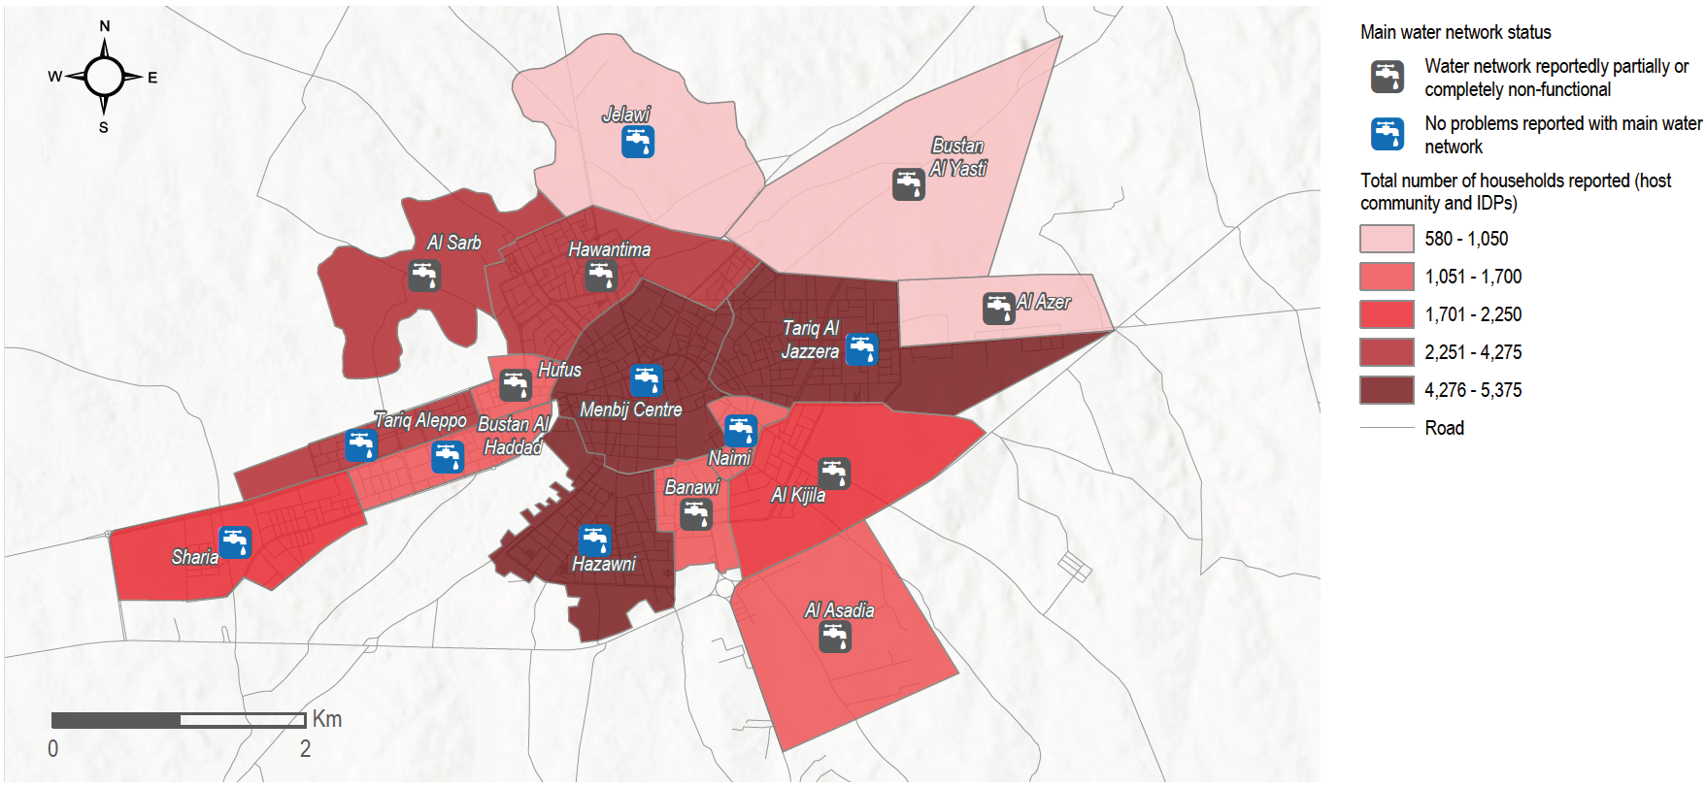
Issues with the main water network in Menbij city by neighbourhood

Slide 54
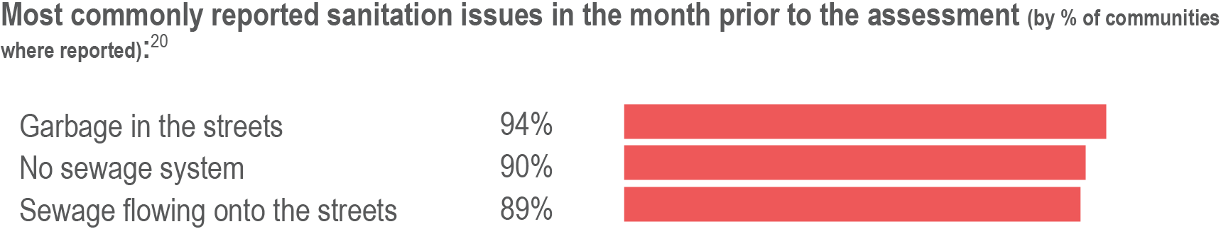
Sanitation
KIs in over 90% of communities reported a lack of garbage collection services and sewage network, presenting significant risks to public health (especially as temperatures rise).
In informal sites, open defecation is a common alternative to latrine use.

Slide 55
WASH
Average number of people reached over 3 months: 10,000
Average reach per area:

Slide 56
WASH
 | Menbij Camps | Menbij City | Menbij SD (rural) | Abu Qalqal | Al Khafsa
Response | Comprehensive across both camps | Water station + network rehab, water safety activities UN convoy: limited dignity kit distributions, family hygiene kits (267?), diapers (210), female sanitary napkins (5,942) | HK to informal settlements/ water station + network rehab, water safety | No response reported | No response reported
Key Issues/ Gaps | Latrine cleanliness in New Camp | Increase access to mains water network (east, SE and west neighborhoods), particularly as other sources too costly | Increase access to latrines/ increase waste management, variable access to water | ? | ?
What steps are being taken in terms of WASH infrastructure rehab in Menbij city (specifically east, SE and west neighborhoods)?
High level of sanitation issues reported across all areas. What are appropriate interventions in Menbij city vs rural areas?
What are barriers to support basic WASH services in informal settlements?
Notes:
We will add heat map indicating number of sector reporting by community

Slide 57
 HEALTHCARE

Slide 58
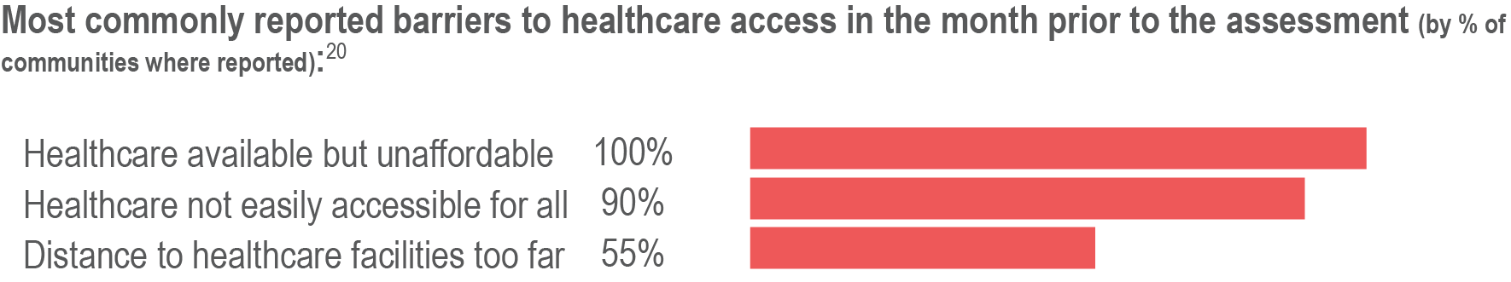
Healthcare
Most health services were available in the district but affordability (high cost of services and transportation) and accessibility (long distance to access services) were primary barriers for many households, especially households with low income.
Households were usually able to access pharmacies, private clinics, primary care facilities, and private and public hospitals in neighbouring communities.
Menbij city was notably reported as the most common place for people to access healthcare

Slide 59
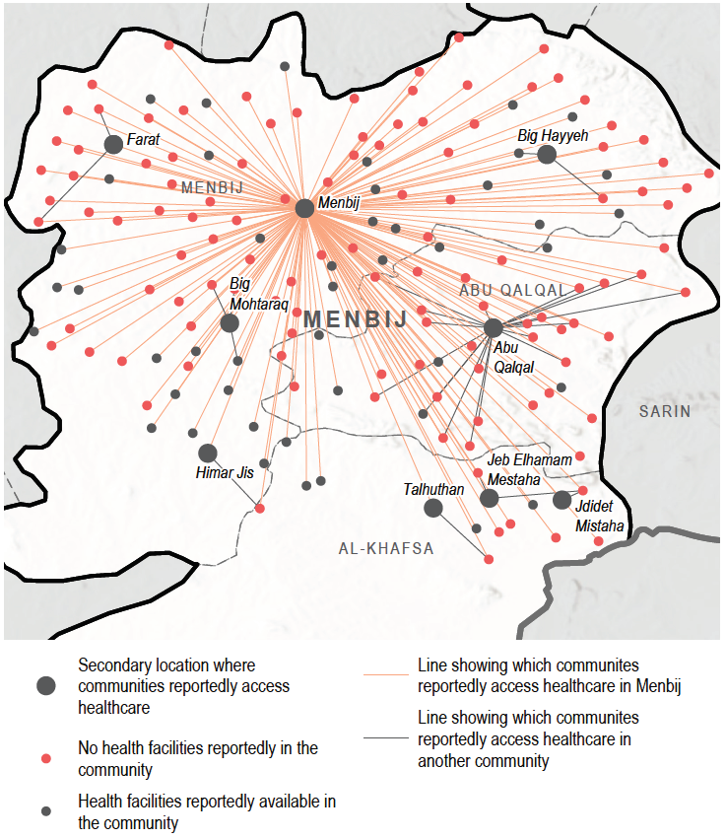

Locations where households access healthcare
Menbij city was reported as the most common place for people to access healthcare in the assessed area.

Slide 60
Healthcare
Average number of people reached over 3 months: 8,000
Average reach per area:

Slide 61
Healthcare
 | Menbij Camps | Menbij City | Menbij SD (rural) | Abu Qalqal | Al Khafsa
Response | Local authority PHC | Support to maternity ward of Al Furat National Hospital | Support to PHCC | Support to PHCC
Key Issues/ Gaps | Affordability and quality. NGO PHC In camps |  | Reliance on healthcare in Menbij city | Affordability issues
How can we address affordability challenges, particularly as related to transport?
What are key considerations in improving quality of healthcare in Menbij?
How do we address sub-standard access in rural areas, particularly among IDPs in informal settlements?
Notes:
We will add heat map indicating number of sector reporting by community

Slide 62
 EDUCATION + PROTECTION

Slide 63
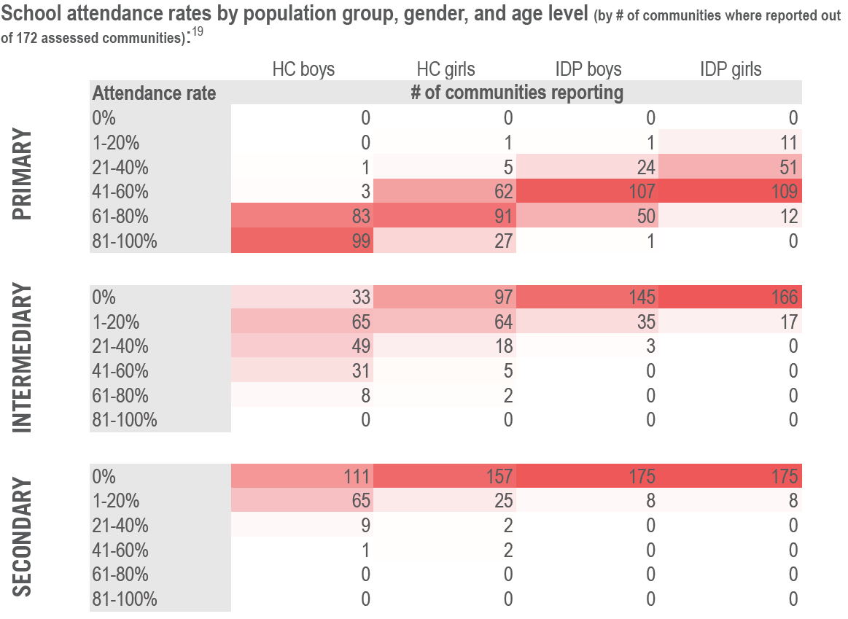
Access to education
Displacement-related barriers (lack of documentation, more precarious livelihood situation) rendered IDP children less likely to be enrolled in school, putting them at protection risks.
Education in Menbij is characterised by a significant lower attendance rate and access for IDP children than for host community children.
In informal sites, there was reportedly no access to education due to a lack of schools within accessible distance.

Slide 64
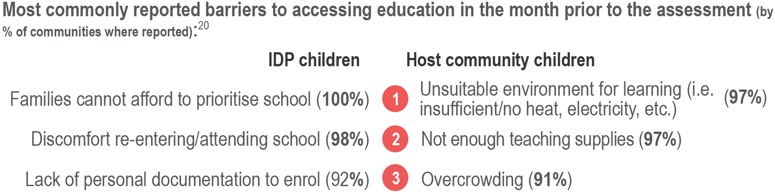
Barriers to accessing education
Child labour was reported as a coping strategy for insufficient livelihoods in 96% of communities for IDPs, compared to 39% for host community members.

Slide 65
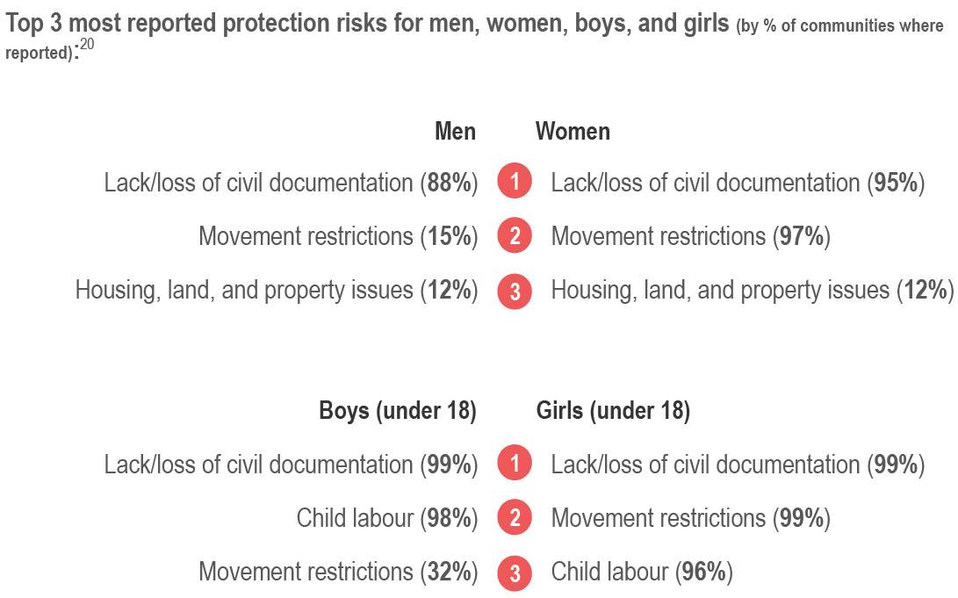
Protection risks
Most protection issues were related to livelihood and legal issues, rather than conflict, with child labour reported almost everywhere and more likely to affect IDP boys.

Slide 66
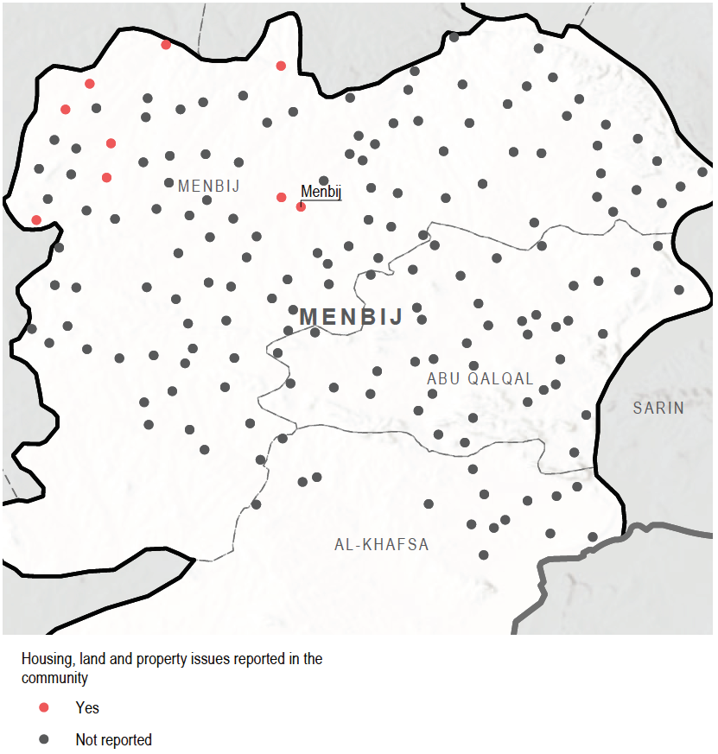
Communities where people faced housing, land, and property issues
Housing, land and property issues were reported as a protection risk in Menbij City and northwest of the district.

Slide 67
Education
 | Menbij Camps | Menbij City | Menbij SD (rural) | Abu Qalqal | Al Khafsa
Response | Local authority supported schools | No response reported | No response reported | No response reported | No response reported
Key Issues/ Gaps | Low levels of primary school attendance particularly in new camp. Barriers: child does not want to attend school/ not considered important | Non-Formal Education: Catch-up learning/ accelerated learning programmes Low IDP school attendance. Barriers affordability/ cannot afford to prioritize school, discomfort attending/ re-entering school/ lack of documentation to enroll
There is no reported education response in Menbij. Why? Lack of donor interest? Perceived lower needs?
How can education programmes be delivered in peri-urban/ rural environment where [IDP] population dispersed and have lower access?
How can we improve education in camps?
Many of barriers to education less about quality of education but rather discomfort attending/re-entering school and or perception that cannot afford to prioritize school – what would be effective programming?
Notes:
We will add heat map indicating number of sector reporting by community

Slide 68
Protection
Average number of people reached over 3 months: 1,900
Average reach per area:

Slide 69
Protection
 | Menbij Camps | Menbij City | Menbij SD (rural) | Abu Qalqal | Al Khafsa
Response | CFS, Adolescent girls programmes | CFS, social cohesion and youth programme | No response reported | No response reported | No response reported
Key Issues/ Gaps | High prevalence of reported CP issues (child labour, early marriage) | High prevalence of CP issues, especially children working. Lack/ loss of civil documentation issues widely reported as issue for women, men, girls and boys.
Which types of interventions are important to addressing child labour?
What are implications of lack/ loss of civil documentation for people in Menbij? Which types of interventions are needed to address this protection risk?
Notes:
We will add heat map indicating number of sector reporting by community

