Slide 1
REACH Monitoring of Hard-to-Reach Areas of Northeast Nigeria
January 2020

Slide 2
Hard-to-Reach Research Questions
Needs
Services
Demographics
Displacement
What are the needs and vulnerabilities of internally displaced person (IDP), returnee and host community populations in hard-to-reach areas with regards to sectoral services?
What services and types of humanitarian assistance are accessible to IDP, returnee and host community populations in hard-to-reach areas and what access constraints exist?
What are the key demographic characteristics of populations present in and moving to or from hard-to-reach settlements?
What are the key displacement trends including push and pull factors for new arrivals, intentions to move, etc.

Slide 3
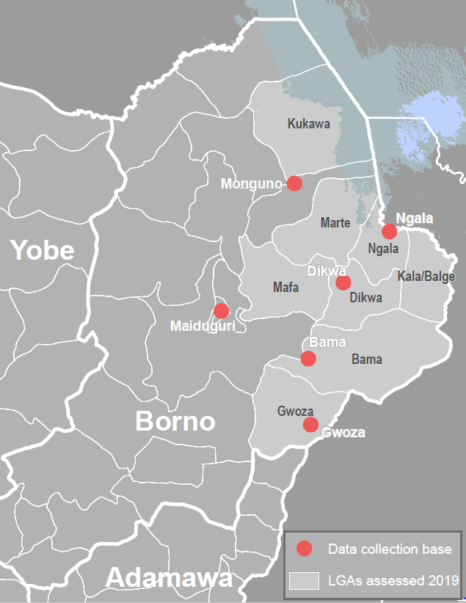
Hard-to-Reach and Area of Knowledge Methodology: Data Collection
A monthly multi-sector quantitative survey with key informants (KIs) who are either:
newly arrived IDPs who have left a hard-to-reach settlement in the last 3 months
KIs who have had contact with someone living or having been in a hard-to-reach settlement in the last month (traders, migrants, family members, etc.)
Displacement mapping focus group discussions (FGDs)
Sectoral or multi-sectoral Service Access Gap FGDs

Slide 4
Hard-to-Reach Methods: Aggregation, Analysis, and Limitations
Quantitative
Qualitative
Limitations
The settlement is the unit of analysis
Data from KIs reporting on the same settlement is aggregated and presented as the percentage of settlements reporting on a given indicator.
During the aggregation process, the response for a settlement is left blank and removed from analysis if KIs do not concur.
Findings for an LGA are only reported if at least 5% of settlements in an LGA are assessed
Thematic analysis is used to code and analyse FGD transcripts from semi-structured data collection.
Participatory mapping exercises are employed to map migration patterns and pair with both quantitative and qualitative results
Qualitative analysis provides inductive, targeted analysis of quantitative indicators.
Only purposive sampling is employed - not randomized sampling. Due to this sampling approach, Hard-to-Reach data is indicative and not representative .
Data collection is dependent on the presence and identification of KIs with recent information concerning an inaccessible area. Thus, we cannot guarantee coverage, or sufficient coverage, of given geographic areas.

Slide 5
Hard-to-Reach Protection Considerations
COLLABORATION
AGGREGATION
DATA SHARING
DISSEMINATION
REACH proactively engages with the protection sector concerning Hard to REACH data collection.
Information is collected and produced in a way that enhances the protection of individuals and reduces risk.
Settlement-level data is aggregated to the ward level or greater.
Raw qualitative data is uploaded to a secure server located in Geneva, Switzerland.
Raw quantitative data is stored on secure KoBo servers in the USA.
REACH will under no circumstances share settlement-level data in an electronic format.
Any hard-copy sharing of settlement-level data will require a data sharing agreement reviewed and agreed-upon by both REACH and OCHA.
REACH and Humanitarian Coordinating Partners are jointly developing a detailed validation and dissemination plan ahead of dissemination of Hard to Reach outputs.

Slide 6
Assessed Locations November 2019
521 Key Informant Interviews
272 Settlements Assessed
14 LGAs Assessed
4 LGAs with 5% or more coverage

Slide 7
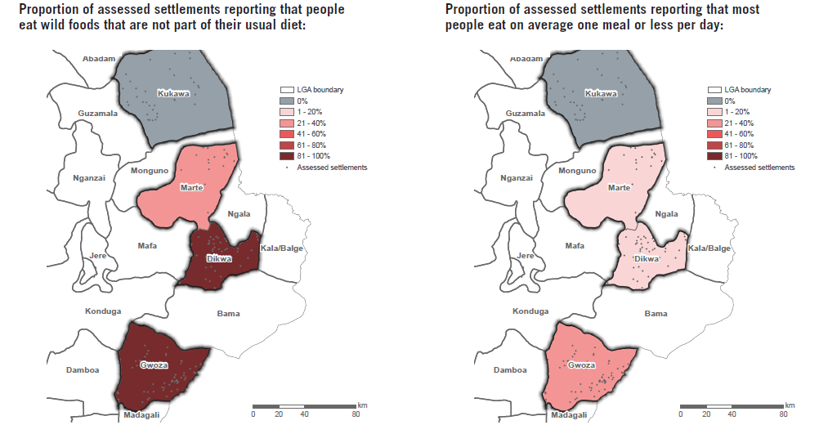
Food Security and Livelihoods

Slide 8
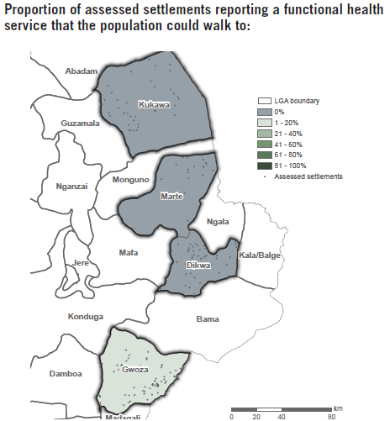
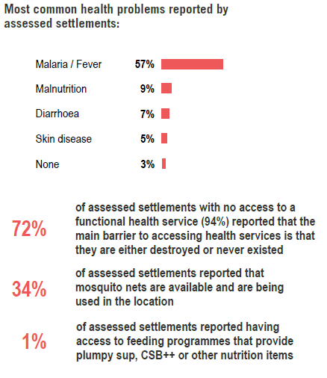
Health

Slide 9
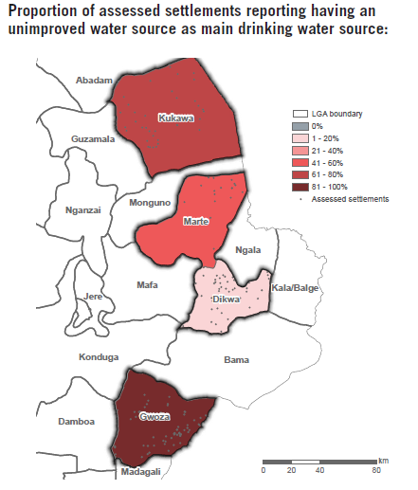
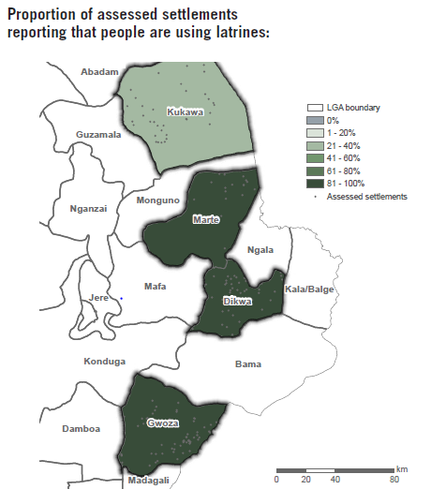
WASH

Slide 10
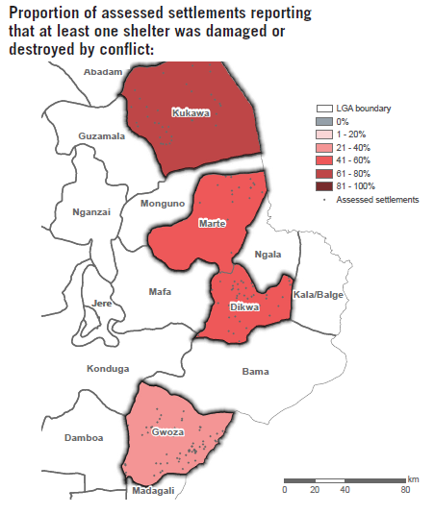
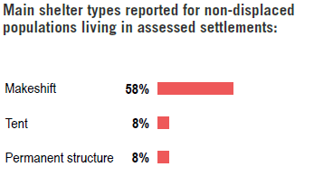
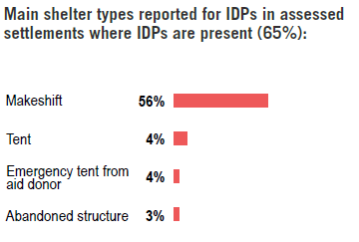
Shelter

Slide 11
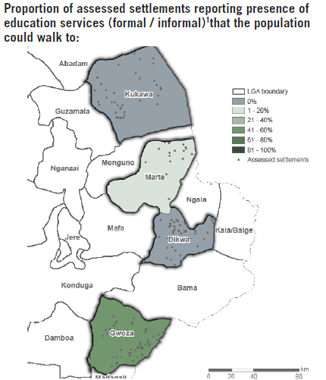
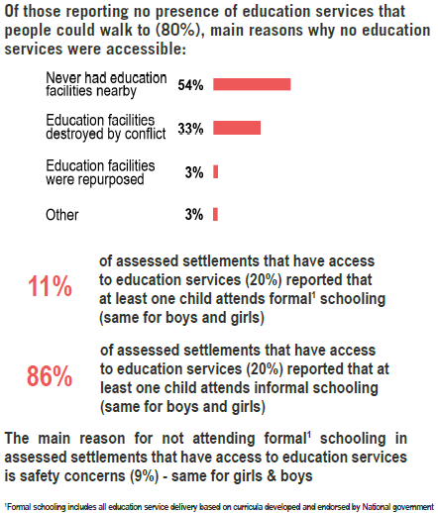
Education
¹ Formal schooling includes all education service delivery based on curricula developed and endorsed by National government

Slide 12
THANK YOU FOR YOUR ATTENTION
Ben Townsend
REACH Assessment Manager
+234 0902 557 0836
ben.townsend@reach-initiative.org
ben_townsend_is
Jessica Murphy
H2R Assessment Officer
+234 0812 917 9148
jessica.murphy@reach-initiative.org
www.reach-initiative.org
IMPACT Initiatives
@REACH_info

