Slide 1
VENA
Vulnerability and Essential Needs Assessment
Key Findings from Cross-Settlement Market Analysis
February 2020

Slide 2
1
METHODOLOGY

Slide 3
VENA (Vulnerability and Essential Needs Assessment)
Jointly conducted by REACH, WFP, and UNHCR and designed in close coordination with sector experts
Aimed to establish a common understanding of:
Essential needs among refugees living in settlements in Uganda
Households’ capacity to meet those needs
Factors influencing household vulnerability: demographic, economic, protection-related
Divided into two sections: a household survey and a market component
Background on the VENA

Slide 4
A mixed-methods assessment of cash feasibility and market functionality among Uganda’s refugee population
Secondary data review: Desk review of available market assessment reports to identify info gaps
Quantitative tool: Market trader survey administered in core markets serving refugee settlements, covering 34 key commodities
2,820 trader interviews across 111 markets
Retailers, producers, wholesalers
Qualitative tool: Semi-structured interviews with key informants (KIs) with strong overall knowledge of their markets
35 KI interviews across 13 settlements
Data collection from 9 August to 7 October 2019 across all 13 major refugee settlements in Uganda
Findings are indicative, not representative
Methodology of VENA market component

Slide 5
2
KEY FINDINGS

Slide 6
Market and trader characteristics
Assessed markets varied greatly in size (< 100 to > 2,000 traders), with those inside refugee settlements usually smaller and more temporary/makeshift
55% of interviewed traders were male, 45% female
66% host community members, 34% refugees (largely from South Sudan and DRC)
Percentage of refugee traders far higher in Kyaka II (73%) and Nakivale (70%), attributable to these settlements’ longevity and greater access to finance
81% retailers, 22% producers, 9% wholesalers
Only 18% reported employing others (generally just 1 other person)
Likely due to low profit margins and a lack of capacity to hire more

Slide 7
Market operations
71% of producers served < 50 customers per week; retailers generally 50-100 per week, wholesalers > 100 per week
Half of traders reported not having a trading license, with this lack much more common among small-scale producers and retailers
Most common reasons: lack of enforcement; did not know how to obtain a license
% traders reporting having a trader license

Slide 8
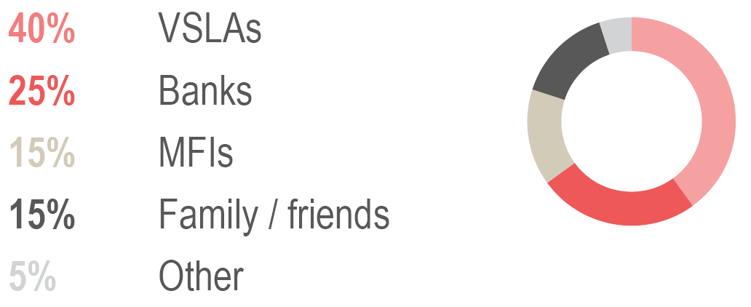
Market operations
% traders reporting having taken loans
22% of traders reported having used credit or loans to fund their businesses
28% of wholesalers, but only 8% of producers
Of those using credit:
25% relied on formal sources (i.e. banks)
55% on semi-formal sources (VSLAs, MFIs)
At least 15% on informal sources
Strong variation among settlements in both use and sources of finance
Most common sources of loans/credit

Slide 9
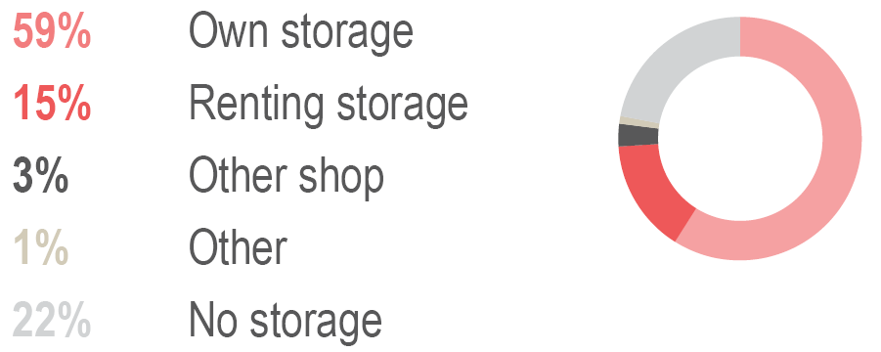
Market operations
59% of traders relied on their own storage space, whether in their shops or at home
15% rented storage space
Median amount spent: 35,000 UGX/month
22% reported having no storage options at all
40-45% in Palabek, Nakivale, Imvepi, Palorinya
Other expenses required for traders to operate:
Registration fees to local authorities (example: median of 75,000 UGX in Adjumani)
Market dues (62% of traders, median of 6,000 UGX monthly)
% traders using different types of storage

Slide 10
Supply and demand
Markets in and near the settlements depend heavily on well-maintained roads and transportation infrastructure in order to function.
Most interviewed traders sourced nearly all of their commodities from suppliers outside their sub-county
Seasonality was the primary factor affecting supply, demand, and prices for many market commodities, both food and NFIs:
Predictably, supply for fresh foods tends to be highest during rainy and harvest seasons, while demand and prices tend to be lowest
For non-fresh foods, both supply and demand peak near harvest time, though supply is at its lowest (and prices highest) just before harvest time
Most NFIs had steady supply and demand throughout the year, with some exceptions:
Educational items: spike in demand at the beginning of each school term
Shelter items: higher demand during dry seasons

Slide 11
Ability to scale up
Nearly all traders self-reported...
No issues scaling up to meet doubled demand
Could sell all the same items at the same prices
Could scale up using current suppliers only
Could scale up within one week
However...
Wholesalers in food and energy items were more likely than retailers to foresee potential supply difficulties and a need to raise prices
78% of traders reported never taking out a loan: may indicate lack of access to formal or semi-formal finance, especially as many report not meeting access criteria
Traders who lack storage, or who are using all their available storage, would not be able to easily scale up; may incur additional costs in rent
High competition among traders results in small customer bases and small-scale operations
Potential accessibility issues caused by remoteness of refugee settlements

Slide 12
Barriers to access
Most households are able to physically access marketplaces...
Just 8% of households reported significant barriers to reaching their nearest marketplace (highest percentage: Imvepi, 17%)
Most commonly reported barrier by far was long distance to the marketplace
Among HHs that reported barriers to physical market access, most commonly reported barriers
...but getting there can be difficult.
91% of HHs most commonly walked to their nearest marketplace, likely due to a lack of funds for transport
Median travel time was 30 minutes, with a maximum of 3 hours: prohibitive for many PSNs, particularly those with physical disabilities

Slide 13
Barriers to access
Nearly all household credit is informal or semi-formal.
90% of HHs report access to some sort of credit...
...but almost exclusively through friends and family (58%), VSLAs (39%), or shopkeepers (16%).
Safety and security issues in markets are relatively uncommon, but still problematic.
16% of interviewed traders reported ever having faced a security incident, almost always theft.
Yet theft was a concern to the point that traders reportedly slept in some markets to protect their stock.
In Kyaka II and Rwamwanja, incidents related to refugee-host community tensions were the most commonly reported (verbal harassment, fears of attack).

Slide 14
CASH WORKING GROUP RECOMMENDATIONS
3

