Slide 1
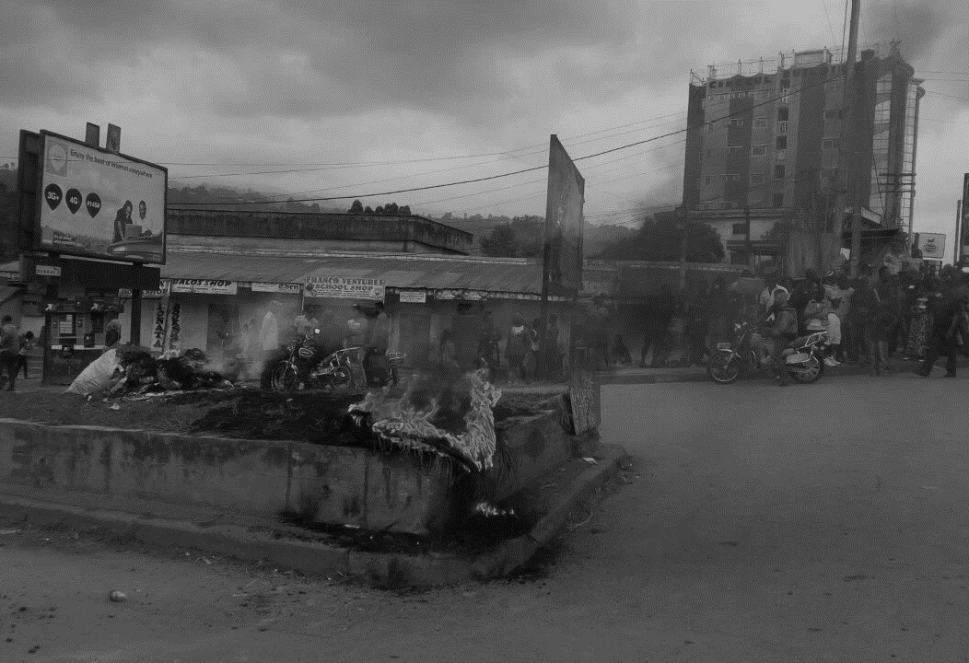
WASH Needs Assessment
Understanding WASH needs in Cameroon
January 2019 | Cameroon

Slide 2
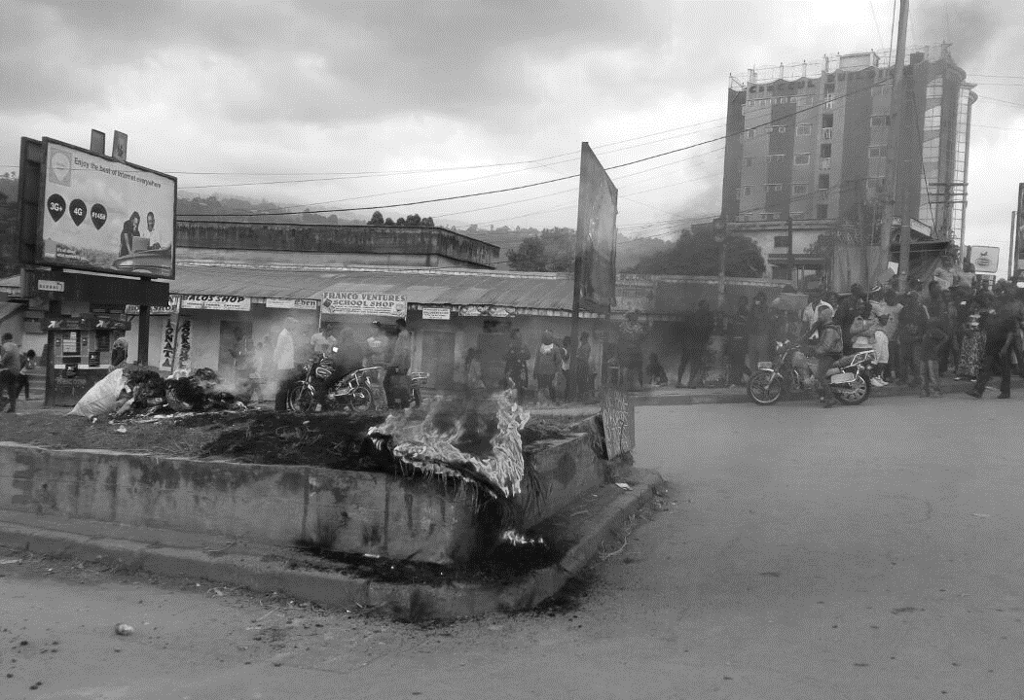
Background
Introduction

Slide 3
Crisis background
The humanitarian crisis in western Cameroon has emerged from long-lasting grievances of parts of the Anglophone community which turned into an open conflict between governmental forces and non-state armed groups in the second half of 2017.
As of January 2019, some 500 civilians have died as a result of violence in the regions . The population has been facing indiscriminate killings, arbitrary arrests, destruction of houses, looting and disruption of market activities for over a year.
This violence has generated large scale displacement, with over 430,000 people estimated to have been internally displaced since the middle of 2017.
The regions directly affected by conflict are the North-West (NW) and South-West (SW) regions while the Littoral and West regions have mostly been affected by influxes of displaced population seeking refuge in secured locations.

Slide 4
In a nutshell
What: REACH deployed in November/December 2018 to implement joint Shelter/NFI and WASH assessment.
Why: inform Shelter/NFI and WASH response planning to assist affected population by identifying for the four regions (SW, NW, West and Littoral) humanitarian needs disaggregated by population groups and settings.
How: 157 semi-structured interviews of key informants (KIs) and extensive secondary data review at all stages of the assessment.
Partners: the assessment was conducted on behalf of the Shelter and WASH clusters, in partnership with local and international NGOs (REACH OUT, PEP, COHESODEC, Plan International and SUDHASER) and and thanks to Shelter and WASH clusters funding.

Slide 5
Methodology
Key disaggregation:
6 population groups (aggregate during in this presentation into to displaced and non-displaced).
3 types of settings (urban, village, bush).
4 regions (North West, South West, Littoral and West).
Data collection:
Sampling: snowball sampling in targeted settlements.
Number of interviews: 157 KI interviews at site-level.
KI profiles: mostly displaced representatives (25%), host family representatives. (23%), teachers (16%), local aid workers (10%), religious leaders (9%).
Coverage: 18 sub-divisions in North West, South West, Littoral and West divisions.

Slide 6
Timeline
November
Preparatory research
Deployment to Cameroon
December
Planification of data collection
Data collection through 5 selected partners
January
Data analysis
Reporting

Slide 7
Limitations
As a qualitative survey the data is not proportionally representative of the target populations and of assessed localities, findings and frequencies show trends but should not be used to extrapolate populations in need.
KIs can express personal opinions rather than the community they represent; as such, findings should be triangulated between KIs and with secondary sources.
Given the time limitations the assessment was not able to cover other key sectors such as food security, health or protection which limits the ability of the exercise to look at holistic needs of the population.
Limited number of KIs by strata, due to the operational constraints, limited resources and short implementation timeframe.

Slide 8
Humanitarian Profile
Humanitarian Profile

Slide 9
Population by Region
15% of people in Cameroon live in NW/SW, 39% in L/W

Slide 10
Age Pyramid
54% of the population is under 20 yo

Slide 11
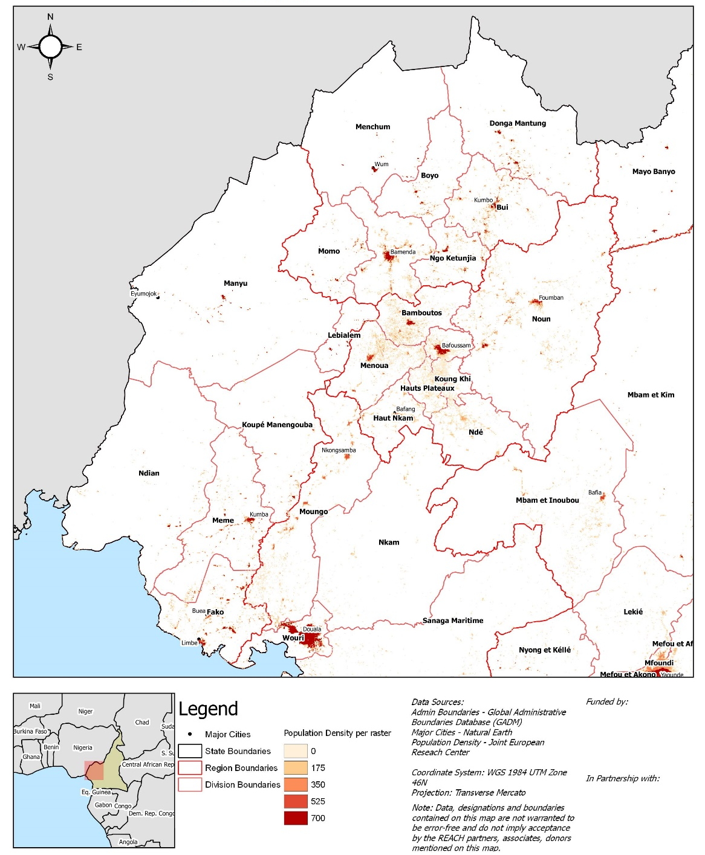
Population Distribution

Slide 12
Incidents of Violence

Slide 13
Geographic Distribution of Incidents
Number of recorded violence incidents (ACLED) by region since 2016
 | 2016 | 2017 | 2018
Littoral | 1% | 1% | 1%
North West | 2% | 8% | 40%
West | 1% | 1% | 2%
South West | 2% | 9% | 34%
Most of the incidents took place in the North West and South West regions (74% or the total number of incidents in 2018)

Slide 14
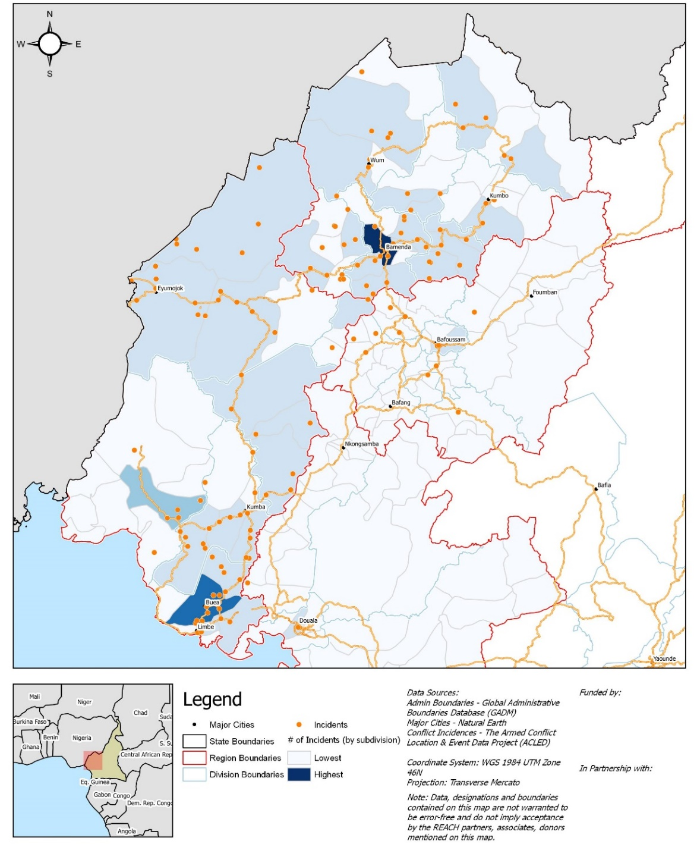
Geographic Distribution of Incidents

Slide 15
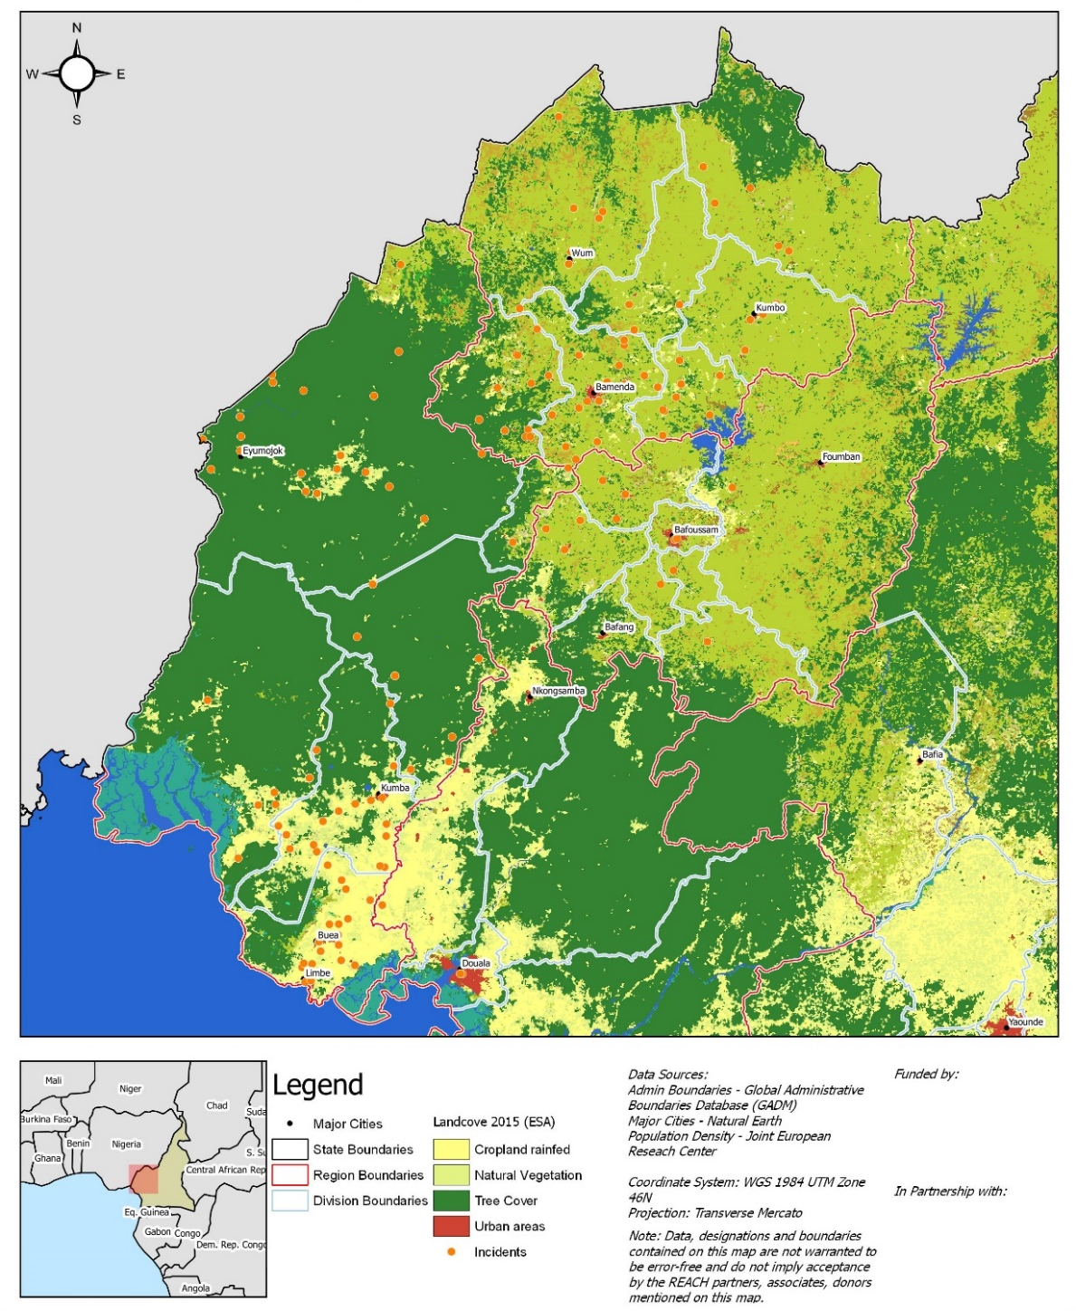
Landcover with Incidents

Slide 16
Push Factors
IDPs' main raison for displacement (by % of KIs reporting)
Insecurity and loss of housing are the main drivers of displacement and reflect the very poor security situation affecting the North West and South West regions.

Slide 17
Humanitarian Profile
Access to Water

Slide 18
Water Supply
% of KIs reporting the proportion of HHs in the community that can access enough water
As few as 5% of KIs say that that there is no water quantity issue in the community they report on.
Especially difficult situation for people living in the bush.
More blurry the disaggregation by population groups, with non-displaced people seemingly worst off, but with a higher percentage of displaced communities being reported as facing very acute issues and no households having access to enough water.

Slide 19
Water Supply Disaggregated
% of KIs reporting the proportion of HHs in the community that can access enough water
By setting
 | Bush | Village | Urban
All | 8% | 3% | 7%
Most | 8% | 18% | 15%
Half | 8% | 22% | 22%
Few | 58% | 49% | 52%
None | 17% | 9% | 4%
By pop group
 | Displaced | Non-displaced
All | 7% | 2%
Most | 16% | 14%
Half | 21% | 16%
Few | 45% | 61%
None | 11% | 6%
By region
 | Littoral | NW | SW | West
All | 18% | 2% | 2% | 10%
Most | 6% | 11% | 31% | 5%
Half | 6% | 19% | 25% | 15%
Few | 65% | 54% | 40% | 55%
None | 6% | 14% | 2% | 15%

Slide 20
Water Sources
% of KIs reporting the types of water sources used by HHs in the community for drinking and cooking
The majority of the communities reportedly rely on a mix of improved and unimproved water sources – however a fifth rely on unimproved sources only.
Reliance on unimproved water sources is more common among people living in villages and displaced communities.

Slide 21
Water Sources Disaggregated
% of KIs reporting the types of water sources used by HHs in the community for drinking and cooking
By setting
 | Bush | Village | Urban
Mixed | 67% | 51% | 46%
Improved | 21% | 22% | 41%
Unimproved | 13% | 27% | 13%
By pop group
 | Displaced | Non-displaced
Mixed | 47% | 60%
Improved | 27% | 30%
Unimproved | 25% | 9%
By region
 | Littoral | NW | SW | West
Mixed | 28% | 59% | 59% | 40%
Improved | 67% | 26% | 20% | 27%
Unimproved | 6% | 16% | 22% | 33%

Slide 22
Water Issues
% of KIs by types of challenges HHs in the community face collecting water
The 3 main issues that hampers water supply are lack of containers, waterpoints and the fact that the latter are too far.
Insecurity is an important challenge in the NW and SW (reported by 38% and 42% of KIs respectively).

Slide 23
Water Treatment
% of KIs reporting the proportion of HHs in the community that treat water before drinking
Water treatment is not a common practice and in 93% of the communities KIs reported that few to none treat water.
The percentage of KIs reporting that nobody treat the water rises above 40% for people living in the bush or villages, as well as among displaced communities.

Slide 24
Water Treatment Disaggregated
% of KIs reporting the proportion of HHs in the community that treat water before drinking
By setting
 | Bush | Village | Urban
Most | 11% | 0% | 0%
Half | 0% | 4% | 3%
Few | 47% | 56% | 81%
None | 42% | 40% | 16%
By pop group
 | Displaced | Non-displaced
Most | 3% | 0%
Half | 3% | 8%
Few | 51% | 80%
None | 43% | 13%
By region
 | Littoral | NW | SW | West
Most | 7% | 0% | 0% | 9%
Half | 0% | 2% | 11% | 0%
Few | 50% | 69% | 50% | 91%
None | 43% | 29% | 39% | 0%

Slide 25
Water Treatment Methods
% of KIs by reporting type of water treatment methods used by HHs in the communities that treat water before drinking
The most frequently reported treatment methods are letting stand/settle the water, boiling it, filtering it and using a disinfection product, be it Aquatabs, bleach, PuR, etc.
Two out of three most frequently reported treatment methods have no effects on pathogens causing water-borne fecal-oral diseases, such as diarrhea and cholera.

Slide 26
Humanitarian Profile
Access to Hygiene

Slide 27
Access to Soap
% of KIs reporting the proportion of HHs in the community that have soap
Access to soap represents a widespread problem, with 71% of KIs reporting that either few people or nobody has soap.
The percentage of KIs goes up to 77% for displaced communities in comparison with 59% for non-displaced ones.

Slide 28
Access/Soap Disaggregated
% of KIs reporting the proportion of HHs in the community that have soap
By setting
 | Bush | Village | Urban
All | 0% | 3% | 0%
Most | 10% | 17% | 16%
Half | 19% | 8% | 14%
Few | 71% | 69% | 66%
None | 0% | 3% | 4%
By pop group
 | Displaced | Non-displaced
All | 0% | 5%
Most | 12% | 23%
Half | 11% | 14%
Few | 73% | 57%
None | 4% | 2%
By region
 | Littoral | NW | SW | West
All | 0% | 2% | 2% | 0%
Most | 6% | 14% | 15% | 24%
Half | 12% | 10% | 17% | 12%
Few | 76% | 73% | 65% | 52%
None | 6% | 0% | 2% | 12%

Slide 29
Handwashing Facilities
% of KIs reporting the proportion of HHs in the community that have handwashing facilities
The situation regarding access to handwashing facilities is very similar to soap ownership and the same patterns can be observed.

Slide 30
Handwashing Facilities Disaggregated
% of KIs reporting the proportion of HHs in the community that have handwashing facilities
By setting
 | Bush | Village | Urban
All | 10% | 3% | 0%
Most | 14% | 11% | 5%
Half | 5% | 6% | 14%
Few | 48% | 67% | 64%
None | 24% | 13% | 17%
By pop group
 | Displaced | Non-displaced
All | 4% | 2%
Most | 11% | 7%
Half | 5% | 16%
Few | 61% | 64%
None | 20% | 11%
By region
 | Littoral | NW | SW | West
All | 0% | 6% | 2% | 0%
Most | 20% | 8% | 12% | 0%
Half | 20% | 4% | 14% | 0%
Few | 53% | 67% | 60% | 65%
None | 7% | 15% | 12% | 35%

Slide 31
Menstrual Material
% of female KIs reporting preferred types of menstrual hygiene material
The most commonly reported preferred types of menstrual hygiene material by female KIs were pads.
As high as 25% of female KIs reported that women living in the bush preferred using no material in comparison with 9% and 5% of female KIs reporting on village and urban centers.
NB: disaggregation (by setting, pop groups and regions) should be taken with caution due to the limited number of female KIs (36% of the total).

Slide 32
Menstrual Material Issues
% of female KIs by types of challenges HHs in the community face accessing menstrual material
The overwhelming majority of female KIs report that the main issues in accessing menstrual material is lack of money
Insecurity is reported as an issue by 29% and 24% of female KIs for NW and SW respectively, in comparison with 0% for the Littoral and the West

Slide 33
Humanitarian Profile
Access to Sanitation

Slide 34
Defecation Practices
% of KIs reporting usual places of defecation of HHs in the community
HH latrines or HH latrines shared with other HHs are reported to be a usual place of defecation by a majority of KIs.
Open defecation (OD) however remains widespread, with 19% and 14% of the KIs reporting OD in random place and OD in designated areas as a usual defecation practice.

Slide 35
Open Defecation Disaggregated
% of KIs reporting “open areas – random places” as usual place of defecation of HHs in the community
By setting
 | Bush | Village | Urban
No | 65% | 80% | 89%
Yes | 35% | 20% | 11%
By pop group
 | Displaced | Non-displaced
No | 80% | 82%
Yes | 20% | 18%
By region
 | Littoral | NW | SW | West
No | 89% | 76% | 78% | 90%
Yes | 11% | 24% | 22% | 10%

Slide 36
Access to Toilets
% of KIs reporting the proportion of HHs in the community that have access to toilets
Access to toilets remains fragile, with half of the KIs reporting that only few or no people at all have access to toilets.
The percentage of KIs goes up to 73% among those reporting on people living in the bush.

Slide 37
Access to Toilets Disaggregated
% of KIs reporting the proportion of HHs in the community that have access to toilets
By setting
 | Bush | Village | Urban
All | 9% | 12% | 14%
Most | 9% | 17% | 18%
Half | 9% | 17% | 30%
Few | 43% | 43% | 38%
None | 30% | 10% | 0%
By pop group
 | Displaced | Non-displaced
All | 15% | 8%
Most | 16% | 16%
Half | 20% | 25%
Few | 35% | 51%
None | 15% | 0%
By region
 | Littoral | NW | SW | West
All | 20% | 17% | 2% | 14%
Most | 33% | 10% | 24% | 0%
Half | 7% | 22% | 27% | 19%
Few | 27% | 44% | 31% | 67%
None | 13% | 7% | 16% | 0%

Slide 38
Issues with Toilets
% of KIs by types of challenges HHs in the community face accessing toilets
The most commonly reported issues linked with sanitation facilities are availability (too many people and not enough facilities) and lack of privacy and gender separation.
Other less frequently reported issues include unhygienic conditions (34%), facilities clogged (20%) and facilities unsafe (15%)

Slide 39
Issues with Toilets
% of KIs reporting the proportion of HHs in the community that have access to toilets
By setting
 | Bush | Village | Urban
All | 9% | 12% | 14%
Most | 9% | 17% | 18%
Half | 9% | 17% | 30%
Few | 43% | 43% | 38%
None | 30% | 10% | 0%
By pop group
 | Displaced | Non-displaced
All | 15% | 8%
Most | 16% | 16%
Half | 20% | 25%
Few | 35% | 51%
None | 15% | 0%
By region
 | Littoral | NW | SW | West
All | 20% | 17% | 2% | 14%
Most | 33% | 10% | 24% | 0%
Half | 7% | 22% | 27% | 19%
Few | 27% | 44% | 31% | 67%
None | 13% | 7% | 16% | 0%

Slide 40
Waste Disposal
% of KIs by reported types of solid waste disposal practice used by HHs in the community
The most common solid waste disposal methods is leaving waste either in designated or undesignated open areas.
74% and 57% of KIs report that the main issue the communities face is that waste attracts vectors such as flies/insects and rodents/animals respectively.

Slide 41
Waste Disposal Disaggregated
% of KIs reporting HHs in the community disposing solid waste in undesignated open areas
By setting
 | Bush | Village | Urban
No | 58% | 56% | 45%
Yes | 42% | 44% | 55%
By pop group
 | Displaced | Non-displaced
No | 55% | 52%
Yes | 45% | 48%
By region
 | Littoral | NW | SW | West
No | 44% | 53% | 45% | 69%
Yes | 56% | 47% | 55% | 31%

Slide 42
Stagnant water
% of KIs reporting presence of stagnant water/ponding close to where HHs live in the community
Around half of the KIs report presence of stagnant water or ponding in/around the place where the community lives.
Surprisingly this issue is more frequently reported by KIs in regards to non-displaced communities than displaced.

Slide 43
Stagnant Water Disaggregated
% of KIs reporting presence of stagnant water/ponding close to where HHs live in the community
By setting
 | Bush | Village | Urban
No | 55% | 48% | 57%
Yes | 45% | 52% | 43%
By pop group
 | Displaced | Non-displaced
No | 61% | 39%
Yes | 39% | 61%
By region
 | Littoral | NW | SW | West
No | 53% | 53% | 44% | 65%
Yes | 47% | 47% | 56% | 35%

Slide 44
Humanitarian Profile
Access to Health Care

Slide 45
Health Issues
% of KIs by main health problems children face in the community
The most commonly reported water-related diseases affecting children are malaria and respiratory diseases.

Slide 46
Health Infrastructure
% of KIs by places HHs in the community go to when their children are sick
Government health facilities are reported to be the most common place where the HHs go to when children are sick.
Still 43% of KIs mention that HHs do no go to any health centre/healer. This percentage goes up to 62% for KIs reporting on people living in the bush.

Slide 47
Health Infrastructure Disaggregated
% of KIs reporting HHs in the community not going to any health facility / healer when children are sick
By setting
 | Bush | Village | Urban
No | 38% | 63% | 57%
Yes | 62% | 37% | 43%
By pop group
 | Displaced | Non-displaced
No | 57% | 58%
Yes | 43% | 42%
By region
 | Littoral | NW | SW | West
No | 44% | 64% | 62% | 43%
Yes | 56% | 36% | 38% | 57%

Slide 48
Mosquito Nets
% of KIs reporting the proportion of HHs in the community that have mosquito nets
Access to mosquito nets is very limited and 89% of KIs report that few to nobody has access to this kind of NFI.
This issue is even more commonly reported by KIs for people living in the bush and displaced communities.

Slide 49
Mosquito Nets Disaggregated
% of KIs reporting the proportion of HHs in the community that have access to mosquito nets
By setting
 | Bush | Village | Urban
All | 0% | 2% | 0%
Most | 5% | 3% | 8%
Half | 5% | 3% | 6%
Few | 43% | 74% | 61%
None | 48% | 18% | 25%
By pop group
 | Displaced | Non-displaced
All | 0% | 2%
Most | 5% | 6%
Half | 6% | 6%
Few | 53% | 76%
None | 36% | 10%
By region
 | Littoral | NW | SW | West
All | 0% | 2% | 0% | 0%
Most | 0% | 10% | 4% | 0%
Half | 6% | 2% | 9% | 8%
Few | 38% | 59% | 80% | 52%
None | 56% | 27% | 7% | 40%

Slide 50
Humanitarian Profile
Access to Markets

Slide 51
Access to Markets
% of KIs reporting that HHs in the community have access to functional markets
Overall, almost 2/3 of KIs report that communities have access to functional markets.
There seem to be noticeable disparity in access to functional markets between people living in the bush/villages and urban contexts, and between displaced and non displaced people.
Access to functional market appears to be much more limited in the NW and SW.

Slide 52
Access to Markets
% of KIs reporting that HHs in the community have access to functional markets
By setting
 | Bush | Village | Urban
No | 46% | 45% | 25%
Yes | 54% | 55% | 75%
 | Displaced | Non-displaced
No | 43% | 31%
Yes | 57% | 69%
By pop group
By region
 | Littoral | NW | SW | West
No | 22% | 49% | 48% | 7%
Yes | 78% | 51% | 52% | 93%

Slide 53
Availability of WASH NFIs
% of KIs reporting availability of key WASH NFIs at local markets (where functional markets are available)
Availability of key WASH NFIs is somehow limited. If 90% of KIs report that soap is available, this percentage drops to 53% and 38% respectively for jerrycans and mosquito nets.

Slide 54
Affordability of WASH NFIs
% of KIs reporting that key WASH NFIs at local markets are affordable (where functional markets are available)
Overall, the majority of KIs report that soap is affordable, while items such as jerrycans and mosquito nets are less so.
Affordability of soap however sharply drops for people living in the bush.

