Slide 1
Returns and Durable Solutions Assessment (ReDS)
Markaz Mosul – Mosul, Ninewa
Findings presentation, Iraq
Data collection period: 10-14 March 2021

Slide 2
1. Introduction to ReDS
2. ReDS methodology
3. Markaz Mosul overview
4. Key findings
5. Detailed findings
6. Questions from the audience
7. Discussion
Presentation outline

Slide 3
1
Introduction to ReDS

Slide 4
In 2020, the number of internally displaced persons (IDPs) returning to their area of origin (AoO) or being re-displaced increased, coupled with persisting challenges in relation to social cohesion, lack of services, infrastructure and - in some cases - security in AoO. Increased returns were driven in part by the ongoing closure and consolidation of IDP camps; at the time of data collection, 14 camps and two informal sites had closed or been re-classified, with planning ongoing surrounding the future of the remaining camps across Iraq.
In light of recent return and re-displacement movement dynamics, REACH conducted a ReDS assessment in Markaz Mosul Sub-district to provide an in-depth profiling of needs and understanding of social relationships between remainee, returnee, and/or IDP populations.
ReDS background

Slide 5
ReDS Specific Objectives
Provide an understanding about the effects of recent movement trends;
Assess perceived intentions to move among all relevant communities to identify potential risk of further instability;
Assess how conditions in areas affected by recent movements may impact the sustainability of durable solutions;
Identify any consequent shift in local social dynamics and power structures; and,
Explore conditions in the area in terms of community needs and inter-relations; and the viability of safe and dignified (re)integration.
ReDS objectives
Notes:
In general, the assessment aimed to provide rapid evidence-base overview of the assessed areas to support humanitarian and development actors to promote durable solutions for returnees and IDPs in situations of protracted displacement on multiple levels, including:
Development of strategic dialogue, policy development, and resource mobilization efforts;
Development of localized interventions; and,
Advocacy with government actors around camp closures, consolidation, premature returns, and conditions in areas of origin to allow sustainable returns.
ReDS Specific Objectives
Provide an understanding about the effects of recent movement trends across different demographic groups in targeted areas;
Assess perceived intentions to move among all relevant communities within the areas to identify potential risk of further instability;
Assess how conditions in areas affected by recent movements may impact the sustainability of durable solutions;
Identify any consequent shift in local social dynamics and power structures following the recent movements; and,
Explore conditions in the area in terms of community needs and inter-relations; and the viability of safe and dignified (re)integration.

Slide 6
2
ReDS methodology

Slide 7
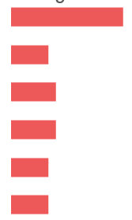
Methodology
The multi-sectoral assessment tool combined qualitative and quantitative data.
Data collection was done remotely by phone between 10 and 14 March 2021, adapted to the context of the COVID-19 pandemic local restrictions and associated pandemic measures.
Purposive sampling methods were employed to identify KIs. Findings should therefore be considered as indicative.
Methodology was based on key informant interviews (KIIs).
 KI profile in Markaz Mosul Sub-district
Community leaders 15 KIs
Remainees/non-displaced 5 KIs
IDPs (displaced from the area) 6 KIs
IDPs (displaced in the area) 6 KIs
Returnees (more than 3 months ago) 5 KIs
Returnees (less than 3 months ago) 5 KIs
^{42 KIs}
Notes:
Community leaders are members of the host community represented by 11 mukhtars (from eight different neighbourhoods in Markaz Mosul), three governmental employees in different ministries and a national NGO employee. A mukhtar can be defined as the head of a village or neighbourhood in some Arab countries.
IDPs (displaced from the area) refer to households from Markaz Mosul displaced the events of 2014 to areas different than their AoO, specifically in Bazian Sub-district (Al-Suleimaniyah Governorate), and Markaz Erbil Sub-district (Erbil Governorate).
IDPs (displaced in the area) refer to households from AoO different than Markaz Mosul Sub-district who were displaced after 2014 events and reside in Markaz Mosul. Households were reportedly originally from different sub-districts in Sumeil, Sinjar and Telafar districts of Ninewa Governorate.
For the purpose of this research, returnees will be categorized as an IDP returning to their AoO, where AoO is defined as the stated original sub-district of origin for the IDP. Given the complexity of (re)integration, this could mean that returnees still face challenges to their sustainable return to their AoO.
There were 42 key informants aged between 24 and 71 years old interviewed for the Markaz Mosul assessment. The majority were male (33 KIs). Ensuring gender balance still a limitation to the assessment, mainly due to the limited response rate of female KIs. One KI was over the age of 65, and one KI was considered in the youth group (between 18 and 24).

Slide 8
Limitations
The findings should be considered as indicative due to the relatively small sample size and the purposive sampling method
42 KIs in Markaz Mosul Sub-district
KIs gender balance
33 male KIs
9 female KIs
Contextualization at sub-district level
To operationalise the identified trends, information was analysed
and visualized at sub-district level, rather than village or neighbourhood
Remote data collection
Data collected remotely by phone


Notes:
Considering the findings as indicative: The sample is small (42 KIs), and findings will only be an indication of trends, needs, humanitarian concerns, gaps and flags for actors to assess further. Findings cannot be analysed or visualised at community-level in the current methodology but for the current analysis REACH included findings per community group as relevant and available.
KIs gender balance: There were 42 individuals aged between 24 and 71 years old interviewed for the Markaz Mosul assessment. The majority were male (33 KIs). Ensuring gender balance still a limitation to the assessment, mainly reported due to female KIs not answering to the phone calls. REACH and RWG are working on the identification process to encourage women to participate in the rapid assessment. Coming assessment are expected to have an increased participation rate.
Contextualization at sub-district level: To operationalize the identified trends, information was analysed and visualised at sub-district level, rather than village and neighbourhood. Extending to more detailed assessment at village, neighbourhood or community-level will depend in the availability of data about KIs. Contact details will need to be provided since the sampling is purposive and snowballing is very limited while doing remote data collection and time consuming taking into consideration the need of the informed consent from individuals to share their contact information with REACH. It will also require additional resources such and budget and human resources (enumerators) and will affect the time-line of the project and report deadlines.
Remote data collection: While collecting data remotely supports more timely and safe information gathering, the openness of respondents is sometimes affected. That being said, REACH enumerators are trained in building rapport with respondents over the phone, and testing processes were very strict as regards the sensitiveness questions and potential for doing harm to interviewees. Some sensitive terminologies related to Iraq context were identified and replaced by explanation text in the Arabic version of the ODK tool (e.g. ‘governance’ was replaced by ‘laws and regulations’).

Slide 9
3
Markaz Mosul overview and current demographics

Slide 10
Markaz Mosul Sub-district overview
Markaz Mosul is a sub-district of Mosul District in Ninewa Governorate.
On 10 June 2014, Markaz Mosul fell under the control of the group known as the Islamic State of Iraq and the Levant (ISIL), resulting in 188,157-191,557 households being displaced, as reported by KIs.
156-173 IDP households (area of origin (AoO) not specified) are reported to reside in Markaz Mosul Sub-district.
Notes:
Markaz Mosul Sub-district was selected for the assessment as: social cohesion severity was classified as ‘high’ in at least eight villages in the sub-district according to the International Organization of Migration’s (IOM) Displacement Tracking Matrix (DTM); it was an AoO for IDPs in camps at risk of closure or recently closed; and dynamic population movements to/from this sub-district were reported through the Returns Working Group (RWG).

Slide 11
4
Key findings

Slide 12
Markaz Mosul Sub-district Key findings
The situation regarding returns to Markaz Mosul remained fluid, with KIs reporting ongoing returns and more projected in the six months following data collection, driven in part by decisions surrounding camp closures.
Perceived improvement in the safety and security situation was the main reported pull factor for returns to Markaz Mosul.
Despite this, insecurity reportedly continued to be a barrier to the return of IDP KIs originally from Markaz Mosul displaced elsewhere. While there were no groups reported to be unwelcome in Markaz Mosul, some IDPs from Markaz Mosul displaced outside the sub-district reported the fear of being perceived as ISIL-affiliated and the fear of inter-communal disputes, retaliation or harassment.
Issues related to housing, land and property (HLP) were also reported barriers to return. These included damaged or destroyed housing, inability to claim HLP due to missing or damaged documentation, and that housing was rented or illegally occupied.
Notes:
In general, most KIs noted that community members felt safe in Markaz Mosul. There were no reported movement restrictions for women, girls, men and boys during the day or at night, and households members did not avoid any areas in Markaz Mosul.
Additionally, due to traditional naming practices in Iraq, some KIs also reported that some displaced people originally from Markaz Mosul could fear returning as their name may be similar to someone with suspected ISIL affiliation or accused of a crime.
The perceived lack of public services and job opportunities in Markaz Mosul also reportedly prevented further returns. However, it should be noted that perceptions on access to livelihoods varied, with KIs reporting it as both a barrier and a driver of returns. This could be due to different levels of access to information on available job opportunities and differential access between population groups. For example, community leader KIs reported the availability of jobs as a driver for returns, while IDP KIs originally from Markaz Mosul reported the lack of jobs as a barrier to return to their AoO.

Slide 13
Markaz Mosul Sub-district Other key findings
KIs reported that IDPs and – to a lesser extent returnees – persistently had less access to housing, including being more likely to live in inadequate shelter (including tents) or living under informal - and therefore more insecure - housing agreements.
The most needed intervention to encourage further returns was reportedly increasing access to livelihoods. All KIs reported an overall decrease in the availability of job opportunities compared to 2014.
KIs from different population groups prioritized community needs differently. Livelihoods and access to food assistance were the most commonly reported primary community needs for IDP and returnee KIs. On the other hand, community leaders and remainee KIs reported the need to develop the health and education sectors in Markaz Mosul, and to rehabilitate the public water infrastructure.
Friendship, kinship ties between community members, work relationships, (re)integration and acceptance of IDPs and returnees, and the intervention of local authorities were reportedly factors contributing to the stability in the area in terms of disputes in the six months prior to data collection.
Notes:
In addition, IDPs were also reportedly disadvantaged in access to compensation for housing and property rehabilitation as well as more at risk of eviction, alongside returnees and families with members with alleged links to ISIL and undocumented people who - as a result of not being able to prove their identity - could not access formal ownership/rental agreements. .
Reportedly, the types of jobs available had also shifted, with employment in public and private healthcare, finance, public education, manufacturing industry, oil industry, and transportation reportedly less available in 2021, compared to 2014. That being said, the availability of construction jobs had reportedly not reduced due to ongoing work to rebuild the sub-district after the conflict.
Generally, there were no reported obstacles to the interaction between groups by the majority of KIs. Kinship ties, work relationships, friendship, common business operation, and going to shops and public places were reportedly the most common types of interaction between the different population groups.
However, IDPs originally from Markaz Mosul displaced elsewhere reported concerns about outstanding inter-communal disputes as a barrier to return.

Slide 14
5
Markaz Mosul findings

Slide 15
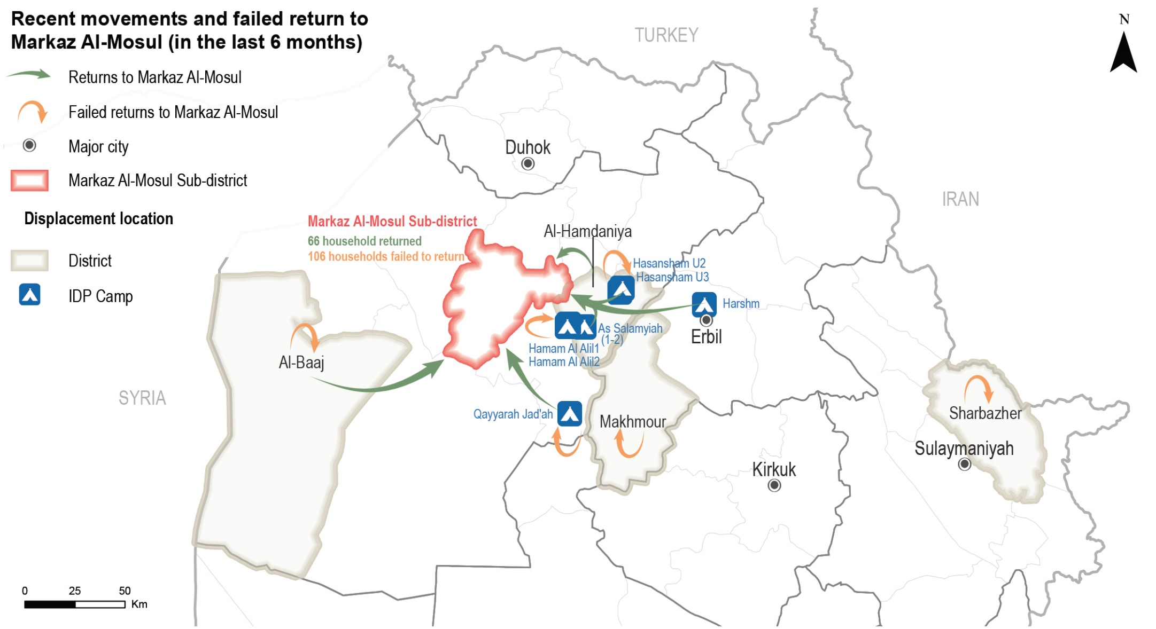
Markaz Mosul Sub-district
Recent movements to Markaz Mosul – reported by KIs
Notes:
Recent returns
Returns were reported from camps in Ninewa (8 KIs) and Erbil (1 KI) governorates. Other households returned from non-camp areas in Al-Baaj (3 KIs) and Hamdaniya (1 KI) districts.
The rest of the KIs reported no returns (20 KIs), did not know about recent movements (7 KIs), or refused to answer (1 KI).
Failed returns
Attempted returns were reported from camps in Ninewa (9 KIs) and Erbil (1 KI) governorates. Other households attempted to return from non-camp areas in Al-Baaj (2 KI), Al-Makhmour (1 KI) and Sharbazher (1 KI) districts.
The rest of the KIs reported no attempted returns (18 KIs), or did not know (9 KIs).

Slide 16
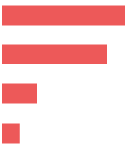
Markaz Mosul Sub-district
Recent movements – data reported by KIs
 Recent returns
⁴⁶⁻⁷⁵
households returned to Markaz Mosul in the six months prior to data collection, as reported by 14 KIs (out of 42).
Reported drivers for recent returns (out of 14 KIs)*
Sense of increased safety and security 7 KIs
Camp closures in area of displacement (AoD) 6 KIs
Nostalgia about previous life 2 KIs
Security clearance granted 1 KI
Reported impact of recent returns (out of 14 KIs)*
These movements reportedly led to higher competition in the labour market (8 KIs), on the other hand some KIs believed that recent returns contributed to increased job opportunities (3 KIs)
Similarly, while the majority reported a decrease in the level of household assistance due to increased demand (5 KIs), one KI reported that access to assistance increased due to the due to the response by different governmental and humanitarian actors to the recent returns.
* Sum of answers may exceed the 100% due to KIs being able to select multiple response options, including other topics.
Notes:
Recent returns
Other drivers for returns
Availability of job opportunities 1 KI
Difficult living conditions in area of displacement (AoD) 1 KI

Slide 17
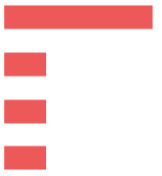
Markaz Mosul Sub-district
Recent movements – data reported by KIs
 Failed returns
⁷⁸⁻¹³³
households attempted to return to Markaz Mosul in the six months prior to data collection but did not succeed (15 KIs out of 42).
Reported reasons for failed returns (out of 15 KIs)*
Destroyed/damaged housing 7 KIs
Fear of being perceived as ISIL-affiliated 2 KIs
Fear of inter-communal disputes or retaliation 2 KIs
Availability of job opportunities in area of displacement (AoD) 2 KIs
Reported impact of failed returns (out of 9 KIs)*
The prolonged displacement of business owners reportedly resulted in more limited access to livelihoods (9 KIs).
In addition, less access to assistance was reported due to the perceived lack of interest of governmental and humanitarian actors in the area (3 KIs).
* Sum of answers may exceed the 100% due to KIs being able to select multiple response options, including other topics.
Notes:
Failed returns
Other reasons for failed returns
Fear of similarity of names 1 KI
Lack of services in AoO 1 KI
Unstable security in AoO 1 KI

Slide 18
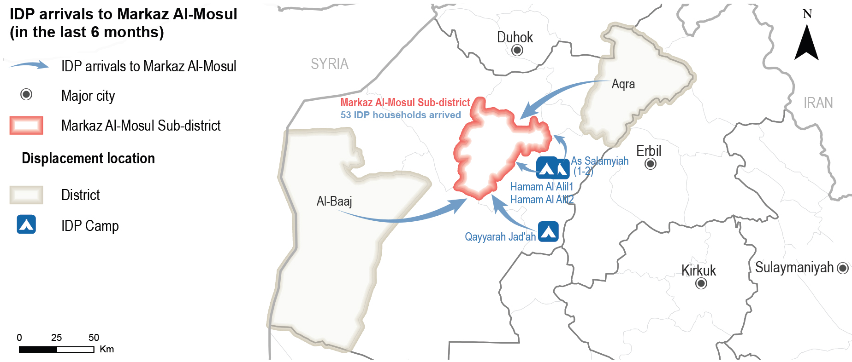
Markaz Mosul Sub-district
Recent movements to Markaz Mosul – reported by KIs
Notes:
IDP arrivals from camps in Ninewa Governorate (4 KIs out of 9) and from non-camp areas in Al-Baaj (1 KI) and Aqra (1 KI) districts. The rest of the KIs reported no IDP arrivals (18 KIs), or did not know (15 KIs).

Slide 19
Markaz Mosul Sub-district
Recent movements – data reported by KIs
 Recent IDP arrivals
⁴¹⁻⁶⁵
IDP households reportedly arrived in Markaz Mosul in the six months prior to data collection (9 KIs out of 42).
Reported driver for IDP arrivals (out of 9 KIs)*
Camp closures in AoD 4 KIs
Denied security clearance to return to AoO 2 KIs
Did not know 6 KIs
Reported impact of IDP arrivals (out of 9 KIs)*
These movements were reported to lead to higher competition in the labour market (6 KIs out of 9), and
A decrease in the level of household assistance due to increased demand was also reported (5 KIs).
* Sum of answers may exceed the 100% due to KIs being able to select multiple response options, including other topics.
Notes:
Reportedly, IDP arrivals to Markaz Mosul negatively impacted access to livelihoods and assistance; these movements were reported to lead to higher competition in the labour market (6 KIs out of 9), and a decrease in the level of household assistance due to increased demand was also reported (5 KIs).

Slide 20
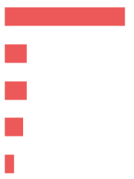
Markaz Mosul Sub-district
Expected movements – data reported by KIs
 Expected returns
^{35 KIs}
(out of 42) reported drivers that might result in return movements to Markaz Mosul. The rest of the KIs did not know (6 KIs), or refused to answer (1KI).
Most reported drivers for expected returns (out of 35 KIs)*
Sense of increased safety and security 30 KIs
Availability of job opportunities 8 KIs
Following the return of other extended family members 4 KIs
Nostalgia about previous life 3 KIs
Most reported barriers for expected returns (out of 42 KIs)*
Destroyed/damaged housing 39 KIs
Fear of contracting COVID-19 7 KIs
Lack of services 7 KIs
Lack of job opportunities 6 KIs
Lack of security 3 KIs
* Sum of answers may exceed the 100% due to KIs being able to select multiple response options, including other topics.
Notes:
While the vast majority of KIs did not know about expected returns to Markaz Mosul (33 KIs out of 42), some KIs reported that no households were expected to return in the six months following data collection (8 KIs). One KI refused to answer.
However, 35 KIs (out of 42) reported drivers that might result in return movements to Markaz Mosul. The rest of the KIs did not know (6 KIs), or refused to answer (1KI).
Other barriers for returns
Fear of inter-communal disputes or retaliation 2 KIs
Fear of being perceived as affiliated with ISIL 2 KIs
House is rented in AoO 2 KIs
Lack of necessary documentation to claim properties 1 KI
Lack of specialised medical treatment in AoO 1 KI
Denial of security clearance26 1 KI
Further returns were expected to have positive and negative impacts in terms of access to job opportunities. A similar number of KIs reported that expected returns could contribute to increased job opportunities due to the return of business owners (19 KIs out of 42) and, on the other hand, that these movements could increase competition for the limited available opportunities (17 KIs).
Other negative impacts of further returns reported included an expected decrease in levels of assistance due to increased demand (7 KIs) and the perception that such movements could increase the number of COVID-19 cases in Markaz Mosul (3 KIs). The rest of the KIs reported no effects related to these movements (3 KIs), or did not know (1 KI).

Slide 21
Markaz Mosul Sub-district
Primary community needs – data reported by KIs
Top reported primary, secondary and tertiary needs (out of 42 KIs)
Primary needs
Healthcare

Education
Secondary needs
Tertiary need
Food security
 Primary community needs per respondent group*
Community leaders
(out of 15 KIs)
Remainees
(out of 5 KIs)
Returnees
(out of 10 KIs)
IDPs
(out of 24 KIs)
Education
Water
Healthcare
11 KIs
9 KIs
8 KIs
Healthcare
Education
Water
2 KIs
2 KIs
2 KIs
Food
Livelihoods
Cash assistance
9 KIs
6 KIs
4 KIs
Livelihoods
Food
Non-food items
9 KIs
6 KIs
5 KIs
* Sum of answers may exceed the 100% due to KIs being able to select multiple response options, including other topics.
Notes:
The most commonly reported primary need in the community was access to livelihoods (12 KIs out of 42) due to the lack of public and private sector job opportunities (8 KIs out of 12), and the lack of investment in the private sector (1 KI). Female heads of household were reportedly more restricted in terms of access to income generating opportunities (3 KIs). In addition, access to healthcare was also considered a primary community need (7 KIs out of 42). Some KIs reported a decline in the quality of the public healthcare services compared to the period before 2014 (10 KIs), particularly due to the limited availability of medication (8 KIs), lack of medical staff (3 KIs) and limited preparedness to confront the COVID-19 pandemic (1 KI). This situation reportedly forced families to resort to private health services in Markaz Mosul (8 KIs), or move to other areas for treatment (1 KI).
The second most commonly reported main community need was access to education (10 KIs out of 42) due to the limited availability of (free) school books corresponding to the new educational curriculum (13 KIs). This led to a perceived decline in the quality of public education in Markaz Mosul (12 KIs) compared with the quality prior to 2014 as - as a result of gaps in up-to-date materials - schools relied on older curriculum now considered obsolete. Other reported barriers to access education were the number of damaged/destroyed schools (2 KIs) and the lack of educational equipment (2 KIs). Access to food assistance was also considered a second community need, particularly for IDPs and returnees, due to the perceived inability of households to afford food (8 KIs out of 42), with large households reportedly disproportionately affected27 (2 KIs).
The third most commonly reported main community need was access to water (7 KIs out of 42). Challenges in terms of access to water were also reported in Markaz Mosul. This includes the deterioration of quality due to the lack of maintenance of the water network and water filters (18 KIs), which reportedly resulted in water pollution (11 KIs). Some KIs noted these challenges resulted in the reliance of some households on purchased bottled water (12 KIs) and contributed to highly inflated prices for private water services (7 KIs).

Slide 22
Markaz Mosul Sub-district
Perceptions on access to humanitarian assistance – data reported by KIs
 Access to humanitarian aid and presence of NGOs
(out of 42) reported that there were NGOs implementing activities and projects in Markaz Mosul at the time of data collection.
^{4 KIs}
Reported activities implemented by NGOs
(out of 4 KIs)
Most needed activities or projects to encourage returns
(out of 17 KIs)
Livelihoods
Housing rehabilitation
Cash assistance
Social cohesion
Food security programmes
Non-food items (NFI) distributions
Water, sanitation and hygiene (WASH)
COVID-19 awareness
2 KIs
2 KIs
2 KIs
1 KI
1 KI
1 KI
1 KI
1 KI
Livelihoods
Infrastructure rehabilitation
Housing rehabilitation
Social cohesion
10 KIs
4 KIs
2 KIs
1 KI
Notes:
Access to humanitarian aid and presence of non-government organizations (NGOs)
The majority of the KIs reported there were no NGOs present in Markaz Mosul at the time of data collection (36 KIs), and two KIs did not know.
Of those reporting presence of NGOs in Markaz Mosul, three KIs reported that there were no groups less involved in humanitarian activities and projects. One KI refused to answer.
17 KIs (out of 42) reported that the availability of humanitarian aid would be a factor encouraging returns to Markaz Mosul. The rest of the KIs refused to answer (14 KIs), did not know (10 KIs), or reported that it was not a factor that would encourage returns (1 KI).

Slide 23
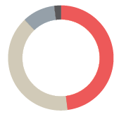
Markaz Mosul Sub-district
Perceptions on access to housing – data reported by KIs
 Access to housing
The majority of households in Markaz Mosul reportedly resided in houses (39 KIs out of 42).
However, of populations reported to be residing in tents, IDPs (12 KIs) and returnees (5 KIs) were reported to be more at risk.
Reported housing agreement (out of 42 KIs)
Owned tenure 20 KIs
Verbal rental agreement 17 KIs
Illegal occupation of private residences 4 KIs
Official rental agreement 1 KI
Risk of eviction
KIs reported risks of evictions for all groups in the long-term (17 KIs out of 42). Of these, IDPs were reportedly most at risk (11 KIs), followed by returnees (5 KIs) and remainees (1 KI).
Other groups reportedly at greater risk of eviction in the longer term were: families with members with alleged links to ISIL (3 KIs) and people lacking civil documentation (2 KIs).
Notes:
Access to housing
The primary type of housing agreement held differed by displacement status. IDP KIs (9 KIs) reported that the majority of IDP households resided in housing under verbal rental agreement. Three IDP KIs reported that some IDP households resided in illegally occupied private residences in Markaz Mosul. At the same time, returnee KIs also reported that the majority of returnee households resided under verbal rental agreement (5 KIs), or that they owned houses in Markaz Mosul (4 KIs). A returnee KI reported that some returnee households also resided in illegally occupied private residences. Community leader and remainee KIs (16 KIs) reported that the majority of host community and remainee households resided in owned houses, though some also reportedly rented under official or verbal agreements (4 KIs).
Risk of Eviction
41 KIs (out of 42) reported that there were no families at immediate risk of eviction in Markaz Mosul at the time of data collection. One KI did not know.

Slide 24
Markaz Mosul Sub-district
Perceptions on access to housing rehabilitation – data reported by KIs
 Access to housing rehabilitation
^{30%-60%}
of houses in Markaz Mosul were damaged during military operations in 2014, as reported by all KIs (42 KIs).
IDPs (12 KIs) and returnees (5 KIs) were reportedly more likely to reside in damaged or unfinished buildings/houses.
IDPs reportedly had less access to housing rehabilitation (6 KIs out of 42).
Reported barriers to access rehabilitation assistance (out of 24 KIs)*
Less connections 22 KIs
Assistance perceived to target specific neighbourhoods 2 KIs
Criteria of selection is perceived to be too specific 2 KIs
Fear of movement due to COVID-19 pandemic 2 KIs
* Sum of answers may exceed the 100% due to KIs being able to select multiple response options, including other topics.

Slide 25
Markaz Mosul Sub-district
Perceptions on access to basic public services – data reported by KIs
 Access to basic public services
^{37 KIs}
(out of 42) reported equal access to basic public services.
However, IDPs reportedly had unequal access to basic public services – namely healthcare and water – (4 KIs) due to:*
Having less connections (3 KIs);
Lack of financial means to access services (2 KIs); and,
The criteria of selection for support was perceived as too specific (1 KI).
* Sum of answers may exceed the 100% due to KIs being able to select multiple response options, including other topics.
Notes:
One KI refused to answer.

Slide 26
Markaz Mosul Sub-district
Perceptions on access to livelihoods – data reported by KIs
 Access to livelihoods
^{22 KIs}
(out of 42, all IDP (12 KIs) and returnee KIs (10 KIs), reported that access to livelihoods was unequal for their population groups.
Types of jobs reportedly available in Markaz Mosul in 2014 compared to March 2021 (out of 42 KIs)*
2014 March 2021
37 KIs
34 KIs
26 KIs
20 KIs
20 KIs
11 KIs
8 KIs
Health (public and private)
Agriculture
Finance
Construction
Public education
Trade and tourism
Public administration
10 KIs
24 KIs
1 KI
20 KIs
4 KIs
1 KI
1 KI
* Sum of answers may exceed the 100% due to KIs being able to select multiple response options, including other topics.
Notes:
The rest of the KIs - including all community leader and remainee KIs - reported that access to livelihoods was equal for all groups (20 KIs).
In addition to IDPs and returnees, KIs reported that people with disabilities (19 KIs), elderly people (14 KIs), and female heads of household (11 KIs) also had less access to livelihoods opportunities.
The main reported reasons for differential levels of access to livelihoods were: perceived limited physical capacity, skill or education attainment (19 KIs), and the lack of connections (3 KIs).
The number and diversity of jobs available had reported reduced compared to the period before 2014. Employment in public and private health (27 KIs), finance (25 KIs), public education (15 KIs), the manufacturing industry (11 KIs), the oil industry (7 KIs), and transportation (6 KIs) were reportedly less available in 2021, compared to 2014. However, there was reportedly no change in the availability of jobs in construction, mainly due to ongoing rehabilitation to rebuild the sub-district following military operations between 2014 and 2017 (20 KIs).

Slide 27
Markaz Mosul Sub-district
Perceptions on governance and access to justice – reported by KIs
 Governance and influencing bodies
Reported most influential bodies in governance (out of 42 KIs)*
Local authorities 42 KIs
Mukhtars 19 KIs
Tribal leaders 11 KIs
 Access to public judicial mechanisms
The vast majority of KIs (40 KIs out of 42) reported that access to public judicial mechanisms was equal. Two KIs reported that access was affected for all population groups due to movement restrictions and health concerns linked to the COVID-19 pandemic.
All KIs reported that there were no governmental offices closed in Markaz Mosul at the time of data collection and all population groups reportedly had access to documentation –including renewal or replacement – in the departments nearest to them.
* Sum of answers may exceed the 100% due to KIs being able to select multiple response options, including other topics.
Notes:
Governance and influencing bodies
Over half of KIs (22 KIs out of 42) did not know about expected changes in the most influential local actors related to governance in the six months following data collection. The rest of the KIs reported no expected changes (19 KIs), or refused to answer (1 KI).
Over half of KIs (23 KIs out of 42) did not know about appointments for new local authorities in the six months prior to data collection. Eighteen KIs reported no new appointments. However, one community leader KI reported that there were appointments for new local authorities in the six months prior to data collection in Markaz Mosul.

Slide 28
Markaz Mosul Sub-district
Perceptions of safety and security – data reported by KIs
 Safety and security
^{41 KIs}
(out of 42) reported that the community members felt safe in Markaz Mosul
Freedom of movement
^{29 KIs}
(out of 42) reported that community members from all population groups did not avoid specific areas in Markaz Mosul.
(out of 42) reported that women, girls, men and boys from all population groups can freely move during the day and at night.
^{40 KIs}
 Perceptions on the presence of security forces
^{41 KIs}
(out of 42) reported that the presence of security forces contributed positively to a feeling of safety.
Reportedly, all KIs (42 KIs) perceived that security forces in Markaz Mosul were effective in resolving disputes within neighbourhoods and between different villages.
Notes:
ERW presence and incidents
All KIs (42 KIs) reported that there were no contaminated fields in Markaz Mosul at the time of data collection.
Feeling of Safety
The rest of the KIs did not know (1 KI), or refused to answer (1 KI). A remainee KI reported not feeling safe but did not share the reasons.
Avoiding specific areas
The rest of the KIs refused to answer (12 KIs) or did not know (1 KI).
Freedom of movement
Two community leaders refused to answer. It should be noted that responses on gendered feelings on freedom of movement could have been impacted by the limited number of female KIs.
Presence of security forces
One KI did not know about how the presence of security forces contributed to the feeling of safety.

Slide 29
Markaz Mosul Sub-district
Perceptions of community disputes – reported by KIs
 Community disputes
^{40 KIs}
(out of 42) reported that there were no disputes within neighbourhoods in Markaz Mosul in the six months prior to data collection. Two KIs did not know.
All KIs (42 KIs) reported that there were no disputes between neighbourhoods in Markaz Mosul Sub-district in the six months prior to data collection.
^{41 KIs}
(out of 42) reported that there were no retaliation incidents in the six months prior to data collection. A returnee KI did not know.
Notes:
Community disputes within the neighbourhoods:
Changes
19 KIs (out of 42) reported expecting no changes in the current situation due to the kinship ties between families (18 KIs), the integration (18 KIs) and acceptance (4 KIs) of IDPs in the community. The majority of KIs (23 KIs) did not know if there would be a change in the occurrence of disputes within neighbourhoods in the six months following data collection.
Community disputes between villages:
Changes
20 KIs (out of 42) reported expecting no change in the current situation due to the (re)integration of IDPs and returnees in the community (18 KIs), kinship ties between families (14 KIs), acceptance of IDPs in the community (12 KIs), the existence of work relationships (2 KIs), and the intervention of the local authorities (1 KI). The rest of the KIs did not know if there would be a change in the occurrence of disputes between villages in the six months following data collection (22 KIs).

Slide 30
Markaz Mosul Sub-district
Perceptions of community inter-relations and co-existence – reported by KIs
 Community inter-relations and co-existence (out of 42 KIs)
^{20 KIs}
(out of 42) reported that their community members trust each other.
All KIs (42 KIs) reported that there were no specific population groups which are not welcomed by the majority of the community.
^{20 KIs}
(out of 42) reported that community members interact with other groups.
Reported types of interaction (out of 20 KIs)*
Kinship ties 19 KIs
Work relationships (employment) 14 KIs
Friendship 12 KIs
Common business operation 7 KIs
^{15 KIs}
(out of 42), all community leader (11 KIs) and remainee KIs (4 KIs), reported that community members were not interested in participating in social and public events.
Notes:
Community trust
The rest of the KIs refused to answer (12 KIs), or did not know (10 KIs).
Interaction with other groups
The rest of the KIs did not know (17 KIs), or refused to answer (5 KIs).
Other interaction types (out of 20 KIs):
Attending to shops and public places 1 KI
Barriers for interaction (out of 37 KIs)
20 KIs (out of 42) reported no obstacles to interaction between population groups. The rest of the KIs did not know (22 KIs).
Participation in social and public events
The rest of the KIs did not know about community members participation in social and public events (16 KIs), or refused to answer (11 KIs).

Slide 31
6
Questions from the audience

Slide 32
Discussion
Any feedback or comments from those operational in these areas?
7

Slide 33
Link to the Factsheet Markaz Mosul Factsheet March 2021
Upon request
http://www.reachresourcecentre.info/
IMPACT Initiatives
@REACH_info

