Slide 1
Integrated Needs Tracking
Implementing a system for systematic data analysis among decision makers
April 2019

Slide 2
INSTITUTIONAL BACKGROUND
FAMINE PREVENTION WORKSHOP – February 2018
INT System
=
Analytical framework
+
FSL, WASH, Health, Nutrition Cluster data
Notes:
Famine workshop 2018 => development of the INT system (funded by DFiD).
Analytical framework and IM system for key nutrition, health, WASH and FSL data.
Since August 2018, REACH has been engaging with mutlple technical leads on how to best approach building the system

Slide 3
Problems to Address
Wealth of information but a lack of communication between clusters
Silo thinking approach to needs analysis
Long gaps between in-depth analysis => periods of ‘flying in the dark’
Donor pressure to be more efficient in responding to needs
Trust/Buy-in from multiple actors
Lack of convergence of data in decision making
Notes:
INT aims to address a number of issues – primary promoting a more integrated conversation to needs analysis
Encourage/support more transparent decision making, by enabling all the information being publicly available.
The INT works to bring transparency and clear guidance on how decisions are made. Everything aout the system is open and can be explored by the user.
Huge push for regularly updated data, however, we all know how difficult this is in SSD. But it is still a push by donors

Slide 4
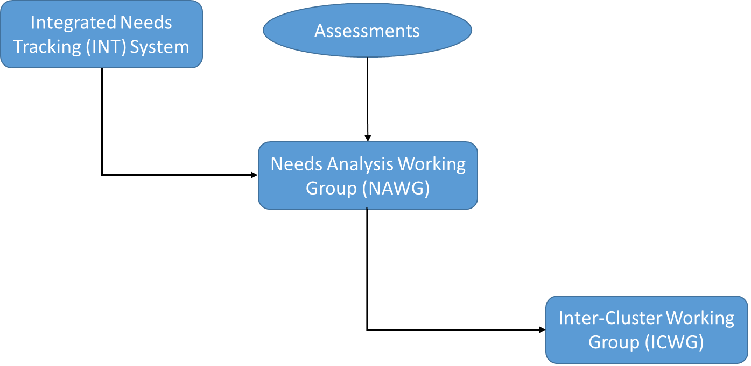
INT Within the Cluster System
Notes:
The INT is designed to feed into existing structures that include key humanitarian partners.
It however is not bound by these. It isn’t only NAWG members can that can use it. If outside partners want to explore the indicators than it is welcomed.
We are not trying to reinvent the system, rather provide as much added value as possible.

Slide 5
Framework
Notes:
The INT builds on the multiple analytical models, including UNICEF model for malnutrition, IPC, Shocks research.
Drivers => outcome/influence => Drivers === Final outcome. Circular approach of interactions between Drivers/Influences, when circle breaks that when we see increases in mortality.
The system is fundamentally designed to encourage convergence
Think resilience, the more these factors are interacting, the less likely a HH can ‘bounce’ back or the lag time from bouncing back is increased => increased vulnerability.
The INT puts a lot of focus on the drivers and outcome/influcers. The INT is designed to prevent the final outcome. It is meant to prevent the spikes in mortality that finally lead to the 2011 famine declaration in Somlia.

Slide 6
DATA SOURCES
IPC
SMART SURVEYS
CFSAM
REACH SITUATION MONITORING DATA
EARLY WARNING, ALERT AND RESPONSE SYSTEM (EWARS)
RAINFALL/NDVI PATTERNS (CHIRPS)
STANDARDIZED WASH CLUSTER ASSESSMENTS
AD-HOC PARTNER ASSESSMENTS
Notes:
Data sources are provided by multiple sources and many were originally agreed on during the inception periods.
We are not against additional data sources, but we do focus on life-saving, reguaraly updated data.
IPC/SMART act as baselines while AoK, climate, EWARS, admission trends act more of a guidance/proxy

Slide 7
5 CORE COMPONENTS
FSL
WASH
Health
Nutrition
Mortality
Notes:
Broken into 5 categories with some sub categories
Each category can be explored individually to see the relative indicators and scores associated
FSL broken in availability/access and livelihoods

Slide 8
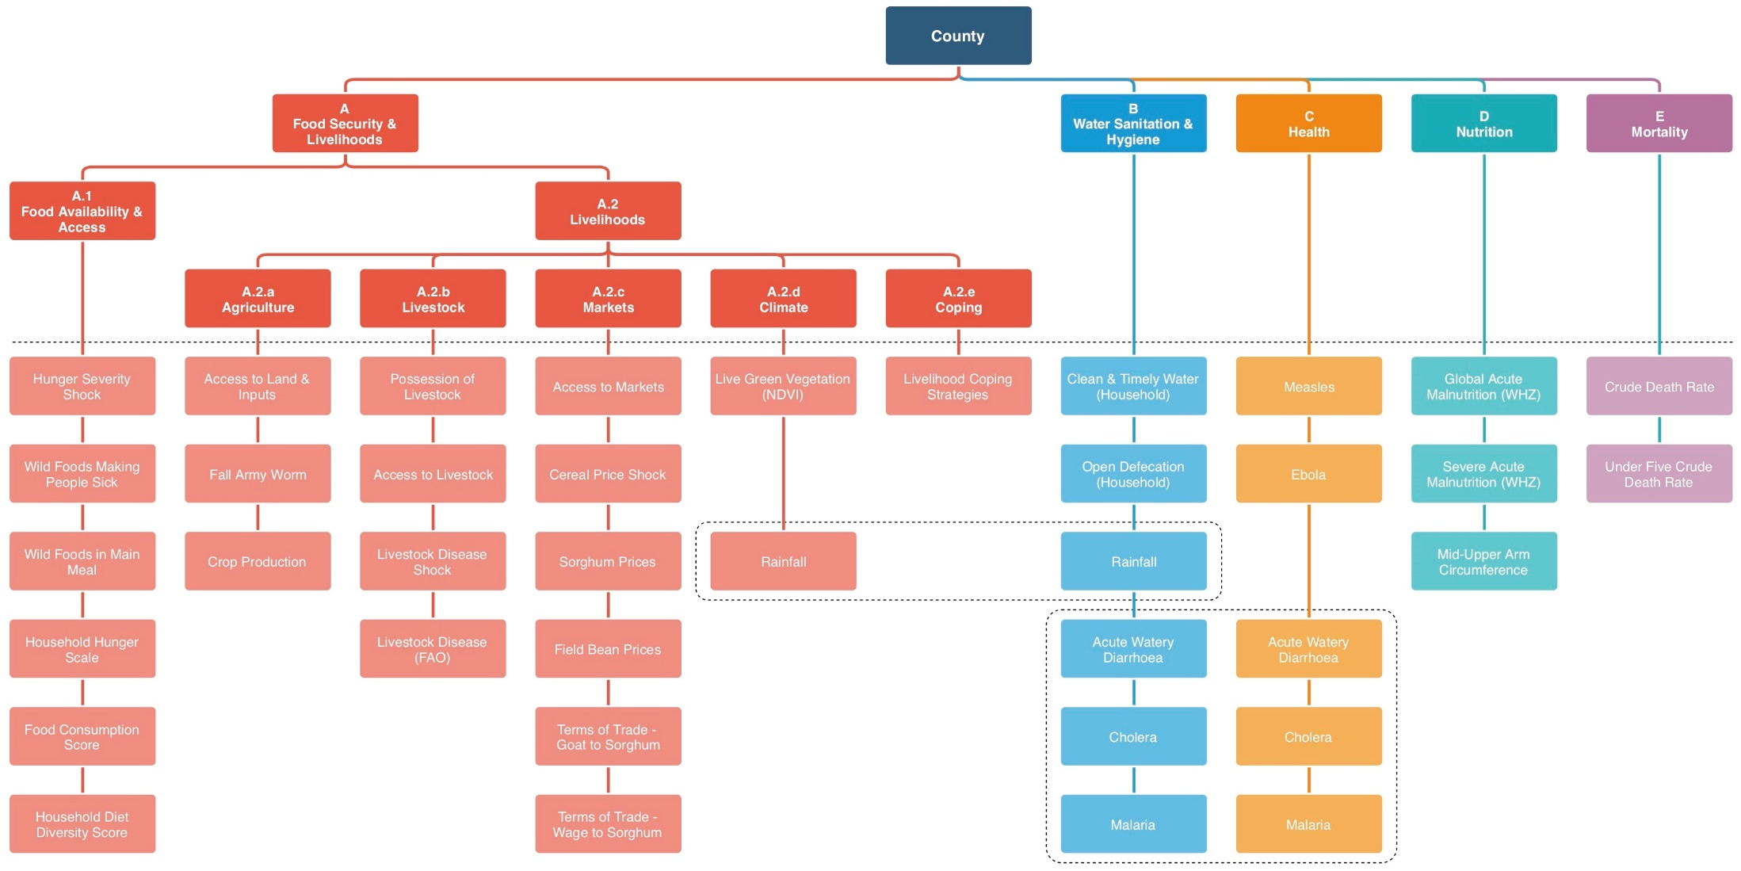
INT+ Framework
FSL
WASH
Health
Nutrition
Mortality
Notes:
The core indicators used in the INT
The circled areas reflect indicators that fall into two separate categories
There are requirements for indicators including timeliness of the data (most be collected on a monthly basis) and transparent and accepted methodology
Most indicators would fall under proxy indicators which fits the purpose of the INT – to provide a guiding light between a major workshops such as the IPC
When IPC outcomes are available (FSL and nutrition) they supercede the proxy indicators. I.e. The phase classification would override any proxy indicator. This is a major lesson learned from the February NAWG workshop

Slide 9
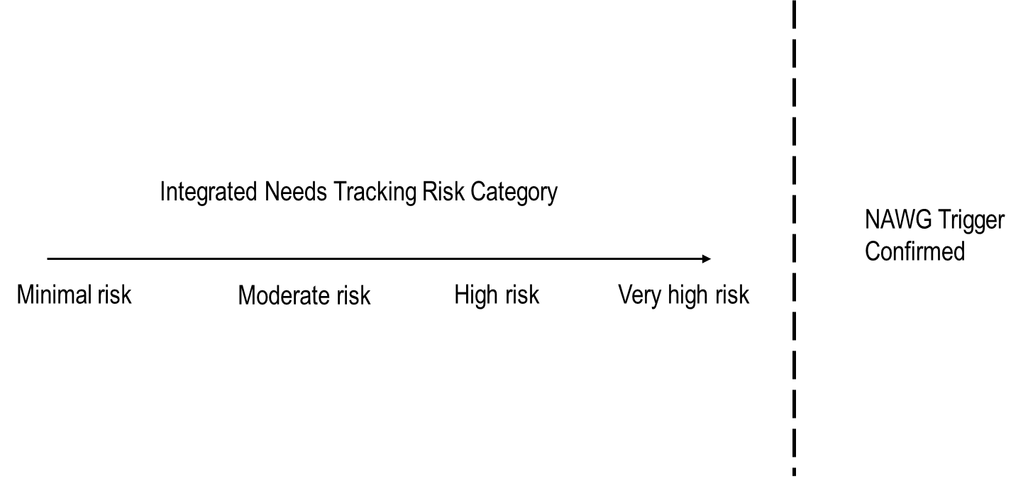
INT outcomes and NAWG Triggers
Needs Analysis Working Group Triggers
IPC Phase 5 Populations
Increasing Mortality
Influx of new arrivals > 5000
Confirmed disease outbreak
GAM (WHZ) Prevalence > 15%
Notes:
The INT is built to always include human contextuliation. A key lesson learned from FSNAU’s early warning system in Somalia.
The INT only provides “at risk of a NAWG trigger” classifications of locations. This fundamentally requires the NAWG to make all final decisions on whether there is a trigger present or now.
The concept is to narrow down where the analyst to look not to suercede the analyst job.

Slide 10
Translating ‘at risk’ levels to NAWG triggers
Category | Description | Action
NAWG Trigger Present | One of the five NAWG presents is confirmed. Each of the triggers represents that a severe level of needs is currently present in the county. | NAWG makes one of three recommendations to the ICWG; response scale up, follow up assessment, or close monitoring.
Very high risk of NAWG trigger present | Based on the available data, there is a strong convergence of proxy data suggesting that there is a very high risk of a NAWG being present. No single conceptual indicator can trigger a very high-risk categorization, therefore, following the framework that as data converges the risk of a NAWG trigger increases. | It is recommended for NAWG discussion and request for additional data.
High risk of NAWG trigger present | One of the conceptual indicators is suggesting a very high risk, but other indicators diverge at high risk or lower. | It is recommended for NAWG discussion and request for additional data.
Moderate risk of NAWG trigger | One conceptual indicator is suggesting high risk, but other indicators diverge at average risk or lower. | Monitored for further deterioration by INT internal team
Minimal risk of NAWG trigger. | None of the conceptual indicators directly indicate immediate intervention to address the needs gap in the area. | Monitored for further deterioration by INT internal team
Insufficient data | There is insufficient data available to meet any of the requirements to reliability provide a category to the county. | Request partners to provide updated data to guide category.
Notes:
This is more of a ‘If needed’ slide. Don’t except you to go through this.

Slide 11
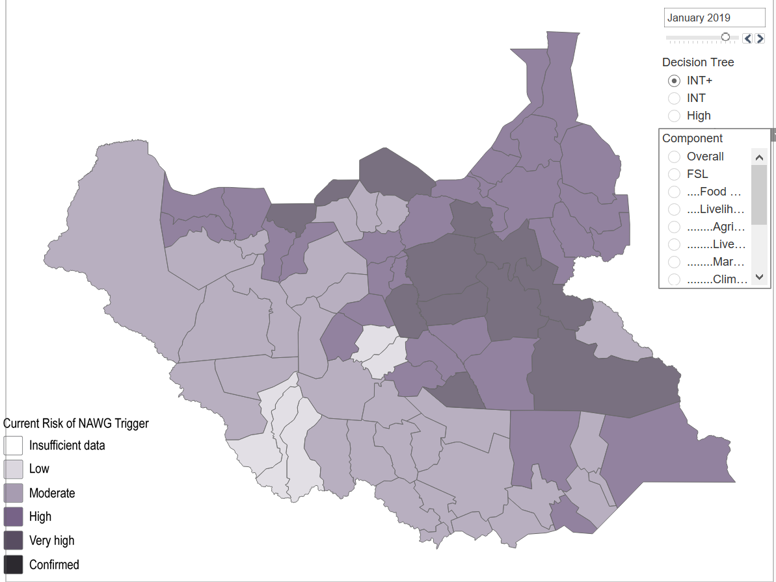
INT Map
Notes:
This is the outcome of the map with the confirmed NAWG triggers being highlighted. Most of the NAWG triggers are driven by GAM >15% according to the IPC.
After this slide I’d suggest opening up the online platform/tableau to show how interactive the map is.

Slide 12
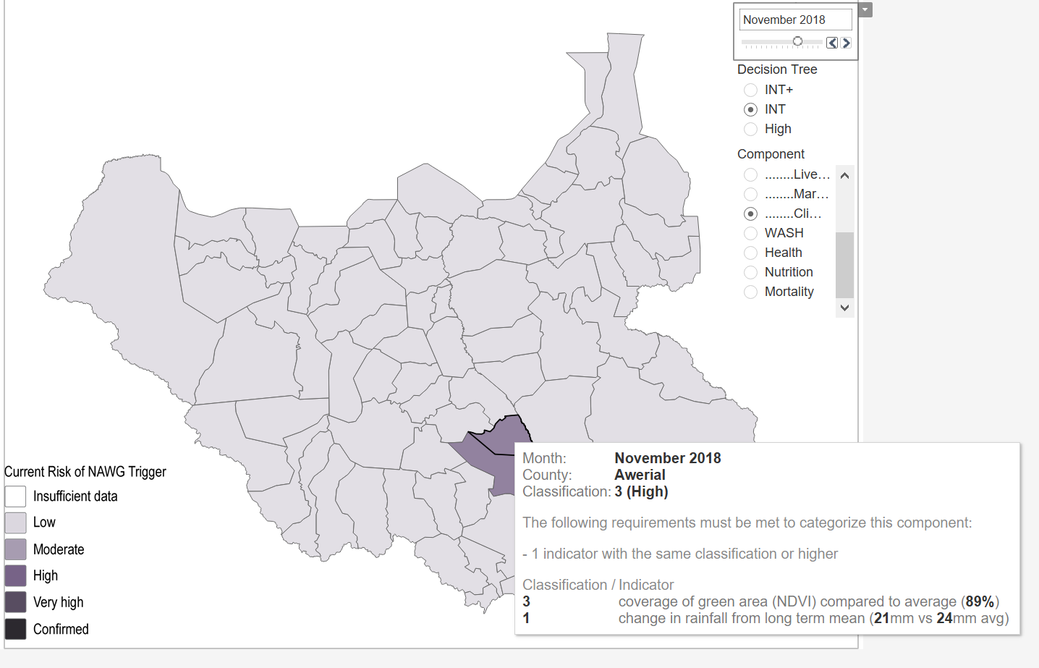
INT Map
Notes:
This slide shows how people can look at trends over time.
This is climate data from November 2018 – shows rainfall and NDVI v long term means

Slide 13
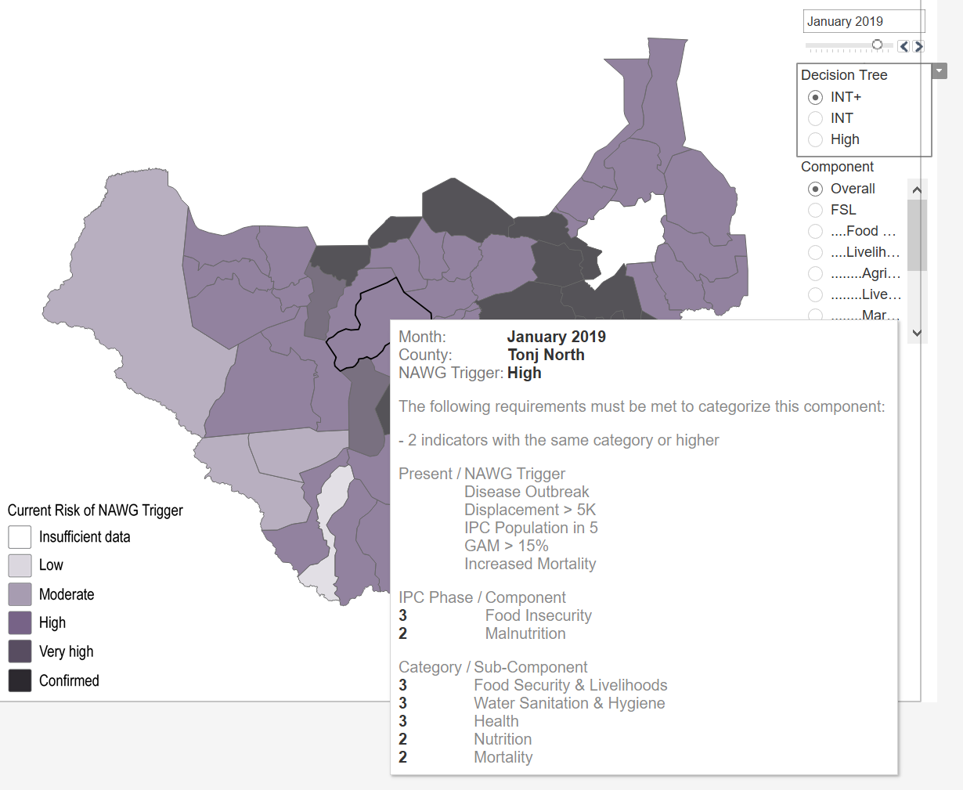
INT Map
Notes:
Shows how categories are broken down and the indicators categories

