Slide 1
Ar-Raqqa City Gap Analysis Workshop
December 2018
Ein Issa, Northeast Syria

Slide 2
Gap Analysis Workshop – Ar-Raqqa City
Agenda
Intro – Northeast Syria Forum - NES Forum
Methodology - REACH
Sector Gap Analysis – REACH
  Each sector presentation followed by discussion

Slide 3
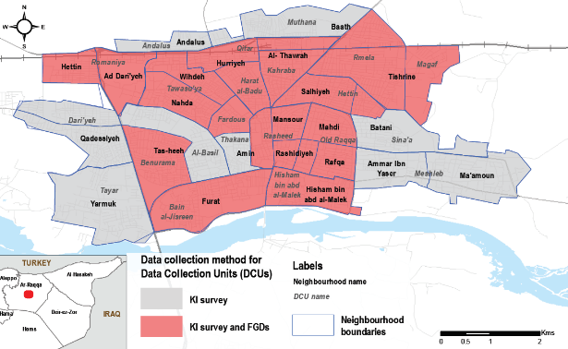
Methodology
Needs data: REACH Area Based Assessment III (ABA) but triangulated with additional sources
Response data: compiled from 4Ws, direct outreach, and NES Forum Response Overview Summaries
Population data: REACH ABA III and OCHA Return Movement in Raqqa city
ABA III Coverage
ABA Methodology
A total of 79 Key Informant (KI) interviews, with a minimum of three KIs interviewed per Ar-Raqqa city neighbourhood.
Additionally, a total of 16 gender-separated focus group discussions were conducted in 14 out of 22 neighbourhoods.
Data collection took place between September 17 and October 14 2018.

Slide 4
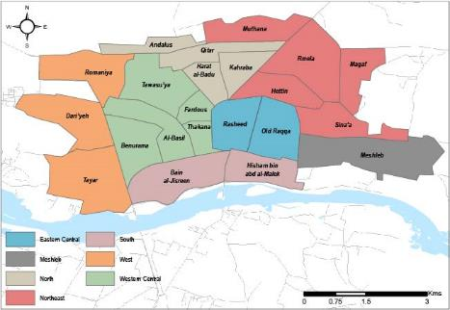
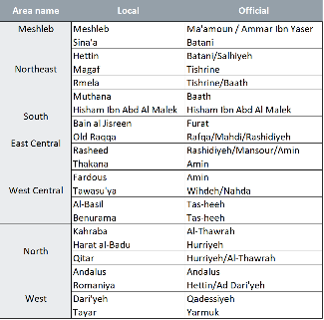
Methodology: Area Boundaries
Multiple data sources do not always align in terms of geographic scale
Consequently, city was divided in 7 homogenous areas where needs and response data could be compared on the same scale
Areas are purely arbitrary and don’t relate to any meaningful response plan

Slide 5
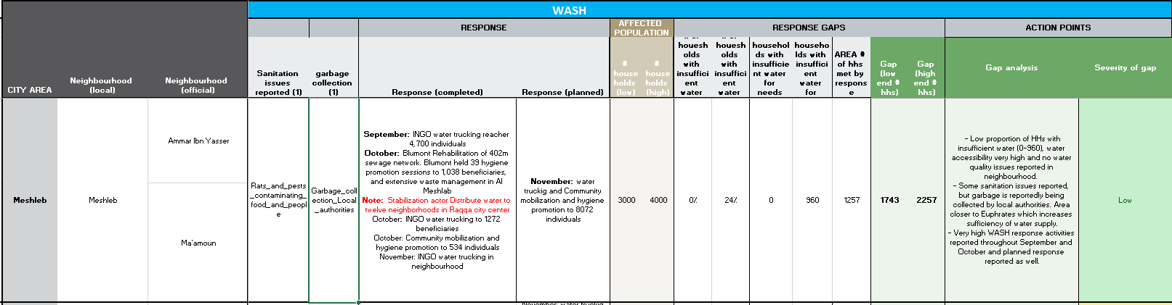
Methodology: Gap Analysis
Needs data and response data is populated into an analysis matrix, and compared in attempt to determine ‘gaps’ in response
Gaps assessed by looking ‘holistically’ at needs indicators and response data
Ranges are used to incorporate the uncertainty in estimates and figures
Sector focal points consulted and included throughout process
All tools and data available for sharing via Scott.sandvik@reach-initiative.org
Data analysis matrix

Slide 6
Limitations
Lack of local-level reporting in 4Ws, e.g. only specifying intervention at city-level.
Possibility of missing intervention data and / or duplication in reporting of activities.
Lack of reporting on planned response.
Findings and gaps are indicative only.

Slide 7
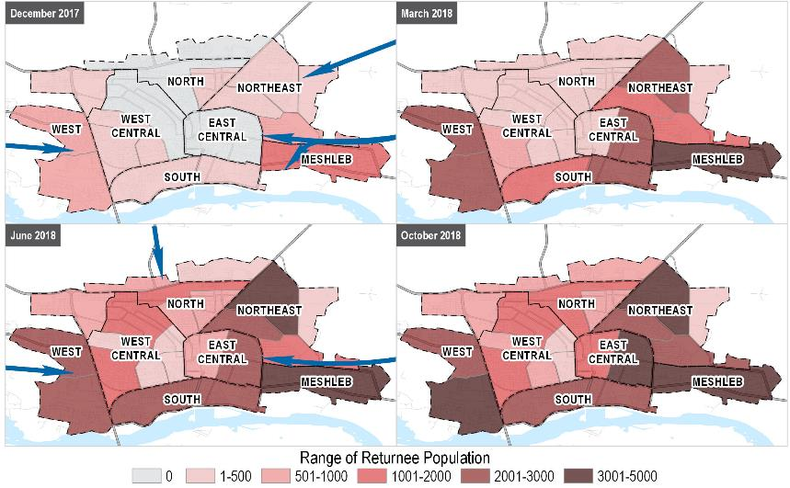
Ar-Raqqa city: Population Returns
Based on REACH Returns Overview and ABA data

Slide 8
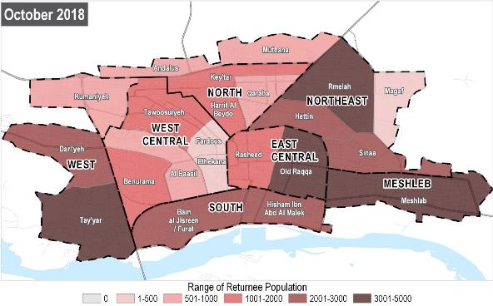
Ar-Raqqa city: Population Returns
Based on REACH ABA III
Area Level Population estimates:
Meshleb: 3,000-4,000
Northeast: 8,000-11,000
North: 4,200-4,900
East Central: 4,000-6,000
West Central: 4,900-5,900
West: 6,300-6,900
South: 5,000-6,000

Slide 9
Response Gap Analysis

Slide 10
Ar-Raqqa City – Key Take-outs
Population returns to Raqqa city are generally decreasing and stabilising
Response is limited particularly within shelter, education, livelihoods and protection
Increase in availability of services within education, healthcare and significant rehabilitation of water infrastructure throughout the city
Still widespread challenges persists related to cost of services and lack of livelihood opportunities for residents
West, West Central and, particularly, North areas stand out with high level of needs across many sectors and a lower level of response compared to other areas

Slide 11
Water, Sanitation and Hygiene (WASH)

Slide 12
WASH: City Wide Findings
Main water network seen significant rehabilitation over the last year
Main source of water for residents has shifted from water trucking to accessing water primarily through main water network.
Although access to water has improved, water quality issues persist.
West area stands out with lower level of WASH response combined with higher levels of water insufficiency and several water quality issues reported

Slide 13
WASH: Key Trends
Primary reported source of water in neighbourhood (# of neighbourhoods)
Avg. number of days water was available from the network in neighbourhoods

Slide 14
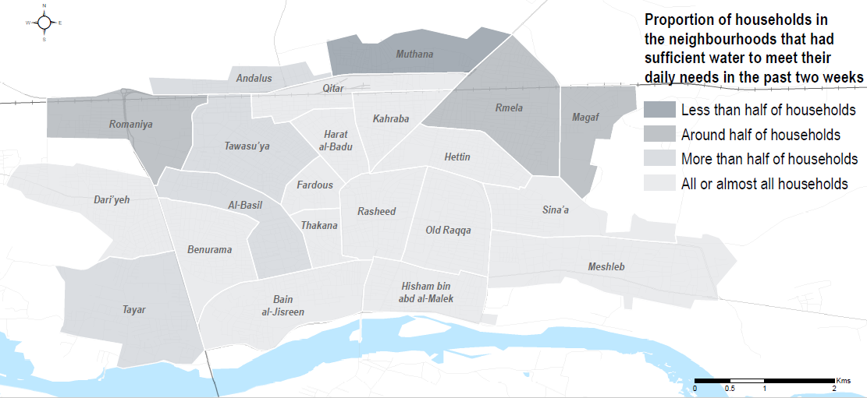
WASH: Key Trends
Level of water sufficiency among population as of October 2018
From ABA III

Slide 15
WASH: Key Trends
Number of neighbourhoods reporting issues with water quality
Water quality issues include: abnormal smell of water, water is discoloured, people got sick after consuming water

Slide 16
WASH: Water Quantity
As of October 2018
 | % households with insufficient water | Number of days water available from water network
Meshleb | 0-24% / 0-960 households | Every day
Northeast | 25-45% / 1,982 - 4,713 households | Between 3 to 5 days (very limited water availability in Magaf neighbourhood)
South | 0 - 24% / 0 - 1,440 households | Every day
East Central | 0 - 24% / 0 - 1,440 households | Every day
West Central | 13 - 37% / 652 - 2,198 households | Between 3 to 6 days
North | 6 - 30% / 238 - 1,463 households | Between 5 to 7 days
West | 29-56% / 1,762 -3,862 households | Between 3 to 6 days
High levels of water insufficiency in West area

Slide 17
WASH: Water Quality
As of October 2018
 | Water quality issues reported in area | Sanitation issues reported in area
Meshleb | No problems, safe to drink | Rats, pests
Northeast | Water smells, water tastes bad, water is discoloured, people got sick after consumption | Rats, pests
South | Water smells, water tastes bad, people got sick after consumption | Rats, pests
East Central | Water smells, water is discoloured (only in Rasheed) | Rats, pests, garbage in the streets
West Central | No problems, safe to drink | Rats, pests, garbage in the streets
North | No problems, safe to drink | Rats, pests, sewage flowing into the streets (Only in Andalus)
West | Water smells, water tastes bad, people got sick after consumption | None
Many water quality issues reported in Northeast, South and West areas

Slide 18
WASH: Response
 | September | October | Planned
Meshleb | INGO water trucking to 4,700 beneficiaries | · INGO water trucking to 1,272 beneficiaries and hygiene promotion to 534 · Stabilisation actor rehabilitation of 402m sewage network, 39 hygiene promotion sessions for 1,038 beneficiaries, waste management services provided in area, and water distribution to 12 neighbourhoods throughout city. | Water trucking and community mobilization and hygiene promotion to 8,072 beneficiaries
Northeast | INGO water trucking to 12,850 beneficiaries | · Stabilisation actor rehabilitation of 1,334m sewage network and 2,000m drinking water network · INGO water trucking to 11,302 beneficiaries · INGO community mobilization and hygiene promotion to 1,322 individuals | · INGO water trucking, community mobilization and hygiene promotion, WASH in school, distribution of hygiene kits to benefit 9,960 residents · INGO rehabilitation of main water supply to benefit 70,000 residents
South | · Stabilisation actor installation and rehabilitation of water infrastructure at Sok al Hal water station benefitted 50,000 residents | · Stabilisation actor rehabilitation of water pumps and installation of chlorinators, as well as rehabilitation of 30m sewage network. | INGO WASH intervention in schools to benefit 1,100 individuals
East Central | No response reported | Stabilisation actor rehabilitation of 303m sewage network | INGO WASH intervention in schools to benefit 2,200 individuals
West Central | INGO water trucking to 750 individuals | · Stabilisation actor rehabilitation of 705m sewage network. · INGO hygiene promotion to 1,066 residents | INGO WASH intervention in schools to benefit 4,000 individuals
North | INGO water trucking to 550 beneficiaries | No response reported | No response reported
West | Stabilisation actor rehabilitation of 67m sewage network | INGO water trucking in neighbourhood (November) | INGO Solid waste collection, transportation and disposal to benefit 5,000 residents

Slide 19
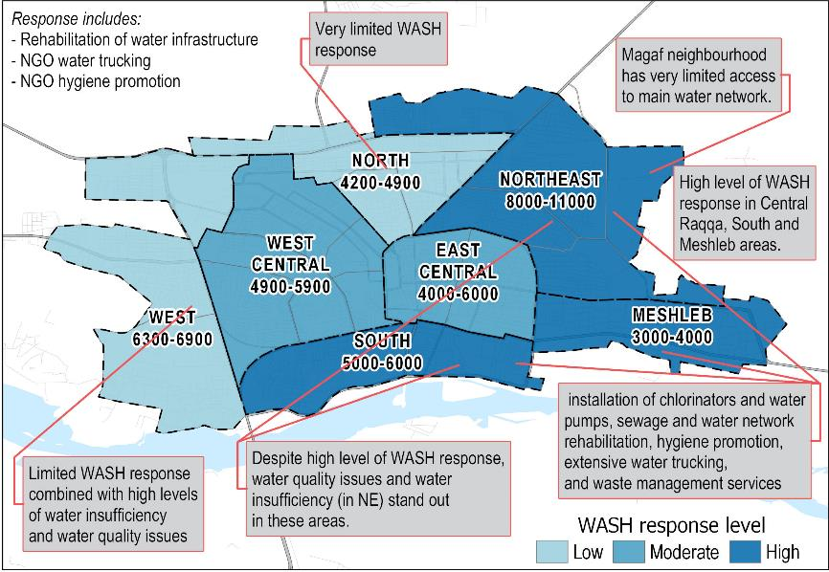
WASH: Response Gaps

Slide 20
Health

Slide 21
Health: City Wide Findings
Access to healthcare is limited even in areas with public or INGO run healthcare facilities offering free services.
Lack of doctors in city hospitals, including doctors with specialisations, and many services are not offered, such as reproductive healthcare and population depend on unaffordable private services.
High shortage of prosthetics, x-ray equipment, and insulin in the city due to high cost of medical items and lack of financial resources for hospitals.
Electricity shortages affect hospital capacity, such as incubators and oxygen.
High need for specialised services such as dialysis machinery, surgical capacities, diagnostic services for tuberculosis and HIV/AIDS, and treatment for skin burns.
North and Northeast areas stand out with no healthcare facilities offering free services in areas, and lower level of access to required treatment reported

Slide 22
Health: Key Trends
Type of medical facilities reported as accessed in neighbourhoods

Slide 23
Health: Key Trends
Number of neighbourhoods by proportion of households requiring medical treatment who have been able to receive it
 | March | June | October
51-75% | 1 | 3 | 8
50% | 5 | 1 | 8
26-49% | 14 | 12 | 6
0-25% | 2 | 6 | 0
% of households

Slide 24
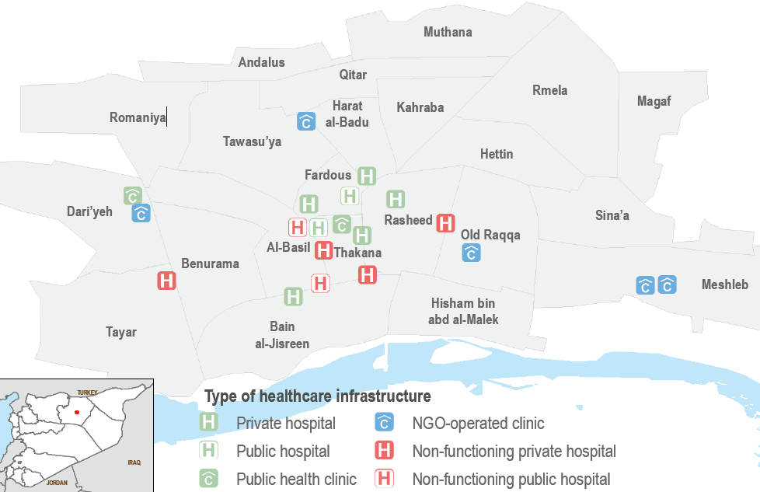
Health: Key Trends
Healthcare facilities in Ar-Raqqa City as of October 2018
From ABA III

Slide 25
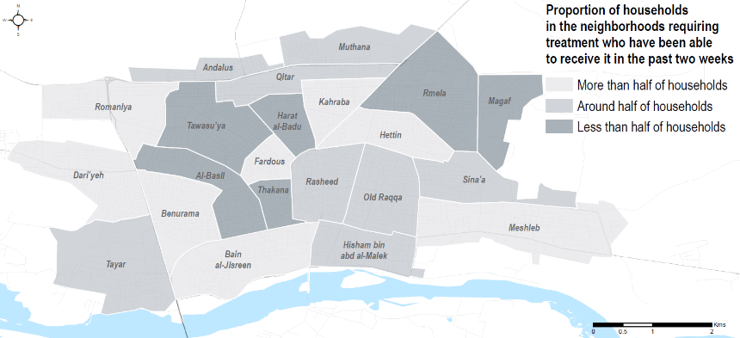
Health: Key Trends
Proportion of households able to access required treatment in neighbourhood as of October 2018
From ABA III

Slide 26
Health: Barriers to Healthcare
Most commonly reported barriers to healthcare across Ar-Raqqa city (% of KIs reporting)
All top three barriers also reported in areas where there are healthcare facilities offering healthcare free services

Slide 27
Health: Access to Healthcare
As of October 2018
 | % households requiring treatment who have been able to receive it | Medical facilities reported accessed by households in area | Medical facilities available area
Meshleb | 51-75% | Mobile clinics Free health clinics Pharmacies | Two INGO run clinics
Northeast | 45-55% | Pharmacies Private clinics | No free health clinics available
South | 55-65% | Pharmacies Hospitals Private clinics | No free health clinics available
East Central | 45-55% | Free health clinics Private clinics Pharmacies | Three health clinics (free) and one private hospital
West Central | 45-55% | Hospitals Pharmacies | Two private hospitals, two public hospitals, two NGO run health clinics
North | 45-55% | Hospitals Pharmacies | No free health clinics available
West | 51-75% | Free health clinics Pharmacies | One NGO run free health clinic, one free health clinic

Slide 28
Health: Barriers to Healthcare
As of October 2018
 | Main barriers to accessing healthcare
Meshleb | Lack of facilities Lack of medicine/medical items Healthcare is unaffordable
Northeast | Lack of facilities Lack of medicine/medical items Healthcare is unaffordable
South | Healthcare is unaffordable Lack of medicine/medical items
East Central | Healthcare is unaffordable Lack of medicine/medical items
West Central | Healthcare is unaffordable Lack of medicine/medical items Healthcare is of low quality
North | Lack of facilities Healthcare is unaffordable
West | Healthcare is unaffordable

Slide 29
Health: Response
 | Ongoing
Meshleb | · INGO medical point distribution of assistive devices and PSS services ongoing for people with disabilities; 213 patients served in September / 187 in October. · INGO Medical clinic offering free services; key medical center for residents throughout the city.
Northeast | 123 individuals screened for acute malnutrition via INGO mobile health unit in September
South | 404 individuals screened for acute malnutrition via INGO mobile health unit in September and October
East Central | INGO health clinic served 7,401 patients (emergency care, pediatric care, consultations) in September - November
West Central | · INGO hospital provided 2,700 consultations (internal, pediatric, gynecology, emergency) in October · INGO Maternity and pediatric hospital served 14,990 patients and performed 2,031 surgeries through September - November · INGO health clinic provided more than 3,000 consultations (GP, pediatrics, dental care) in October-November · INGO preparing plans for physical rehabilitation of Raqqa National Hospital
North | 425 individuals screened for acute malnutrition via INGO mobile health unit in September and October
West | · 213 individuals screened for acute malnutrition via INGO mobile health unit in October · INGO medical clinic served 4,144 patients in October (same INGO operates a mobile clinic as well serving residents throughout city) · INGO integrated Primary Care Facility served 832 beneficiaries.

Slide 30
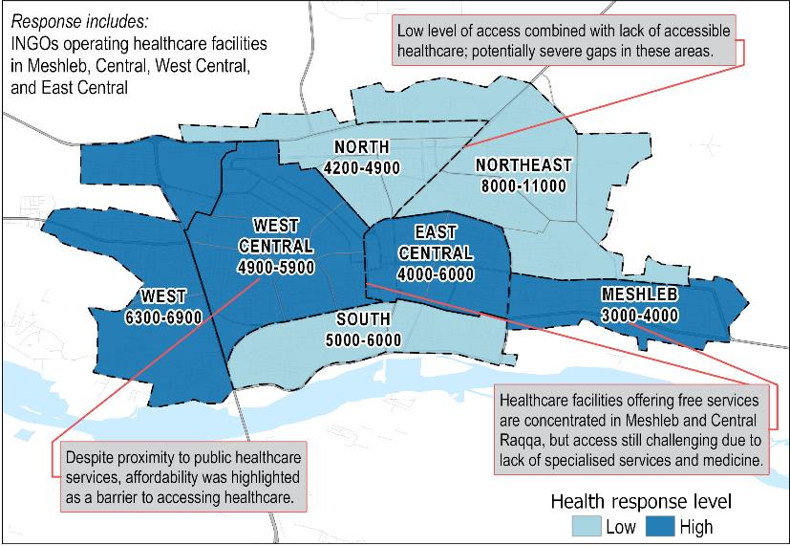
Health: Response Gaps

Slide 31
Education

Slide 32
Education: City Wide Findings
Low INGO response, mostly LNGOs/stabilization actors responding
  School attendance has increased for primary level education since June, but access to intermediary/secondary level education remains very low.
  Findings coming out of our focus group discussions from the ABA highlight severe issues with quality of education, overcrowding, and infrastructure damage to school facilities.
South, East Central, North and West stand out with lower level of school attendance rates and few schools available to serve area populations.
Potential ‘in-depth’ component on education sector for ABA IV (February)

Slide 33
Education: Key Trends
Access to primary level education (6-12) by neighbourhoods

Slide 34
Education: Key Trends
Access to intermediary/secondary level (13-15) education by neighbourhoods

Slide 35
Education: Key Trends
# neighbourhoods with access to education facilities inside their neighbourhood

Slide 36
Education: Attendance
% school attendance rate for primary level (6-12) and intermediary/secondary level (13-17) education

Slide 37
Education: Attendance
Drop-out rates for primary, intermediary and secondary level school children
As of October 2018
 | % of children 6-12 dropping out of education services | % of children 13-17 dropping out of education services | Prevalence of Child Labour
Meshleb | 0-20% | 20-40% | Common
Northeast | 0-20% | 20-40% | Common
South | 10-30% | 40-60% | Common
East Central | 10-30% | 30-50% | Common
West Central | 0-20% | 50-70% | Common
North | 0-20% | 10-30% | Common
West | 10-30% | 60-80% | Common

Slide 38
Education: Access to Education
As of October 2018
 | Number of schools available in area | Area population range estimates
Meshleb | 6-7 schools | 3,000-4,000 HHs
Northeast | 4-5 schools | 8,000-11,000 HHs
South | 3-4 schools | 5,000-6,000 HHs
East Central | 2-3 schools | 4,000-6,000 HHs
West Central | 5-7 schools | 4,900-5,900 HHs
North | 1-2 schools | 4,200-4,900 HHs
West | 6-8 schools | 6,300-6,900 HHs
Most commonly reported barriers to education among Key Informants (KIs)

Slide 39
Education: Response
 | Response activities
Meshleb | Two schools rehabilitated by LNGO
Northeast | · Two schools rehabilitated by LNGO · LNGO operating CFS providing PSS and awareness raising activities in a local school
South | · Three schools rehabilitated by LNGO · LNGO operating CFS providing literacy and numeracy, targeting children aged from 9 to 16 years old, as well as a mobile team for PSS
East Central | Two schools rehabilitated by LNGO
West Central | · Five schools rehabilitated by LNGO · LNGO center providing English language training, computer courses, life skills, and leadership and entrepreneurship skills
North | One school rehabilitated by LNGO
West | One school rehabilitated by LNGO
City-wide | · INGO distribution of 121,250 sets of books via the self-learning program (not limited to Raqqa city) · LNGO providing training of teachers via 8 formal trainers on PSS (not limited to Raqqa city) · INGO planning to open two non-formal education centers in Raqqa city, as well as rehabilitation of 15 formal schools. · LNGO operating CFS covering 1000 children providing Literacy and numeracy sessions, as well as distributed 5000 school seats throughout the city · LNGO planning to distribute heaters and fuel to schools across Raqqa city.

Slide 40
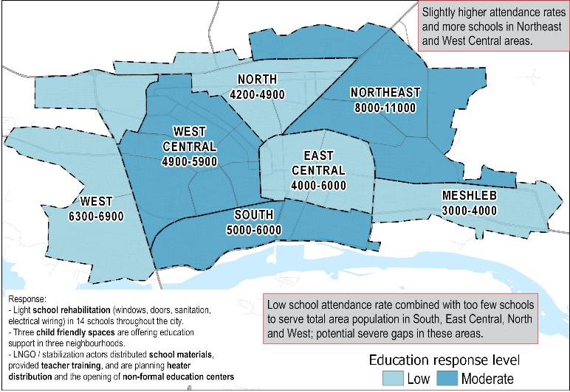
Education: Response Gaps

Slide 41
Food security

Slide 42
Food Security: City Wide Findings
Availability of core food items has increased, while affordability has decreased despite food prices remaining stable
The usage of negative coping strategies prevalent despite high level of food distributions throughout the city
Average amount of income and ability to cover basic needs very limited throughout city (except Meshleb area)
North area may potentially have a lower level of response compared to area population

Slide 43
Food Security: Key Trends
Proportion of Core Food Items available on average across Ar-Raqqa City neighbourhoods
Core food items assessed include bread, flour, rice, lentils, sugar, cooking oil, chicken, meat, tomatoes, cucumbers, and onions.

Slide 44
Food Security: Key Trends
Proportion of Core Food Items affordable for the majority of residents in Ar-Raqqa city neighbourhoods

Slide 45
Food Security: Key Trends
Average cost of Food items in the Survival Minimum Expenditure Basket (SMEB) in Ar-Raqqa Sub-District in Syrian Pounds (SYP)*
*SMEB represents the minimum culturally adjusted items required to support a 6-person household for a month and is comprised of 18 items.

Slide 46
Food Security: Key Trends
Number of neighbourhoods with access to public or private bakeries
Number of neighbourhoods by sufficiency and affordability of bakeries*
*No data was available for this indicator in two neighbourhoods for the March round of the Area Based Assessment

Slide 47
Food Security: Access to Food
As of October 2018
 | % core food Items available | % of core food items affordable for majority of people
Meshleb | 100% | 73%
Northeast | 100% | 51%
South | 100% | 32%
East Central | 100% | 73%
West Central | 93% | 25%
North | 95% | 55%
West | 88% | 27%

Slide 48
Food Security: Sufficiency of food
As of October 2018
 | Households with insufficient food* | % of households able to cover basic needs through sources of income
Meshleb | 0-25% / 0 - 1,000 HHs | 51-75%
Northeast | 53-70% / 4,200 - 7,708 HHs | 26-49%
South | 52-73% / 2,580 - 4,377 HHs | 45-55%
East Central | 51-75% / 2,040 - 4,500 HHs | 45-55%
West Central | 45-64% / 2,181 - 3,797 HHs | 26-49%
North | 34-57% / 1,430 - 2,815 HHs | 26-49%
West | 41-70% 2,611 - 4,811 HHs | 0-25%
* Households with insufficient food is calculated assessing prevalence of the negative coping strategies skipping meals, reducing meal sizes, and using money usually spent on other things.

Slide 49
Food Security: Response
 | October | November
Meshleb | No response reported | INGO Cash for food planned for 3,000 HHs
Northeast | - INGO 30-day RTEs distribution to 622 HH | - INGO 30-day RTEs distribution to 622 HHs - Food vouchers distributed to 164 HHs - INGO cash for food planned for 1,000 HHs
South | - Stabilization actor distribution of 5-day RTEs to 4,506 beneficiaries - INGO distribution of food vouchers to 3,494 HHs | - Stabilization actor distribution of 5-day RTEs to 4,506 beneficiaries - INGO distribution of food vouchers to 2,867 HHs
East Central | - INGO Food distribution to 3,132 HHs - Stabilization actor distribution of 5-day RTEs to 4,506 beneficiaries | - INGO Food distribution to 1,733 HHs - Stabilization actor distribution of 5-day RTEs to 4,506 beneficiaries
West Central | - INGO Food distribution to 4,085 HHs | - INGO Food distribution to 2,123 HHs
North | - INGO Food distribution to 575 HHs | - INGO Food distribution to 2,428 HHs
West | - INGO food voucher distribution to 3,264 HHs - INGO food distributions to 622 HHs | - INGO food voucher distribution to 2,430 HHs - INGO food distributions to 317 HHs

Slide 50
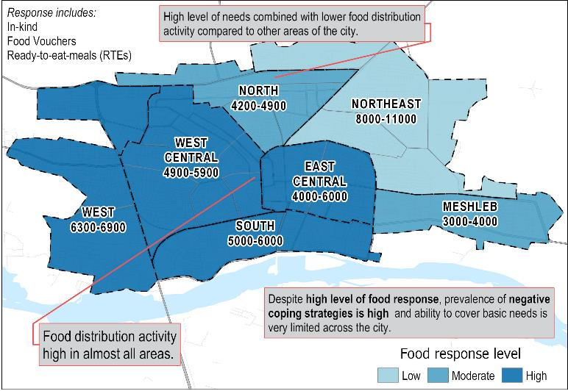
Food Security: Response Gap

Slide 51
Food Security: Response
Number of households targeted by food distributions in area
 | October | November | Estimated Area Population
Meshleb | 0 HHs | 0 HHs | 3,000-4,000
Northeast | 622 HHs | 786 HHs | 8,000-11,000
South | 4,245 HHs | 3,618 HHs | 5,000-6,000
East Central | 4,469 HHs | 3,883 HHs | 4,000-6,000
West Central | 4,085 HHs | 2,123 HHs | 4,900-5,900
North | 575 HHs | 2,428 HHs | 4,200-4,900
West | 3,886 HHs | 2,423 HHs | 6,300-6,900

Slide 52
Livelihoods

Slide 53
Livelihoods: City Wide Findings
Average amount of income in Raqqa city is less than 50,000 SYP
Cash response limited and primarily focused in Northeast area
Cash for work response in some areas but on a very limited scale
West area stands out with low average income and lowest ability for households to cover basic needs

Slide 54
Livelihoods: Sources of Income
Most commonly reported sources of income (% of KIs reporting )
Men Women

Slide 55
Livelihoods: Challenges to Livelihoods
Most commonly reported barrier to livelihoods (% of KIs reporting )

Slide 56
Livelihoods: Ability to Cover Basic Needs
As of October 2018
 | Average amount of income | % households able to cover basic needs through sources of income
Meshleb | From 50,000-100,000 SYP | 51-75%
Northeast | Less than 50,000 SYP | 26-49%
South | From 25,000-75,000 | 45-55%
East Central | From 50,000-100,000 SYP | 45-55%
West Central | Less than 50,000 SYP | 26-49%
North | Less than 50,000 SYP | 26-49%
West | Less than 50,000 SYP | 0-25%

Slide 57
Livelihoods: Response
 | September | October | Planned
Meshleb | No response reported | INGO second round of unconditional cash transfer to 246 HHs | No response reported
Northeast |  | · INGO first round of cash distribution to 1,472 HHs · INGO unconditional cash transfer to 248 HHs | · INGO CFW program to support 40 workers · INGO third round of unconditional cash transfer to 1,642 HHs (November)
South |  | INGO supported 22 HHs through light rehabilitation of schools (CFW) 6 days per week | No response reported
East Central |  | No response reported | · INGO CFW program to support 50 workers
West Central |  | INGO supported 22 HHs through light rehabilitation of schools (CFW) 6 days per week | No response reported
North |  | No response reported | · INGO unconditional cash transfer to 505 HHs · INGO blanket cash for food distribution to 1,884 HHs
West |  | No response reported | No response reported

Slide 58
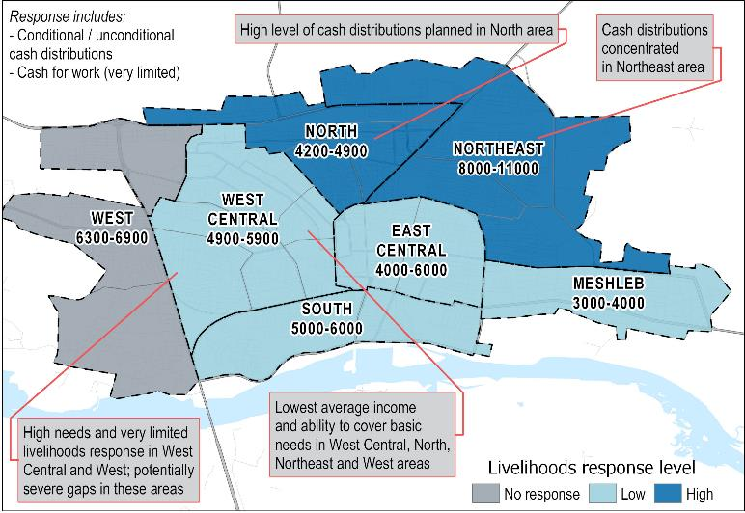
Livelihoods: Response Gaps

Slide 59
Shelter and NFIs (SNFI)

Slide 60
SNFI: City Wide Findings
There remains extensive shelter damage across Raqqa city, with high levels of severity of damage, particularly in locations Central Raqqa and North
There have been limited shelter interventions by humanitarian actors and more assessments are needed to identify households where small-scale shelter rehabilitation is feasible
The main NFI needs in the city at present relate to winter items - most items are available in around half of neighbourhoods in Raqqa City
Electricity networks are still mostly not functioning with electricity primarily available through community or private generators and is available between 8 – 10 hours on average - this is affecting the functionality of a number of key services
No NFI distributions in North, South, East Central and Meshleb areas.

Slide 61
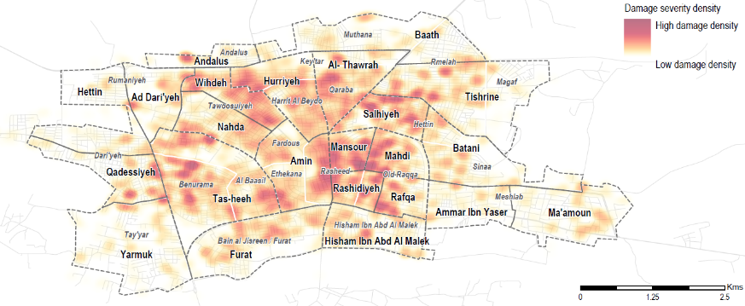
Ar-Raqqa city: Shelter
Damage density within the city (as of March 2018)
Around half (40-60%) of shelters in South, West Central, and North areas area in need of repair and reconstruction
Primary barrier to shelter reconstruction is that repair require professional expertise and that shelter materials are too expensive
Households living in damaged shelter was reportedly highest in North area (42-62%)
Between 26-49% of households in South area are living in overcrowded shelter, suggesting many households live below recommended 3.5/m2 per person.

Slide 62
SNFI: Shelter Rehabilitation
As of October 2018
 | % of shelters in need of reconstruction | % of shelters in need of repair | Main barriers to shelter repairs
Meshleb | A few to no shelters 0-20% | A few to no shelters 0-20% | Repairs require professionals and professionals are available but repair materials are too expensive
Northeast | A few to no shelters 0-20% | Less than half of shelters 20-40%
South | Around half of shelters 40-60% | Around half of shelters 40-60%
East Central | Less than half of shelters 20-40% | Around half of shelters 40-60%
West Central | Around half of shelters 40-60% | Around half of shelters 40-60%
North | Around half of shelters 40-60% | Around half of shelters 40-60%
West | A few to no shelters 0-20% | A few to no shelters 0-20% | Repairs require professionals and professionals are available but people cannot afford to pay professionals

Slide 63
SNFI: Shelter Conditions
As of October 2018
 | % of households living in damaged shelter* | % of households living in shared or overcrowded shelter
Meshleb | 0-20% / 0-800 households | 0-25%
Northeast | 0-20% / 0-2,200 households | 0-25%
South | 10-29% / 512 - 1,764 households | 26-49%
East Central | 15-32% / 600-1,943 households | 0-25%
West Central | 18-38% / 904-2,271 | 0-25%
North | 42-62% / 1,788 - 3,049 households | 0-25%
West | 0-27% / 0 - 1,877 households | 0-25%
*This indicator uses data from the June ABA due to inadequate data for the October round.

Slide 64
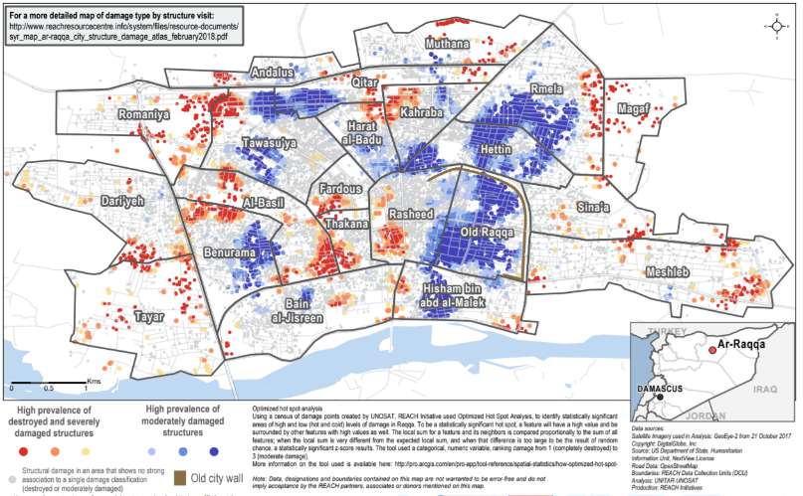
SNFI: Shelter Rehabilitation
Prevalence of Moderately Damaged Structures for Shelter Rehabilitation

Slide 65
SNFI: Shelter Response
 | September | October | Planned
Meshleb | No response reported | INGO distribution of shelter kits to 905 households | No response reported
Northeast |  | No response reported
South |  | No response reported
East Central |  | INGO emergency shelter kit distribution to 371 households
West Central |  | No response reported
North |  | INGO cash assistance distribution for shelter rehabilitation to 500 households
West |  | No response reported | INGO Shelter Regular unconditional CASH distribution to 236 HHs

Slide 66
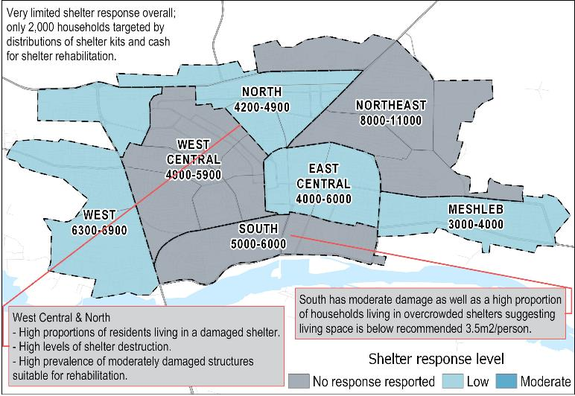
SNFI: Shelter Response Gaps

Slide 67
SNFI: Key NFI Trends
Proportion of Core Non-Food Items (NFIs) available on average by area
 | March | June | October
Meshleb | 92% | 42% | 96%
Northeast | 38% | 51% | 52%
South | 54% | 44% | 85%
East Central | 23% | 73% | 90%
West Central | 8% | 38% | 37%
North | 26% | 43% | 67%
West | 68% | 53% | 32%
Core NFIs assessed were bedding items, mattresses/sleeping bags, cooking utensils, cooking fuel, water containers, torches, solar lamps, solar panels, clothing, shoes, batteries, winter heaters, heating fuel, winter clothes, winter blankets, disposable diapers, sanitary pads, soap, laundry powder, cleaning liquid (for the house), detergent for dishes, baby diapers, and adult diapers..

Slide 68
SNFI: NFI Needs and Availability
As of October 2018
 | % availability of core NFIs in neighbourhood | % of households able to cover basic needs through their income source(s)
Meshleb | 96% | 51-75%
Northeast | 52% | 26-49%
South | 85% | 45-55%
East Central | 90% | 45-55%
West Central | 37% | 26-49%
North | 67% | 26-49%
West | 32% | 0-25%

Slide 69
SNFI: NFI Needs
Most commonly reported NFI needs across Ar-Raqqa City (% of KIs reporting)

Slide 70
SNFI: Electricity
As of October 2018
 | Average number of hours of electricity per day | Average price paid to access community generator (in Syrian Pounds)
Meshleb | Between 8 to 10 hours | 7,000 SYP
Northeast | Between 8 to 10 hours | 6,300 SYP
South | Between 8 to 10 hours | 7,500 SYP
East Central | Between 10 to 12 hours | 6,000 SYP
West Central | Between 8 to 10 hours | 6,000 SYP
North | Between 8 to 10 hours | 6,100 SYP
West | Between 8 to 10 hours | 6,200 SYP

Slide 71
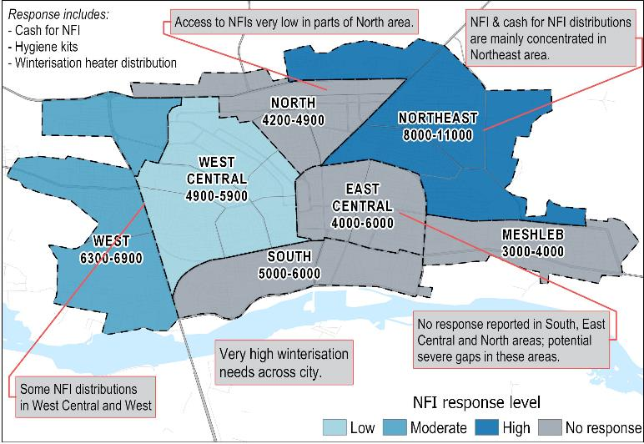
SNFI: NFI Response Gaps

Slide 72
Protection

Slide 73
Protection: City Wide Findings
Drug abuse amongst young men and boys frequently raised in Focus Group Discussions as key protection concerns among community members
Protection sector response increased since last workshop, but still primarily focused on mine risk awareness raising
Child labour remains a widespread problem in the city and most likely related to low rates of intermediary and secondary school attendance and widespread livelihood challenges for residents
In addition to child labour, child-headed households and early marriage are common in many areas of the city

Slide 74
Protection: Key Trends
Most commonly reported safety/security issues (% KIs reporting)
In October, 19% of KIs reported fear of conscription as a safety/security issue

Slide 75
Protection: Prevalence of Protection Issues
As of October 2018
 | Child Labour | Early marriage | Child-headed households
Meshleb | Common | Uncommon | Uncommon
Northeast | Common | Uncommon | Common
South | Common | Common | Common
East Central | Common | Common | Uncommon
West Central | Common | Common | Uncommon
North | Common | Common | Common
West | Common | Uncommon | Uncommon
* REACH also assessed the prevalence of involvement of children in illegal activities, involvement of children in armed activities, separated or unaccompanied children, and physical and sexual violence against children. These child protection issues were not reported to be as prevalent as the above indicators.

Slide 76
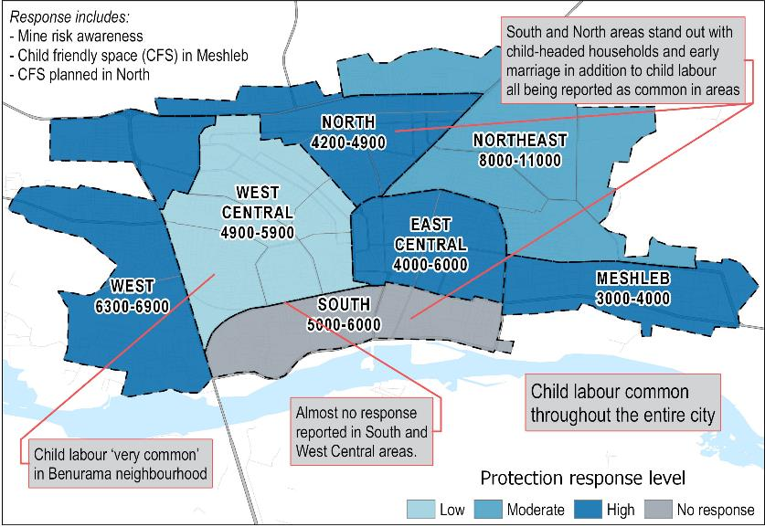
Protection: Response Gaps

Slide 77
Protection: Response
 | September | October | Planned
Meshleb | INGO mine risk awareness raising for 39 individuals | INGO mine risk awareness raising for 2,492 individuals | Ongoing: fixed Child Friendly Space providing PSS, case management, awareness raising sessions by UNICEF/Mawadah
Northeast | INGO mine risk awareness raising for 1,884 individuals | No response reported | No response reported
South | No response reported | No response reported | No response reported
East Central | INGO mine risk awareness raising for 2,216 individuals | INGO mine risk awareness raising for 1,688 individuals | No response reported
West Central | INGO mine risk awareness raising for 537 individuals | No response reported | No response reported
North | INGO mine risk awareness raising for 1,422 individuals | INGO mine risk awareness raising for 158 individuals | INGO plans to open its child friendly space for children in Qitar neighbourhood, as well as an integrated protection space for women
West | INGO mine risk awareness raising for 1,457 individuals | INGO mine risk awareness raising for 1,268 individuals | Mine risk activities planned by INGO

