Slide 1
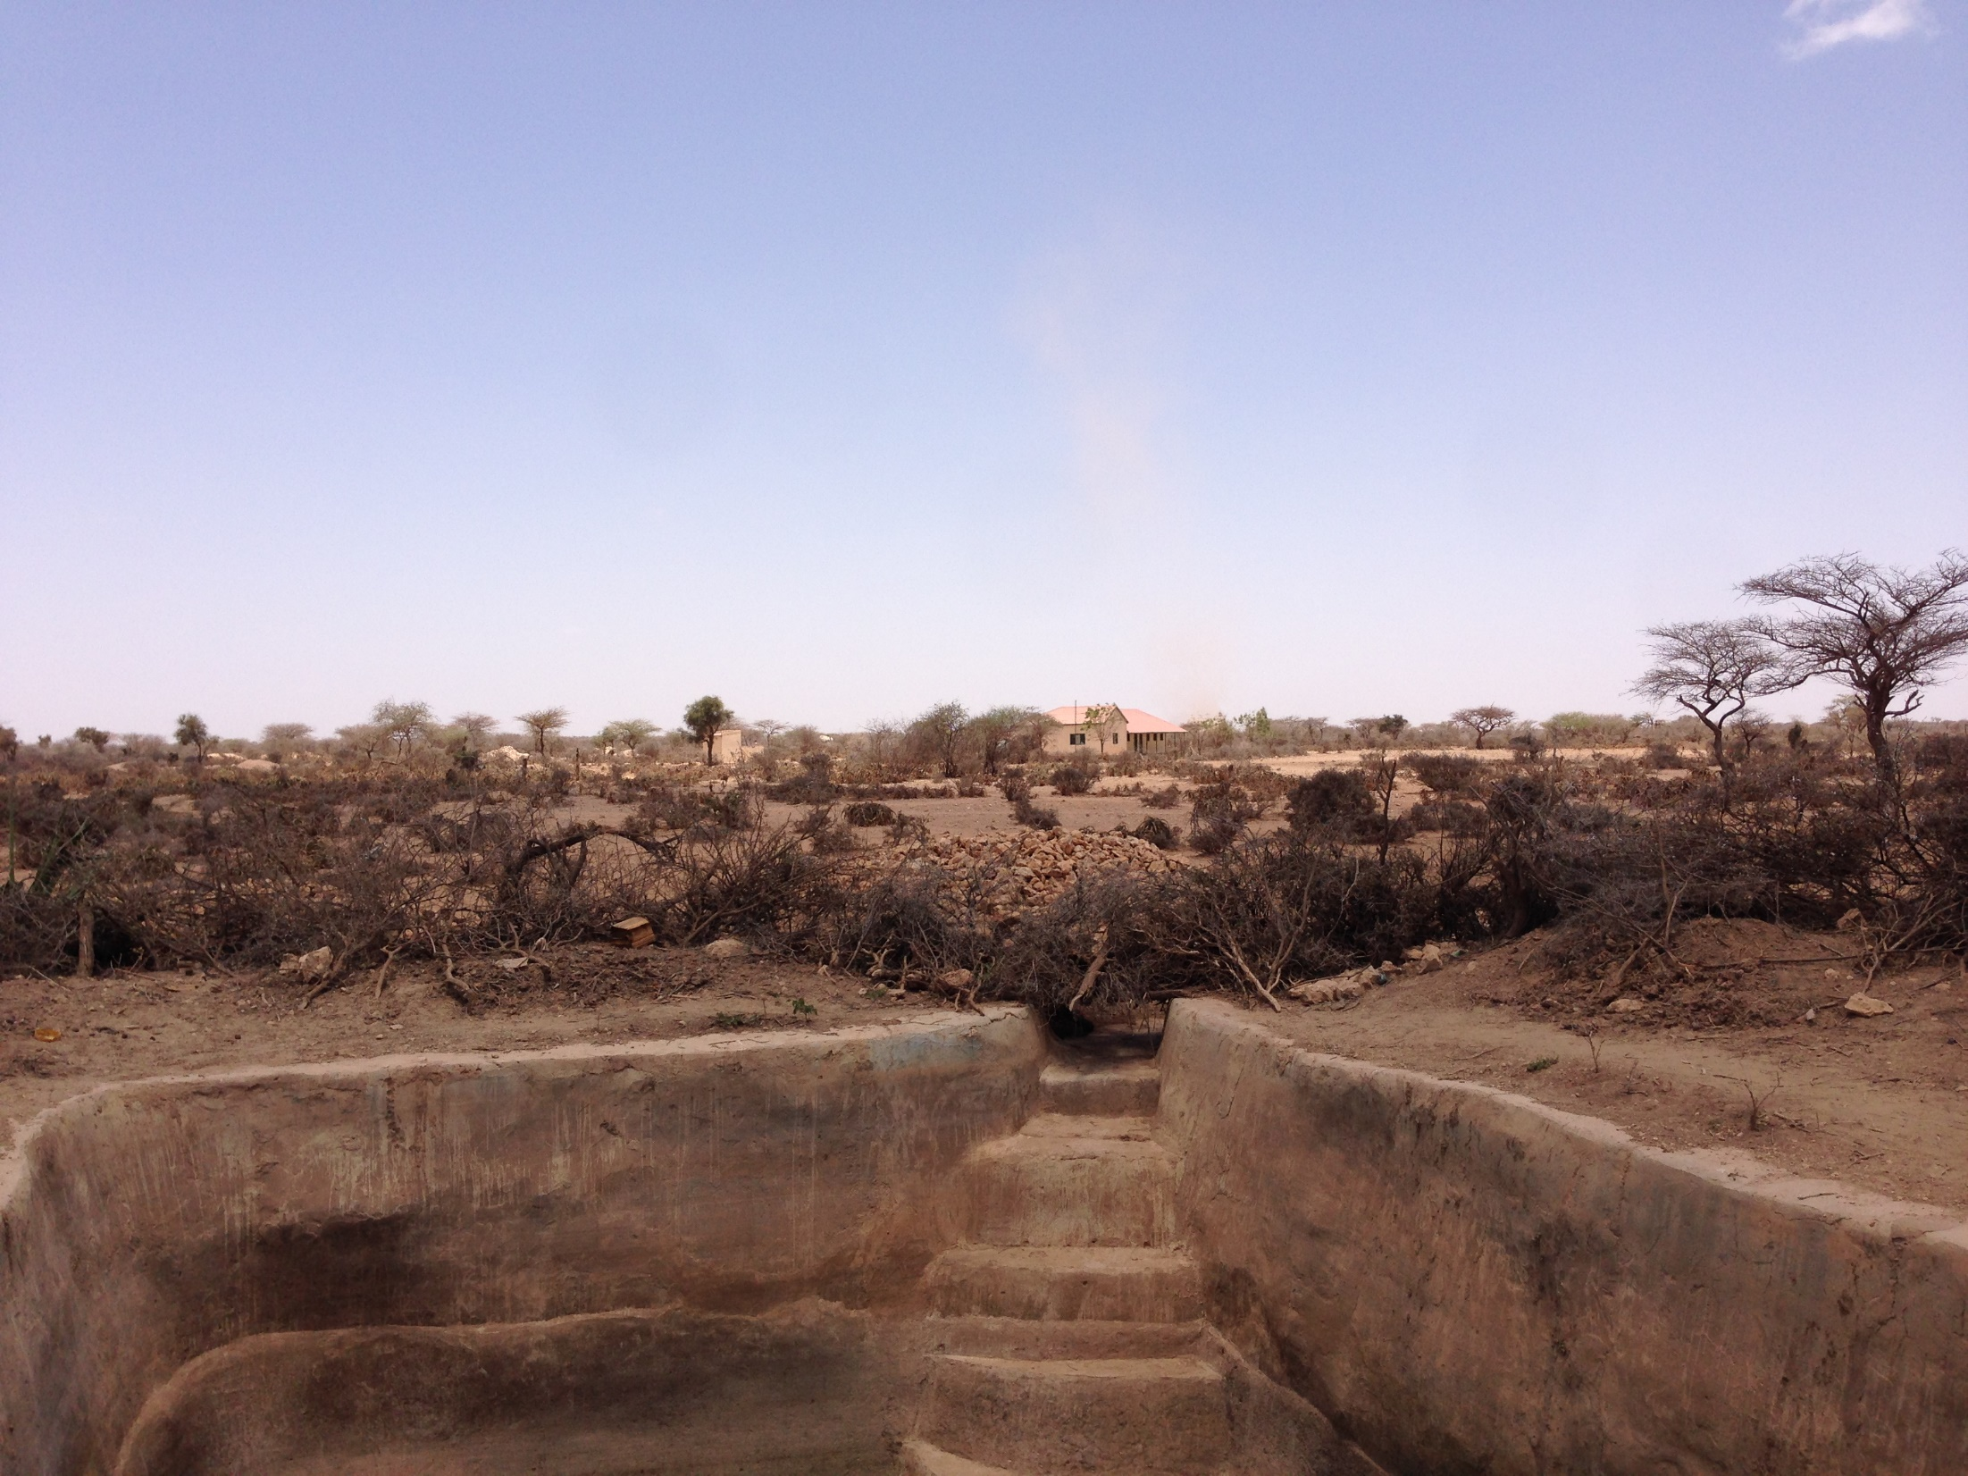
Water, Sanitation and Hygiene Behaviour Study
Puntland, December 2017

Slide 2
Introduction
With the threat of cholera and other water-borne diseases prevalent in Somalia, increased understanding of household access to clean water, as well as hygiene and sanitation practice is paramount.
In order to improve understanding of the above, this assessment was conducted as part of the Durable Solutions for Internally Displaced People and Refugees in Somalia (DSIRS) project.
The assessment is being conducted to identify WASH needs amongst displaced and non-displaced groups in the five targeted districts under DSRIS (Bossaso, Cadaado, Dhuusamarreeb, Galkacyo North and Galkacyo South)
The assessment findings will inform WASH responses in the targeted districts.

Slide 3
Methodology
Data collection for this assessment was carried out between 28 November 2017 and 9 December 2017 in the five targeted districts. Findings presented here relate to Bossaso and Galkacyo North in Puntland.
It comprised of 1,283 household surveys, conducted with both IDP and non-displaced households. A small number of households identified as refugee and returnees but the proportion was too small to be statistically significant when findings were disaggregated by displacement status.
Additionally the assessment mapped the GPS points of 407 functional and 44 non-functional water points.
Households were sampled using a confidence interval of 90% and a 10% margin of error. Findings presented here are representative at the district level.
A small number of data errors were made due to enumerator mistakes. These have been rectified during the data cleaning phase of the assessment

Slide 4
Assessed settlements Bossaso
No of HH surveys conducted: 481
Notes:
Assessed settlements

Slide 5
Assessed settlements Galkacyo North
No of HH surveys conducted: 366

Slide 6
Displacement
Over 80% of assessed households in both districts identified as IDPs. In Bossaso, 1% of the households were reported as being returnees and refugees.

Slide 7
Displacement
Actual conflict in community was reported as the primary push factor by 21% of IDP households in Galkayco North.
Drought was the second most common push factor, reflecting the greater impact that climate shocks have had in Galkacyo relative to Bossaso.
Actual conflict in community was reported as the primary push factor by 26% of the IDP households in Bossaso, followed by conflict in the surrounding area (19%).

Slide 8
Water
Water kiosks were the most commonly reported primary sources of drinking water by both displaced and non-displaced households in Galkayco North and Bossaso.
Water kiosks are considered an unimproved water source*, with a generally lower quality of water. This has implications on the likelihood of the spread of water borne diseases.
*WHO/UNICEF Joint Monitoring Process – which is responsible for reporting on Sustainable Development Goal targets and indicators related to WASH
Notes:
Point 1 - In both districts, water kiosks were reported by almost half of the IDP households to be the main source of primary drinking water. This was followed by 24% non-displaced households reporting their dependence on berkads in Bossaso and 12% non-displaced households reliant on piped systems in Galkacyo North for their drinking water.

Slide 9
Water
Boiling and treating water with chlorine were the most commonly reported methods for treating drinking water. In North Galkacyo, chlorine was used to treat drinking water by 15% of IDP and 2% of the non-displaced households, indicating the comparatively higher access of IDP households to materials required for treating drinking water.
Eighty-two percent (82%) of households in Galkacyo North and 74% households in Bossaso reported that they do not treat their drinking water, which increase their risks of contracting water borne diseases through the consumption of contaminated water.
Notes:
Point 1- Treating with chlorine was indicated by 17% households as the most common method of treating water in Galkacyo North, indicating some access to materials required to treat drinking water.

Slide 10
Water
In both districts, an average of 74% households did not treat their drinking as they did not have access to materials such as filter and chlorine tabs. No significant difference was noted between IDP and non-displaced households.
The high proportion of households in Bossaso (71%) and Galkacyo North (78%) reporting that they did not have access to treatment materials suggests that the main barrier to water treatment was a lack of resources rather than a lack of awareness.
However, one must note that a sizeable proportion of households in both districts indicated that they either did not know how to treat their water, or did not think treatment was necessary, suggesting that there was still a need for awareness campaigning in these areas.
Notes:
Point 1 - There were lower proportion of overall households that reported not knowing how to treat their water (14%) or did not feel the need to treat their water (11%).
Point 3 – Having said that, it is also important to keep in mind that some households might not have the need to treat their water because they depend upon a protected water source as their primary source of water. As in the case of North galkacyo, where 28% of all households rely on a piped system as their primary source of drinking.

Slide 11
Water
In both districts, jerry cans were noted as the common way to store water. More than 90% of all non-displaced households and 60% of all IDP households reported using jerry cans for storing drinking water.
Lower proportion of IDP households in both districts indicating storing drinking water in jerry cans may be indicative of lower access to key non-food items (NFIs) amongst displaced populations.
In Bossaso, 28% of IDP households and 14% of non-displaced households indicated using covered water tanks for storing drinking water, reducing the risk of contamination of water.
Notes:
Point 1 - Jerry cans are perceived to reduce the risk of contamination of water due to their narrow openings and easy portability.
Point 2 - While these households in Bossaso may not be using jerry to store their drinking water , these are still better alternatives to open buckets and tanks as they are covered. Hence, rate of contamination of water is still lower.

Slide 12
Water
According to the SPHERE minimum humanitarian standards*, households should have access to at least two clean containers of 10-20 litres for storing water.
Thirty-two percent (32%) of IDP households in Galkacyo North and 19% of IDP households in Bossaso, reported having two containers/jerry cans for storing water. 30% of non-displaced households in Galkacyo North and 26% of non-displaced households in Bossaso indicated the same.
On average, 22% households in each district reported access to three containers/jerry cans for storing water, indicating slightly higher number of containers than mentioned in the minimum SPHERE standards for number of jerry cans per household.
*SPHERE minimum standards in water supply, sanitation and hygiene promotion.
Notes:
Point 1 - In Galkacyo North, an extremely high level of awareness was witnessed in non-displaced population as 86% reported cleaning their containers every day, as opposed to IDP households.

Slide 13
Water
Overall, a higher proportion of IDP households indicated that they clean their drinking water containers once a week than non-displaced households in both districts, which maybe due to higher outreach and awareness raising in IDP settlements.
The majority all assessed households in Bossaso (80%) and Galkacyo North (75%) reported cleaning their containers with water only.
However, stagnant water was observed in 38% household compounds in Bossaso and 26% households in North Galkacyo, which increases the risk of water-borne disease and contamination of water sources.
Notes:
Point 1 - In Galkacyo North, an extremely high level of awareness was witnessed in non-displaced households as 86% reported cleaning their containers every day, as opposed to IDP households.
Point 2 – While this might not be the most effective way of keeping their drinking water containers clean and to prevent the water supply from becoming contaminated, It is a much better practice being adopted by households compared to not cleaning containers at all.

Slide 14
Sanitation
Communal latrines were reported by almost 80% of all households as the most commonly accessible form of latrines in Bassaso and Galkacyo North, followed by 16% households in both districts with access to private latrines.
Four percent (4%) households in North Galkacyo and 6% households in Bossaso did not have access to any type of latrine, indicating that a small proportion of the population is practicing open defecation
In Bossaso, 5% of IDP households reported having access to a commercial latrine, to be paid for each time used. Overall, an extremely high level of access to latrines was reported in both districts, which is likely contributing to higher sanitation levels and reducing the risk of contraction of water-borne diseases.
Notes:
Point 1 - In Galkacyo North, 1% households were defecating in community defecation points, 1% were defecating in in the open away from their homes and 1% in the open by their homes.
Point 2- In both districts, this proportion that does not have access to any type of latrine, comprises mainly of IDP households.
Point 3 - However, it must be noted that IDPs in Bossaso are paying for commercial latrines which might not be sustainable in the long run.

Slide 15
Sanitation
Concerning cleaning of latrines, sanitation conditions in households across both Galkacyo North and Bossaso could be regarded as unhygienic as a limited proportion of households reported using soap (18%) or disinfectant (7%) to clean latrines. Using only water to clean latrines is the least effective way of reducing the risk of diseases such as Hepatitis A in households.
In Bossaso, 61% of all households were observed with unhygienic levels of latrine cleanliness. However, in Galkacyo North, 39% of all assessed households were observed with hygienic levels of latrine cleanliness.
Notes:
A very small proportion of the households in the two districts reported never cleaning their latrines. (1%)

Slide 16
Sanitation
Ninety-nine percent (99%) households in Galkacyo North and 85% of households in Bassaso indicated using water after defecation as a cleaning practice, as opposed to leaves, paper or stone, indicating high awareness of hygienic defecation practices.
Households in Bossaso showed more variation in terms of what was used for cleaning after defecation, indicating that awareness of hygiene practice likely varies substantially across the district.

Slide 17
Sanitation
Households in Galkacyo North indicated relatively higher awareness of hygiene defecation practices for children, with 44% of IDP households and 14% of non-displaced households using latrines for children, followed by them defecating on the ground outside the compound.
Households in Bossaso indicated lower awareness of hygiene defecation practices for children with a negligible proportion using latrine for the same. 68% of IDP and 38% of non-displaced households reporting children defecating in pots.
Households in North Galkacyo showed more variation in terms of ways that children were defecating, indicating that awareness of infant hygiene practice likely varies significantly across the district.

Slide 18
Sanitation
Fifty-six percent (56%) of households in Galkacyo North and 42% of households in Bossaso reported disposing of children's faeces in the latrine, indicating a relative level of awareness about waste disposal practices.
In North Galkacyo, 70% of assessed households were observed without faeces in the household compound whereas in Bossaso this was the case in 56% of assessed households. This suggests higher levels of awareness around appropriate waste disposal practices in Galkacyo than in Bossaso.
Notes:
Point 1 - 56% of households in Galkayco North and 42% of households in Bossaso reported disposing children’s faeces in the latrine. This was followed by disposing it in the open away from home in Galkacyo North (26%) and 20% of households utilising garbage dump in Bossaso.
Point 2 - In both districts however, it was the higher proportion of IDP households (67%) contributing to this proportion indicating higher hygiene standards as opposed to non-displaced households (32%). It is true that the observable evidence of disposing children’s faeces matched the self-reporting by households.

Slide 19
Sanitation
Sixty-one (61%) households in Bossaso were observed with unhygienic standards of latrines, out of which 90% were IDP households and 10% were non-displaced households.
Thirty-nine (39%) households in Galkacyo North were observed to be hygienic, out of which 91% were IDP households and 9% were non displaced households.
In both districts , very unhygienic standards of latrines were observed in a higher proportion of IDP households (14%) than in non displaced households (4%).
Faeces were observed on the latrine slabs in 64% of households in Bossaso but were not observed in 71% of households in Galkacyo North.
Notes:
Point 1 -
Point 2 -

Slide 20
Sanitation
Just under one third (29%) of households in Bossaso and 6% households in Galkacyo North indicated disposing household waste in the garbage dump, suggesting limited awareness of hygienic waste disposal.
Out of the proportion of households disposing solid/garbage waste in the garbage dump, 5% households in Galkacyo North and 28% households in Bossaso were IDP households, indicating higher awareness of waste disposal practices as opposed to non-displaced households.
Almost 90% of households in Bossaso and 44% households in Galkacyo North were observed with solid/garbage waste in their household compound.
Notes:
Point 1 - In Galkacyo North, the most reported practice was disposing household waste in the open away from home (75%), indicating moderate levels of sanitation. This hygiene standard was also linked to the 13% of households that were disposing household waste in the open close to their homes.
Point 3- Even though households reported that household waste was disposed by throwing it away in the open away from home and disposing it in the garbage dump, there was actually high observable evidence of garbage within their compounds, indicating that households are overreporting this practice.

Slide 21
Hygiene
Sixty-two percent (62%) of IDP households in Galkacyo North and 60% IDP households in Bossaso reported the lack of access to soap. Similar was the case for 54% of non displaced households in Bossaso and 13% of non displaced households in Galkacyo North. Poor handwashing hygiene practice could increase the likelihood of the spread of diseases amongst these households.
The most commonly reported reason for lack of access to soap was the inability to afford it, as indicated by an average of 48% households in Bossaso and 54% households in Galkacyo North.

Slide 22
Hygiene
Reported handwashing behaviour showed that low proportion of households (20%) in both districts used soap with water to wash their hands.
An average of 77% of households in both districts were reliant on using just water for hand-washing, relating to the earlier observation on the lack of access to soap by households. Out of this proportion with no soap, more than 70% of the households were IDPs.

Slide 23
Hygiene
In both districts, households demonstrated extremely limited understanding of the need to wash hands before feeding baby (6%), before serving food (6%) and washing baby's bottom (6%) -- indicating little awareness of faecal-oral transmission routes of diseases such as diarrhea.
Awareness of the need to wash hands before eating has been high in both districts, with 45% households in Bossaso and 47% of households in Galkacyo North reporting the same.

Slide 24
Hygiene
The majority (74%) of all households in both districts reported bathing with water only. The low usage of soap (22%) for bathing by households is likely related to the earlier observation about low access to soap for households for handwashing.

Slide 25
Conclusion: Water
In both assessed districts, water kiosks were indicated by both non-displaced and IDP households as their most commonly reported primary source of drinking water.
The risk of contracting water borne diseases such as cholera remains high in both districts as 82% households in Galkacyo North and 74% households in Bossaso reported not being able to treat their drinking water.
A high proportion of households in Bossaso (71%) and Galkacyo North (78%) reported not having access to treatment materials, which suggests the main barrier to water treatment for these households was a lack of resources rather than a lack of awareness.

Slide 26
Conclusion: Sanitation
Communal latrines were the most commonly available form of latrine reported by 80% households across Bossaso and Galkayco North districts. Those households with no access to latrines were either practicing open defecation (1%) or had access to commercial latrines to be paid for every use (5%) . A limited proportion of households reported using soap (18%) or disinfectant (7%) to clean latrines, suggesting hygiene levels of communal latrines are poor.
Disposal of children’s faeces showed comparatively high level of awareness of hygienic waste disposal in both districts, with 56% of households in Galkayco North and 42% of households in Bossaso, reporting disposing children’s faeces in the latrine.
When it comes to disposing household waste, both districts reported a moderate standard of hygiene, with 75% households in Galkacyo North disposing household waste in the open away from home and 29% in Bossaso disposing their household waste in the garbage dump

Slide 27
Conclusion: Hygiene
The risks for diseases spreading in households was fairly high. At an average, more than 50% of IDP households in both Galkacyo North and Bossaso and almost 50% of non displaced households in Bossaso, did not have access to soap and were unable to afford it.
Reported handwashing behaviour showed that an average of only one-fifth of households (20%) in both districts used soap with water to wash their hands. Reported behaviour of bathing showed a very low proportion of households using soap for bathing (22%), indicating low hygiene levels.
Households reported extremely limited understanding of need to wash hands before feeding baby (including breastfeeding), before serving food and after washing baby's bottom. The proportion of households reporting awareness on the need to wash hands before eating indicated high level of awareness, with 45% households in Bossaso and 47% of households in Galkacyo North, reporting the same

