Slide 1
Returns and Durable Solutions Assessment (ReDS)
Markaz Al-Garma – Al-Falluja, Al-Anbar
Findings presentation, Iraq
Data collection period: 15-19 January 2021

Slide 2
1. Introduction to ReDS
2. ReDS methodology
3. Markaz Al-Garma overview
4. Key findings
5. Detailed findings
6. Questions from the audience
7. Discussion
Presentation outline

Slide 3
1
Introduction to ReDS

Slide 4
In 2020, the numbers of internally displaced persons (IDPs) returning to their area of origin (AoO) or being re-displaced for a second time increased, coupled with persisting challenges in relation to lack of services, infrastructure and - in some cases - security in areas of origin.
The need to better understand the sustainability of returns, conditions for the (re)integration of IDPs and returnees, and the impact of their presence on access to services and social cohesion has been an identified need for humanitarian and development planning.
Decisions related to the closure of all IDP camps by the end of 2020 have also impacted these dynamics.
ReDS background

Slide 5
ReDS Specific Objectives
Provide an understanding about the effects of recent movement trends;
Assess perceived intentions to move among all relevant communities to identify potential risk of further instability;
Assess how conditions in areas affected by recent movements may impact the sustainability of durable solutions;
Identify any consequent shift in local social dynamics and power structures; and,
Explore conditions in the area in terms of community needs and inter-relations; and the viability of safe and dignified (re)integration.
ReDS objectives
Notes:
In general, the assessment aimed to provide rapid evidence-base overview of the assessed areas to support humanitarian and development actors to promote durable solutions for returnees and IDPs in situations of protracted displacement on multiple levels, including:
Development of strategic dialogue, policy development, and resource mobilization efforts;
Development of localized interventions; and,
Advocacy with government actors around camp closures, consolidation, premature returns, and conditions in areas of origin to allow sustainable returns.
ReDS Specific Objectives
Provide an understanding about the effects of recent movement trends across different demographic groups in targeted areas;
Assess perceived intentions to move among all relevant communities within the areas to identify potential risk of further instability;
Assess how conditions in areas affected by recent movements may impact the sustainability of durable solutions;
Identify any consequent shift in local social dynamics and power structures following the recent movements; and,
Explore conditions in the area in terms of community needs and inter-relations; and the viability of safe and dignified (re)integration.

Slide 6
2
ReDS methodology

Slide 7
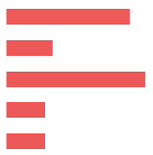
Methodology
The multi-sectoral assessment tool combined qualitative and quantitative data.
Data collection was done remotely by phone between 15 and 19 January 2021, adapted to the context of the COVID-19 pandemic local restrictions and associated measures.
Purposive sampling methods were employed to identify KIs. Findings should therefore be considered as indicative.
Methodology was based on key informant interviews (KIIs).
 KI profile in Markaz Al-Garma Sub-district
Community leaders 16 KIs
Remainees/non-displaced 6 KIs
IDPs (displaced from the area) 18 KIs
Returnees (more than 3 months ago) 5 KIs
Returnees (less than 3 months ago) 5 KIs
50 KIs
Notes:
Community leaders are members of the host community represented by eight public sector employees, five health sector employees and two educational sector employees.
IDPs (displaced from the area) refer to households from Markaz Al-Garma displaced after 2014 events to other areas different than their AoO, specifically in Khaifan and Bradost sub-districts (Rawanduz District of Erbil Governorate); and in Al-Suleimaniyah Governorate specifically in Markaz Chamchamal Sub-district (Chamchamal District), Sourdash and Gnareen Sub-districts (Dokan District), Markaz Kalar Sub-district (Kalar District) and Bazian Sub-district (Al-Suleimaniya District).
For the purpose of this research, returnees will be categorized as an IDP returning to their AoO, where AoO is defined as the stated original sub-district of origin for the IDP. Given the complexity of (re)integration, this could mean that returnees still face challenges to their sustainable return to their AoO.
There were 50 individuals aged between 20 and 75 years old interviewed for the Markaz Al-Garma assessment. All KIs were male. Lack of gender balance is a limitation of the assessment, largely due to the limited response rate of and challenges identifying female KIs. In addition, 4% of the KIs were elderly (over 65 years old), and 4% represented youth (aged between 20 and 23 years old) which ensured inclusion of vulnerable age groups.

Slide 8
Limitations
Considering the findings as indicative due to the relatively small sample size and the purposive sampling method
50 KIs in Markaz Al-Garma Sub-district
KIs gender balance
50 male KIs (lack of female KIs participation)
Contextualization at sub-district level
To operationalise the identified trends, information was analysed
and visualized at sub-district level, rather than village or neighbourhood
Remote data collection
Data collected remotely by phone


Notes:
Considering the findings as indicative: The sample is small (50 KIs), and findings will only be an indication of trends, needs, humanitarian concerns, gaps and flags for actors to assess further. Findings cannot be analysed or visualised at community-level in the current methodology but for the current analysis REACH included findings per community group as relevant and available.
KIs gender balance: REACH and RWG are working on the identification process to encourage women to participate in the rapid assessment. Coming assessment are expected to have an increased participation rate.
Contextualization at sub-district level: To operationalize the identified trends, information was analysed and visualised at sub-district level, rather than village and neighbourhood. Extending to more detailed assessment at village, neighbourhood or community-level will depend in the availability of data about KIs. Contact details will need to be provided since the sampling is purposive and snowballing is very limited while doing remote data collection and time consuming taking into consideration the need of the informed consent from individuals to share their contact information with REACH. It will also require additional resources such and budget and human resources (enumerators) and will affect the time-line of the project and report deadlines.
Remote data collection: While collecting data remotely supports more timely and safe information gathering, the openness of respondents is sometimes affected. That being said, REACH enumerators are trained in building rapport with respondents over the phone, and testing processes were very strict as regards the sensitiveness questions and potential for doing harm to interviewees. Some sensitive terminologies related to Iraq context were identified and replaced by explanation text in the Arabic version of the ODK tool (e.g. ‘governance’ was replaced by ‘laws and regulations’).

Slide 9
3
Markaz Al-Garma overview and current demographics

Slide 10
Markaz Al-Garma Sub-district overview
Markaz Al-Garma is a sub-district of Al-Falluja District, located in the eastern area of Al-Anbar Governorate close to Baghdad Governorate.
In 2014, Markaz Al-Garma and the nearby cities came under the control of the so-called Islamic State of Iraq and the Levant (ISIL), resulting in the displacement of over 47,700 households as reported by KIs.
47,106-47,807 households displaced since 2014 had reportedly returned at the time of data collection, as reported by 16 community leader KIs.
66-70 IDP households (area of origin (AoO) not specified) were displaced in Markaz Al-Garma at the time of data collection.

Slide 11
4
Key findings

Slide 12
Markaz Al-Garma Sub-district Key findings on safety and security
Overall, Markaz Al-Garma was perceived to have a positive environment in terms of security, and community integration and acceptance. In addition, the perceived improvement in the safety and security situation had created a pull factor for returns to Markaz Al-Garma.
Housing rehabilitation and livelihoods were reportedly the most needed interventions in Markaz Al-Garma to encourage further returns. Damaged/destroyed housing was the most persistent challenge to sustainable (re)integration and returns.
Recent and expected return movements into Markaz Al-Garma were perceived differently by some IDP and returnee KIs. A minority considered that less returns could ensure increased access to job opportunities for the community members in Markaz Al-Garma and less competition for limited available jobs. Other KIs believed that these movements could ensure family reunification and social stability.
KIs from different population groups prioritized community needs differently, with community leader and remainee KIs reporting education, returnee KIs reporting livelihoods, and IDPs reporting housing rehabilitation as the primary need.
Notes:
In general, most KIs noted that community members felt safe in Markaz Al-Garma, there were no restrictions of movements and that there were no groups reported to be unwelcome in the area.
In addition, lack of basic services and job opportunities were not only obstacles to future returns to Markaz Al-Garma, but equally might contribute to risk the sustainability of durable solutions exemplified by expected departures of host community members as reported by KIs.
Healthcare was the most commonly reported primary community need. In addition to healthcare, community leader and remainee KIs reported the need for further efforts to restore education services in Markaz Al-Garma. In comparison, access to livelihoods was commonly cited by returnee KIs as the primary community need closely linked to the need for further efforts to rehabilitate the roads and factories in Markaz Al-Garma to facilitate dignified access to employment, mainly for youth. IDPs KIs reported housing rehabilitation as their main need.

Slide 13
Markaz Al-Garma Sub-district Other key findings
KIs reported different levels of access to services across population groups. IDPs and returnees were consistently reported to have less access to housing, including being more likely to live in inadequate shelters (tents) or living under informal – and therefore more insecure – housing agreements.
Some KIs reported that girls were slightly less involved in education than boys, mainly due to the limited number of available schools for girls in Markaz Al-Garma.
An overall decrease in the diversity and availability of employment opportunities was reported in Markaz Al-Garma compared to 2014.
KIs reported that interaction between different population groups in Markaz Al-Garma was promoted by kinship ties, friendship, work relationships and common operation of businesses.
The majority of the KIs reported that no disputes occurred within neighbourhoods and/or between villages in Markaz Al-Garma.
Notes:
In line with this, IDPs and returnees were also reportedly disadvantaged in access to compensation for housing and property rehabilitation and more at risk of eviction.
Lack of transportation was reportedly one of the main reasons for both boys and girls to drop-out of school, potentially linked to the reported decrease in transportation service in Markaz Al-Garma.
Reportedly, construction, oil industry and manufacturing jobs were more available in 2021 than other types of jobs such as public administration and defense, and transportation. KIs reported that access to livelihoods in Markaz Al-Garma was unequal for vulnerable groups, namely people with disabilities, elderly people, and female heads of household.
However, a returnee KI reported that lack of communal harmony in Markaz Al-Garma was the main barrier for returnees to interact with other groups. In terms of participation in community and social affairs, KIs reported that the main barrier was the lack of interest to actively participate in social meetings, events or being involved in the work of a group/organisation. This suggests that further efforts are required to improve participation in social events and interaction between displaced, returnee and host community populations.
Almost half of KIs reported that this situation was expected to remain the same in the long-term due to the (re)integration and acceptance of IDPs and returnees in the community of Markaz Al-Garma, kinship ties between families, work relationships established between community members of different population groups and the intervention of the local authorities and formal security forces to resolve those disputes.

Slide 14
5
Markaz Al-Garma findings

Slide 15
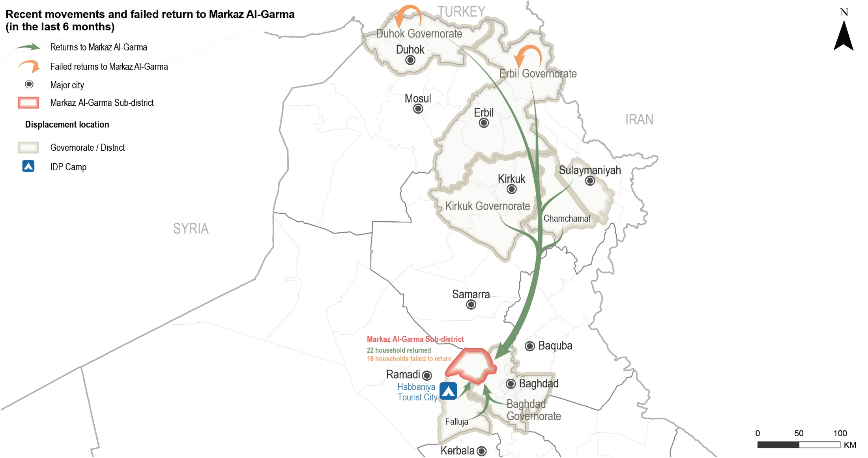
Markaz Al-Garma Sub-district
Recent movements to Markaz Al-Garma reported by KIs

Slide 16
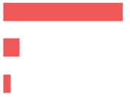
Markaz Al-Garma Sub-district
Recent movements – data reported by KIs
 Recent returns
²⁰⁻⁵⁰
households returned to Markaz Al-Garma in the six months prior to data collection, as reported by 15 KIs (out of 50 KIs).
Driver for recent returns (out of 15 KIs)*
Sense of increased safety and security 15 KIs
Availability of job opportunities 2 KIs
Access to services 1 KI
Impact of recent returns (out of 15 KIs)*
Increased job opportunities due to the return of business owners (6 KIs out of 15) and ensured family reunification and social stability with the return of some family members (4 KIs).
On the other hand, these movements were also negatively perceived due to the presence of higher competition in the labour market (7 KIs) and a reported decrease in the level of household assistance due to increased demand (3 KIs).
* Sum of answers may exceed the 100% due to KIs being able to select multiple response options.

Slide 17
Markaz Al-Garma Sub-district
Recent movements – data reported by KIs
 Failed returns
¹²⁻²⁰
households attempted to return to Markaz Al-Garma, but were unable to, in the six months prior to data collection (7 KIs out of 50).
Reported reasons for failed returns (out of 7 KIs)*
Destroyed/damaged housing 4 KIs
Lack of services 2 KIs
COVID-19 pandemic movement restrictions 1 KI
Did not know 1 KI
Impact of recent returns (out of 15 KIs)*
Negatively affected the availability of job opportunities due to some business owners remaining displaced (3 KIs) and contributed to a decrease in the availability of assistance due to the assumed lack of attention from governmental and humanitarian actors due to more limited return movements (3 KIs).
On other hand, they were perceived by some KIs as a factor which positively affected access to jobs due to less competition for limited available jobs (3 KIs).
* Sum of answers may exceed the 100% due to KIs being able to select multiple response options.

Slide 18
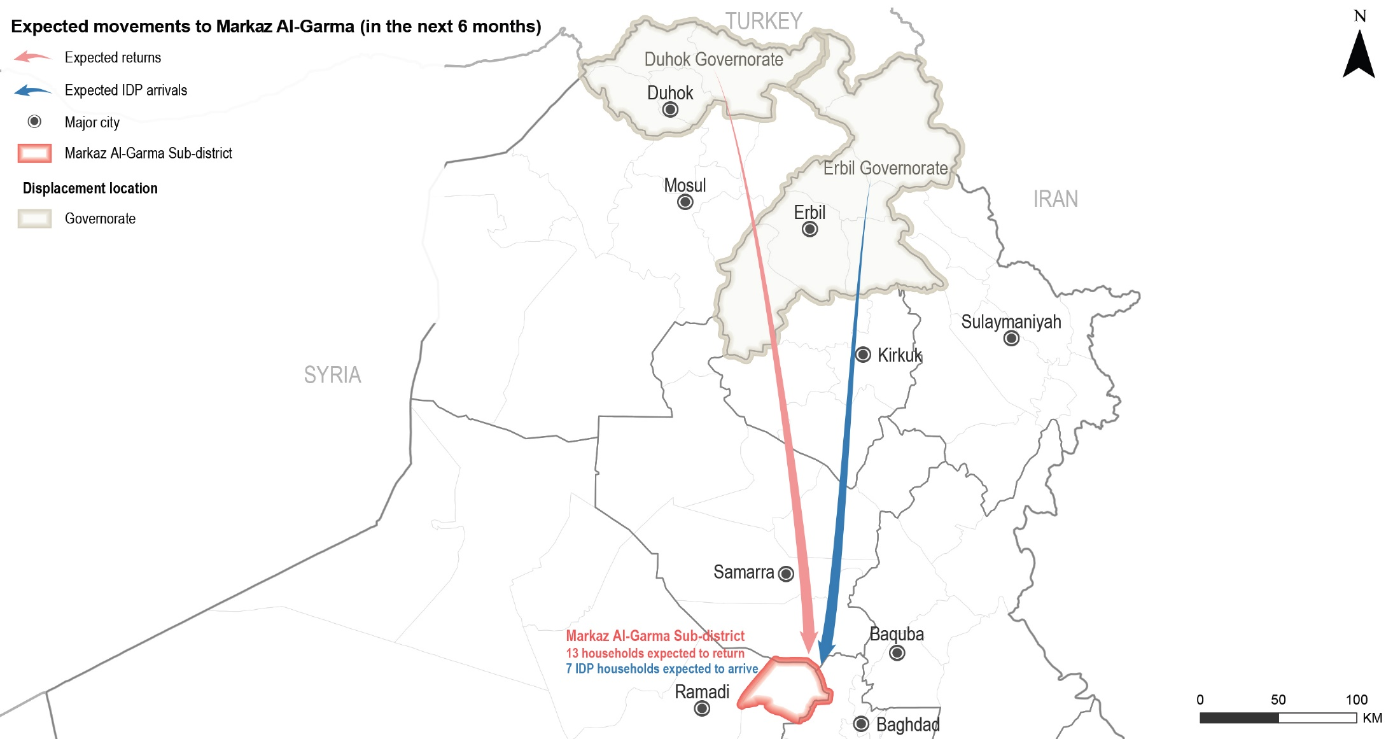
Markaz Al-Garma Sub-district
Expected movements to Markaz Al-Garma reported by KIs

Slide 19
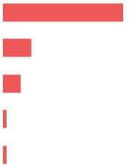
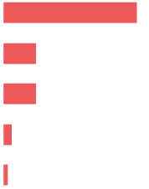
Markaz Al-Garma Sub-district
Expected movements – data reported by KIs
 Expected returns
¹⁰⁻¹⁵
households were expected to return in the six months following data collection (1 KI out of 50).
47 KIs (out of 50) reported drivers that might contribute to returns in the future.
Drivers for expected returns (out of 47 KIs)*
Sense of increased safety and security 45 KIs
Increased access to job opportunities 11 KIs
Following the return of other extended family members 7 KIs
Camp closures 1 KI
Barriers for expected returns (out of 50 KIs)*
Destroyed/damaged housing 44 KIs
Lack of services 11 KIs
Lack of job opportunities 11 KIs
Lack of necessary documentation to claim properties 3 KIs
Lack of specialised medical treatment 1 KI
* Sum of answers may exceed the 100% due to KIs being able to select multiple response options.

Slide 20
Markaz Al-Garma Sub-district
Expected movements – data reported by KIs
 Expected host community departures
^{31 KIs}
(out of 50) reported no expected departures of host community households in the six months following data collection.
However, 23 KIs (out of 50) reported drivers that might result in host community departures.
Drivers for expected host community departures (out of 23 KIs)*
Lack of job opportunities 12 KIs
Lack of services 11 KIs
Lack of specialised medical treatment 4 KIs
* Sum of answers may exceed the 100% due to KIs being able to select multiple response options.

Slide 21
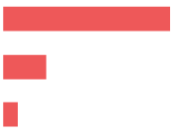
Markaz Al-Garma Sub-district
Expected movements – data reported by KIs
 Expected IDP arrivals
⁵⁻¹⁰
IDP households were expected to arrive from Erbil Governorate to Markaz Al-Garma in the six months following data collection, as reported by a returnee KI.
However, 49 KIs (out of 50) reported drivers that might result in IDP households arrivals.
Drivers for expected IDP arrivals (out of 49 KIs)*
Sense of increased safety and security 47 KIs
Availability of jobs and services 12 KIs
Arrival of other family members 4 KIs
* Sum of answers may exceed the 100% due to KIs being able to select multiple response options.

Slide 22
Markaz Al-Garma Sub-district
Primary community needs – data reported by KIs
Top reported primary, secondary and tertiary needs (out of 50 KIs)
Primary need
Housing rehabilitation

Education
Secondary need
Tertiary need
Healthcare
 Primary community needs per respondent group*
“Attention to education is important since the progress of cities starts with the development of new generations, and raising children begins with schools, teachers and education system in general. Children love school and they love to attend classes!”
- Male returnee KI -
* Sum of answers may exceed the 100% due to KIs being able to select multiple response options.

Slide 23
Markaz Al-Garma Sub-district
Perceptions on access to services and assistance – data reported by KIs
Access to humanitarian aid and presence of non-governmental organisations
(NGOs)
A minority (6 KIs) reported that there were NGOs implementing food security activities or projects in Markaz Al-Garma at the time of data collection, and there were no reported groups which were less involved in activities and projects.
Reported most needed projects or activities in Markaz Al-Garma (out of 50 KIs)
Housing rehabilitation
Livelihoods
Basic services provision
Food security
Social cohesion
23 KIs 23 KIs
2 KIs
1 KI
1 KI

Slide 24
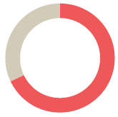
Markaz Al-Garma Sub-district
Perceptions on access to services and assistance – data reported by KIs
 Access to housing
All KIs (50 KIs) reported that the majority of families in Markaz Al-Garma resided in houses or apartments.
Reported housing agreement (out of 50 KIs)
Owned tenure 27 KIs
Verbal rental agreement 23 KIs
Risk of eviction
^{47 KIs}
(out of 50) reported that there were no families at immediate risk of eviction in Markaz Al-Garma at the time of data collection. The rest of the KIs did not know (3 KIs).

Slide 25
Markaz Al-Garma Sub-district
Perceptions on access to services and assistance – data reported by KIs
 Access to housing rehabilitation
^{20%-60%}
of houses in Markaz Al-Garma were damaged during military operations in 2014, as reported by 46 KIs (out of 50). The rest of the KIs reported a smaller perception of damage (4 KIs).
IDPs and returnees were reported as having less access to housing rehabilitation (18 KIs out of 50).
Reported barriers to access assistance for rehabilitation (out of 20 KIs)*
Lack of connections 20 KIs
Selection criteria for support was perceived as too specific 19 KIs
Limited capacity to physically access assistance 14 KIs
Assistance perceived to target specific neighbourhoods 2 KIs
* Sum of answers may exceed the 100% due to KIs being able to select multiple response options, including other topics.

Slide 26
Markaz Al-Garma Sub-district
Perceptions on access to services and assistance – data reported by KIs
 Access to basic public services
The majority of the KIs perceived there was equal access to basic public services (44 KIs).
However, six KIs (out of 50) reported unequal access to basic public services, namely healthcare, education, water and sanitation (WASH).
IDPs and returnees reportedly had less access to basic public services (6 KIs).
Reported barriers to access basic public services (out of 6 KIs)*
Limited physical capacity to access assistance 5 KIs
Lack of connections 3 KIs
Selection criteria for support was perceived as too specific 3 KIs
* Sum of answers may exceed the 100% due to KIs being able to select multiple response options, including other topics.

Slide 27
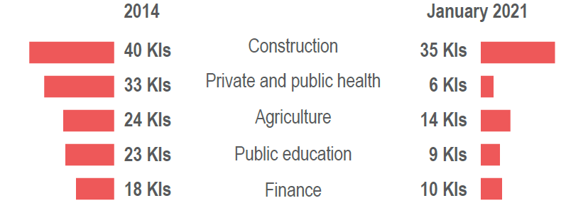
Markaz Al-Garma Sub-district
Perceptions on access to services and assistance – data reported by KIs
 Access to livelihoods
IDPs and returnees reportedly had less access to livelihoods opportunities (15 out of 18 KIs).
Reported barriers to access livelihoods (out of 18 KIs)*
Limited physical capacity or lower skill/education level 17 KIs
Lack of connections 15 KIs
Criteria of selection for support was perceived as too specific 12 KIs
Types of jobs reportedly available in Markaz Al-Garma in 2014 compared to January 2021 (out of 50 KIs)*
* Sum of answers may exceed the 100% due to KIs being able to select multiple response options, including other topics.
Notes:
Access to livelihoods was reportedly a primary community need in Markaz Al-Garma (18 KIs). KIs reported that the lack of governmental and private sector job opportunities (10 KIs) as well as COVID-19 movement restrictions and closure of business due to the lockdown (1 KI) were additional barriers for households to access job opportunities.
KIs reported that jobs available in 2021 were less diverse than those in 2014. Employment in the public administration and defense (10 KIs) and transportation (2 KIs) were not reported to be available at the time of data collection. Construction, oil industry and manufacturing jobs were reportedly reduced in availability in 2021 compared to 2014.

Slide 28
Markaz Al-Garma Sub-district
Perceptions on governance and access to justice – reported by KIs
 Governance and influencing bodies
Reported most influential bodies in governance (out of 50 KIs)*
Local authorities 49 KIs
Mukhtars 19 KIs
Tribal leaders 6 KIs
Community-based governance structures 1 KI
 Access to public judicial mechanisms
^{48 KIs}
(out of 50) reported no governmental offices were closed in Markaz Al-Garma during the period around data collection and all population groups reportedly had access to documentation in the departments nearest to them.
* Sum of answers may exceed the 100% due to KIs being able to select multiple response options, including other topics.
Notes:
Access to judicial mechanisms
The rest of the KIs did not know (2 KIs).

Slide 29
Markaz Al-Garma Sub-district
Perceptions of community disputes, relations and co-existence – reported by KIs
 Community disputes
^{44 KIs}
(out of 50) reported that there were no disputes within neighbourhoods in Markaz Al-Garma in the six months prior to data collection. The rest of the KIs did not know (5 KIs), or refused to answer (1 KI).
(out of 50) reported that there were no disputes between villages in Markaz Al-Garma in the six months prior to data collection. The rest of the KIs did not know (14 KIs), or refused to answer (1 KI).
(out of 50) reported no retaliation incidents in the six months prior to data collection. The rest of the KIs did not know (7 KIs), or refused to answer (2 KIs).
^{35 KIs}
^{41 KIs}
 Community relations and co-existence
^{22 KIs}
(out of 50) reported that community members from different population groups interacted with each other.
^{5 KIs}
(out of 50) reported that some community members did not participate in social and public events, but did not specify which groups. The rest of the KIs did not know (44 KIs), or refused to answer (1 KI).
Notes:
Disputes within neighbourhoods
23 KIs (out of 50) reported that there were no expected changes in the situation in the 6 months following data collection. The rest of the KIs did not know (24 KIs), or refused to answer (3 KIs).
Reasons for no change:
Integration and acceptance 16 KIs
Kinship ties 11 KIs
Intervention of local authorities and formal security forces 6 KIs
Work relationships (employment) 3 KIs
Types of interaction
Kinship ties 21 KIs
Work relationships (employment) 14 KIs
Friendship 10 KIs
Common business operation 6 KIs
Interaction in shops and public places 1 KI
However, ten KIs (10 KIs) reported no interaction between different population groups. The rest of the KIs did not know (17 KIs), or refused to answer (1 KI).
While almost half of KIs believed that there were no obstacles for interaction between different population groups (22 KIs out of 50), a returnee KI reported that the lack of harmony in the area was the main barrier for the interaction between different groups. Over half of the KIs (27 KIs) did not know about obstacles for interaction.
Barriers for participation
Lack of interest in participating 19 KIs
No barriers 2 KIs
Did not know 26 KIs
Refused to answer 4 KIs

Slide 30
Markaz Al-Garma Sub-district
Perceptions of safety and security – data reported by KIs
 Safety and security
^{48 KIs}
(out of 50) reported that their community members felt safe in Markaz Al-Garma.
All KIs (50 KIs) reported that the community members did not avoid any area or neighbourhood in Markaz Al-Garma.
Freedom of movement
All KIs (50 KIs) reported that both women, girls, men and boys could freely move in Markaz Al-Garma during the day and at night.
 Explosive remnant of war (ERW) contamination
All KIs (50 KIs) reported that there were no contaminated fields in Markaz Al-Garma.
 Perceptions on the presence of security forces
All KIs (50 KIs) reported that the presence of formal security forces contributed positively to a feeling of safety, and were perceived to be effective in resolving disputes within the community and between different villages.
Notes:
Feeling of safety
A remainee KI reported not feeling safe but did not report the reasons. A community leader KI did not know if the community members felt safe in Markaz Al-Garma.
Freedom of movement
It should be noted that responses on gendered feelings on freedom of movement could have been impacted by the limited number of female KIs.

Slide 31
6
Questions from the audience

Slide 32
Discussion
Any feedback or comments from those operational in these areas?
7

Slide 33
Link to the Factsheet
Markaz Al-Garma Factsheet
Upon request
http://www.reachresourcecentre.info/
IMPACT Initiatives
@REACH_info

