Slide 1
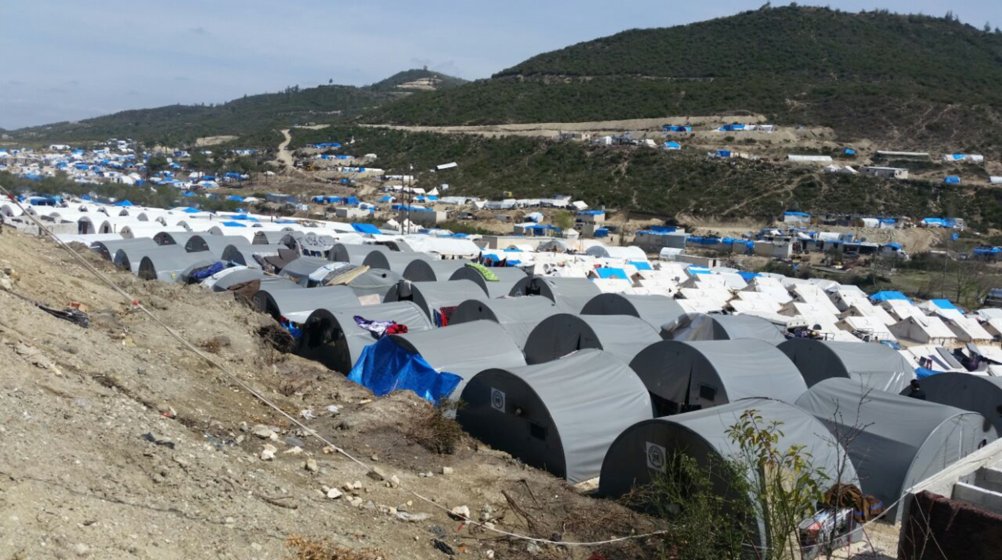
IMPACT
Shaping practices Influencing policies Impacting lives
Key Informant Interview
Training & Best Practices
TRAINING TOOLS - October 2016

Slide 2
Training Objectives
This training has three main objectives:
Improve the monitors knowledge and skills on this type of data collection method
Improve the quality of the KII data by training the monitors that will conduct the KII sessions
Improve the satisfaction of the KII participants by managing the KII process in a professional way

Slide 3
What is a KII?
A key informant interview (KII) is a qualitative data collection method consisting in in-depth interviews with people who have specific knowledge of the topic of interest for the research
The key advantages of KII are:
Getting information in a time-effective manner from a limited number of well-informed people
Collecting specific data by asking in-depth and probing questions
Discussing sensitive topics, as individual interview creates a comfortable environment where people can respond in a frank way

Slide 4
Defining a KII
A KII is a one-to one interview between the monitor and a person that has specific knowledge on the topic of interest and participates in the interview as a volunteer
The monitor’s role is to ask a series of open-ended and close-ended question to the key informant and note down his/her answers
KIIs are structured around a set of carefully predetermined questions that should be read out by the monitor, who nevertheless needs to ask for clarifications when appropriate
The ideal amount of time to set aside for a KII is anywhere from 25 to 60 minutes. Beyond that most people are not productive and it becomes an imposition on participants’ time

Slide 5
Key Informant Interview
    The interview

Slide 6
Introducing the KII
The facilitators needs to introduce the KII by:
welcoming the participant and thanking them
introduce yourselves and IMPACT (this will change in each case depending on the program), refer to the questionnaire!
explaining the purpose of the KII
providing information on how long the KII will last
assuring that everything said in the KII is confidential
assuring that IMPACT will protect participants’ anonymity
Refer to the written introduction on the KII guide!

Slide 7
Fueling the interview
The monitor fuels the interview by asking questions to the key informant. There are two type of questions:
Close-ended questions:
They lead to yes-or-no or multiple-choice answers that the monitor should note down by ticking the right case
Open-ended questions:
They lead the key informant to give extensive and lengthy answers
The monitor sometime needs to ask for clarifications in order to make sure he understands the answers correctly
Make sure that all questions are asked during the interview!

Slide 8
Managing the interview
In addition to reading the questions the monitor needs to manage the interview to make sure comments are relevant and as specific as possible
Here are some tips on how to…...
How to…
Dig deeper | Can you talk about that more? Please, continue, that’s if very interesting
Clarify the discussion | Can you help me understand what you mean? Could you please explain this point?
Be more specific | Can you give an example? Can you be more specific?

Slide 9
Key tasks during the interview
Key tasks of the monitor include:
Covering all prepared questions within the time allotted
Asking the key informant for clarifications when appropriated
Inducing the key informant to dig deeper or to be more specific when needed
Demonstrating active listening and interest in what the key informant tells
Remaining neutral, refraining from agreeing/disagreeing, or praising/denigrating any comment made
Tactfully dealing with challenging key informants

Slide 10
Wrapping up the KII
The monitor is respirable for properly closing the session. This include:
Thanking the key informant, as he/she is a volunteer
Appreciating the work that has been done as his/her opinions will be very valuable to the monitoring
Asking his/her comments of the KII process
Communicating IMPACT Skype ID: IMPACT_Initiatives_Turkey that key informants can use to provide feedback on the interview

Slide 11
Recap for the monitor
A good monitor . . .
Shows flexibility
Shows sensitivity
Has a sense of humor
Asks for clarifications
Encourages the key informant to be as specific as possible
A good monitor tries not to . .
Dictate the course of interview
Lose control over the interview
Be judgmental
Try to be an “expert”
Lecture the key informant
Ask leading questions

Slide 12
Key Informant Interview
    Note taking

Slide 13
Taking notes
The key output of a KII are the records of the discussion. This is why note taking is essential to the success of the KII. During the interview the monitor is responsible for:
Noting down answers to close-ended questions by ticking the appropriate case
Taking detailed writing notes of the key informant’s answers to open-ended questions, as ALL that is said must be recorded
Using the empty space under each question – so the translator will know which notes belongs to which questions
Noting down direct observations on the overall KII process
Details are crucial as they may cause big change during the analysis!

Slide 14
Recording metadata
Metadata are data that provide information (time, locations, etc.) about the data collected during the KII. The monitor is in charge of recording this type of data, including:
Recording the date, the start and end times of the KII
Fulfill the Preliminary Information section, including the geographical location where the KII is held
Engaging with the key informant to record his/her personal details
NB: do not write key informants’ names, but use the list of codes provided by your team leader!

Slide 15
Debriefing with Field Coordinators
The day after the KII the monitoring needs to perform very important task including:
Expanding all notes taken for open-ended questions for them to be as comprehensive as possible
Entering the notes into a new, clean questionnaire, making sure the writing is readable
Sending the notes to the Field Coordinators – Mahmood and Muna
Going through a debrief session with the Field Coordinators in order to make sure all fields have been correctly filled in, and notes are clear.
Good notes are always clear and comprehensive!

Slide 16
Key Informant Interview
    Other information

Slide 17
External participation
What if nonparticipants want to observe the KII?
  KII are preferably carried out with no outside observers
  Presence of outsiders may influence the key informant and inhibit him/her from speaking freely
  Even stakeholders should be discouraged from attending the interview
  If external people express the wish to participate in the KII, this needs to be noted in the Comments section of the questionnaire

Slide 18
Participants leaving the group
What if a key informant does not stay for the entire interview?
Participation in KII is always voluntary
If a key informant does not want to remain, he/she should be reminded of the confidentiality agreement and thanked for his/her participation
The withdrawal of a key informant should be noted in the Comments section of the questionnaire, explaining the reasons that pushed him/her to leave

Slide 19
Key Informant Interview
    Questions?

Slide 20
Key Informant Interview
    Thank you!

