Slide 1

IRAQ MULTI-CLUSTER NEEDS
ASSESSMENT (MCNA) VII
Key Findings
October 2019

Slide 2
CONTENT
1 – Introduction
  Purpose of the MCNA
  Institutional framework
  The MCNA within the Humanitarian Needs Overview (HNO)
  Methodology, data collection & coverage
  Challenges and limitations
2 – Key cross-sectoral findings & trends
  Movement intentions
  Accountability to affected populations (AAP)
  Durable solutions
  Vulnerabilities : Female-headed households, disability, coping strategies, income
3 – Key Sectoral findings & trends
  Shelter, Non-food items, WASH, Food Security, Livelihoods, Health, Protection
4 – Conclusion

Slide 3
1 - INTRODUCTION

Slide 4
PURPOSE OF THE MCNA
The purpose of the MCNA is to provide impartial and evidence-based information to clusters for strategic planning within the Humanitarian Planning Cycle:
Facilitate coordinated, joint analysis across and between sectors
Inform multi-sectoral humanitarian planning throughout Iraq
Provide a comprehensive evidence base to inform the 2020 HNO and Humanitarian Response planning (HRP)
Support inter-sectoral humanitarian planning and response
Develop an evidence-based analytical framework for prioritization and ranking of severity of needs
Fulfill Core Commitment 5 of the Grand Bargain (conducting joint and impartial needs assessments)

Slide 5
INSTITUTIONAL FRAMEWORK
The MCNA is an initiative of the Assessment Working Group (AWG):
Chaired by OCHA
Co-chaired by REACH
Involvement of the humanitarian community in all stages:
Design of indicators and tools
Endorsement of indicators, tools, and the terms of reference (through the AWG and the inter-cluster coordination group (ICCG))
Partner collaboration in data collection
Bilateral consultations and presentations to individual clusters
Joint analysis excercise across all sectors and partners
Presentation of full data and cross sectoral findings

Slide 6
THE MCNA WITHIN THE 2020 HNO PROCESS
Within the HNO 2020 process, the MCNA data and analysis provided:
1- Findings for all indicators part of the cross-sectoral model in line with the new HNO 2020 template, to calculate overall Iraq People in Need (PiN) figures and severity, per humanitarian consequence.
2- Sectoral findings based on indicators agreed on with clusters, for cluster-specific PiN and severity calculations.
3- An overview of non sector-specific needs and conditions of populations affected by the 2014 conflict (intentions, AAP, durable solutions, vulnerabilities).

Slide 7
METHODOLOGY & DATA COLLECTION
Scope
Covering all populations affected by the 2014 displacement crisis, including Internally Displaced People (IDP) in camp, IDP out of camp, and returnee.
Nationwide: all districts with at least 200 IDP and/or returnee households (based on the International Organization for Migration (IOM) Displacement Tracking Matrix (DTM) figures and list of locations).
Host communities hosting IDPs in 9 selected districts surveyed as well, for parallel research on the potential effect of varying IDP caseloads (not covered in this presentation).
Population group | Sampling methodology | Population data source | Level of confidence / margin of error
IDP households in camp | 2-stage random sampling | CCCM* June 2019 camp masterlist | 90 / 10 camp level
IDP households out of camp | Cluster sampling | IOM DTM (April 2019) | 90 / 10 district level
Returnee | Cluster sampling | IOM DTM (April 2019) | 90 / 10 district level
Host communities | Cluster sampling | Estimates based on World Pop data (2015) | 90 / 10 district level
*Iraq Camp Coordination Camp Management cluster.
Notes:
13,000 surveys – 63 districts
18 partners Dat

Slide 8
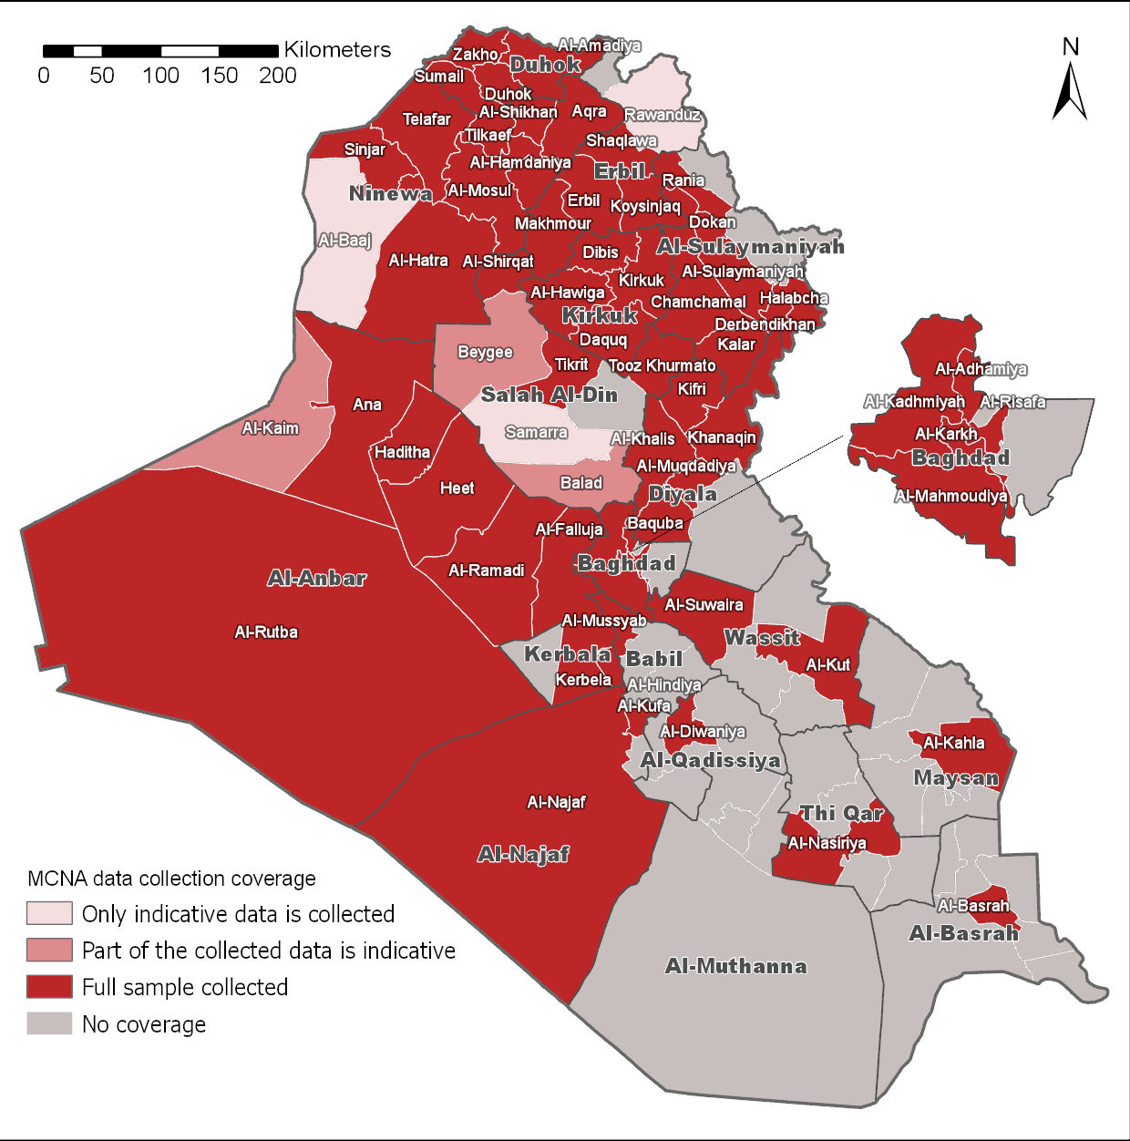
DATA COLLECTION & COVERAGE
Data collection
Between mid-June and mid-August 2019
63 districts (coverage in map)
13,086 households surveyed:
  3,209 IDP in camp,
  5,902 IDP out of camp,
  3,249 returnee,
  726 host community
Data collected by REACH and 19 partners: NRC, Mercy Corps, SIF, Caritas CZ, IOM, SSORD, OXFAM, REACH-Iraq, Medair, People in Need, ZOA International, ACF, Save the Children, Human Appeal, COOPI, INTERSOS, Justice Center, IRC.
Notes:
13,000 surveys – 63 districts
18 partners Dat

Slide 9
CHALLENGES & LIMITATIONS
Surveys were conducted with one respondent (usually the head of household) only, who answered on behalf of the household, including for individual level questions on other members of the household.
The month of Ramadan which ended two weeks prior to data collection may have impacted certain survey responses that had a recall period of 30 days (coping strategies, income, expenditure, etc.)
Collaboration between 20 organizations collecting data may have led to some minor inconsistencies in terms of data collected.
Some areas were inaccessible due to authorization restrictions, or security limitations, which meant that target samples were not fully achieved there.
Only districts with 200 IDP and/or returnee households were surveyed. Therefore, districts with less than 200 households are not included in the scope of the assessment.

Slide 10
2 - KEY CROSS-SECTORAL FINDINGS & TRENDS

Slide 11
DEMOGRAPHICS
Family composition and size were similar across the three population groups:
The average household size for all population groups was 6 members.
  The household is defined as individuals who share housing, food, and income with other members.
The average family size for all population groups was 5 members for all but IDP out of camp families, for which the average was 6.
  The family includes individuals under the guardianship or responsibility of a family unit (parents and their children), such as disabled relatives, separated children, or elderly relatives under their care.
The ratio of male to female within families was close to 1-1:
  On average, 49% (IDP in-camp) to 52% (returnee) members were female.
The ratio of children to adult within families was close to 2-3 for all three population groups:
  For IDP households in camp, 43% were children;
  For IDP households out of camp, 40% were children;
  For returnee households, 36% were children.

Slide 12
IDP MOVEMENT INTENTIONS
Three-month movement intentions for IDP households nationwide:
A vast majority of IDP households did not intend to return to their Area of Origin (AoO) within the 3 months following data collection, in particular those living in camps.
Notes:
Similar patterns between in and out of camp IDPs.

Slide 13
IDP MOVEMENT INTENTIONS
One year movement intentions for IDP households nationwide:
Intentions to return to AoO within the year slightly increased compared to intentions to return during the three months following data collection.
Meanwhile, the proportion of households that reported not knowing considerably increased, in particular for IDP households living in camps (from 11% to 34%). This is particularly relevant within the context of camp consolidations and closures.

Slide 14
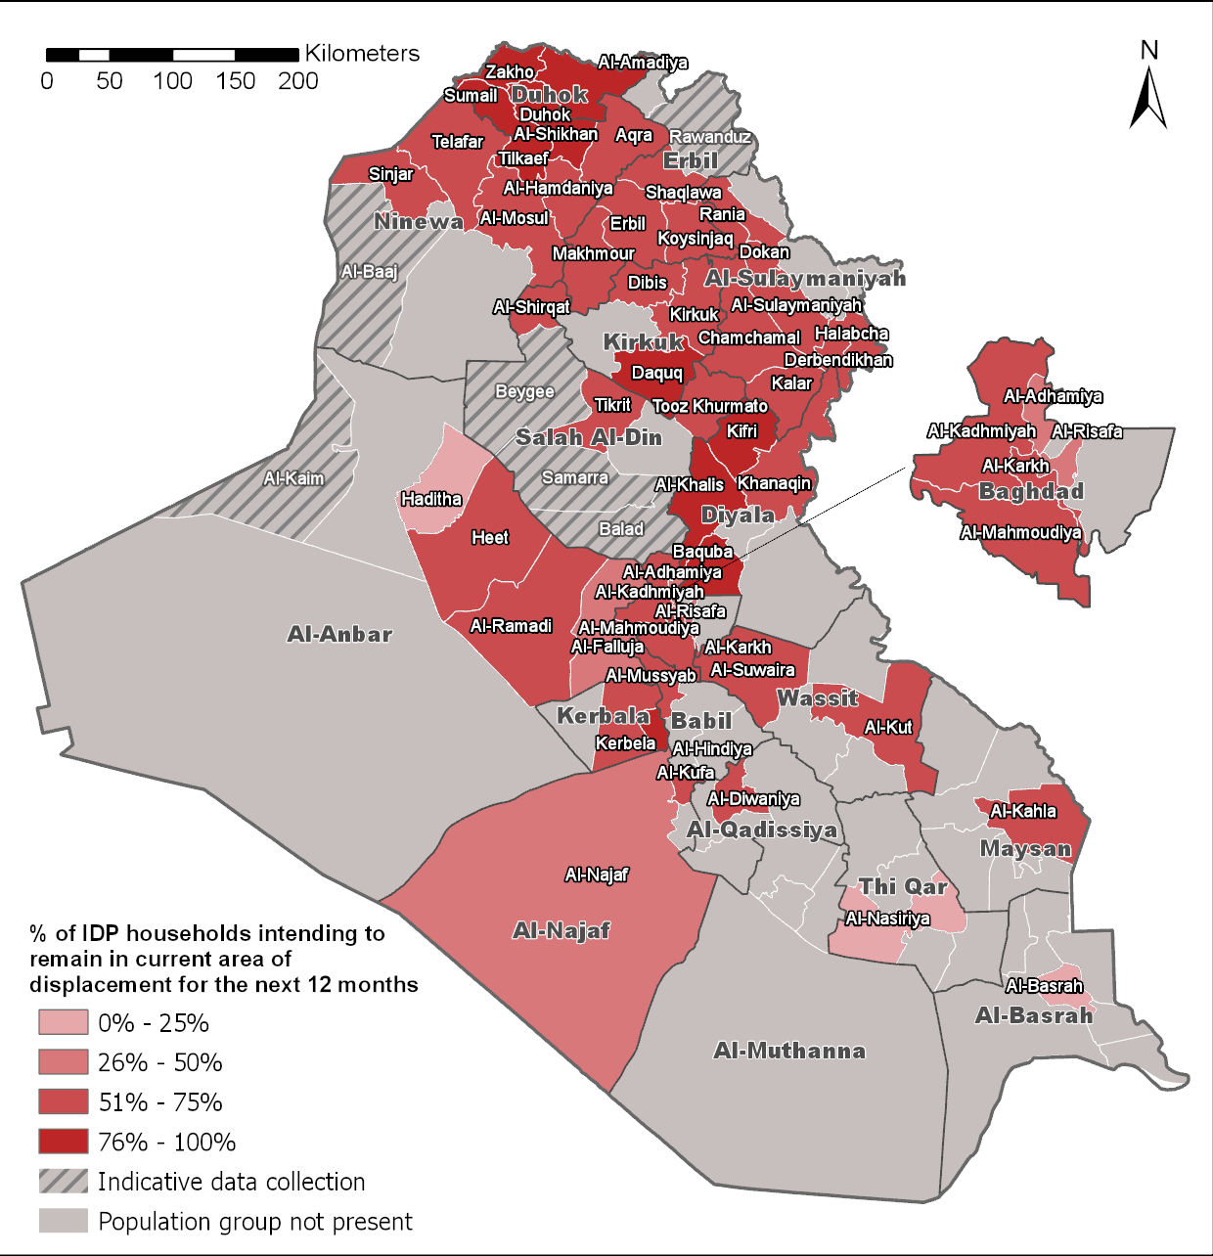
IDP MOVEMENT INTENTIONS – DISTRICT LEVEL
One year movement intentions for IDP households, by district:
Intention to remain in current areas of displacement within 12 months differed across districts, but was mostly similar within regions of the country:
In northern districts (mainly in Duhok), 76% to 100% of households reported they intended to remain in current area of displacement.
In Southern districts, intention to remain was usually under 50% (with the exception of Al-Hindiya in Babil) of households.
In the Ninewa plains, Kirkuk, Sulaymaniyah, intentions to remain in current area of displacement were mainly between 51% and 75% of households.

Slide 15
IDP MOVEMENT INTENTIONS - REASONS
Obstacles to return were similar to previous rounds of intentions surveys, underlining issues relating to security, housing and livelihoods as persistent barriers.

Slide 16
RETURNEE MOVEMENT INTENTIONS
Three-month movement intentions for returnee households nationwide:
Only 1% of returnee households indicated they intended to re-displace in the three months following data collection, citing, for the most part (60%), lack of stable security in their area. Other reasons cited were lack of livelihoods (17%) and lack of basic services (12%).

Slide 17
AAP – AID RECEIVED & SATISFACTION
Among households that received aid, 33% of IDP households in camp said they were not satisfied with the aid they received, followed by IDP households out of camp (29%), and returnee households (11%).

Slide 18
AAP – TYPE OF AID RECEIVED
*Other types of aid cited included: water, fuel, shelter, education services, protection and legal services.

Slide 19
DURABLE SOLUTIONS
% households falling under each indicator, by population group:
Durable Solutions pillars | Indicators (household-level) | IDP in camps | IDP out of camps | Returnee
1. Long-term safety, security, and freedom of movement | Experience movement restrictions in daylight. | 47% | 31% | 64%
2. Adequate standard of living | Evicted from previous shelter/housing in the 12 months prior to data collection | 6% | 6% | 4%
 | Lack of access to essential health services (emergency, maternity, pediatric and surgical within 10km) | 60% | 44% | 43%
3. Access to livelihoods & employment | Do not own or have secure rights over agricultural lands | 77% | 75% | 76%
4. Access to effective mechanisms to restore housing, land and property (HLP) or to provide compensation | Unable to access property compensation (among those with damaged housing that requested compensation) | 90% | 96% | 92%
5. Access to and replacement of personal and other documentation | At least one key household or individual document missing | 99% | 98% | 96%
6. Voluntary reunification with family members separated during displacement | Separated household members | 4% | 2% | 2%
7. Participation in public affairs | At least one adult unable to register to vote | 16% | 13% | 15%
8. Access to remedies | Lack of awareness of how to access complaint mechanisms | 19% | 47% | 41%
Notes:
With the exception of access/knowledge of complaint mechanisms (considerably higher for IDPs in camp than out of camp populations) and movement restrictions in daylight (returnees notably), findings on durable solutions were similar for all population groups.
Inability to access property compensation scheme when owning a damaged property was particularly high for all population groups.
Lack of documentation was also particularly high for all population groups, with the caveat that these include all documents – which has been revised by sectors in their analysis for sectoral purposes.

Slide 20
VULNERABILITIES – COPING STRATEGIES
Overall, a higher percentage of IDP households in camp reported relying on coping strategies in the month prior to data collection, including emergency strategies.
Notes:
Stress includes: Selling household property; Buying food on credit; Borrowing money through friends and relatives; Reducing expenditures on NFI
Crisis includes: Selling means of transport; Changing place of residence; Children under 18 owrking to provide resources)
Emergency includes: Children dropping out from school; Accepting that adults engage in risky behavior; Migration of all family; Children or adult forcefully married)

Slide 21
VULNERABILITY – INCOME
A higher proportion of IDP households living in camps, compared to out of camp populations, had income-related vulnerabilities.
*households that took on debt to be able to cover healthcare, food, education,
or basic household expenditures, in the 30 days prior to data collection.

Slide 22
VULNERABILITIES – DISABILITY
12 - 16 % of IDP households in camp, IDP households out of camp, and returnee households reported having at least one household member with a physical and/or cognitive difficulty.*
At the district level:
  The proportion of households reporting having at least one member with physical and/or cognitive difficulties ranged between less than 1% and 54%.
  The highest proportion were in Rutba (54%), Baiji (35%), Sulaymaniyah (32%), Kaim (31%), Ana & Hawiga (30%).
*As per Washington Group guidance, this included individuals that had "lots of difficulty" or "could not do at all" one of the following activities: seeing, hearing, walking/climbing steps, remembering / concentrating, self-care, communicating).

Slide 23
VULNERABILITIES – FEMALE HEADED HOUSEHOLDS
The proportion of Female Headed households in camp was substantially higher than for IDP households out of camp and returnee households.
Female Headed households might be more prone to vulnerabilities, including with regards to income. For example, a higher proportion of Female Headed households had income from employment and pension in the month prior to data collection lower than 480,000 IQD, than all households:
  IDP households in camp: 90% rather than 85%
  IDP households out of camp: 76% rather than 60%
  Returnee households: 80% rather than 60%

Slide 24
3 – KEY SECTORAL FINDINGS & TRENDS

Slide 25
SHELTER
% households facing shelter-related needs, by population group
All IDP households living in camp were in critical shelter conditions (defined as any housing outside of houses, apartments or hotels).
The proportion of IDP households out of camp living in critical shelters was three times higher than returnee households (14% and 4% respectively).
However, the proportion of returnee households reporting issues with shelter and need for at least 2 shelter improvements was similar to IDP out of camp, indicating the need to focus on both population groups, regardless of status.

Slide 26
SHELTER
Top 3 shelter issues most frequently reported among households reporting issues with their shelter, by population group:
 | Main issue reported | Second issue reported | Third issue reported
IDP in camp | Shelter poorly insulated from hot / cold weather (24%) | Shelter without separate rooms (15%) | Fire risks (14%)
IDP out of camp | Leaking roof during rain (20%) | Shelter poorly insulated from hot / cold weather (11%) | Openings on the walls (7%)
Returnee | Leaking roof during the rain (12%) | Shelter poorly insulated from hot / cold weather (8%) | Openings on the walls (7%)
Shelter issues most frequently reported across population groups were related to climatic hazards (insulation and leaking during rain).
Other reported issues also raised concerns over privacy and fire hazards.
Openings on the walls were cited as the third main issue, and can strongly be related to climatic hazards as well.

Slide 27
WASH
Levels of severity for households’ access to sufficient quantity of safe water for drinking and domestic purposes, by population group
Access to sufficient quantity of safe water was overall similar for all population groups, and although more than half had access to sufficient water (quantity per day per person), and to water of quality (type of source), a considerably proportion did not:
Over 20% of IDP (in camp and out of camp) households did not have access to 80 liters of water per person per day (severity level 3 and above);
Over 20% of IDP in camp and returnee households – at best – relied on bottled water or water trucking to access safe water, and – at worst – on surface water or unprotected sources.
Notes:
How is the indicator calculated? Indicator categorized (with the SNFI cluster) into the 5 levels of severity, then each households assigned to one level. The graph shows the percentage of households for each population group that fell under each severity level.
Quality: level 1 (water comes from an improved source, including piped water into compound) / level 2 (water from an improved source, including piped water connected to public tap, borehole, protected well, protected rainwater tank, protected spring) / level 3 (water comes from an improved source including bottled water / water trucking) / level 4 (water comes from an unimproved water source / level 5 (water comes directly from rivers, lakes, ponds, etc.)
Quantity: level 1 (more than 80 l/d/p); level 2 (50 or more but less thand 80 l/d/p); level 3 (15 or more but less than 50 l/d/p); level 4 (7.5 or more but less than 15 l/d/p); level 5 (less than 7.5 l/d/p)

Slide 28
WASH
% households with access to soap and that practice handwashing:
The proportion of households with access to soap and practicing handwashing was lowest in camps, suggesting the need to focus on hygiene promotion-based interventions and/or soap distributions there.

Slide 29
FOOD SECURITY
Level of severity in relation to food insecurity*, by population group:
The proportion of households that was food insecure was similar for all population groups. However, the proportion of IDP households in camp found to be vulnerable to food insecurity was approximately 20 percentage points higher than the other population groups.
*Based on the Consolidated approach to reporting indicators (CARI) for food insecurity
analysis, that looks at food consumption, food expenditure, and coping strategies to
cope with lack of food.
Notes:
How is the indicator calculated? Indicator categorized (with the SNFI cluster) into the 5 levels of severity (there were only 3 levels calculated), then each household assigned to one level. The graph shows the percentage of households for each population group that fell under each severity level.

Slide 30
LIVELIHOODS
22% (IDP out of camp), 27% (returnee) and 37% (IDP in camp) households had at least one adult unemployed and seeking work.
Top three primary barriers to employment, by population group:
 | Main reason | Second reason | Third reason
IDP in camp | Increased competition for jobs (66%) | Lack of family / personal connections (28%) | Available jobs are too far away (24%)
IDP out of camp | Increased competition for jobs (80%) | Lack of family / personal connections (14%) | Underqualified for available jobs (13%)
Returnee | Increased competition for jobs (86%) | Lack of family / personal connections (10%) | Underqualified for available jobs (7%)
Lack of family / personal connections as a barrier to employment was cited more frequently by IDP households in camp (28%) than other population groups (14% of IDP out of camp, 10% returnee).
Lack of job opportunities, together with the considerable high proportion of households with adults unemployed and seeking work underlined the need for livelihood-based interventions to address the employment gap.
Notes:
Increased competition for jobs was the main barrier to employment for all three population groups, and in particular for returnee households (83%).

Slide 31
EDUCATION
Access to schools
Around 90% of households across all population groups (91% for IDP households in camp and returnee households; 86% for IDP households out of camp) indicated they had access to a functional primary and secondary school within 5 kilometers.
% households with at least one child not attending formal or informal school:
The proportion of IDP households reporting having at least one child not attending either formal or informal education was significantly higher than the proportion of IDP households not having access to schools.
Notes:
Notable that despite relatively good access for almost all households to education, not all children were attending school.

Slide 32
EDUCATION
Top three barriers to education, among households with at least one school-aged child not attending school (formal or informal), by population group:
IDP in camps | IDP out of camps | Returnee
Can’t afford to pay for the school related expenses Lack of interest of children in education School stopped functioning and is now closed / School is not safe | Can’t afford to pay for the school related expenses Lack of interest of children in education Children can’t physically go to the school | Can’t afford to pay for the school-related expenses Lack of interest of children in education School stoped functioning and is now closed
Among reasons reported as barriers to education the inability to afford to pay for school-related expenses was the most frequently cited by households in all three population groups.
Other reasons frequently cited were lack of interest of children in education, schools no longer functioning, and children not being able to physically go to school.
Notes:
We can’t afford to pay for the school related expenses (Examples include: Cannot afford to pay for the school fees (e.g. school supplies, tuition, textbook, food, uniforms, etc.), Cannot afford to pay for transport)
Going or attending school is not safe (Examples include: it is unsafe to travel or go to school, Fear of recruitment in/on way to school, Fear of bombing, Fear of violence against children at school (corporal punishment, harassment by teachers and other students, bullying, etc.), Fear of abduction in/on way to school)
School stopped functioning and is now closed (Examples include: Occupied by armed forces, Partially damaged, Totally damaged, Occupied by displaced persons, Lack of students)
Our children can’t physically go to the school (Examples include: Disability (of child), Traumatization (of child), School is too far away, No transport available to bring to school, No fuel available to bring to school, Child ill, disabled or unhealthy, Child is too young)

Slide 33
HEALTH
Access to health services, by population group:
Access to health services was overall consistent across population groups, with steady access to health clinics but inconsistent access to specialized and essential services.
Although 91% to 98% of households reported having access to functional health clinics within 5 km, the proportion having access to a functional hospital within 10 km with emergency, maternity, surgical and pediatric services was about half.
Just over three quarter of households reported that women had acces to specialized reproductive services for out of camp populations. It was lower for in camp (65%).

Slide 34
HEALTH
Main reported barriers to accessing health services, by population group:
 | Main reason | Second reason | Third reason
IDP in camp | Cost of services and / or medecine was too high (35%) | No medecine available at health facility / pharmacy (6%) | Did not get access to qualified health staff at the health facility (4%)
IDP out of camp | Cost of services and / or medecine was too high (42%) | No medecine available at health facility / pharmacy (6%) | No treatement available for my disease at the health facility (5%)
Returnee | Cost of services and / or medecine was too high (26%) | No medecine available at the health facility / pharmacy (9%) | No treatment available for my disease at the health facility (6%)
The main barriers to medical services were the same for in camp and out of camp populations and mainly related to cost and lack of availability of medecine, staff, and treatments:
Overwhelmingly, the main barrier to accessing health services was the high cost of medical services and medecines.
Other reasons reported as main barriers to accessing medical services were non availability of medecine, qualified staff, or specific treatment.
Inconsistent access to health services is particularly relevant within the context of 25% (in camp), 28% (returnee) and 33% (out of camp) of households with at least one
member with a chronic disease.

Slide 35
HEALTH / PROTECTION
3% - 5% of households reported that at least one child was showing signs of psychosocial distress (measured through self-reported behavior change):
  3% for IDP households out of camp;
  4% for returnee households;
  5% for IDP households in camp.
5% - 6% of households across population groups reported such signs among adults.
In contrast, within the districts in which data was collected with host populations, 1% of households reported signs of psychosocial distress among children, and 2% among adults.
  Higher reporting of psychosocial distress within IDP or returnee households than host could indicate a link between displacement and trauma.*
*Given the self-reporting / non-diagnostic nature of this indicator, this interpretation should be taken with caution.

Slide 36
PROTECTION – GENERAL PROTECTION
Levels of severity in terms of households missing core documentation, by population group
Missing documentation was a major protection concern for all three population groups, with more than half of households having a level 3 severity or more, meaning they were missing at least 1 core household or individual document (PDS card, information card, national ID, birth certificate, citizenship certificate).
Notes:
How is the indicator calculated? Indicator categorized (with the SNFI cluster) into the 5 levels of severity, then each households assigned to one level. The graph shows the percentage of households for each population group that fell under each severity level.
Level 1 (missing no document); level 2 (missing document but none of the core 5 documents); level 3 (missing 1 or 2 core documents; level 4 (missing 3 core documents); level 5 (missing 4 or more core documents)

Slide 37
PROTECTION – MINE ACTION
% IDP households not intending to return to their AoO due to perceived presence of mines, among IDP households not intending to return, by top district of origin:
Governorate | District | Households
Ninewa | Al-Baaj | 34%
Babil | Al-Mussyab | 33%
Ninewa | Sinjar | 22%
Kirkuk | Dibis | 18%
Al-Anbar | Al-Falluja | 16%
Ninewa | Al-Mosul | 16%
Ninewa | Al-Shikhan | 13%
Ninewa | Telafar | 13%
Ninewa | Al-Hatra | 12%
Salah Al-Din | Balad | 12%
Kirkuk | Al-Hawiga | 10%
Ninewa | Al-Hamdaniya | 9%
Salah Al-Din | Al-Shirqat | 8%
Diyala | Al-Muqdadiya | 5%
Salah Al-Din | Beygee | 5%
Presence of mines was a considerable factor influencing intentions to remain in displacement for quite a proportion and number of IDP households, underlining it as an important issue still needing significant attention.

Slide 38
PROTECTION – GENDER-BASED VIOLENCE (GBV)
% households reporting female and girls avoiding areas because they feel unsafe:
A considerably high proportion of households indicated that women and girls were avoiding particular areas because they felt unsafe there:
  For IDP households in camp and returnee households, over 40% of households reported this issue.
  The proportion of IDP households out of camp was lower but still over 20%.
This finding suggests attention should be given to understanding reasons behind these fears and the potential consequences on both women’s psychosocial health and their ability to access infrastructure and services, the latter being particularly relevant for Female Headed households.
Notes:
Reminder: proportion of female headed households higher in camps

Slide 39
PROTECTION – HOUSING, LAND & PROPERTY (HLP)
Overall, 8% of IDP households out of camp and 4% of returnee households reported fearing eviction, which in terms of absolute numbers, raises considerable eviction-related concerns.
Top 6 reasons reported by households fearing eviction, by population group:
The main reason cited for fear of eviction was lack of funds to pay rental costs. Once again, this underlined the need for livelihood and resilience based interventions.
At the same time, 12% (returnee) to 18% (IDP out of camp) households reported that their current property or property they owned in AoO was under dispute, indicating the
need for HLP based interventions as well.
Notes:
Secure tenure of housing means their housing is under some kind of dispute

Slide 40
4 – CONCLUSIONS

Slide 41
CONCLUSIONS – CROSS-SECTORAL
IDP households’ intentions to return were overall low both in the short and the long-term, suggesting that IDP caseloads are likely to remain constant through early to mid 2020.
In line with previous assessments conducted with IDPs in and out of camps, findings indicate systemic issues that prevent IDPs from considering returning to their AoO: security, livelihoods, and shelter.
Durable solutions findings also suggest needs for resilience-based interventions.
Durable Solutions indicators measured through the MCNA, for the most part, had similar findings across population groups. Two exceptions were freedom of movement which was higher for IDP households in camps, and awareness of how to access complaint mechanisms, also higher for IDP households in camps.
Overall access to services was consistent across population groups but many barriers were raised, with the main one being lack of financial means.
Finally, IDP households in camps appeared to be more prone to vulnerabilities and utilizing coping strategies to meet basic needs.

Slide 42
OUTPUTS
  Available
  Dataset available on the REACH Resource Center.
  Preliminary findings and HNO inter-sectoral findings available upon request.
  Terms of reference available on the REACH Resource Center.
  HNO / MCNA presentation available on the REACH Resource Center.
  Upcoming
  MCNA Factsheets (December)
  MCNA final report (December)
  MCNA Dashboard (January)

