Slide 1
Izium City
Infrastructure damage and its impacts
February 2024
Notes:
Preliminary findings

Slide 2
01
Damage Impact Analysis: Research Design & Rationale
Izium overview & findings
Contents
02

Slide 3
01
Damage Impact Analysis: Rationale & Research Design

Slide 4
Damage Impact Analysis Research Cycle
Objective To provide evidence-based data to inform the prioritisation of response, recovery and reconstruction, by combining geo-spatial analysis and qualitative data with a focus on Accountability to Affected Populations.
Assess
Understand
Identify
Amplify
the extent and severity of conflict-related building damage
the localised short- and long- term impacts of residential and non-residential infrastructure damage
contextual and systemic factors likely to facilitate or hinder recovery
The priorities of affected populations for recovery and facilitate their inclusion in planning
Notes:
What

Slide 5
Damage Impact Analysis Outputs
01
Non-Residential Infrastructure Damage Assessment Geo-spatial analysis of conflict-induced damage to public service infrastructure.
02
Residential Infrastructure Damage Assessment Geo-spatial analysis of conflict-induced damage to residential infrastructure.
03
Web-based Damage Monitoring Platform A web-based platform utilising tools from REACH's partner UADAMAGE, to visualise damage assessment findings.
04
Damage Impact Analysis Complements geo-spatial assessments with a primary data-driven analysis, aimed at understanding the impact, needs and priorities resulting from conflict-related damage. This approach aims to inform localised evidence-based humanitarian and recovery action, including from an Accountability to Affected Populations (AAP) perspective.
Notes:
How
Kherson, Nikopol, Saltivka (Kharkiv), Mykolaiv, Izium

Slide 6
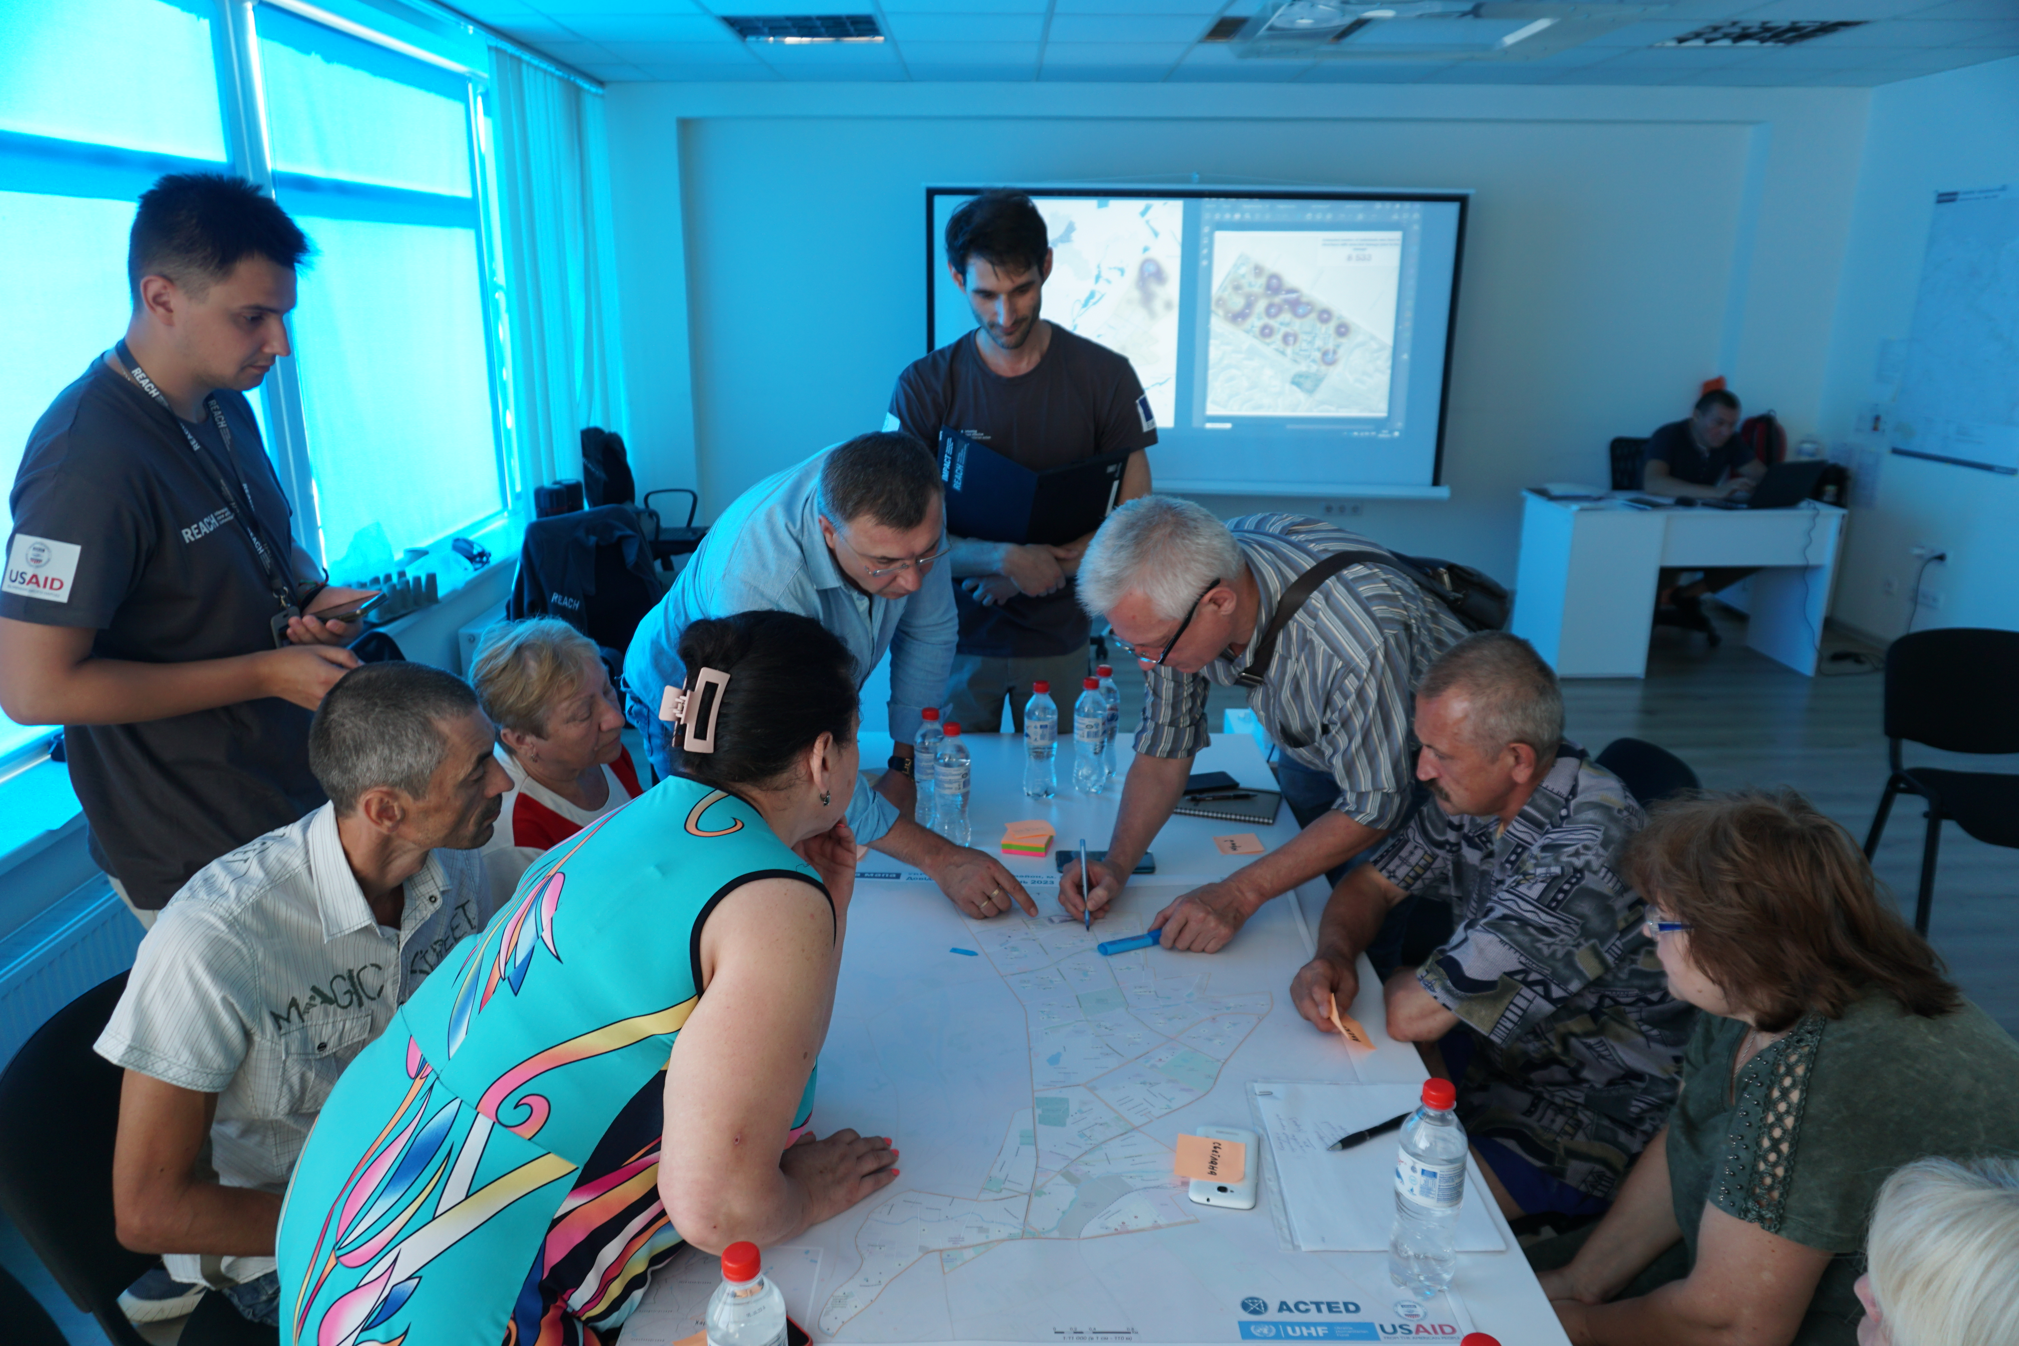
Methodology
Damage Assessments
Geo-spatial analysis Based on high-resolution satellite imagery (spatial resolution of 30cm).
AI and visual inspection Damage detection utilising the capabilities of REACH’s partner UADamage’s artificial intelligence neural networks. AI-assisted damage detection is complemented by visual inspection, involving a review of each building to assess damage severity.
Damage Impact Analysis Primary data Focus group discussion with community members, key informant interviews with representatives from local authorities, utilities and civil society organisations. Mapping focus group discussion to capture residents' perceptions on impacts and recovery priorities.
Impact score During the analysis, the findings were broken down by sector and rated as either low, medium or high impact based on frequency of mentions and severity of perceived impacts.

Slide 7
Data utilisation
Local authorities
Humanitarian actors
Support a localised understanding of infrastructure damage for the development of impact mitigation and recovery measures.
Inform humanitarian programming that addresses the impacts of infrastructure damage (Shelter, NFI, WASH, FSL).
Civil Society Organisations
Recovery actors
Support local actions to affected population and advocacy efforts.
Provide baseline data to inform recovery and reconstruction planning, taking into account impacted populations' perceptions, needs and priorities.
Notes:
Donors

Slide 8
Izium Overview & Findings
02

Slide 9
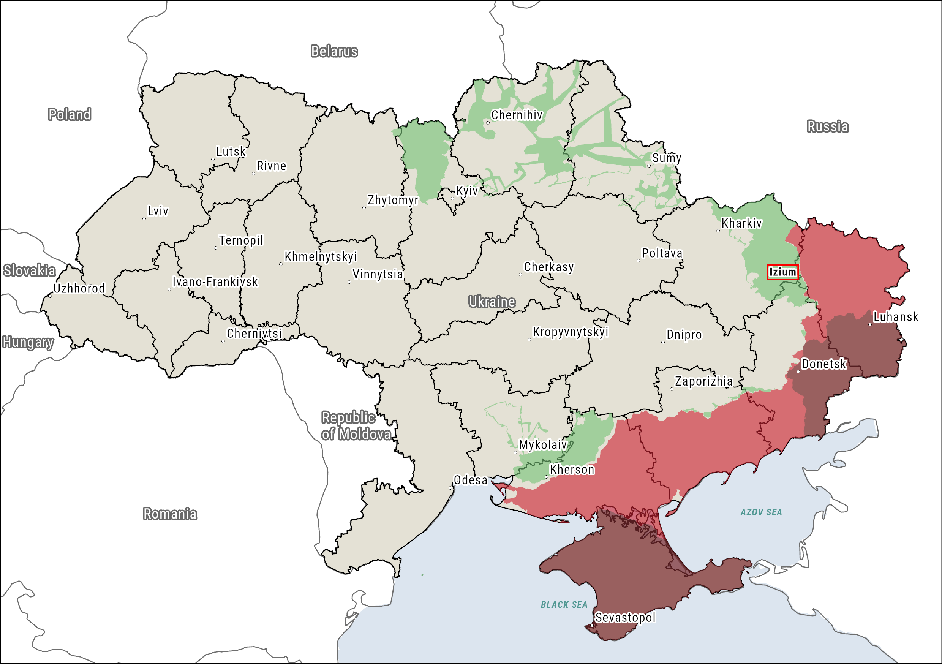
Izium: Context
Kharkivska Oblast's second largest city, after Kharkiv. The city was temporarily occupied from March – September 2022. Damage to both residential and non-residential infrastructure has impacted access to essential services and led to displacement.

Slide 10
Timeline
Prior to the war
10 September
2022
2024
Izium has a population of 46,653. Industry, public sector, small business and agriculture are major employers.
The Ukranian Armed Forces regain control of Izium.
The city continues to face insecurity and occasional shelling.
Izium is occupied by the Armed Forces of the Russian Federation.
Between 5,000 – 7,000 residents return to the city. By September, the total resident number stands at 27,000.
7 March 2022
2023

Slide 11
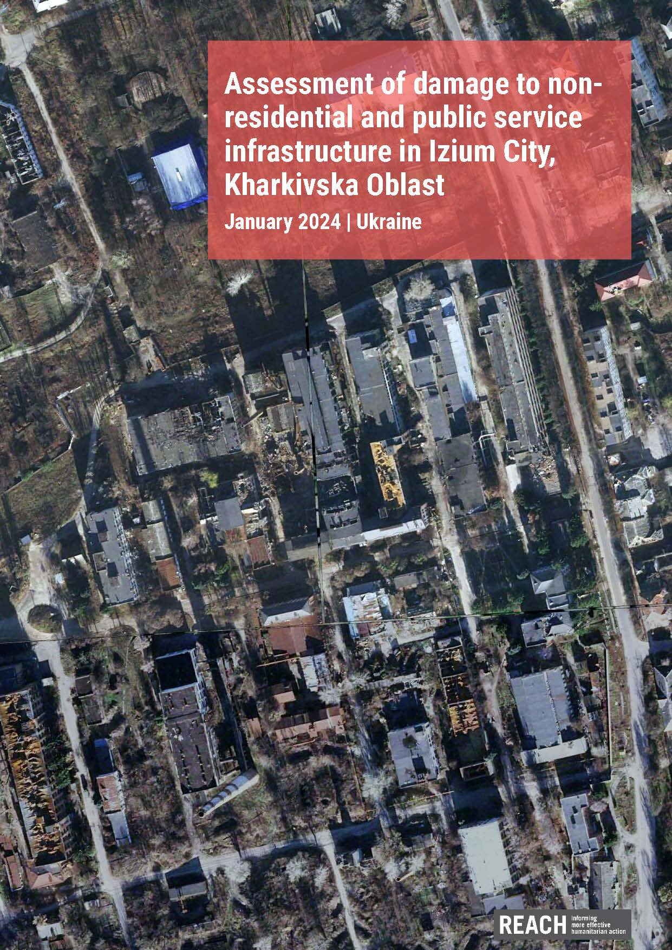
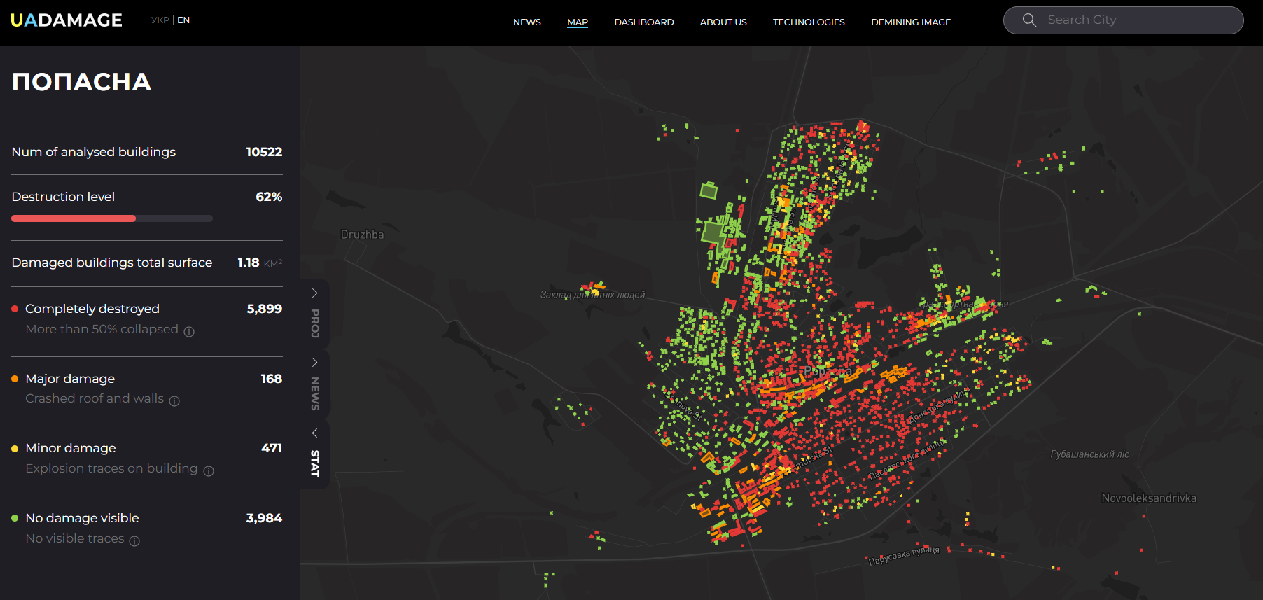
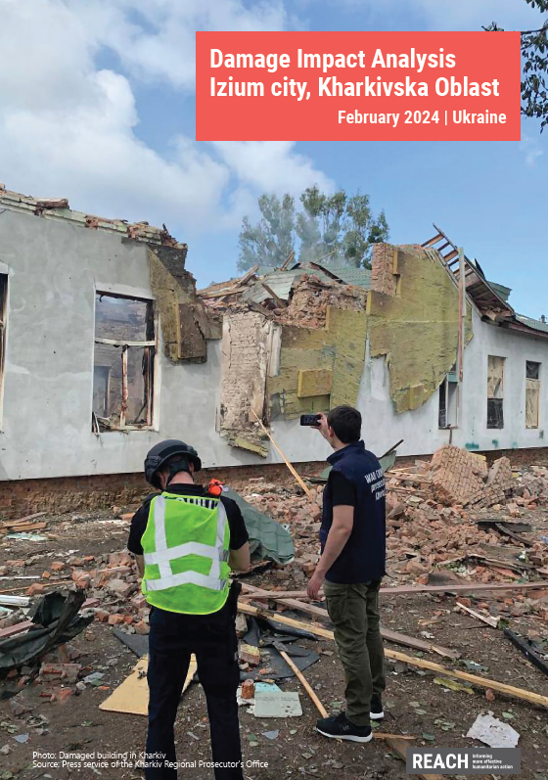
Izium Damage Impact Analysis Suite
01
Non-Residential Infrastructure Damage Assessment – Izium City
02
Residential Infrastructure Damage Assessment – Izium City
03
Web-based Damage Monitoring Platform – Izium City
04
Damage Impact Analysis – Izium City

Slide 12
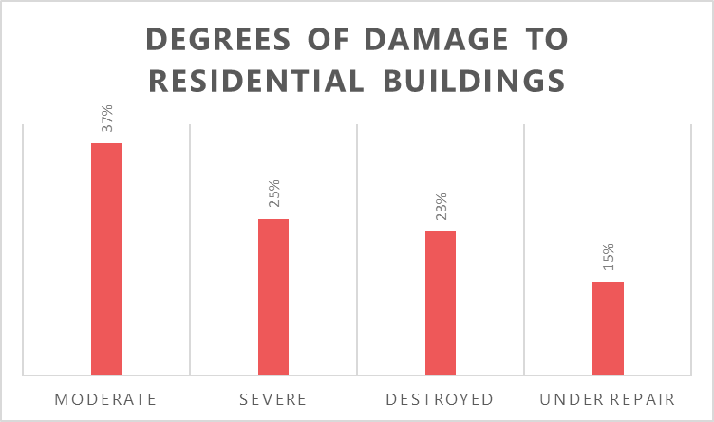
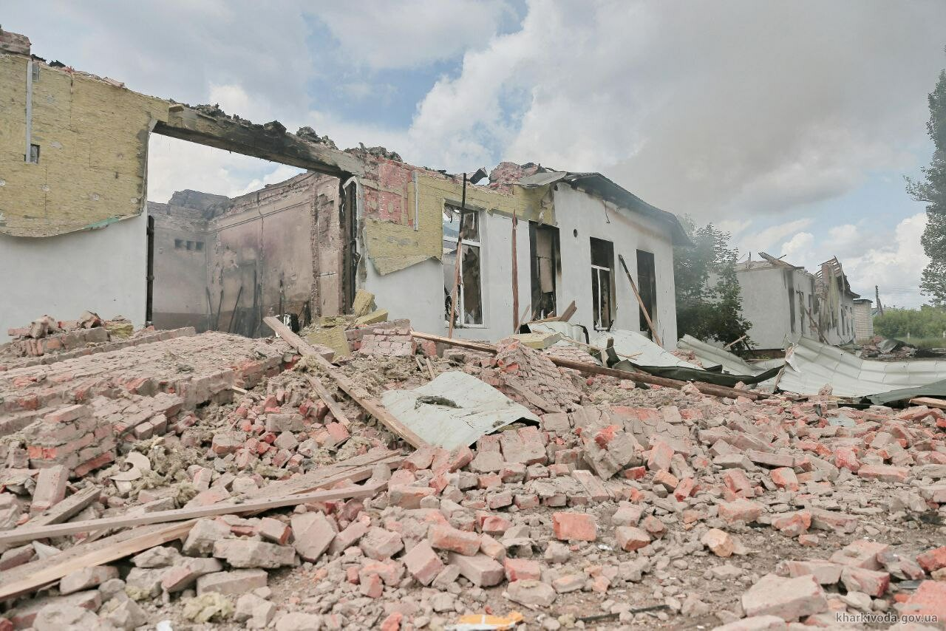
Residential Infrastructure Damage Assessment
Overall, 652 residential buildings were identified as damaged in Izium City. This includes 592 single-family houses and 60 multi-story buildings.
The city centre of Izium, along with its western area exhibits the highest density of residential damage. Significant destruction is also present in the South and South-East with more than 20 buildings identified as destroyed in each part.
A drone attack in Izium on May 26th, 2023, damaged and destroyed businesses, schools and residential buildings.

Slide 13
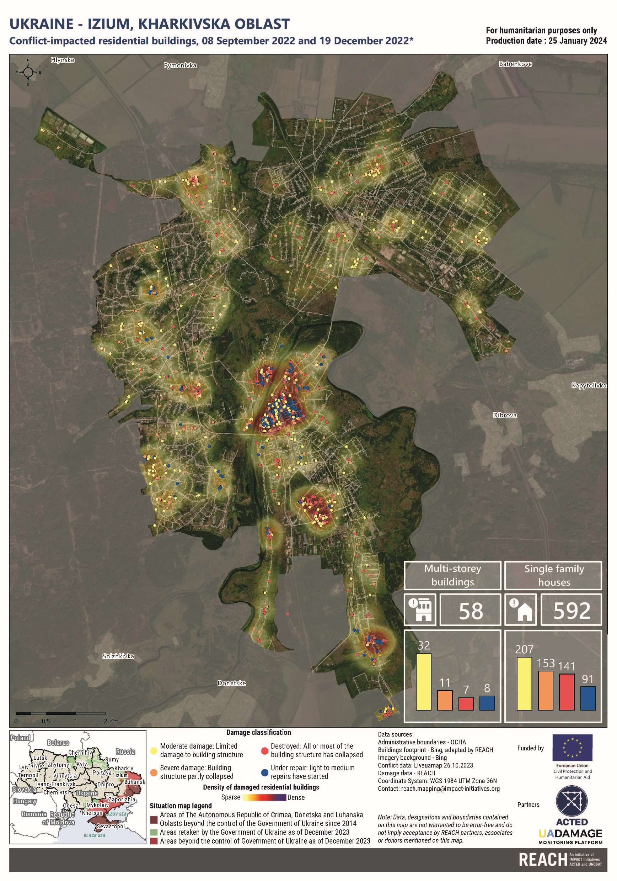
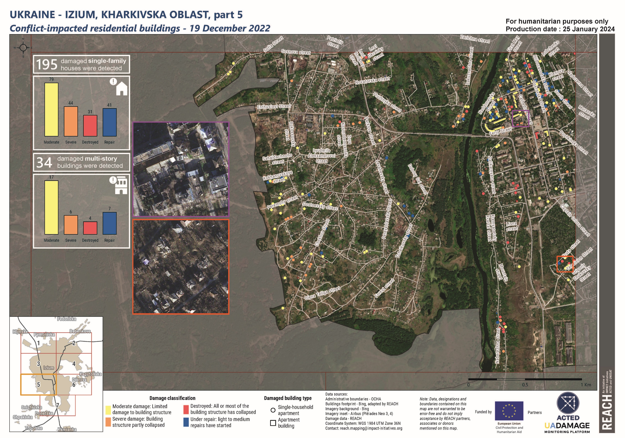
Residential Damage assessment

Slide 14
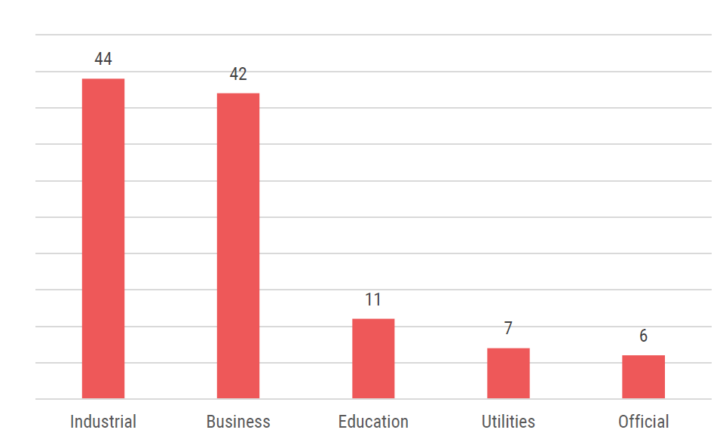
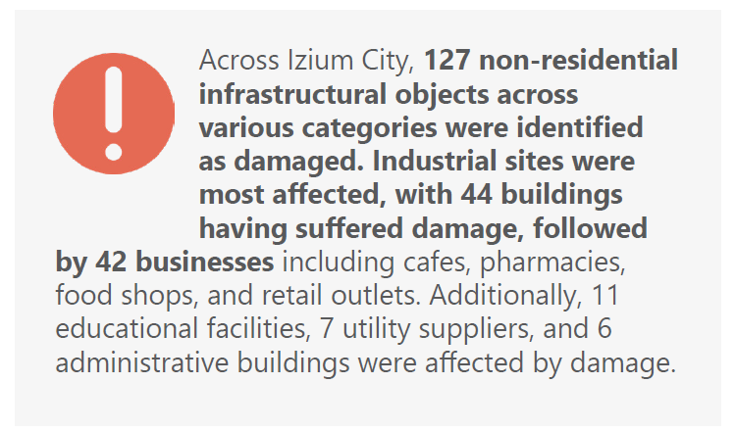
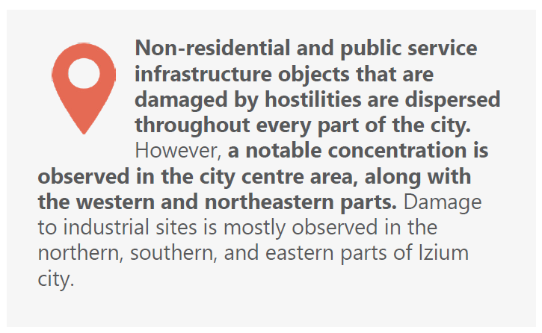
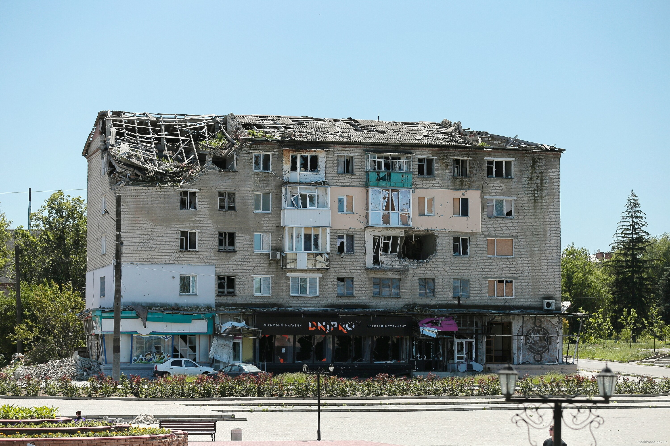
Non-Residential Infrastructure Damage Assessment
Infrastructure and public services most impacted by war-related damage
Damage to residential homes and businesses in Izium city.

Slide 15
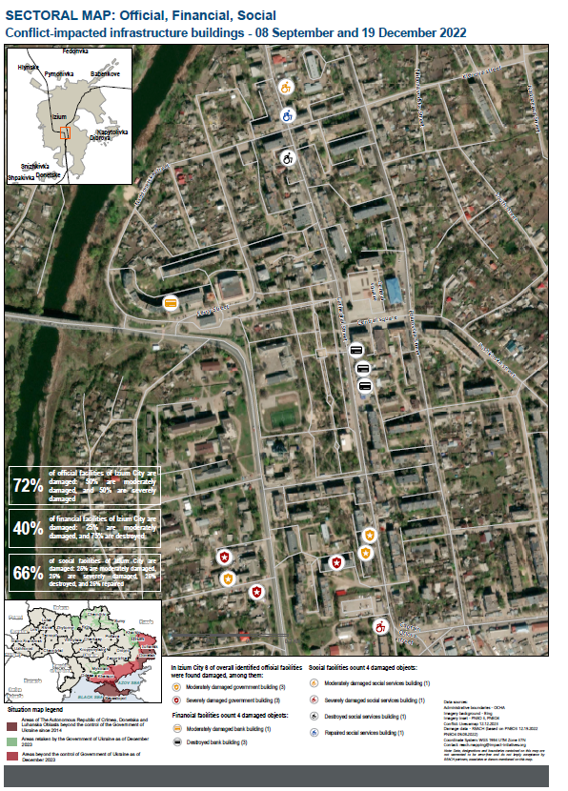
Non-Residential Infrastructure Damage Assessment
Notes:
This situation overview presents the findings of an assessment of conflict-induced damage to non-residential and public service infrastructure in Izium City conducted by REACH. This city of regional significance was selected for this assessment based on the extent and severity of damage it has incurred since the onset of Russia’s invasion of Ukraine in February 2022.
Despite continued insecurity and ongoing humanitarian needs, Izium has seen the return of many of its displaced residents, highlighting the need for early and long-term recovery efforts to ensure population’s access to housing, utilities, essential services and livelihoods. This assessment aims to support data-driven humanitarian and recovery programming through a detailed understanding of damage to non-residential and public service infrastructure. It complements a parallel assessment of damage to housing infrastructure, and a qualitative analysis of damage impacts.

Slide 16
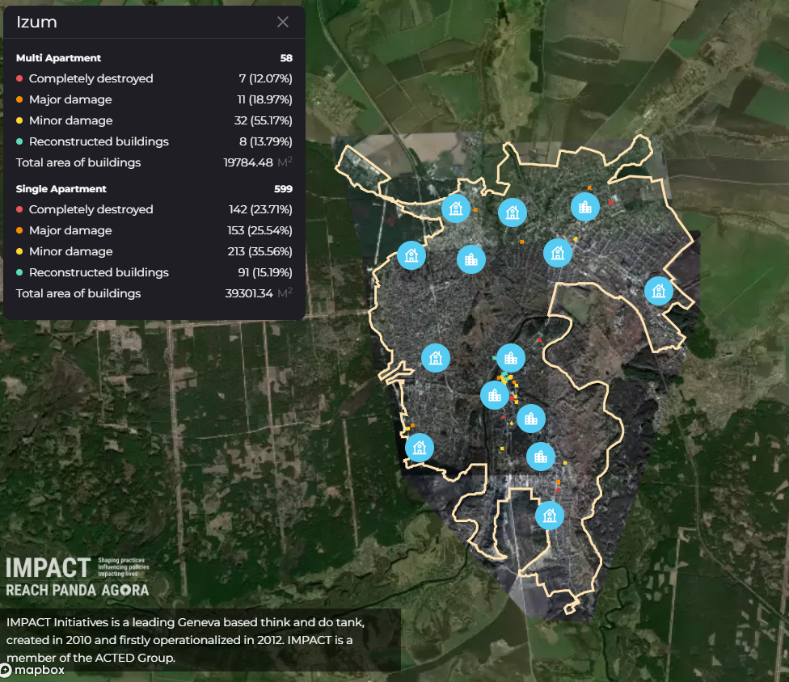
Web-based Damage Monitoring platform
REACH is developing a web-based damage monitoring platform with its partner UADamage to visualise damage assessments findings. This initiative is utilises the existing platform to enhance the dissemination process, prioritizing accuracy, security, accessibility and operability.

Slide 17
Damage Impact Analysis
The Damage Impact Analysis aims to develop understanding of the impact of conflict-related damage in Ukraine by complementing geo-spatial data with qualitative analysis, focusing on non-residential and residential impacts. This approach aims to inform recovery strategies that are inclusive and meet the needs of affected communities.
Notes:
While geo-spatial data has significantly improved the understanding of the extent of conflict-driven infrastructural damage in Ukraine, it falls short in capturing its nuanced, localised impacts on various sectors over different timescales. To address this gap, REACH complements GIS-based damage assessments with qualitative impact analyses to enhance the understanding of infrastructure damage impacts, with a particular emphasis on service availability and accessibility. It aims to inform targeted, context-specific strategies for humanitarian action, early recovery, and reconstruction that address the consequences of damage. Through an Accountability to Affected Populations perspective, this approach ensures that recovery initiatives are not only inclusive and data-informed but also align with the needs and priorities of affected communities.

Slide 18
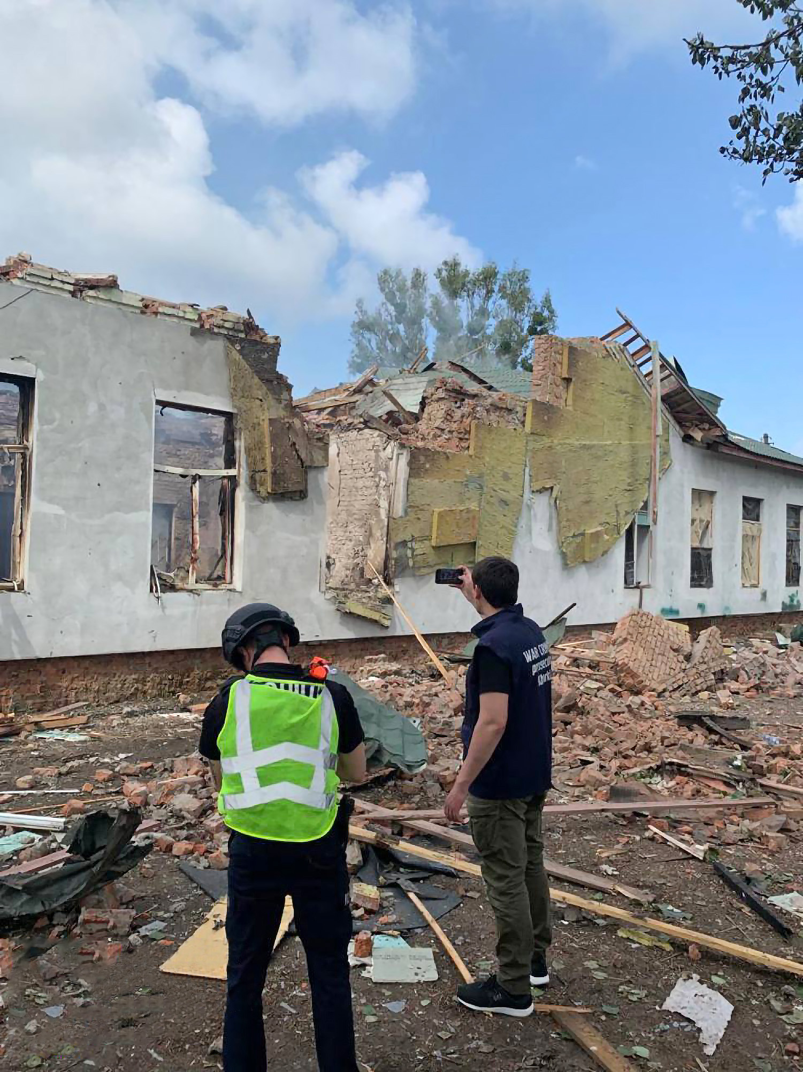
Key findings
[Title]
Izium’s housing stock has been significantly impacted by war-related damage, which has led to large-scale displacement of its residents and high levels of humanitarian needs, particularly with regards to shelter and essential services.
Extensive damage to public infrastructure and utilities is impacting availability and accessibility to essential services, including healthcare, education, and essential services such as power and water.
The impacts of damage to residential and public service infrastructure are closely interconnected and mutually reinforcing. While residential damage affects living conditions, damage to public service infrastructure disrupts daily lives and service functionality. These intertwined impacts necessitate recovery strategies that address both areas simultaneously to ensure that recovery interventions rehabilitate both physical infrastructure and support the restoration of community’s fabric.
Prosecutors and police investigators recorded numerous destructions in Izium after massive drone attack on 26 of May 2023.
Notes:
Perhaps split these between two slides.

Slide 19
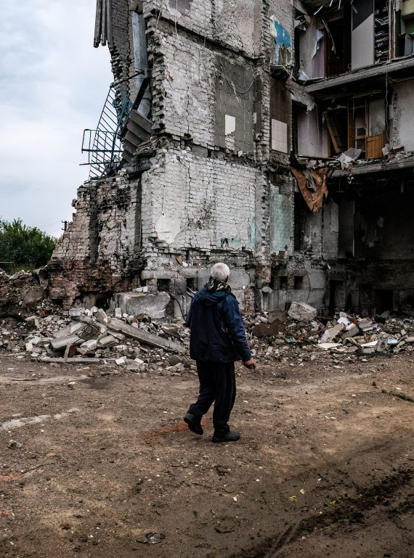
Key findings
Immediate challenges facing residents include housing shortages and emotional distress, while long-term needs include financial assistance, long-term housing solutions, and access to employment opportunities.
A major concern expressed by key informants is that healthcare facilities are critically understaffed and unable to meet residents’ needs, while the education sector faces the challenges from the shift to online learning due to inadequate facilities.
The economy, particularly the industrial and services sectors, has been severely impacted by infrastructure damage, resulting in reduced employment opportunities, which constitutes a significant barrier to the return of IDPs. However, community resilience is evident through adaptive strategies, with signs of economic recovery in certain areas.
Fig. Chris sampson photography, 4 october 2022
Notes:
Perhaps split these between two slides.

Slide 20
Damage impact score
The damage impact score is an indicative quantitative measure derived from primary qualitative data, triangulated with data on the extent and severity of damaged infrastructure. Sectoral in nature, this score provides an estimation on the severity of the impacts resulting from damage to different types of infrastructure.
Low impact
Medium impact
High impact
Represents minimal disruption, with most facilities operational and services largely accessible.
No sector was assessed to have experienced a low level of impact from conflict related damage.
Noticeable disruption, with services operating at reduced capacity or being intermittently unavailable. Residents face notable challenges in accessing services Damage to infrastructure is significant but generally repairable. Need for temporary solutions and external assistance.
Healthcare
Water and sanitation
Power & communication networks
Transport
Reflects major disruption or severe/complete service unavailability; often couple with extensive damage requiring significant reconstruction efforts. Residents experience severe challenges in accessing services, with resulting decline in living standards. Restoration of services requires comprehensive and long-term external support
Education
Business and livelihoods
Notes:
Low impact Represents minimal disruption, with most facilities operational and services largely accessible.
Medium impact Noticeable disruption, with services operating at reduced capacity or being intermittently unavailable. Residents face notable challenges in accessing services Damage to infrastructure is significant but generally repairable. Need for temporary solutions and external assistance.
High impact Reflects major disruption or severe/complete service unavailability; often couple with extensive damage requiring significant reconstruction efforts. Residents experience severe challenges in accessing services, with resulting decline in living standards. Restoration of services requires comprehensive and long-term external support

Slide 21
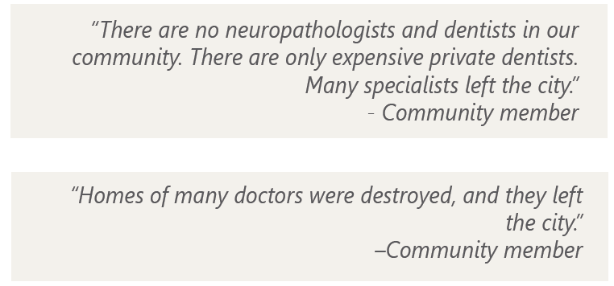
Healthcare
Healthcare accessibility is severely compromised in Izium, with hospitals often unable to provide necessary medical care, leading to patients either traveling long distances for treatment or foregoing medical treatment entirely.
Damaged infrastructure and transportation limitations significantly hinder the ability of patients to reach healthcare facilities in other districts, exacerbating the healthcare crisis.
The healthcare system is further strained by a shortage of qualified medical personnel, due in part to housing issues caused by residential damage, as well as limitations in diagnostic and therapeutic capabilities.

Slide 22
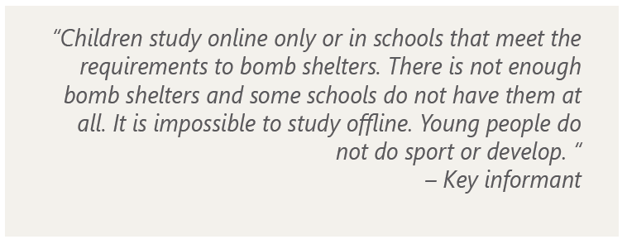
Education
The transition to online learning due to security concerns in Izium has led to deteriorated education quality, communication challenges, and difficulties in social adaptation for students, with only four out of eleven schools operational.
The psychological and emotional well-being of students has declined due to the educational disruptions and the absence of safe study environments, notably the lack of bomb shelters in schools.
Access to education is hindered by a lack of essential resources, including school materials and reliable internet access

Slide 23
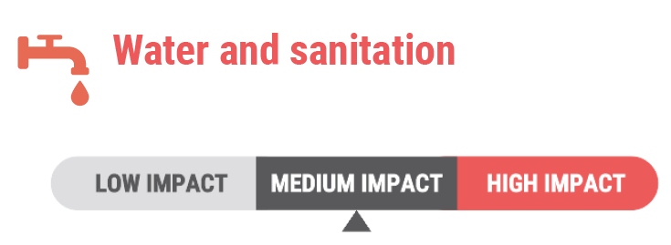
Water and Sanitation
Repairs to Izium's water supply infrastructure and the use of borehole water have addressed initial challenges caused by hostilities, with residents and key informants reporting no current problems with water access.
Despite these improvements, concerns remain about the time-consuming water collection process, poor water quality, and potential health risks, particularly during the winter period.

Slide 24
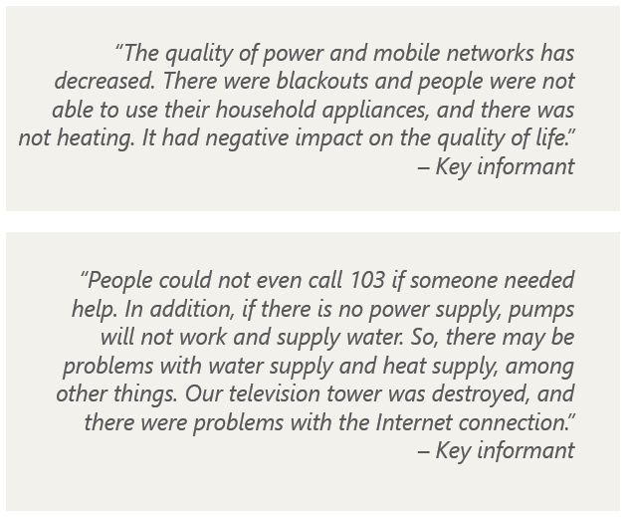
Power and Communication Networks
Residents and key informants in Izium report the effective restoration of power supply, however concerns about grid reliability and potential blackouts during winter persist, threatening access to essential services.
Communication networks have been largely reinstated, but full restoration of the mobile network remains challenging, leading to intermittent service.

Slide 25
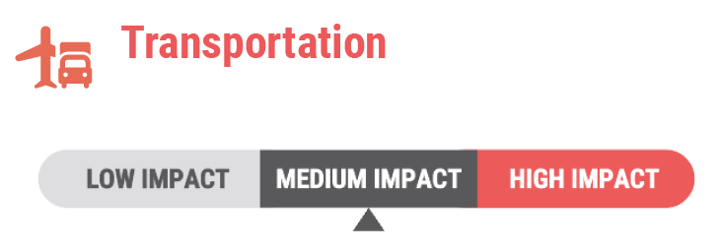
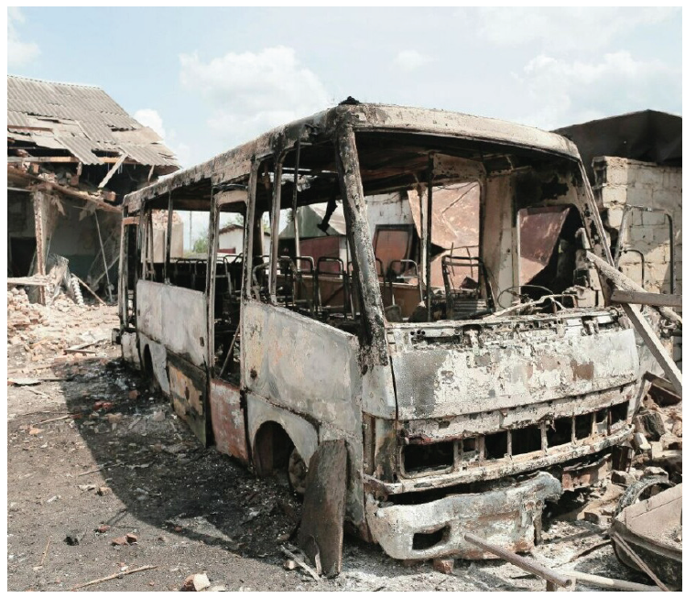
Transport
Key informants highlight logistical challenges in transportation due to damaged infrastructure and public transport scarcity, while community feedback on current transportation issues is mixed, with some noting improvements.
Transportation difficulties lead to significant challenges, including hindered access to food and medicine, psychological stress, and financial constraints, disproportionately affecting vulnerable groups.
The impact of the drone attack on transportation infrastructure on May 26th, 2023.

Slide 26
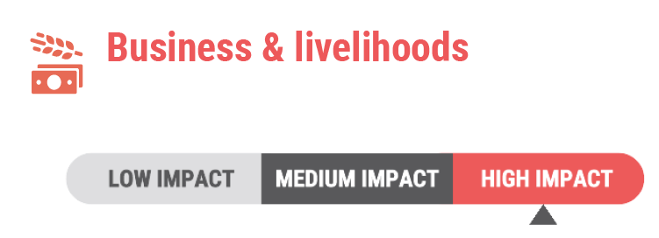
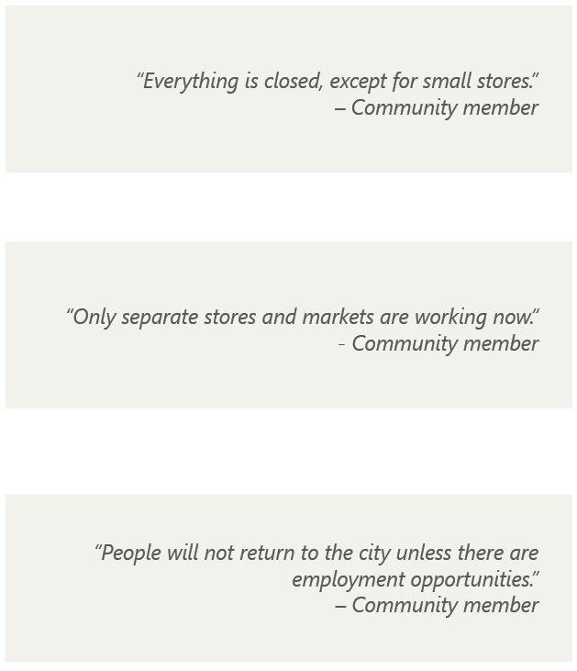
Business and livelihoods
Damaged infrastructure in Izium has severely impacted the economy, particularly the industrial sector, leading to significant job losses and affecting small businesses and the service sector, thereby increasing unemployment and reducing the workforce.
Mined territories and the reluctance of displaced people to return compound the economic challenges, hindering efforts towards recovery and rebuilding the city's economic base.
Despite these challenges, there are signs of economic recovery in certain sectors, particularly in commerce and public institution.

Slide 27
Damage impact analysis
Systemic factors reported as affecting recovery
Cost of repairs being covered individually
Shortage of housing stock
Shortage of construction materials and technicians
Jobs shortage and sense of insecurity
Community priorities for recovery and reconstruction
Critical repairs to minimally-damaged structures
Demographic-based approach
Creating employment opportunities
Rebuilding utilities infrastructure

Slide 28
Thank you for your attention
antoine.chandonnet@impact-initiatives.org
Notes:
Put back the w

