Slide 1
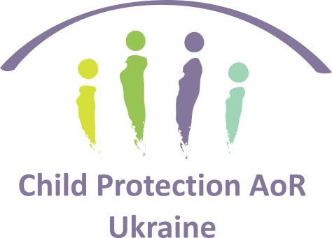
Child Protection Assessment Key findings
Resilience & Early Recovery Unit
June 2024

Slide 2
Contents
01
Objectives and research questions
02
Methodology
03
Key findings
04
Feedback and questions

Slide 3
Objectives and research questions
01

Slide 4
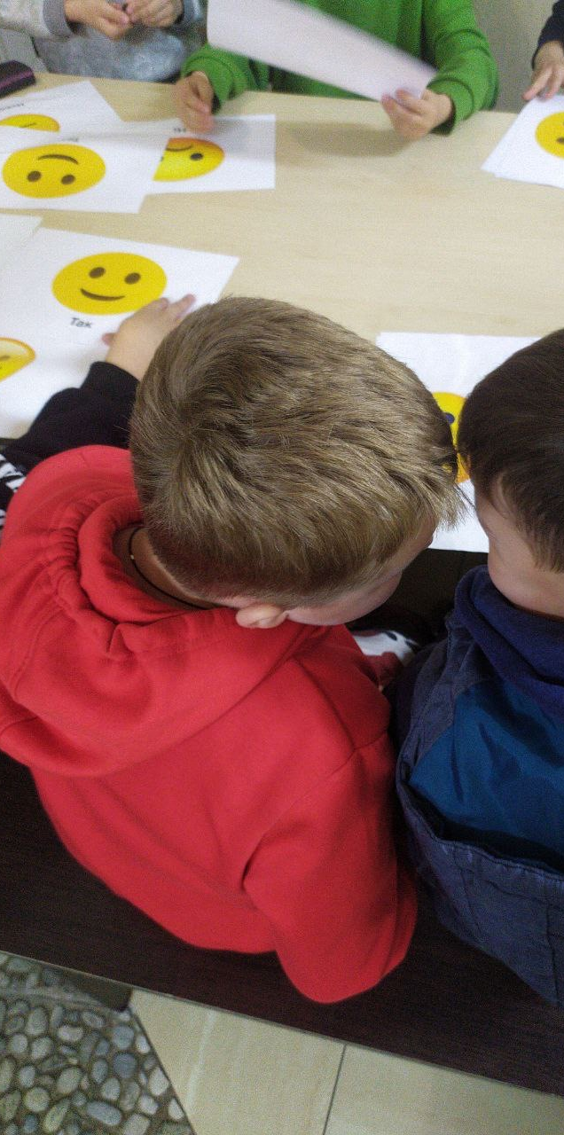
Context
According to the 2024 Humanitarian Needs and Response Plan (HNRP), there are 14.6 million people in need of assistance in Ukraine, of whom 2.9 million (20%) are children.[1]
Children in Ukraine are exposed to a range of protection risks, several of which have been exacerbated by the 2022 escalation of the war in Ukraine.
Between 24 February 2022 and 8 October 2023, OHCHR recorded 27,768 civilian casualties as a result of the large-scale armed invasion by the Russian Federation, including 1,756 children (560 killed and 1,196 injured).[2]
Protection risks are higher for children in frontline areas and along the Russian border, including Kharkivska, Luhanska, Donetska, Zaporizka, Khersonska, Sumska, and Mykolaivska.[3]

Slide 5
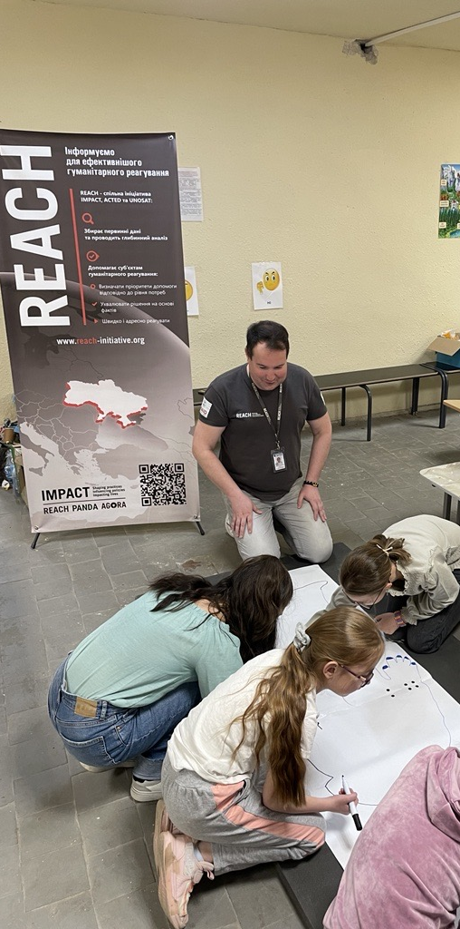
General objective
To inform evidence-based strategic planning among child protection actors through the provision of up-to-date, relevant, and comparable information on the child protection risks, vulnerabilities, needs and access to protection services of children, adolescents and their parents in South-Eastern Ukraine.

Slide 6
Research questions
Which child protection risks and concerns do communities consider to be the most significant, and what are the drivers of these risks?
What are the main risk factors and most vulnerable groups?
What are the main protective factors?
To what relevant protection services do children and families have access, what are the barriers to access, and which service gaps exist?
To what extent are children and families likely to seek support/trust these protection services?
To what extent do the child protection services coordinate with each other at local and/or national level?
To what extent do communities tolerate, condemn, and cope with violence and abuse against children?
To what extent do communities know about and use reporting mechanisms or existing resources for child protection issues?
Where relevant, how do these issues differ across children’s demographic groups?
How do these issues differ across age and gender groups?
How do these issues differ across particularly vulnerable groups of children?
How does the need for and access to services vary across different geographic areas?
Across different oblasts?
Across rural vs. Urban areas?
Notes:
The objectives of this assessment are to:
Conduct a nationwide, comprehensive analysis of child protection risks and concerns in Ukraine
Update statistical and qualitative data to support the HNO and HRP process
And identify differences in needs and services across demographics and geographic areas

Slide 7
Methodology
02

Slide 8
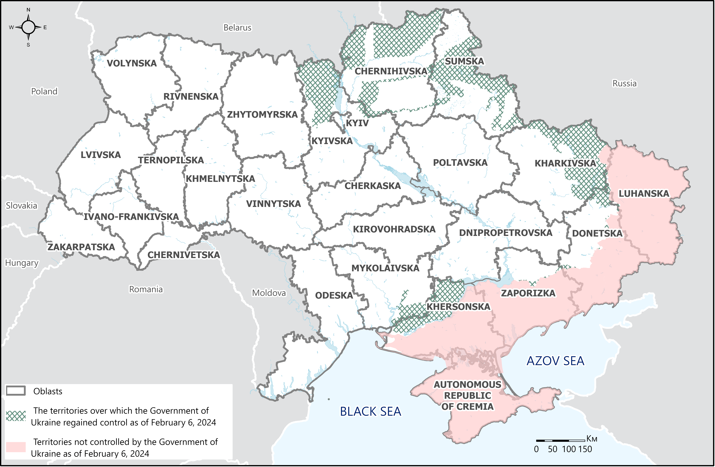
Scope of the assessment: South-Eastern Ukraine
Population of Interest:
Ukrainian children living in de-occupied oblasts and oblasts in proximity to the frontline, incl. IDPs, and children living in rural/urban areas
Geographical scope:
Oblasts: Dnipropetrovska, Donetska, Kharkivska, Khersonska, Mykolaivska, Sumska, Zaporizka

Slide 9
Methods applied
 | Household survey | Key Informant Interviews | Focus Group Discussions
Type | Quantitative | Qualitative | Qualitative
Respondents | Adult members of households with children | Representatives of public/NGO/private service providers: Healthcare, Education, Social and legal services | Children aged 8-17 y.o.
Quantity | 2917 | 105 | 24
Representa tiveness | 95% confidence level, 5% margin of error at oblast level (indicative for Donetska); Probability cluster sampling | Indicative | Indicative
Geo. scope | Dnipropetrovska, Donetska, Kharkivska, Khersonska, Mykolaivska, Sumska, Zaporizka | Dnipropetrovska, Donetska, Kharkivska, Khersonska, Mykolaivska, Sumska, Zaporizka | Dnipropetrovska, Kharkivska, Mykolaivska, Sumska
Data was collected between April-May 2024.

Slide 10
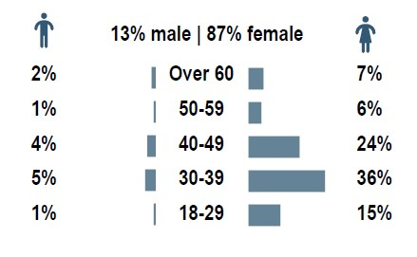
Sampling: Quantitative survey
Results of the household survey represent perceptions of adult members of the households with children: 85% of respondents were parents of children in their household, 14% were grandparents and 1% other relatives.
Overall, 20% of interviewed households were located in rural areas and 80% in urban.
32% of the households were internally displaced.

Slide 11
Challenges & Limitations
Chosen methodology allowed to gather overall perceptions of the most significant risks to children, rather than statistical data on the prevalence of existing child protection risks. Collecting such statistics at the household level would be highly challenging, due to sensitive nature of the topics discussed.
To avoid putting children under distress, children in the FGDs were not interviewed about experienced or perceived risks. Instead, the FGDs covered children’s activities and safety networks, bringing insight on their potential risk and protection factors.
Sensitive nature of the topics discussed poses the risk of respondent bias, as participants may be inclined to present themselves or their community in a more favourable light (this concerns in particular the topics of reporting risks and practices/attitudes).
Due to security considerations some settlements previously identified for data collection had to be replaced, which introduces a minor effect on the randomness of the sample.
Any comparisons of answers' prevalence between strata are indicative only.

Slide 12
Key findings
03

Slide 13
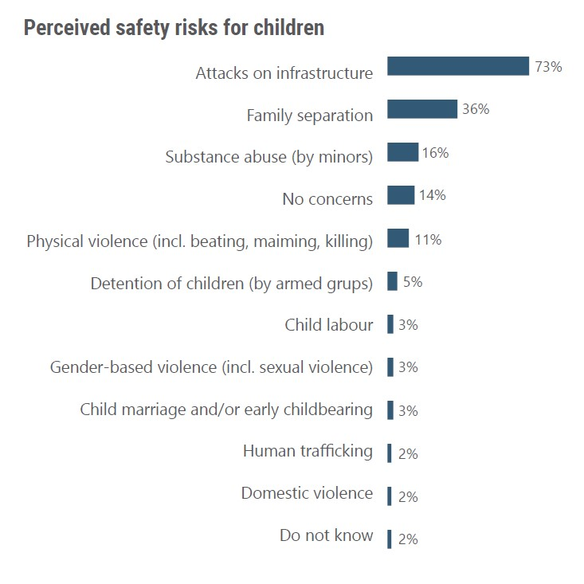
Perception of the main risks to children's safety
Overall, 86% of respondents expressed safety concerns for children, most commonly attacks on infrastructure, i.e., bombing/shelling. Concerns for safety were greater in urban (88%), than rural areas (79%). Most respondents noted that risks significantly increased since the beginning of full-scale invasion.
The lowest share of perceived risks manifested in Donetska oblast (40%), although it must be noted that respondents in Donetska largely did not want to discuss such issues out of concerns for their own safety.
Overall, many indicated that their children felt unsafe everywhere (45%) or outdoors (18%), while about 28% did not indicate any places where children felt particularly unsafe.
Surveyed IDPs noted similar risks and their scale as non-IDPs but were more likely to report that children felt unsafe everywhere (51% against 42% among non-IDPs).

Slide 14
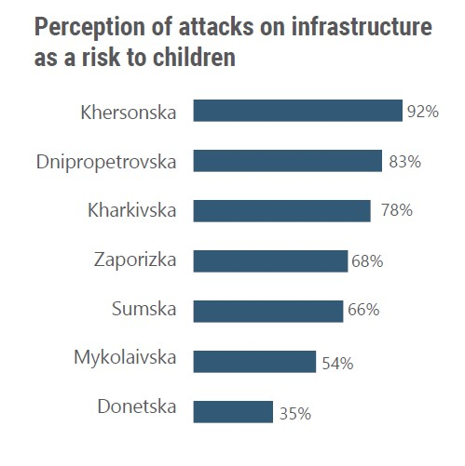
Bombing/shelling
Attacks on infrastructure, including bombing and shelling, were the most frequently mentioned risks across urban (76%) and rural (61%) locations.
The general threat of military hostilities was often mentioned by key informants in Donetska, Khersonska, Sumska, and Zaporizka.
Specific attacks on infrastructure, including educational and healthcare institutions, and resulting limited access to facilities, were also frequently mentioned, particularly in Khersonska and Kharkivska oblasts.
Many key informants noted cases of children injured due to bombing, shelling, and incidents involving explosive objects, most often in Mykolaiv and Zaporizhzhia oblasts.
The attacks and air raid alerts were reportedly causing stress, anxiety, and long-term deterioration of children's psychological state.
Some informants in Donestka, Kharkivska, Mykolaivska, Sumska and Zaporizka noted lack of bomb shelters in premises, mostly at educational institutions, which implied online education.

Slide 15
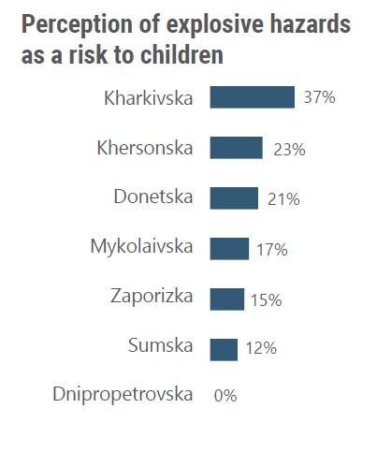
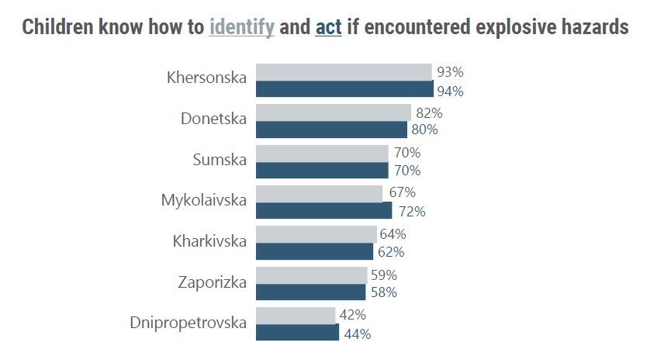
Explosive hazards
15% of respondents (15% urban and 12% rural inhabitants) declared that explosive hazards (e.g., landmines, grenades, unexploded ordinances, bombs) were present in their location. Nonetheless, many respondents did not know whether explosive hazards were present in their location (23%).
Over half of the households (58%) reported that their children knew how to identify explosive ordonnance and knew what to do if they encountered it (59%), with a higher level of awareness manifested in rural areas (about 10 p.p. difference in each case). Awareness campaigns were conducted by education providers and the state.

Slide 16
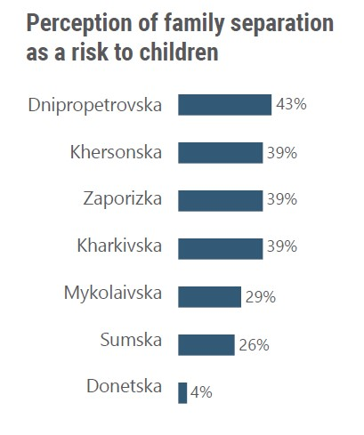
Family separation
Family separation was commonly indicated risk for children’s safety (36%) and indicated as a factor that can increase vulnerability to other risks (30%).
Informants emphasized that good parent-child relationship, attention, and care contribute to children's safety.
3% declared that parents of the children in their household did not reside with them. This was the most frequent in Dnipropetrovska oblast (5%) and did not occur in Donetska. 32% stated that only one parent was residing with children.
2% of adults in the households had children who resided outside of the household, as they mostly left to study, or live in a safer location. Cases of children residing outside of the household were most common in Sumska oblast (4%) and did not occur in Dnipropetrovska.

Slide 17
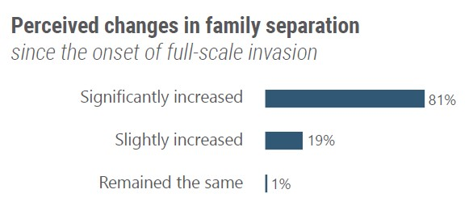
Family separation
Potential risk factors:
Military activity in the location and parents joining the army
Displacement
n=911
“It seems to me that we can separately talk about the greater vulnerability of children from those families who left the occupied territory because they are not at home. And secondly, these are children whose parents are now at the front. (…) That is, families are separated, I mean, not legally, but cannot live together. I think that this affects primarily psychologically, also financially.”
NGO healthcare provider, Zaporizka

Slide 18
Substance abuse
16% recognized substance abuse as a risk for children, slightly more often in urban areas (17% compared to 15% in rural areas).
Informants frequently mentioned substance abuse among children as their coping mechanism or a broader risk.
Substance abuse by family members was recognized as a risk factor to children.
Some children aged 15-17y.o. confirmed substance abuse by children and other members of the family. Children asserted, that alcohol and cigarettes were sometimes sold to children at local shops, while drugs were sold online.

Slide 19
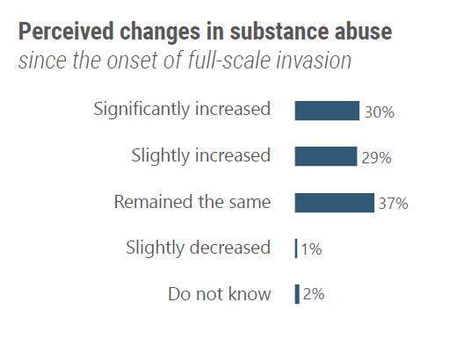
Substance abuse
Potential risk factors:
Military activity in the location
Mental health issues and psychosocial distress
Lack of leisure opportunities
n=411
“Here, at the level of mental health, everything is very difficult. Even though alcohol is banned, it's still sold under the counter. And teenagers mostly relax in this way. On the other hand, a lot of things are closed, and there is no access to normal recreation.”
Public healthcare provider, Donetska

Slide 20
Physical violence
The risk of physical violence toward children, including beating, maiming and killing (but excluding domestic violence) was indicated by 11% of respondents. It was more often mentioned by those in urban (12%) than rural (6%) areas.
Some children highlighted the dangers posed by strangers on the streets, including verbal aggression directed at them or others, and encounters with individuals under the influence of substances.
Additionally, bullying and violence among children were noted, although anti-bullying campaigns were reportedly conducted at many schools.

Slide 21
Physical violence
Reported risk factors:
Military activity in the location and proliferation of weapons
Displacement
n=293
“Violence as such has increased, that is, war and military conflict, this is already about death, this is already about violence, physical, sexual, and psychological (…). That is, before the war, these risks were smaller. Now it is violence, aggression, fear of death, the person feels unprotected, others use this power over people who are weaker, stronger, that is, this moment will worsen. There are also cases when, for example, weapons appear in everyday life among ordinary citizens. And there was no such access to weapons before.
NGO legal/social aid provider, Zaporizka

Slide 22
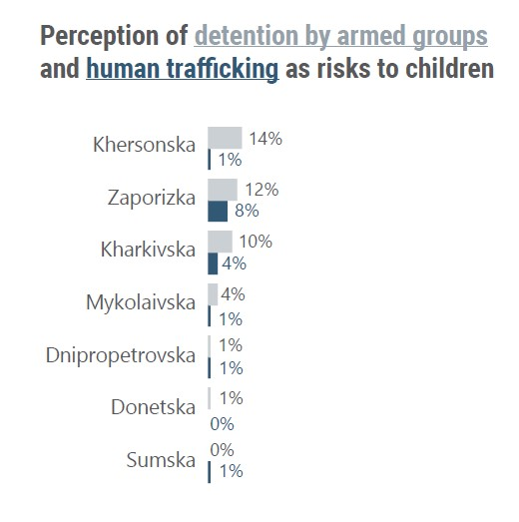
Human trafficking, transfer and detention
Overall, only 2% of the household survey respondents perceived human trafficking as a risk to children, with marginal differences between rural (3%) and urban areas (2%). Similarly, most informants across all oblasts had not heard of human trafficking in their locations.
Detention by armed groups was perceived as a risk to children by slightly more respondents (5%), more often in rural (9%) than urban (4%) areas.
A few informants in Kharkivska, Khersonska and Zaporizka noted cases of harassment, detention, torture and forced transfer of Ukrainian children to occupied territories or other undisclosed locations by Russian military personnel.

Slide 23
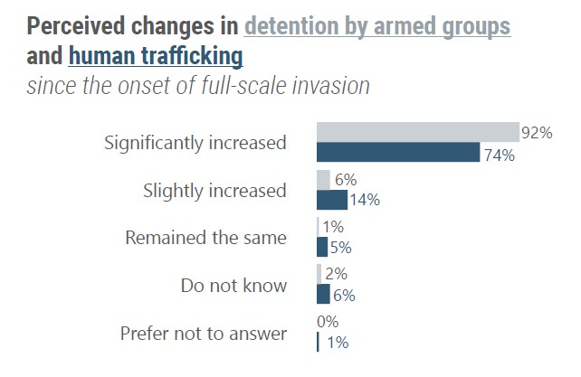
Human trafficking, transfer and detention
Reported risk factors:
Military activity in the location
Unstable psychosocial conditions of people in the location
Worsening financial situation of the households
Limited supervision of children (incl. due to online schooling)
Insufficient access to social services
Detention, n=176; Human trafficking, n=61
“Last year, we had several cases, social service workers worked out these cases when children were taken to Crimea without consent for rehabilitation, and then not returned, and even one of these cases was proven and established as human trafficking.”
Public legal/social aid provider, Khersonska

Slide 24
Child labour
Only 3% of household survey respondents considered child labour as a risk, slightly more often in urban (4%) than rural (2%) areas.
Among respondents who could not fully meet their financial needs, one of the most common coping strategies was having children aged 16-17 y.o. participate in income-generating activities (22%, n=419), while 2% sent children aged less than 16y.o. to work (n=2754).
Overall, 14% agreed that a child should take up employment if needed to support family's finances, with the attitude being slightly more common across rural areas (15% against 13% in urban areas). Children aged 15-17 y.o. frequently stated that they would seek employment if their family struggled financially.
Several older children and key informants mentioned children performing not severe income-generating activities to cover their own expenses.
Some reported exploitation of children, begging or hard physical labour.

Slide 25
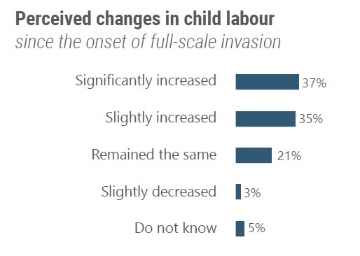
Child labour
Reported risk factors:
Military activity in the location
Worsening financial situation of the households
Displacement and family separation
n=69
“When the war started, many minor children went to work. I don't know how it was with or without registration, but the children went to earn money. These are mostly normal children from well-to-do families. Just to help parents.”
Public education provider, Donetska

Slide 26
Gender-Based Violence (GBV), child marriage and early childbearing
GBV (including sexual violence) and child marriage or early childbearing were only indicated as significant risks to children by 3% respectively. Differences between rural and urban areas were marginal.
Few informants noted isolated cases of GBV, while child marriage was mentioned by one in Kherson.
Most informants reported that the attitude towards boys and girls was similar and that there was no gender discrimination. However, they occasionally revealed unintentional gender biases in their descriptions of attitudes toward boys and girls.
Some reported gender discrimination and violence against girls.

Slide 27
GBV, child marriage and early childbearing
Some informants noted imposition of gender stereotypes, and disproportionate distribution of household chores, although some emphasized a shift in perceptions of gender roles.
Children's perceptions of gender discrepancies in decision-making varied. Some stated that there were no differences in how boys and girls were treated, while others noted disparities.
“My brother is younger, but he's allowed more than me. They don't control my brother when he comes home, but they call me every half hour."
Girl aged 15-17y.o., Sumska
“I think some parents have the idea that boys aren't as sensitive. Boys are afraid to show their emotions to their parents, and girls have more restrictions.”
Girl aged 12-14y.o., Dnipropetrovska
GBV, n=791; Child marriage, n=81
“Yes, we have heard about cases of gender discrimination that occurred in our locality. These incidents are often associated with attempts at violence."
NGO healthcare provider, Dnipropetrovska

Slide 28
Domestic violence and neglect
Only 2% considered domestic violence as a significant risk to children in their location, slightly more often across urban locations (3%, compared to 1% in rural areas).
Informants frequently mentioned presence of domestic violence cases, including psychological abuse and witnessing violence. Cases were reported in urban and rural areas, most often in Dnipropetrovska and Kharkivska.
Informants emphasized the difficulty of investigating domestic violence cases due to lack of cooperation of some suspects and witnesses.
6% of the household survey respondents rather agreed that physical punishment can be used by the family members to educate or bring up a child.
Tolerance for physical punishment within the family was higher than use of such methods by another person of authority (e.g., a teacher), tolerated by 1%.

Slide 29
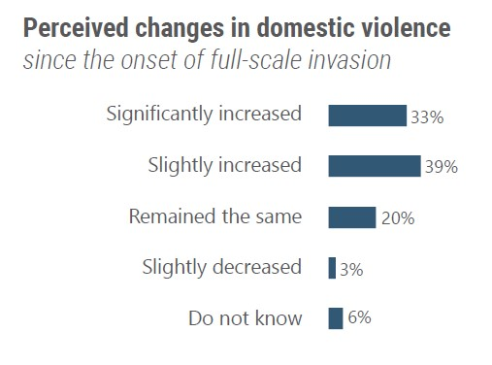
Domestic violence and neglect
Reported risk factors:
Military activity in the location
Worsening financial situation of the households
Mental health issues and psychosocial distress among adult household members
Substance abuse among household members
Limited supervision of children (incl. due to online schooling)
n=61
“Since the start of the full-scale invasion, cases of domestic violence have increased and are deeper and longer lasting. That is, if a child suffered from domestic violence before the full-scale invasion, now people's condition has deteriorated more and has become more unstable, due to stress, stress, and poor economic situation.“
NGO healthcare provider, Dnipropetrovska

Slide 30
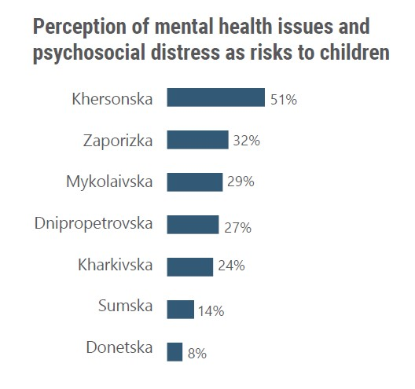
Mental health issues and psychosocial distress
25% identified mental health issues and psychosocial distress as a risk to children. 68% noted children worrying about the future, 28% believed that children were at risk of limited socialization, and 26% indicated children missing and worrying about displaced family/friends.
Overall, 84% identified any of the above issues related to mental or psychosocial wellbeing as risks to children in their location.
Informants often noted distress among children, frequently in relation to the bombing and other attacks, social isolation and psychosocial issues of adult household members.
Several informants noted children’s psychological issues (mental disorders and general deterioration of psychological state), loss of family members, and other traumatic experiences as factors increasing their vulnerability to other risks.

Slide 31
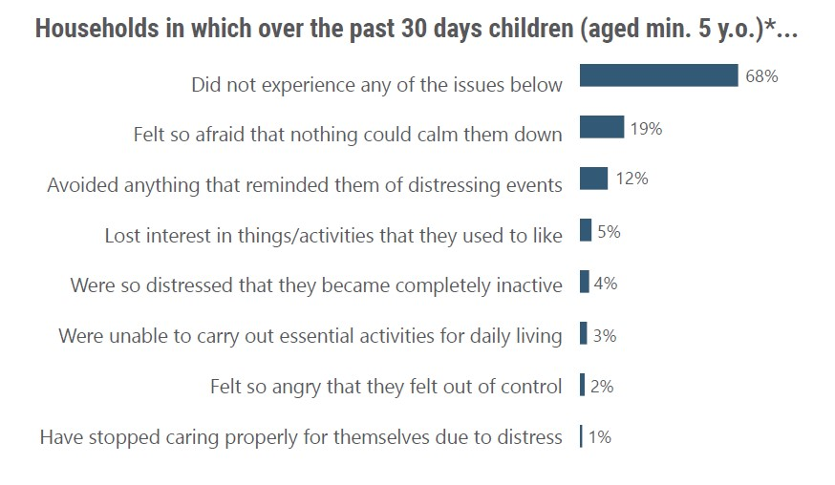
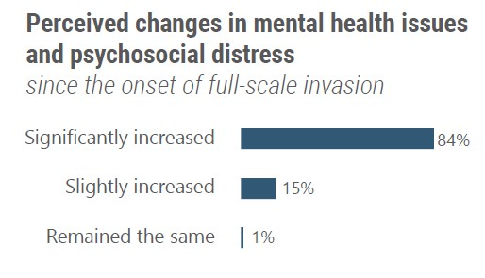
Mental health issues and psychosocial distress
32% of respondents noted that children in their household (aged min. 5 y.o.) exhibited signs of psychosocial distress. The highest rate of psychosocial distress was observed among children in Mykolaivska (45%) and Khersonska (42%).
Overall, the declared rate was slightly higher in urban (33%) than rural (27%) areas.
*n=2384
n=753

Slide 32
Access to child protection services
Barriers and gaps
Shortage of staff, including qualified specialists
Shortage of MHPSS services
Shortage of foster/guardian families or other premises for children without parental care or removed from families
Physical barriers, incl. long distance to the facility
Safety concerns at the facilities or when travelling there
Lack of information or awareness of CP services
Prolonged waiting time or long response time of CP actors
Cultural barriers, fear judgement, shame
High costs of services or limited range of services available for free
Bureaucracy
Among available child protection (CP) services, informants most frequently mentioned the Service for Children (Cлужбa у справах дітей), social services, mental health and psychosocial support (MHPSS), legal aid and law enforcement.
Informants often assessed availability and quality of CP services as satisfactory. Many indicated higher availability and a wider range of services in urban areas.
Nearly all respondents who sought access to social services, MHPSS, legal assistance or police succeeded. Most were satisfied with service provision, although they noted some barriers.
Accessed social services and MHPSS were most often provided by public institutions and international organisations, while legal assistance – by private entities.

Slide 33
CP response and coordination
Most informants reported that local CP response was in line with the national policy, although a few mentioned limited ability to fulfill national plans.
Many emphasized that CP services were collaborating with each other, as well as with service providers (including healthcare and education providers). Additionally, cooperation between governmental and non-governmental actors was noted.
Informants, including representatives of healthcare and education institutions, declared that they would report child abuse or other risks to relevant CP services or to the police.
Many, particularly education providers, reported conducting preventive checks and monitoring potential CP risks. They communicated with parents and children, highlighting their crucial role in ensuring children's safety from the outset. Some noted that this role was hindered by transition to online schooling.

Slide 34
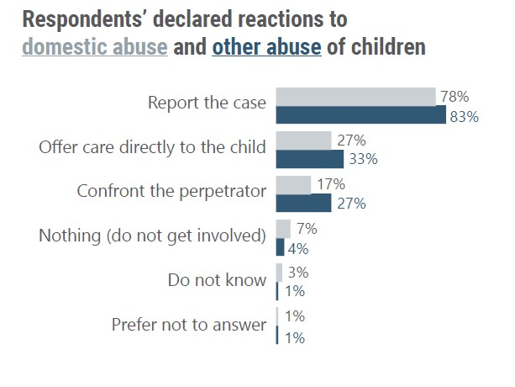
Communities' reaction to child abuse
The majority of respondents across all oblasts indicated that they would report domestic (78%) and other (83%) child abuse. There were no differences in reporting across urban and rural areas.
The highest share of respondents who would not react to a CP incident was in Dnipropetrovska and Kharkivska.
Most informants believed that members of their community would report child abuse and rather trusted that reporting would improve child's situation.
Some noted that community members would not report CP incidents due to lack of trust, concern of worsening the child's situation, or taking measures themselves.

Slide 35
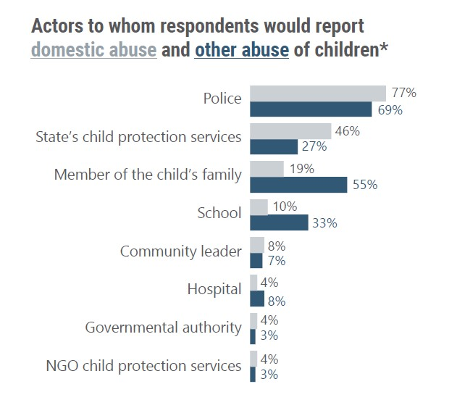
Reporting child abuse by communites
Declared reporting risks to the police and child protection services was more common across urban areas, while reporting to service providers or community leaders was more frequent across rural areas.
About a quarter of respondents fully trusted that reporting child abuse to the actor they mentioned would improve child's situation, while about a tenth were skeptical (rather didn't trust or didn't trust at all).
The highest share of respondents believed that children themselves could report cases to the police (50%), member of their family (44%) or school (35%).
*Out of those who declared that they would report child abuse (n=2513).

Slide 36
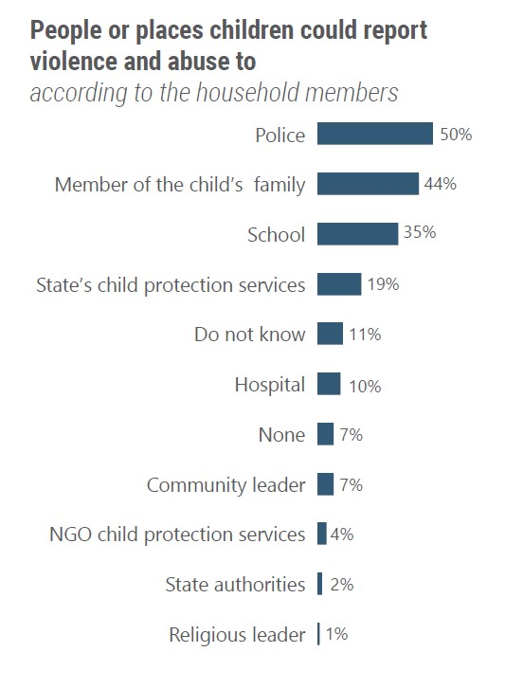
Child reporting and safety networks
Children mostly reported that they had someone they could trust with their issues and problems, indicating an overall good level of safety networks.
Entrusted persons were most frequently parents, friends and siblings.
Among younger groups*, children mostly reported having someone who made them feel safe. Some, particularly younger boys, indicated that they did not have such a person.
Most commonly those who made children feel safe included parents, friends, and siblings, with some children pointing to authority figures such as teachers and police officers.
Children mostly emphasized the importance of emotional support over technical solutions, emphasizing importance of emotional support, communication, and advice.
Children often noted that they would try to solve their problems on their own, before seeking help from adults.
*The oldest groups were not explicitly asked this question.

Slide 37
Child emancipation
Children most often reported that their caregivers took their opinions into account and discussed matters of daily life, family and community with them. Some mentioned that parents did not always consider their opinions. Most children stated that they could make at least some decisions concerning their own lives - this sentiment was slightly less common among the oldest girls.
Most respondents agreed that a child should be allowed to make their own decisions:
82% agreed* that a child should be able to make decisions about how they wish to spend their free time.
62% declared* that if a child cannot live with their primary caregivers, the child should be allowed to decide where (with whom) they want to live, an attitude more common across rural areas (66%).
51% reported* that a child should be able to make decisions concerning their education.
51% agreed* that a child should be able to make decisions about their physical and mental healthcare. This attitude was more common in rural areas (55%).
*Includes those who chose answers "Rather agree" and "Strongly agree".

Slide 38
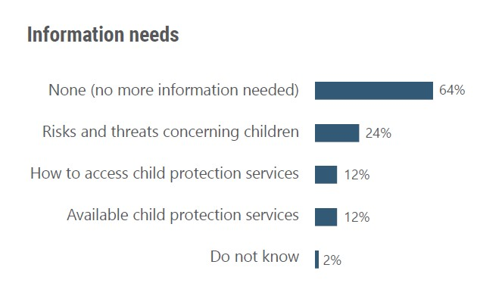
Information access and awareness
34% households indicated that they would like to receive more information concerning child protection. The need for additional information was particularly common in Khersonska (50%), Kharkivska (43%) and Zaporizka (42%) oblasts.
The majority of those who wished to receive additional information (n=950) would like to obtain it via social media (66%), followed by leaflets or booklets (30%), websites (29%), hotlines or phone calls (28%).
Satisfactory community awareness of child protection risks and rights was often reported by informants, although several stated that community awareness was insufficient and additional campaigns on child protection were needed. Most indicated satisfactory child awareness of rights.
Informants reported numerous CP awareness campaigns, mostly conducted by public institutions, including schools, and NGOs.

Slide 39
Conclusion
Most (84%) households noted at least one safety concern for children in their location, including risks directly and indirectly related to war, e.g., bombing and shelling (73%), family separation (36%), and substance abuse by children (16%). 25% identified mental health issues as a risk to children. 15% reported presence of explosive hazards in their location, while over half declared that children did not know how to identify or act if found an explosive hazard.
Most stated that risks significantly increased since the beginning of full-scale invasion. Concerns for safety were slightly higher among urban than rural areas.
Many risks and risk factors are intertwined. Frequently mentioned risk factors included armed conflict, household’s financial difficulty, family separation and displacement, children's and parents’ mental health problems, or limited supervision of children due to online schooling.
Overall, availability and quality of CP services was reportedly satisfactory, although some gaps and barriers remained (incl. shortage of staff, physical, operational and financial barriers). CP services cooperated with each other, as well as healthcare and education providers, who were involved in CP response at various stages (incl. prevention, monitoring, reporting and providing support to victims).
Most households stated that they would report domestic (78%) or other child abuse (83%), predominantly to the police, CP services or child's family. Reasons for not reporting included limited trust in CP services, reluctance to get involved in others' issues, or concern about removal of the child from the family.
Households demonstrated a relatively high recognition of child autonomy and a low tolerance for behaviours that could endanger children.
Satisfactory community awareness of child protection risks and rights was often reported by informants, highlighting numerous child protection awareness campaigns. However, about a third of the households (34%) needed additional information, including present risks, available CP services and ways to access them.

Slide 40
Feedback & Questions
04

Slide 41
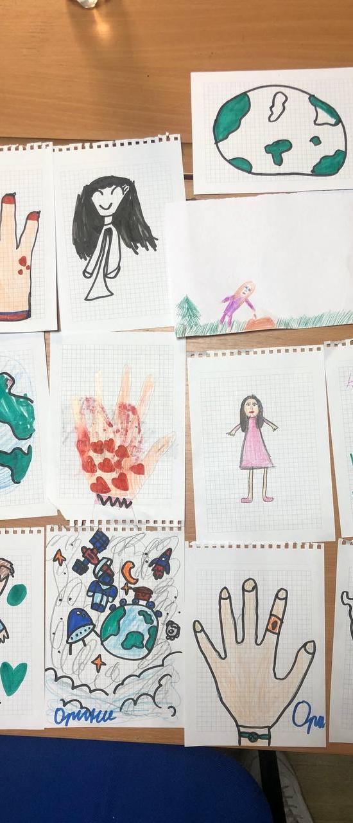
Feedback & Questions
Questions?
Final report will be disseminated in July.

Slide 42
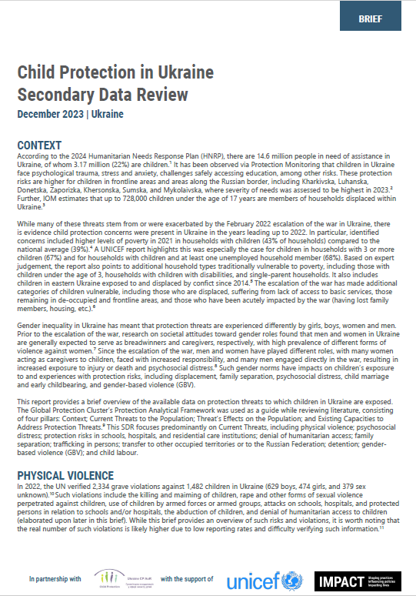
Bibliography
[1] OCHA, “Humanitarian Needs and Response Plan, Ukraine”, December 2023, https://reliefweb.int/report/ukraine/ukraine-humanitarian-needs-and-response-plan-2024-december-2023-enuk
[2] OHCR, “Ukraine: Civilian casualties”, October 2023, https://ukraine.un.org/en/248799-ukraine-civilian-casualties-8-october-2023
[3] OCHA, “Humanitarian Needs Overview Ukraine 2023,” December 2022, https://reliefweb.int/report/ukraine/ukraine-humanitarian-needs-overview-2023-december-2022-enuk
[4] United Nations Secretary-General, “Children and Armed Conflict: Report of the Secretary-General (A/77/895-S/2023/363)” (United Nations, June 2023), https://reliefweb.int/report/afghanistan/children-and-armed-conflict-report-secretary-general-a77895-s2023363-enarruzh.
[5] “War in Ukraine Pushes Generation of Children to the Brink, Warns UNICEF,” accessed November 9, 2023, https://www.unicef.org/press-releases/ war-ukraine-pushes-generation-children-brink-warns-unicef; Nadine Haddad, Phiona Koyiet, and Kate Shaw, “No Peace of Mind: The Looming Mental Health Crisis for the Children of Ukraine” (World Vision, 2022), https://www.wvi.org/sites/default/files/2022-07/No%20Peace%20of%20Mind.pdf.
[6] Ratings Group & Ukraine Children’s Action Project, “Problems of Ukrainian Children in Conditions Of War (January 27 - February 1, 2023)”, https://ratinggroup.ua/en/research/ukraine/problems_of_ukrainian_children_in_conditions_of_war_january_27-february_1_2023.html
[7] OCHA, “Humanitarian Needs Overview Ukraine 2023.”
[8] OHCHR, “Report on the Human Rights Situation in Ukraine 1 August 2022 - 31 January 2023,” March 2023, https://www.ohchr.org/en/documents/country-reports/report-human-rights-situation-ukraine-1-august-2022-31-january-2023
[9] REACH, “Multi-Sector Needs Assessment 2023: Child Protection Findings.”, October 2023, https://reach-info.org/ukr/msna/2023/
[10] UNICEF, “UNICEF Data Country Profiles: Ukraine,” UNICEF DATA, accessed November 24, 2023, https://data.unicef.org/country/ukr/.
[11] UNFPA Ukraine, “UNFPA Ukraine Data Overview,” accessed November 24, 2023, https://www.unfpa.org/data/UA
[12] Human Rights Watch, “‘We Must Provide a Family, Not Rebuild Orphanages’: The Consequences of Russia’s Invasion of Ukraine for Children in Ukrainian Residential Instutuions.” https://www.hrw.org/report/2023/03/13/we-must-provide-family-not-rebuild-orphanages/consequences-russias-invasion
[13] World Vision, “Child Protection Multisectoral Needs Assessment - Ukraine 2023,” 2023, https://www.wvi.org/publications/research/ukraine/child-protection-multisectoral-needs-assessment-ukraine-2023
[14] U.S. BILA, "Findings on the Worst Forms of Child Labor – Ukraine", 2020, https://www.dol.gov/sites/dolgov/files/ILAB/child_labor_reports/tda2020/ukraine.pdf
[15] Ministry of Education of Ukraine, “Education Under Threat,” Освіта під загрозою, accessed November 10, 2023, https://saveschools.in.ua/
[16] ACAPS, “Ukraine Quarterly Humanitarian Access Update,” November 8, 2023, https://www.acaps.org/fileadmin/Data_Product/Main_ media/20231101_ACAPS_Thematic_Report_Ukraine_Humanitarian_access_Q3.pdf.
[17] United Nations Secretary-General, “Children and Armed Conflict: Report of the Secretary-General (A/77/895-S/2023/363)”. https://reliefweb.int/report/afghanistan/children-and-armed-conflict-report-secretary-general-a77895-s2023363-enarruzh
[18] IOM, “Trafficking in Persons: IOM Ukraine Caseload (January - September 2023),” 2023, https://ukraine.iom.int/sites/g/files/tmzbdl1861/files/ documents/2023-11/trafficking_in_persons_january-september_2023-eng.pdf.
[19] OHCHR, “Report on the Human Rights Situation in Ukraine 1 February - 31 July 2023.” https://www.ohchr.org/sites/default/files/documents/hrbodies/hrcouncil/coiukraine/23-10-04-OHCHR-36th-periodic-report-ukraine-en.pdf
[20] OHCHR, “Detention of Civilians in the Context of the Armed Attack by the Russian Federation Against Ukraine 24 February 2022 - 23 May 2023,” June 2023, https://ukraine.un.org/sites/default/files/2023-06/OHCHR%20Ukraine%20Detention%20report%20-%20June%202023%20-%20ENG.pdf
Link to the Secondary Data Review:
https://repository.impact-initiatives.org/document/reach/ead5fc5e/SDR_UNICEF_Dec4.pdf

Slide 43
Thank you for your attention
Mariia Dubyk, Assessment Officer mariia.dubyk@reach-initiative.org
Joanna Jaworska, Senior Assessment Officer joanna.jaworska@impact-initiatives.org
Brett Schmicking, Research Manager brett.schmicking@impact-initiatives.org

