Slide 1
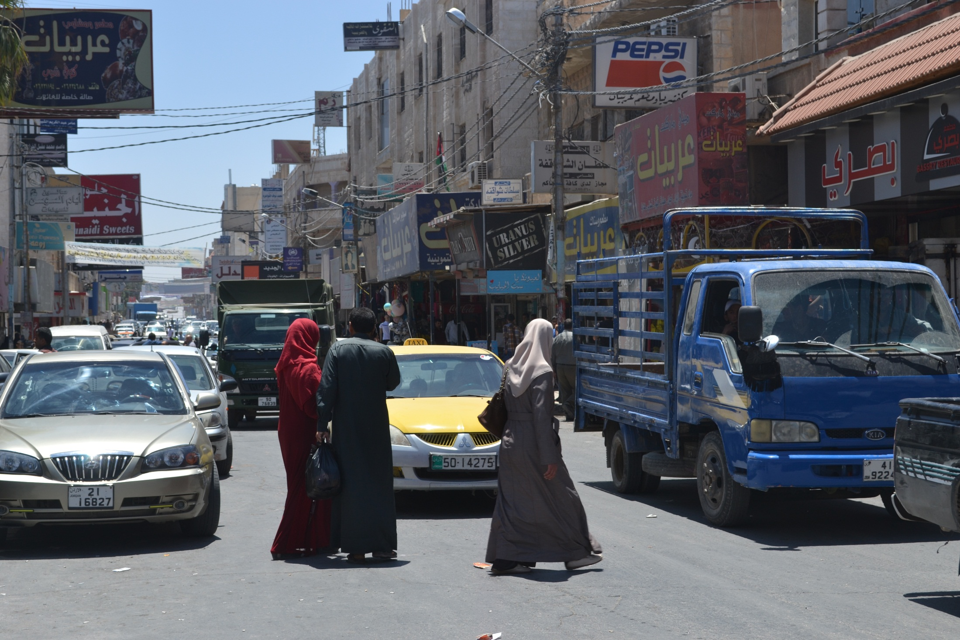
ECHO Protection Consortium
Endline Assessment – Preliminary findings
December 2018

Slide 2
Contents
Assessment Background: Objectives and Context
Methodology
Preliminary key findings
Documentation
Feeling of safety and dignity
CSI and debt
Cash beneficiaries
Satisfaction with project
Summary of preliminary findings
Questions

Slide 3
Objectives
Endline assessment follows the baseline conducted in November 2017 in order to assess the effectiveness of the intervention
Inform evidence-based programming decisions
Measure two key indicators:
SO.2 - % of Syrian refugees who have obtained civil or legal documentation reporting an improved feeling of safety and dignity by the end of the intervention compared to baseline (target: 60%)
4.2 - The average Coping Strategies Index (CSI) score for the target population improves following the 6 months RCA

Slide 4
Context – Theory of Change
Outcome
Impact
Outputs
Information Provision
Individuals are better informed about their legal and civil documentation needs and the processes to obtain them
Refugees are able to obtain their civil and legal documentation
The protection of displacement-affected populations living in host communities in Jordan is improved
Cash for Documentation
Individuals receive cash to meet the associated cost of acquiring documentation
Refugee families are better able to meet their basic and protection-related needs
Regular Cash Assistance
The monthly income of families with critical documentation issues is increased

Slide 5
Methodology
Quantitative household-level (‘family’) survey – Longitudinal methodology
Baseline: 1,001 surveys with HHs missing at least one piece of documentation. Shadowing of partners as initial CAT survey was conducted with potential beneficiaries, between 12th November – 21st December.
Endline: 773 of the 1,001 baseline households surveyed, 668 of which declared receiving assistance.
+ Extra sample of 348 cash beneficiaries added for research questions on cash transfer use and modalities.
Qualitative FGDs
28 in total
Focus on documentation obtained in the last 12 months, experience with RSP, Health Policy change, and cash modalities.

Slide 6
Household surveys completed
Number of surveys per governorate, per partner
 | DRC | ICMC | INTERSOS | Mercy Corps | PUI | Total
Amman | 193 | 7 | 77 | 0 | 46 | 323
Mafraq | 5 | 143 | 0 | 136 | 3 | 287
Irbid | 4 | 2 | 56 | 160 | 1 | 223
Zarqa | 5 | 5 | 1 | 4 | 36 | 51
Ma'an | 52 | 0 | 1 | 0 | 1 | 54
Madaba | 2 | 0 | 4 | 1 | 41 | 48
Karak | 0 | 0 | 31 | 0 | 0 | 31
Balqa | 0 | 0 | 0 | 0 | 31 | 31
Jerash | 1 | 15 | 0 | 4 | 0 | 20
Aqaba | 26 | 0 | 0 | 1 | 0 | 27
Ajloun | 1 | 18 | 0 | 0 | 0 | 19
Tafileh | 1 | 0 | 6 | 0 | 0 | 7
Total | 290 | 190 | 176 | 306 | 159 | 1121

Slide 7
Assistance received by Endline sample

Slide 8
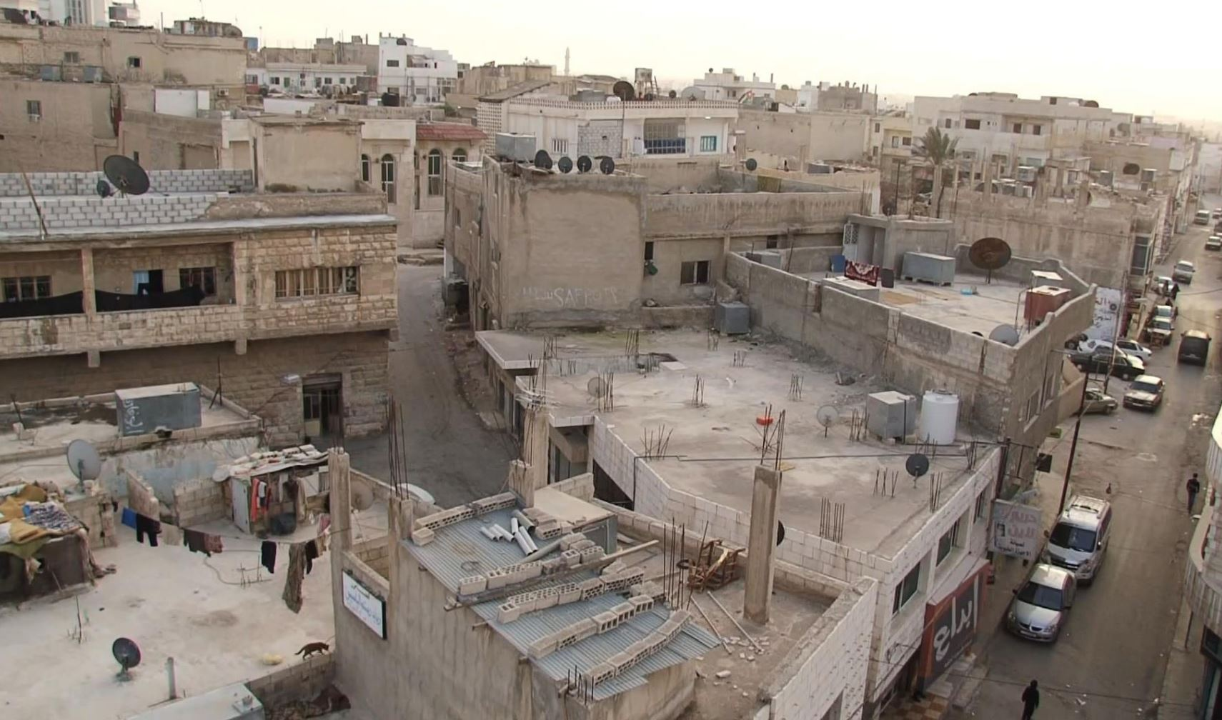
Key Preliminary Findings

Slide 9
Documents obtained
In total, 2,032 individual documents were obtained by the 668 households in the past 12 months, an average of 3 individual documents per household.
70% of households obtained at least one document.
Most commonly obtained documents by households – UNHCR ASC (45% of households), MOI card (42%) and Birth certificate (14%)
Almost two thirds (63%) of obtained MoI cards were for children under 18. Half of UNHCR ASCs (50%) for children.
RCA beneficiary households obtained an average of 4.9 individual documents, while CfD and Information provision beneficiaries obtained 2.7 documents.
Notes:
58% of all obtained documents were for children under 18.

Slide 10
Documents obtained
Households that have obtained documents, by type

Slide 11
Remaining documentation needs
In total, 817 individual missing documents among the surveyed households- on average, 1.3 documents per household, 3.9 at baseline
Most commonly missing documents by household – MOI card (39% of households), Birth Certificate (7%), UNHCR ASC (7%) and Marriage certificate (4%)
45% of households are still missing at least one document
80% of missing MoI cards are for children under 18. 70% of overall missing documents are for childen.
61% of households in Central Jordan have no remaining documentation needs, 52% in Northern Jordan and 44% in Southern Jordan
Notes:
At baseline 80% of households missing MoI, 26% missing UNHCR ASC.
At baseline, Children represented 53% of the total documentation missing
More than two thirds (67%) of RCA beneficiaries have no remaining documentation needs, 49% of CfD and 55% of Info provision

Slide 12
Remaining documentation needs

Slide 13
Perceptions of documentation
Main household needs:
Most frequently reported household needs were:
Paying rent (91%, 83% at baseline),
Food (49%, 44% at baseline),
Medicine/health needs (45%, 43% at baseline)
Access to credit/cash (42%, 38% at baseline)
Documentation (12%, 40% at baseline)

Slide 14
Main challenges of missing documentation
Overall, challenges related to missing documentation have decreased.
Access to health services is the biggest challenge, particularly for those missing an MoI card (56%, vs. 19% of HHs that have MoI card)
Notes:
Amongst those that are missing docs
Access to health service remains largest challenge
Ability to travel outside neighbourhood has improved – overall improved security
Unability to register child and marriage have increased: birth certificate for their children form the Syrian embassy, necessary if they wish to return to Syria. The cost of this is very high however (175USD plus).

Slide 15
Barriers to accessing documentation
Common perception that barriers exist that prevent access to documentation
Of HHs missing still missing documentation, only 28% actually in the application process
Of those not in application process, 88% because they face barriers to apply
Barriers to obtaining documentation
Notes:
FGDs: costs particularly linked to transport

Slide 16
Feeling of Safety and Dignity (FSD) Index
Composite indicator:
1. Freedom of movement
2. Access to basic services
3. Stability of household accommodation
4. Dignity and respect
Average mean index score was 78.1, up from 71.9 at baseline
Average FSD Index by region
Region | Baseline | Endline | Trend
North | 71.9 | 77.5 | 
Central | 78.6 | 78.5 | =
South | 50.6 | 74.8 | 

Slide 17
Feeling of Safety and Dignity (FSD) Index
58% of beneficiary households showed improved FoSD index at endline compared to baseline.
69% of RCA beneficiary HHs, 59% of HHs that obtained at least one document.

Slide 18
1. Freedom of movement
Overall, respondents are not restricting their movement patterns due to safety concerns (94% at endline, vs. 82% at baseline).
Similar feeling of safety to move around (in) neighbourhood as at baseline.
Improved feeling of safety in traveling outside their neighbourhood (83% confident at endline, 68% at endline)
Degree of safety to move around the neighbourhood during the day

Slide 19
1. Freedom of movement
Amongst those not feeling safe to move in neighbourhood, strong decrease in fear due to lack of documentation (23%, 71% at baseline)
Reasons for feeling unsafe amongst adults

Slide 20
2a. Access to basic services
In general, households are not able to access all the basic services which they require – 70% in the past month unable to access at least one basic service (up from 62% at baseline).
Medical care the basic service most commonly not able to be accessed (65%, same in baseline)
Main barriers to basic services:
Associated costs are too expensive (97%, up from 79%) – Health policy change?
Ineligible; missing documentation (7%, down from 35%) – Improved documentation

Slide 21
2b. Access to basic services – employment
Generally low perceptions of dignified employment, not much change since baseline
For 26% of households the main breadwinner is ‘not at all gainfully and fairly employed’
27% reported there was no breadwinner at all
Degree to which the main breadwinner is perceived to be employed with dignity:

Slide 22
3a. Stability of household accommodation
Shelter type, by region

Slide 23
3b. Stability of household accommodation
Perceptions of accommodation security:
Extent to which accommodation is secure for as long as wanted
Notes:
Maybe linked to increase in rental prices?

Slide 24
3b. Stability of household accommodation
Households that have been forced to move accommodation in the last 6 months
Notes:
At Baseline, only 25% of HHs selected rent was too high, but was not select multiple

Slide 25
4. Dignity and respect
Overall, perceived disrespect from all groups has decreased. The most frequently to treat beneficiaries with disrespect are naieghbours (6%),
Beneficiaries perceived to be treated with disrespect from community groups on basis of refugee status
Notes:
Particularly decreased disrespect from Employer, School, Healthcare (public officiales), linked to documentation?

Slide 26
Livelihood Coping Strategy Use
Average CSI Index decreased from 8.2 at baseline to 5.4 at endline
Slightly less households have resorted to livelihood coping strategies in the past 30 days to meet their basic household needs than at baseline (90% vs 95%)
Less households are using Emergency coping strategies (43% at Baseline, 23% at Endline.
Livelihood coping strategy use

Slide 27
Livelihood Coping Strategy Use
RCA beneficiaries are using less Livelihood Coping Strategies than CFD and Info provision beneficiaries.
Average CSI scores: 5 for RCA beneficiaries, 5.4 CfD and 5.5 Info provision.
Livelihood coping strategy use

Slide 28
Use of coping strategies
Overall, the most (9/12) coping strategies are used by less households in 2018. All the emergency coping strategies used less.
The most commonly used coping strategies are buying food on credit (76%) and reducing non-food essential expenditure (64%)
Coping strategy use

Slide 29
Coping strategies - Debt
Almost all households are in debt (97%, 94% at baseline)
Average of 858 JOD of debt per household (756 at baseline)
Similar % of households are indebted by assistance type, however, RCA beneficiaries have smaller debts
85% of households in debt report that their debt is not manageable
Cash for documentation | Information provision | Regular Cash Assistance
886 JD | 878 JD | 729 JD

Slide 30
Coping strategies - Debt
77% of households in debt says debt has increased in the last year
Reasons for increased debts are mostly expenditure on food, rent, and health
Reasons for increased debt

Slide 31
Use of Cash assistance – Cash sample
87% of respondents reported that the purpose of the cash transfers were explained to them.
Three quarters of households (75%) spent the cash assistance received on rent payments
Expenditure of cash assistance
Notes:
Associated costs of obtaining documentation: transport, blood tests (but these are relatively small, most of the RCA used for basic households needs)

Slide 32
Use of Cash assistance – Cash sample
Cash assistance covering urgent needs
72% of cash beneficiaries reported the cash assistance was enough to cover documentation needs.
Almost one quarter (23%) of RCA beneficiaries reported the cash assistance covered more than half of their urgent needs

Slide 33
Cash modalities – Cash sample
97% of cash beneficiaries were satisfied with the cash modality they had used.
87% reported ATM card to be their preferred modality
Preferred cash transfer modalities
Notes:
ATM increased safety and convenience (accessible 24/7). more discrete – if you go the hawala everyone in the community knows you are getting cash assistance and might try to influence how you spend it/judge you. Queues greater at the hawala.

Slide 34
Satisfaction with project
54% of beneficiaries reported that information received was useful to obtain documentation, 25% neutral and 16% not useful
Overall, around half (49%) of beneficiaries are satisfied with the overall assistance received, 26% neutral and 25% not satisfied.
Notes:
Q3_17_Why_not_satisfied
Did_not_obtain_documentation_I_needed 39.8%
Cash_assistance_was_not_enough_to_cover 29.8%
Cash_assistance_stopped_too_early 15.8%
Information_provided_was_not_clear_not_e 29.8%
Difficulties_challenges_in_accessing_cas 6.4%
Not_treated_well_by_staff 5.8%
Other 18.7%

Slide 35
Preliminary conclusions
Overall, the project has significantly contributed to households obtaining their missing documentation – on average 3 documents per household. More than two thirds (67%) of RCA beneficiaries have no remaining documentation needs.
UNHCR ASC the most common document received (amnesty).
Documentation needs remain: nearly half (45%) of households still missing at least one document, and facing related protection challenges.
Children obtained the majority of documents, but are also still missing the highest amount.
Overall, a feeling of safety and dignity improved, particularly in the South. 69% of those receiving RCA improved FoSD and 59% of those who obtained a document.
Beneficiaries’ freedom of movement, and sense of being treated with respect improved.
However access to basic services did not improve – impact of the health policy change – and stability of accommodation also worsened.
Households using less coping strategies, including less severe coping strategies – particularly RCA beneficiary households. Buying food on credit and reducing non-food essential expenditure increased. Overall debt has increased.
While documentation has had benefits in terms of access to services and freedom of movement, the rising cost of living has limited the overall impact of the documentation achieved.

Slide 36
Questions & Discussion

