Slide 1
Whole of Syria Education Assessment –Key Findings
October 2018

Slide 2
PRESENTATION OVERVIEW
Purpose: This presentation displays some of the key findings from the data from the Whole of Syria (WoS) education sector assessment of Education in Syria. Findings from this assessment will be used by to inform the HNO 2019.
Acknowledgement: This assessment was conducted by REACH in collaboration with the WoS education sector led by UNICEF and Save the Children and funded by the Education Cannot Wait (ECW) fund.
Presentation overview:
Introduction to the Assessment
Household demographics of school-aged children
Access to education
Barriers to accessing education and educational needs
Quality of education

Slide 3
01
Introduction

Slide 4
INTRODUCTION TO THE ASSESSMENT
Objective: The assessment aims to provide an in-depth understanding of the access and quality of education in Syria, as well as educational barriers and needs amongst IDPs, spontaneous returnees*, and resident community populations. It also seeks to inform effective response planning for accessible opposition-controlled areas in northwest, northeast, and south Syria.
Geographical coverage: The assessment covers accessible communities in opposition-held areas in the following governorates: Aleppo, Ar-Raqqa, Deir-ez-Zor, Hama, Al-Hassakeh, Idleb, Dar’a and Quneitra.
Survey types:
Household (HH) Questionnaire (direct access areas)
School Questionnaire (direct access areas)
Key Informant (KI) Questionnaire (remote access areas)
*Spontaneous returnees encompasses a broad spectrum of individuals, including IDPs or refugees who have returned to the community they lived in prior to their displacement but not necessarily to their former homes.

Slide 5
PRIMARY RESEARCH QUESTIONS
What is the demographic profile of the school-aged children (including IDPs, spontaneous returnees, and pre-conflict populations) in assessed areas across Syria?
With reference only to the household level survey, what is the enrolment and availability of early childhood education and home learning for pre-primary school aged children (aged 3-5)?
What are the attendance, repetition, and dropout rates of school-aged children in assessed areas across Syria?
What are the barriers preventing children from accessing education in assessed areas across Syria?
What are the main education needs of school-aged-children across assessed areas in Syria?
What percentage of schools are functioning and what is the state of school facilities across assessed areas in Syria?
What is the quality of education for school-aged children across assessed areas in Syria?
Notes:
Quality of education is measured by the number of teachers and education personnel trained, number of teachers and education personnel receiving incentives (salary/non-salary), number of teachers and education personnel receiving teaching resources, kits and guides, number of school-aged children receiving textbooks and the number of school-aged children receiving supplementary materials in formal and non-formal/informal settings.
It may be too specific of a question for KIs to know the enrollement and availability of early childhood and home learning for children aged 0-4; therefore, only households are asked questions related to this.

Slide 6
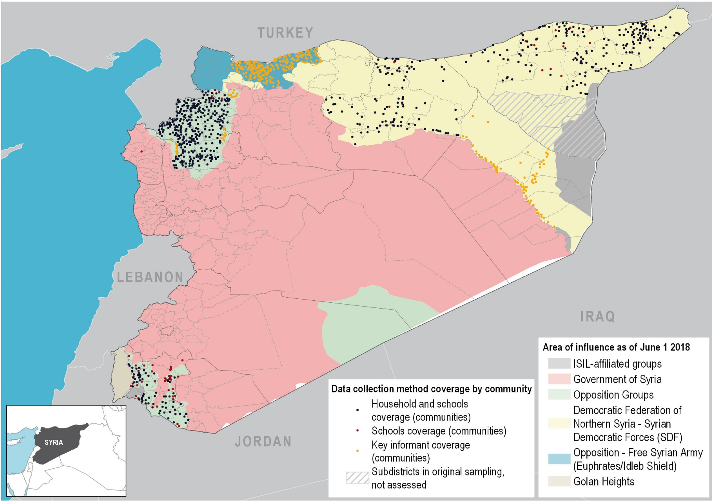
DATA COLLECTION METHOD COVERAGE
Data sources: Administrative boundaries: OCHA, Areas of Influence: Live UA Map

Slide 7
CHALLENGES
Data collection in South Syria was stopped prematurely on the 20th of June due to increased insecurity and resultant access constraints. Out of 1,604 targeted household forms in South Syria, 1,496, or 93%, were completed. Although not all of the household questionnaire targets were met, there is sufficient data to produce statistically significant results at the sub-district, governorate, and country levels. Any reduction in confidence levels as a result of early termination of data collection will be caveated in the report and factsheets.
The education assessment aimed to cover 100 sub-districts. Due to security threats and the inaccessibility of some sub-districts (including the early termination of data collection in South Syria described above), data was collected in 88 sub-districts. A breakdown of the sub-districts assessed and the number of surveys completed in each governorate can be found in the appendices.

Slide 8
INTERPRETATION OF DATA
Survey reporting: Each of the three surveys (HH, Schools, and KI) covered different geographical areas and collected different information. To distinguish findings from each survey type this presentation includes text indicating whether the results are from the HH, School, or KI questionnaire. For example, for HH results you will see “Households reported:”.
Data representativeness and weighting: Results displayed in this presentation are only representative of assessed areas. Where possible, data collected in this assessment was weighted by proportional population sizes during analysis in order to aggregate results to be representative of a larger geographic region.
HH survey data is representative at the sub-district level and is weighted to be representative at the governorate level.
School survey data is not weighted and is only representative of the schools assessed.
KI survey data is representative at the community level and is weighted to be representative at the sub-district level.
2017/18 school year: Results of this assessment are representative of the 2017/2018 academic school year.

Slide 9
02
Household Demographics

Slide 10
HOUSEHOLD COMPOSITION
Of the assessed households, there were approximately 12 boys for every 10 girls.
6 Average HH size
16% of HHs were female-headed
Notes:
HH

Slide 11
HOUSEHOLD COMPOSITION: POPULATION GROUPS OF CHILDREN 3 TO 17 YEARS OLD
Highest proportion of IDPs was found in Dar’a and Ar-Raqqa.
Highest proportion of spontaneous returnees was found in Ar-Raqqa and Idleb.
Refugees (non-Syrians) totalled less than 0.1% of assessed household members in all governorates.
Notes:
HH

Slide 12
03
Access to Education

Slide 13
ATTENDANCE: EARLY CHILDHOOD EDUCATION
Households reported:
On average, 27% of girls aged 3-5 in assessed households attended Early Childhood Care and Education or primary school at some point in the 2017/18 school year, compared to 26% of boys aged 3-5.
Notes:
HH

Slide 14
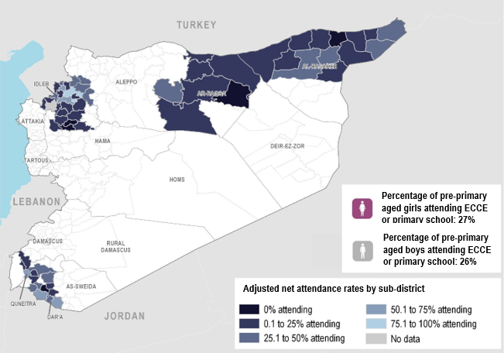
ADJUSTED NET ATTENDANCE RATE FOR PRE-PRIMARY AGED CHILDREN IN ASSESSED HOUSEHOLDS, 2017/2018

Slide 15
TOTAL NET ATTENDANCE: PRIMARY AND SECONDARY SCHOOL-AGED CHILDREN
Households reported:
On average, 16% of both school-aged girls and school-aged boys never attended school in the 2017/18 school year.
Notes:
97% of children who attended school attended formal education.

Slide 16
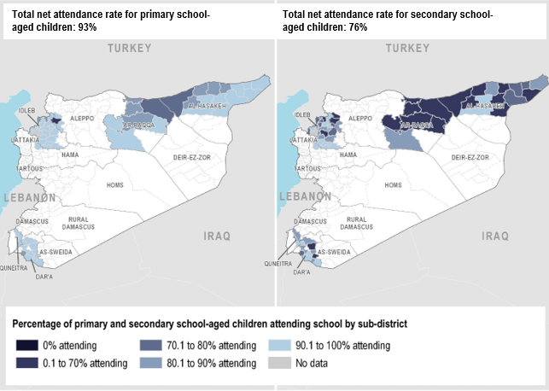
TOTAL NET ATTENDANCE RATES FOR PRIMARY AND SECONDARY SCHOOL-AGED CHILDREN, 2017/2018

Slide 17
STUDENTS IN THE CORRECT GRADE FOR THEIR AGE
Households reported:
On average, 11% of primary and secondary students attending school in assessed households were not in the correct grade for their age.

Slide 18
REPETITION AND DROPOUTS
Households reported:
On average, 7% of school-aged children reportedly had ever repeated a grade.*
Schools reported:
On average, 5% of students dropped out during the 2017/2018 school year.*
*57% of household respondents did not have responses for this question.
*Drop out rates calculated by grade
Notes:
Complete

Slide 19
FUNCTIONING SCHOOLS
Schools report:
KIs report:
Kis in Deir-ez-Zor governorate estimated that on average only 47% of schools in their communities were functioning.

Slide 20
04
Barriers to Accessing Education and Educational Needs

Slide 21
MOST COMMON REASONS WHY CHILDREN AGED 5-14 DID NOT ATTEND SCHOOL
Percentage of children in assessed households and assessed schools reporting each educational barrier (top 3)
Households reported:
1
2
3
Schools reported:
Child needs to work/help family (32%)
Child needs to work/help family (44%)
Lack of learning materials (31%)
Children are psychologically distressed (29%)
Poor quality of teaching (26%)
Lack of learning materials (26%)
Notes:
KI and Schools, interviewees asked to list top 3 most urgent needs, this slide and the next look at all 3 reported and the percentage of interviewees who listed each need in their top 3

Slide 22
MOST COMMON REASONS WHY CHILDREN AGED 15-17 DID NOT ATTEND SCHOOL
Percentage of children in assessed households and assessed schools reporting each educational barrier (top 3)
Households reported:
1
2
3
Schools reported:
Child needs to work/help family (64%)
Child needs to work/help family (70%)
Poor quality of teaching (25%)
Early marriage (33%)
Early marriage (24%)
Tuition or supplies not available (21%)
Notes:
KI and Schools, interviewees asked to list top 3 most urgent needs, this slide and the next look at all 3 reported and the percentage of interviewees who listed each need in their top 3

Slide 23
MOST URGENT EDUCATIONAL NEEDS
Percentage of assessed households and assessed schools reporting each educational need (top 3)
Households reported:
Schools reported:
1
2
3
Ensuring safety and security for children and teachers (37%)
Additional classrooms (35%)
Additional classrooms (30%)
Appropriate WASH facilities (32%)
Appropriate WASH facilities (28%)
School equipment (32%)
Notes:
KI and Schools, interviewees asked to list top 3 most urgent needs, this slide and the next look at all 3 reported and the percentage of interviewees who listed each need in their top 3

Slide 24
05
Quality of Education

Slide 25
SCHOOL CURRICULUM
Households reported:
48% Kurdish curriculum
72% Syria Interim Government curriculum
99% Government of Syria curriculum
Northeast Syria
Northwest Syria
South Syria
Notes:
Complete

Slide 26
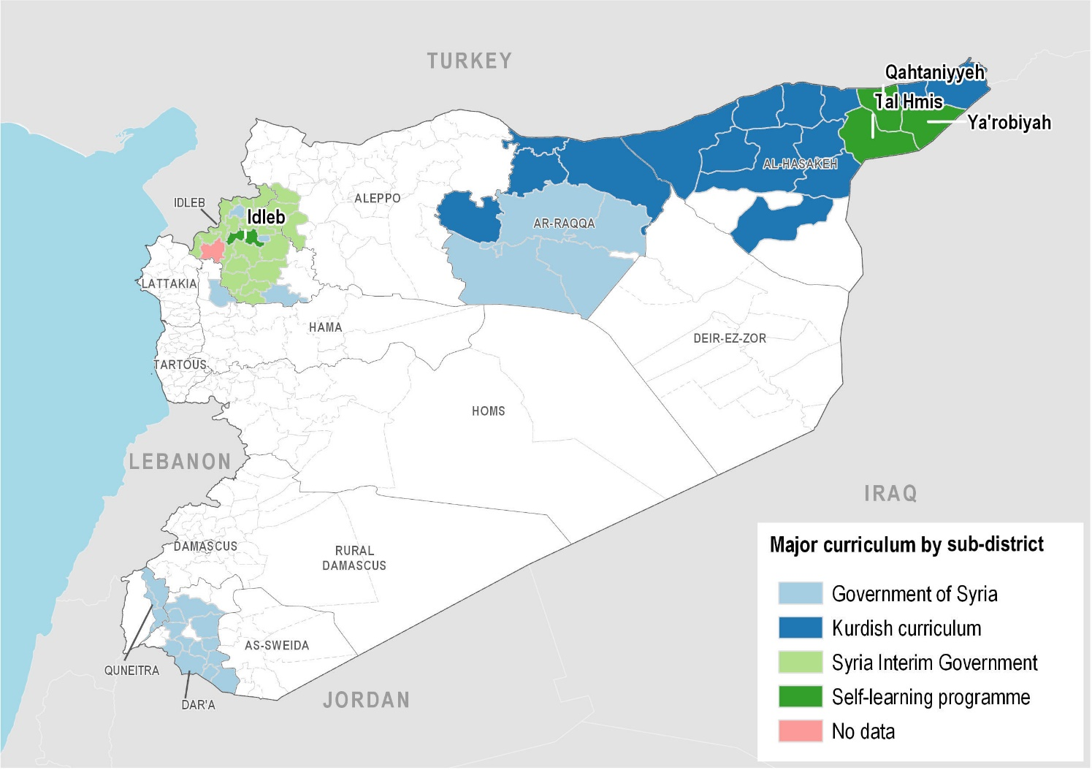
CURRICULUM MOST COMMONLY USED BY STUDENTS IN ASSESSED HOUSEHOLDS

Slide 27
TEACHER SALARIES
Schools reported:
On average, 9% of assessed schools reported teachers did not receive financial compensation (salary or incentives).
On average, of the 91% of assessed schools that reported teachers received compensation, 17% were paid irregularly.
Notes:
School and/or KI

Slide 28
SOURCES OF TEACHER COMPENSATION
Schools reported:

Slide 29
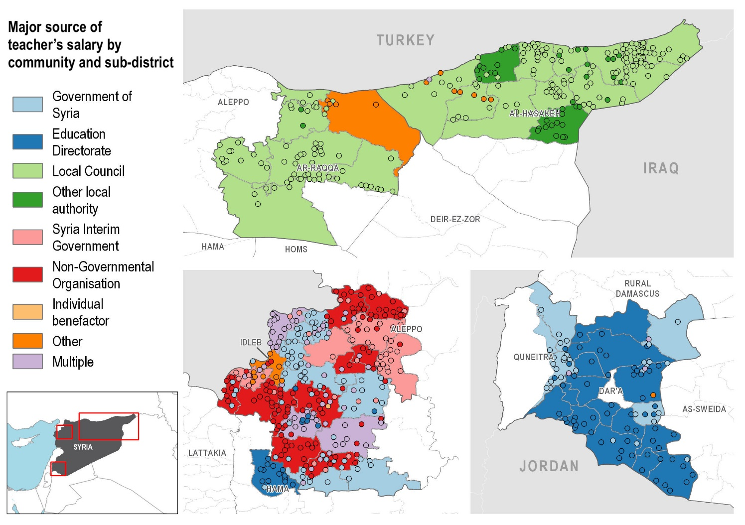
THE LARGEST SOURCE OF TEACHER COMPENSATION IN ASSESSED SCHOOLS

Slide 30
Sarah Needler
+962 (0)79 153 6223
sarah.needler@reach-initiative.org
Sarah.needler@reach-initiative.org
www.reach-initiative.org
IMPACT Initiatives
@REACH_info

Slide 31
06
Appendices

Slide 32
APPENDIX 1: SURVEYS COMPLETED
Household and School Coverage | Household Surveys | School Surveys
Aleppo | 327 | 86
Atareb, Daret Azza, Zarbah
Al-Hasakeh | 1600 | 278
Al-Hasakeh, Al-Malikeyyeh, Amuda, Be'r Al-Hulo Al-Wardeyyeh, Darbasiyah, Hole, Jawadiyah, Qahtaniyyeh, Quamishli, Ras Al Ain, Shadadah, Tal Hmis, Tal Tamer, Ya'robiyah
Ar-Raqqa | 872 | 126
Al-Thawrah, Ar-Raqqa, Ein Issa, Jurneyyeh, Karama, Mansura, Suluk, Tell Abiad
Dar'a | 1132 | 468
As-Sanamayn, Busra Esh-Sham, Da'el, Dar'a, Hrak, Izra', Jasim, Jizeh, Kherbet Ghazala, Mseifra, Mzeireb, Nawa
Hama | 101 | 34
Madiq Castle
Idleb | 2696 | 552
Ariha, Armanaz, Badama, Bennsh, Dana, Darkosh, Ehsem, Harim, Heish, Idleb, Janudiyeh, Jisr-Ash-Shugur, Kafr Nobol, Kafr Takharim, Khan Shaykun, Maaret Tamsrin, Ma'arrat An Nu'man, Mhambal, Qourqeena, Salqin, Saraqab, Sarmin, Tamanaah, Teftnaz
Quneitra | 369 | 60
Al-Khashniyyeh, Khan Arnaba, Quneitra
TOTAL | 7097 | 1604
KI Coverage | KI Surveys
Aleppo | 185
Aghtrin, Al Bab, Ar-Ra'ee, A'zaz, Ghandorah, Haritan, Jarablus, Mare', Suran, Zarbah
Deir-ez-Zor | 66
Basira, Deir-ez-Zor, Hajin, Khasham, Kisreh, Sur, Tabni, Thiban
Hama | 8
Ziyara
Idleb | 8
Abul Thohur
TOTAL | 267

