Slide 1
Returns and Durable Solutions Assessment (ReDS)
Markaz Daquq – Daquq, Kirkuk
Findings presentation, Iraq
Data collection period: 14-17 December 2020

Slide 2
1. Introduction to ReDS
2. ReDS methodology
3. Markaz Daquq overview
4. Key findings
5. Detailed findings
6. Questions from the audience
7. Discussion
Presentation outline

Slide 3
1
Introduction to ReDS

Slide 4
In 2020, the numbers of internally displaced persons (IDPs) returning to their area of origin (AoO) or being re-displaced for a second time increased, coupled with persisting challenges in relation to lack of services, infrastructure and - in some cases - security in areas of origin.
The need to better understand the sustainability of returns, conditions for the (re)integration of IDPs and returnees, and the impact of their presence on access to services and social cohesion has been an identified need for humanitarian and development planning.
Decisions related to the closure of all IDP camps by the end of 2020 have also impacted these dynamics.
ReDS background

Slide 5
ReDS Specific Objectives
Provide an understanding about the effects of recent movement trends;
Assess perceived intentions to move among all relevant communities to identify potential risk of further instability;
Assess how conditions in areas affected by recent movements may impact the sustainability of durable solutions;
Identify any consequent shift in local social dynamics and power structures;
Explore conditions in the area in terms of community needs and inter-relations; and the viability of safe and dignified (re)integration.
ReDS objectives
Notes:
In general, the assessment aimed to provide rapid evidence-base overview of the assessed areas to support humanitarian and development actors to promote durable solutions for returnees and IDPs in situations of protracted displacement on multiple levels, including:
Development of strategic dialogue, policy development, and resource mobilization efforts,
Development of localized interventions,
Advocacy with government actors around camp closures, consolidation, premature returns, and conditions in areas of origin to allow sustainable returns.
ReDS Specific Objectives
Provide an understanding about the effects of recent movement trends across different demographic groups in targeted areas;
Assess perceived intentions to move among all relevant communities within the areas to identify potential risk of further instability;
Assess how conditions in areas affected by recent movements may impact the sustainability of durable solutions;
Identify any consequent shift in local social dynamics and power structures following the recent movements;
Explore conditions in the area in terms of community needs and inter-relations; and the viability of safe and dignified (re)integration.

Slide 6
2
ReDS methodology

Slide 7
Methodology
The multi-sectoral assessment tool combined qualitative and quantitative data.
Data collection was done remotely by phone between 14 and 17 December 2020, adapted to the context of the COVID-19 pandemic local restrictions and associated pandemic measures.
Purposive sampling methods were employed to identify KIs. Findings should therefore be considered as indicative.
Methodology based on key informant interviews (KIIs).
 KI profile in Markaz Daquq Sub-district
Community leaders 15 KIs
Remainees/non-displaced 5 KIs
IDPs (displaced from the area) 5 KIs
IDPs (displaced in the area) 5 KIs
Returnees (more than 3 months ago) 5 KIs
Returnees (less than 3 months ago) 5 KIs
^{40 KIs}
Notes:
Community leaders are members of the host community represented by eight public sector employees, five health sector employees and two educational sector employees.
IDPs (displaced from the area) refer to households from Markaz Daquq displaced after 2014 events to other areas different than their AoO, specifically in Markaz Erbil Sub-district (Erbil District of Erbil Governorate); and in Markaz Dibis Sub-district (Dibis District of Kirkuk Governorate).
IDPs (displaced in the area) refer to households from AoO different than Markaz Daquq who were displaced after 2014 events and reside in Markaz Daquq. Households were reportedly originally from Hawiga District of Kirkuk Governorate; Kifri District of Diyala Governorate; and, Shirqat District of Salah Al-Din Governorate.
For the purpose of this research, returnees will be categorized as an IDP returning to their AoO, where AoO is defined as the stated original sub-district of origin for the IDP. Given the complexity of (re)integration, this could mean that returnees still face challenges to their sustainable return to their AoO.

Slide 8
Limitations
Considering the findings as indicative due to the small sample size and the purposive sampling method
40 KIs in Markaz Daquq Sub-district
KIs gender balance
30 male KIs
10 female KIs
Contextualization at sub-district level
To operationalise the identified trends, information was analysed
and visualized at sub-district level, rather than village or neighbourhood
Remote data collection
Data collected remotely by phone


Notes:
Considering the findings as indicative: The sample is small (40 KIs), and findings will only be an indication of trends, needs, humanitarian concerns, gaps and flags for actors to assess further. Findings cannot be analysed or visualized at community-level in the current methodology but [mitigation] for the current analysis REACH included findings per community group as relevant and available.
KIs gender balance: REACH and RWG are working on the identification process to encourage women to participate in the rapid assessment. Coming assessment are expected to have an increased participation rate.
Contextualization at sub-district level: To operationalize the identified trends, information was analysed and visualized at sub-district level, rather than village and neighbourhood. Extending to more detailed assessment at village, neighbourhood or community-level will depend in the availability of data about KIs. Contact details will need to be provided since the sampling is purposive and snowballing is very limited while doing remote data collection and time consuming taking into consideration the need of the informed consent from individuals to share their contact information with REACH. It will also require additional resources such and budget and human resources (enumerators) and will affect the time-line of the project and report deadlines.
Remote data collection: While collecting data remotely can sometimes, the openness of respondents is sometimes affected. [mitigation] Testing process was very strict and discussions with field staff were ongoing to avoid sensitive questions and doing harm to interviewees. Some sensitive terminologies related to Iraq context were identified and replaced by explanation text in the Arabic version of the ODK tool (e.g. ‘governance’ was replaced by ‘laws and regulations’).

Slide 9
3
Markaz Daquq overview and current demographics

Slide 10
Markaz Daquq Sub-district overview
Markaz Daquq is a sub-district of Daquq District, located in the central area of Kirkuk Governorate.
In the summer of 2014, the so-called Islamic State of Iraq and the Levant (ISIL) undertook military activities in the district of Daquq resulting in the displacement 3,803-4,010 households as reported by KIs.
906-987 IDP households (area of origin (AoO) not specified) are reported to reside in Markaz Daquq settlements.
Notes:
Markaz Daquq Sub-district was selected for the assessment as: social cohesion severity11 is high; it is an AoO for IDPs in camps at risk of closure or already closed;12 and dynamic population movements and movement intentions to/from this sub-district were reported by relevant actors through the RWG.
1. IOM DTM: http://iraqdtm.iom.int/ReturnIndex - refer to methodology, to compute the severity index, different parameters are combined.
2. REACH camp profiles updates of September 2020

Slide 11
4
Key findings

Slide 12
Markaz Daquq Sub-district Key findings
Overall, Markaz Daquq was perceived to have a positive environment in terms of security and community acceptance. In addition, it was considered a transition area¹ for IDPs originally from other AoOs outside the sub-district.
While the perceived improvement in the safety and security situation has created a pull factor for returns to Markaz Daquq, returns were reported to be mainly attributed to push factors in areas of displacement (AoD) including ongoing processes linked to the closure or consolidation of all IDP camps in Iraq.
In general, most KIs noted that community members feel safe in Markaz Daquq, there are no restrictions of movements and that there are no specific groups that are not welcomed.
KIs reported that some households had members who remained displaced at the time of data collection, of which all reported these were male members.
1 A transition area refers to an area where IDPs stay temporarily until the conditions for return to their AoO are ensured or or move to a new location (relocation/resettlement).
Notes:
Feeling of safety:
However, some IDP and returnee KIs voiced concerns around the reported presence of explosive remnants of war (ERW) in Markaz Daquq which negatively affected their freedom of movement.
Unwelcomed: However, the majority of the IDP and returnee KIs reported concerns around the presence of explosive remnants of war (ERW) in Markaz Daquq which negatively affected their freedom of movement.
Reasons to remain in displacement:
Lack of or not enough resources to return 3 KIs
Lack of job opportunities in AoO 2 KIs
Registered in education in AoD 1 KI
Damaged housing in AoO 1 KI
COVID-19 pandemic movement restrictions 1 KI

Slide 13
Markaz Daquq Sub-district Other key findings
Perceptions on primary community needs varied by KI profile.
IDPs and returnees persistently reported to have less access to housing, housing rehabilitation, basic public services and being more at risk of eviction.
IDP and returnee KIs reported that access to livelihoods in Markaz Daquq is unequal for different vulnerable groups.
In addition, an overall decrease in the diversity and availability of employment opportunities was reported in Markaz Daquq compared with 2014.
KIs reported that the interaction between different population groups in Markaz Daquq was promoted by friendship, kinship ties and work relationship between community members.
Some community leaders reported that disputes occurred within neighbourhoods and between villages in Markaz Daquq, and that it was expected that further returns to Markaz Daquq will increase the number of disputes between households.
Notes:
Primary community needs:
Community leader KIs and remainee KIs reported the need for further efforts to restore public infrastructure such as water and sanitation systems, hospitals and schools. Many KIs reported a decline in the quality of public healthcare and education services compared to pre-2014. In comparison, access to livelihoods was commonly cited by returnee and IDP KIs as the primary community need closely linked to the need of further efforts to rehabilitate the roads in Markaz Daquq to facilitate safe access to job opportunities in other areas.
Less access to services:
There are reported differences in access to services across different groups.
This is commonly attributed to the lack of relationships and connections in the community. Vulnerable groups such as female-headed households, child-headed households, unaccompanied/separated children (UASC), large households, elderly-headed households and people with disabilities and people with less connections also face distinct challenges to access services.
In particular, UASC, child-headed households and people with disabilities reported to be the most affected, suggesting a need for further outreach to and participation of different population groups.
Less access to livelihoods population: namely people with disabilities, elderly, and female heads of household
Interaction and participation:
However, the majority of returnee KIs reported that the lack of harmony between some groups was the main barrier for interaction, suggesting that further efforts are required to improve participation in social events and interaction between displaced, returnee and host community populations.
Community disputes:
However, community leaders also reported that the situation in this regard was expected to improve in the long-term due to the (re)integration and acceptance of IDPs and returnees in the community of Markaz Daquq, kinship ties between families, work relationships established between community members of different population groups and the intervention of the local authorities to solve those disputes.

Slide 14
5
Markaz Daquq findings

Slide 15
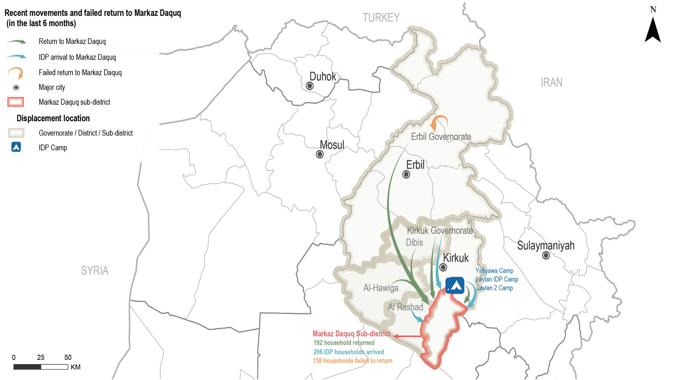
Markaz Daquq Sub-district
Recent movements to Markaz Daquq reported by KIs
Notes:
The presented map reflects the recent movement of households to Markaz Daquq reported by KIs during data collection.

Slide 16
Markaz Daquq Sub-district
Recent movements – data reported by KIs
 Recent returns
¹⁷⁹⁻²⁰⁵
households returned to Markaz Daquq in the six months prior to data collection, as reported by 15 KIs (out of 40 KIs).
Reported drivers for recent returns (out of 15 KIs)*
Sense of increased safety and security 8 KIs
Camp closures 6 KIs
Availability of job opportunities 4 KIs
Nostalgia about previous life in AoO 3 KIs
Difficult conditions in the area of displacement (AoD) 2 KIs
Reported impact of recent returns (out of 15 KIs)*
Increased job opportunities due to the return of business owners (9 out of 15 KIs) and access to assistance reportedly increased due to the response from different service providers to the recent returns (3 KIs).
Presence of higher competition in the labour market (6 KIs) and decreased level of household assistance due to increased demand (6 KIs).
* Sum of answers may exceed the 100% due to KIs being able to select multiple response options, including other topics.
Notes:
Recent returns
From Dohuq Governorate, specifically from non-camp areas in Hawiga, Kirkuk and Dibis districts and from Laylan IDP, Laylan 2 and Yahyawa camps in Kirkuk Governorate, as reported by 15 KIs (out of 40 KIs).
The rest of the KIs reported no returns (20 KIs) or did not know about recent movements (12 KIs).
Reportedly, recent returns had positive and negative impacts on access to livelihoods and assistance for all population groups. On one hand, recent returns reportedly contributed to increased job opportunities due to the return of business owners (9 out of 15 KIs) and access to assistance reportedly increased due to the response by different governmental and humanitarian actors to the recent returns (3 KIs). On the other hand, these movements were also negatively perceived due to the presence of higher competition in the labour market (6 KIs) and it was reported a decrease in the level of household assistance due to increased demand (6 KIs).

Slide 17
Markaz Daquq Sub-district
Recent movements – data reported by KIs
 Recent IDP arrivals
¹⁹⁶⁻²¹⁶
IDP households arrived in Markaz Daquq in the six months prior to data collection, as reported by five KIs.
Reported drivers for recent IDP arrivals (out of 5 KIs)*
Kinship ties with other families 2 KIs
Availability of job opportunities and services 2 KIs
Failed returns to AoO 1 KI
Considering Markaz Daquq as a transition area 1 KI
Sense of increased safety and security 1 KI
Reported impact of recent IDP arrivals (out of 5 KIs)*
KIs reported increased availability of assistance due to the attention from governmental and humanitarian actors in the area (5 out of 5 KIs); and,
IDP arrivals contributed to an increased number of skilled labourers as reported by two remainee KIs.
* Sum of answers may exceed the 100% due to KIs being able to select multiple response options, including other topics.

Slide 18
Markaz Daquq Sub-district
Recent movements – data reported by KIs
 Failed returns
¹⁰⁰⁻²¹⁷
households attempted to return to Markaz Daquq in the six months prior to data collection but did not succeed, as reported by three returnee KIs.
Reported reasons for failed returns (out of 3 KIs)*
Lack of job opportunities 2 KIs
Limited access to services in Markaz Daquq 2 KIs
Unstable security situation in Kirkuk governorate 2 KIs
Reported impact of failed returns (out of 3 KIs)*
Negatively affected the availability of job opportunities due to some business owners remaining displaced (3 KIs); and,
The availability of assistance was perceived to decrease due to the assumed lack of attention from governmental and humanitarian actors in the area due to more limited return movements (3 KIs).
* Sum of answers may exceed the 100% due to KIs being able to select multiple response options, including other topics.

Slide 19
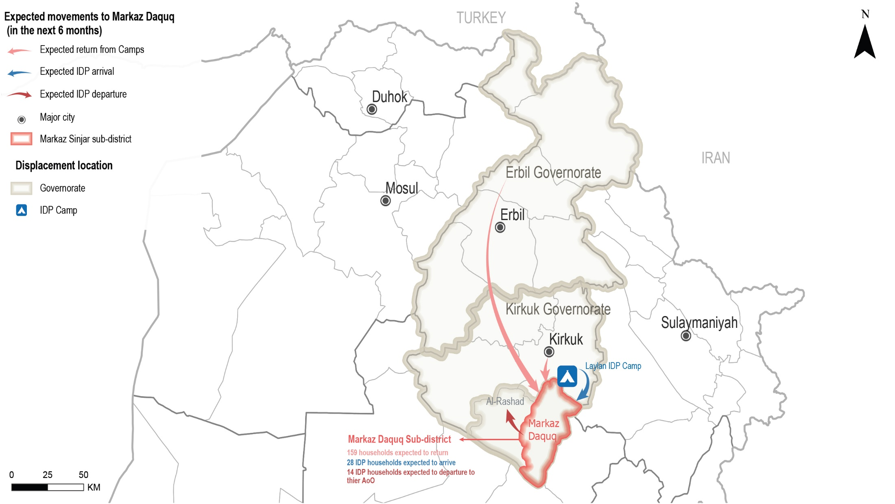
Markaz Daquq Sub-district
Expected movements to Markaz Daquq reported by KIs
Notes:
The presented map reflects the expected movement of households to/from Markaz Daquq.

Slide 20
Markaz Daquq Sub-district
Expected movements – data reported by KIs
 Expected returns
¹⁰⁰⁻²¹⁷
households are expected to return in the six months following data collection, as reported by four KIs.
Drivers for expected returns (out of 29 KIs)*
Sense of increased safety and security 8 KIs
Camp closures 8 KIs
Increased access to jobs and services 6 KIs
Following the return of other family members 5 KIs
Nostalgia about previous life 4 KIs
Difficult conditions in the AoD 4 KIs
Processing of security clearance to return 3 KIs
Barriers for expected returns (out of 40 KIs)*
Destroyed/damaged housing 22 KIs
Lack of services 21 KIs
Lack of job opportunities 20 KIs
Lack of documentation to claim properties 11 KIs
* Sum of answers may exceed the 100% due to KIs being able to select multiple response options, including other topics.
Notes:
Households returned from non-camp areas in Erbil Governorate, Kirkuk District of Kirkuk Governorate, and from Khashimina village in Daquq District (Kirkuk Governorate)
Other barriers
Security concerns 3 KIs
Lack of specialized medical treatment 2 KIs
Former housing is rented in AoO 1 KI
Further returns reportedly could lead to positive and negative impacts on the community. Expected returns reportedly could contribute to increased job opportunities with the return of business owners (16 out of 40 KIs) as well as an expected increase in assistance due the expected attention of humanitarian and governmental actors (2 KIs). At the same time, it was reported that there could be higher competition for the limited available job opportunities (22 KIs) in addition to an expected decrease in the level of household assistance due to the presence of a higher number of households in the area (22 KIs) and the limited capacity of humanitarian and governmental actors to absorb the demand for assistance (1 KI). A community leader KI also reported that the return of further households might increase the number of disputes between households.

Slide 21
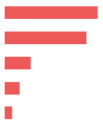
Markaz Daquq Sub-district
Expected movements – data reported by KIs
 Expected host community departures
No expected host community departures reported by 15 KIs (out of 40 KIs)
The majority of the KIs (25 KIs) did not know about expected departure movements.
However, 35 KIs (out of 40 KIs) reported that there are drivers that might result in further departures. The rest of the KIs did not know (5 KIs), or refused to answer (1 KI).
Drivers for expected host community departures (out of 35 KIs)*
Lack of services 25 KIs
Lack of job opportunities 22 KIs
Lack of specialized medical treatment 7 KIs
Lack of security 4 KIs
Arrival of security forces 2 KIs
* Sum of answers may exceed the 100% due to KIs being able to select multiple response options, including other topics.

Slide 22
Markaz Daquq Sub-district
Expected movements – data reported by KIs
 Expected IDP departures
¹³⁻¹⁵
IDP households are expected to depart from Markaz Daquq in the six months following data collection to their AoO due to the perceived increase safety and security in their AoO, as reported by 1 KI.
 Expected IDP arrivals
²⁵⁻³⁰
IDP households are expected to arrive to Markaz Daquq in the six months following data collection, as reported by 1 KI.
Although only 1 KI reported expected IDP arrivals, 29 KIs were able report drivers for arrivals.
Drivers for expected IDP arrivals (out of 29 KIs)*
Sense of increased safety and security 10 KIs
Availability of jobs and services 3 KIs
Camp closures 2 KIs
Arrival of other family members 2 KIs
* Sum of answers may exceed the 100% due to KIs being able to select multiple response options, including other topics.
Notes:
Expected IDP arrivals
The majority of the KIs did not know about expected movements (26 KIs), reported no IDP arrivals (12 KIs), or refused to answer (1 KI).

Slide 23
Markaz Daquq Sub-district
Primary community needs – data reported by KIs
Top reported primary, secondary and tertiary needs (out of 40 KIs)
Primary need
Livelihoods

Education
Secondary need
Tertiary need
Water and sanitation
 Primary community needs per respondent group*
Community leaders
(out of 15 KIs)
Remainees
(out of 5 KIs)
Returnees
(out of 10 KIs)
IDPs
(out of 10 KIs)
Education
Water and sanitation
Healthcare
14 KIs
13 KIs
12 KIs
Water and sanitation
Education
Healthcare
5 KIs
4 KIs
3 KIs
Livelihoods
Infrastructure
Electricity
10 KIs
8 KIs
5 KIs
Livelihoods
Electricity
Water and sanitation
9 KIs
8 KIs
5 KIs
“Developing the infrastructure [in Markaz Daquq], mainly the rehabilitation of the roads, will improve the movement of community members and mostly facilitate their access to work.”
- Male returnee KI -
* Sum of answers may exceed the 100% due to KIs being able to select multiple response options, including other topics.
Notes:
KIs reported that the primary need for the community was livelihoods (11 out of 40 KIs). As reported by 21 KIs, livelihoods was an overall community need due to the lack of governmental and private sector job opportunities (17 KIs), and the lack of investment in the private sector (1 KI). In some cases (20 KIs) lack of livelihood opportunities were reported as a barrier for returns and a risk to the sustainability of the returns. Five KIs reported that household members were forced to move to other governorates for job opportunities in order to meet the basic needs of their families.
The second main community need most commonly reported was access to education (9 out of 40 KIs). Overall, all KIs who reported education as a primary community need (18 KIs) referred to the decline in the public education system in Markaz Daquq compared to pre-2014 (see access to basic services below).
The third main community need most commonly reported was access to water and sanitation (16 out of 40 KIs), which was generally reported due to the limited access to public water services in Markaz Daquq (7 out of 26 KIs who reported water and sanitation as a primary need) and water pollution due to lack of filter maintenance (11 KIs). As a result, households resorted to buying bottled water (13 KIs) and/or depending on wells as the main potable water source (3 KIs). In addition, the lack of waste transportation services in Markaz Daquq was reported as an important gap to be covered by the relevant public institution (8 KIs).

Slide 24
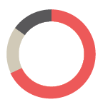
Markaz Daquq Sub-district
Perceptions on access to services and assistance – data reported by KIs
 Access to housing
The majority of families in the area reportedly reside in houses (39 out of 40 KIs).
Reported housing agreement (out of 40 KIs)
Owned tenure 27 KIs
Verbal rental agreement 7 KIs
Illegal tenure occupation 6 KIs
Risk of eviction
IDPs and returnees were persistently reported to be more at risk of eviction (22 KIs out of 40).
Notes:
Access to housing:
Most of the KIs (39 out of 40 KIs) reported that the majority of families in Markaz Daquq resided in houses. In addition, 20 KIs reported that IDPs, recent returnees, child-headed households, UASC, people with disabilities and large households were more likely to reside in tents in Markaz Daquq.
IDP KIs (6 KIs) reported that the majority of IDP households resorted to illegal tenure occupation.29 Other IDP households resided in houses under a verbal rental agreement (4 KIs). Remainee KIs (5 KIs) and community leader KIs (14 KIs) reported that the majority of community members resided in owned houses. Returnee KIs reported that the majority of returnee households resided in owned houses (8 KIs) and other households rented through verbal agreements (2 KIs).
Risk of Eviction:
IDPs and returnees are most at risk of eviction as reported by 22 KIs (out of 40 KIs), in addition to UASC, people with disabilities, child-headed households, elderly-headed households, large households and people with less connections due to a perceived lack of resources.

Slide 25
Markaz Daquq Sub-district
Perceptions on access to services and assistance – data reported by KIs
 Access to housing rehabilitation
^{30%-40%}
of houses in Markaz Daquq were reportedly damaged during military operations in 2014, as reported by 29 KIs (out of 40 KIs).
IDPs and returnees were reported having less access to housing rehabilitation 20 KIs out 40).
Reported barriers to access rehabilitation assistance (out of 24 KIs)*
Assistance perceived to target specific neighbourhoods 20 KIs
Criteria of selection for support is too specific 20 KIs
Less connections 17 KIs
Did not know 4 KIs
* Sum of answers may exceed the 100% due to KIs being able to select multiple response options, including other topics.

Slide 26
Markaz Daquq Sub-district
Perceptions on access to services and assistance – data reported by KIs
 Access to basic public services
^{20 KIs}
(out of 40) reported unequal access to basic public services namely healthcare, water and sanitation.
IDPs and returnees have less access to basic public services due to having less connections (20 KIs) and the vulnerability criteria for support is perceived as too specific (1 KI).
 Access to public judicial mechanisms
All KIs (40 KIs) reported that access to public judicial mechanisms was equal for all population groups.
There were no governmental offices reported to be closed in Markaz Daquq.
All population groups reportedly had access to documentation in the departments nearest to them.
* Sum of answers may exceed the 100% due to KIs being able to select multiple response options, including other topics.
Notes:
In terms of access to public education, all KIs (40 KIs) reported that boys and girls between 6-15 years old can access school and there were no children between 6-15 years out of school in Markaz Daquq. However, there was reportedly no free distribution of books and/or educational stationery for students, resulting in families purchasing them (18 KIs).
There was also a reported decline in the quality of public healthcare services after the events of 2014 (7 KIs) due to the lack of medical staff and medications (17 KIs).30 This situation reportedly forced families to resort to private hospitals and doctors (15 KIs). Other households reportedly moved to other areas to access medical treatment.
Households reported frequent cuts of public electricity services due to lack of maintenance (18 KIs). This resulted in households using private generators (5 KIs). The limited public service hours and the restricted presence of private generators reportedly prevented small businesses from fully operating (17 KIs).
The limited capacity of municipal waste disposal infrastructure, including lack of waste collection services (8 KIs), has reportedly resulted in waste accumulation in urban areas (8 KIs).
The lack of maintenance of the public water network in addition to the challenges related to water pollution and scarcity contributed to reliance on purchased bottled water, reportedly contributing to highly inflated prices (12 KIs).
Overall, the above mentioned challenges resulted in key gaps in access to public services, and at the same time negatively affected household income due to reported increased reliance on private services.

Slide 27
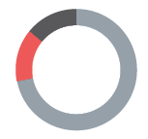
Markaz Daquq Sub-district
Perceptions on access to services and assistance – data reported by KIs
 Access to humanitarian aid and presence of non=governmental organisations
(NGOs)
^{7 KIs}
(out of 40) reported that there are NGOs implementing activities and projects in Markaz Daquq.
Reported activities implemented by NGOs (out of 7 KIs)
Non-food items (NFI) distributions 5 KIs
Food security programmes 1 KI
Shelter rehabilitation 1 KI
Reported most needed projects or activities in Markaz Daquq (out of 40 KIs)
Livelihoods
Rehabilitation
Water and sanitation
Social cohesion
Psycho-social support
Monthly cash assistance
26 KIs
6 KIs
4 KIs
2 KIs
1 KI
1 KI
Notes:
Access to humanitarian aid and presence of non-government organizations (NGOs)
The majority of the KIs reported there were no NGOs present in Markaz Daquq at the time of data collection (27 KIs), and the rest did not know (6 KIs).
11 KIs (out of 40) reported that the availability of humanitarian aid would be a factor encouraging returns to Markaz Daquq. The rest of the KIs reported that it is not a factor that would encourage returns (4 KIs), or did not know (25 KIs).

Slide 28
Markaz Daquq Sub-district
Perceptions on access to services and assistance – data reported by KIs
 Access to livelihoods
^{20 KIs}
(out of 40) reported that access to livelihoods was unequal.
Types of jobs reportedly available in Markaz Daquq in 2014 compared to December 2020 (out of 40 KIs)*
2014 December 2020
36 KIs
29 KIs
27 KIs
26 KIs
12 KIs
10 KIs
5 KIs
Agriculture
Finance
Public education
Construction
Public administration/defense
Manufacturing
Transportation
5 KIs
17 KIs
21 KIs
17 KIs
1 KI
1 KI
1 KI
* Sum of answers may exceed the 100% due to KIs being able to select multiple response options, including other topics.
Notes:
The rest of the KIs reported that it was equal for all population groups (20 KIs).
In addition to IDPs and returnees, people with disabilities, elderly and female heads of household reportedly had less access to livelihoods opportunities, as reported by 20 KIs (out of 40 KIs). KIs (20 KIs) also reported that child-headed households and UASC had less access to income, which may lead to child labour for these groups to meet their basic needs.
The main reported reasons for different groups to have less access to livelihoods were: perceived limited physical capacity, lower skill/education level, or trauma (19 out of 20 KIs); lack of connections (1 KI); and, that the criteria of selection for support is too specific (1 KI).

Slide 29
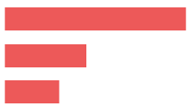
Markaz Daquq Sub-district
Perceptions on governance and presence of security forces – reported by KIs
 Governance and influencing bodies
Reported most influential bodies in governance (out of 40 KIs)*
Local authorities 40 KIs
Mukhtars 18 KIs
Tribal leaders 12 KIs
Two community leader KIs (out of 40 KIs) reported that there were new appointments resulting in turnover of existing local authorities.
 Perceived presence of security forces
^{39 KIs}
(out of 40) reported that the presence of security forces contributed positively to a feeling of safety.
In addition, all KIs (40 KIs) reported that security forces were effective in resolving disputes within the community and between different villages.
* Sum of answers may exceed the 100% due to KIs being able to select multiple response options, including other topics.
Notes:
Governance and influencing bodies
The rest of the KIs reported that there were no appointments for new local authorities (15 KIs), or did not know (23 KIs).
In addition, over the half of the KIs did not know about expected changes in most influential local actors related to governance (23 KIs). The rest reported that this was not expected to change in the six months following data collection (17 KIs).

Slide 30
Markaz Daquq Sub-district
Perceptions of community disputes, relations and co-existence – reported by KIs
 Community disputes
^{4 KIs}
(out of 40) reported that disputes within neighbourhoods happened in the six months prior to data collection. The situation was reportedly expected to improve due to the integration and acceptance of different groups in the community of Markaz Daquq and the kinship ties between families (2 KIs out of 4).
^{3 KIs}
(out of 40) reported that disputes between villages happened in the six months prior to data collection. The situation was reportedly expected to improve due to the integration and acceptance of different groups in the community, the work relationships established and the intervention of the local authorities to solve the disputes (3 KIs).
 Community relations and co-existence (out of 40 KIs)
^{20 KIs}
reported that their community members trust each other.
^{21 KIs}
reported that community members interact with other groups.
^{19 KIs}
reported that community members do not participate in social and public events.
Notes:
Community disputes within the neighbourhoods:
Over the half of the KIs (21 out of 40 KIs) did not know about disputes within neighbourhoods in Markaz Daquq, and 15 KIs reported that there were no disputes in the six months prior to data collection.
Community disputes between villages:
Over the half of the KIs (25 KIs) did not know about disputes between villages in Markaz Daquq. A community leader KI reported that there were no disputes in the six months prior to data collection. The rest of the KIs refused to answer (11 KIs).
Retaliation Incidents
(14 out of 40 KIs) reported that there were no retaliation incidents in the six months prior to data collection. The rest of the KIs (24 KIs) did not know and two community leaders KIs refused to answer.
Community trust
A community leader KI did not know and another refused to answer.
Participation in social and public events
The rest of the KIs (15 KIs) did not know and six KIs refused to answer.

Slide 31
Markaz Daquq Sub-district
Perceptions of safety and security – data reported by KIs
 Explosive remnant of war (ERW) contamination
^{6 KIs}
(out of 40) reported that there were contaminated fields in Markaz Daquq.
 Safety and security
^{34 KIs}
(out of 40) reported that their community members feel safe in Markaz Daquq and they did not avoid any areas or specific neighbourhoods.
However, five KIs reported that their community members did not feel safe and avoid certain areas in Markaz Daquq due to the presence ERW.
Freedom of movement
^{34 KIs}
(out of 40) reported that both females and males can freely move in Markaz Daquq during the day and at night.
However, six KIs reported that their community members do not freely move during the day or at night in Markaz Daquq due to the unstable security situation.
Notes:
ERW presence and incidents
Six KIs reported ERW incidents in the 6 months prior to data collection. The majority of the KIs (34 KIs) did not report incidents of this type.
Feeling of Safety and avoiding specific areas
However, five returnee KIs and an IDP KI reported that their community members did not feel safe and avoid certain areas in Markaz Daquq due to the presence ERW.
Freedom of movement
However, five returnee KIs and an IDP KI reported that their community members do not freely move during the day or at night in Markaz Daquq due to the unstable security situation.

Slide 32
6
Questions from the audience

Slide 33
Discussion
Any feedback or comments from those operational in these areas?
7

Slide 34
Link to the Factsheet
Markaz Daquq Factsheet December 2020
Upon request
http://www.reachresourcecentre.info/
IMPACT Initiatives
@REACH_info

