Slide 1
Ukraine Veterans Reintegration Area-Based Assessment
Dnipro, Dnipropetrovska Oblast
January 2024

Slide 2
01
Context
Research objectives and methodology
Key findings
Conclusion
02
Contents
03
04

Slide 3
01
Context

Slide 4
Veterans in Ukraine
As of December 2023, there were over 850,000 veterans in Ukraine according to the Ministry of Veterans Affairs, marking a twofold increase since the escalation of hostilities in February 2022 [1]. The Ministry of Veterans Affairs projects that the number of veterans and their family members will rise to 4-8 million in coming years [2].
The transition to civilian life for veterans in Ukraine has historically been characterised by a unique set of challenges, including those related to MHPSS, health, social integration, access to employment, and administrative barriers to accessing social services guaranteed by the state [3].
OCHA

Slide 5
Becoming a veteran
Veterans' profiles
Services and benefits
Combat veteran
Person with a disability caused by war
Family member of a fallen defender
Veterans and their families are entitled to a variety of services and benefits, including:
medical services
employment services
education benefits
housing-related benefits
financial benefits
Example pathway
Evacuation
Treatment
Rehabilitation
MMC*
MSEC**
Veteran
*Military Medical Commission
**Medical and Social Expert Commission

Slide 6
02
Research objectives and methodology

Slide 7
Research objectives
To provide a comprehensive understanding of veterans’ needs, level of access to services, associated barriers and experience of reintegration at the local level, relying on Dnipro city as a case study.

Slide 8
Research questions
What are the service needs of veterans and their family members in Dnipro?
To what extent are services available and accessible for veterans and their family members, and what is the perceived quality of these services?
What coordination takes place between actors working with veterans?
To what extent are national-level veteran policy priorities implemented at the community level?

Slide 9
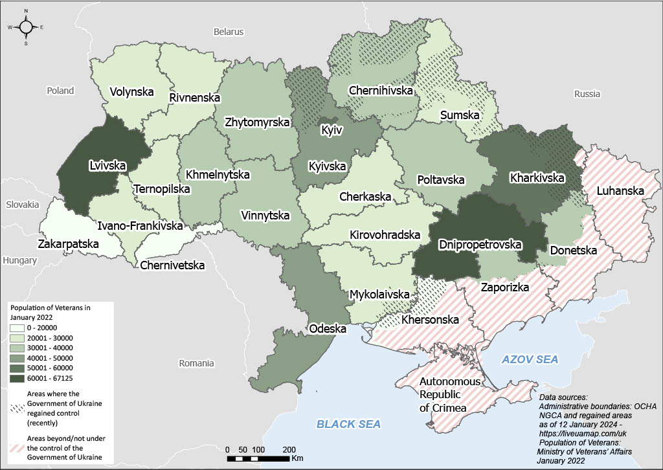
Methodology
Geographical scope:
Dnipro, Dnipropetrovska Oblast
Localised approach
Distribution of veterans by oblast, as of January 2022

Slide 10
Methodology
15 KIIs
with service providers
(NNGOs, INGOs, CSOs, government service providers)
5 KIIs
with government representatives
6 IIs
with family members of veterans / fallen soldiers
32 IIs
with veterans
(incl. men, women, people with disability)
Qualitative methods:
Key Informant Interviews (KIIs)
Individual Interviews (IIs)
Data collection:
18th October – 12th November 2023

Slide 11
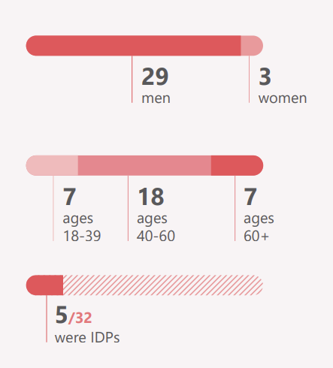
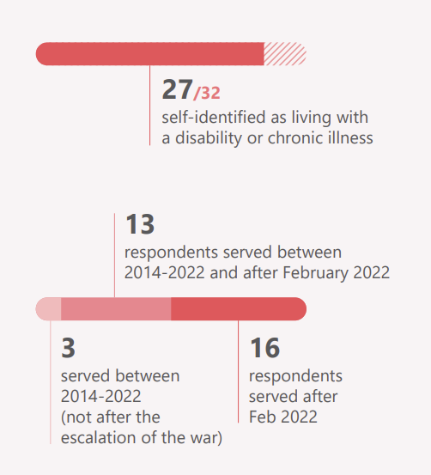
Veteran sample

Slide 12
Challenges and Limitations
Difficulties with accessing the veteran population (incl. challenges of locating respondents and the sensitivity of topics discussed)
Consultations with stakeholders in government, and collaboration with veterans' organisations
Sample is not representative of Dnipro's veteran population
Results are indicative and reflect perceptions in Dnipro in October-November 2023

Slide 13
03
Key findings

Slide 14
Most frequently mentioned needs included: psychosocial support, healthcare services, and support with securing employment and retraining.
Veterans reported needing increased administrative and legal assistance to understand and obtain the benefits to which they are entitled.
The types of needs have reportedly not changed since the full-scale invasion, but the number of those in need has increased.
Some did not apply for any services, e.g., veterans in good health and with secure financial standing.
Needs of veterans and their families

Slide 15
Importance
MHPSS
MHPSS was the most frequently reported need, crucial for return to civilian life.
Issues faced
Psychological issues experienced after demobilisation included: PTSD, anxiety, chronic stress, feeling withdrawn, anti-social, or apathetic.
Services needed
Some veterans may need community support groups, in-patient psychological rehabilitation, and outpatient long-term mental health support, including counselling and medications.

Slide 16
Importance
Healthcare (physical)
Some respondents reported an increase in veterans returning from the war with serious injuries compared to the period of fighting between 2014-2022.
Issues faced
Many veterans reportedly demobilised due to injuries (incl. disabilities), while others developed health issues (e.g., chronic pain) over time.
Services needed
Healthcare needs often included: surgical operations, limb prosthetics, rehabilitation and physiotherapy, dental services (incl. implants), regular check-ups, and provision of medications.

Slide 17
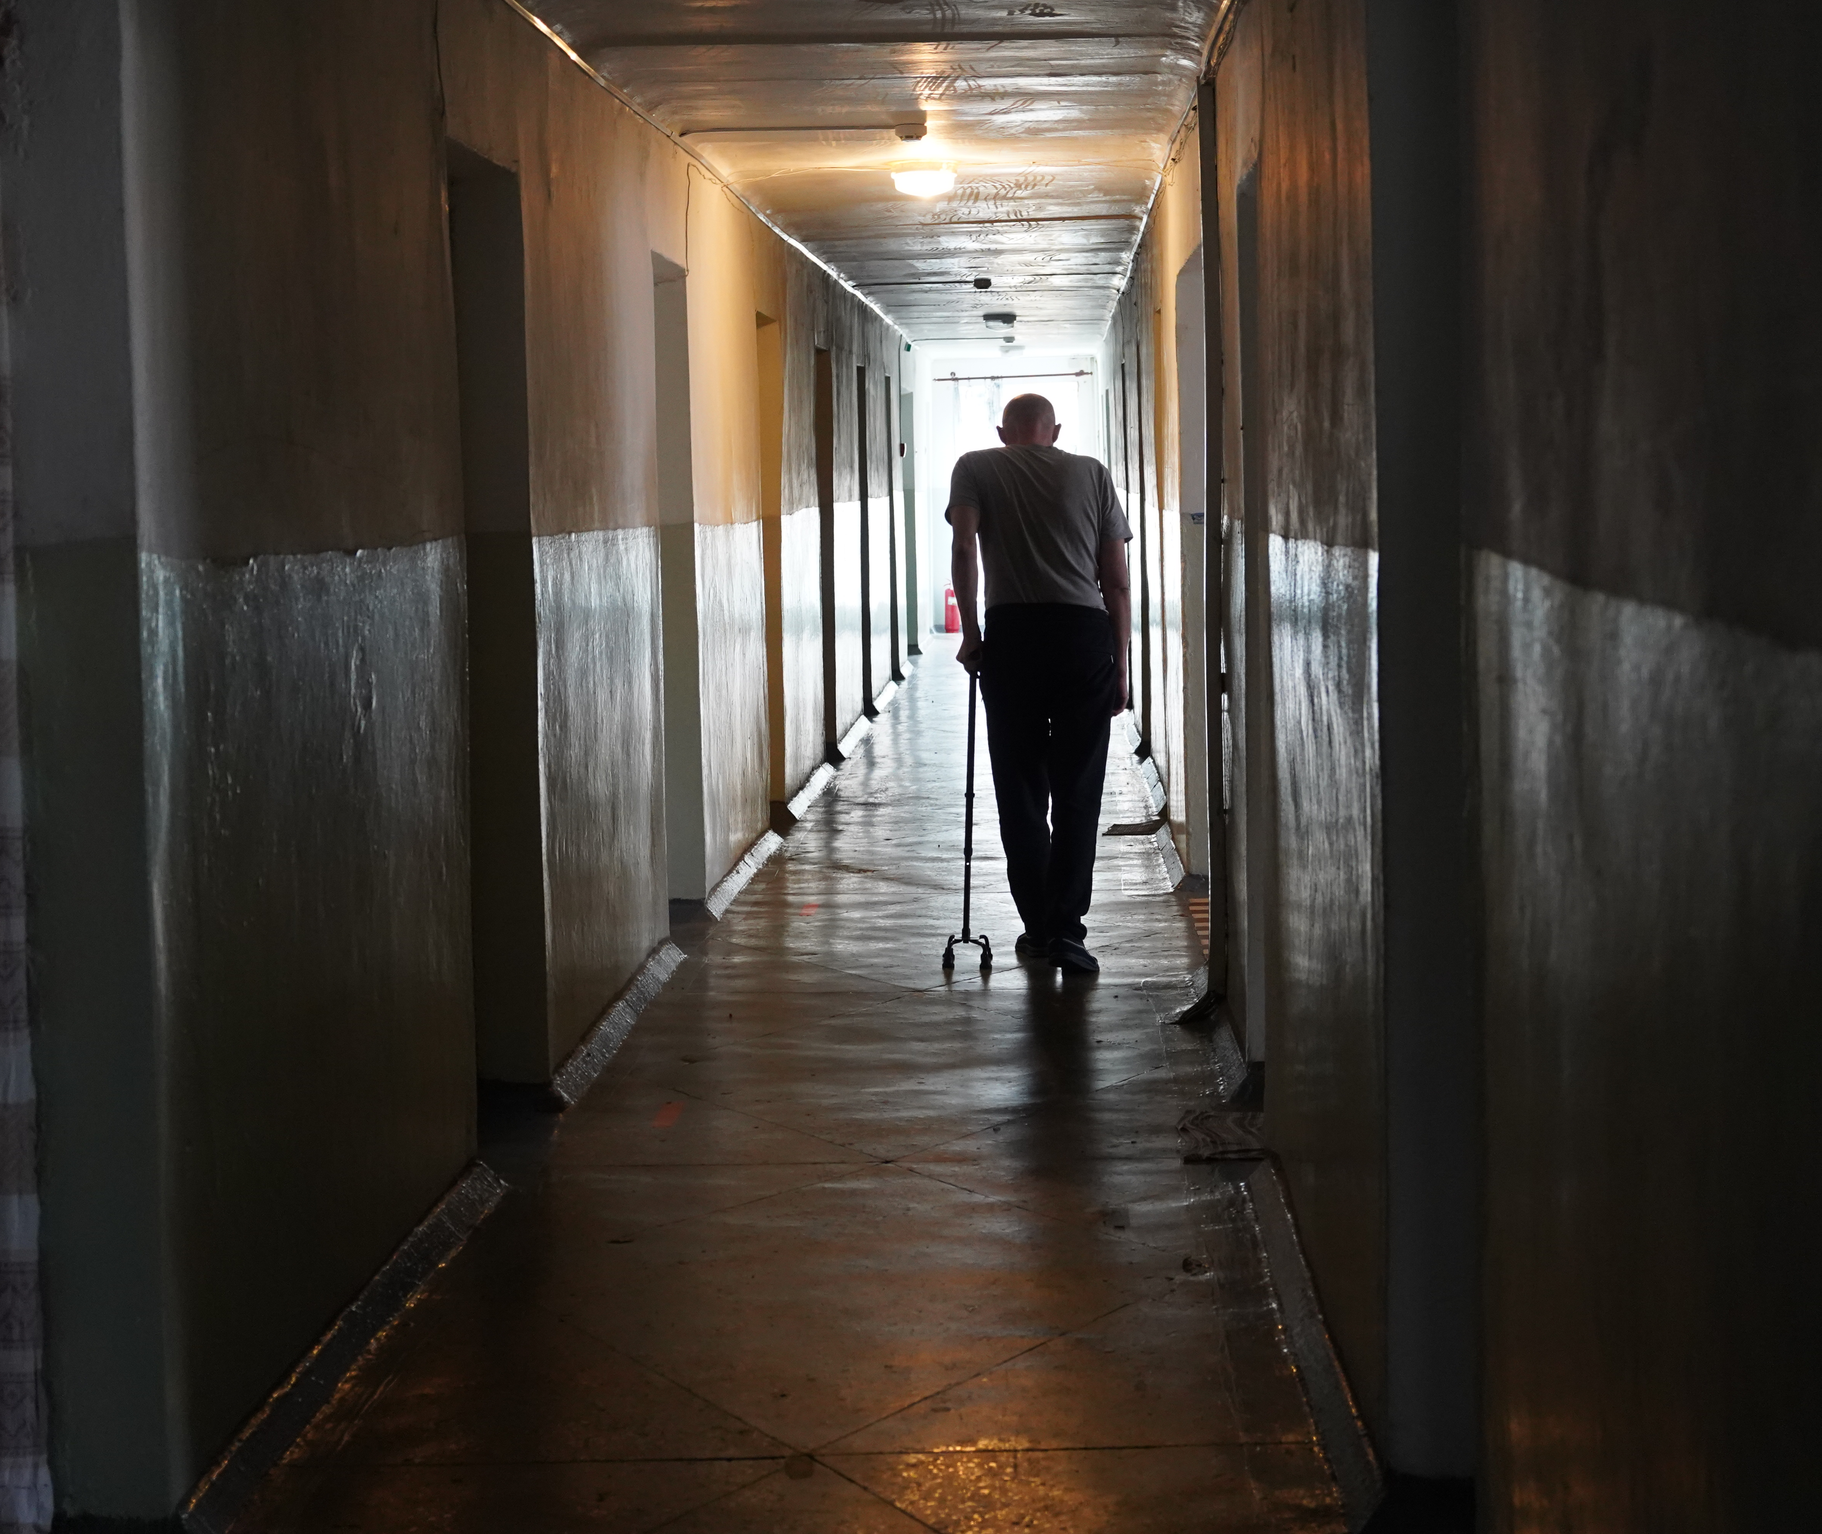
'There are many people who came back without limbs, so most of all they need mental health support. If a person has [physically] adapted to life without a limb, it is still very difficult for him psychologically to understand that he will not be able to return to normal life'.
- Veteran, 40-60, male, disability, civilian prior to February 2022
© Ines Dadda for Acted Ukraine 2023

Slide 18
Importance
Employment
Many veterans highlighted that support with employment and retraining after demobilisation, was crucial to secure financial stability.
Issues faced
Some were unable to return to their previous professions, e.g., due to disability or mental health issues.
Services needed
Required services included: assistance with securing employment, learning new professional skills, and support in starting a business.

Slide 19
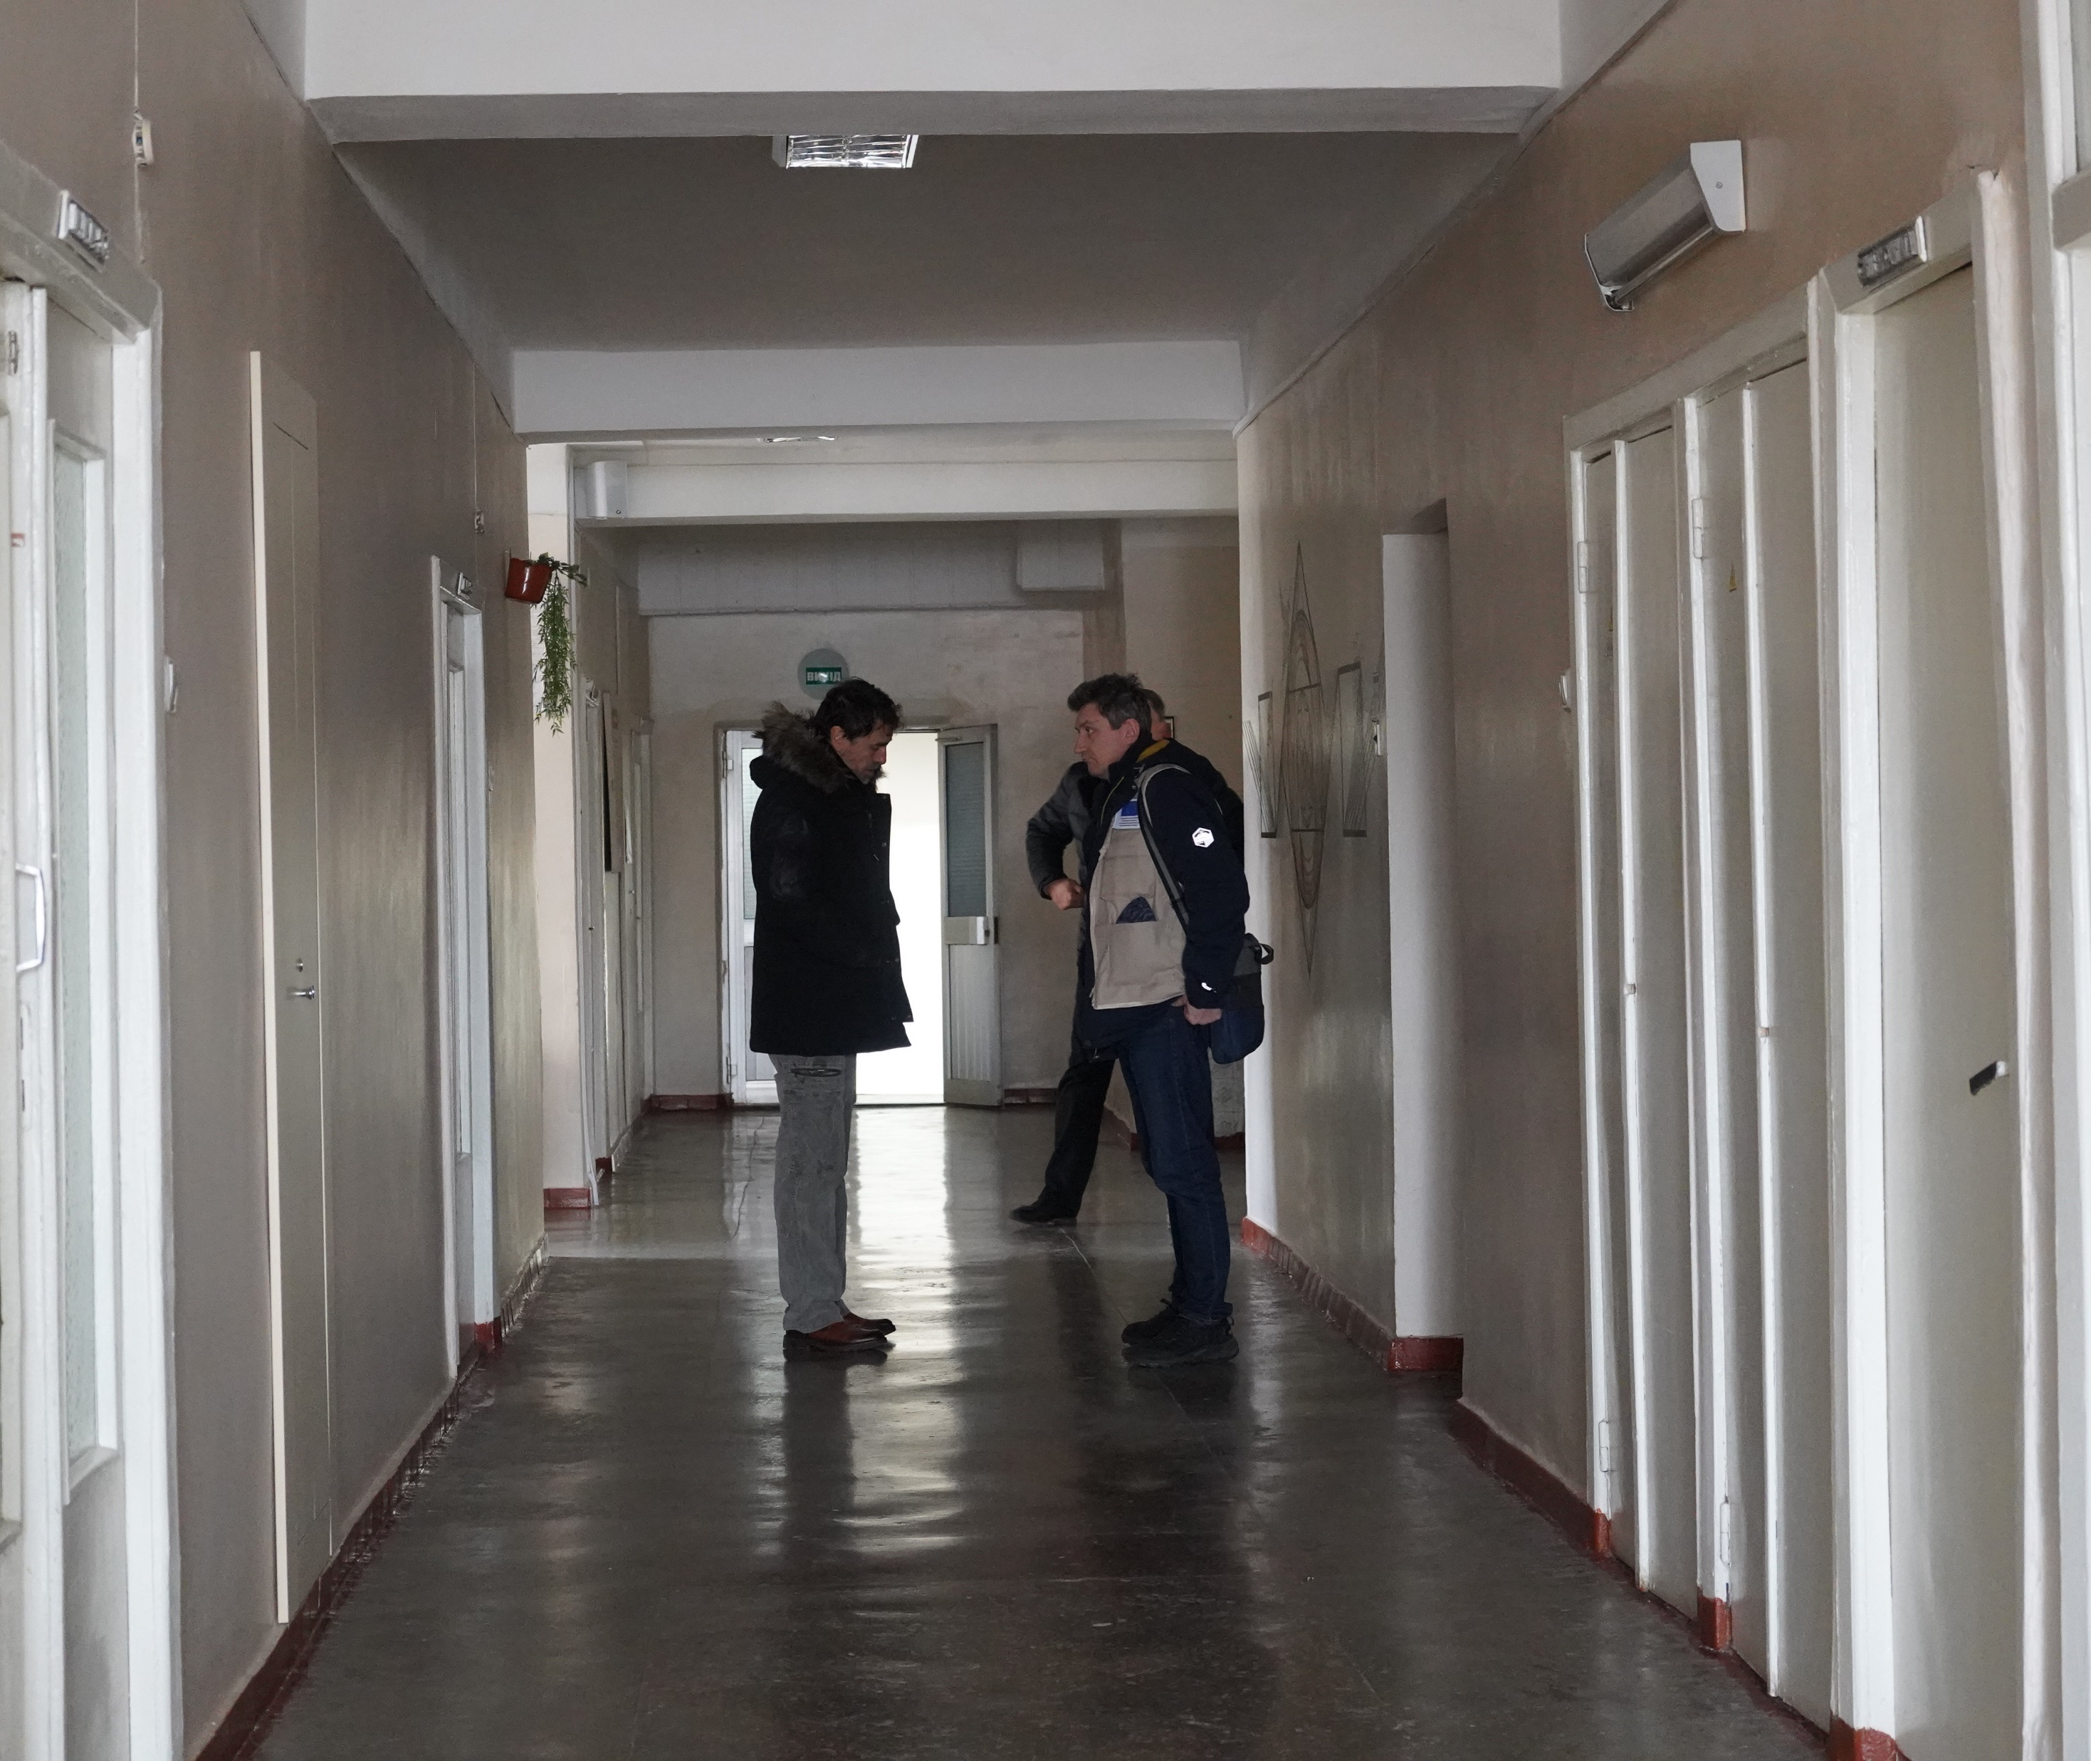
'I see the same servicemen with disabilities returning. Six months ago, a year ago, they were self-sufficient. Now they are returning, they have disabilities, problems with limbs, they do not know what to do, they cannot work as before, they are confused'. - Veteran, 40-60, male, civilian prior to military service
'Veterans with disabilities especially need help finding jobs because businesses are not designed to employ people with disabilities at all'. - Veteran, 18-39, female, disability, civilian prior to military service
© Ines Dadda for Acted Ukraine 2023

Slide 20
A variety of services were provided to veterans and their families in Dnipro by state and non-state institutions:
State institutions: Administrative Service Centre, Veterans Development Centre, Pension Fund, Social Protection Department, military enlistment offices, and state hospitals.
Non-state institutions: veterans’ associations, local volunteer groups, charitable foundations, international organisations, and local NGOs.
Respondents highlighted insufficient funding of service providers as a barrier to ensuring the availability of services, which often resulted in prolonged waiting times.
Availability of services

Slide 21
Services available
MHPSS
Provided by state institutions and NGOs
Specialised NGOs providing trainings to medical and other workers on veterans' mental health
Healthcare
Provided at military and public hospitals, private clinics, family doctor practices
Included surgery, outpatient treatment, medical examinations, dental services, provision of medications
Concerns over availability of rehabilitation services

Slide 22
Services available
Employment
Provided, e.g., by the Veterans Development Centre, Employment Centre, and Veteran Hub
Included consultations regarding employment and retraining, loans for small business development, cash and in-kind assistance
Law and administration
State institutions (e.g., Administrative Services Centres) - issuing certificates, managing applications for access to services, providing information
Non-state organisations (e.g., the Veteran Hub) - providing legal aid

Slide 23
Accessibility of services
Veterans with disabilities faced difficulties getting to, and moving through, facilities where they accessed services (e.g., hospitals).
Some respondents found services unaffordable and, though many services are meant to be free, veterans and their families often paid for services.
Unclear information and complicated administrative and bureaucratic procedures also served as significant barriers to services' accessibility.

Slide 24
Physical accessibility
Opinions diverged – some faced physical challenges, while others reported that the services were in an appropriate proximity, well-connected by public transport and adjusted for persons with disability.
Most reported that the facilities were safe.
Issues faced
Physical challenges when trying to access services when travelling to the institutions and moving inside them:
Institutions located far from the place of residence
Limited public transport connections in rural areas, not adapted for persons with disability
Numerous institutions not adapted for persons with disability
Limited access to the bomb shelters at the facilities
Vulnerable groups
People with disability
Veterans residing in rural areas

Slide 25
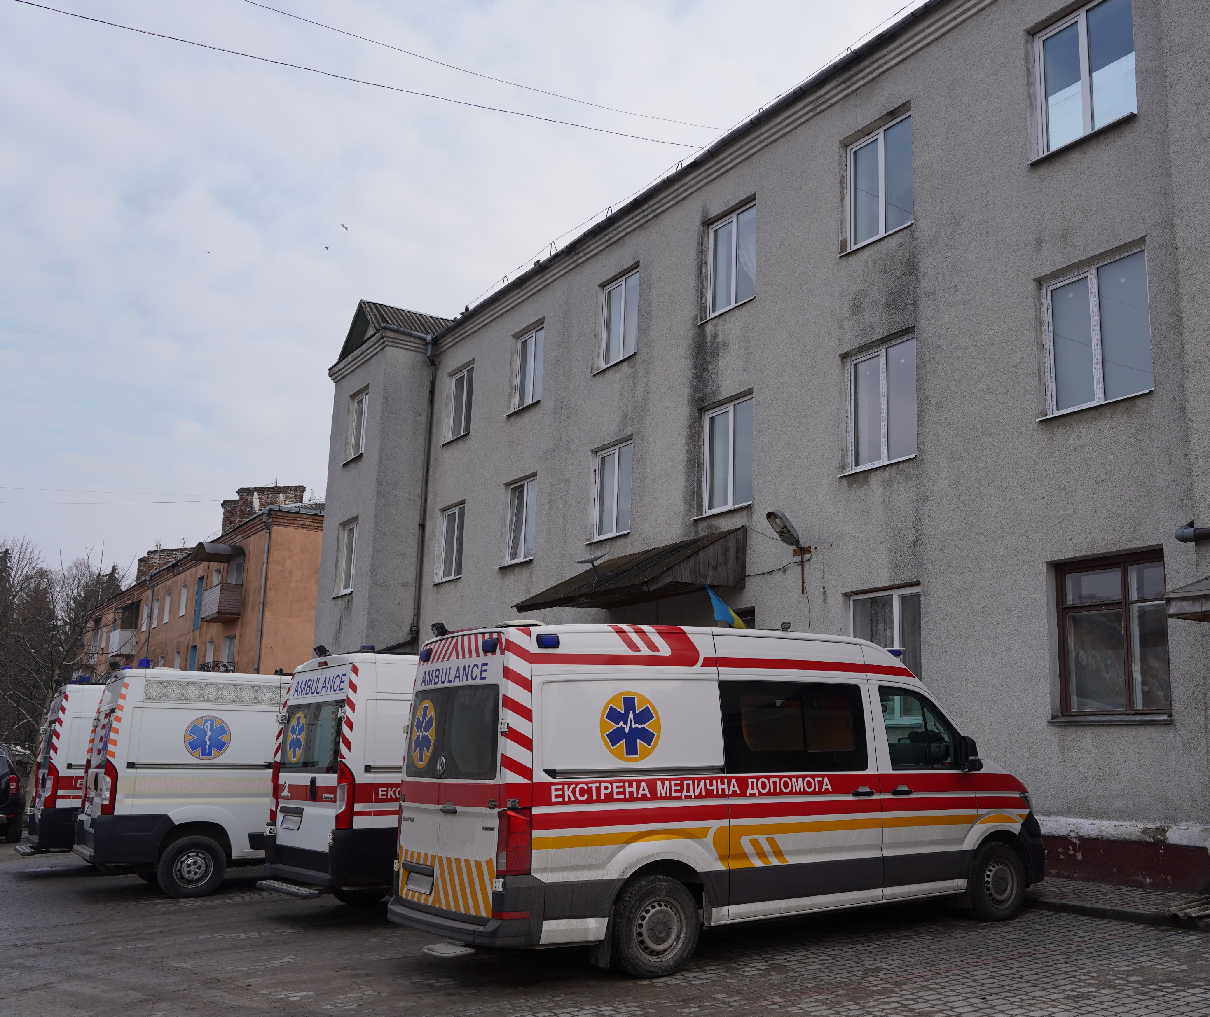
‘In the hospitals I went to, there were those that did not have elevators. […] I didn't know how to get to the 3rd floor of the hospital in a wheelchair, no one could help me in this matter. In the hospital, I also have to go around many rooms, put stamps in some, signatures in others, etc., and it is difficult for me to move’. - Veteran, 40-60, male, disability, civilian prior to February 2022
© Ines Dadda for Acted Ukraine 2023

Slide 26
Financial accessibility
Opinions diverged – some reported that services (e.g., healthcare) were often free of charge for the veterans, while others reported that they were unaffordable.
Some noted a difference in quality between state-funded and private medical services.
Issues faced
Veterans reportedly had to pay for some services (incl. MHPSS, dental and other medical services)
Some healthcare services deemed unaffordable
Difference in quality between private clinics and the public healthcare system
Confusion over services available to the veterans free of charge
Vulnerable groups
Unemployed; those in a challenging financial situation
'If the services are expensive, it means that they are not available to me'. - Veteran, 40-60, male, disability, served between 2014-2022, civilian prior to military service

Slide 27
Information accessibility
The majority reported that information was poorly communicated, obstructing access to services.
Some declared that access to information on services available to the veterans was sufficient (provided, e.g., by local Administrative Services Centres).
Issues faced
Lack of comprehensive information campaigns and sources, veterans having to find information on their own
Incomplete or inaccurate information
Frequently limited awareness of available services and relevant access paths
Common sources of information
Personal networks (family and friends)
Social media (incl. veterans' groups)
Internet websites (incl. of service providers)

Slide 28
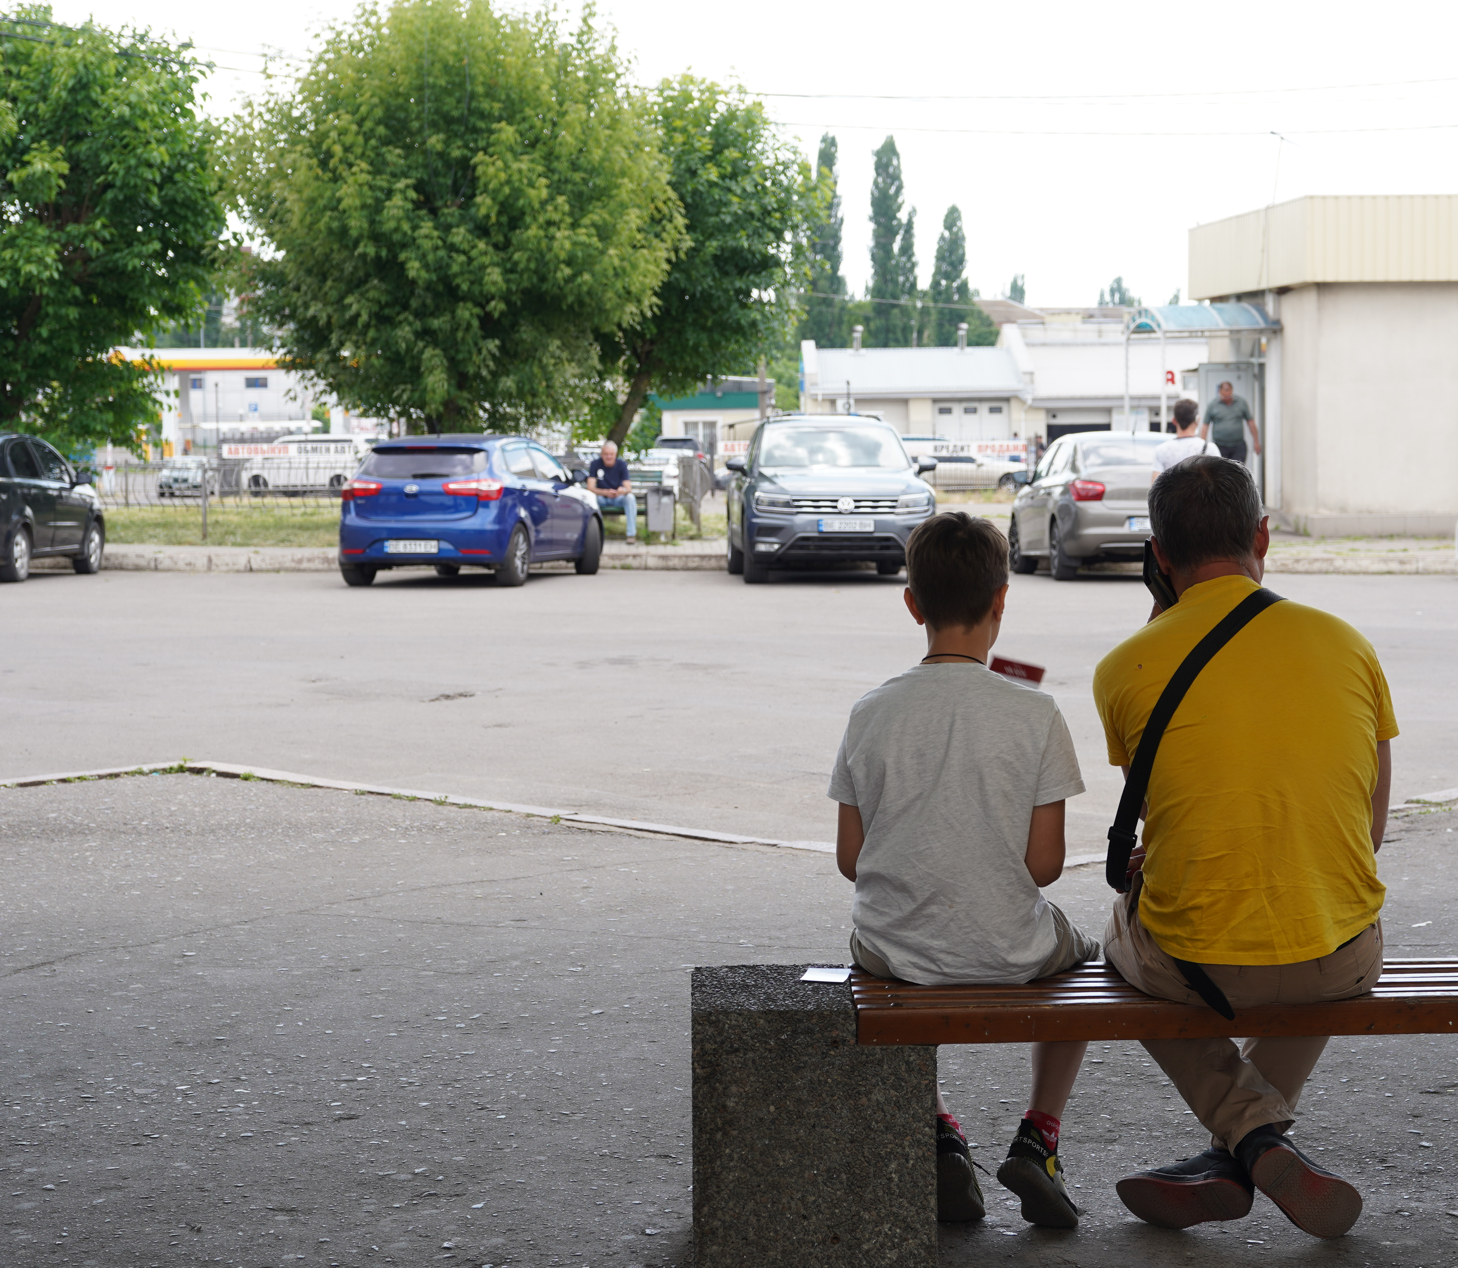
‘Now veterans really need some kind of information support in all institutions, and they lose their patience, because they don't understand where to go, what to do, and don't have a clear plan of action. […] And if we talk about awareness, then there are services, but there is no complete and clear information about them, people do not know how to get them’. - Veteran, 40-60, female, disability, civilian prior to February 2022
© Ines Dadda for Acted Ukraine 2023

Slide 29
Administrative accessibility
Most veterans faced bureaucratic difficulties regarding the length and complexity of the process to access services.
A minority did not encounter bureaucratic obstacles. Local ASCs began piloting the ‘I Am a Veteran’ programme, where veterans can receive a wide range of dedicated administrative services at a single location.
Issues faced
Underlying difficulty of registering as a veteran and/or a person with a disability
Prolonged process and waiting times to access services/benefits
Complexity of the process (e.g., involving multiple authorities)
Unclear application process and documentation requirements
Vulnerable groups
Veterans initially registered in another oblast
People with disability

Slide 30
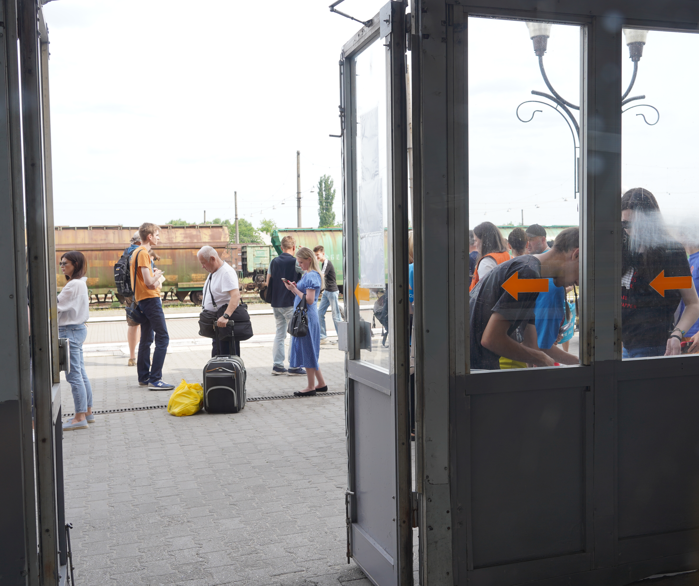
'To obtain the status of a veteran, the bureaucracy is present. Some documents are missing, they fail to inform people when they apply for the first time that another package of documents is required, and I, as a person with a disability, cannot move at all after a serious injury. My mother submits documents for me on her own. And again, you have to wait 2-3 months for the documents to be reviewed. […] Without a certificate I cannot get any free public services'. - Veteran, 40-60, male, disability, civilian prior to February 2022
© Ines Dadda for Acted Ukraine 2023

Slide 31
Responses varied greatly depending on the services in question and the individual's unique experience.
Many respondents found specialists and service providers, from staff at Administrative Service Centres to medical professionals, to be helpful and qualified.
However, concerns about the quality of services were frequently raised, regarding the quality of specialist care and available resources. These perceptions stood out in relation to MHPSS and rehabilitation.
Veterans and their families often turned to private service providers, which are more expensive but thought to be of higher quality.
Quality of services

Slide 32
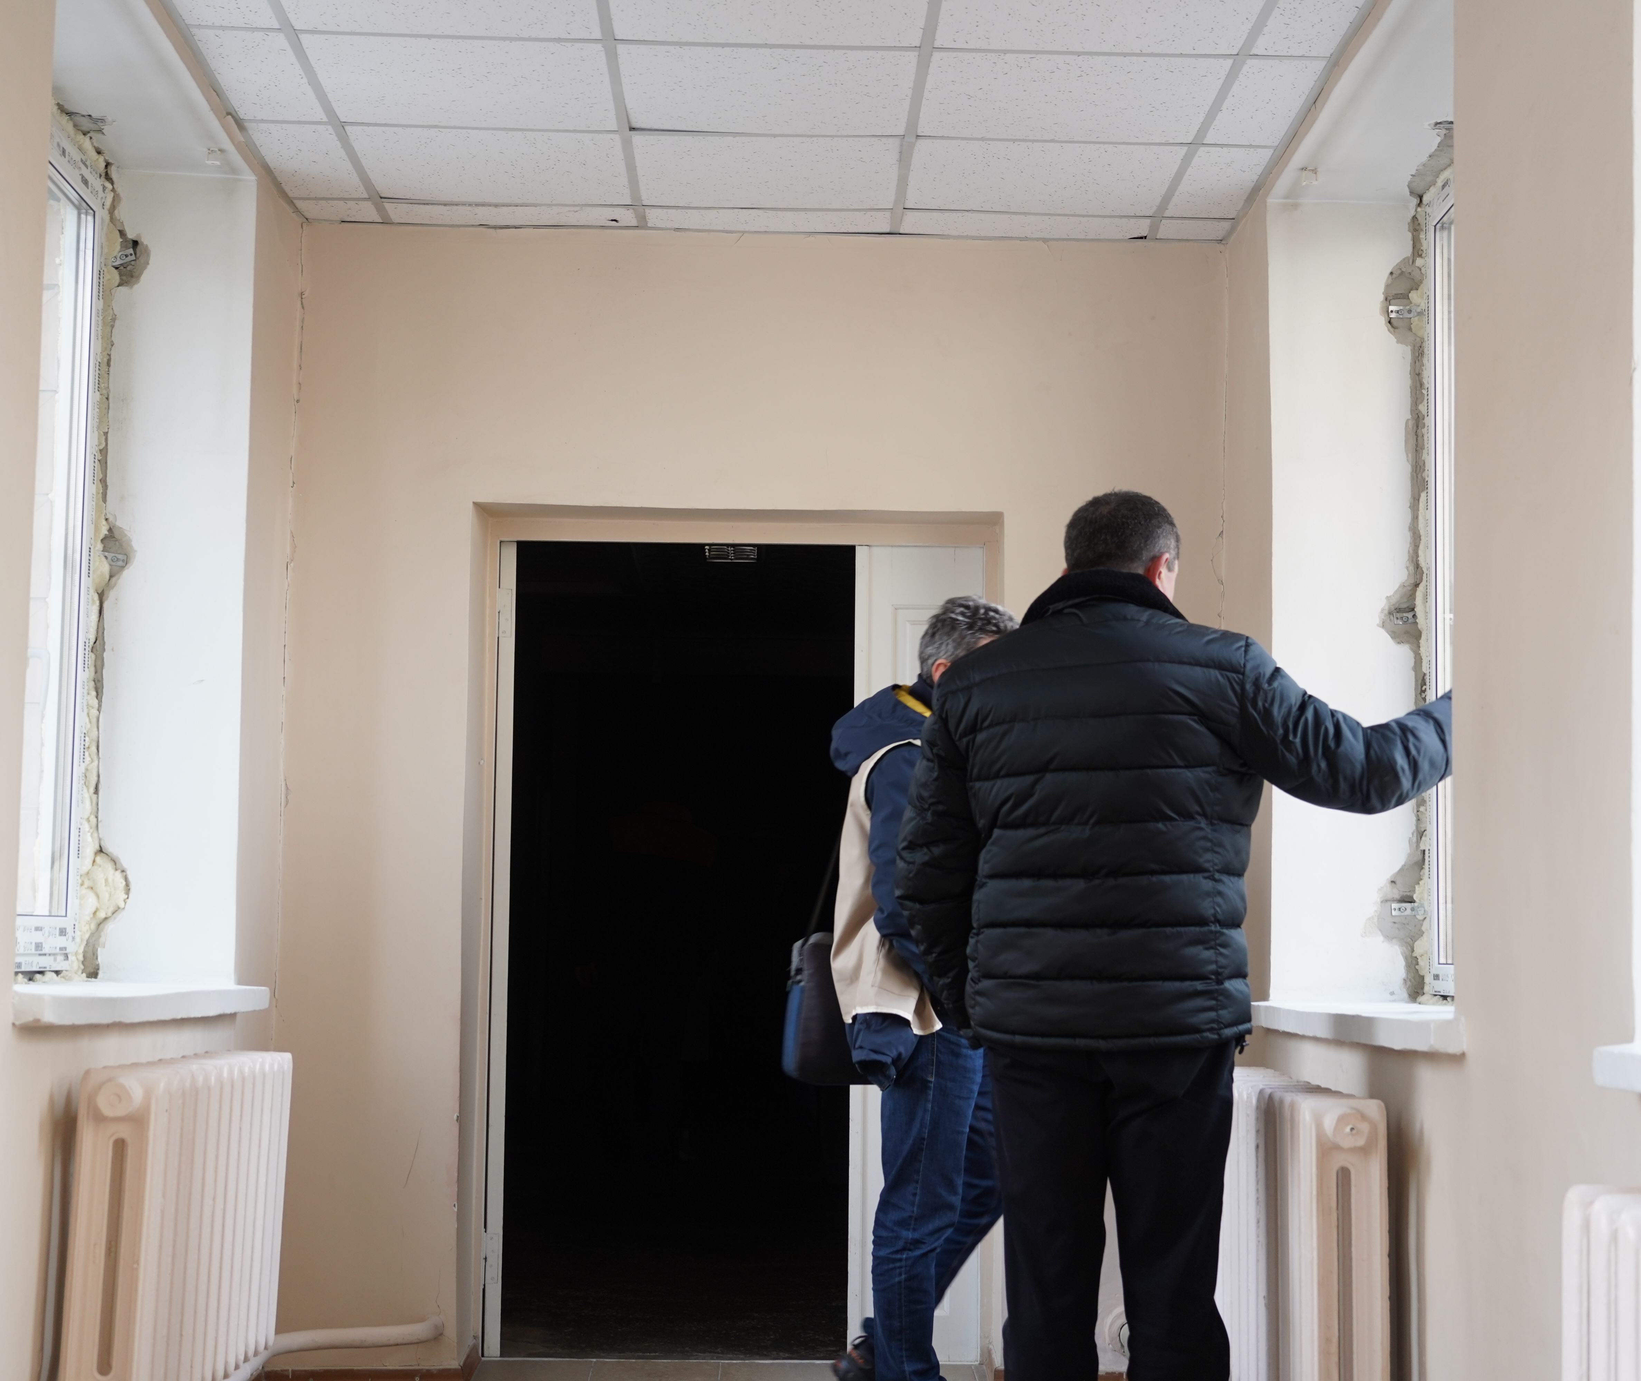
'[The specialists] always helped me with everything, told me what necessary documents I needed in order not to go to the appropriate institution that provides services twice'. - Veteran, 40-60, male, disability, civilian prior to military service
‘Regarding a prosthetic hand, I do not go anywhere in Ukraine, because this prosthesis for the hand will be of very poor quality, it is not comfortable and does not hold. […] And there are high-quality prostheses, for example, in the United States, but it costs a lot of money, which I don't have’. - Veteran, 40-60, male, disability, civilian prior to February 2022
© Ines Dadda for Acted Ukraine 2023

Slide 33
The massive increase in the size of the veteran population reportedly created an imbalance between the supply and demand of services, affecting services' availability, accessibility, and quality.
However, many respondents believed that services had improved since the war's escalation, due to increased attention to the veteran population.
Changes since February 2022

Slide 34
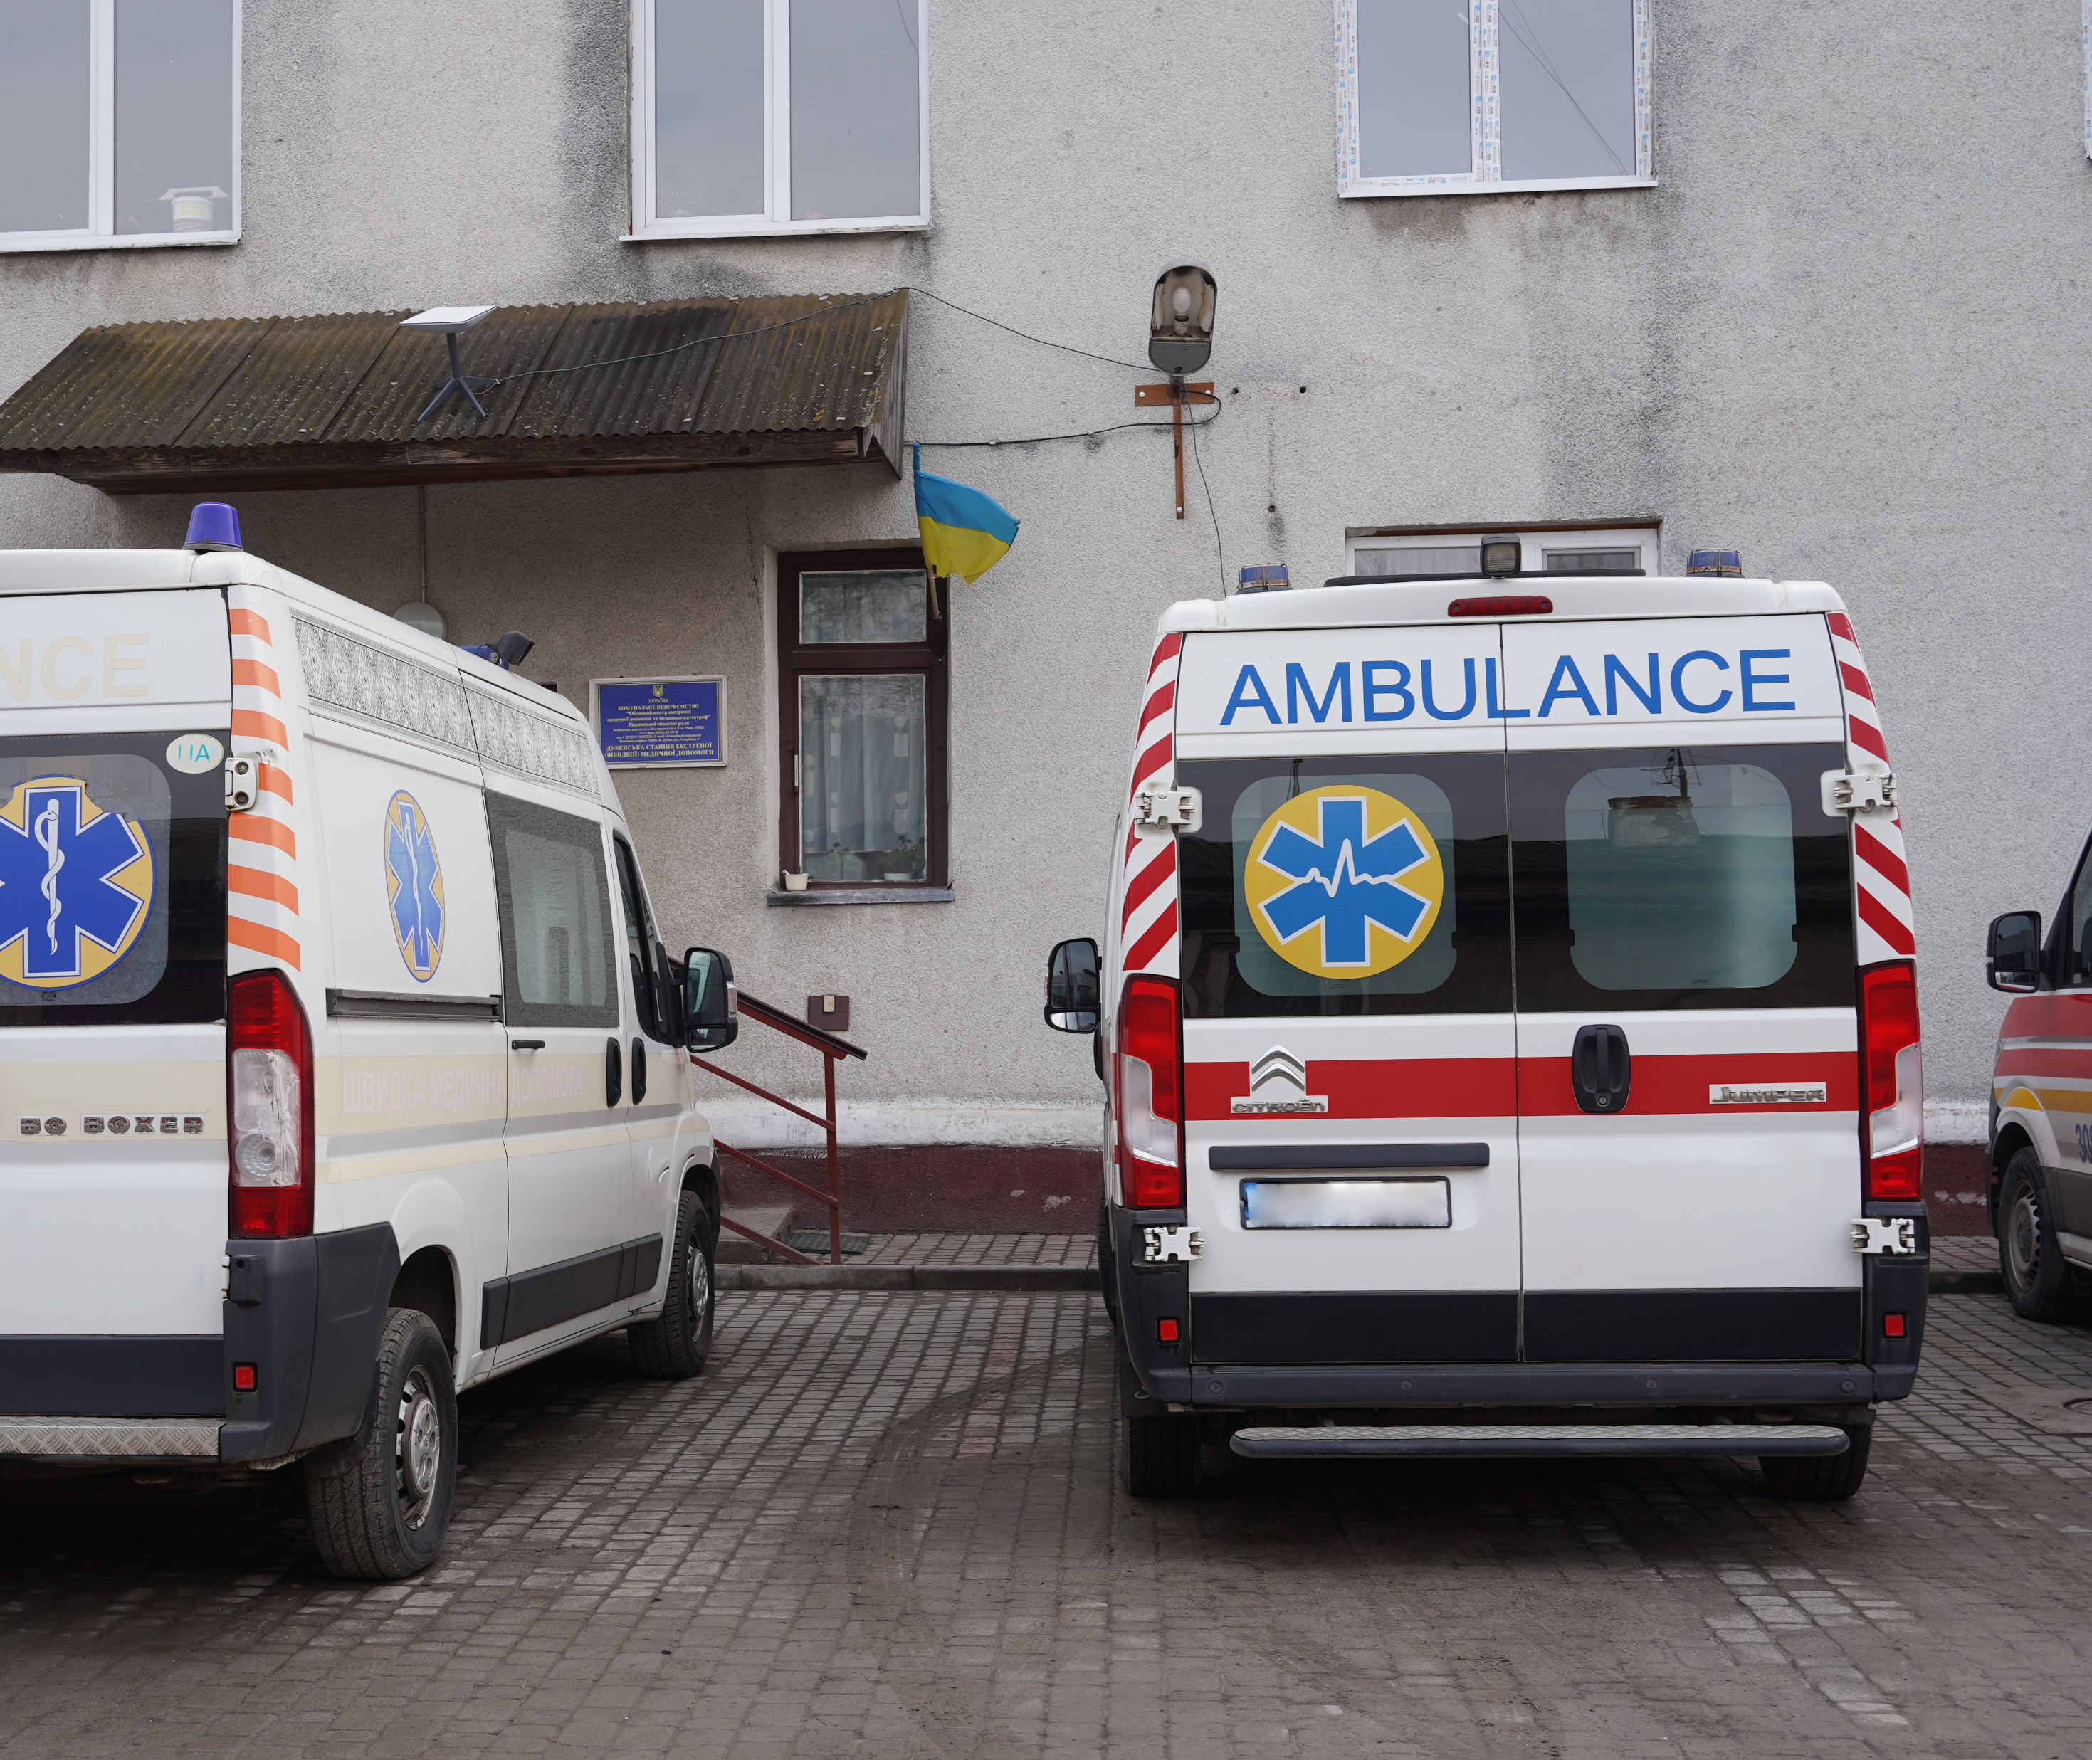
'Through conversations with comrades who have been in combat since 2014, I have heard that medical services for veterans have seen some improvement compared to past years'. - Veteran, 40-60, male, disability, internally displaced, civilian prior to February 2022
'As for health care, something needs to be improved. […] No one cares if patients have completed their treatment or not. Due to the large number of people arriving at the hospital with complex injuries all the time, there is not enough space, medicine and good specialists'. - Veteran, 40-60, male, disability, civilian prior to February 2022
© Ines Dadda for Acted Ukraine 2023

Slide 35
The extensive network of actors working on veterans’ affairs in Dnipro forms an interconnected system of service provision, where coordination and cooperation occurs by varying degrees of formality.
Coordination among veterans' affairs actors
State actor
State actor
Non-state actor
Non-state actor

Slide 36
04
Conclusion

Slide 37
Conclusion
The system of service provision for veterans in Dnipro is extensive and improving, but does not meet veterans' needs in several domains, while demand for services is expected to continue to increase.
Recommendations raised by respondents:
Ensure adequate funding and capacity
Expand and improve medical services (including MHPSS) and facilities
Simplify and improve administrative processes
Avenues for further research

Slide 38
Bibliography
[1] Maryna Orekhova, 'How an Educators and a Veteran Guides Fellow Veterans Through Return to Civilian Life', IOM, 14 December 2023, https://ukraine.iom.int/stories/how-educator-and-veteran-guides-fellow-veterans-through-return-civilian-life
[2] Ministry of Veterans Affairs, 'Ministry for Veterans Affairs is consistently implementing the project "Development of Sports for Veterans" within the framework of creating a barrier-free space in Ukraine, says Yuliia Laputina', 1 December 2023, https://mva.gov.ua/ua/news/minveteraniv-poslidovno-realizuye-proyekt-rozvitok-sportu-dlya-veteraniv-v-mezhah-stvorennya-bezbaryernogo-prostoru-v-ukrayini-yuliya-laputina; '"It's a category of powerful people." Minister for Veterans Affairs spoke about assistance to veterans and their families', 23 May 2023, https://mva.gov.ua/ua/news/ce-kategoriya-potuzhnih-lyudej-ministr-u-spravah-veteraniv-rozpovila-pro-dopomogu-veteranam-i-yihnim-rodinam; IOM, ‘The Social Reintegration of Veterans in Ukraine: With a Special Focus on the Inclusivity of Particularly Vulnerable Veterans and the Role That Veterans’ Organisations Can Play in Building Inclusivity’, January 2024, https://ukraine.iom.int/sites/g/files/tmzbdl1861/files/documents/2024-01/veterans-social_reintegration_eng.pdf
[3] IOM, 'Veterans' Reintegration in Ukraine: National Survey', February 2022, https://ukraine.iom.int/sites/g/files/tmzbdl1861/files/documents/VETERANS%E2%80%99%20REINTEGRATION%20IN%20UKRAINE_ENG-NEW.pdf; UNDP, 'Reintegrating ATO & JFO Veterans', 31 January 2022, https://reliefweb.int/report/ukraine/reintegrating-ato-jfo-veterans-january-2022

Slide 39
Thank you for your attention
Brett Schmicking, Research Manager: brett.schmicking@impact-initiatives.org
Owen Boed, Assessment Officer: owen.boed@impact-initiatives.org
Joanna Jaworska, Senior Assessment Officer: joanna.jaworska@impact-initiatives.org

