Slide 1
COVID-19 KAP Survey
Presentation of final results
Sebastian LANGER – REACH GIS Specialist
November 2020

Slide 2
COVID-19 KAP Survey
Situation in Somalia
Somalia confirmed its first case of COVID-19 in Mogadishu on 16 March 2020
As of 24 November, there are 4,445 confirmed cases in Somalia
As of 24 November, there are 113 confirmed death cases in Somalia
Some reports suggest that the actual numbers might be higher
Little information on awareness, rumors and adaption of behavior with regards to COVID-19
Knowledge, Attitudes & Practices (KAP) survey by REACH in collaboration and funded by WASH Cluster Somalia
Research awareness and behavior with regards to COVID-19
Identify existing information gaps
See relation with situation with regards to WASH services
Support evidence-based decision making for WASH intervention to the COVID-19 pandemic
KAP survey

Slide 3
Methodology
Methodology
Key informant (KI) interviews in 7 locations
Location choice to achieve high geographic coverage
Minimum target of 100 phone interviews per location
50% of KIs from displaced populations
50% of KIs from non-displaced communities
Minimum target of 10% especially knowledgeable KIs
Classification of especially knowledgeable KIs based on role
Total KIs:
1,052

Slide 4
Methodology
Methodology
KI selection based on previous REACH assessments
… and referrals during the survey
Data collection from 20 Sept – 30 Sept 2020
Data collected using KoBo
Total of 42 questions
Findings should be considered as indicative only
Total KIs:
1,052

Slide 5
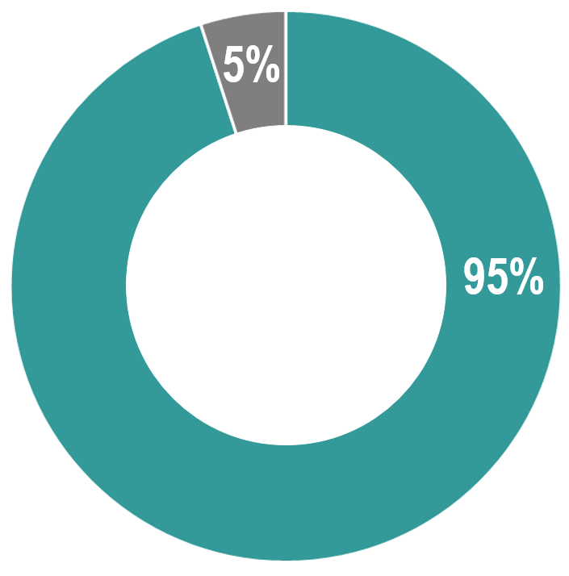
Results - General
Heard about COVID-19
Differences between status
No significant differences between displaced populations and non-displaced populations were observed across all indicators
95% of all KIs reported having heard about COVID-19

Slide 6
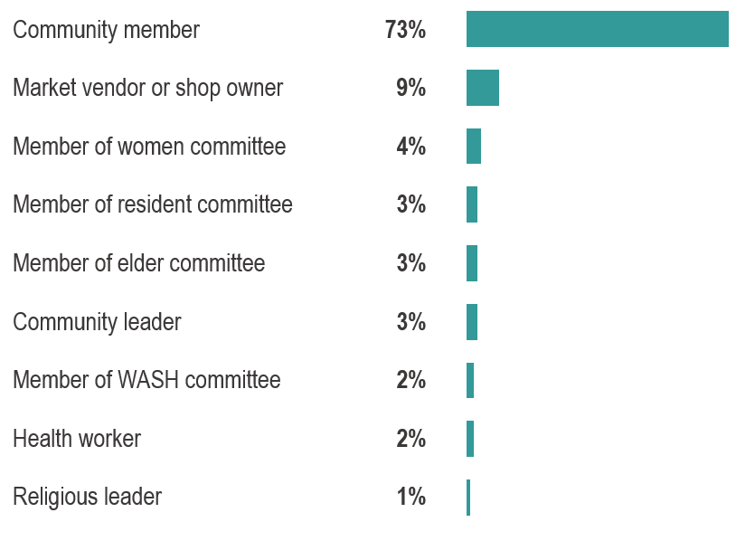
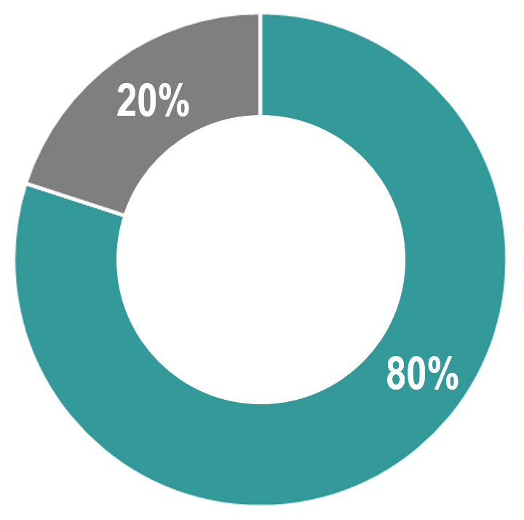
Results - General
Especially knowledgeable KIs interviewed for this assessment
Type of site displaced KIs reported to live in
80% of all displaced KIs reported living in IDP camps
“especially knowledgeable”

Slide 7
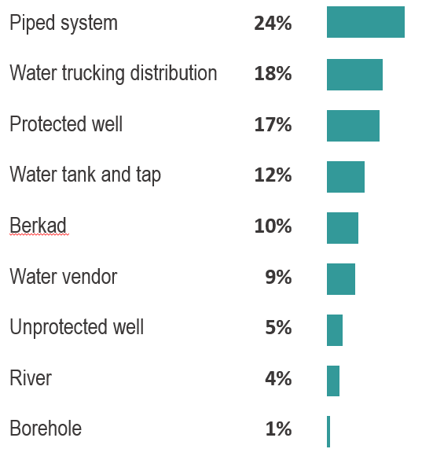
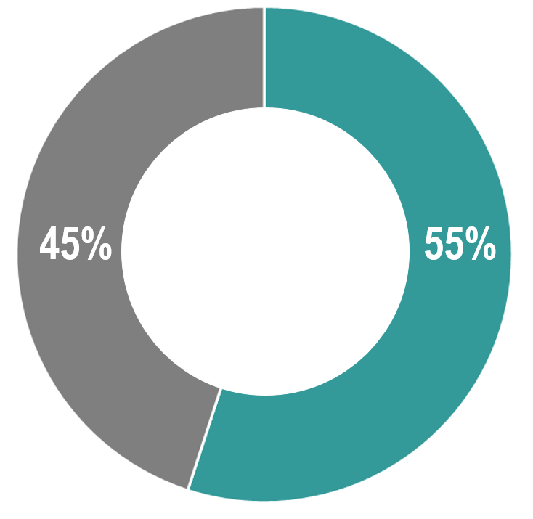
Results - General
% of KIs reporting main water source used in the community they live in
Access to water
55% of all KIs reported most community members being able to access a sufficient quantity of water

Slide 8
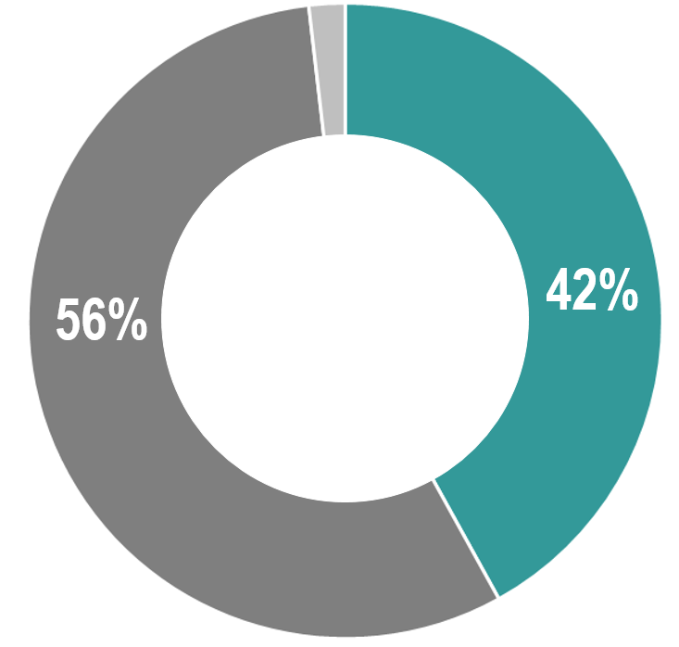
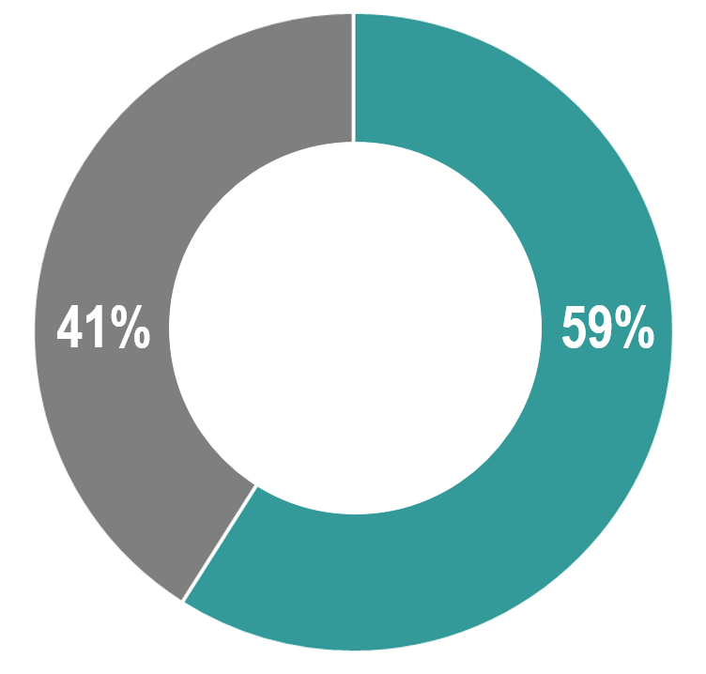
Results - General
Hygiene
Health
42% of all KIs reported most community members being able to access handwashing facilities and soap
2% responded “don’t know”
59% of all KIs reported most community members being able to access a health facility

Slide 9
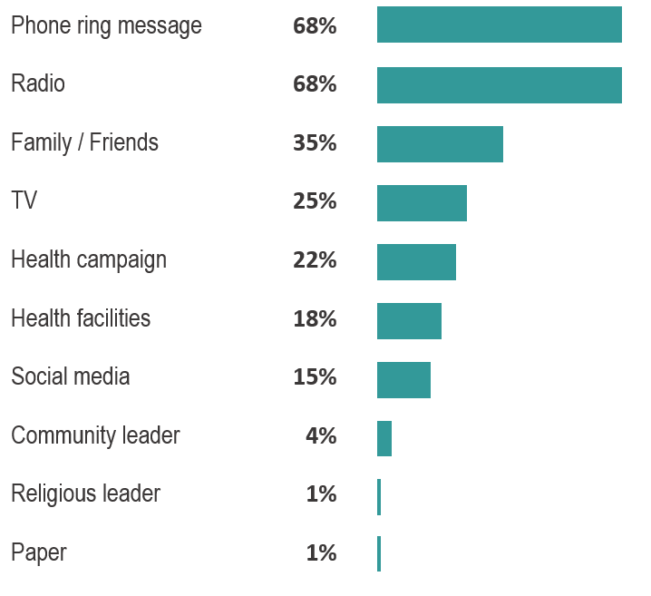
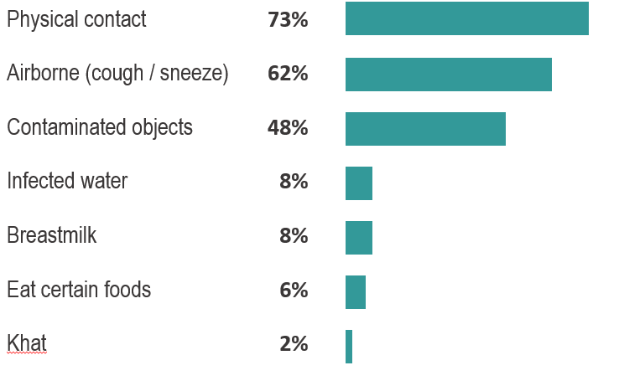
Results - Knowledge
% of KIs reporting source where people get most information about COVID-19*
% of KIs reporting perceived ways to get COVID-19*
* Multiple answers possible

Slide 10
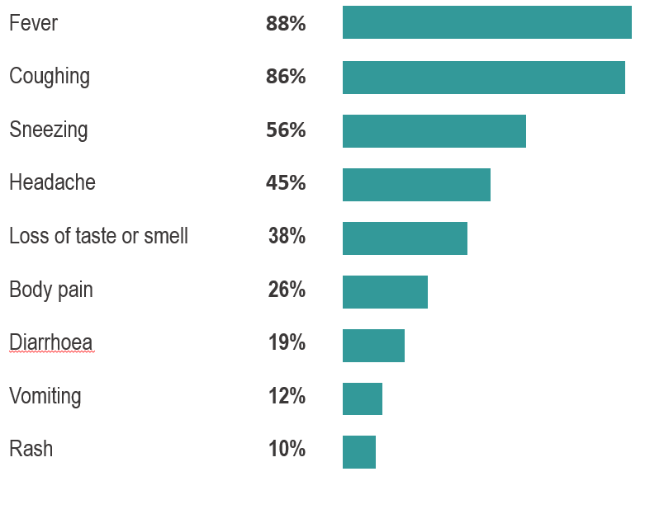
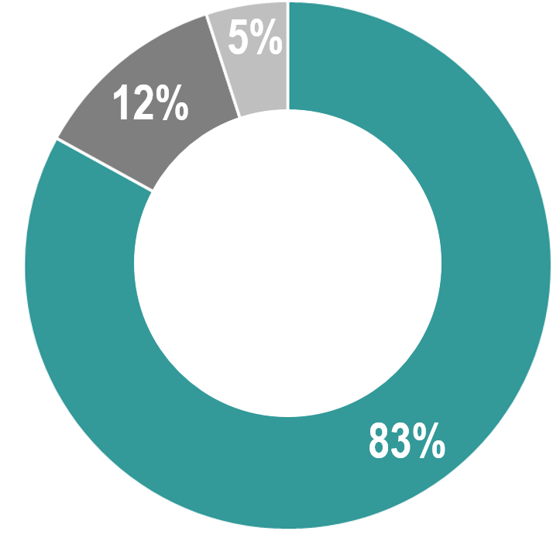
Results - Knowledge
COVID-19 symptoms
% of KIs reporting perceived possible symptoms of COVID-19*
83% of all KIs believed that everyone infected with COVID-19 shows signs or symptoms
5% responded “don’t know”
* Multiple answers possible

Slide 11
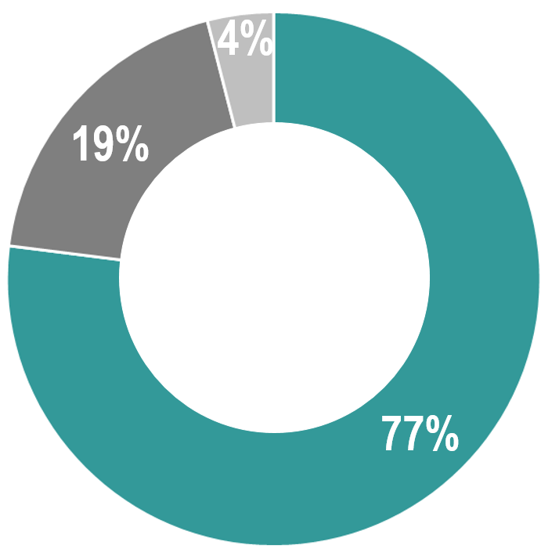
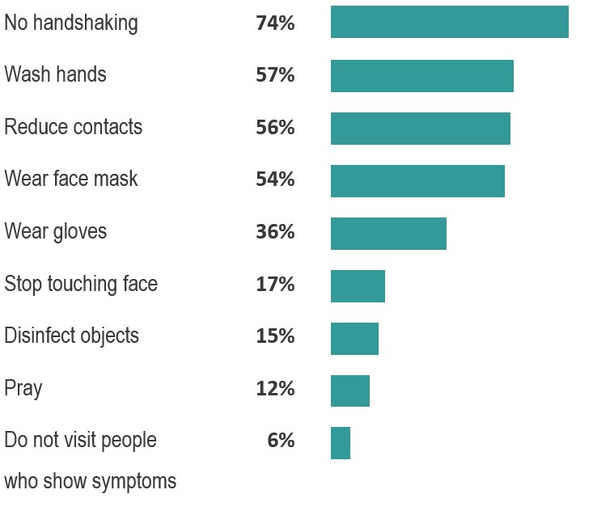
Results - Knowledge
COVID-19 risk reduction
% of those perceiving that measures can be taken, reported measures to reduce the risk of getting COVID-19*
77% of all KIs believed that measures can be taken to reduce the risk of getting infected with COVID-19
4% responded “don’t know”
* Multiple answers possible

Slide 12
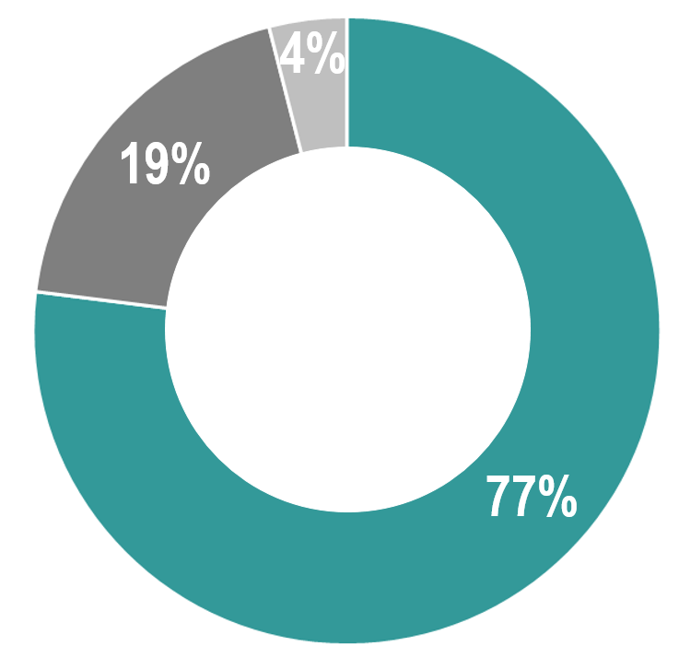
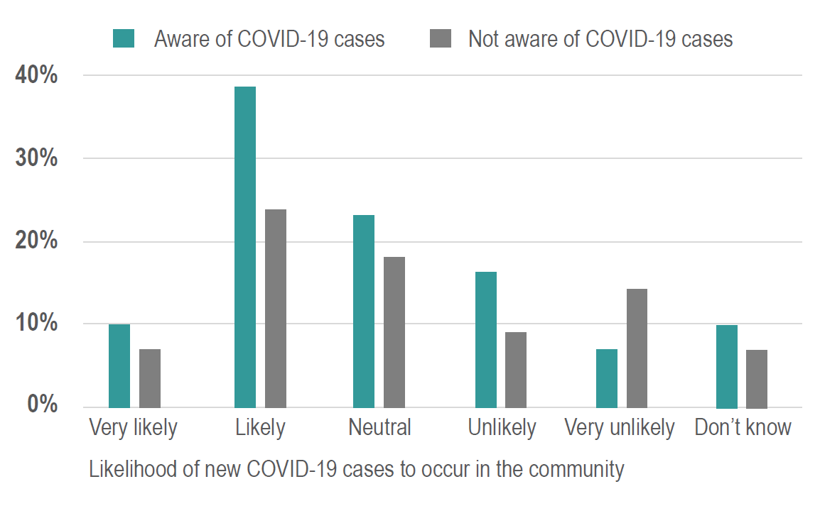
Results - Attitudes
COVID-19 cases
% of KIs reporting perceived likelihood of new COVID-19 cases to occur in their community, grouped by those reporting being aware / not aware of COVID-19 cases
77% of all KIs reported being aware of at least one COVID-19 case in their communities*
4% responded “don’t know”
*Question could have been misunderstood, or people know of suspected, but unconfirmed cases

Slide 13
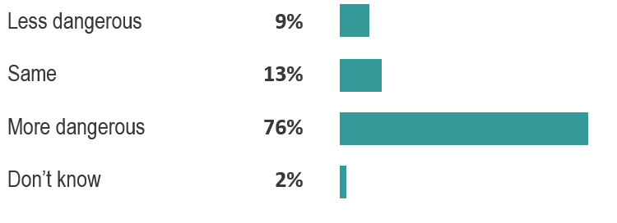
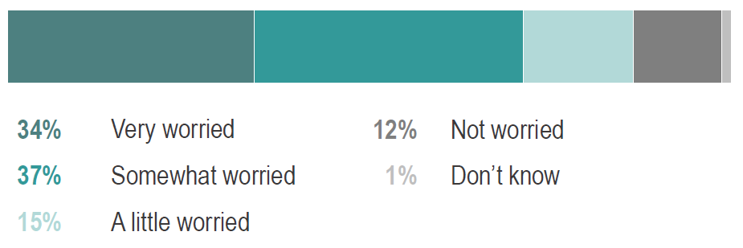
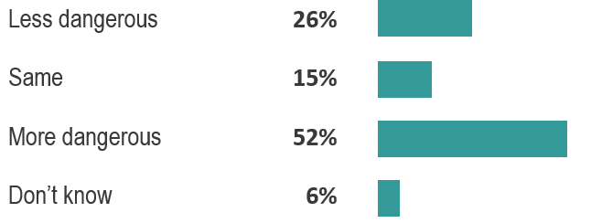
Results - Attitudes
% of KIs reporting levels of worry among the community about COVID-19
% of KIs reporting perceived danger of COVID-19 as compared to…
… a common cold
… cancer

Slide 14
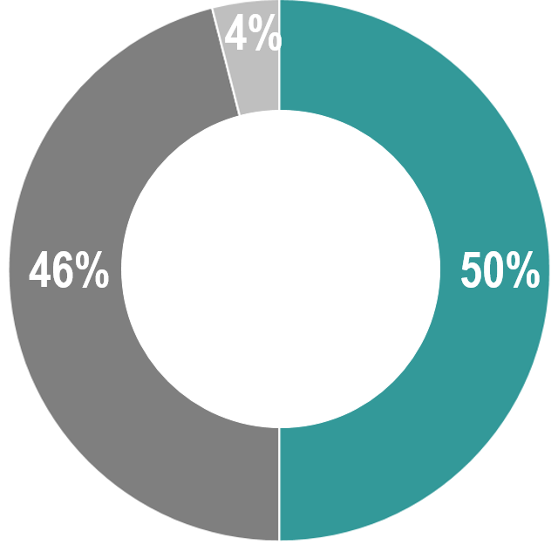
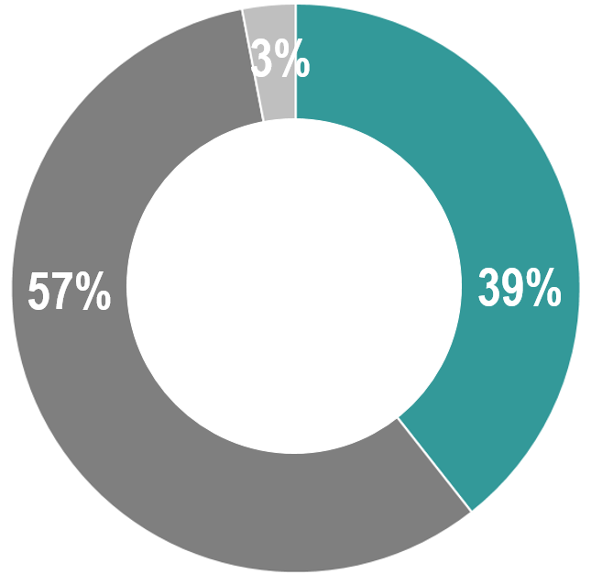
Results - Attitudes
Social behaviour
39% of all KIs reported that their community generally believed that people should not continue to participate in social gatherings
3% responded “don’t know”
50% of all KIs reported that their community generally believed that people should not shake or kiss hands to greet each other
4% responded “don’t know”

Slide 15
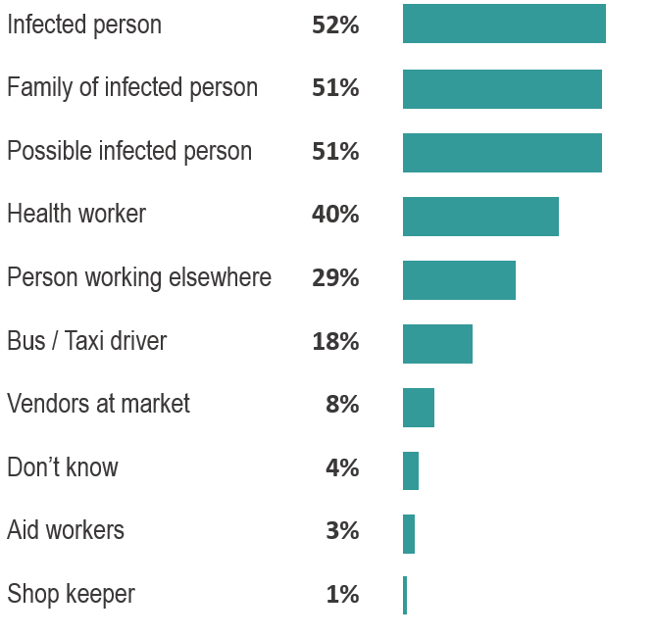
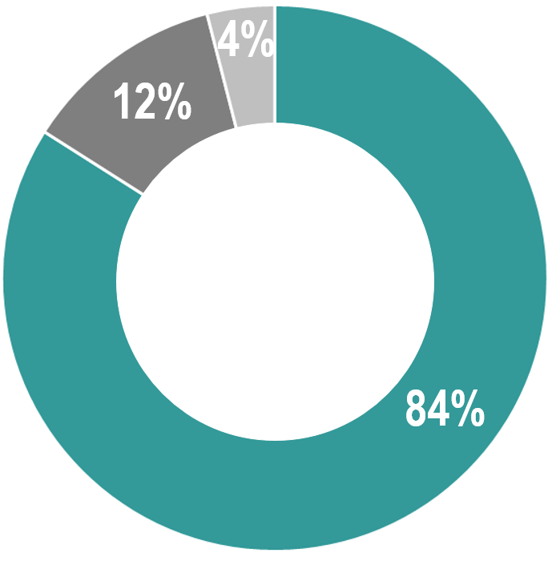
Results - Attitudes
COVID-19 related discrimination
% of KIs reported perceived groups that are discriminated against*
1
84% of all KIs believed that COVID-19 is generating discrimination against some groups of people
4% responded “don’t know”
2
* Multiple answers possible.
Of those that believe such discrimination is happening
¹ No distinction between confirmed cases and perceived positive cases was made when the question was asked
² Working outside the community, having to commute regularly

Slide 16
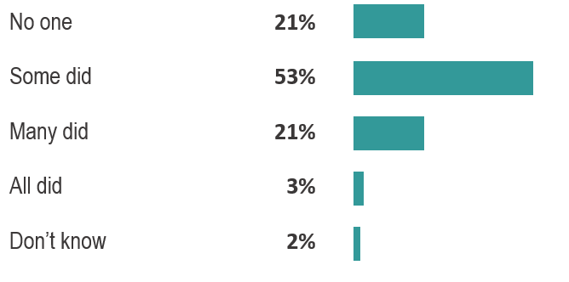
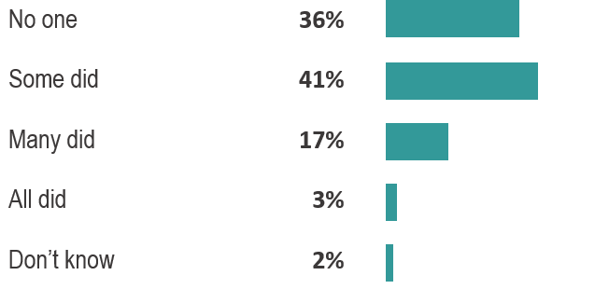
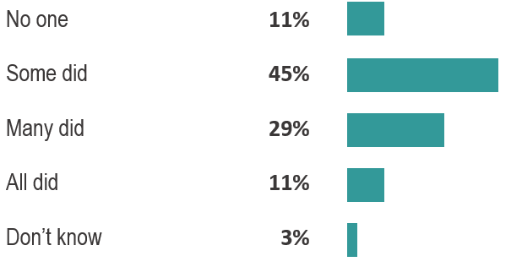
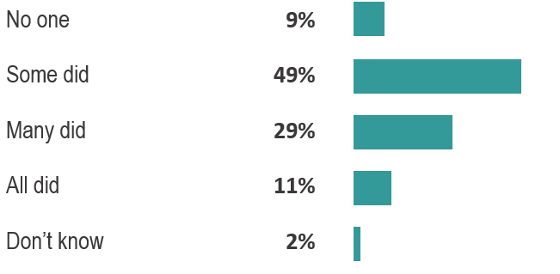
Results - Practices
Adaptation of behavior against COVID-19: “In the week before data collection, did people…?”
… shake hands when they met?
… try to keep a distance of 2m between them and others?
… attend large social gatherings?
… wash their hands more often?

Slide 17
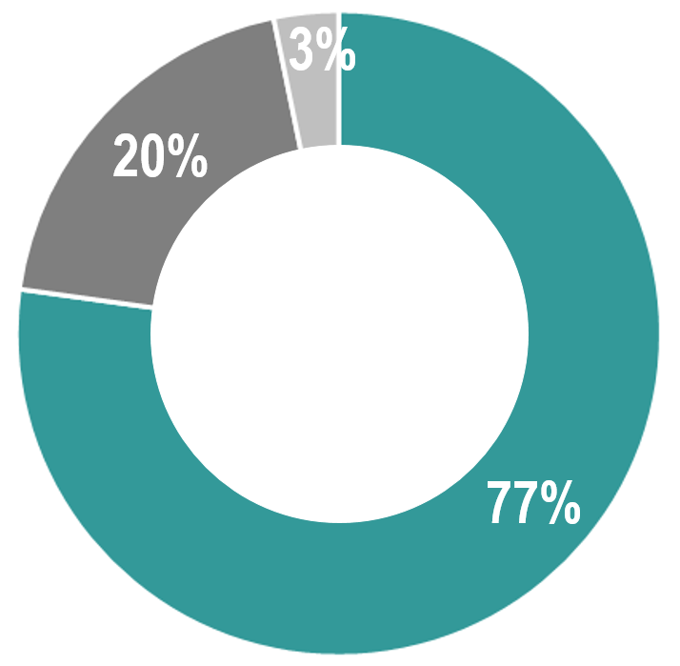
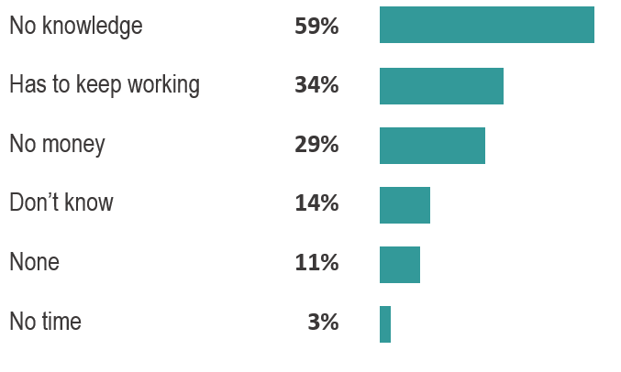
Results - Practices
Measures against COVID-19
% of KIs reporting barriers faced by those not having taken preventative measures against COVID-19*
77% of all KIs reported that people have taken preventive measures against COVID-19
3% responded “don’t know”
* Question only answered by those reporting that people in their communities have not taken preventative measures against COVID-19
Multiple answers possible

Slide 18
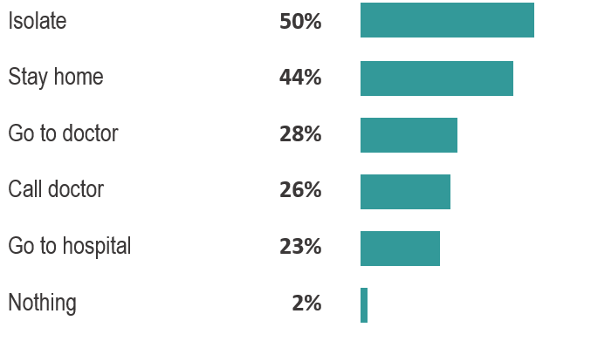
Results - Practices
% of KIs reporting perceived actions by community members if they think they or someone in their household might have COVID-19
* Multiple answers possible

Slide 19
Conclusion
Conclusion
Most people in the assessed locations are aware of COVID-19, know about its significance, and strategies to avoid getting infected
Still, most people in the assessed locations do not apply all measures towards preventing infections
Best ways to pass on information seems to be phone-ring-messages and the radio (also most trusted ones)
Of those who reported perceived discrimination because of COVID-19, infected persons (52%*) and their families (51%*) are the most likely to face discrimination (health workers – 40%*)
A reported lack of access to WASH & health services seems a larger, underlying issue which amplifies the risks of contracting COVID-19
*percentage of KIs

Slide 20
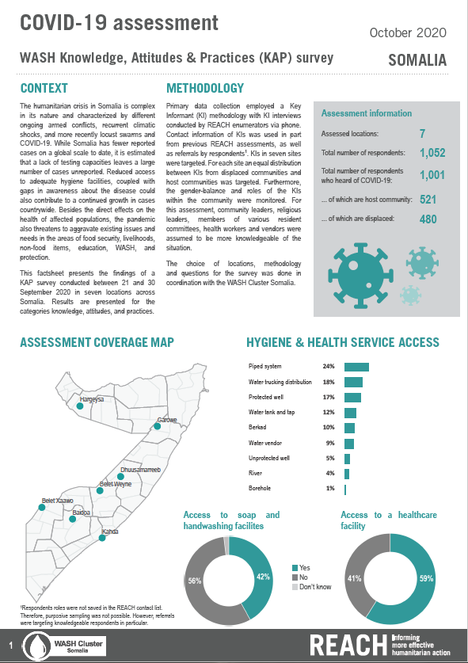
Outlook
Outlook
Publication of set of factsheets
Dissemination through WASH Cluster channels
Publication on REACH resource centre
Further analysis possible, if needed
Monitor COVID-19 situation in Somalia and neighbouring countries

Slide 21
Feedback & Questions
Do you have any Questions?
Do you have any feedback?

Slide 22
Sebastian LANGER
+252 - (0)636 360 305
Sebastian.langer@reach-initiative.org
geolanger
www.reach-initiative.org
REACH initiative
@REACH_info

