Slide 1
Returns and Durable Solutions Assessment (ReDS)
Al-Qairawan – Sinjar, Ninewa
Findings presentation, Iraq
Data collection period 19-23 August 2020
Notes:
In light of recent movement trends related to returns, displacement and/or secondary displacement, there was identified a need for more immediate and in-depth profiling of affected areas to understand the needs and community inter-relations between remainee, host, returnee, and/or IDP populations.
To address this gap, REACH will be working with RWG to conduct rapid assessments in locations where there are mixed groups, identified anticipated movements and where understanding dynamics can provide insights into factors affecting durable solutions.
ReDS Specific Objectives
Provide an understanding about the effects of recent movement trends across different demographic groups in targeted areas;
Assess perceived intentions to move among all relevant communities within the areas to identify potential risk of further instability;
Assess how conditions in areas affected by recent movements may impact the sustainability of durable solutions;
Identify any consequent shift in local social dynamics and power structures following the recent movements;
Explore conditions in the area in terms of community needs and inter-relations; and the viability of safe and dignified (re)integration.
In addition to the rapid assessments done in July 2020 covering Al Rummaneh in Al Anbar governorate and Markaz Al Baaj in Ninewa governorate; REACH, in coordination with the RWG, conducted a rapid assessment in Al-Qairawan between 19 and 23 of August 2020.

Slide 2
1. Introduction to ReDS
2. ReDS methodology
3. Assessment limitations
4. Al-Qairawan overview
5. Key findings
6. Detailed findings
7. Questions from the audience
8. Discussion
Presentation outline

Slide 3
1
Introduction to ReDS

Slide 4
In light of recent movement trends related to returns, displacement and/or secondary displacement, there is a need for more immediate and in-depth profiling of affected areas to understand the needs and community inter-relations between remainee, host, returnee, and/or IDP populations.
The assessment aimed to provide rapid evidence-based overview of the assessed areas to support humanitarian and development actors to promote durable solutions for returnees and IDPs in situations of protracted displacement on multiple levels at the local and national level.
ReDS background
Notes:
To address this gap, REACH proposed a rapid assessment to profile priority areas of return and/or secondary displacement where there may be a risk to sustainable (re)integration of populations.
Why conducting a rapid assessment?
In coordination with the RWG and other actors, discussions took place to conduct a rapid assessment in the way to immediately identify the main conditions affecting return, durable solutions and the sustainability of safe and dignified integration or re-integration in the community.
The assessment aimed to provide rapid evidence-base overview of the assessed areas to support humanitarian and development actors to promote durable solutions for returnees and IDPs in situations of protracted displacement on multiple levels, including:
Development of strategic dialogue, policy development, and resource mobilization efforts,
Development of localized interventions,
Advocacy with government actors around camp closures, consolidation, premature returns, and conditions in areas of origin to allow sustainable returns.

Slide 5
ReDS Specific Objectives
Provide an understanding about the effects of recent movement trends;
Assess perceived intentions to move among all relevant communities to identify potential risk of further instability;
Assess how conditions in areas affected by recent movements may impact the sustainability of durable solutions;
Identify any consequent shift in local social dynamics and power structures;
Explore conditions in the area in terms of community needs and inter-relations; and the viability of safe and dignified (re)integration.
ReDS objectives
Notes:
ReDS Specific Objectives
Provide an understanding about the effects of recent movement trends across different demographic groups in targeted areas;
Assess perceived intentions to move among all relevant communities within the areas to identify potential risk of further instability;
Assess how conditions in areas affected by recent movements may impact the sustainability of durable solutions;
Identify any consequent shift in local social dynamics and power structures following the recent movements;
Explore conditions in the area in terms of community needs and inter-relations; and the viability of safe and dignified (re)integration.

Slide 6
2
ReDS methodology

Slide 7
Methodology
The assessment tool combined qualitative and quantitative data.
Data collection was done remotely over the phone between 19 and 23 August 2020, adapted to the context of the COVID-19 pandemic and local restrictions associated pandemic measures.
Purposive sampling methods were employed to identify KIs. Findings should therefore be considered as indicative.
Methodology based on key informant interviews (KIIs).
 KI Profile in Al-Qairawan
Community leaders 11 KIs
IDPs (displaced from the area) 16 KIs
Returnees (more than 3 months ago) 4 KIs
IDPs (displaced in the area) 5 KIs
^{36 KIs}
IOM DTM Link: http://iraqdtm.iom.int/ReturnIndex
Notes:
Community leaders are members of the host community (regardless their displacement status) and were represented by eight mukhtars (from eight different villages in Al-Qairawan) and three local authority officials. Mukhtar can be defined as the head of a village or neighbourhood in some Arab countries.
IDPs (displaced from the area) refer to families from Al-Qairawan displaced after 2014 events in other areas different than their AoO, specifically in Hamam Al Alil and Bashiqa sub-districts, in Mosul district.
IDPs (displaced in the area) refer to families from AoO different than Al-Qairawan who displaced after 2014 events and reside in Al-Qairawan in the meantime.

Slide 8
3
Assessment limitations

Slide 9
Limitations
Considering the findings as indicative
KIs gender balance
Contextualization at sub-district level
Remote data collection
Notes:
Considering the findings as indicative: The sample is small (36 KIs: 11 community leaders, 16 IDPs displaced from the area, 4 returnees and 5 IDPs displaced in the area), and findings will only be an indication of trends, needs, humanitarian concerns, gaps and flags for actors to assess further. Findings cannot be analysed or visualized at community-level in the current methodology but [mitigation] for the current analysis REACH included findings per community group as relevant and available.
KIs gender balance: The main concern still the consent from females to be contacted over the phone. [mitigation] REACH and RWG still working in the identification process to encourage women to participate in the rapid assessment. Coming assessment are expected to have an increased participation rate.
Contextualization at sub-district level: To operationalize the identified trends, information was analysed and visualized at sub-district level, rather than village and neighbourhood. Extending to more detailed assessment at village, neighbourhood or community-level will depend in the availability of data about KIs. Contact details will need to be provided since the sampling is purposive and snowballing is very limited while doing remote data collection and time consuming taking into consideration the need of the informed consent from individuals to share their contact information with REACH. It will also require additional resources such and budget and human resources (enumerators) and will affect the time-line of the project and report deadlines.
Remote data collection: There is a concern related to how accurate are the answers since interviewees have concerns to answer sensitive questions over the phone rather than face-to-face. [mitigation] Testing process was very strict and discussions with field staff were ongoing to avoid sensitive questions and doing harm to interviewees. Some sensitive terminologies related to Iraq context were identified and replaced by explanation text in the Arabic version of the ODK tool (e.g. ‘governance’ was replaced by ‘laws and regulations’).

Slide 10
4
Al-Qairawan overview and current demographic

Slide 11
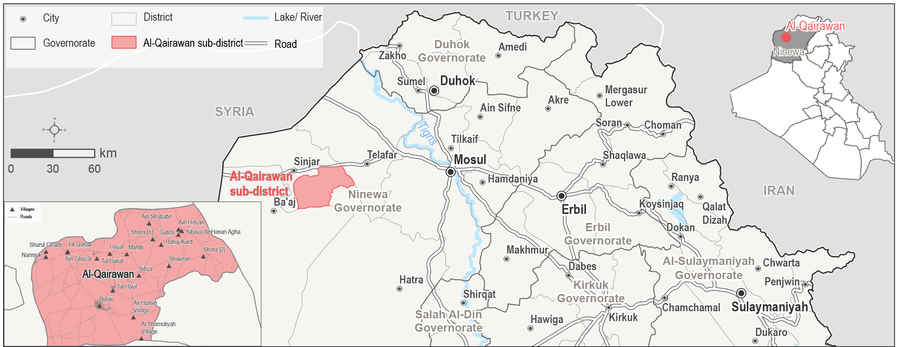
Al-Qairawan sub-district overview
Al-Qairawan is a sub-district of Sinjar district, located in the west of Ninewa governorate.
During ISIL occupation in 2014, 98-100% of the families were forced to flee their homes, as reported by KIs during data collection.
91-97% of the families displaced since 2014 had reportedly returned at time of data collection.
33-58 IDP families (area of origin (AoO) not specified) are reported to reside in Al-Qairawan settlements (46-52% of them arrived in the six months prior to data collection as reported by KIs)
Notes:
Al-Qairawan sub-district was selected for the assessment as: more than 50% of host community members are reported to have returned⁷; social cohesion severity⁸ is high; it is an AoO for IDPs in camps at risk of closure⁹; and dynamic population movements and movement intentions to/from this district recently reported by relevant actors through the Returns Working Group (RWG).
7. IOM DTM: http://iraqdtm.iom.int/ReturnIndex - April 2020 and June 2020
8. IOM DTM: http://iraqdtm.iom.int/ReturnIndex - refer to methodology, to compute the severity index, different parameters are combined.
9. Data reported by the CCCM Cluster in Iraq, in April 2020, upon request for the purpose of the assessment.

Slide 12
5
Key findings

Slide 13
Key findings
While the majority of the pre-2014 population has returned to Al-Qairawan, the situation is still fluid, with returns, displacement of existing host community members, and secondary displacement of IDPs in Al-Qairawan all reported during data collection.
While the general perceived improvement in security has created pull factors for returns to Al-Qairawan, returns appear to be mostly attributed to push factors in areas of displacement.
Persisting challenges of damaged homes, lack of basic services and job opportunities within Al-Qairawan are not only reported obstacles to future returns but also pose a risk to the sustainability of returns.
Healthcare was commonly cited as a priority need by all population groups. The priority needs reported by community leaders were water and sanitation, electricity and education. Returnees also highlighted housing rehabilitation, livelihoods and education, while IDPs mostly shared the same priorities as returnees but also noted access to food.
IDPs reported feeling less engaged in humanitarian projects across all respondent groups, suggesting a need for further outreach and participation of displaced populations.
Notes:
Overall, Al-Qairawan has a positive environment in terms of perceived security, community acceptance and cohesion of different groups. Many households have returned due to sense of increased safety and security in their areas of origin in Al-Qairawan compared to areas of displacement and many IDPs are using Al-Qairawan as a transit location before returning to areas of origin having been secondarily displaced. However, a perceived sense of increased access to services poses a risk to the sustainability of returns, exemplified by host community households being displaced due to lack of services in Al-Qairawan. Further efforts are required to restore infrastructure. In addition, there are some reported differences in access to services between different groups. Understanding distinct barriers to access will improve the overall conduciveness to return as well as sustainability of returns, while improving the well-being of vulnerable groups such as IDPs, female-headed households, child-headed households, unaccompanied/separated children (UASC), large families13, elderly-headed households and people with disabilities.
Persisting challenges of damaged homes, lack of basic services and job opportunities within Al-Qairawan are not the only reported obstacles to future returns but also pose a risk to the sustainability of returns when contributing to displacement out of the area of host community members and IDPs.
The top reported needs were similar for different respondent groups.

Slide 14
Key findings
The movements into and out of the area were affecting the perception of access to jobs and having varying effects on population groups:
The departure of IDPs is viewed as contributing to less assistance and reducing available labourers according to returnee households, while remaining IDPs report that this increases opportunities and their access to assistance.
The departure of host community members, specifically business owners originally from Al-Qairawan who are looking for better living and economic-development conditions in other areas, was perceived as a factor negatively affecting the availability of jobs in Al-Qairawan.
IDPs persistently reported to have less access to housing and housing rehabilitation, livelihoods and basic public services. Returnees also indicated lack of access, albeit to a lesser degree, to services such as housing and being at risk of eviction.
The civil status department and the Ministry of Displacement and Migration (MoDM) in Al-Qairawan are not open, creating challenges to obtaining documentation.
All population groups noted that they feel safe in the community in Al-Qairawan.
Notes:
There are reported differences in access to services across different groups with IDPs persistently reported to have less access to housing and housing rehabilitation, livelihoods and basic public services. Returnees also indicated lack of access, albeit to a lesser degree, to services such as housing and being at risk of eviction.
The civil status department and the Ministry of Displacement and Migration (MoDM) in Al-Qairawan are not open, creating challenges to obtaining documentation such as identification documents (ID), civil status certificates, passports, rent attestations, and birth certificates. This is reported to affect all population groups equally.
Encouragingly, all population groups noted that they feel safe in the community in Al-Qairawan, there are no restrictions of movements, that there had not been any disputes, and there are no specific groups that are treated unfavorably.

Slide 15
Al-Qairawan findings
6.1. Recent movements
6.2. Expected movements
6.3. Primary community needs
6.4. Perceptions on access to services and assistance
6.5. Perceptions on governance and ERW contamination
6.6. Perceptions of community disputes, relations and co-existence
6.7. Perceptions of safety and security
6

Slide 16
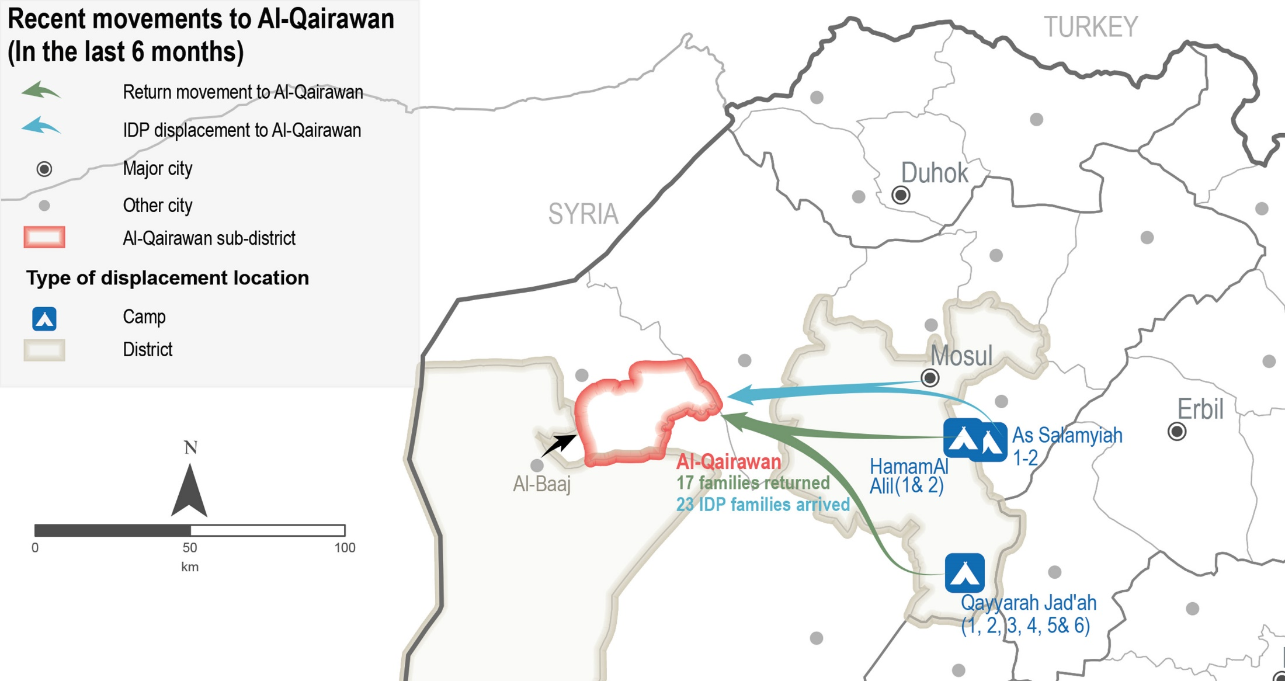
Al-Qairawan sub-district
Movements to Al-Qairawan reported by KIs
Notes:
As reflected in the map, movement reported to Al-Qairawan were mainly from camps. Returns were reported from the camps Hamam Al Alil (1 and 2) and Qayyarah Jad’ah (1, 2, 3, 4, 5 and 6) and IDPs displacement were reported from As Salamiyah camp and from non-camps areas in Mosul.

Slide 17
Al-Qairawan sub-district
Recent movements – data reported by KIs
 Recent returns
¹²⁻²¹
families reportedly returned to Al-Qairawan in the six months prior to data collection, as reported by 5 KIs (out of 36)
Driver for recent returns
Sense of increased security in Al-Qairawan (as reported by 3 KIs out of 36).
 Recent IDP (originally from areas different than Al-Qairawan) arrivals
¹⁵⁻³⁰
IDP families have arrived to Al-Qairawan in the six months prior to data collection as reported by 6 KIs (out of 36).
Drivers for recent IDP arrivals (out of 6 KIs)*
Lack of jobs in previous area of displacement (AoD) 5 KIs
Al-Qairawan is considered a transition area 4 KIs
Sense of increased safety and security in Al-Qairawan 3 KIs
* Sum of answers may exceed the 100% due to KIs being able to select multiple response options, including other topics.
Notes:
Impact of recent returns in the community of Al-Qairawan
Family reunification, and
Increased job opportunities and services for the community members.
The arrival of additional IDP families negatively affected access to jobs and assistance for host community members, as reported by 5 KIs (out of 6). However, one IDP KI reported that access to assistance had increased for IDPs displaced in Al-Qairawan.
Transition area refers to an area where IDPs will wait temporarily (not considering durable solutions there) until the conditions for return are ensured or until they can move to a third country, or until they can secondarily displace.

Slide 18
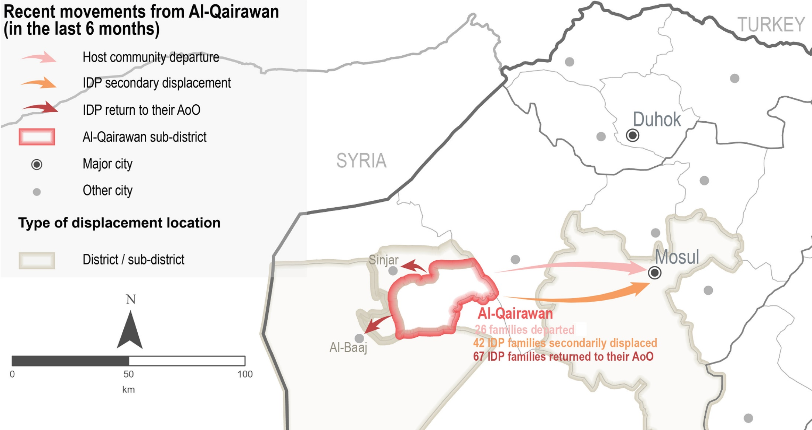
Al-Qairawan sub-district
Movements from Al-Qairawan reported by KIs
Notes:
As reflected in the map, reported movements from Al-Qairawan were all to non-camps areas. Host community families departed to Mosul, while IDP families returned to their area of origin in Al-Baaj and Sinjar districts and other displaced to Mosul.

Slide 19
Al-Qairawan sub-district
Recent movements – data reported by KIs
 Recent host community departures
¹⁶⁻³⁶
host community families departed from Al-Qairawan to non-camp areas in Mosul district due to lack of services and jobs in the six months prior to data collection, as reported by 4 KIs (out of 36).
Impact of recent host community departures in the community of Al-Qairawan (out of 4 KIs)
Family separation,
Perceived decrease in assistance, and
Reduction in job opportunities due to the departure of business owners.
 Recent IDP (originally from areas different than Al-Qairawan) departures
²⁷⁻⁵⁷
IDP families departed from Al-Qairawan in the six months prior to data collection as reported by 3 KIs (out of 36).
Drivers for recent IDP departures (out of 3 KIs)*
Sense of increased safety and security in their area of origin (AoO) 2 KIs
Nostalgia for their previous life in AoO 2 KIs
Lack of jobs and services in Al-Qairawan 1 KI
* Sum of answers may exceed the 100% due to KIs being able to select multiple response options, including other topics.
Notes:
The impact of the IDP departures was reported differently depending on the community group. Returnees reported a decrease in the number of labourers, less jobs and assistance. IDPs in Al-Qairawan reported an increase in job opportunities and access to assistance for them.

Slide 20
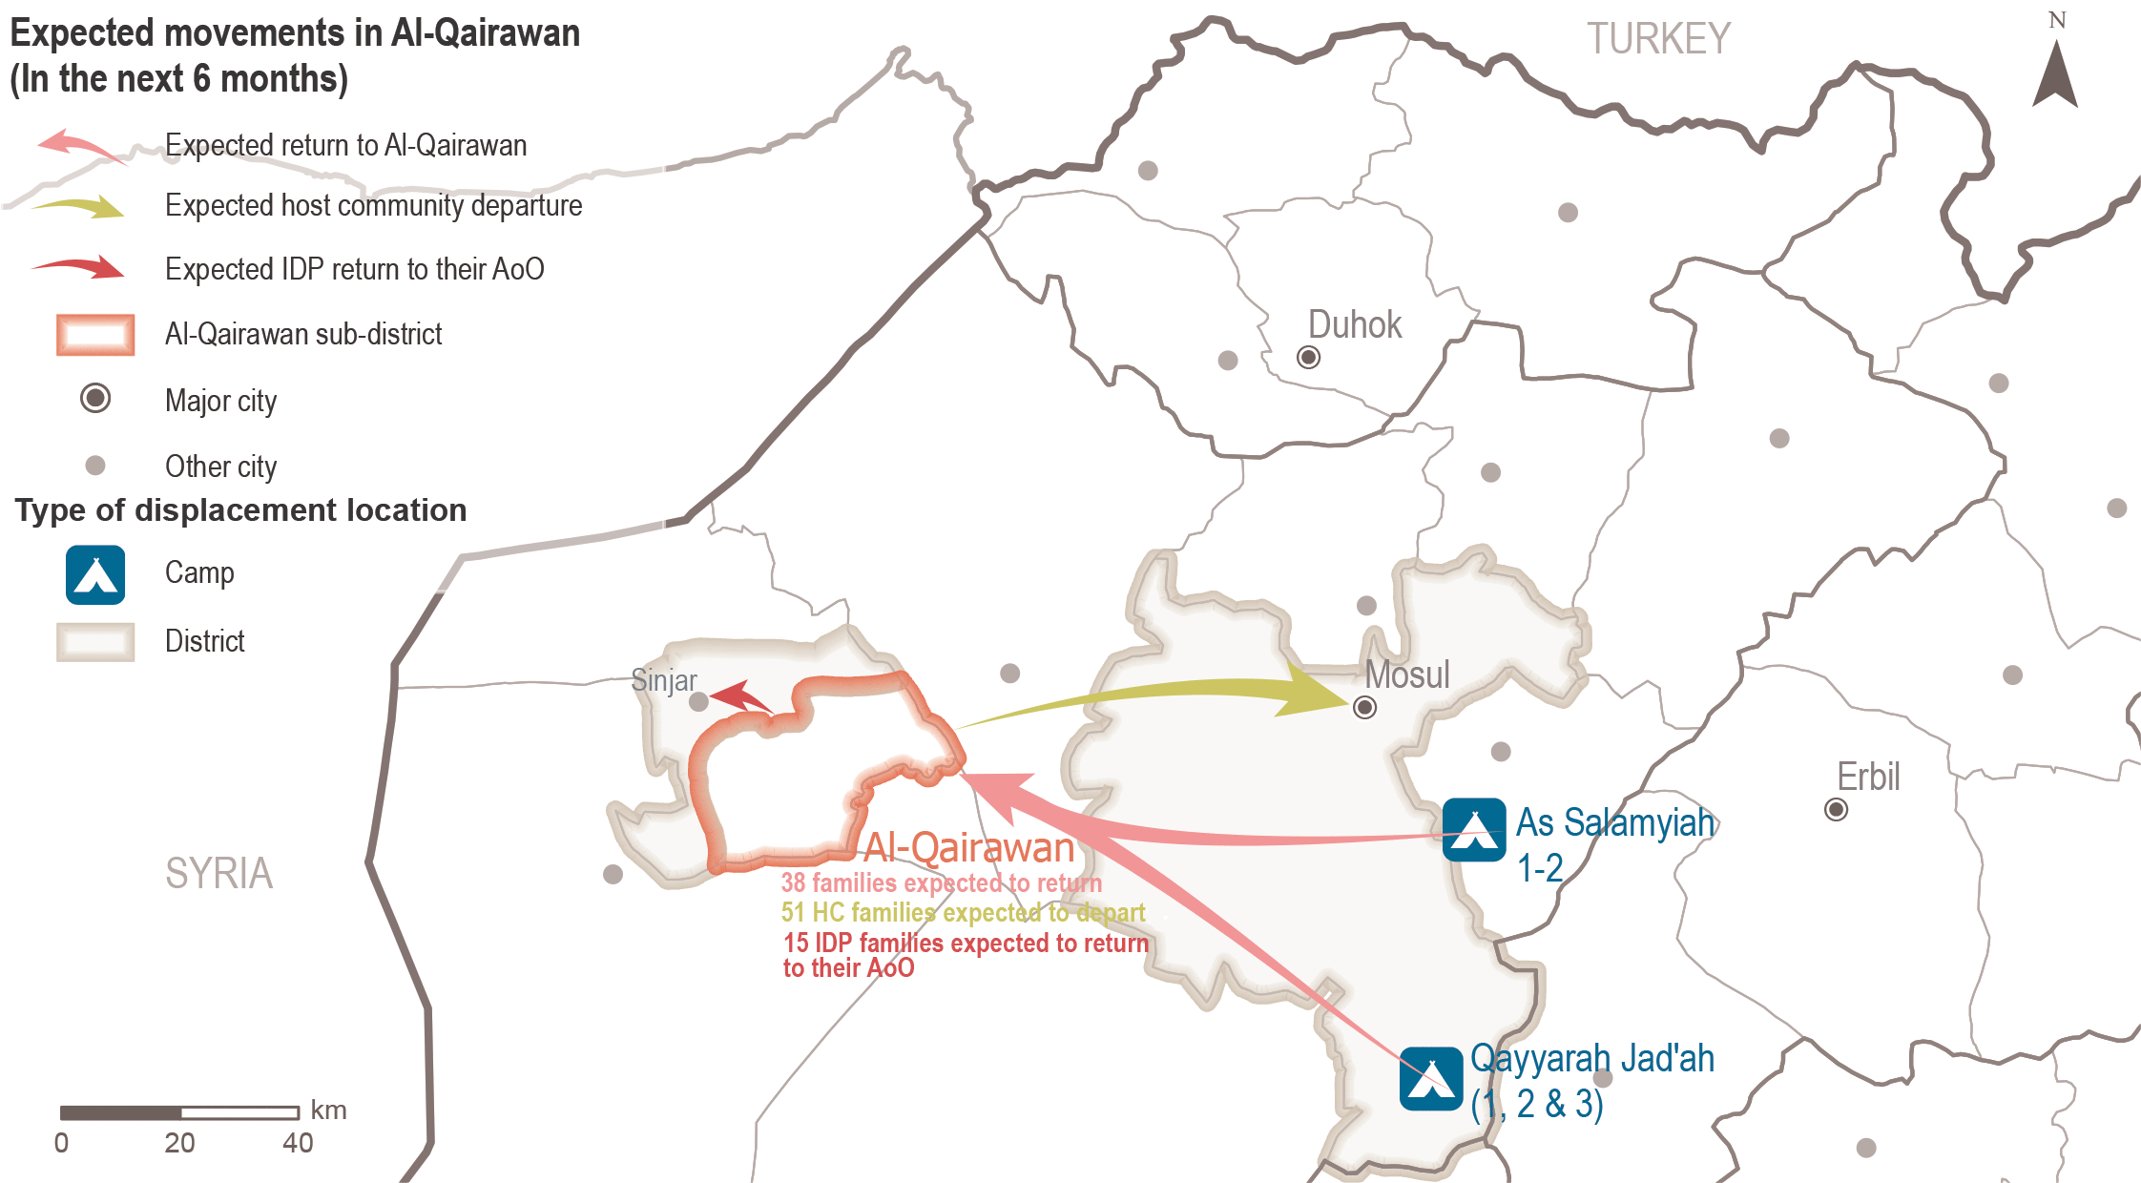
Al-Qairawan sub-district
Expected movements reported by KIs
Notes:
This map reflects the expected movements in the six months following data collection. As reported by KIs, it is expected returns to Al Qairawan from As Samamiyah 1-2 and Qayyarah Jad’ah (1, 2 and 3) camps, and movements from Al-Qairawan by IDP families expected to return to their areas of origin in Sinjar district; in addition to host community expected departures to non-camp areas in Mosul.

Slide 21
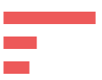
Al-Qairawan sub-district
Expected movements – data reported by KIs
 Expected returns
²⁵⁻⁵⁰
families are expected to return from camps in Ninewa governorate to Al-Qairawan in the six months following data collection, according to a returnee KI.
Drivers for expected returns (most reported) (out of 36 KIs)*
Sense of increased safety and security 25 KIs
Camps closure in AoD 9 KIs
Difficult living conditions in AoD 7 KIs
Barriers for expected returns (most reported) (out of 36 KIs)*
Destroyed/damaged housing in AoO 28 KIs
Lack of jobs 25 KIs
Lack of services 13 KIs
 Expected host community departures
³³⁻⁶⁸
host community families are expected to depart from Al-Qairawan to non-camp areas in Mosul district due to the lack of services and jobs in the area, as reported by 4 KIs (out of 36).
* Sum of answers may exceed the 100% due to KIs being able to select multiple response options, including other topics.
Notes:
Other reported drivers were:
Perceived increase in access to services and jobs 6 KIs
Return of other family members/family reunification 4 KIs
Nostalgia about previous life in AoO 2 KIs
81% of KIs (29 out of 36) reported that further returns will result in family reunification, increased job opportunities and humanitarian assistance. However, 6 KIs reported an expected decrease in job opportunities and assistance.

Slide 22
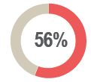
Al-Qairawan sub-district
Expected movements – data reported by KIs
 Expected IDP (originally from areas different than Al-Qairawan) arrivals
of KIs (20 out of 36) reported that there are no IDP families expected to arrive in the six months following data collection. The rest of the KIs did not know.
Drivers for expected IDP arrivals (out of 36 KIs)*
Lack of jobs in previous area of displacement (AoD) 5 KIs
Al-Qairawan is considered a transition area 4 KIs
Sense of increased safety and security in Al-Qairawan 3 KIs
 Expected IDP (originally from areas different than Al-Qairawan) departures
¹⁰⁻²⁰
IDP families residing in Al-Qairawan are expected to return to their AoO in Sinjar district in the six months following data collection, as reported by one KI.
Reasons for recent IDP departures (out of 36 KIs)*
Sense of increased safety and security in their AoO, as reported by one KI.
* Sum of answers may exceed the 100% due to KIs being able to select multiple response options, including other topics.

Slide 23
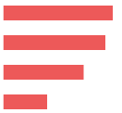
Al-Qairawan sub-district
Primary community needs reported by 36 KIs
Top two reported primary, secondary and tertiary needs
Primary needs
Healthcare Livelihoods

Housing rehabilitation Water and sanitation
Secondary needs
Tertiary needs
Education Electricity
 Primary community needs per respondent group*
Community leaders (out of 11 KIs)
Returnees (out of 4 KIs)
IDPs (out of 19 KIs)
Water and sanitation
Healthcare
Electricity
Education
9 KIs
5 KIs
5 KIs
4 KIs
House rehabilitation
Healthcare
Livelihoods
Education
3 KIs
3 KIs
2 KIs
1 KI
Livelihoods
Healthcare
House rehabilitation
Access to food
15 KIs
14 KIs
11 KIs
6 KIs
“Infrastructure rehabilitation will provide the services and facilities necessary for the economy to function, thus contributing to the development of the region, supporting society and facilitating the production of basic social goods and services”
- Male IDP KI (displaced in the area) -
* Sum of answers may exceed the 100% due to KIs being able to select multiple response options, including other topics.
Notes:
KIs reported that the primary needs for the community are: 1) healthcare due to the reported lack of specialized hospitals and medical centers, lack of competent health staff and equipment, and the evolvement of the COVID-19 pandemic and the related lack of preparedness from the local authorities in Al-Qairawan; and 2) livelihoods due to the high level of unemployment, lack of jobs and impact of COVID-related measures on daily work (which many depend on as their main source of income), closure of businesses and restriction of movement.
The second main community needs most commonly reported were: 3) housing rehabilitation taking into consideration that a high number of houses do not meet the minimum standards of habitability as reported by KIs; and 4) access to water and sanitation due to the reduced operation hours for governmental services, the high cost of private water trucking and bottled drinking water. It was reported by KIs that the district water filters are non-functional and the water pipes are broken, producing water pollution and consequently water is not drinkable.
The third main community needs most commonly reported were: 5) access to education due to reported decline in the quality of free education services, and the high cost of private education and school stationery; and 6) access to electricity, due to continued cuts of the governmental electricity service and high demand, as well as impacts of severe weather conditions in Iraq. This has created an opportunity for exploitation by increasing the amperage cost for private generators. This has not only affected families but also small businesses that require electricity to operate.
The commonly reported need throughout all respondent groups was health.

Slide 24
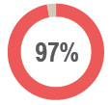
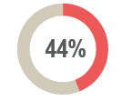
Al-Qairawan sub-district
Perceptions on access to services and assistance – data reported by KIs
 Access to housing
of KIs (35 out of 36 KIs) reported that the majority of families in the area reside in houses.
Reported housing agreement (out of 36 KIs)
Owned tenure 19 KIs
Hosted by other family 9 KIs
Verbal rental agreement 7 KIs
Illegal tenure/occupation 1 KI
Risk of eviction
All KIs (36 KIs) reported that there are no families from the different population groups at immediate risk of eviction in Al-Qairawan.
of KIs (16 out of 36 KIs) reported that returnees, IDPs, child-headed households, unaccompanied/separated children (UASC), large families, elderly people and people with disabilities would be most at risk of eviction since they have less resources.
Notes:
Access to housing:
One KI reported that there are also IDP families residing in tents in Al-Qairawan.
44% of KIs (16 out of 36) reported that most of the population reside in damaged houses.
Illegal occupation of tenure was reported by a returnee KI.
Most affected groups:
Reportedly returnees and IDPs are more likely to reside in damaged or unfinished buildings/houses and tents.
In all groups, female-headed households, child-headed households, UASC, large families, elderly-headed households and people with disabilities are reportedly more affected as they have less resources.

Slide 25
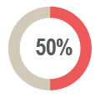
Al-Qairawan sub-district
Perceptions on access to services and assistance – data reported by KIs
 Access to housing rehabilitation
^{41%-60%}
of houses in Al-Qairawan were reportedly damaged during the events in 2014 due to military operations, as per 20 KIs (out of 36).
of KIs (18 out of 36 KIs) reported that access to housing rehabilitation is unequal.
Reported barriers to access assistance for rehabilitation (out of 18 KIs)*
Less connections (wasta) 13 KIs
Assistance perceived to target specific neighbourhoods 10 KIs
Lack of financial means for rehabilitation 10 KIs
Criteria of selection for support is perceived to be too specific 7 KIs
COVID-19 restrictions 6 KIs
“One of the most important needs of a family or community is housing, as it protects them from danger and it is a safe place for the family.”
- Male community leader KI -
* Sum of answers may exceed the 100% due to KIs being able to select multiple response options, including other topics.
Notes:
Reportedly IDPs, female-headed households, child-headed households, UASC, large families, elderly-headed households and people with disabilities have less access to housing rehabilitation.

Slide 26
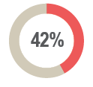
Al-Qairawan sub-district
Perceptions on access to services and assistance – data reported by KIs
 Access to basic public services
of KIs (15 out of 36 KIs) reported unequal access to basic public services.
Reported barriers to access basic public services (out of 15 KIs)*
Less connections (wasta) 13 KIs
Lack of financial means to access the services 12 KIs
COVID-19 restrictions 11 KIs
Criteria of selection for support is perceived to be too specific 3 KIs
 Access to public judicial mechanisms
All KIs (36 KIs) reported that access to public judicial mechanisms is equal for all population groups.
The civil status department and the Ministry of Displacement and Migration (MoDM) in Al-Qairawan were reportedly closed at the time of data collection.
* Sum of answers may exceed the 100% due to KIs being able to select multiple response options, including other topics.
Notes:
Basic public services: namely education and healthcare, water and sanitation, governmental cash assistance grants and legal representation.
93% of KIs (14 out 15 KIs) reported that IDPs, female-headed households, child-headed households, UASC, large families, elderly-headed households and people with disabilities have less access to basic public services.
All KIs (36 KIs) reported that boys and girls (between 6-15 years old) can access public education. However, it was reported that access to school was affected due to: “some schools’ directors impose the use of uniforms to be brough at high prices from specific sellers which families cannot afford”; schools lack furniture and equipment for educational activities; lack of teachers; and COVID-19 movement restrictions.
Access to justice
However, one KI reported that access to legal representation is unequal.
The civil status department and the Ministry of Displacement and Migration (MoDM) in Al-Qairawan were reportedly closed due to COVID-19 restrictions, damage to the building(s) and lack of funding for operation and rehabilitation.
47% of KIs (17 out of 36 KIs) reported that there is documentation which is not possible to obtain because the relevant departments/offices are closed at the moment and/or families cannot afford the cost of the process.
Identification document (ID) 12 KIs
Civil status certificate 8 KIs
Passport 7 KIs
Rent attestation 1 KI
Birth certificate 1 KI

Slide 27
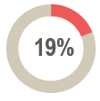
Al-Qairawan sub-district
Perceptions on access to services and assistance – data reported by KIs
 Access to humanitarian aid
of KIs (7 KIs out of 36) reported knowledge about presence of non-governmental organisations (NGOs) which are implementing projects or activities in Al-Qairawan.
Reported activities conducted
by NGOs in Al-Qairawan (out of 7 KIs)*
Reported most needed projects or activities
in Al-Qairawan (out of 36 KIs)*
5 KIs
4 KIs
1 KI
1 KI
Livelihoods
Housing rehabilitation
Water and sanitation
Food security
Social cohesion
Psycho-social support
16 KIs
10 KIs
6 KIs
2 KIs
1 KI
1 KI
NFI distribution
Food security
Social cohesion
Livelihoods
One KI reported that IDPs, female-headed households, child-headed households, UASC and youth, elderly and people with disabilities are less involved in humanitarian activities or projects.
* Sum of answers may exceed the 100% due to KIs being able to select multiple response options, including other topics.
Notes:
All KIs (36 KIs) reported that the availability of humanitarian aid was a factor to encourage return.
Furthermore, an increased need for health guideline awareness interventions on COVID-19 together with masks distribution was reported.

Slide 28
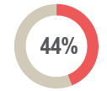
Al-Qairawan sub-district
Perceptions on access to services and assistance – data reported by KIs
 Access to livelihoods
of KIs (16 out of 36 KIs) reported unequal access to livelihoods opportunities.
Reported barriers to access livelihoods (out of 16 KIs)*
Less connections (wasta) 12 KIs
COVID-19 restrictions 8 KIs
Criteria of selection for support is perceived to be too specific 3 KIs
Available jobs require certain expertise and competency 2 KIs
Services perceived to target specific neighbourhoods 1 KI
Lack of financial means to provide assets 1 KI
“Work is the main mean of obtaining cash through undertaking a certain profession. Livelihoods will ensure access to a suitable income, employ a large number of young and reduce the high unemployment rate.”
- Male community leader KI -
* Sum of answers may exceed the 100% due to KIs being able to select multiple response options, including other topics.
Notes:
IDPs, elderly heads of households, people with disabilities, female heads of households, child heads of household, UASC and youth, and people with less connections reportedly have less access to livelihoods.

Slide 29
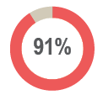
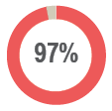
Al-Qairawan sub-district
Perceptions of governance and ERW contamination – data reported by KIs
 Governance and influencing bodies tailored to interview community leaders only
Local authorities are the most influential body with regards to governance.
of community leaders (10 out of 11 KIs) reported that the main actors influencing laws and rules implementation did not change in the six months prior to data collection.
of community leaders (10 out of 11 KIs) reported that there has been no appointment of new local authorities in the six months prior to data collection.
 Explosive remnant of war (ERW) contamination
of KIs (35 out of 36 KIs) reported that there are no contaminated lands/fields.
All KIs (36 KIs) reported no incidents due to mines in the six months prior to data collection.
Notes:
Governance and influencing bodies
All community leaders (11 KIs) reported that local authorities are the most influential body with regards to governance.

Slide 30
Al-Qairawan sub-district
Perceptions of community disputes, relations and co-existence – reported by KIs
 Community disputes, relations and co-existence
 Community disputes
^{97%}
of KIs (34 out of 36 KIs) reported that there were no disputes within the neighbourhoods in the six months prior to data collection. The rest of the KIs did not know.
^{11%}
of KIs (4 out of 36 KIs) reported that there were no disputes between villages in the six months prior to data collection. The rest of the KIs did not know.
^{75%}
of KIs (27 out of 36 KIs) reported that there were no retaliation incidents in the six months prior to data collection. The rest of the KIs did not know.
 Community relations and co-existence
^{97%}
of KIs (35 out of 36 KIs) reported that community members trust each other.
^{89%}
of KIs (32 out of 36 KIs) reported that their community members interact with other groups in the community.
All KIs (36 KIs) reported that there are no specific population groups which are not welcome by the majority of the community in the area.
Notes:
Community disputes within the neighbourhoods: 69% of KIs (25 out of 36 KIs) reported no change is expected in this regard in the six months following data collection due to IDPs and returnees are (re)integrating well in Al-Qairawan.
Community disputes between villages: 58% of KIs (21 out of 36 KIs) reported no change is expected in this regard in the six months following data collection due to the (re)integration process for IDPs and returnees in Al-Qairawan, kinship ties between families from different population groups, and acceptance from the community regarding the presence of different groups.

Slide 31
Al-Qairawan sub-district
Perceptions of safety and security – data reported by KIs
 Safety and security
of KIs (35 out of 36 KIs) reported that their community members do not avoid any areas or neighbourhoods in Al-Qairawan.
Freedom of movement
All KIs (36 KIs) reported that females and males can freely move in Al-Qairawan at night or during the day.
 Perceived presence of security forces
All KIs (36 KIs) reported that the presence of the security forces such as the police and the Iraqi armed forces contributed positively to a feeling of safety.
In addition, it was generally reported that security forces are effective in resolving disputes within the community and between different villages.
“So that the citizen can move in full freedom in the area, day and night, without fear of anything, so that the law and the ruling authority will protect him/her”
- Male IDP KI (displaced in the area) -
Notes:
All KIs (36 KIs) reported that their community members feel safe in Al-Qairawan.

Slide 32
7
Questions from the audience

Slide 33
Any key locations that should be prioritized for future assessments?
Discussion
Any feedback or comments from those operational in these areas?
8
Additional themes it would be useful to explore in the assessment?

Slide 34
Upon request
حسب الطلب
http://www.reachresourcecentre.info/
IMPACT Initiatives
@REACH_info
https://www.impact-repository.org/document/reach/fc3a6ace/IRQ_ReDS_RA_Factsheet_Qairawan_Final_October2020.pdf

