Slide 1

Area-Based Assessment (ABA) Chisinau and Stefan Voda
Preliminary Findings
Moldova, September 2022

Slide 2
CONTENTS
Assessment Objectives
Assessed Areas
Methodology
Preliminary Findings
Chisinau
Stefan Voda

Slide 3
Assessment Objectives
General Objective
To inform a more holistic and sustainable area-based response by humanitarian actors and local authorities about the needs and access to services of the refugee population and their hosts, as well as to examine the relationship between the refugees and the hosts in Chisinau and Stefan Voda with high numbers of refugees in Moldova.

Slide 4
Assessment Objectives
Specific Objectives
Identify displacement dynamics, household priority and winter needs, including protection concerns of key at-risk groups.
Identify barriers to access to basic services and barriers to integration, including employment for the refugee population.
Assess the impact of refugee arrival on the local economy and access to basic services for the host community, as well as social cohesion between the refugee and host communities.
Identify and provide information on local and external actors engaged in the crisis response and basic service provision in the assessed areas.

Slide 5
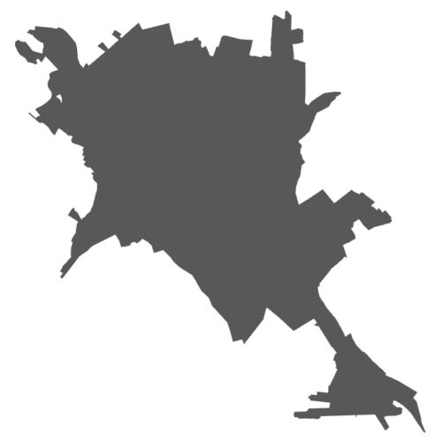
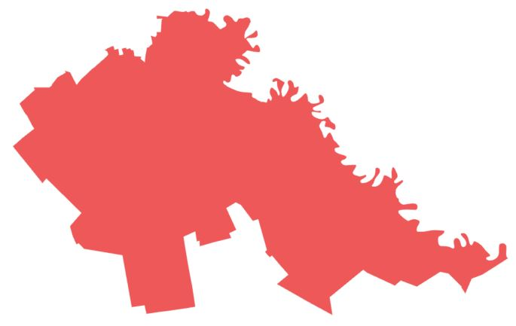
Assessed Areas
Areas with highest number of refugees were selected.
One urban and one rural area, as there are considerable rural-urban disparities in basic service provision in Moldova.
Urban Area - Chisinau
Botanica, Centru, Rascani, Ciocana and Buiucani sectors
Rural Area - Stefan Voda
Palanca, Tudora, Crocmaz and Popeasca villages

Slide 6
Methodology
Design | The ABA used a mixed-methods approach. Primary data collection: Surveys with heads/adult members of refugee/host households (HH) Focus group discussions (FGD) and individual interviews (II) with refugees and host population members Key informant interviews (KII) with local authorities, service providers, NGOs and businesses
Dates | August 30 - October 7, 2022
Sample Size | Chisinau: 174 refugee HH surveys, 172 host HH surveys, 2 refugee FGDs, 6 refugee IIs, 2 host FGDs, 6 host IIs, 14 KIIs Stefan Voda: 76 refugee HH surveys, 181 host HH surveys, 2 refugee FGDs, 1 host FGD, 3 host IIs, 16 KIIs
Sampling Strategy | Surveys with host population HHs: Two-stage cluster sampling. Findings are representative at the household level. Surveys with refugee HHs: Purposive. Findings for the refugee population are indicative only. Refugee and host FGDs, IIs, KIIs: Purposive. Findings for the refugee population are indicative only.
For further information, refer to the TOR.

Slide 7
Challenges and Limitations
A probabilistic sampling strategy was adopted for host population household surveys, allowing for representative findings at household and area levels at a 95% level of confidence and 8% margin of error. Conversely, due to the absence of accurate refugee population figures, findings should only be considered indicative and should not be generalized for the refugee population across both assessed areas.
As respondents were asked about their individual perceptions besides questions pertaining to the household and its members, findings are presented by the number of respondents instead of households.
Household respondents were asked about what they perceived were the priority needs and challenges faced by key at-risk groups, e.g., people with disabilities, Romani and LGBTQ+. Therefore, related findings might not fully reflect the realities faced by these groups.

Slide 8
Key Definitions
Refugees: persons or groups of persons with a place of habitual residence within Ukraine who have left Ukraine since the escalation of hostilities which began on 24 February 2022. In this assessment, refugees only include refugees living outside of Refugee Accommodation Centres (RACs).
Host population: Moldovan population who live in areas where refugees live including those who share their own accommodation with refugees and the general population who live where refugees reside.
Household: all individuals living together in a housing unit which includes both Moldovan individuals and refugee individuals who travelled to Moldova since the escalation of hostilities on 24 February 2022.
Family: group of individuals who are related and acquaintances who habitually live together. The refugee family refers to all individuals who travelled together from Ukraine to Moldova and live together.

Slide 9
Preliminary Findings
The findings included in this presentation are drawn from the refugee and host HH surveys. Qualitative findings were not incorporated.

Slide 10
Preliminary Findings: Chisinau

Slide 11
Accommodation
Findings from refugee HH surveys
Refugee respondents reported living in a rented private accommodation (61%) or being hosted by family or friends (31%).
Two thirds (63%) of surveyed hosted refugee families were reportedly sharing accommodation with the host family.
Some hosted refugee respondents (40%) reported their hosting family benefitting from assistance for accommodating them, usually from UN organisations (71%).

Slide 12
Refugee Movement & Integration Intentions
Findings from refugee HH surveys
Reported movement intentions by the proportion of surveyed refugee households in Chisinau*
Surveyed refugee HH respondents reportedly factored in the availability of permanent accommodation (42%) and the proximity of friends/relatives (37%) when choosing to settle/stay in Chisinau.*
About half of refugee HH respondents surveyed (45%) intended to remain in the same location over the 6 months following data collection.
Approximately 1/3 of surveyed HH respondents (37%) reported no plans to integrate into the community. Others plan to look for employment, register with a GP, and enrol children in school in Moldova.*
*Respondents could select multiple answers.

Slide 13
Refugee and Host Relationship
Findings from refugee HH surveys
Surveyed HH respondents described the refugee-host community relationship in their area as good (49% of HHs) or very good (42%) overall.
Refugee-host community relationship described as very good in Ciocana (63%), less so in other surveyed areas.
Respondents did not notice a change in the relationship since arriving. Less than 1% reported that it had worsened.
Most surveyed HH respondents (60%) were unaware of formal or informal initiatives to promote community integration.

Slide 14
Refugee and Host Relationship
Findings from host HH surveys
The host HH respondents were generally very or somewhat sympathetic towards Ukrainian refugees and stated that refugees are welcomed in Moldova.
There are mixed opinions on whether there are too many refugees in Moldova, but only 5% of respondents stated that borders should be closed.
The majority of respondents thought that Moldova has done more than it needs to support refugees.
Most stated that refugees get more help than Moldovans, and Moldova should focus on helping the Moldovan population, not refugees.

Slide 15
Refugee Arrival Impact on Services
Findings from host HH surveys
It was rarely reported (13%) that refugee arrival impacted access to basic services in the area.
Those who perceived the opposite stated that access to healthcare, social services and employment became more difficult, and that providing additional services and funding could reduce the impact.

Slide 16
Priority Needs & Access to Services
Findings from refugee HH surveys
Reported priority needs by the proportion of surveyed refugee households in Chisinau*
Most surveyed refugee HH respondents selected health (56%), food (55%) or cash assistance (52%) as their top 3 HH priority needs.*
Services needed by HH members included financial assistance (43% of HHs), general medical care (40%) and pharmacies (25%).*
*Respondents could select multiple answers.

Slide 17
Winter Needs
Findings from refugee and host HH surveys
Half of surveyed refugee HH respondents (52%) reportedly did not have and did not foresee having sufficient funds to purchase fuel/pay for heating for the winter season, as did a quarter of host population HH respondents (24%).
Some houses/apartments reportedly required heating system repairs, for both refugee and host population HHs. However, many respondents did not know if they needed these repairs or not.
In rare cases, HHs also mentioned not having sufficient hot water for shower and laundry (5% refugee HH, 4% host population HH).

Slide 18
Livelihoods
Findings from refugee HH surveys
The main reported sources of HH income were savings (52% of HH), NGO/agencies cash support (40%) and government cash support (27%).*
Only 19% Ukrainian adult HH members were reported to be employed (16% of females, 26% of males). The most commonly mentioned employment sectors were informal labour, retail/wholesale trade, hospitality, and construction.
Reported reasons for not being employed included looking for work (26%), being retired (21%), or needing to care for children (17%).
* Respondents could select multiple answers.

Slide 19
Education
Findings from refugee HH surveys
Around one-third of school-aged children (29%) in surveyed HHs were reportedly enrolled in Moldovan schools/kindergartens for the 2022-2023 school year in Moldova, while from the remaining children almost half (46%) were found to be attending Ukrainian schools/kindergartens online.
Respondents explained that the non-enrolment in Moldovan schools/kindergartens was mostly due to not making an application for enrolment (95%) rather than particular challenges faced when enrolling the child.

Slide 20
Health
Findings from refugee HH surveys
Among 21% of individuals from surveyed refugee HHs who reported needing healthcare, one third (31%) could not access it.
The main mentioned barriers to accessing healthcare were the unaffordability of consultation or treatment costs, or the unavailability of specific needed medicine/treatment.

Slide 21
Protection
Findings from refugee HH surveys
Only some refugee HHs (10%) reported applying for asylum in Moldova, others did not mostly because they intended to return to Ukraine (79%).
In rare cases, families reported caring for children who they were not caring for in Ukraine (2%).
Infrequent reports of discriminatory treatment (3% of HHs) due to Ukrainian origin.

Slide 22
Protection
Findings from host HH surveys
Most frequently reported perceived threats for vulnerable groups:
  Older people: being robbed (7% of respondents)
  People with disabilities: verbal harassment (7%)
  Roma ethnicity: discrimination/persecution (9%)
  Women: suffering from sexual harassment or violence (5%)
  Boys: violence within the home (12%)
  Girls: risk of sexual abuse/violence (15%)

Slide 23








AAP
Findings from refugee HH surveys
Information Sources on Humanitarian Aid*
Information Needs for Humanitarian Aid*
59%
41%
27%
Social media
Friends, relatives, neighbours
Community meetings
53%
47%
37%
How to access health services
How to get more financial support
How to register for aid
Main reported barriers to accessing needed information*
Lack of data
Technology access
* Respondents could select multiple answers.

Slide 24
Preliminary Findings: Stefan Voda

Slide 25
Accommodation
Findings from refugee HH surveys
Surveyed refugee HH respondents reported being mostly hosted by relatives/friends (68%) or hosted by a Moldovan family (18%).
Hosted refugee families were reportedly typically sharing an accommodation with a host family (86%).
Four out of five respondents (82%) reported their hosting family benefitting from assistance for accommodating them, usually from UN organisations (63%).

Slide 26
Refugee Movement & Integration Intentions
Findings from refugee HH surveys
Reported movement intentions by the proportion of surveyed refugee households in Chisinau*
Surveyed refugee HH respondents reportedly factor in the proximity of friends/relatives (65%) and availability of permanent accommodation (21%) when choosing to settle/stay in Stefan Voda.*
Two thirds of surveyed HH respondents (67%) reportedly intend to remain in the same location over the 6 months following data collection.
Most surveyed HH respondents (57%) reported no plans to integrate into the community. Others plan to register with a general practitioner, look for employment, and enrol children in school in Moldova.*
*Respondents could select multiple answers.

Slide 27
Refugee and Host Relationship
Findings from refugee HH surveys
Surveyed HH respondents describe the refugee-host community relationship in their area as very good (71%) or good (22%) overall.
Respondents exclusively described the relationship as having improved (53%) or not changed (47%) since their family arrived. None stated that it had worsened.
Most respondents (75%) were unaware of formal or informal initiatives to promote community integration.

Slide 28
Refugee and Host Relationship
Findings from host HH surveys
The host HH respondents were generally very or somewhat sympathetic towards Ukrainian refugees and stated that refugees are welcome in Moldova.
There were mixed opinions on whether there are too many refugees in Moldova, and 10% of respondents stated that borders should be closed.
The majority of respondents thought that Moldova has done more than it needs to support refugees.
Most stated that refugees get more help than Moldovans, and Moldova should focus on helping the Moldovan population, not refugees.

Slide 29
Refugee Arrival Impact on Services
Findings from host HH surveys
Respondents rarely reported that refugee arrival impacted access to basic services in the area (11%).
Those who perceived the opposite stated that access to social services and healthcare became more difficult, and that providing additional services and funding could reduce the impact.

Slide 30
Priority Needs & Access to Services
Findings from refugee HH surveys
Reported priority needs by the proportion of surveyed refugee households in Stefan Voda*
Most surveyed refugee HH respondents selected cash assistance (78%), food (58%), or health (50%) as their top 3 HH priority needs.*
Services needed by HH members included financial assistance (50% of HHs), general medical care (33%), refugee or humanitarian protection registration in Moldova (28%) and pharmacies (25%).*
*Respondents could select multiple answers.

Slide 31
Winter Needs
Findings from refugee and host HH surveys
Half of surveyed refugee HH respondents (51%) reportedly did not have, and did not foresee having sufficient funds to purchase fuel/pay for heating for the winter season, as did almost half of host population HHs (44%).
One in five surveyed refugee HH respondents (21%) reportedly required heating system repairs, as does almost one third of hosting HH respondents (29%), however, many respondents did not know if they needed these repairs or not.
Two thirds of host and refugee homes were not insulated (66% and 68%, respectively).
Some HHs also mentioned not having sufficient hot water for shower and laundry (34% refugee HH, 27% host population HH).

Slide 32
Livelihoods
Findings from refugee HH surveys
The main reported sources of family income were NGO/agencies cash support (45%), savings (43% of HH), and employment (24%).*
One in four (24%) adult Ukrainian HH members were reported to be employed (18% of females, 35% of males). The most commonly mentioned employment sectors were informal labour, retail/wholesale trade, hospitality, and construction.
Of those not employed, reported reasons for not being employed were being retired (39%), looking for work (26%), or needing to care for children (16%).
*Respondents could select multiple answers.

Slide 33
Education
Findings from refugee HH surveys
One third of school-aged children (33%) in surveyed HHs were reportedly enrolled in Moldovan schools/kindergartens for the 2022-2023 school year in Moldova, while from the remaining children two thirds (45%) were found to be attending online school/kindergarten in Ukraine.
Respondents explained that the non-enrolment in Moldovan schools/kindergartens was mostly due to not making an application for enrolment (87%) rather than particular challenges faced when enrolling the child.

Slide 34
Health
Findings from refugee HH surveys
Among 9% of individuals from the surveyed refugee HHs who reported needing healthcare, one third (36%) could not access it.
The main mentioned barrier to accessing healthcare was the unavailability of specific needed medicine/treatment (18%).

Slide 35
Protection
Findings from refugee HH surveys
One in four (27%) families reported applying for asylum in Moldova, others did not mostly because they intended to return to Ukraine (76%). One in ten who did not apply for asylum stated that they don’t know how to apply (9%).
No respondents reported themselves or their families facing discriminatory treatment since arrival.

Slide 36
Protection
Findings from host HH surveys
Most frequently reported perceived threats for vulnerable groups:
  Older people: being robbed (4% of respondents)
  People with disabilities: being robbed (2%)
  Roma ethnicity: discrimination/persecution (5%)
  Women: robbed, threatened, verbal harassment, injury (2% for each)
  Boys: violence within the home (4%)
  Girls: risk of sexual abuse/violence (15%)

Slide 37

AAP
Findings from refugee HH surveys
Information Sources on Humanitarian Aid*
Information Needs for Humanitarian Aid*
67%
33%
17%
Local leaders
Friends, relatives, neighbours
Social media
53%
29%
24%
How to register for aid
How to get more financial support
How to access health services
News on what is happening here
Main reported barriers in accessing needed information
Lack of data
Technology access
Misinformation
* Respondents could select multiple answers.

Slide 38
THANK YOU FOR YOUR ATTENTION
andrea.szenasi@reach-initiative.org

