Slide 1
Ar-Raqqa City Area Based Workshop, Round III
May 2019

Slide 2
Table of Contents
Introduction
Security overview and Mine Clearance Update
Methodology, sector presentations followed by discussions
  Food Security, Livelihoods and Protection
  Education
  Health
  WASH
  Shelter and NFI
Summary and Wrap Up

Slide 3
Sector Analysis and Discussions

Slide 4
Methodology: Objectives
Area-Based Assesment (ABA): Identification of primary needs of civilians and barriers to accessing services in Ar-Raqqa City.
Response Plan: Compiling humanitarian needs from the ABA and other relevant sources, and comparing these with the humanitarian response, in an effort to highlight gaps and inform better coordination of future responses.
Area-Based Workshop: Bringing stakeholders together and support in building a common understanding of the response progress, operational challenges, sources of information, and help inform a better overview of gaps in the response highlighted during the analysis progress.

Slide 5
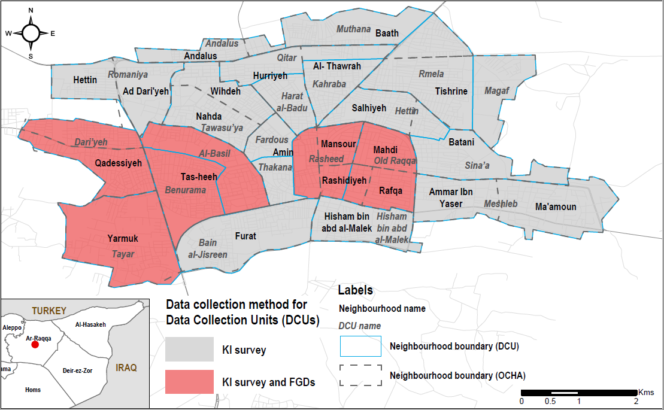
Methodology: Data Sources
Needs data: REACH Area Based Assessment III (ABA) conducted in February 2019, but triangulated with additional sources where possible.
Response data: compiled from Jan-Mar 4Ws, direct outreach, and NES Forum Response Overview Summaries.
Population data: REACH ABA IV but triangulated with figures from NESMMI, local authorities, INGOs, operational actors in city, additional Key Informants (KIs), and Focus Group Discussions (FGDs).
Direct outreach: REACH has consulted with Inter-Sector Working Group, sector focal points and operational actors throughout entire process.
ABA IV Coverage
ABA Methodology
A total of 75 Key Informant (KI) interviews, with a minimum of three KIs interviewed per Ar-Raqqa city neighbourhood.
Additionally, a total of 8 gender-separated focus group discussions were conducted in 6 out of 22 neighbourhoods.
Data collection took place between 3-21 February 2019.
The findings of this assessment should only be considered indicative of the situation in Ar-Raqqa city at the time of data collection.

Slide 6
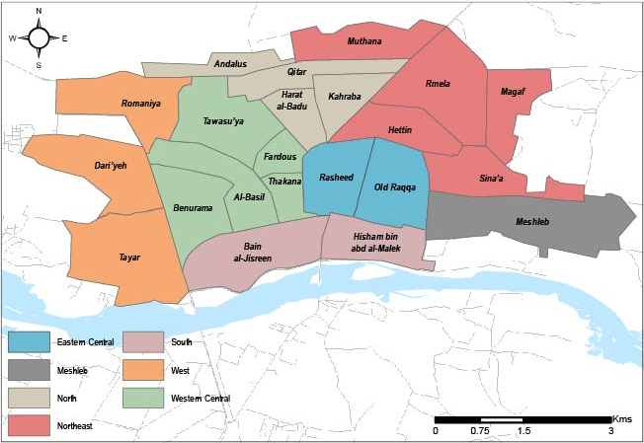
Methodology: Analysis and Area Boundaries
Multiple data sources do not always align in terms of geographic scale. Therefore neighbourhoods were grouped for ease of analysis but they are not formal or relate to a response plan.
Identified needs were compared with available data about the response in order to establish an overview of potential gaps. Ranges are used to incorporate the uncertainty in estimates and figures.
Not all interventions undertaken in Raqqa city were reported through the 4Ws, and some interventions not reported at neighbourhood level. Therefore likely to be some gaps in response data and the gap analysis should be considered indicative only.
Data gathered through key informant interviews are not statistically significant and should be considered indicative only.
All tools and data available for sharing via Scott.sandvik@reach-initiative.org

Slide 7
Ar-Raqqa City – Inter-Sector Overview
Since the last workshop in December, we are seeing some improvements in the humanitarian situation in Raqqa city. More households have access to the water network as rehabilitation continues, more schools have opened, and food/NFI markets are functioning across the city.
But key challenges remain; we are seeing increased estimated usage of negative food-based coping strategies among residents in most areas, access to income and ability to cover basic needs are overall very low.
Many issues with quality of services still persist, such as for education, water and the sewage network in most areas across the city. Additionally, access to service, especially healthcare, has shown a decline over the past quarter, school attendance rates have largely stagnated, with persistently lower rates of attendance in North and West areas, despite more schools being open, and child labour is widely acknowledged as common across all areas of the city.
Many factors compound these issues, such as:
  the continued depreciation of the Syrian pound,
  increased prices reported across the city,
  the average salary below even the Survival Minimum Expenditure Basket (SMEB), causing residents to have reduced purchasing power thanks to the increased cost of living.
  In addition, since October, an estimated increase in population returns may have strained access to many services.

Slide 8
Ar-Raqqa city: Population Overview
Estimated number of households returning to each area location, by ABA rounds
While population returns in October reportedly appeared to have stabilised, findings suggest returns have increased again between October and February.
*These figures are based on the average of the area estimated population range.

Slide 9
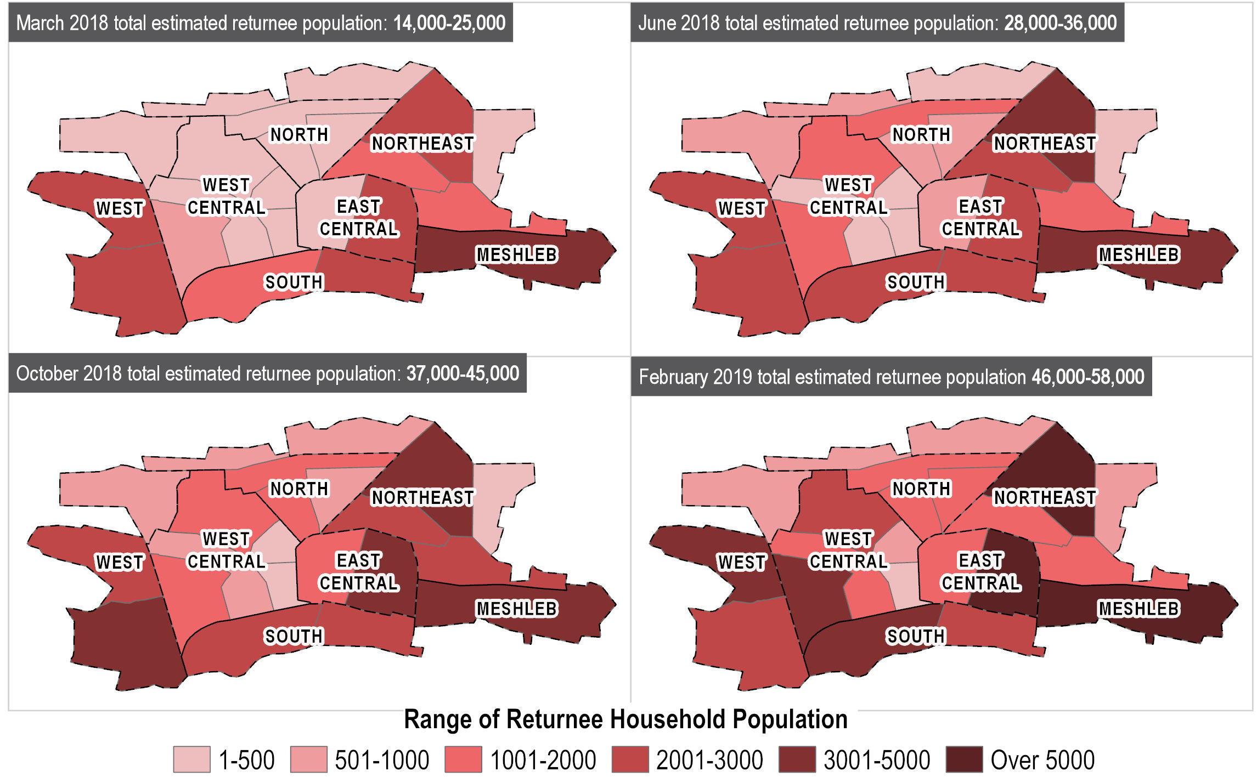
Ar-Raqqa city: Population Overview
As of February 2019, KIs estimated the population to be somewhere between 46,000 and 58,000 households (compared to 37,000-45,000 in October).
Meshleb, East Central and West Central are estimated to have a higher increase of returns compared to other areas since October 2018.
*Data is based on KI methodology and have been triangulated with available sources. Including other REACH assessments, local authorities, INGOs, operational actors in city, follow-up KI interviews, and Focus Group Discussions (FGDs). Estimates are to be considered indicative only.

Slide 10
Food security

Slide 11
Food Security and Livelihoods: City Wide Findings
Since October, the general food security situation has continued to decline across the city with KIs reporting:
  Decreasing ability to afford food,
  increased usage of food-based coping strategies,
  this is coupled with increased food prices, poor harvests, and flour shortages are reported to be increasing among bakeries in Raqqa City.
Monthly food distributions continue at the same level across the city with Meshleb, Northeast and West Central areas highlighted as priority areas by the FSL sector going forward.*
While the Syrian Pound (SYP) continues to depreciate and the ability to cover basic needs becomes harder, access to livelihoods also remain a significant challenge for residents:
  under half of residents are estimated to be engaging in (primarily casual) income-generating activities,
  equally low proportions are able to cover basic needs through these income sources which yield salaries that are below the average across all governorates in Northeast Syria.
Overall livelihoods programming remains very low across the city.
*Compared to the average coverage level estimated during the Raqqa workshop in December.

Slide 12
Food Security: Key Trends
Proportion of core food Items estimated to be affordable for the majority of residents in Ar-Raqqa city neighbourhoods
Average cost of food items in the Survival Minimum Expenditure Basket (SMEB) in Ar-Raqqa sub-District in Syrian Pounds (SYP)*
The negative trend of food affordability which was reported during the last workshop has continued; on average, 29% of all core food items in February 2019 were reported by KIs to be affordable for the majority of residents in Raqqa city.
Despite fluctuations for Ar-Raqqa sub-district, food prices have reportedly increased since January 2018.
*Assessed core food items were bread, flour, rice, lentils, sugar, cooking oil, chicken, meat, tomatoes, cucumbers, and onions. SMEB represents the minimum culturally adjusted items required to support a 6-person household for a month and is comprised of 18 items. Data source: REACH, Market Monitoring February 2019

Slide 13
Food Security: Key Trends
Price of one US Dollar in Syrian Pounds
The exchange rate for the Syrian Pound against the US Dollar has declined significantly since the beginning of 2018 contributing to the increased cost of living.
Data source: REACH, Market Monitoring February 2019

Slide 14
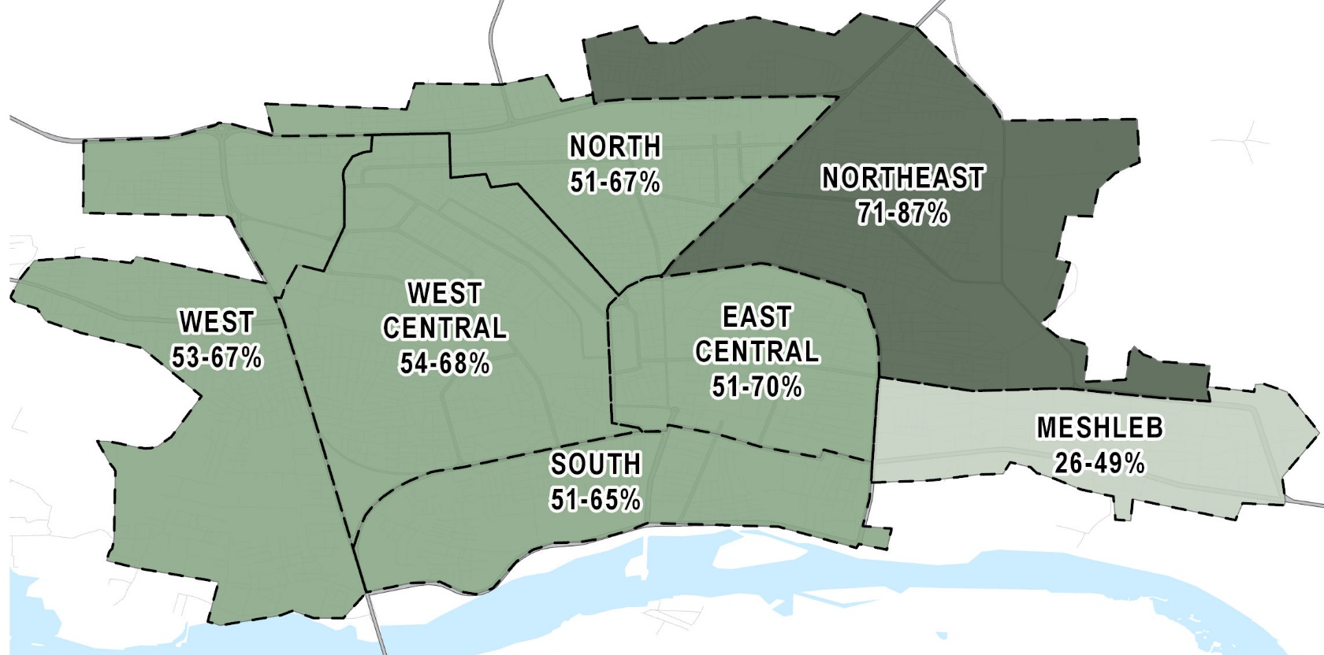
Food Security: Coping Strategies
Estimated proportion of households using at least one food-based coping strategy as of February 2019
At least half of households are estimated to be employing at least one food-based coping strategy, and this rate has reportedly increased slightly since October (from 40-61% to 53-70%). Northeast area stands out with the highest reported usage of coping strategies.
The majority of assessed core food items were reportedly available in markets across the city, suggesting main reason for food insecurity is a lack of cash rather than a lack of goods in markets.
*Food-based coping strategies used for this indicator include reducing meal sizes, skipping meals, and using money on food usually spent on other things.

Slide 15
Food Security: Key Trends
Number of neighbourhoods by sufficiency and affordability of bakeries
Bakeries are reportedly less able to produce sufficient quantities of bread to meet the needs of residents compared to October.
Owners of public bakeries report that they are not receiving enough flour which is inhibiting production of affordable bread.*
*REACH conducted additional KI interviews with five public bakery owners and local authority members in Raqqa city to investigate this issue.

Slide 16
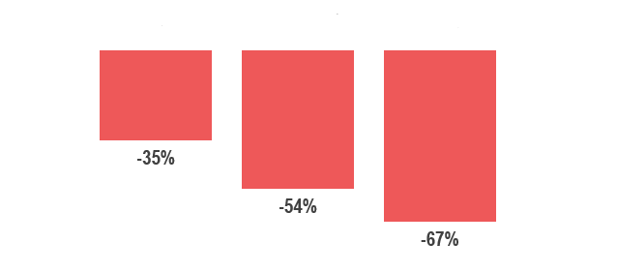
Food Security: Wheat and Barley Production
Estimated change wheat and barley production between 2016/17 and 2017/18 seasons
Ar-Raqqa Al-Hasakah Deir-Ez-Zor
The 2017/18 wheat and barley season resulted in the lowest production rates in many years, due largely to delayed rain, affecting both income and markets across NES.
Outlooks for the 2018/19 wheat harvest are tentatively positive. However, as harvesting takes place in May-July, this year’s crop has not yet affected markets and livelihoods.
Data source: FAO/WFP Crop and Food Security Assessment Mission to the Syrian Arab Republic, October 2018

Slide 17
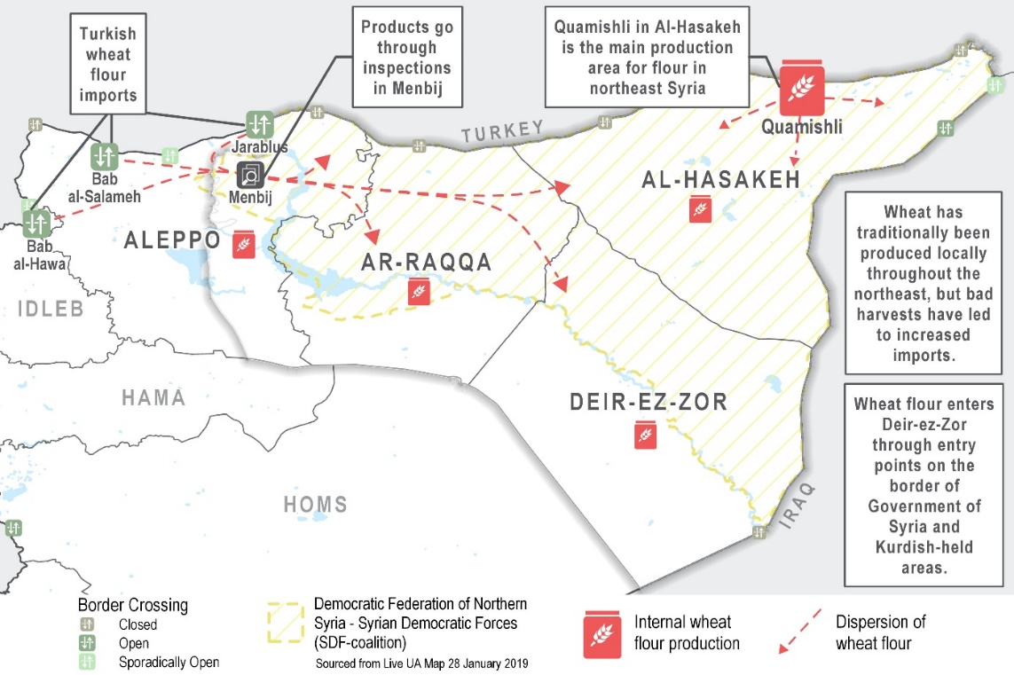
Food Security: Wheat and Flour
Map of the flour supply chain in northeast syria
Flour in Northeast Syria is supplied through a mix of internal production, imports from Turkey and trade with areas under Government of Syria control.
Kis report supply chain actors in Ar-Raqqa governorate rely on imported supplies purchased at high costs through the Menbij corridor.
Data source: REACH, Cash and Markets Assessment, November 2018, soon to be published

Slide 18
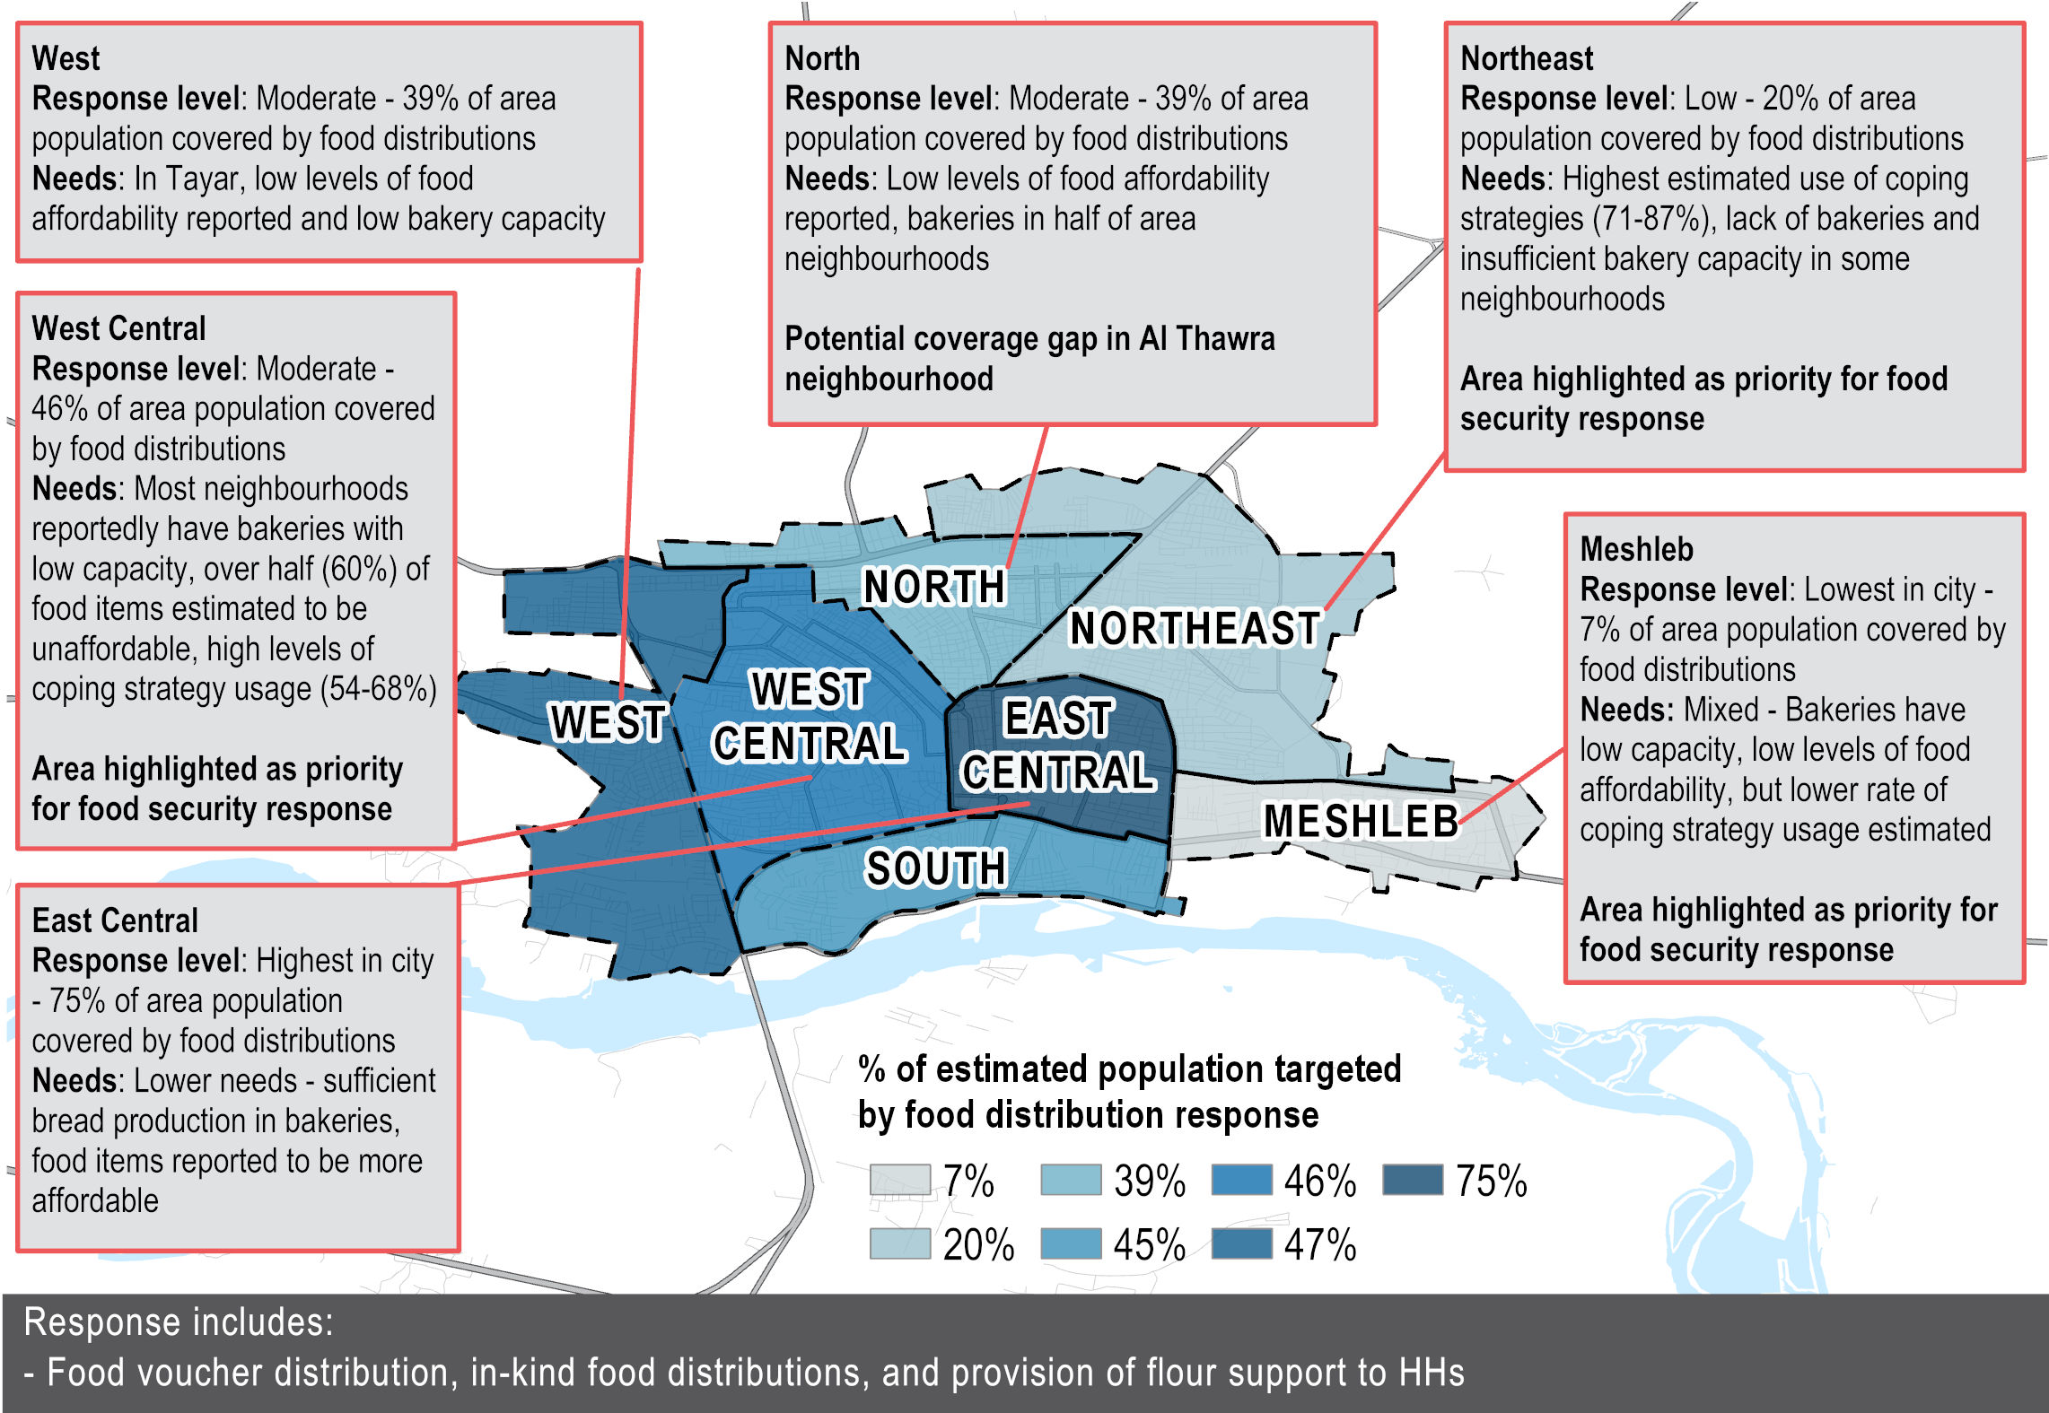
Food Security: Response and Area Overview

Slide 19
Livelihoods

Slide 20
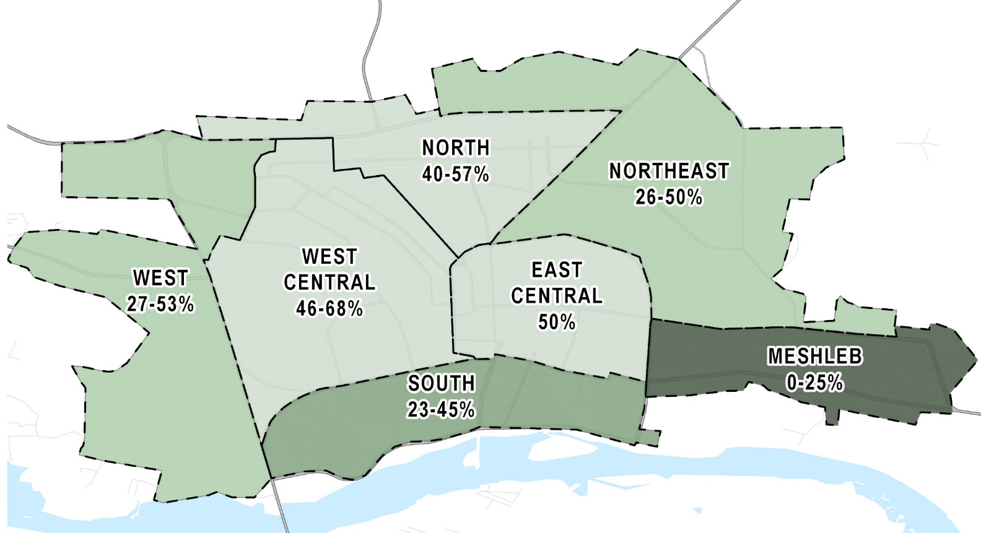
Livelihoods: Access to Income
Estimated proportion of adult male population (aged 18-65) engaging in income-generating activities as of February 2019
Access to income is very low: across Raqqa city, under half of the adult male population is estimated to be engaging in income-generating activities (35-54%). KIs reported that households in Meshleb have a lower level of access to income-generating activities.
Kis in all neighbourhoods reported that between 0-25% of women aged 18-65 were engaging in income-generating activities.

Slide 21
Livelihoods: Access to Income
Most commonly reported type of income as of February 2019 (% of KIs reporting)*
Average cost of SMEB in Ar-Raqqa sub-district in Syrian Pounds (SYP)*
Main income sources are reported to be casual and low-salaried.
Average cost of SMEB is reportedly above the reported average monthly income for households in Raqqa city which was estimated to be below 50,000 SYP in 15 out of 22 neighbourhoods.
Multiple response were possible, so answers may exceed 100%. Data source: REACH, Market Monitoring March 2019

Slide 22
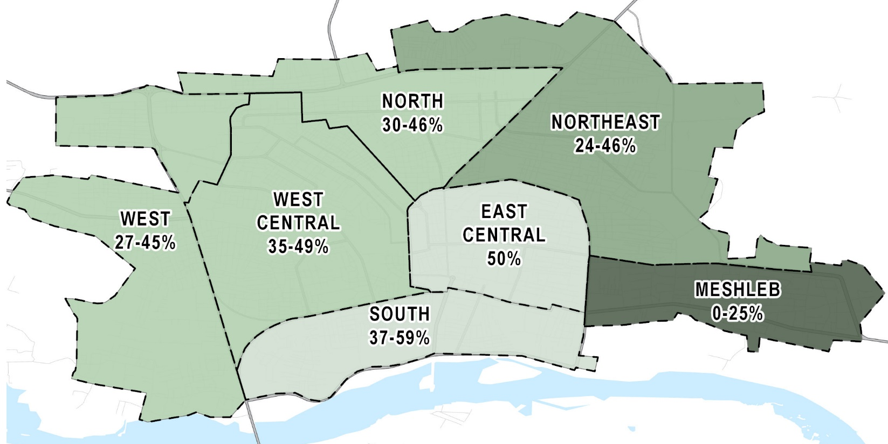
Livelihoods: Ability to Cover Basic Needs
Proportion of households able to cover basic needs through sources of income
Under half of households are estimated to be able to cover their basic needs through sources of income (28-46%), and this has remained at similar levels since October (29-49%)
Households in Meshleb reportedly have the lowest ability to cover basic needs through their sources of income.

Slide 23
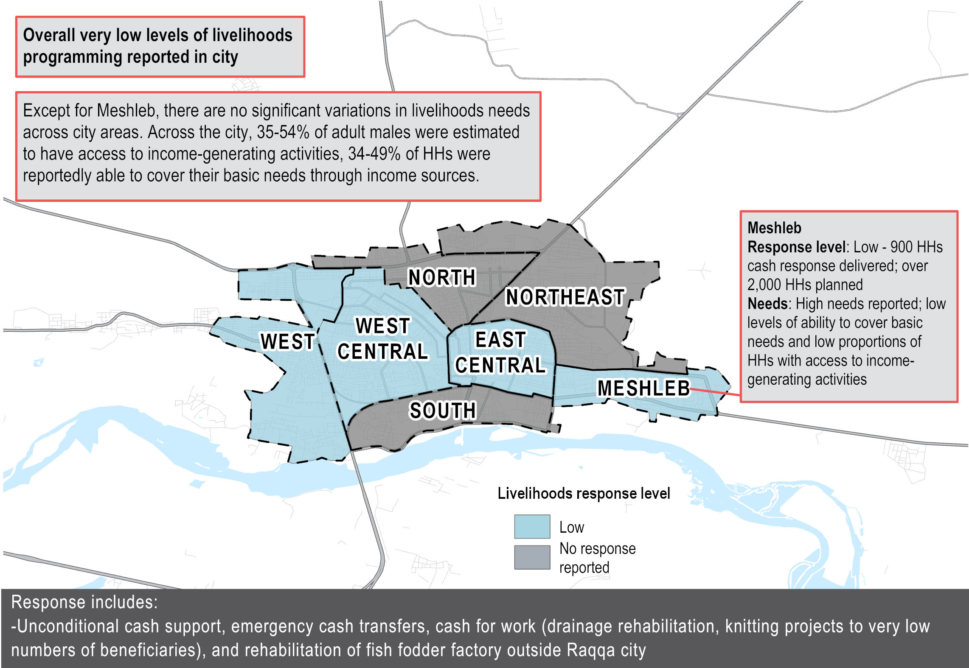
Livelihoods: Response and Area Overview

Slide 24
Protection

Slide 25
Protection: City Wide Findings
Residents in Raqqa face numerous protection risks, the most reported of which is theft. However, following the conscription campaign earlier this year, fear of conscription has increasingly been reported compared to October.
Declining livelihoods compound many child protection issues, and the rate of several of these are perceived to have increased since October despite a scale-up of the protection response:
  Child labour is perceived to be the most prevalent of these issues and has been reported more commonly as a barrier to education since October 2018.
  Perceived rates of child-marriage and child-headed households are also reported to have increased.

Slide 26
Protection: Key Trends
Most commonly reported safety/security issues as of February 2019 (% KIs reporting)*
Theft was the most frequently reported safety/security issue throughout all ABA rounds. Fear of conscription has sharply increased as a perceived safety/security issue since October 2018.
* Multiple responses were possible, so answers may exceed 100%.

Slide 27
Protection: Child Protection
Perceptions on prevalence of child protection issues in the community, as of February 2019
 | Child Labour (by children under the age of 16) | Early marriage | Child-headed households
Meshleb | Common | Common ↑ | Common ↑
Northeast | Common | Common ↑ | Common
South | Very common ↑ | Common | Common
East Central | Common | Common | No consensus among Kis
West Central | Common | Common | Common ↑
North | Common | No consensus among Kis | Common
West | Common | Common ↑ | Common ↑
↑ Increase since Oct-18
KIs continued to report child labour as common throughout the city, and may be related with the challenging livelihood conditions.
Similarly, KIs reported that rates of early marriage and child-headed households had also increased
* REACH also assessed the prevalence of involvement of children in illegal activities, involvement of children in armed activities, separated or unaccompanied children, and physical and sexual violence against children. These child protection issues were not reported to be as prevalent as the above indicators.

Slide 28
Protection: Child Labour
Proportion of KIs reporting ‘children having to work’ as most common barrier to accessing education
Rates of child labour as a barrier to accessing education have reportedly increased since March 2018. Given this increase, child labour may be particularly prevalent in areas where school attendance is reportedly lowest, namely in North and West areas, although more research is required to confirm this.

Slide 29
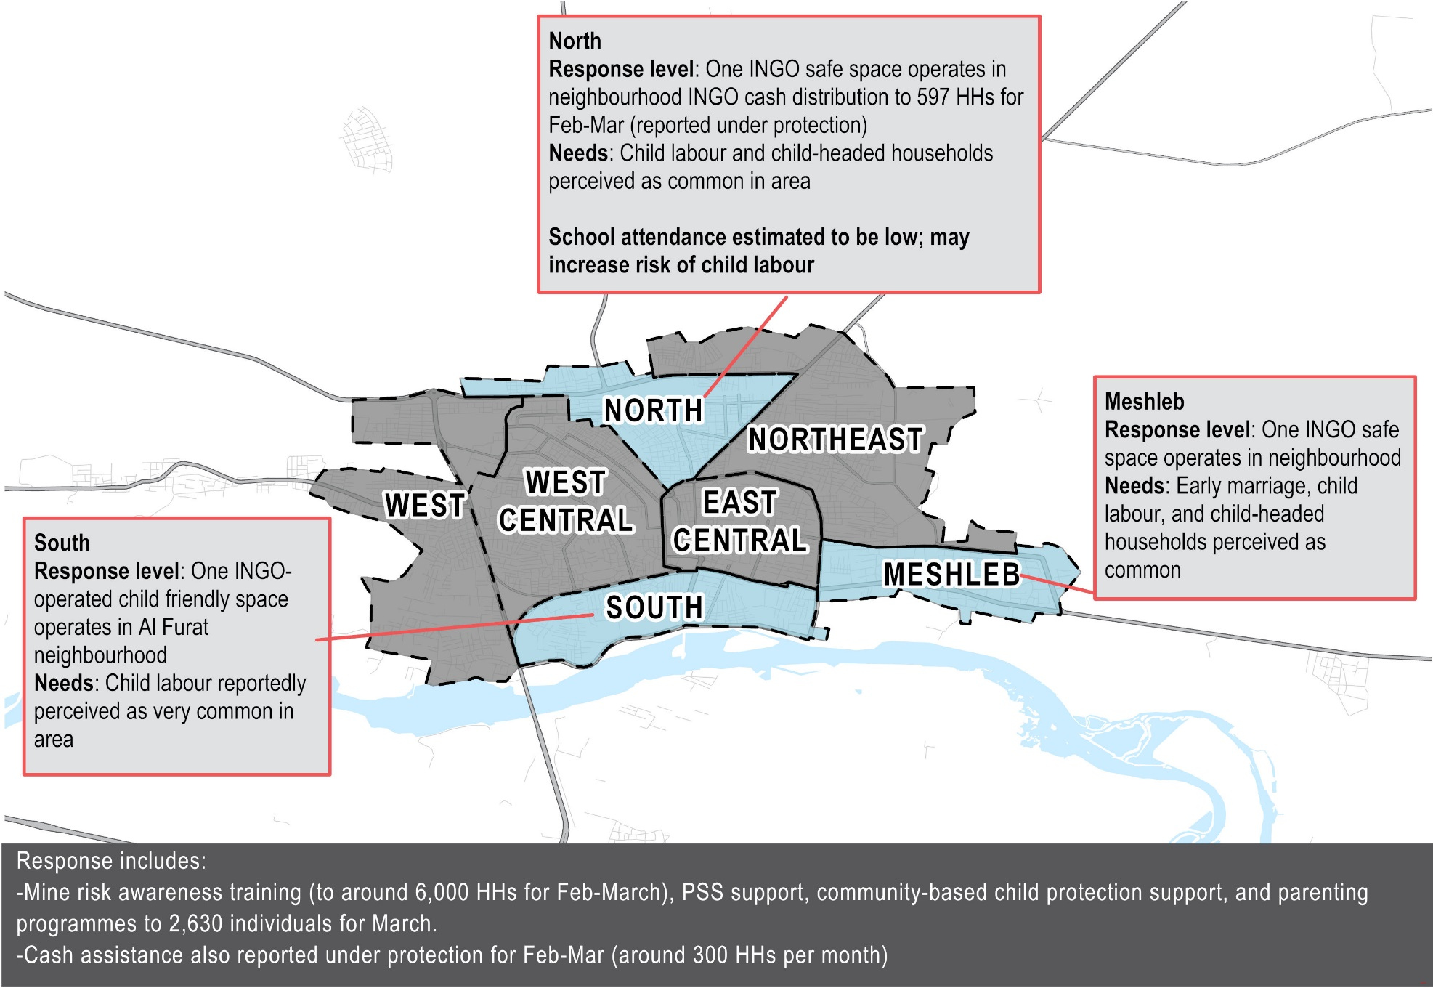
Protection: Response and Area Overview

Slide 30
Discussion: FSL and Protection
Top line findings: limited livelihoods, increased food insecurity, and main protection finding showing linkages with child labour (as harmful coping strategy)
Continue to observe limited progress in addressing absence of livelihoods opportunities – especially given urban context and inability to invest in agricultural.
What are barriers to scaling up in NE/EW where there is lower FS and livelihood response and higher recourse to food based coping strategies? What possible explanations are there for comparable findings in Meshleb? Does this suggest we should once again redirect response to Meshleb?
Given impact on purchasing power and level of recourse to harmful coping strategies (e.g. child labor), livelihood interventions remain critical to building longer-term resilience in Raqqa city. In view of this, and noting challenges of livlelihood programming in urban environments, what kind of interventions are feasible? Do you have examples of what’s been effective?
Populations cite cash-based interventions as a solution. RCC has highlighted cash, as well as business grants. CFW for repair of infrastructure. What are the challenges humanitarians are facing?

Slide 31
Education

Slide 32
Education: City Wide Findings
Since October, there has been an increase in the response and more schools have been opening, but no overall improvements in attendance to education have been recorded:
  Primary level education remains relatively high, but increased returns lead to overcrowding of classrooms,
  despite a slight improvement, access to intermediary education remains limited.
  As noted in October, North and West areas still stand out with a lower estimated access to education, coupled with lower capacity of schools to serve residents’ needs, and a lower level of reported response compared to other areas.
Raqqa city school education infrastructure has suffered significant material damage and their capacity and poor condition is highlighted as primary barriers to accessing education.
Almost half of all functioning schools are estimated to have minor damage rendering them more suitable for both shelter and WASH rehabilitation, and the majority of these are located in West Central area.

Slide 33
Education: Key Trends
Proportion of children aged 6-12 who accessed education services in the past two weeks prior to collecting data (by number of neighbourhoods %s reported)
Access to primary level education has increased consistently since March 2018, but has remained at the same levels since October 2018.

Slide 34
Education: Key Trends
Proportion of children aged 13-15 who accessed education services in the past two weeks prior to collecting data (by number of neighbourhoods %s reported)
Access to education for children aged 13-15 has also increased slightly since March 2018, but remains very limited.
*For the month of October 2018, data includes children aged 13-18.

Slide 35
Education: Attendance
Estimated school attendance rate for children aged 6-17 as of February 2019*
As reported in October, North and West areas have the lowest reported estimated rate of school attendance (South area is estimated to have increased access).
Between 19,000–48,000 children aged 6-17 are estimated to not be attending school in Raqqa city.
Figures are based on data provided by KIs and an age distribution for Raqqa governorate imported from REACH’s SNFI Assessment from August 2018.

Slide 36
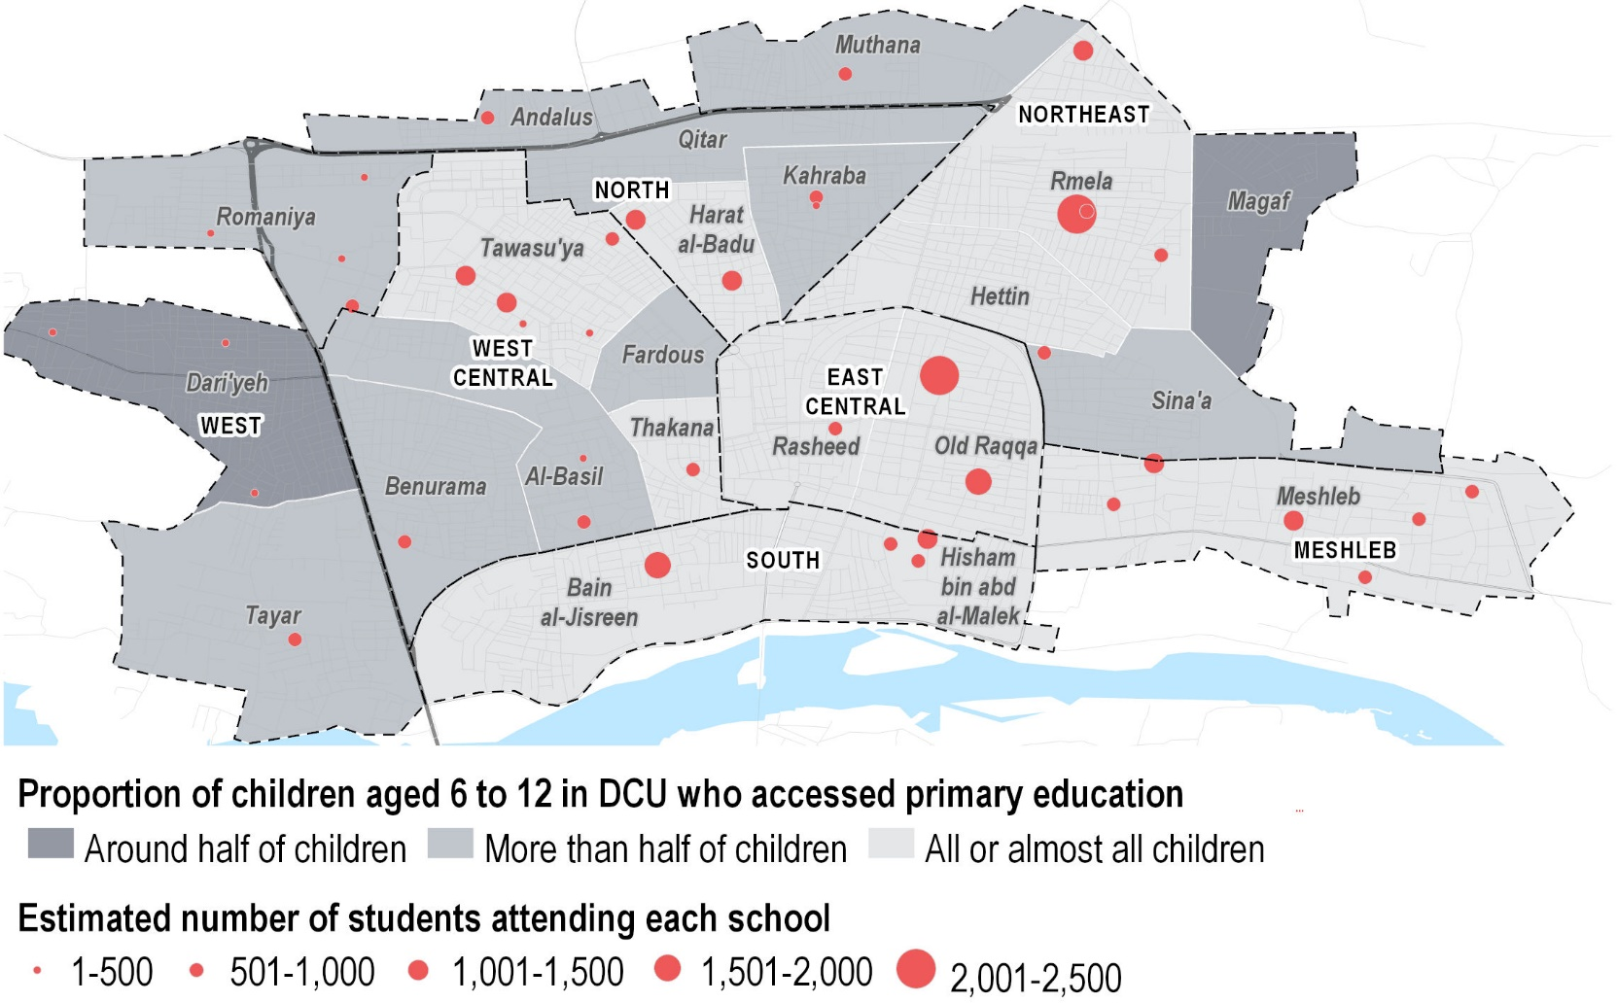
Education: Attendance
Access to education and functioning schools by neighbourhoods, as of February 2019
As reported in October, West, parts of West Central and North areas have lower estimated rates of primary school attendance.
In addition to having a lower reported rate of school attendance for children aged 6-12, West and North areas have fewer schools that serve a lower number of students compared to other areas.

Slide 37
Education: Barriers to Education
Most commonly reported barriers to education among KIs as of February 2019 (%of Kis reporting)*
With increased estimated returns and more schools opening, barriers to education have shifted since October; overcrowding of classrooms highlighted as the most commonly reported barrier.
Condition of schools also commonly reported as a barrier indicating potential for rehabilitation and repair of school facilities, as well as increase in need for children to work.
* Multiple responses were possible, so answers may exceed 100%. ‘Lack of teaching and learning materials’ was added as an option in February 2019.

Slide 38
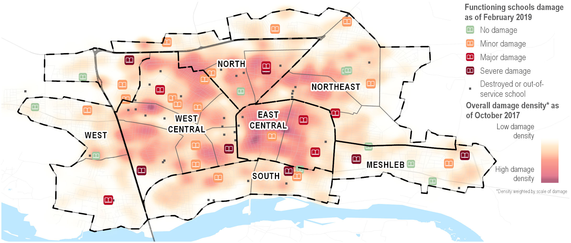
Education: School Infrastructure Damage
Level of material damage to functioning school buildings in Ar-Raqqa city, by % of schools
There are 43 schools in the city that are not functioning, 31 of which are destroyed. There are 41 functioning schools operating in the city, 76% have suffered at least minor damage which are suitable for repair and shelter rehabilitation.

Slide 39
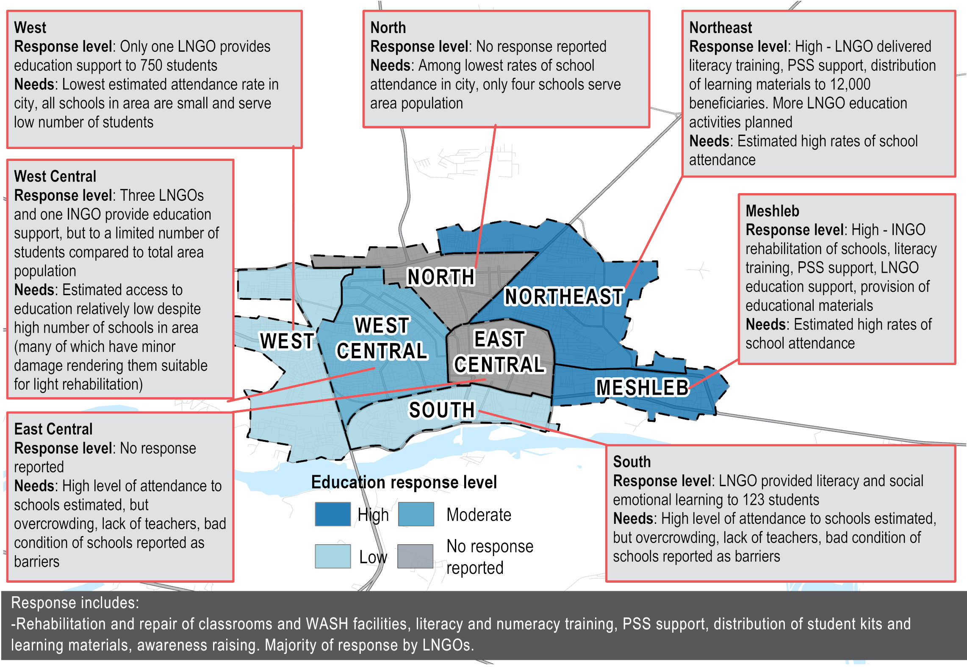
Education: Response and Area Overview

Slide 40
Education: Discussion
Improvements in attendance of primary education remains the same, still very limited attendance for intermediary education.
There has been a scale up and good examples of integrated programming where wash, shelter and education brought together – at the same time, and potentially linked, increased number of schools in the city.
However, still extensive school damage, large numbers of children out of school and big quality issues. Underserved areas persistently North and West, and somewhat West Central.
In view of scale of education needs in Raqqa city as well as challenging operating environment, integrated programming offers an opportunity to maximize impact of interventions. Which NGOs have adopted an integrated approach to responding to education needs? What additional steps could we take to promote/ support more integrated programming in Raqqa City?
There remains a perception that NES, is not conducive to education programming. To what extent is this valid in Raqqa City?

Slide 41
Water, Sanitation and Hygiene (WASH)

Slide 42
WASH: City Wide Findings
Access to the city’s main water network has improved since October with almost daily access to water reported in 19 neighbourhoods (out of 22), and water trucking as a primary source of water has declined significantly. However, challenges still persist;
  With particularly lower access reported in some outlying neighbourhoods, and slightly lower access in the western part of the city ,
  Water quality issues persist and improvements have not been reported since October,
  Widespread challenges remain with the city’s sewage infrastructure with reports of sewage flowing into the streets having increased significantly since October,
  Despite regular garbage collection by local authorities, residents in some neighbourhoods still burn garbage in large piles due to these inadequate garbage collection services

Slide 43
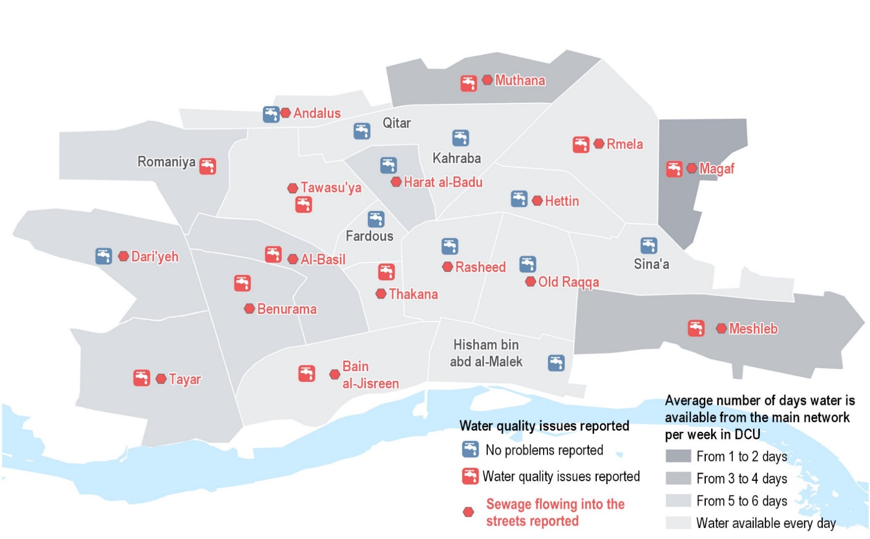
WASH: Access to Water and Water Quality Issues
Reported frequency of access to main water network and issues with water quality and sanitation, as of February 2019
Most of the city reportedly have daily access to the main water network, but lower access was reported in the same outlying neighbourhoods as indicated in October. Issues with water quality are reportedly also widespread in these and other areas.
Reports of sewage flooding into the streets area also widespread throughout all areas.
*Water quality issues include: abnormal smell of water, water is discoloured, people got sick after consuming water. Sewage data includes findings from Kis, FGDs, and information provided by a WASH stabilization actor active in Raqqa City.

Slide 44
WASH: Key Trends
Primary reported source of water in neighbourhoods (# of neighbourhoods)
Water trucking continues to decline overall as a primary source of water.
Avg. number of days water was available from the network in neighbourhoods (# of neighbourhoods)
The main water network is available almost daily in the majority of neighbourhoods.

Slide 45
WASH: Key Trends
Number of neighbourhoods where KIs report issues with water quality*
Issues with water quality have reportedly remained at the same level for almost a year.
Number of neighbourhoods where KIs report sanitation issues
Reports of sewage flowing into the streets have increased significantly since October, which may cause adverse effects on health towards summer.
*Water quality issues include: abnormal smell of water, water is discoloured, people got sick after consuming water

Slide 46
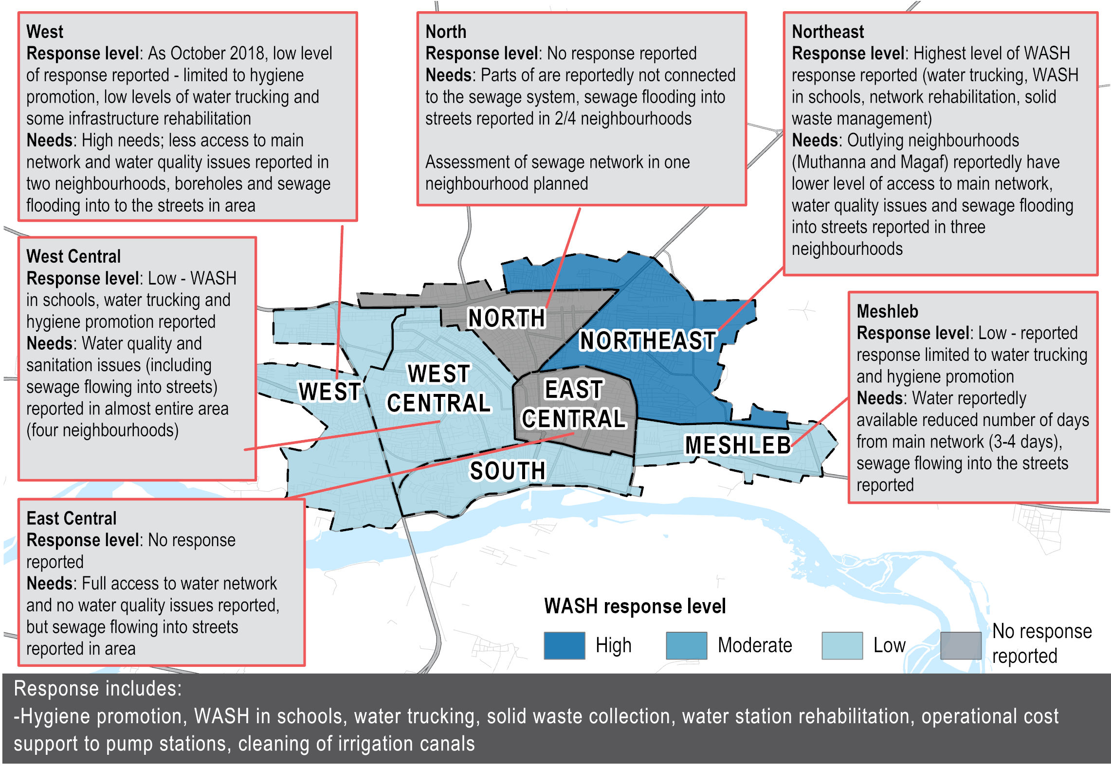
WASH: Response and Area Overview

Slide 47
WASH: Discussion
Overall continued improvements in access to water through main network.
However issues with water quality remain and sewage is an increasing problem. There are still specific neighbourhoods with higher reported needs and lower response.
While water availability has improved, water quality issues continue to be reported. As there has been increasing support to improving water quality, does this match with your own assessments? Could this be an issue of community perceptions?
What steps are being taken in terms of infrastructure rehabilitation (e.g. sewage networks)? What are the limitations humanitarian NGOs face in terms of supporting more extensive infrastructure rehabilitation in Raqqa city?

Slide 48
Health

Slide 49
Health: City Wide Findings
The level of access to required healthcare treatment is estimated to have declined in Raqqa since October:
  In 11 neighbourhoods, KIs reported that lower proportions of households are unable to access the treatment they require compared to October, especially in Northeast area which stands out with lower access in many neighbourhoods and large distances to the city’s existing health services.
  There has been an increase in the reported need for treatment for chronic disease/specialised services, suggesting specialized services that are often available primarily in private health facilities, are increasingly in need.
  Reduced levels of access to healthcare may be compounded by increased populations, declining livelihoods, reduced purchasing power, as affordability of healthcare has been increasingly reported as the most common barrier to accessing health services.
Humanitarian assistance remains at similar levels with at least six NGO-run clinics operating in the city, but a key INGO-operated pediatric and maternal hospital will soon be in shortage of funds.

Slide 50
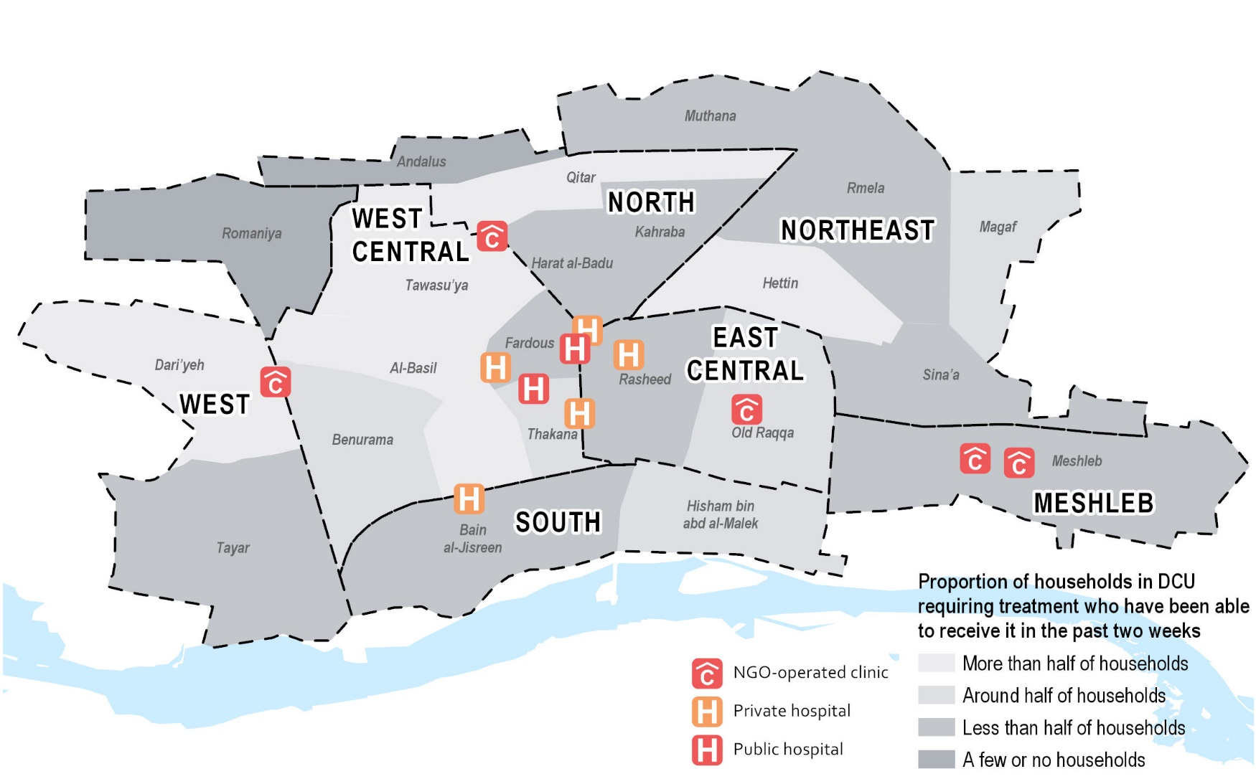
Health: Access to Health Services
Proportion of households requiring treatment who have been able to access it in the past two weeks, as of February 2019
Overall, access to required health treatment has reportedly declined in 11 neighbourhoods (although increased in five), but notably increased in West Central area since October.
Increased access to healthcare is not necessarily determined by proximity to healthcare facilities, suggesting the required treatment is not accessible or available.

Slide 51
Health: Key Trends
Most commonly reported health needs (% of Kis reporting)*
Notable increase in treatment for chronic disease/specialised services as a primary health need since October 2018
Proportion of households requiring medical treatment who were able to access it in the past two weeks, as of February 2019 (by number of neighbourhoods)
KIs report that access to required medical treatment have decreased since October
* Multiple responses were possible, so answers may exceed 100%.

Slide 52
Health: Barriers to Accessing Health Services
Most commonly reported barriers to healthcare across Ar-Raqqa city as of February 2019 (% of KIs reporting)*
The most commonly reported barrier to healthcare is related to cost of services and has been increasingly reported by KIs as a key barrier since March 2018.
Distance to facilities also cited as a primary barrier, which suggest transportation is a gap, or that nearby facilities do not offer required treatment.
* Multiple responses were possible, so answers may exceed 100%.

Slide 53
Health: Gaps in Specialised Services
Higher need for treatment for chronic disease and increased barriers related to cost, highlight gaps in specialized services which are often only available through costly private services. These include: *
Mental health, PSS, Sexual and Reproductive health (SRH)
Maternity and Child Health
Supporting diagnostic laboratory capacity at health facilities
Thalassemia: safe transfusion/chelation therapy
Tuberculosis and HIV testing
Dialysis
*Source: NES Health Sector. Gaps pertain to the governorate of Raqqa, and is not limited to the city.

Slide 54
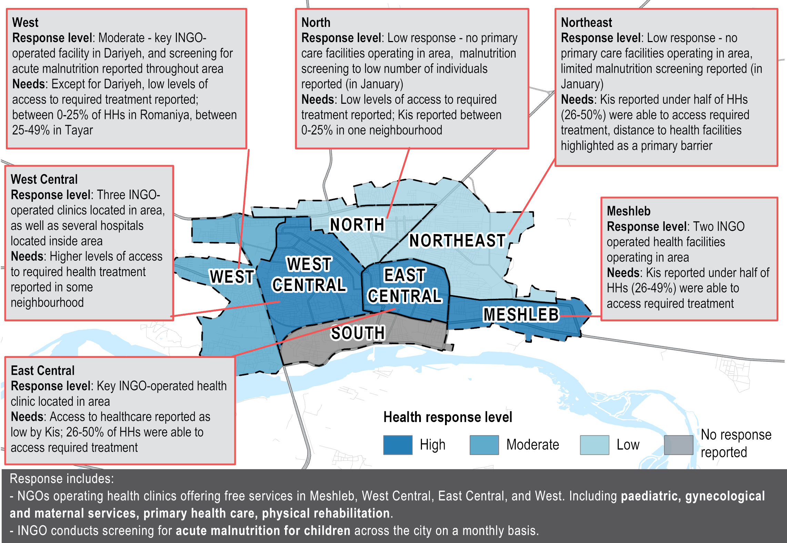
Health: Response and Area Overview

Slide 55
Health: Discussion
Continued reporting of lack of affordability since October but no significant change.
A the same time there is increased demand for specialized services and increased reporting of distance to healthcare as a barrier since last assessment
  How can we address challenges around affordability particularly as it relates to transportation? What possible intervention could be explored to assist with transportation?
  What are the key considerations in increasing provision of specialized services which, even when available are largely unaffordable?

Slide 56
Shelter and NFIs (SNFI)

Slide 57
SNFI: City Wide Findings
Despite a gradual increase in shelter rehabilitation activities, there has been a limited increase since October with shelter and infrastructure damage widespread.
Northeast, West Central and East Central areas are estimated to have both a higher proportion of shelters with moderate damage and higher proportions of residents living in shelters with minor damage. Neighbourhoods in these areas may be more suitable for shelter rehabilitation programming.
The most commonly reported NFI needs are generally less available in markets across the city. Given transportation costs, availability of NFIs in neighbourhoods should be factored in when choosing modality of NFI distribution activities.

Slide 58
SNFI: NFI Needs
Most commonly reported NFI needs across Ar-Raqqa City as of February 2019 (% of KIs reporting)*
Availability of top 5 NFIs (by % of neighbourhoods)
Regular NFIs
Bedding items | Cooking Fuel | Clothing | Baby Diapers | Batteries
18% | 59% | 27% | 100% | 23%
Winter NFIs
Heating fuel | Winter clothes | Winter blankets | Winter heaters | Winter shoes
36% | 27% | 23% | 23% | 27%
Compared to October, NFI needs have generally shifted away from winterization items (winter heaters were previously the highest reported NFI need).
* Multiple responses were possible, so answers may exceed 100%.

Slide 59
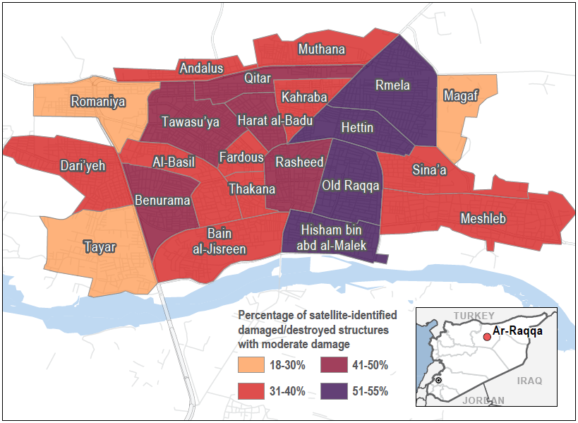

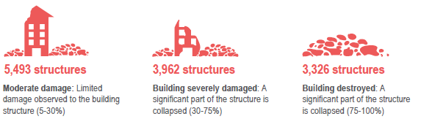
SNFI: Satellite-Detected Severity of Structure Damage - 21 October 2017
Satellite-detected moderately damaged structures for shelter rehabilitation
Northeast, West Central and East Central and parts of North areas are estimated to have a higher proportion of shelters with moderate damage.
These are more suitable for rehabilitation within the scope of a humanitarian shelter response.
West Central is estimated to also has a high number of schools with minor damage.
Ar-Raqqa city structural damage totals by UNITAR-UNOSAT classification:
Information on methodology can be found here.

Slide 60
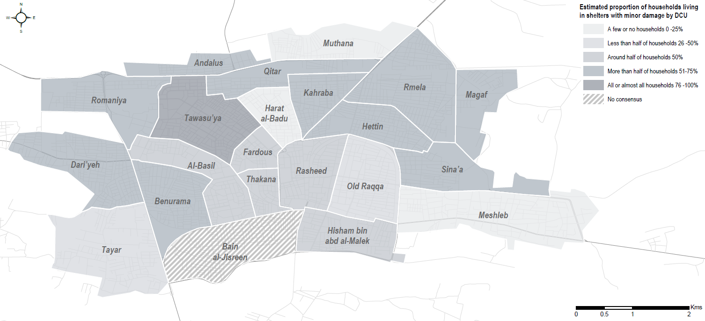
SNFI: Shelter Damage
Proportion of household residing in shelters with minor damage as of February 2019
Similarly, West Central and Northeast areas are estimated to have higher proportion of families living in shelters with minor damage.
With higher populations, Benurama, Tawasu’ya and Rmela neighbourhoods may be locations of focus moving forward for the shelter response.
REACH have used the shelter damage categories developed by the Shelter Sector for the North East Syria (NES) Hub. Minor damage includes shelters with limited damage to walls, doors and windows.

Slide 61
SNFI: Shelter Damage
Main Reasons for not repairing damaged shelters in the past two weeks, as of February 2019 (by % of Kis reporting)
The reported primary reasons for not repairing shelter are predominately related to cost of materials and hiring professionals.
Given the type and scale of damage in the city, residents are reportedly unable to make repairs themselves.

Slide 62
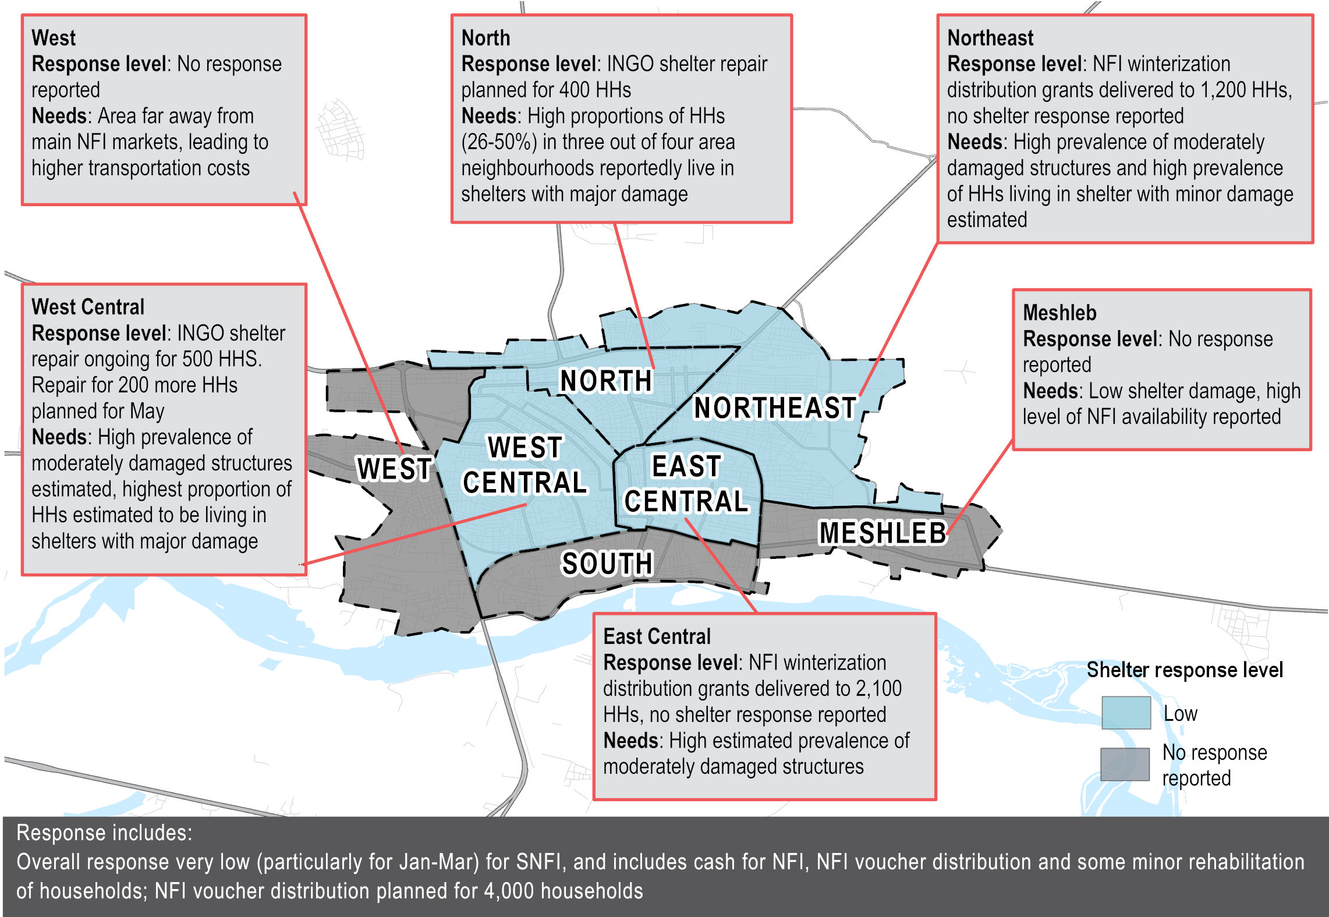
SNFI: Response and Area Overview

Slide 63
SNFI: Discussion
No major change since last workshop- limited shelter response, high levels of damage.
However, increasingly actors are beginning to explore shelter response, particularly in areas where minor or moderate damage where greater scope for humanitarian programming.
What are the plan to scale-up shelter rehabilitation programmes, particularly in NE, west central and east central areas?
What are some of the challenges and considerations around scaling-up shelter programming? Are there any sustainable ways shelter partners can support residents conduct their own shelter repairs?

