Slide 1
Returns and Durable Solutions Assessment (ReDS)
Markaz Sinjar – Sinjar, Ninewa
Findings presentation, Iraq
Data collection period: 26 November and 1 December 2020

Slide 2
1. Introduction to ReDS
2. ReDS methodology
3. Markaz Sinjar overview
4. Key findings
5. Detailed findings
6. Questions from the audience
7. Discussion
Presentation outline

Slide 3
1
Introduction to ReDS

Slide 4
In 2020, the numbers of internally displaced persons (IDPs) returning to their area of origin (AoO) or being re-displaced for a second time increased, coupled with persisting challenges in relation to lack of services, infrastructure and - in some cases - security in areas of origin.
The need to better understand the sustainability of returns, conditions for the (re)integration of IDPs and returnees, and the impact of their presence on access to services and social cohesion has been an identified need for humanitarian and development planning.
Decisions related to the closure of all IDP camps by the end of 2020 have also impacted these dynamics.
ReDS background

Slide 5
ReDS Specific Objectives
Provide an understanding about the effects of recent movement trends;
Assess perceived intentions to move among all relevant communities to identify potential risk of further instability;
Assess how conditions in areas affected by recent movements may impact the sustainability of durable solutions;
Identify any consequent shift in local social dynamics and power structures;
Explore conditions in the area in terms of community needs and inter-relations; and the viability of safe and dignified (re)integration.
ReDS objectives
Notes:
In general, the assessment aimed to provide rapid evidence-base overview of the assessed areas to support humanitarian and development actors to promote durable solutions for returnees and IDPs in situations of protracted displacement on multiple levels, including:
Development of strategic dialogue, policy development, and resource mobilization efforts,
Development of localized interventions,
Advocacy with government actors around camp closures, consolidation, premature returns, and conditions in areas of origin to allow sustainable returns.
ReDS Specific Objectives
Provide an understanding about the effects of recent movement trends across different demographic groups in targeted areas;
Assess perceived intentions to move among all relevant communities within the areas to identify potential risk of further instability;
Assess how conditions in areas affected by recent movements may impact the sustainability of durable solutions;
Identify any consequent shift in local social dynamics and power structures following the recent movements;
Explore conditions in the area in terms of community needs and inter-relations; and the viability of safe and dignified (re)integration.

Slide 6
2
ReDS methodology

Slide 7
Methodology
The multi-sectoral assessment tool combined qualitative and quantitative data.
Data collection was done remotely by phone between 26 November and 1 December 2020, adapted to the context of the COVID-19 pandemic local restrictions and associated pandemic measures.
Purposive sampling methods were employed to identify KIs. Findings should therefore be considered as indicative.
Methodology based on key informant interviews (KIIs).
 KI profile in Markaz Sinjar Sub-district
Community leaders 16 KIs
Remainees/non-displaced 4 KIs
IDPs (displaced from the area) 8 KIs
IDPs (displaced in the area) 5 KIs
Returnees (more than 3 months ago) 5 KIs
Returnees (less than 3 months ago) 5 KIs
^{43 KIs}
Notes:
Community leaders are members of the host community represented by three mukhtars (from five different locations in Markaz Sinjar), five public sector employees, four health sector employees and four educational sector employees. Mukhtar can be defined as the head of a village or neighbourhood in some Arab countries.
IDPs (displaced from the area) refer to households from Markaz Sinjar displaced after 2014 events to other areas different than their AoO, specifically in Shamal Sub-district (Sinjar District of Ninewa Governorate); in Markaz Telafar Sub-district (Telafar District of Ninewa Governorate); and, in Markaz Duhoq Sub-district (Duhoq District of Dohuq Governorate).
IDPs (displaced in the area) refer to households from AoO different than Markaz Sinjar who were displaced after 2014 events and reside in Markaz Sinjar. Households were reportedly originally from Aqra District of Duhoq Governorate
For the purpose of this research, returnees will be categorized as an IDP returning to their AoO, where AoO is defined as the stated original sub-district of origin for the IDP. Given the complexity of (re)integration, this could mean that returnees still face challenges to their sustainable return to their AoO.

Slide 8
Limitations
Considering the findings as indicative due to the small sample size and the purposive sampling method
43 KIs in Markaz Sinjar Sub-district
KIs gender balance
35 male KIs
8 female KIs
Contextualization at sub-district level
To operationalise the identified trends, information was analysed
and visualized at sub-district level, rather than village or neighbourhood
Remote data collection
Data collected remotely by phone


Notes:
Considering the findings as indicative: The sample is small (43 KIs), and findings will only be an indication of trends, needs, humanitarian concerns, gaps and flags for actors to assess further. Findings cannot be analysed or visualized at community-level in the current methodology but [mitigation] for the current analysis REACH included findings per community group as relevant and available.
KIs gender balance: REACH and RWG are working on the identification process to encourage women to participate in the rapid assessment. Coming assessment are expected to have an increased participation rate.
Contextualization at sub-district level: To operationalize the identified trends, information was analysed and visualized at sub-district level, rather than village and neighbourhood. Extending to more detailed assessment at village, neighbourhood or community-level will depend in the availability of data about KIs. Contact details will need to be provided since the sampling is purposive and snowballing is very limited while doing remote data collection and time consuming taking into consideration the need of the informed consent from individuals to share their contact information with REACH. It will also require additional resources such and budget and human resources (enumerators) and will affect the time-line of the project and report deadlines.
Remote data collection: While collecting data remotely can sometimes, the openness of respondents is sometimes affected. [mitigation] Testing process was very strict and discussions with field staff were ongoing to avoid sensitive questions and doing harm to interviewees. Some sensitive terminologies related to Iraq context were identified and replaced by explanation text in the Arabic version of the ODK tool (e.g. ‘governance’ was replaced by ‘laws and regulations’).

Slide 9
3
Markaz Sinjar overview and current demographics

Slide 10
Markaz Sinjar Sub-district overview
Markaz Sinjar is a sub-district of Sinjar District, located in the western area of Ninewa Governorate close the Iraq-Syria border.
During the occupation by the so-called group Islamic State of Iraq and the Levant (ISIL) in the summer of 2014 , 89%-90% of the households were forced to flee their homes, as reported by KIs during data collection.
13,791-14,475 households displaced after 2014 had reportedly returned at the time of data collection, as reported by 16 community leader KIs.
3,249-3,675 IDP households (area of origin (AoO) not specified) are reported to reside in Markaz Sinjar settlements.
Notes:
Markaz Sinjar was selected for the assessment due to: social cohesion severity is high;¹ it is an AoO for IDPs in camps at risk of closure² and dynamic population movements and movement intentions to/from this district related to the camp closures decision were recently reported by relevant actors through the RWG.
1. IOM DTM: http://iraqdtm.iom.int/ReturnIndex - refer to methodology, to compute the severity index, different parameters are combined.
2. REACH camp profiles updates of September 2020

Slide 11
4
Key findings

Slide 12
Markaz Sinjar Sub-district Key findings on safety and security
Overall, Markaz Sinjar is perceived by KIs to have a positive environment in terms of security and community acceptance of certain groups.
Many households have returned due to a sense of increased safety and security in their areas of origin (AoO) in Markaz Sinjar Sub-district.
However, IDP KIs originally from Markaz Sinjar displaced elsewhere and returnee KIs reported security concerns related to the presence of armed groups in the area negatively affecting their freedom of movement.
The fear of persecution in their AoO or perceived ISIL affiliation was reported by IDP KIs originally from Markaz Sinjar displaced elsewhere as barriers for returns.

Slide 13
Markaz Sinjar Sub-district Other key findings
In addition, damaged or destroyed housing reportedly poses a risk to the sustainability of returns and was identified as the main barrier to return by all KIs.
IDPs and returnees were reportedly facing challenges when it comes to housing, land and property (HLP) due to the lack of necessary documents to claim their properties; and they are most at risk of eviction.
Some KIs reported differences in access to services between different groups, mainly affecting IDPs and returnees.
Recent and expected return movements into Markaz Sinjar affected the perception of access to job opportunities and access to assistance across the different respondent groups.
The top primary need is access to healthcare, with the exception being returnees who mostly report house rehabilitation.
Notes:
Secondary data¹ report:
UNHCR reported that at least 5,000 Sunni Arab families have expressed that they do not feel safe returning to their areas of origin in Sinjar and Ba’aj. They also informed that secondary occupation of their houses by other members of the community remains a key concern, in addition some of their homes are being illegally sold while in some instances they are being pressurized to sell off their homes at giveaway prices. Some of the Sunni Arab returnees that could not integrate have reportedly now been secondarily displaced to Mosul. The need to scale up social cohesion interventions in the areas have yet again been emphasized.
UN-Habitat has informed that they are working closely with the Government to help conflict affected families to obtain their HLP documents and are also providing HLP support/ follow up for returnee families. They informed that they have so far registered 5,500 HLP related cases that require follow up/ redress
¹ Ninewa Sub National Inter Cluster Coordination Group Meeting, 17 August 2020 – Not published

Slide 14
5
Markaz Sinjar findings

Slide 15
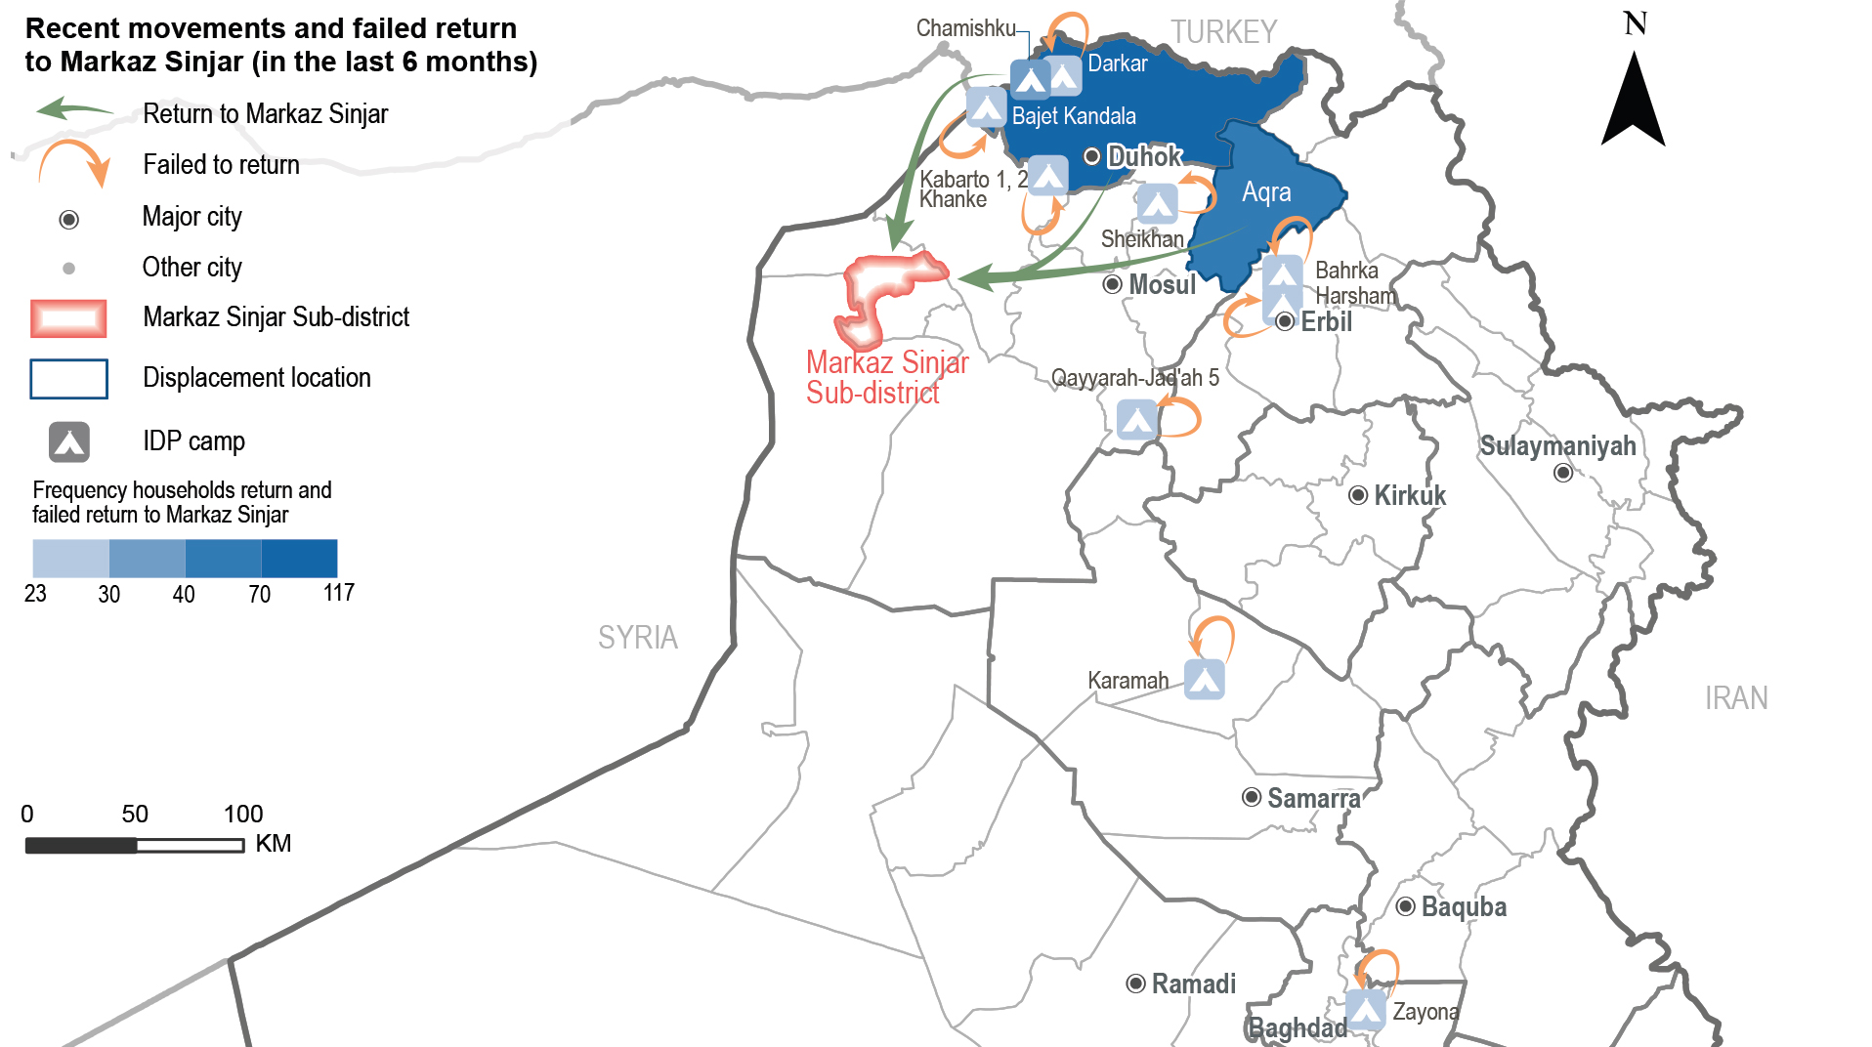
Markaz Sinjar Sub-district
Recent movements to Markaz Sinjar reported by KIs
Notes:
The presented map reflects the recent movement of households originally from Markaz Sinjar reported by KIs during data collection. Between 35 to 65 households reportedly returned to Markaz Sinjar in the six months prior to data collection.
Failed returns were reported by secondary data (REACH Camp Profiling and Intentions)

Slide 16
Markaz Sinjar Sub-district
Recent movements – data reported by KIs
 Recent returns
³⁵⁻⁶⁷
households returned to Markaz Sinjar in the six months prior to data collection, as reported by 11 KIs (out of 43 KIs).
Driver for recent returns (out of 11 KIs)*
Sense of increased safety and security in Markaz Sinjar 9 KIs
Nostalgia about previous life in AoO 3 KIs
Following the return of other family members 1 KI
Impact of recent returns (out of 11 KIs)
Contributed to increased job opportunities due to the return of business owners (6 out of 11 KIs)and access to assistance reportedly increased due to the response from different service providers to the recent returns (6 KIs).
Perceived as negative due to the presence of higher competition in the labour market (5 KIs) and it was reported that the level of household assistance decreased due to increased demand given the presence of a higher number of households in the area (5 KIs).
* Sum of answers may exceed the 100% due to KIs being able to select multiple response options, including other topics.
Notes:
Recent returns
The rest of the KIs (20 KIs) reported no returns or did not know about recent movements (12 KIs).
According to IOM-DTM, between 8 Jun and 29 Nov 2020, more than 1,100 households have already returned to Markaz Sinjar.
Family reunification
During data collection, 21 KIs (out 43 KIs) reported that there are no households with members who are displaced. The rest of the KIs (21 KIs) did not know and a community leader KI refused to answer.

Slide 17
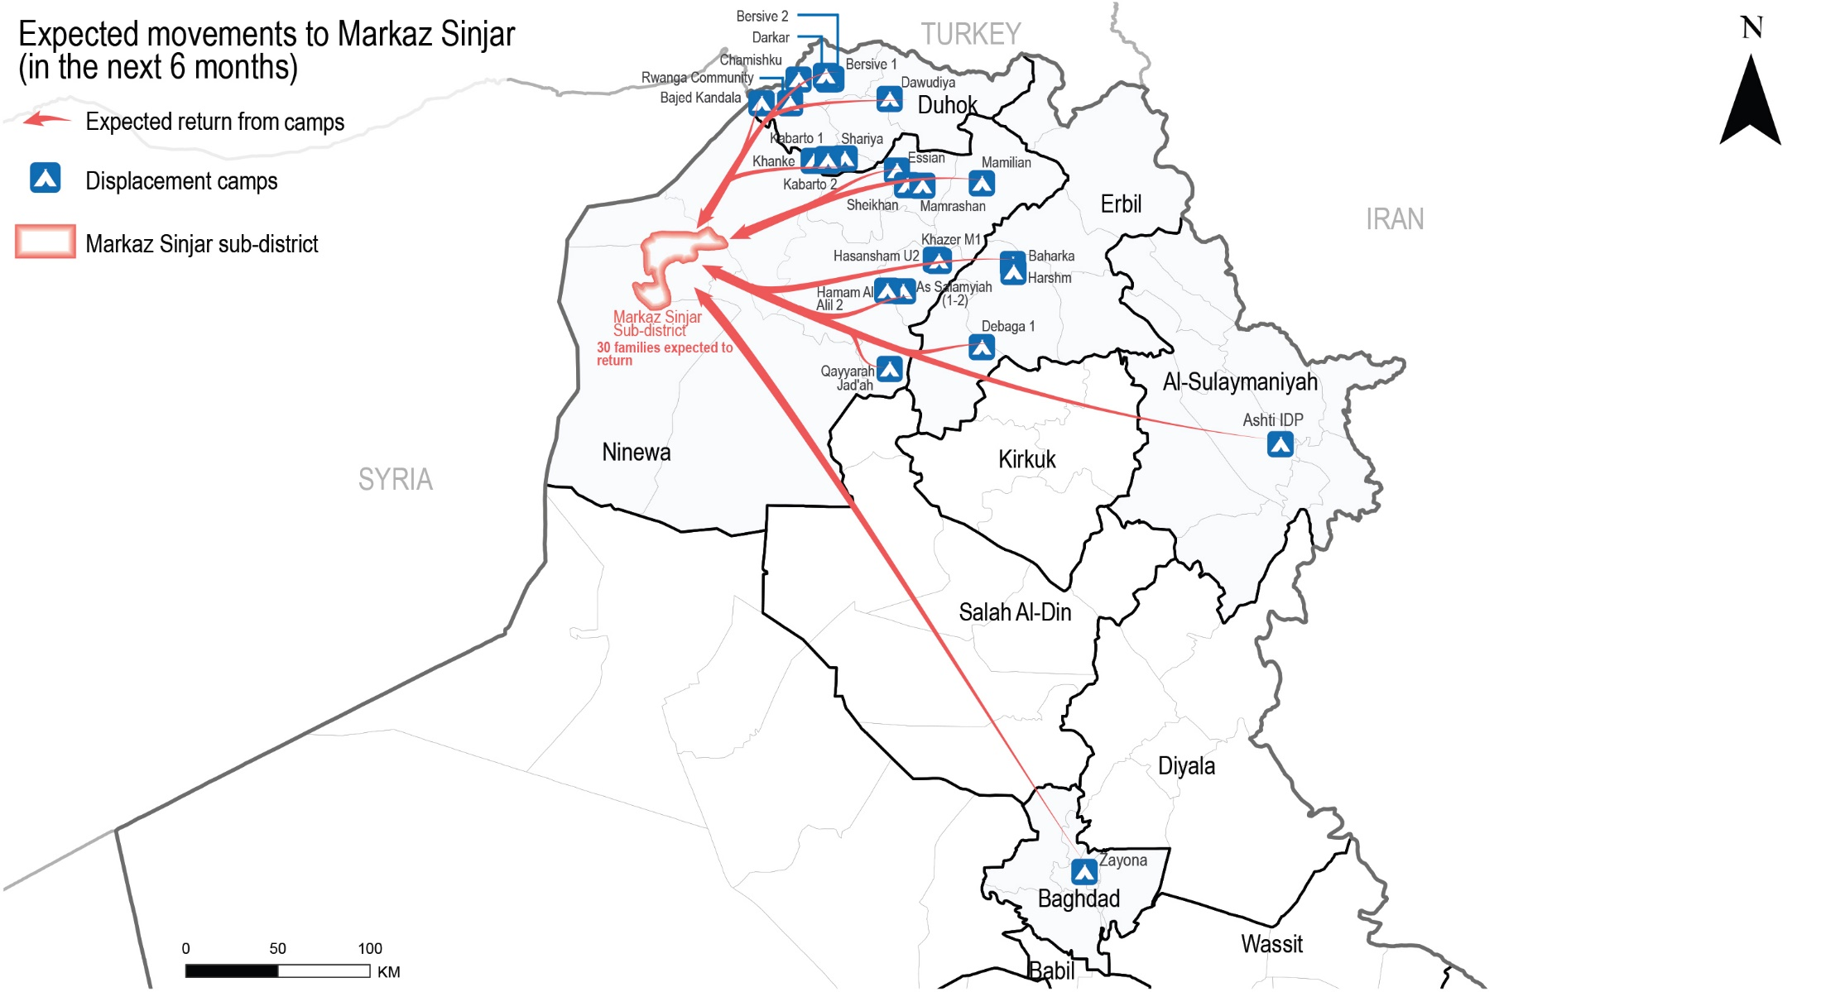
Markaz Sinjar Sub-district
Expected movements to Markaz Sinjar reported by KIs
Notes:
The presented map reflects the expected movement of households originally from Markaz Sinjar. (Source: secondary data – REACH Camp profiling and intentions)

Slide 18
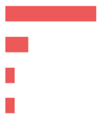
Markaz Sinjar Sub-district
Expected movements – data reported by KIs
 Expected returns
No expected returns reported by 8 KIs (out of 43 KIs). The rest of the KIs (30 KIs) did not know and 5 KIs refused to answer.
Drivers for expected returns (out of 43 KIs)*
Perceived increase of safety and security 25 KIs
Camp closure in areas of displacement (AoD) 5 KIs
Nostalgia about previous life in AoO 2 KIs
Following the return of other family members 2 KIs
Barriers for expected returns (out of 43 KIs)*
Destroyed/damaged housing in AoO 36 KIs
Perceived lack of services and jobs in AoO 24 KIs
Lack of documents needed to claim properties 9 KIs
Perceived security concerns in AoO 3 KIs
Lack of specialised medical treatment in AoO 3 KIs
Fear of persecution in AoO or perceived ISIL affiliation 2 KIs
* Sum of answers may exceed the 100% due to KIs being able to select multiple response options, including other topics.
Notes:
The majority of the KIs (30 KIs) did not know about expected return movements and five KIs refused to answer (four community leader KIs and a remainee KI).
Further returns reportedly could lead to positive and negative impacts. On one hand, expected returns reportedly might contribute to increased job opportunities with the return of business owners (10 out of 43 KIs) and it was reported an expected increase on assistance due the expected attention of service providers in the area following the returns movements (6 KIs). At the same time, it was reported that there would be a higher competition for the limited available job opportunities (17 KIs), in addition to a expected decrease of households level assistance due to the presence of a higher number of households in the area (19 KIs), and the perceived limited capacity of humanitarian and governmental actors to absorb the demand for assistance (1 KI).

Slide 19
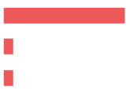
Markaz Sinjar Sub-district
Expected movements – data reported by KIs
 Expected host community departures
No expected host community departures reported by 18 KIs (out of 43 KIs)
Drivers for expected host community departures (out of 20 KIs)*
Perceived lack of services and jobs 20 KIs
Arrival of security forces 2 KIs
Perceived lack of security 2 KIs
Lack of specialised medical treatment in AoO 1 KI
 Expected IDP arrivals
No expected IDP arrivals reported by 17 KIs (out of 43 KIs)
Drivers for expected IDP arrivals (out of 29 KIs)*
Perceived increased safety and security 26 KIs
Camp closure in AoD 2 KIs
Following arrival of other family members 2 KIs
* Sum of answers may exceed the 100% due to KIs being able to select multiple response options, including other topics.
Notes:
Expected host community departures
Over the half of the KIs (23 KIs) did not know about expected host community departure movements and two community leader KIs refused to answer.
However, 20 KIs (out of 43 KIs) reported that there are drivers that might result in further departures. The rest of the KIs (22 KIs) did not know and a community leader KI refused to answer.
Expected IDP arrivals
The majority of the KIs (23 KIs) did not know about expected IDP arrivals and three KIs refused to answer (a community leader KI, a remainee KI and an IDP KI from Markaz Sinjar displaced elsewhere).
However, 29 KIs (out of 43 KIs) reported that there are drivers that might result in further IDP household arrivals. The rest of the KIs (13 KIs) did not know and a remainee KI refused to answer.

Slide 20
Markaz Sinjar Sub-district
Primary community needs – data reported by KIs
Top reported primary, secondary and tertiary needs (out of 43 KIs)
Primary need
Healthcare

Housing rehabilitation
Secondary need
Tertiary need
Water and sanitation
 Primary community needs per respondent group*
Community leaders
(out of 16 KIs)
Remainees
(out of 4 KIs)
Returnees
(out of 10 KIs)
IDPs
(out of 13 KIs)
Healthcare
Education
Water and sanitation
3 KIs
3 KIs
3 KIs
15 KIs
11 KIs
7 KIs
Healthcare
Education
Water and sanitation
House rehabilitation
Electricity
Healthcare
8 KIs
8 KIs
7 KIs
Healthcare
House rehabilitation
Livelihoods
11 KIs
8 KIs
7 KIs
“Implementation of infrastructure rehabilitation activities are important for the modernisation of the area. Its continuous development will allow for enhanced provision of services to the community.”
- Male community leader KI -
* Sum of answers may exceed the 100% due to KIs being able to select multiple response options, including other topics.
Notes:
KIs reported that the primary need for the community was healthcare. There was reported a decline in the quality of the public healthcare in Markaz Sinjar due to the lack of specialised medical staff (24 KIs) and lack of preparedness to respond to the COVID-19 pandemic (4 KIs). As a result, families resorted to services from the private health sector at high costs, negatively affecting their monthly expenditure (19 KIs); and other families were forced to move to other areas for public medical services as they cannot afford the cost of the private health sector in Markaz Sinjar (7 KIs).
The second main community need most commonly reported was housing rehabilitation which was reportedly related to housing damaged, burnt or uninhabitable in Markaz Sinjar as reported by 15 KIs. Reportedly, households have no resources to rehabilitate their houses (12 KIs), rents are too expensive (3 KIs) and families resorted to illegal occupation as per two returnee KIs.
The third main community need most commonly reported was access to water and sanitation. There was reported a limited access to public water services in Markaz Sinjar (6 KIs) and reportedly the lack of public filter maintenance resulted in to water pollution (11 KIs). To cope, households resorted to buying bottled water (11 KIs) and another household reportedly depended on wells as the main potable water source.

Slide 21
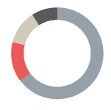
Markaz Sinjar Sub-district
Perceptions on access to services and assistance – data reported by KIs
 Access to housing
The majority of families in the area reportedly reside in houses (37 out of 43 KIs).
Reported housing agreement (out of 39 KIs)
Owned tenure 28 KIs
Verbal rental agreement 6 KIs
Hosted by other family 5 KIs
Illegal tenure occupation 4 KIs
Risk of eviction
IDPs and returnees were persistently reported to be more at risk of eviction.
Notes:
Access to housing:
Two KIs (a community leader KI and a returnee) reported that other households reside in apartments. Four IDP KIs reported that some households in their community reside in tents; including returnees, child-headed households, UASC, people with disabilities, large households and elderly-headed households, as reported by 22 KIs (out of 43 KIs).
IDP KIs (5 KIs) reported that the majority of IDP households reside in houses or tents under a verbal rental agreement, other households are hosted by families in the community. Returnee KIs (6 KIs) reported that the majority of the returnee households own houses in Markaz Sinjar and four returnee KIs reported that some returnee households resorted to illegal tenure occupation.³⁰ Community leader and remainee KIs reported that the majority of the households in the community reside in owned houses.³¹
Risk of Eviction:
IDPs and returnees are most at risk of eviction as reported by 22 KIs (out of 43 KIs), in addition to UASC, people with disabilities, child-headed households, elderly-headed households, large households and people with less connections due to a perceived lack of resources.
30. IOM DTM, September-October 2020: http://iraqdtm.iom.int/ReturnIndex - Illegal occupation of private residencies severity in Markaz Sinjar Sub-district was classified as high. It was one of the parameters reported affecting negatively the overall severity score for social cohesion in Markaz Sinjar upon the return index assessment of September and October 2020.
31. Intentions Survey Round VII, REACH Iraq, August 2020: https://www.reachresourcecentre.info/country/iraq/theme/movements-and-intentions/cycle/646/?toip-group=data&toip=dataset-database#cycle-646 - Interviewed IDP households originally from Markaz Sinjar displaced in camps reported that they were residing in houses under a different type of arrangement. The majority (68%) reported owning houses in their AoO, 12% reported renting, and 10% were reportedly hosted by other families in the community in Markaz Sinjar.

Slide 22
Markaz Sinjar Sub-district
Perceptions on access to services and assistance – data reported by KIs
 Access to housing rehabilitation
^{30%-50%}
of houses in Markaz Sinjar were damaged during military operations in 2014, as reported by all KIs (43 KIs).
IDPs and returnees were reported having less access to housing rehabilitation.
Reported barriers to access assistance for rehabilitation (out of 24 KIs)*
Assistance perceived to target specific neighbourhoods 22 KIs
Criteria of selection for support is perceived to be too specific 21 KIs
Limited connections 2 KIs
Lack of financial means 1 KI
* Sum of answers may exceed the 100% due to KIs being able to select multiple response options, including other topics.
Notes:
IDPs and returnees are reportedly more likely to reside in damaged or unfinished buildings/houses (22 out of 43 KIs). In addition, 22 KIs reported that UASC, child-headed households, people with disabilities, large households, elderly-headed households and female-headed households are more affected.
Access to rehabilitation
From the rest of the KIs, six community leader KIs and four remainee KIs reported that access to rehabilitation is equal, six community leader KIs did not know and two refused to answer.

Slide 23
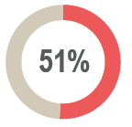
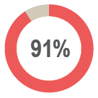
Markaz Sinjar Sub-district
Perceptions on access to services and assistance – data reported by KIs
 Access to basic public services
of KIs (22 out of 43 KIs) reported unequal access to basic public services namely healthcare, education, water and sanitation.
Reported barriers to access basic public services (out of 18 KIs)*
Limited connections (18 KIs)
COVID-19 restrictions (1 KI)
 Access to public judicial mechanisms
of KIs (39 out of 43 KIs) reported that access to public judicial mechanisms is equal for all population groups.
Returnee KIs (5 KIs) reported that the department granting civil status documents was closed at the time of data collection.
* Sum of answers may exceed the 100% due to KIs being able to select multiple response options, including other topics.
Notes:
Access to basic public services:
The rest of the KIs reported it is equal (16 KIs) and five KIs did not know.
KIs (18 out of 39 KIs) reported that IDPs and returnees, in addition to child-headed households, UASC, people with disabilities, elderly headed households have less access to basic public services due to having less connections. Large households were reportedly affected due to a perceived lack of resources.

Slide 24
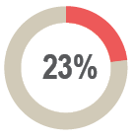
Markaz Sinjar Sub-district
Perceptions on access to services and assistance – data reported by KIs
 Access to humanitarian aid and presence of non-governmental organisations (NGOs)
of KIs (10 out of 43 KIs) reported that there are NGOs implementing food security programming, infrastructure rehabilitation, livelihood activities and NFI distributions in the area.
Reported most needed projects or activities in Markaz Sinjar (out of 42 KIs)
Livelihoods
Housing rehabilitation
Water and sanitation
COVID-19 awareness
Social cohesion
23 KIs
14 KIs
3 KIs
1 KI
1 KI
Notes:
Access to humanitarian aid and presence of non-government organizations
The rest of KIs (19 out of 43) reported perceiving that there are no NGOs implementing activities and projects present in Markaz Sinjar at the time of data collection, four KIs did not know and a returnee KI refused to answer.

Slide 25
Markaz Sinjar Sub-district
Perceptions on access to services and assistance – data reported by KIs
 Access to livelihoods
22 KIs reported that people with disabilities, UASC, elderly, child heads of household and people with less connections have less access to livelihoods opportunities.
Reported types of jobs in Markaz Sinjar in 2014 compared to November 2020
(out of 43 KIs)*
2014 November 2020
39 KIs
34 KIs
32 KIs
16 KIs
Construction
Finance
Public education
Agriculture
2 KIs
11 KIs
22 KIs
0 KI
* Sum of answers may exceed the 100% due to KIs being able to select multiple response options, including other topics.
Notes:
Access to livelihoods
The main reported reasons were the perceived limited physical capacity, skill or education level, or trauma that prevents these groups from performing the available jobs (22 KIs) and the lack of connections these groups have (4 KIs).
The types of jobs available have reportedly shifted since 2014 in Markaz Sinjar. KIs reported that jobs available in 2020 were less diverse than those in 2014. Employment in the public and private health sectors (14 KIs); manufacturing (6 KIs); transportation (5 KIs); public administration and defense (4 KIs); and trade, hotels and restaurants (1 KI) were not reported to be available at the time of data collection. Nineteen KIs (19 KIs) did not know about available jobs in 2020 and a community leader KI refused to answer.

Slide 26
Markaz Sinjar Sub-district
Perceptions on governance and presence of security forces – reported by KIs
 Governance and influencing bodies
Reported most influential bodies in governance (out of 43 KIs)*
Local authorities 43 KIs
Mukhtars 18 KIs
Tribal leaders 4 KIs
 Perceived presence of security forces
The majority of the KIs (42 out of 43 KIs) reported that the presence of the security forces contributed positively to a feeling of safety. A community leader did not know.
In addition, it was generally reported that security forces are effective in resolving disputes within the community and between different villages in Markaz Sinjar.
* Sum of answers may exceed the 100% due to KIs being able to select multiple response options, including other topics.
Notes:
Governance and influencing bodies
The majority of the KIs (25 KIs) did not know about expected changes in most influential bodies in governance, 17 KIs reported that it is not expected to change in the six months following data collection. A community leader KI refused to answer.

Slide 27
Markaz Sinjar Sub-district
Perceptions of community disputes, relations and co-existence – reported by KIs
 Community disputes
^{28%}
of KIs (12 out of 43 KIs) reported that there were no disputes within the neighbourhoods in the six months prior to data collection. The rest of the KIs (22 KIs) did not know and nine KIs refused to answer.
^{7%}
of KIs (3 out of 43 KIs) reported that there were no disputes between villages in the six months prior to data collection. The rest of the KIs (28 KIs) did not know and 12 KIs refused to answer.
^{37%}
of KIs (16 out of 43 KIs) reported that there were no retaliation incidents in the six months prior to data collection. The rest of the KIs (22 KIs) did not know and five KIs refused to answer.
 Community relations and co-existence
^{95%}
of KIs (41 out of 43 KIs) reported that their community members trust each other.
^{100%}
of KIs reported that community members interact with other groups.
^{51%}
of KIs (22 KIs) reported that community members participate in social and public events.
Notes:
Community disputes within the neighbourhoods:
Nine KIs refused to answer (seven community leader KIs, a remainee KI and an IDP displaced outside Markaz Sinjar).
The majority of the KIs (33 KIs) did not know if there could be an increase on disputes within neighbourhoods, and 10 KIs refused to answer (six community leader KIs, three remainee KIs and an IDP elsewhere KI).
Community disputes between villages:
Refused to answer: eight community leader KIs, three remainee KIs and a IDP elsewhere KI.
The majority of the KIs (32 KIs) did not know if there could be an increase on disputes between villages, and 11 KIs refused to answer (eight community leader KIs and three remainee KIs).
Retaliation Incidents
Refused to answer: four community leader KIs and a remainee KI.
Community trust
A community leader KI did not know and another refused to answer.
Participation in social and public events
The rest of the KIs (15 KIs) did not know and six KIs refused to answer.

Slide 28
Markaz Sinjar Sub-district
Perceptions of safety and security – data reported by KIs
 Safety and security
^{95%}
of KIs (41 out of 43 KIs) reported that their community members feel safe in Markaz Sinjar.
^{54%}
of KIs (23 out of 43 KIs) reported that their community members avoid specific areas or neighbourhoods in Markaz Sinjar.
Freedom of movement
^{98%}
of KIs (42 out of 43 KIs) reported that females and males can freely move in Markaz Sinjar during the day.
^{91%-95%}
of KIs (39-41 out of 43 KIs) reported that females and males respectively can freely move in Markaz Sinjar at night.
 Explosive remnant of war (ERW) contamination
^{95%}
of KIs (41 out of 43 KIs) reported no incidents due to ERW took place in the six months prior to data collection.
Notes:
Feeling of Safety
A community leader KI did not know and a returnee reported not feeling safe due to the presence of armed groups.
Avoid specific areas
21 KIs reportedly avoided specific areas due to the fear of the COVID-19 pandemic (21 KIs) and one returnee reported that they avoid specific areas due to the presence of armed groups. The rest of the KIs did not know (9 KIs), reported not avoiding areas (6 KIs) and five community leader KIs refused to answer.
Freedom of movement
A returnee KI reported that males and females do not freely move during the day or at night due to the sensitive security situation.
ERW presence and incidents
The rest of the KIs (2 KIs) did not know whether there were incidents due to ERW in the past six months.

Slide 29
6
Questions from the audience

Slide 30
Discussion
Any feedback or comments from those operational in these areas?
7

Slide 31
Link to the Factsheet
Markaz Sinjar Factsheet
Upon request
http://www.reachresourcecentre.info/
IMPACT Initiatives
@REACH_info

